Slide 1
Tweaking -khb- to control for post-treatment confounders in mediation analysis
Kristian Bernt Karlson
Department of Sociology
University of Copenhagen
Email: kbk@soc.ku.dk

Slide 2
Mediation analysis
Decomposition:
Total effect: β+θγ
Direct effect: β
Indirect effect: θγ
M
θ
γ
X
Y
β

Slide 3
Post-treatment confounders
Even if X is a randomized treatment, M may still be endogenous.
Potential strategy: Control for proxies for U to obtain unbiased estimate of γ*.
U
δ
λ
M
θ
γ*
X
Y
β*

Slide 4
Post-treatment confounders
However: If (some element in) U depends on X, then everything breaks down…
Direct effect of on Y other than through M is not identified, even if proxies for U are included…
… damned if you do (control), damned if you don’t (control)!
U
δ
π
λ
M
θ*
γ*
X
Y
β*

Slide 5
Solutions
Inverse probability weighting or g-computation (James Robins and colleagues).
Logic: Reweigh data in such a way that the X-U edge disappears, i.e., X and (proxies for) U become statistically independent.
In this talk: Residualize (observed proxies for) U
for O by regression...

Slide 6
Solutions
Let Z be observed elements of U and assume linearity.
Direct effect:
Indirect effect:
Z
δ
π
λ
M
θ*
γ*
X
Y
β*

Slide 7
Solutions
Estimate the direct effect other than through M via
Where is the residual from the auxiliary regression
That is
Z
δ
π
λ
M
θ*
γ*
X
Y
β*
- and then back out indirect effect.

Slide 8
The logistic case and -khb-
Breen, Karlson, and Holm (2013, Sociological Methods and Research) suggest a way of decomposing total effects into direct and indirect effects in logistic regression models (that accounts for the attenuation bias implied in these models).
Method implemented in -khb-.
In this presentation: Use “residualization trick” to construct Z that are uncorrelated with X, and then apply
-khb- to the transformed variables…

Slide 9
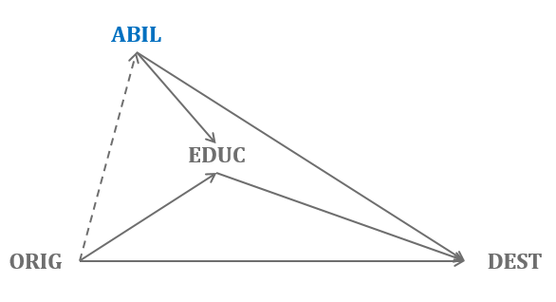
Example
Education (E) is viewed as the key mediator of the association between class origins (O) and class destinations (D) in sociological stratification research.
Yet the impact of education (E) on class destinations (D), i.e., the “status returns” to education, may be biased by omitted ability (A) – or so the economists say…
But ability (A) also depends strongly on class origins (O); that is, ability (A) is a post-treatment confounder.

Slide 10
Example
Data from GB cohorts born 1958 and 1970
Class origins and destinations measured by binary distinction between service class and working class. Education is a ordinal variable with 6 levels. Ability is a standardized cognitive test score (measured at around 11).
The conclusion – percent mediated by education:
Conventional estimate: 54 %
“Ability-corrected” estimate: 44 %

Slide 11
Example (conventional approach)

Slide 12
Example (ability-corrected)

Slide 13
Example (attenuation-corrected conventional)

Slide 14
Conclusion
Example: We overestimate the role of education in social mobility in conventional studies (but perhaps not much?).
Generally, difficult to know the bias, but even without ability observed, we could have figured this out, given the evidence we have on the causes and effects of ability.
Convenient “tweak” of -khb-: Under linearity assumption, one can quite easily control for post-treatment confounders.
To do: Standard errors in ability-corrected analysis are wrong. Bootstrap the easy solution (delta method another).

