Slide 1
Segregation as overexposure
- adjusting for covariates when units are small
Oskar Nordström Skans
IFAU and Uppsala University

Slide 2
Segregation
Separation of groups (e.g. minority/majority) across units (occupations, schools, firms, families…)
Host of segregation indices (Gini, Duncan, Hutchens,..)
  All measure the distance between the actual distribution and a distribution where the groups are equally represented in all units
  With small (measured) units, groups will not be equally represented within each unit, even if randomly allocated

Slide 3
Standard solution to small unit bias
Generate ”counterfactual segregation” by randomly allocating individuals across the units, keeping the group sizes constant
  This counterfactual segregation is huge if, e.g., looking at segregation across firms
  Measure non-random segregation as the distance between actual and random segregation.

Slide 4
What about covariates/confounders?
Suppose that you want to analyze the extent of segregation that cannot be explained by differences in the distribution of education and place-of-residence within the different groups.

Slide 5
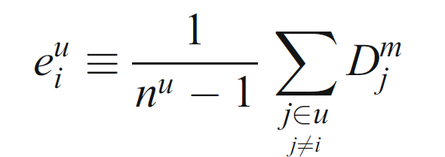
In Åslund and Skans, Journal of population economics, 2009, we propose
Measure the exposure to minority workers (D=1) as the fraction of coworkers (i.e. excluding self) that belong to the minority
  Under random allocation, average exposure among both minority and majority workers is (trivially) equal to the minority share
  Hence, the distance between the minority share and average exposure among minority workers is a measure of segregation

Slide 6
Again, what about covariates..
We want to contrast the minority status of actual ”coworkers”, with coworkers of a similar kind.
We could imagine all jobs being filled by predetermined ”types” of workers defined by some covariates.
➔ Think of the counterfactual (non-segregated) world as providing random coworkers, conditional on their ”types” defined by some covariates

Slide 7
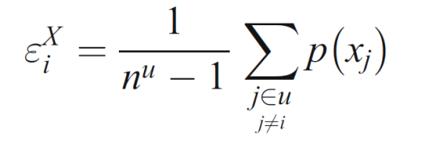
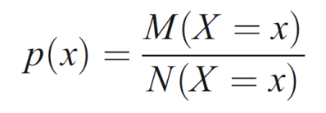
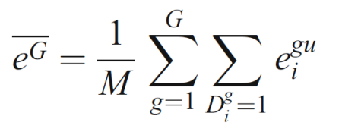
Introduce covariates
Replacing actual exposure by exposure to minority propensities and calculate expected exposure to these propensities instead.
  We estimate the propensities using averages within cells
  Measure segregation as the distance between averages of actual exposure and conditional expected exposure
  Convenient, do not require simulations.
  Easily extended to account for multiple groups.

Slide 8
Some stata
* Individual level cross section, with unit identifiers, minority status, and X:s
*Minorities are Dj==1, majority Dj=0,
* Units and UnitSize:
bysort UnitID: gen UnitSize = _N
* Calculate exposure
bysort UnitID: egen Dsum=sum(Dj)
gen Exposure=(Dsum-Dj)/(UnitSize-1) /* Subtract self */
* Average among minority workers
sum Exposure if Dj==1, meanonly
global ActEx=r(mean)
g

Slide 9
Some stata
* Define a set of covariates (all are chategorical variables)
global Xvar "IndustryId RegionID Edulevel AgeCategory Female"
* calculate immigrant propensity
bysort $Xvar: egen Px=mean(Dj)
* Calculate expected exposure
bysort UnitID: egen Psum=sum(Px)
gen ExpectedExposure$model=(Psum-Px)/(UnitSize-1) /* Subtract self */
* Sum over minority workers
sum ExpectedExposure$model if Dj==1, meanonly
global Eeps$model=r(mean)

Slide 10
Extensions
1) Use Px as a threshold and randomly allocate minority status across the population:
    gen Rand=uniform()
    gen FakeDj=Rand<Px
Calculate alternative segregation indices based on Dj and FakeDj
Without covariates ➔ back to standard solution to small-unit bias
Calculate exposure to confirm that the intuition is right…
Calculate Px semi-parametrically to avoid over-fitting:
probit[logit] Dj [varlist] \ predict Px
3) To expand into a multi-group setting, simply calculate exposure to the own group, and then average over the groups to get the average own-group exposure.

Slide 11
Simulation-based results

Slide 12
Overexposure results, by duration

Slide 13
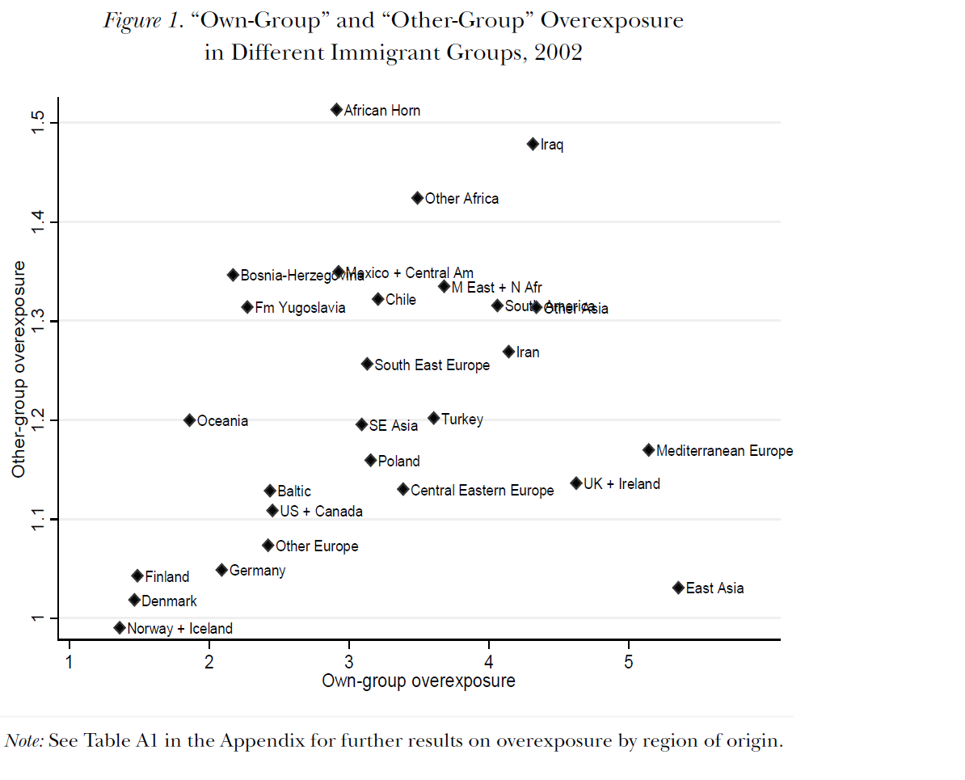

Slide 14
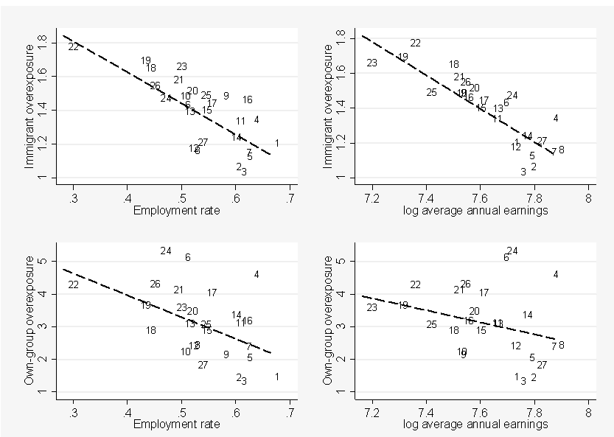
Associations between overexposure and economic outcomes, by origin (Å&S, Ind Lab Rel Rev 2011)

Slide 15
To sum up…
The overexposure framework is a simple, fast and powerful tool to measure segregation
The framework has nice properties in terms of interpretation
It is straightforward/trivial to implement in Stata, relying on sums by groups

