Slide 1
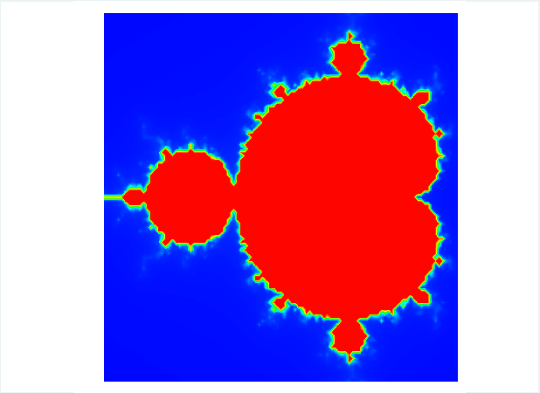
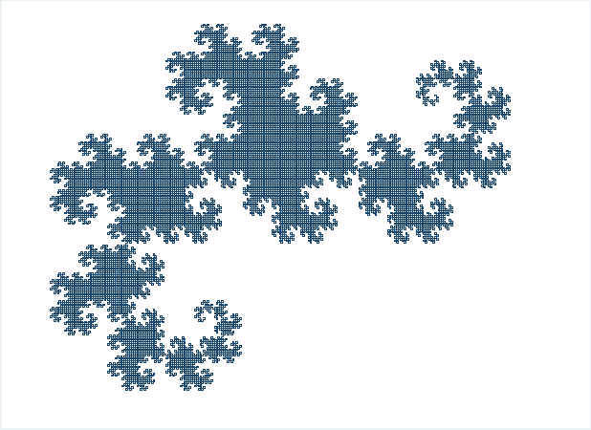
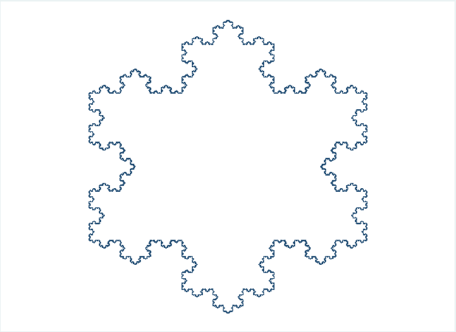
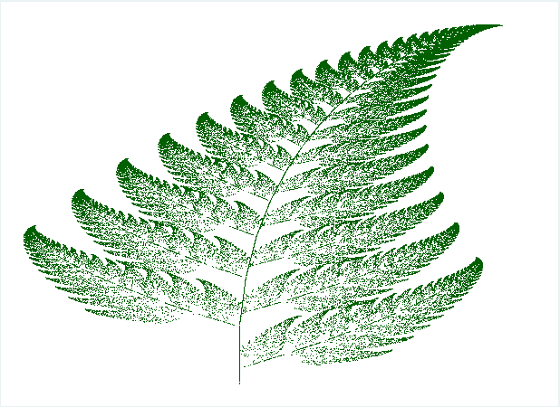
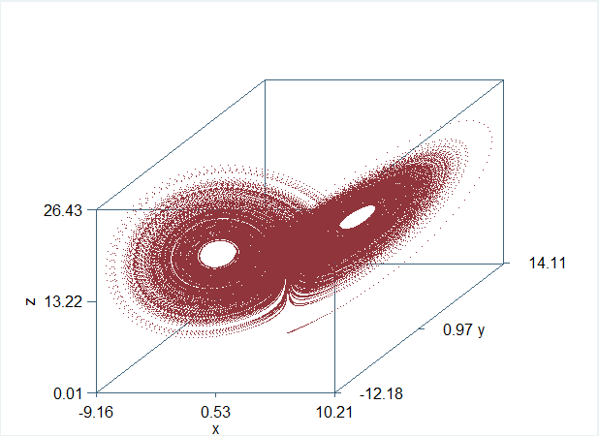

Structured Chaos:
Using Mata and Stata
to Draw Fractals
Seth Lirette, MS

Slide 2
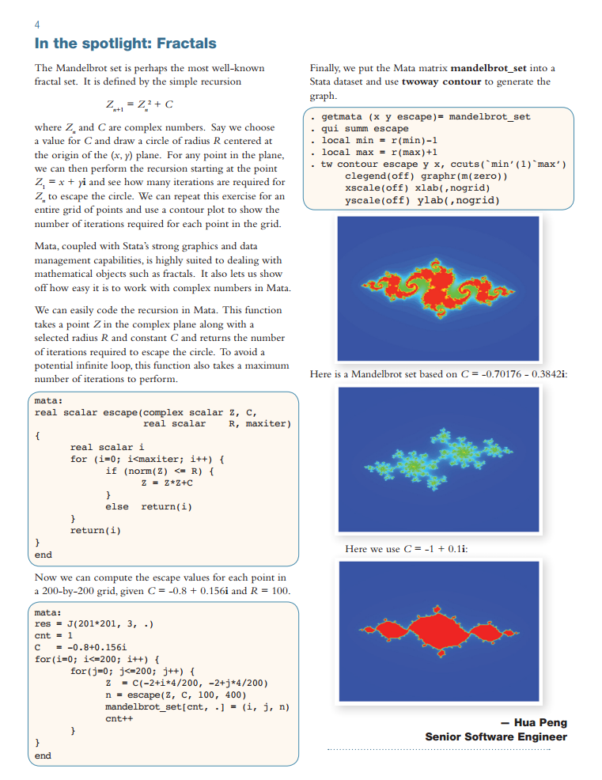

Inspiration

Slide 3
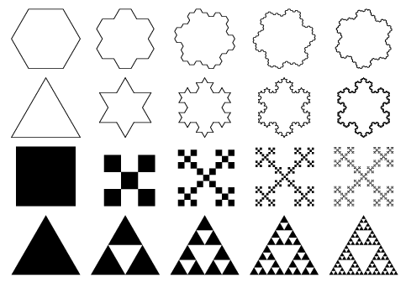
Types
Of
Fractals

Slide 4
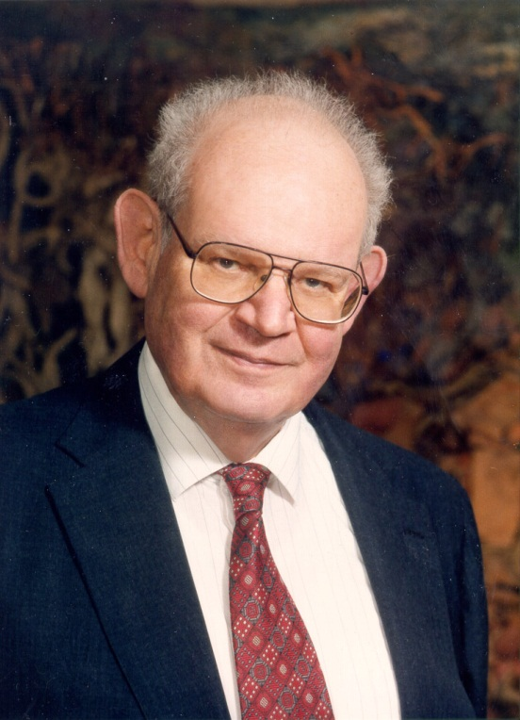
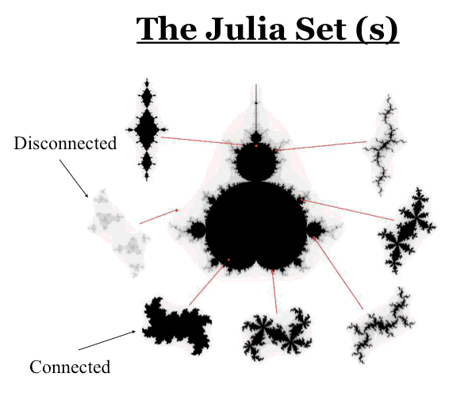
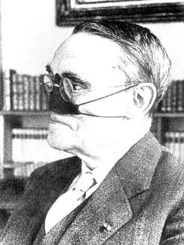
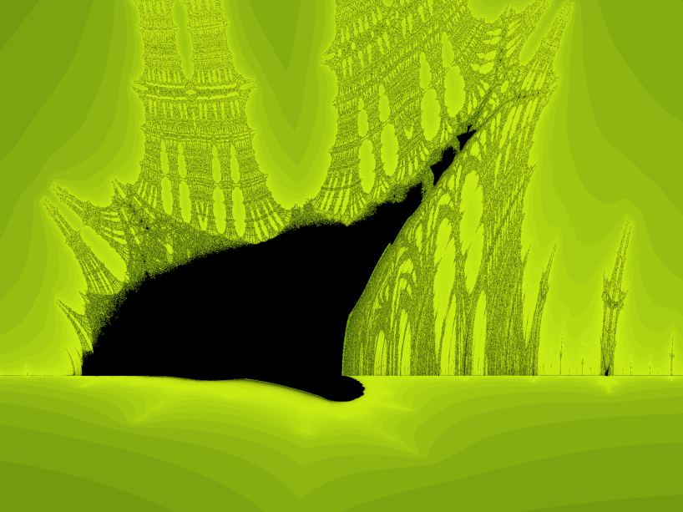
Escape-time Fractals
Formula iteration in the complex plane
Iterate many times
If doesn’t diverge to infinity, it belongs in the set and you mark it.
Otherwise, color the point depending on how fast it escapes to infinity.
Mandelbrot Set
Julia Sets
Burning Ship Fractal

Slide 5

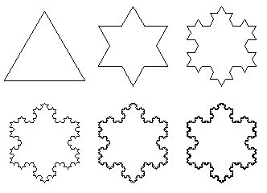
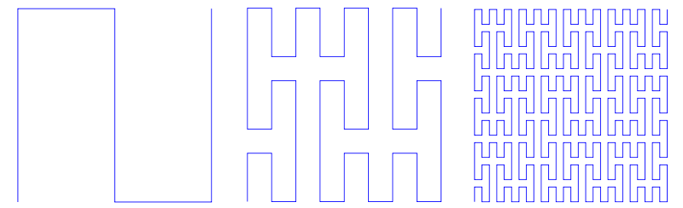
Iterated Function Systems (IFS)
Draw a shape
Replace that shape with another shape, iteratively
Barnsley Fern
Koch Snowflake
Peano Curve

Slide 6
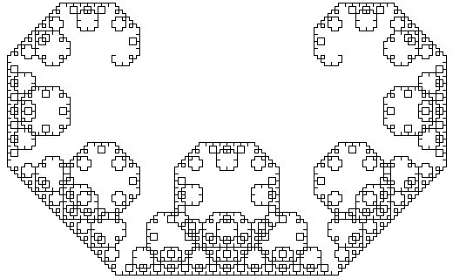
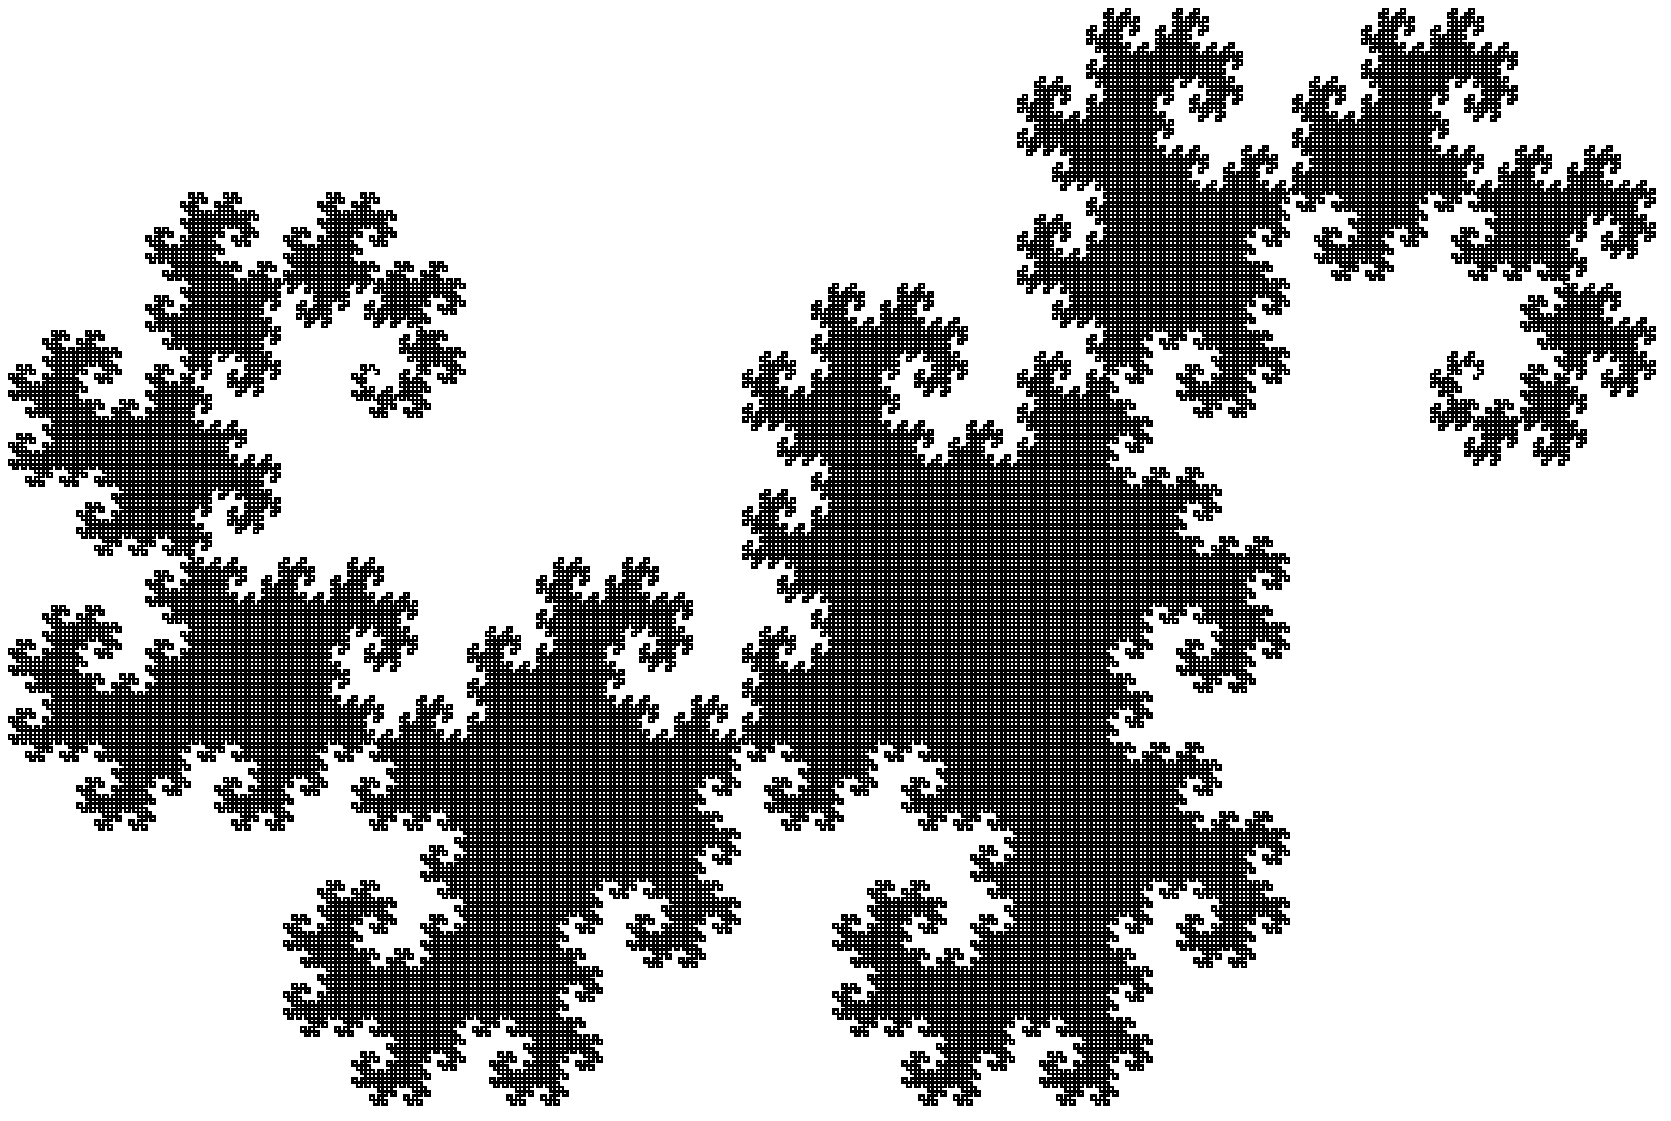
Lindenmayer Systems (L-systems)
Different “Language”
A form of string rewiring
Starts with an axiom and has a set of production rules
Levy Curve
Dragon Curve

Slide 7
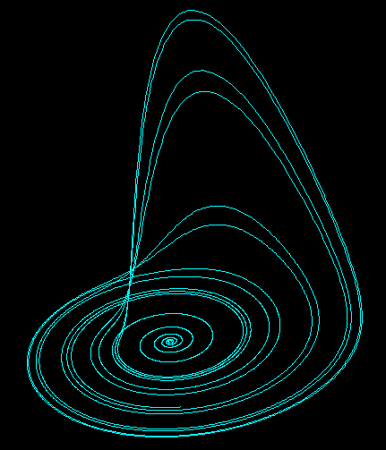
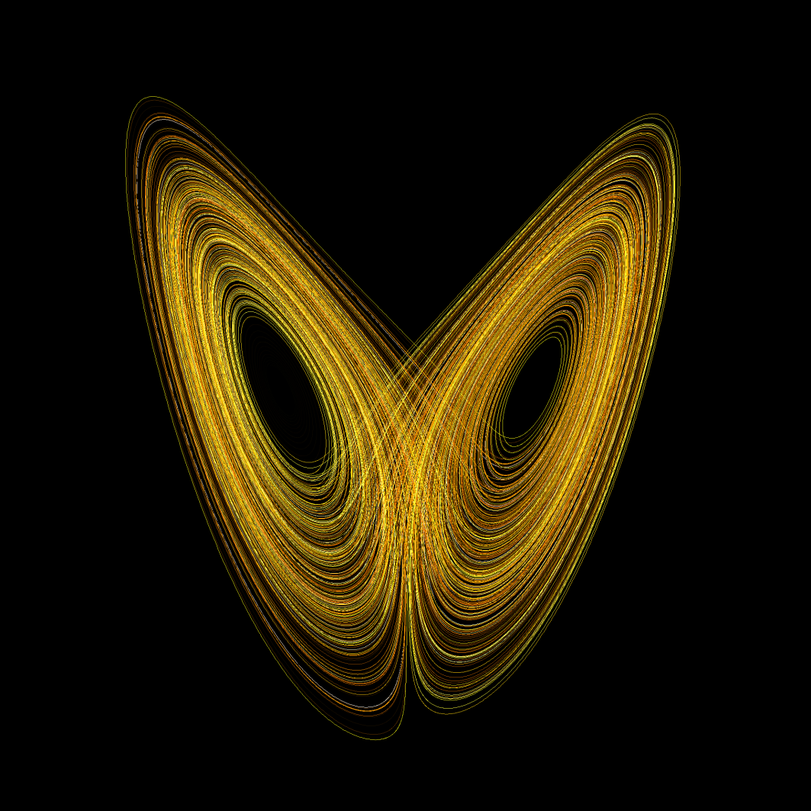
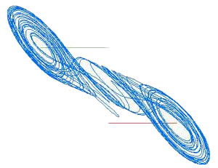
Strange Attractors
Solutions of intial-value differential equations that exhibit chaos
Double Scroll Attractor
Rossler Attractor
Lorenz Attractor

Slide 8

mata +
Examples

Slide 9
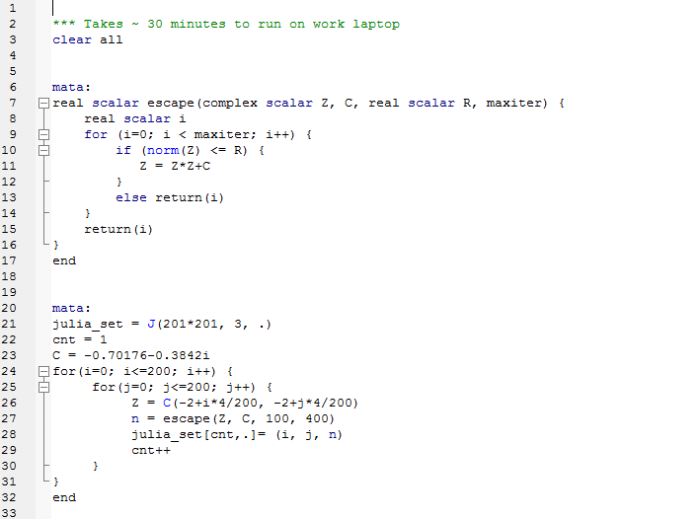
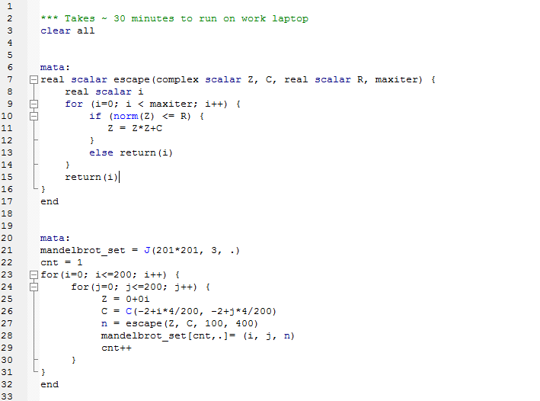
Mandelbrot Set
The set M of all points c such that the sequence
z → z² + c
does not go to infinity.

Slide 10
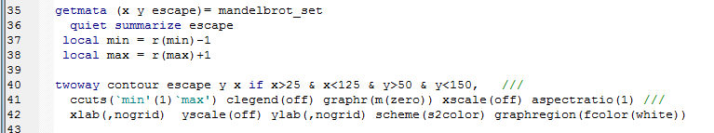
Mandelbrot Set

Slide 11
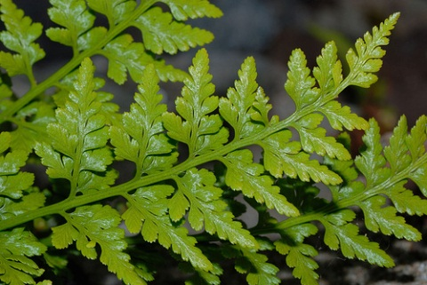
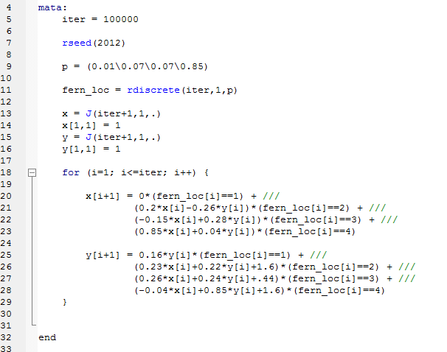
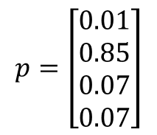




Barnsley Fern
Created by Michael Barnsley in his book Fractals Everywhere.
Defined by four transformations
$$f_{1}\left(x,y\right)=\left[\begin{matrix}0.00 & 0.00 \\ 0.00 & 0.16\end{matrix}\right]\left[\begin{matrix}x \\ y\end{matrix}\right]$$
Black Spleenwort
$f_{2}\left(x,y\right)=\left[\begin{matrix}0.85 & 0.04 \\ −0.04 & 0.85\end{matrix}\right]\left[\begin{matrix}x \\ y\end{matrix}\right]$+$\left[\begin{matrix}0.00 \\ 1.60\end{matrix}\right]$
$f_{3}\left(x,y\right)=\left[\begin{matrix}0.20 & −0.26 \\ 0.23 & 0.22\end{matrix}\right]\left[\begin{matrix}x \\ y\end{matrix}\right]$+$\left[\begin{matrix}0.00 \\ 1.60\end{matrix}\right]$
$f_{4}\left(x,y\right)=\left[\begin{matrix}−0.15 & 0.28 \\ 0.26 & 0.24\end{matrix}\right]\left[\begin{matrix}x \\ y\end{matrix}\right]$+$\left[\begin{matrix}0.00 \\ 0.44\end{matrix}\right]$
with assigned probabilities:
$$p=\left[\begin{aligned}0.01 \\ 0.85 \\ 0.07 \\ 0.07\end{aligned}\right]$$

Slide 12

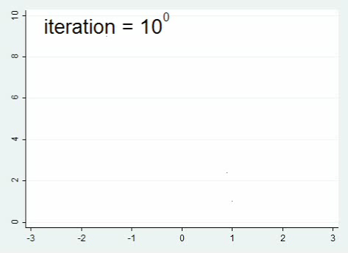
Barnsley Fern

Slide 13
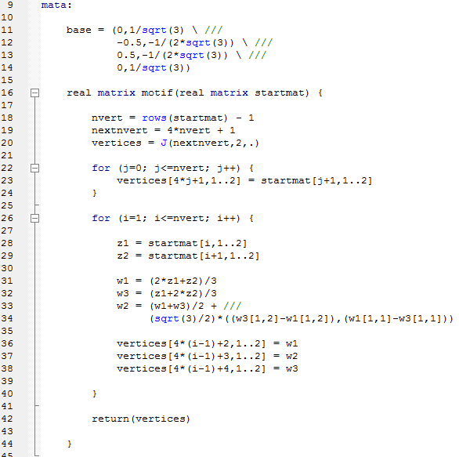
Koch Snowflake
Based on the Koch curve, described in the 1904 paper “On a continuous curve without tangents, constructible from elementary geometry” by Helge von Koch
Construction:
(1) Draw an equilateral triangle;
(2) Replace the middle third of each line segment with an equilateral triangle;
(3) Iterate

Slide 14
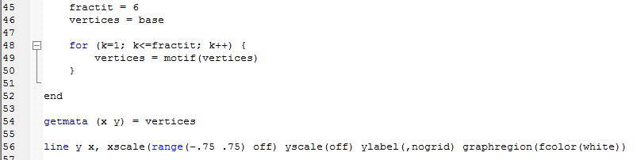
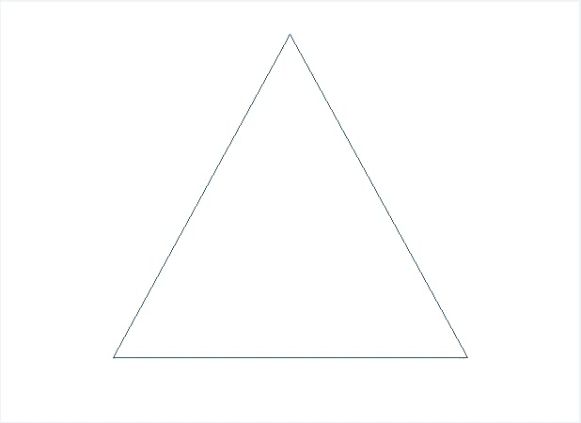
Koch Snowflake

Slide 15
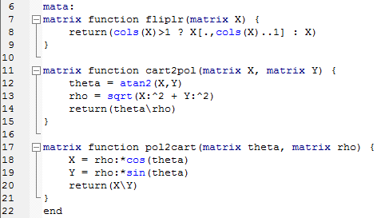
Dragon Curve
First investigated by NASA physicists John Heighway, Bruce Banks,
and William Harter.
Construction as an L-system:
Start: FX
Rule: (X → X + YF), (Y → FX – Y)
Angle: 90º
Where:
F = “draw forward”
- = “turn left 90º”
+ = “turn right 90º”

Slide 16

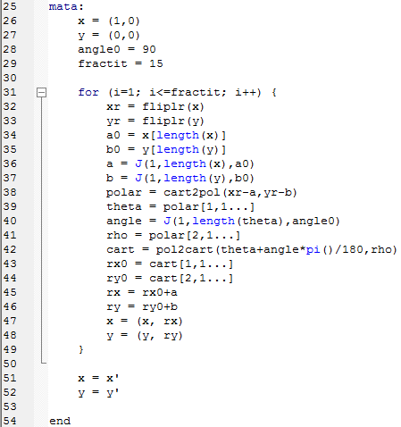

Dragon Curve

Slide 17
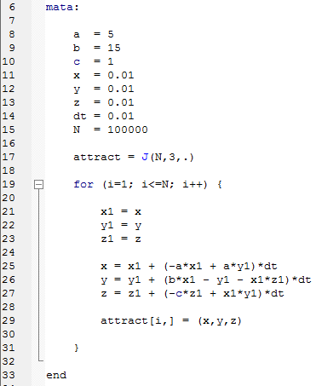
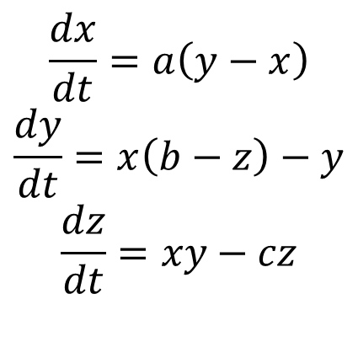
Lorenz Attractor
Plots the “Lorenz System” of ordinary differential equations:
$$\frac{dx}{dt}=a\left(y−x\right)$$
$$\frac{dy}{dt}=x\left(b−z\right)−y$$
$$\frac{dz}{dt}=xy−cz$$

Slide 18


Lorenz Attractor

Slide 19
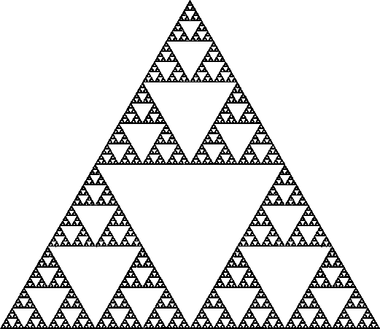
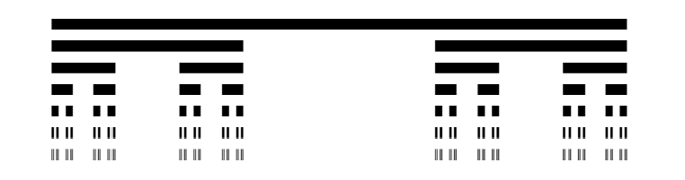
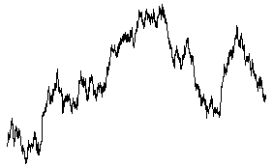
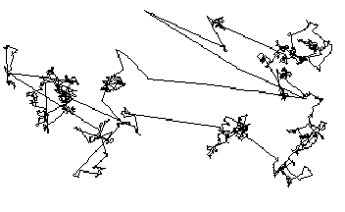
Finite Subdivisions
Cantor Set
Sierpinski Triangle
Random Fractals
Brownian Motion
Levy Flight

Slide 20
Thank You

