Slide 1
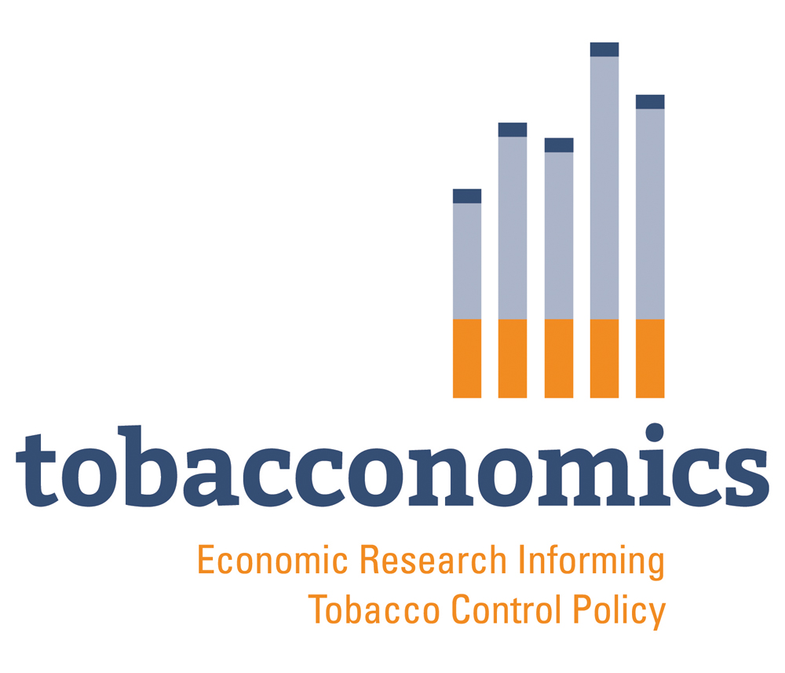

A toolkit on household expenditure surveys for research in the economics of tobacco control using Stata
Rijo John, Violeta Vulovic, Grieve Chelwa, Frank Chaloupka.
Presented by Msc. Carlos M. Guerrero López
cguerr44@uic.edu
Mexican Stata Conference. Hermosillo, Sonora, México.
26 October, 2023

Slide 2
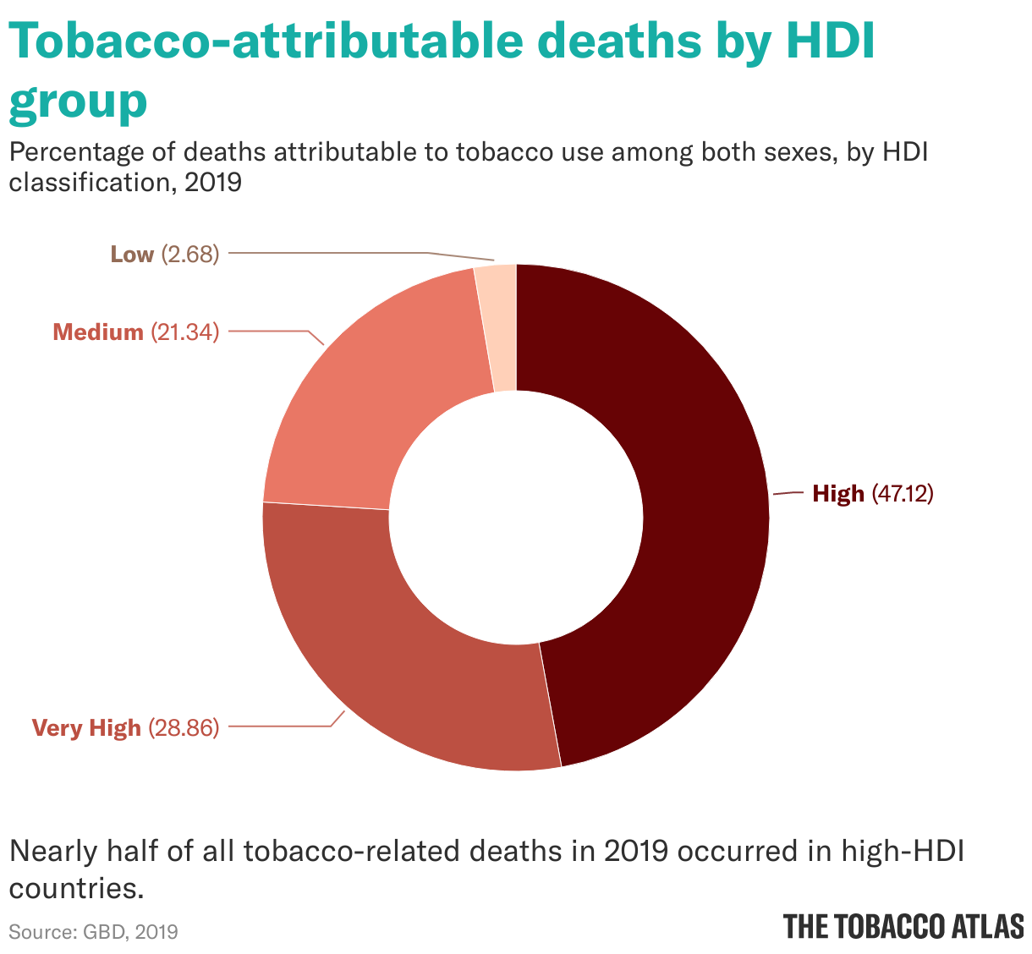

Burden of tobacco
Tobacco is a leading cause of premature death and disability worldwide and Mexico is not the exception*
  Globally, around 8.7 million people died in 2019 due to tobacco use
  In Mexico, around 64,000 people die each year
  Medical costs could increase to 116 billion MXN (9.3% of the health expenditures) in Mexico
Tobacco use is associated with many other negative consequences
  Huge economic and social costs, environmental harm, impoverishment, and increased inequities, among others.
* www.tobaccoatlas.org
Palacios A, Reynales-Shigematsu LM, Bardach A, Casarini A, Rodriguez Cairoli F. La importancia de aumentar los impuestos al tabaco en México – Impuestos al Tabaco [Internet]. 2022. Available from: https://impuestotabaco.org/?repositorio=la-importancia-de-aumentar-los-impuestos-al-tabaco-en-mexico
www.tobacconomics.org | @tobacconomics

Slide 3
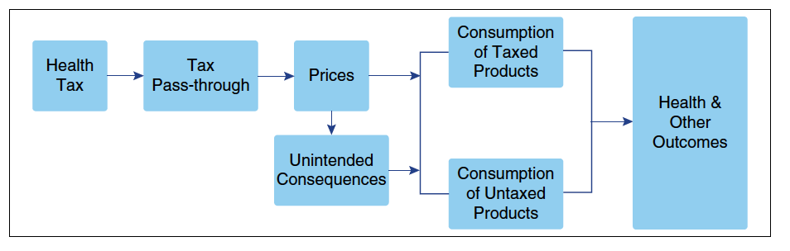
Tobacco taxes: a solution
Increasing taxes is the single most effective intervention to reduce tobacco use
  Consumers DO respond to price increases: they stop smoking or consume less
  Increasing prices through higher excise taxes could help to avoid or delay tobacco use initiation
  Revenues from tobacco taxes can be used to fund healthcare or other social programs
*Figure taken from Chapter 3 “Protecting and promoting Health throug taxation: evidence and gaps”, by Lisa Powell & Frank Chaloupka.
Available at https://library.oapen.org/bitstream/handle/20.500.12657/61366/9781800612396.pdf?sequence=1&isAllowed=y
www.tobacconomics.org | @tobacconomics

Slide 4
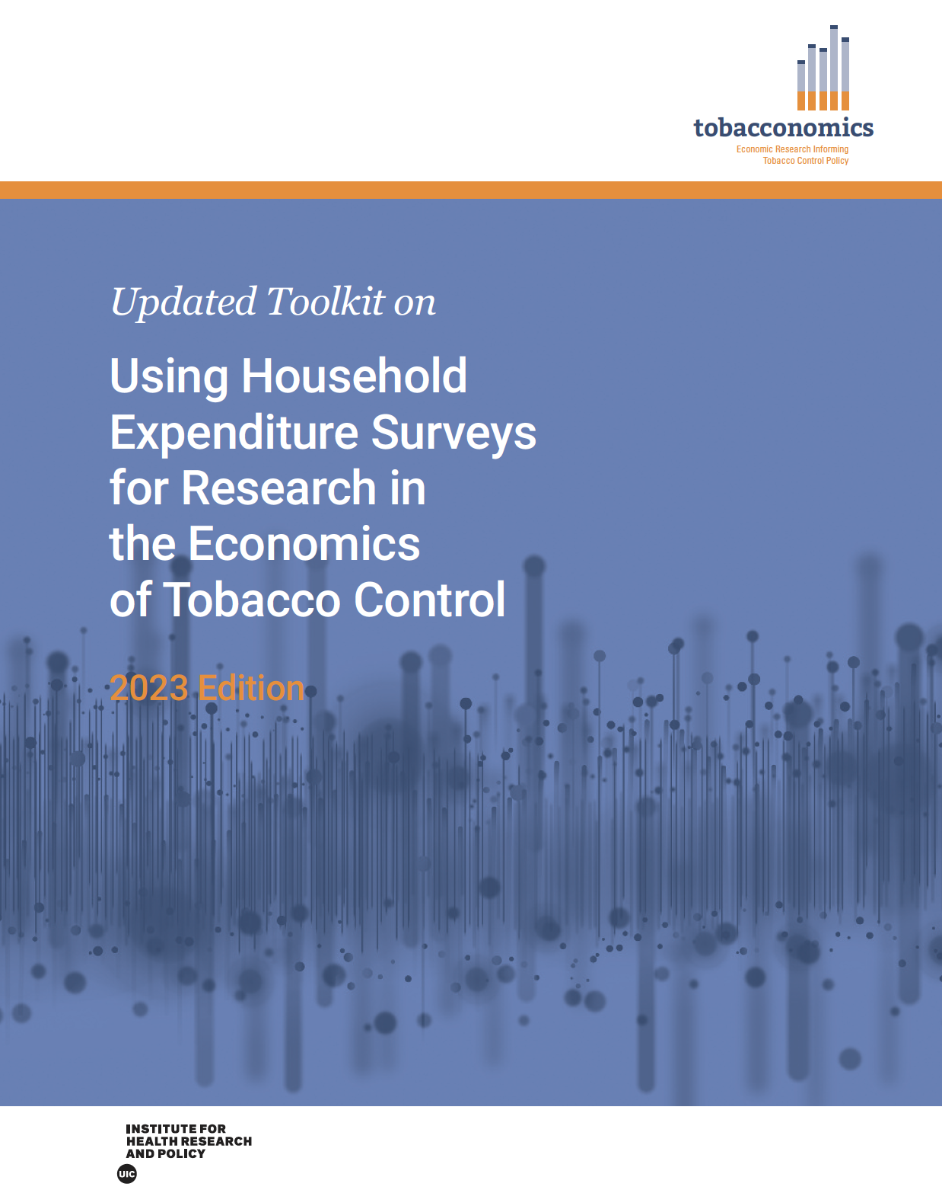
The UPDATED toolkit on household expenditure surveys*
(Available in English and in Spanish!)
Who should use it?
  Policy makers, government agencies, researchers, civil society organizations, and… Applied Econometrics professors and students too! It could help to those who study not only Tobacco, but Alcohol, SSBs or other harmful products
Toolkit Index
  Introduction to household surveys
  Estimating own and cross-price elasticities
  Estimating the crowding-out effect of tobacco spending
  Quantifying the impoverishing effect of tobacco use
*Available at: https://tobacconomics.org/research/updated-toolkit-on-using-household-expenditure-surveys-for-research-in-the-economics-of-tobacco-control/
www.tobacconomics.org | @tobacconomics

Slide 5
Introduction to Household Economic Surveys (HES)
What are HES?
  Cross-section data to describe, among other things, income and expenditure patterns
  In Mexico, we have the ENIGH, collected and published every two years by INEGI*
  ENIGH is the main source to estimate the prevalence of poverty, to describe the income distribution, and to evaluate the impact of social programs
Tips in Stata
  Do-files
  Macros
  Merging data
  Cleaning data
  Basic statistics
*Available at: https://www.inegi.org.mx/programas/enigh/nc/2022/
www.tobacconomics.org | @tobacconomics

Slide 6
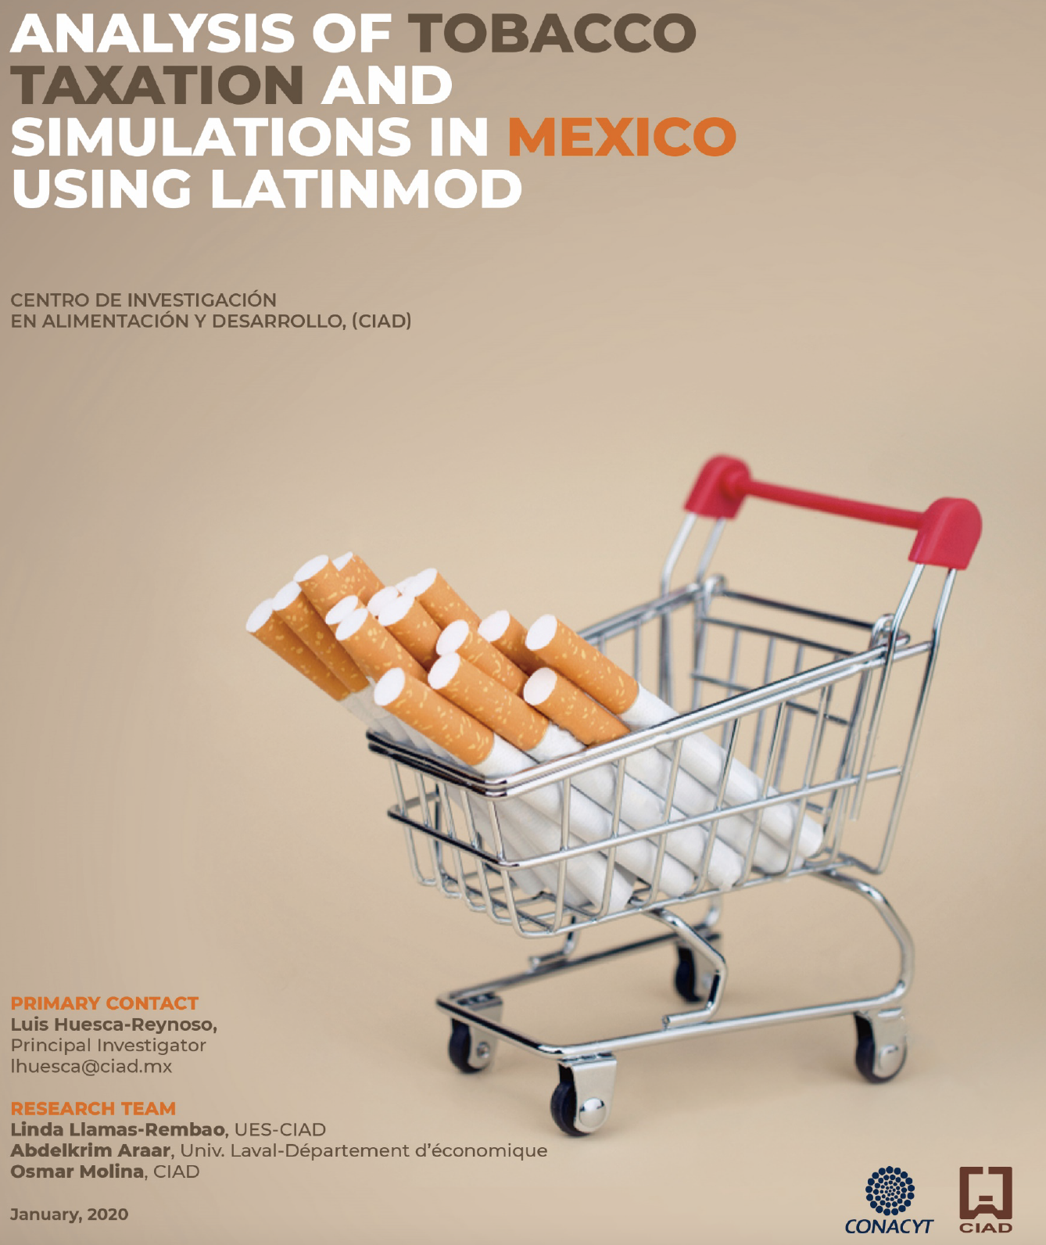
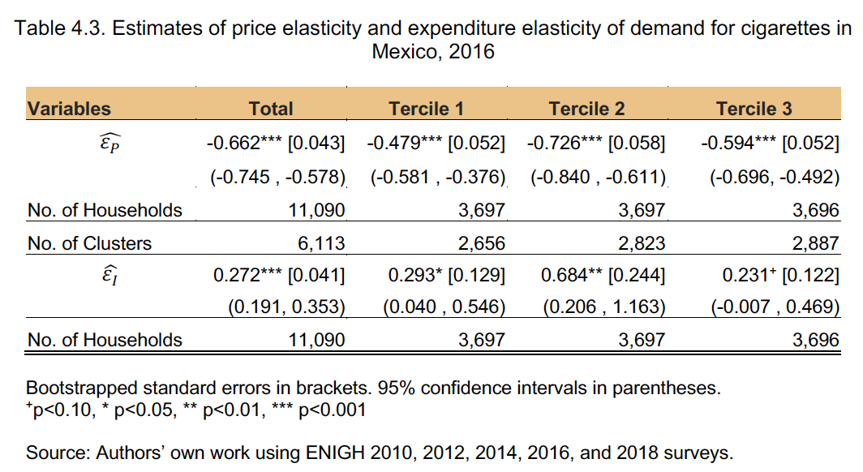
Own and cross-price elasticities
What is a price-elasticity of the demand?
  Percent change in demand of a product in relation to a percent change in its price
Deaton Model
  Unit values (UV)
  Testing spatial variation in UV
  Within-cluster regressions
  Cluster-level demand and UV
  Cluster-level regressions
  Price and expenditure elasticities
Example
*Available at: https://tobacconomics.org/research/analysis-of-tobacco-taxation-and-simulations-in-mexico-using-latinmod/
www.tobacconomics.org | @tobacconomics

Slide 7
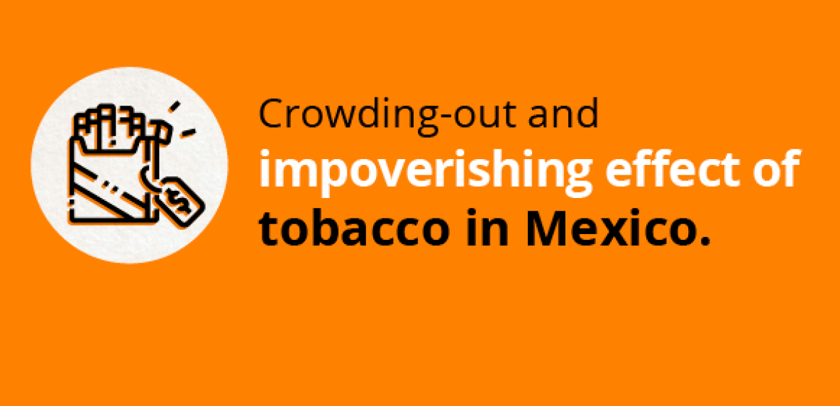
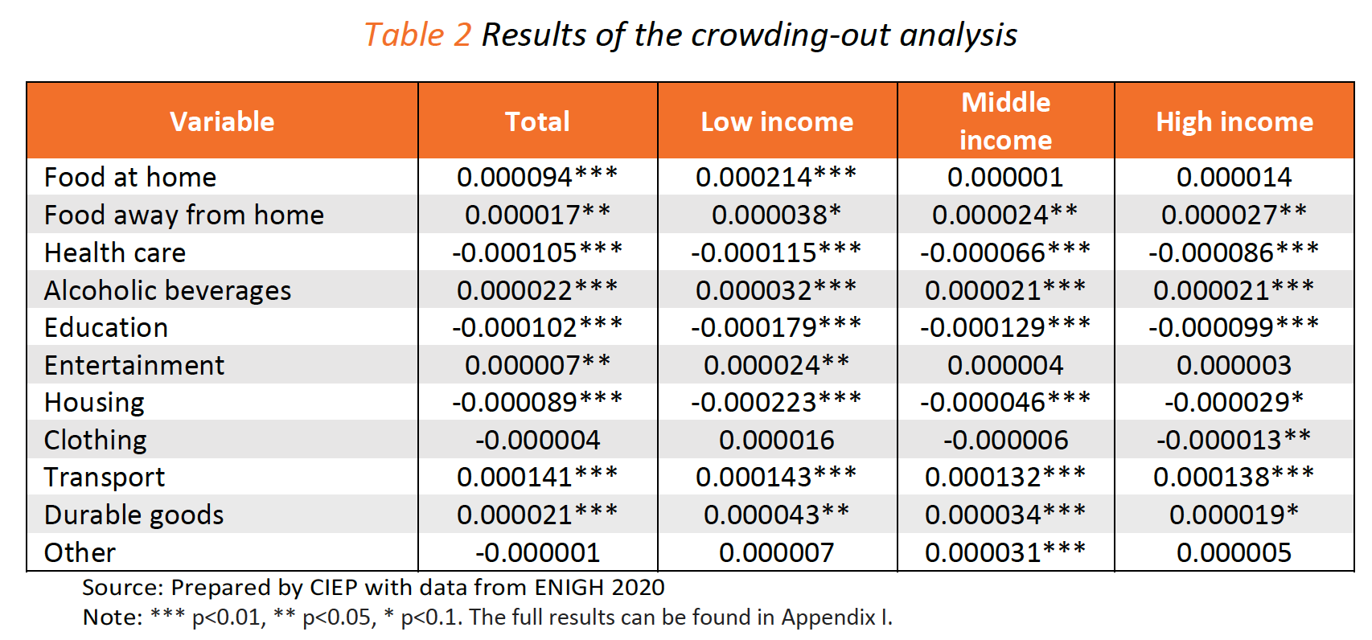
Crowding-out effect of tobacco use
Example
What is the crowding-out effect?
  When households spend on tobacco products, they have less money to spend on other goods such as education, healthcare, housing, and others
In the toolkit:
  Conceptual framework
  Data preparation
  Estimating the crowding-out effect
  Case study from Turkey
*Available at: https://tobacconomics.org/research/crowding-out-and-impoverishing-effect-of-tobacco-in-mexico/
www.tobacconomics.org | @tobacconomics

Slide 8
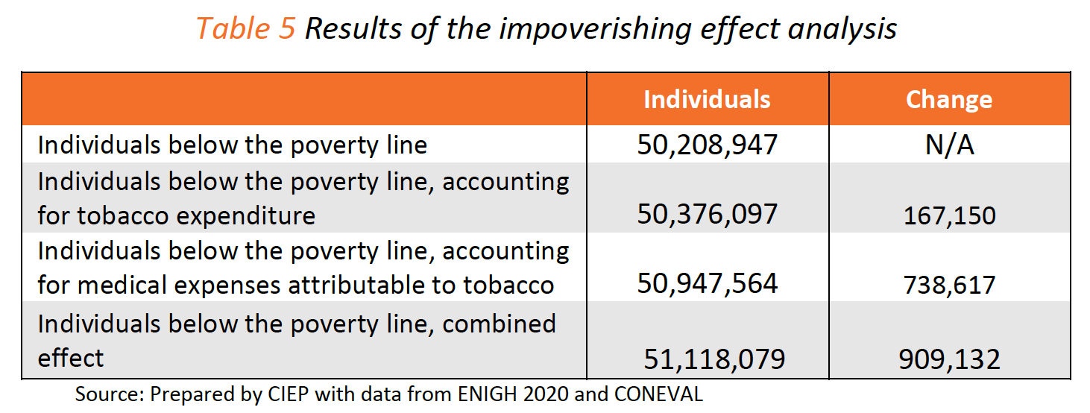
Impoverishing effect of tobacco use
Example
What is the impoverishing effect of tobacco use?
  Because of expenditure on tobacco, households may fall under the poverty line
In the toolkit:
  Conceptual framework
  Data preparation
  Estimating the impoverishing effect
  Case study from India
*Available at: https://tobacconomics.org/research/crowding-out-and-impoverishing-effect-of-tobacco-in-mexico/
www.tobacconomics.org | @tobacconomics

Slide 9
Thank you for attending!
https://tobacconomics.org/research/updated-toolkit-on-using-household-expenditure-surveys-for-research-in-the-economics-of-tobacco-control/

Slide 10
Stay Connected
Tobacconomics
Website: www.tobacconomics.org
Twitter: @Tobacconomics
LinkedIn: Tobacconomics
Facebook: Tobacconomics
Email: info@tobacconomics.org
www.tobacconomics.org | @tobacconomics

