Slide 1
DETERMINANTS OF AID GIVING: A PANEL ANALYSIS
ARNAB ACHARYA, MELISA MARTINEZ ALVAREZ, JOSEPHINE BORGHI, LEONDARO Arregoces and CATHARINE pitt
Work in Progress
Tlaxcala , mexico
Notes:
A presentation about how we should study important aspects of aid effectiveness and Aid giving.

Slide 2
THIS PRSENTATION
INTRODUCTION: Aid giving in general
WHY HEALTH AID?
PANEL DATA
DESCRIPTIVE ANALYSIS
MODEL SELECTION
RESULTS
CONCLUSIONS

Slide 3
LANDSCAPE OF AID GIVING
MARSHALL PLAN: Single donor to countries who previously had high industrial development (1945-1955)
AID GIVING, LOW AND MIDDLE INCOME COUNTRIES (LMIC): Population issues, Big Push, Elimination of Famine and Cold War (1958-1990)
POST COLD WAR: Aid giving falls to LMIC, Political stability for the ex-Soviet Block (1991-2000)
HIV/AIDS, ENDOGENOUS GROWTH THEORY and the CAPABILITY APPROACH: Aid given to improve health and education, MDGs (2001 to present)

Slide 4
DEBATE: Growth
IS AID EFFECTIVE: Does it create growth? (Easterly 2003 Bourguignon and Sundberg 2007, Rajan and Subramaniam 2009, Minoiu and Reddy 2010, Clements, Radelet and Bhavnani, 2004)
  ALL AID: it does not have an impact, or very little impact
  DISAGGREGATE AID INTO GEO-POLITICAL AND ALL OTHER TYPE: The results improve, geo-political aid does not do much, but other types of aid giving have impact
  DISAGGREGATE TO HUMANITARIAN, SHORT-RUN AND LONG-RUN INTENTION AID: Short run aid affects growth

Slide 5
DEBATE: Recipient Response
FINANCING AND AID: Countries replace domestic financing with aid receipts (Pack and Pack, 1994)
CAPITAL FORMATION: Not much impact (Boone, 1994)
ACCOUNTABILITY AND AID: Foreign aid reduces accountability and increases dependency
DAH and HEALTH FINANCING: Sectoral issues are complicated, Development assistance for health reduce or increase government spending on health (Mishra and Newhouse 2009 and Liu et al.2010).

Slide 6
DEBATE: Motivations, empirical work
WHY AND HOW IS AID GIVEN, Does it have any intention of improving welfare or just political or bribery? (Pack and Pack, 1993; Alesina and Dollar, 2000, Knack and Rahman, 2007, Gehring, Michaelowa and Dreher, 2017, Acharya, de Lima and Moore, 2006)
  MOTIVATION FOR AID GIVING: Supposedly poverty alleviation and economic growth (Collier and Dollar, 1999)
  MODATLLITY OF AID GIVING: Are there too many aid givers for any single country and do they burden the recipient bureaucracy with too many individual projects? Herd-effect, risk, Nash, Houtthaker effect

Slide 7
THEORY OF AID GIVING
MOTIVATION FOR AID GIVING: Aid giving is somewhat motivated by intention to help countries: political stability, influence, old Colonial Ties (Together imperfect altruists, Knack and Rahman, 2007).
AID GIVING TO THE SAME COUNTRY: Increased number of donors, Everyone wants to buy influence, Risk reduction—give to the same country because they are stable—Herd Effect or Donor Darling

Slide 8
PAPER’S TOPIC
  MOTIVATION FOR AID GIVING: Can we determine the intention of aid giving in development assistance for health?
    A good question, as health aid should have no other intention than improve health, and not that hard to measure
      IMR, Life-Expectancy, perhaps just assist any country that is poor
  MODATLLITY OF AID GIVING: Giving aid for HIV/AIDS is politically popular in donor countries and UNICEF has cultural recognition, providing for child and maternal health is popular. Too many donors
    Paris: Development Assistance for aid should be coordinated, and fewer countries per single country

Slide 9
EMPIRICAL TESTING
WHAT DATA TO USE?
  ALL AID: Aid is given for multi-purposes even poverty alleviation or related factors are the main aim—poverty measures are not collected all that often in developing countries, so difficult for analysis
  HEALTH AID: Given for improving health, but mostly for IMR, MMR and not for adult health except HIV/AIDS, not all countries were affected by HIV/AIDS
  PERIOD TO COVER: Avoid the cold war period, there is a drop in all types of aid in 1990s, but picked up after George W. Bush, note the US survey, May 2017
    71 percent chose the statement that “when hunger is a major problem in some part of the world, we should send aid whether or not the U.S. has a security interest in that region”—up from 63 percent when asked in the year 2000. 2018, even with Trump, https://www.brookings.edu/wp-content/uploads/2017/08/global-20170731-blum-stevenkull-brief-6.pdf

Slide 10
EMPIRICAL IMPLICATIONS
HYPOTHESIS: Foreign aid should be delivered so that:
  THOSE NEEDING AID: Those where the poorest live should receive aid, proxy measure has been GDP, measured at PPP or those with the most ill health should receive aid-HIV/AIDS, Low life-expectancy, IMR
  THOSE WHO MANAGE AID WELL: Perhaps those who have rule of law, efficiency raising revenue should receive aid or are democratic
  TOO MANY COUNTRY GIVING AID (corollary): Are countries giving aid to aid popular countries?
  COUNTER TO THESE: To improve voting in the UN for the donor, this may be exclusive to the US

Slide 11
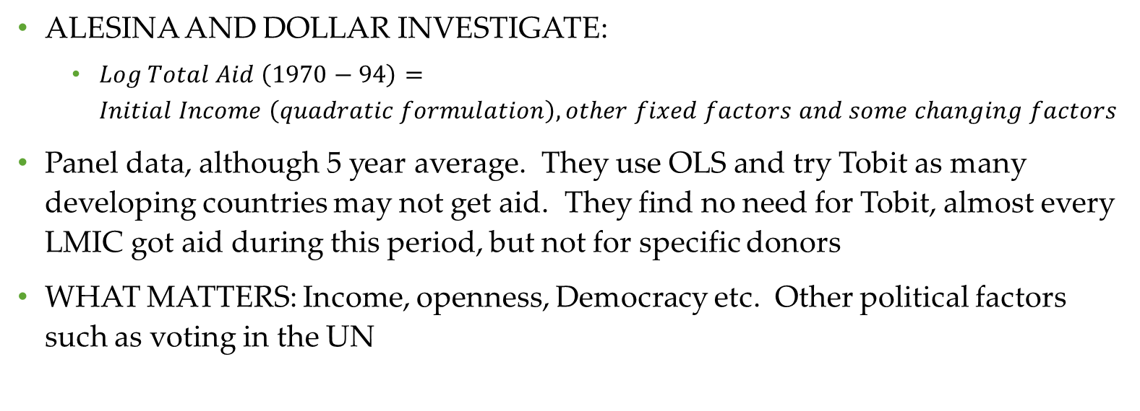
LITERATURE REPORTS
ALESINA AND DOLLAR INVESTIGATE:
  $Log Total Aid \left(1970−94\right)=Initial Income \left(quadratic formulation\right), other fixed factors and some changing factors$
Panel data, although 5 year average. They use OLS and try Tobit as many developing countries may not get aid. They find no need for Tobit, almost every LMIC got aid during this period, but not for specific donors
WHAT MATTERS: Income, openness, Democracy etc. Other political factors such as voting in the UN

Slide 12
MORE FROM LITERATURE
AID/GDP: is affected by poverty ratio (quadratic), population and sometime country management variable, 1994 cross country data (Collier and Dollar, 1999)
MODE OF AID GIVING: Recipient countries report inefficiencies due to having too many donors

Slide 13
QUESTIONS!
  DO DONORS GIVE AID FOR THE RIGHT MOTIVES?
    IMR, POVERTY, RULE OF LAW
  WHAT CAUSES TOO MANY DONORS?
    IMR, POVERTY OR EMULATION
  DO THEY GIVE AID IN SIMILAR WAYS?
    ARE THERE PATTERNS TO BE OBSERVED
  DO GOOD DONORS HAVE SMALLER FEWER RECIPIENTS? META-ANALYSIS, NOT DONE
Notes:
Does Aid induce growth? Varied answers! Some say if the intention of aid is growth oriented then it helps growth. Many others say no even for that last type of aid giving it is not effective.
Aid promotes fungibility and reduces revenue collection. It may reduce expenditure on social spending. Some show it does not affect revenue generation or is neutral regarding revenue generation?

Slide 14
WHICH DATA AND WHY?
DATA USED AID GIVEN SPECIFICALLY FOR REPRODUCTIVE MATERNAL AND CHILD HEALTH (RMNCH)
  Specializing in a sector as have been recommended
FEW FIELDS TRACK DATA FOR SPECIFIC TYPE OF AID GIVING
RMNCH IS GIVEN FOR SPECIFIC REASONS
  Motivations will be easy to determine
DATA FROM 2003-2013
  Beginning from the US PEPFAR, All results will be updated to 2015. Averaged over 3 years and then, 2012-13. Panel Data.

Slide 15
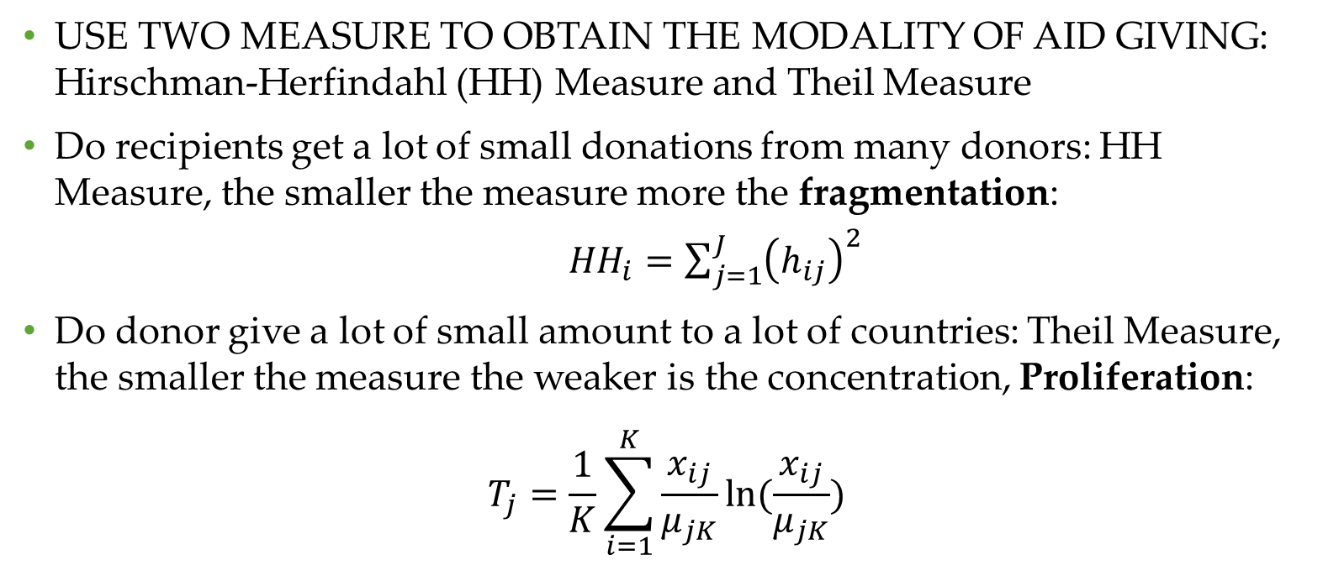
TWO MEASURES
USE TWO MEASURE TO OBTAIN THE MODALITY OF AID GIVING: Hirschman-Herfindahl (HH) Measure and Theil Measure
Do recipients get a lot of small donations from many donors: HH Measure, the smaller the measure more the fragmentation:
  ${HH}_{i}=\sum_{j=1}^{J}{{\left(h_{ij}\right)}^{2}}$
Do donor give a lot of small amount to a lot of countries: Theil Measure, the smaller the measure the weaker is the concentration, Proliferation:
$$T_{j}=\frac{1}{K}\sum_{i=1}^{K}{\frac{x_{ij}}{μ_{jK}}ln⁡(\frac{x_{ij}}{μ_{jK}})}$$

Slide 16
` | Avg. no of donor per recipient/Total | Total yearly Aid (in Billion US$) | Per-capita Aid | HH-index | Average Number of Recipients | Theil Index | Average Recipient GDP/PPP | Average Recipient IMR
2003-05 | 20/29 | 4.9 | 2.5 | 0.277 | 117 | 0.162 | 5199 | 50
2006-08 | 22.5/33 | 6.65 | 4.19 | 0.305 | 116 | 0.147 | 5274 | 47
2009-11 | 27.15/39 | 8.5 | 6.02 | 0.262 | 115 | 0.110 | 5052 | 45
2012-13 | 25/46 | 10.45 | 6.702 | 0.341 | 112 | 0.142 | 5428 | 40
India PPP: 3004-5143, No. of Donor: 28-34, Per-capita Aid: 0.34 to 0.34, IMR: 57-41 Tanzania PPP: 1750-2335, No. of Donor: 28-38, Per-capita Aid: 3.44-10.52 IMR: 63-37.53

Slide 17
RMNCH funding in Tanzania
MCH funding is a large portion of health expenditure, basket funding in place for (03-11?) decreases aid fragmentation--HH Index, PEPFAR US increase-a larger concentration
Year | No of Donor | HH-index | Total Aid | Total Health Exp, per capita | Aid/Exp | Rev/GDP | IMR
2003-05 | 28 | 0.103 | 3.47 | 18.55 | 19% | 9% | 63
2006-08 | 29 | 0.143 | 6.11 | 27.53 | 22% | 10% | 52
2009-11 | 34 | 0.211 | 8.64 | 34.17 | 25% | 10% | 43
2012-13 | 38 | 0.192 | 10.53 | 48.84 | 22% | 12% | 38
Notes:
In 06-08, basket funding is really introduced, HH index, high HH index indicates less harmonization. US funding is much larger through PEPFAR so the concentration is larger. Basket funding is prominent up until 2011. Then it drops by 2013.

Slide 18
Some Donors
 | No. of Recipients | Average Per-Capita Amount | Minimum Per-capita | Maximum Per-capita
Total | 141 | 4.75 | 0.03800 | 31.60
USA | 135 | 1.60 | 0.00003 | 91.50
Euro | 120 | 0.26 | 0.00003 | 4.91
GFUND | 109 | 0.87 | 0.00040 | 11.08
GAVI | 72 | 0.36 | 0.00018 | 1.86
UK | 65 | 0.29 | 0.00003 | 4.85
Canada | 75 | 0.13 | 0.00001 | 2.38
Norway | 52 | 0.20 | 0.00004 | 6.04
Averaged over 2003-2004, 4 periods

Slide 19
Donors and the Theil Measure: No real relation, everybody proliferates

Slide 20
Recipients get a lot of small aid and this is increasing in time. Are donors behaving like each other, in that they copy each other.

Slide 21
Motivation for Aid giving
Are countries motivated by standard normative health indicators in giving maternal health:, do these factors at the recipient country level play a role?
  Low per-capita income
  High burden of ill health
  Country effort in health
  Domestic Resource Mobilization
  Country Governance
  Following the leader
Notes:
The question for ODA health giving at least normatively clear. The motivation should be:
Low per-capital income
High burden of ill health
Country effort in health
Domestic Resource Mobilization
Country Governance
Well, do these affect ODA health giving?
But answering this question is difficult: how to model statistical relation? And which countries to include as the recipient.

Slide 22
Donors respond to low income, negative slope

Slide 23
Donors respond to IMR, positive slope

Slide 24
Sample matters: use of small countries can produce odd results
137-144 small and large countries, (Scale 0-100)
109-113 countries, Population > 1,000,000 (Scale 0-30)
Notes:
Inclusion of small countries can really distort one’s conclusions.

Slide 25
MODEL SELECTION
MAIN QUESTION: How can we explain the amount recipients get from each donor given that the donors are motivated by, IMR, Income and that they tend act like each other.
We are ruling out political motivations, so we look for improved results from proper management
Behaving like other donors, Paris and Busan declaration: coordinate aid and don’t give to everyone. We see little evidence of this in the last graph

Slide 26
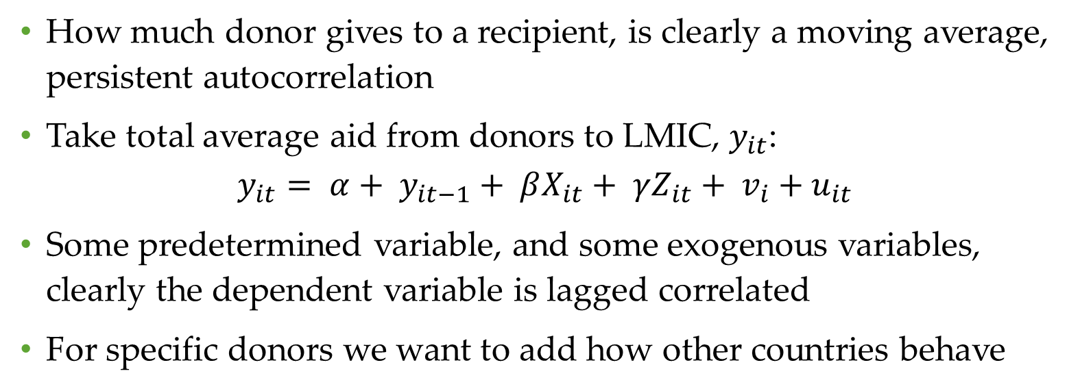
PANEL DATA
How much donor gives to a recipient, is clearly a moving average, persistent autocorrelation
Take total average aid from donors to LMIC, $y_{it}$:
$$y_{it}= {α+ y}_{it−1}+ βX_{it}+ γZ_{it}+ v_{i}+u_{it}$$
Some predetermined variable, and some exogenous variables, clearly the dependent variable is lagged correlated
For specific donors we want to add how other countries behave

Slide 27
Most have considered cross country
Add specific recipient characteristic: political factor such as UN voting, but many time invariant factors such being an old colony of the donor.
Take care of endogeneity problem of income for Life Expectancy or IMR to run 2SLS
Many just carry out OLS, as already stated

Slide 28
Total Aid Given, No Dynamic Panel
Variable | OLS, all time | Fixed Effect | OLS, time 1 | OLS, Time 4
No. of donor | 0.109*** | .043** | 0.141*** | 0.0752**
Log IMR | 0.808*** | -0.751 | 0.771*** | 1.145***
Dummy for 2009-13 | 0.331** | -0.036
Revenue | -0.412 | 0.848 | -2.15 | 1.531
Log Population | 0.312*** | 2.654*** | 0.347*** | 0.359**
Law | 0.292* | 0.599* | -0.071 | 0.305
Aid/Gov Budget | 0.00003 | 0.0005 | -0.0009 | -0.001
Constant | 6.755*** | -24.567 | 5.606*** | 5.94***
R-Square | 0.691 | rho = 0.988 | 0.621 | 0.698
Hausman Test: Rule out Random Effect, legend: * p<0.05; ** p<0.01; *** p<0.001 Dependent Variable, log of Total Aid given to a country from all donors,

Slide 29
Strange Results
From the fixed effect, rho—very high, suggesting a lot of variations comes from the cross-section
IMR most likely pre-determined by aid in general, thus first differencing does cause some problems
Lagged levels are poor instruments

Slide 30
STATA COMMAND
xtabond2 ln_tot_aid L.ln_tot_aid L.ln_imr L.count paris lnPop revenue law if include == 1, gmm(L.(ln_tot_aid count ln_imr) ) iv( L.hexpratio L.aid_gov_bud law paris revenue lnPop ) robust

Slide 31
Log of Total Aid to a Country (N=160)
 | Cons-tant | lag aid | lag ln IMR | Count | Dummy, 09-11 and 12-13 | Log Pop | Reve-nue | Law | AR(1) | Hansen
Model 1 | 2.566** | 0.701*** | 0.370* | 0.008 | -0.143 | 0.099 | -0.606 | 0.090 | NO | NO
Model 2 | 2.566* | 0.757*** | 0.287 |  | -0.160 | 0.083 | -0.611 | 0.046 | NO | NO
Model 3 | 2.248* | 0.713*** | 0.423** |  |  | 0.101* | -0.681 | 0.111 | Yes | 0.167

Slide 32
Observations: Amount of Aid
Two important factors population and IMR are not robust to having time a factor, the time Paris: a dummy for 09-11, and 12-13. This is the factor that reports the agreement to reduce fragmentation. Here it reflects probably the Great Recession when the number of donor rose but the amount decrease.
Two factors are important in the right way: population (+) and IMR (+). But no response to revenue and rule of law
We probably needed a larger series.

Slide 33
Log No. of Donors (N=160)
 | Con-stant | lag log Count | lag ln IMR | log PPP | log Pop | Reve-nue | Dummy, 09-13 | law | ln Top 8 | AR | Han-son
Model 1 | 1.918* | 0.252* |  | -0.07** | 0.06*** | -0.055 |  | -0.066 |  | YES | YES
Model 2 | 2.433* | -0.115 |  | -0.091 | 0.039 | -0.149 | 0.100* | -0.050 | 0.070* | YES | YES
Model 3 | 0.738* | 0.243 | 0.195** |  | 0.065* | -0.306 | 0.120** | 0.171 |  | YES | YES
Model 4 | 1.15* | 0.187 | 0.495 | 0.212 | 0.212* | -0.265 |  | -0.072 | -0.056* | YES | YES

Slide 34
Observations: Number of Donors
Lagged dependent variable, nearly insignificant
Number of donors increased after 2008, as this was an international policy.
Whether to engage in giving aid may depend on how much aid is being given by bigger donors
Population is positively related to number of donors

Slide 35
Single Donors
AGGREGATION IS MISLEADING
  Aid giving is a single donor’s decision, the amount is not given in coordination
EXAMINE SINGLE DONORS
  There are some large donors giving over 1 billion dollars, 11 in this period, although per-capita yearly amount are small
  And some that are traditionally thought to be ideal aid giver and also give a large amount

Slide 36
SINGLE DONOR BEHAVIOR (IMR)

Slide 37
SINGLE DONOR BEHAVIOR (PPP)

Slide 38
Observations
Most likely Lagged PPP works as a better predictor for all donors than lagged ln PPP
US aid giving seems extremely strongly motivated since 2003-2013 by IMR and PPP
Not shown, these donors and many smaller donors give amounts of aid independent of each other
Perhaps smaller number of recipients per donor makes the standard deviation larger! Could make proliferators look better. Or we need larger series

Slide 39
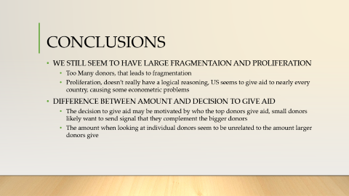
CONCLUSIONS
WE STILL SEEM TO HAVE LARGE FRAGMENTAION AND PROLIFERATION
  Too Many donors, that leads to fragmentation
  Proliferation, doesn’t really have a logical reasoning, US seems to give aid to nearly every country, causing some econometric problems
DIFFERENCE BETWEEN AMOUNT AND DECISION TO GIVE AID
  The decision to give aid may be motivated by who the top donors give aid, small donors likely want to send signal that they complement the bigger donors
  The amount when looking at individual donors seem to be unrelated to the amount larger donors give

Slide 40
CONCLUSIONS
IMPROVING THE FINDINGS
  Larger series is needed, up to 2015 is available now
  Hard to include country specific factors, perhaps certain factors such as changes in government for both donors and countries can be used, UN votes in the previous year in favor of US and NATO
  Add lagged Foreign Direct Investment as an independent variable
  Analyse larger number of donors to examine what explains the results we obtain, a meta analysis on the donors, Classifying the characteristics of good aid donors. Ranking donor

