Slide 1
Endotoxin associated to particulate matter (PM₁₀) of a landfill facility in Cuautla, Morelos, Mexico
MARIA ALEJANDRA TERRAZAS MERAZ, Irma Aurora Rosas Pérez, Ernesto Alfaro Moreno, Sonia Patricia Romano Riquer, Natividad Sara García Jiménez, Margarita Sánchez Arias, Horacio Riojas-Rodríguez
EUSMEX 2016 May 18th, 2016 11:40 – 12:00

Slide 2
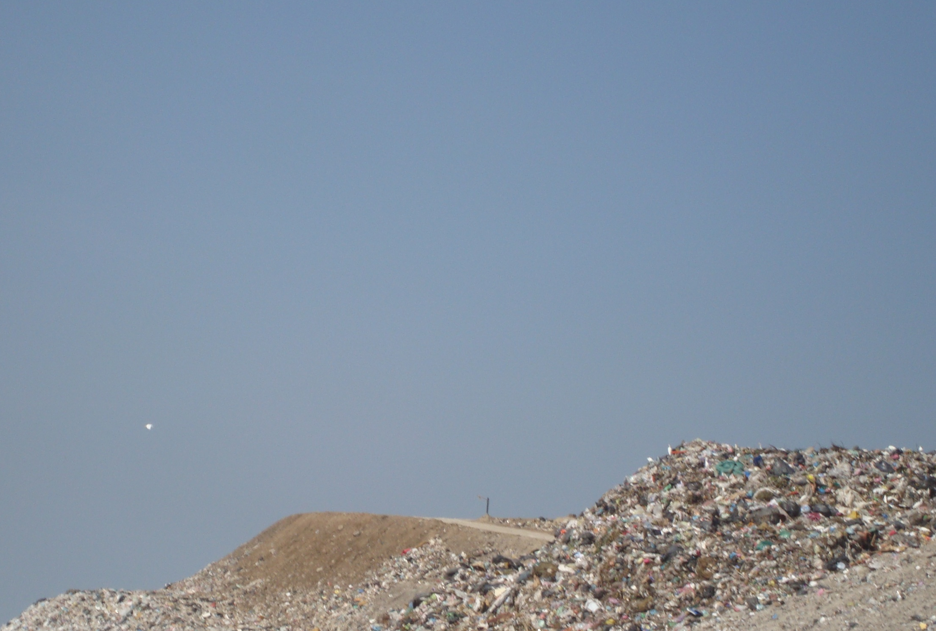
Background
Solid waste handling in a landfill may affect the surrounding environment in a radius at least of 3 km (Gomez et al. 2008)
Workers are exposed to pollutants through inhalation, ingestion or dermal contact
Particulate matter is usually a mixture of many chemicals and biological materials (Heaney et al. 2011, Mueller-Anneling et al. 2006).
Consistent association between health outcomes and PM₁₀ concentration in working environments (Porta et al. 2009; Duquenne et al. 2013; Nemmar et al. 2013)

Slide 3
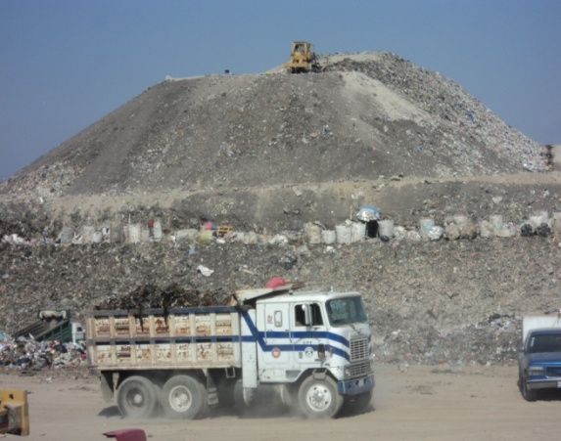
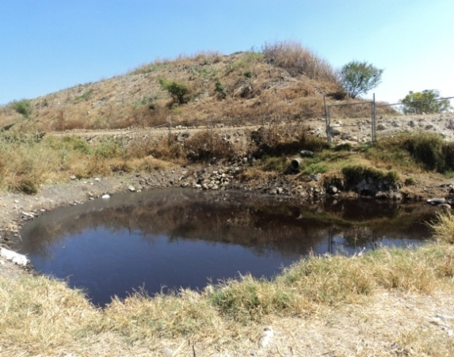
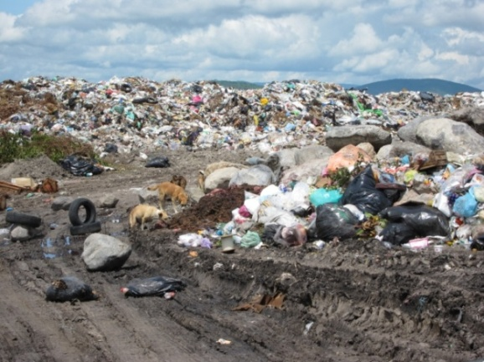
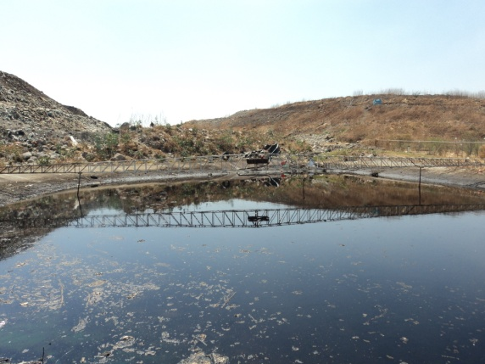
Landfill “La Perseverancia” Cuautla, Morelos
From November 2011 to October 2012 we conducted an ecosystemic study with an interdiciplinary team
Three phases: socio-environmental characterization, workers health and adjacent population health effects.

Slide 4
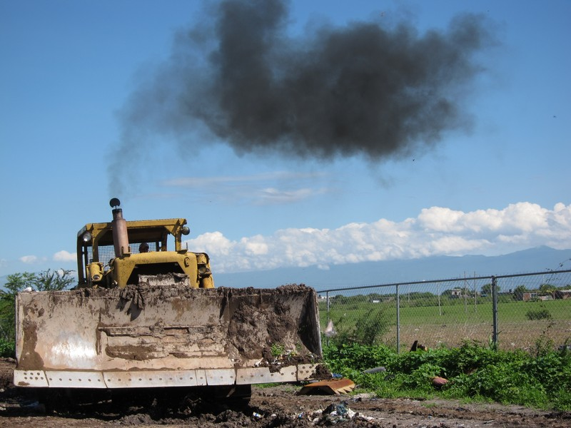
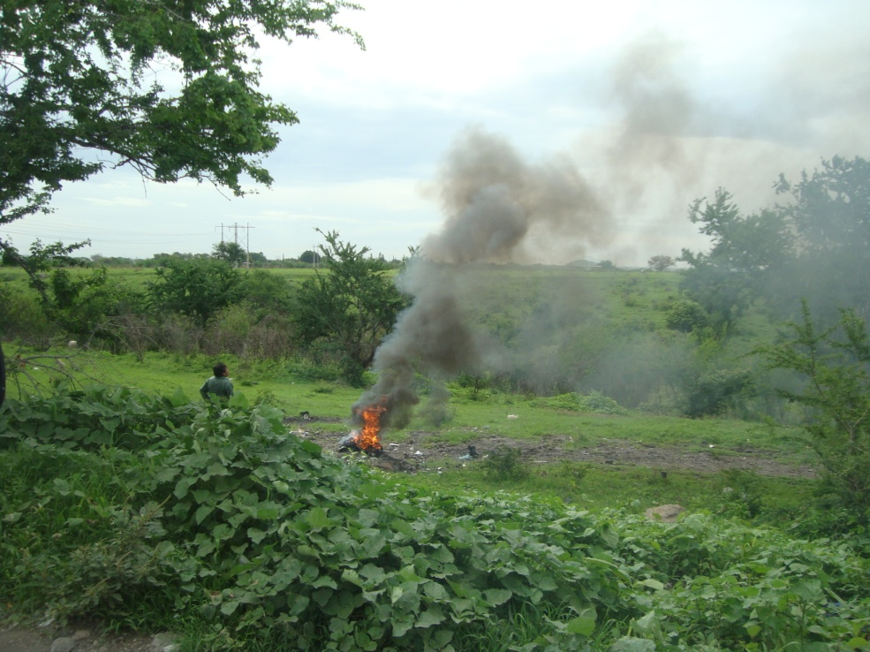
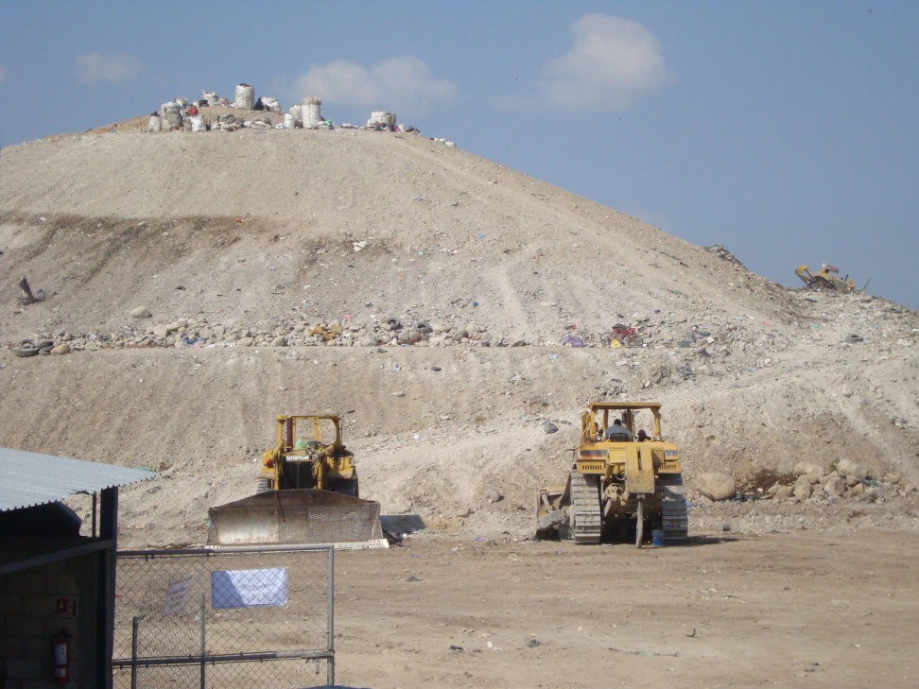
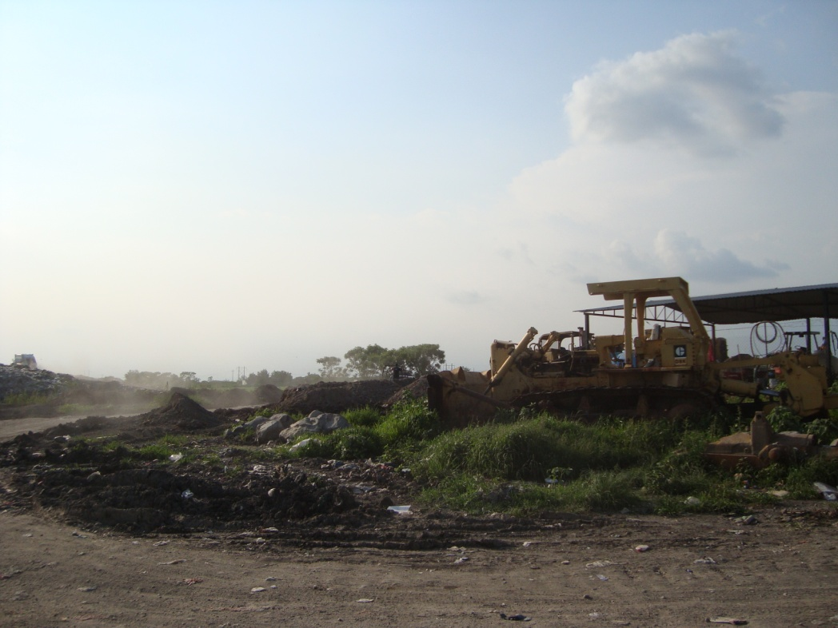
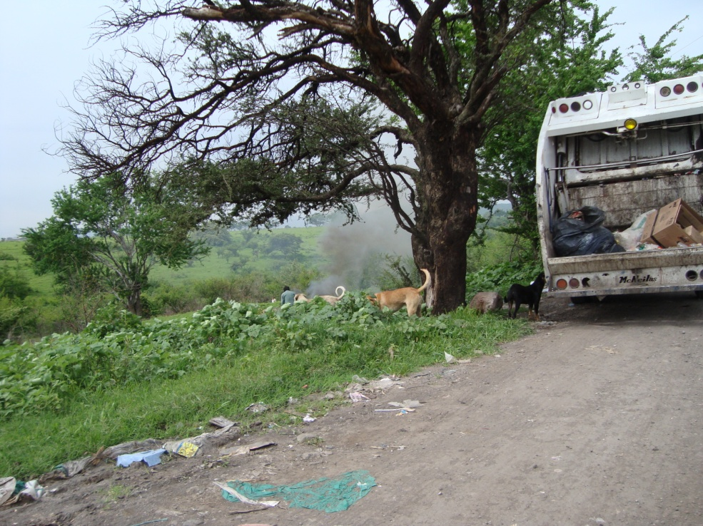
Landfill management involves moving truck discharge, heavy dustcarts for daily waste coverage, separating waste, compacting waste with bulldozers and crushers.
Such movements involve diésel fumes, and all material are susceptible to wind re-suspensión and dispersión (Koshy et al, 2009)

Slide 5
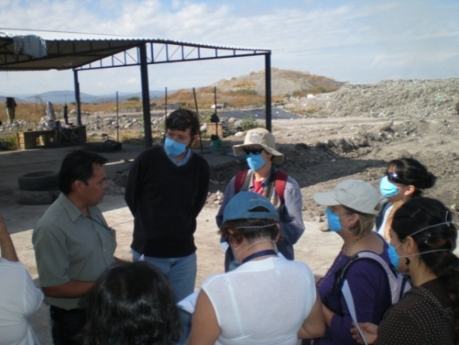
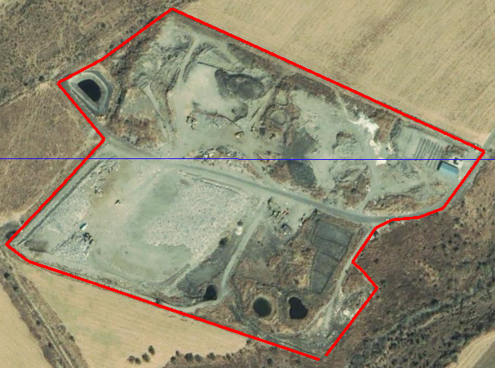
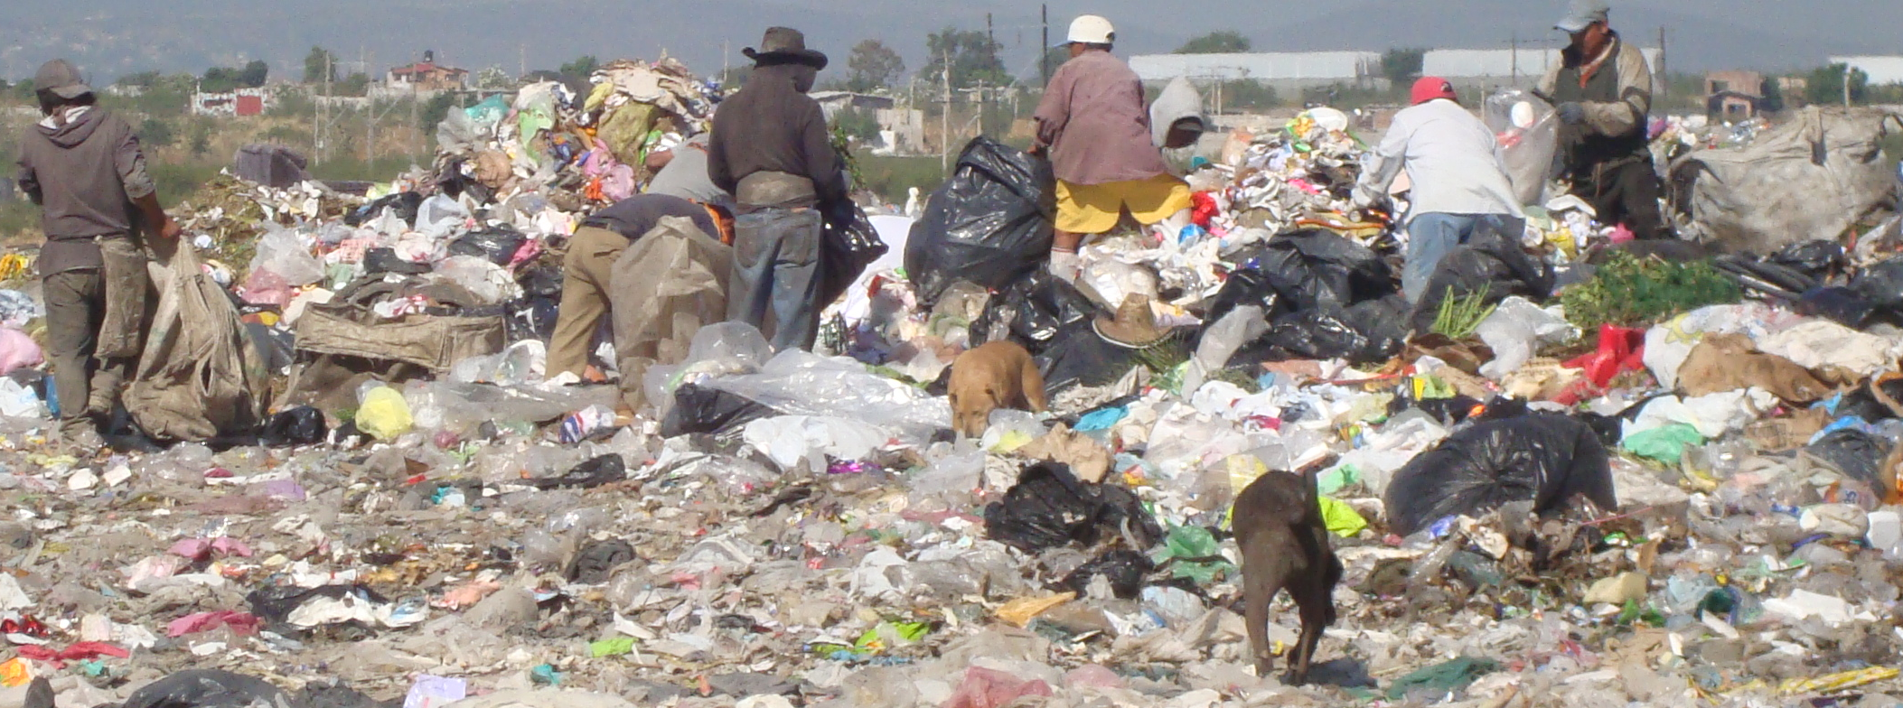

Slide 6
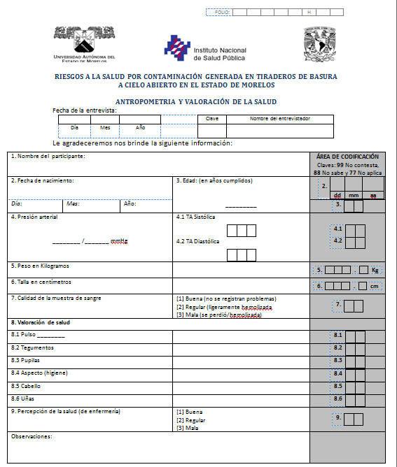

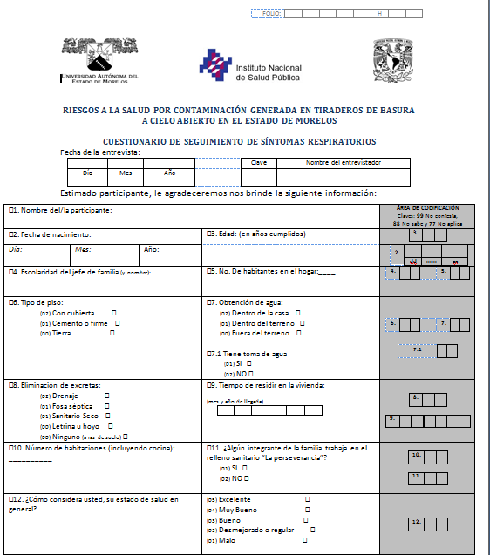
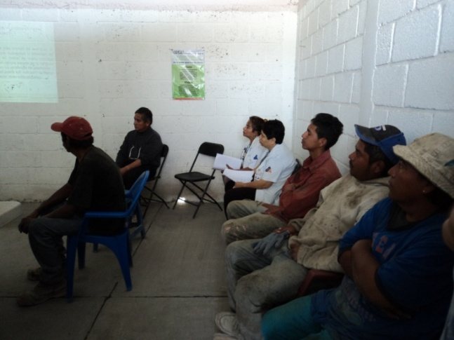


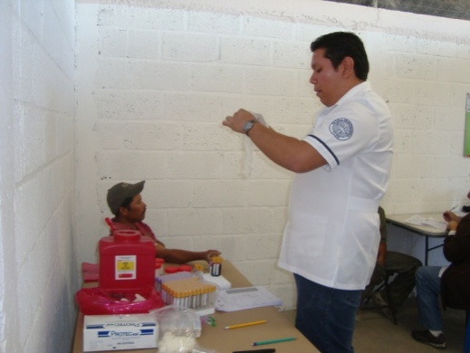
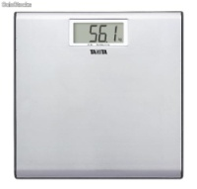
Cross sectional study
We recruited 58 males: 24 workers from landfill considered exposed group an a comparison group conformed by 34 participants
Selection criteria: age between 18 -40; not self-reported history of mental illness; and sign a consent form approved by Bioethics Commission.
Population

Slide 7
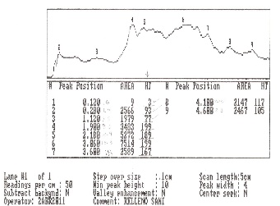
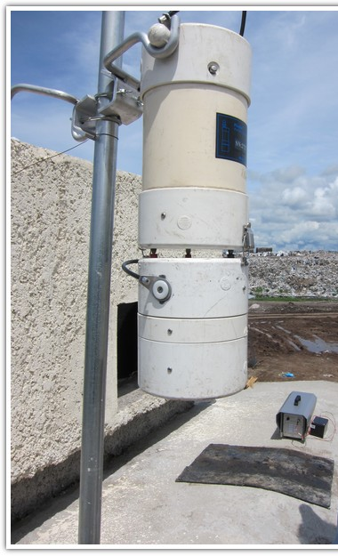
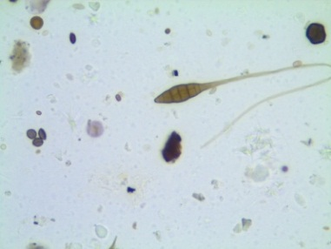
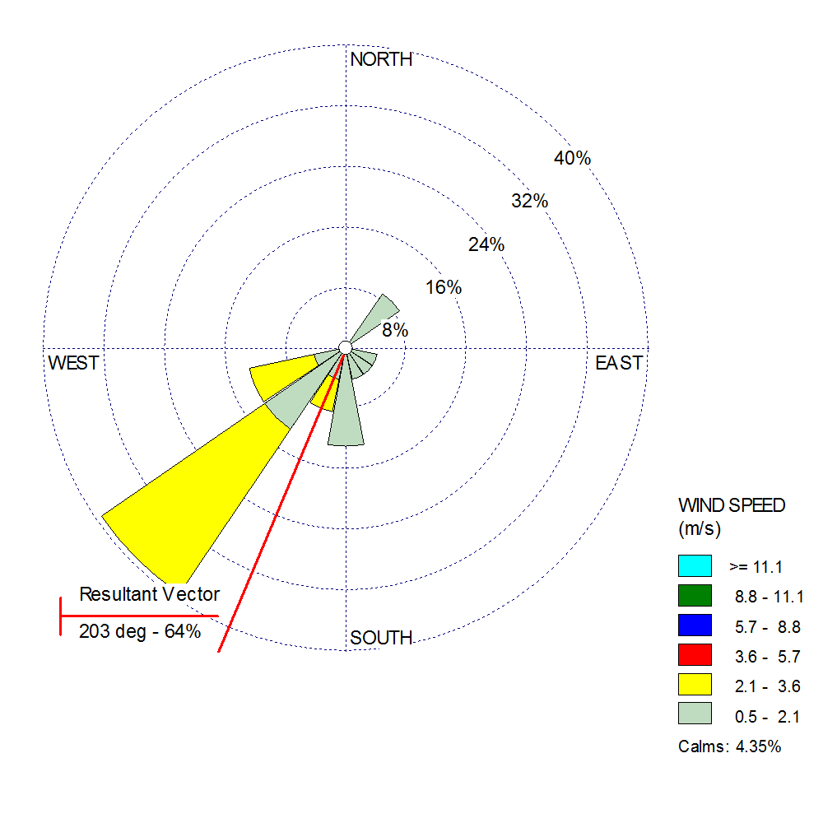
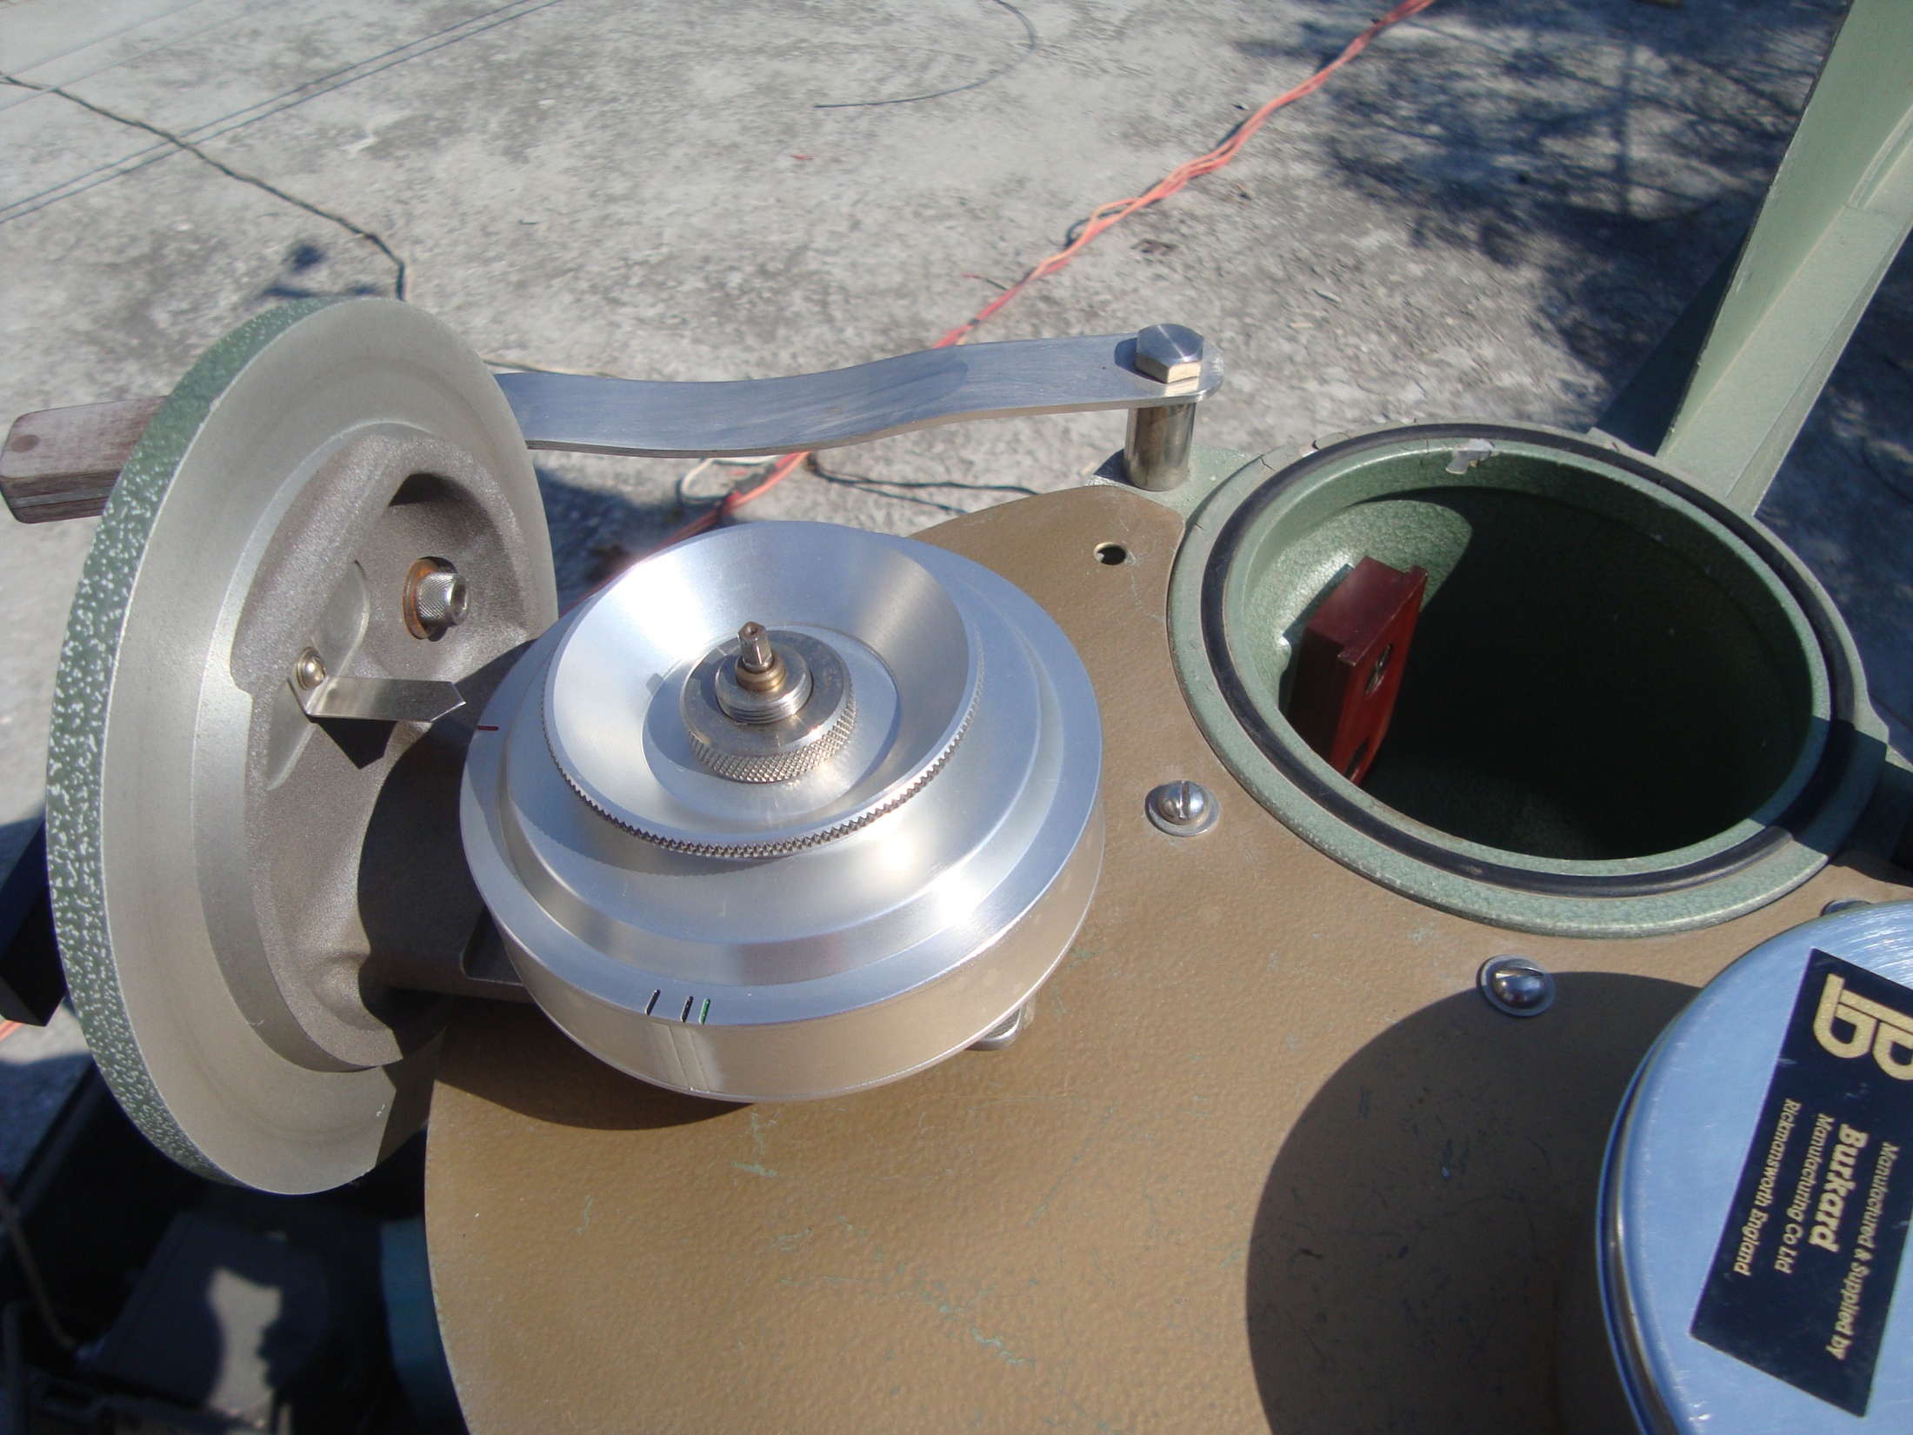
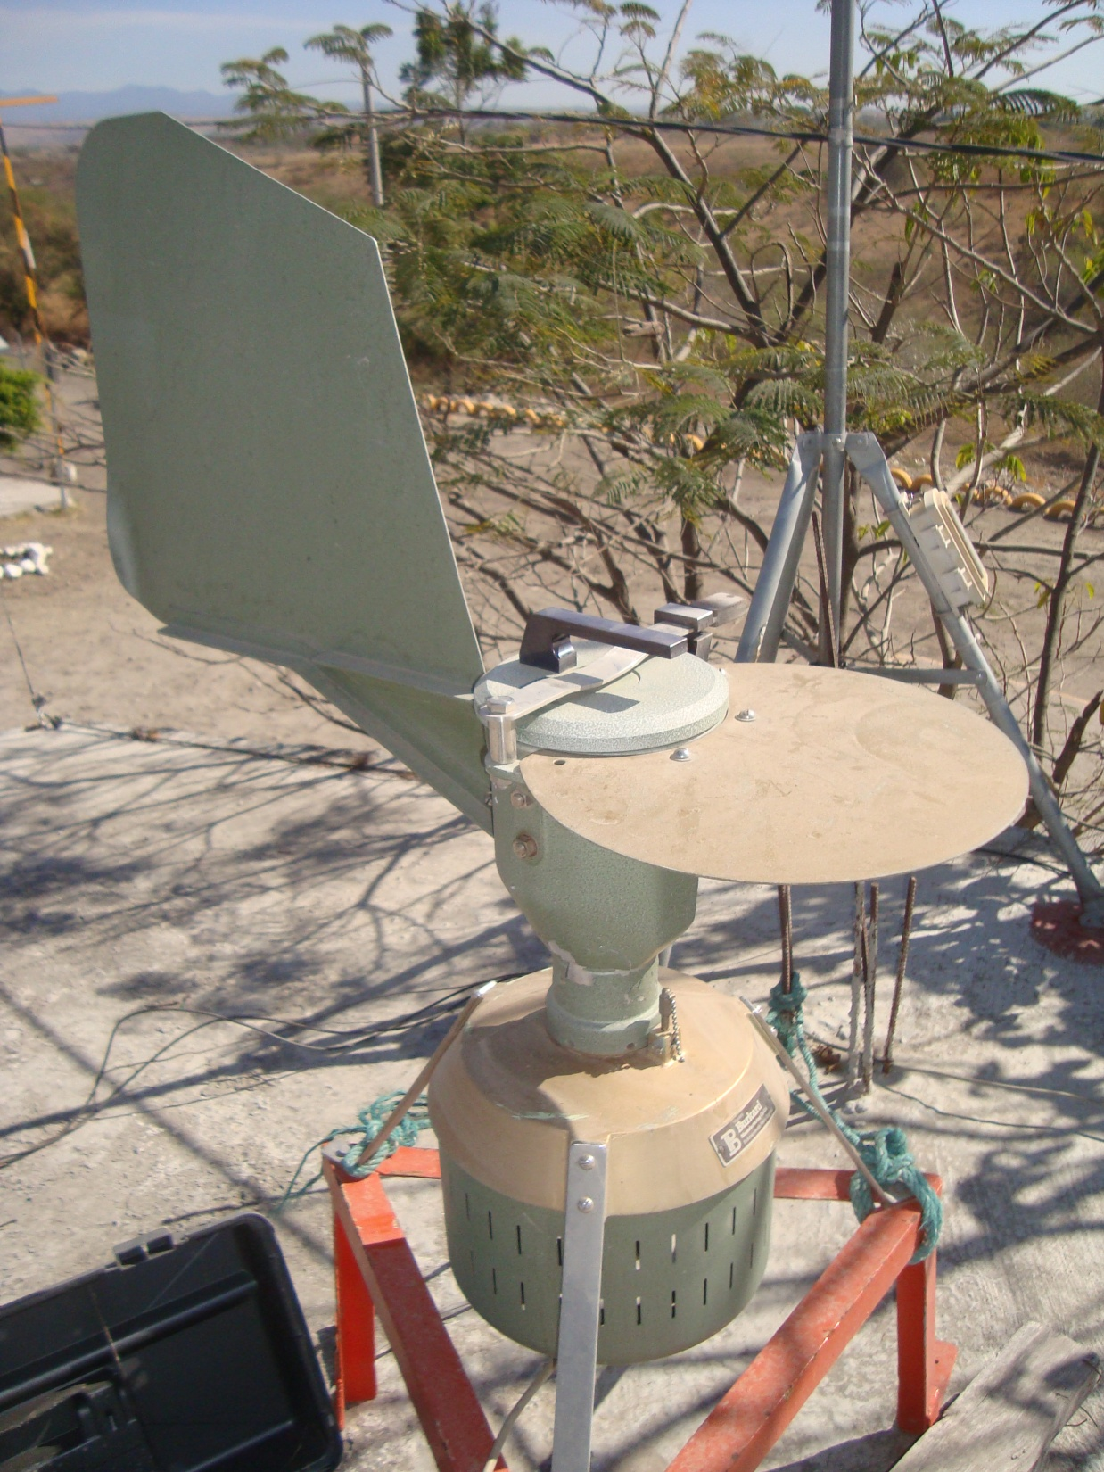
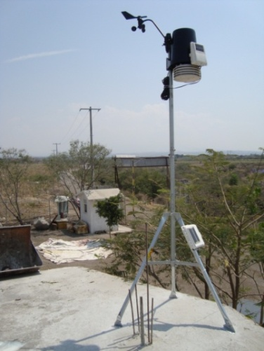
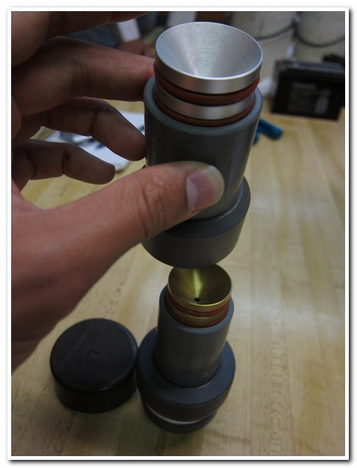
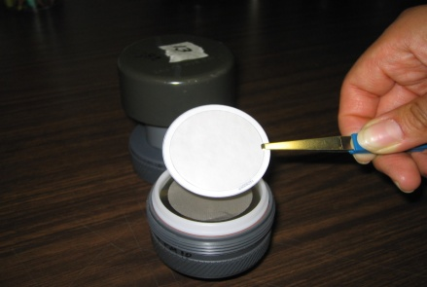
Meterorological data and airborne particles
Davis
Burkard (STP, spores)
Mini vol (PM₁₀)

Slide 8
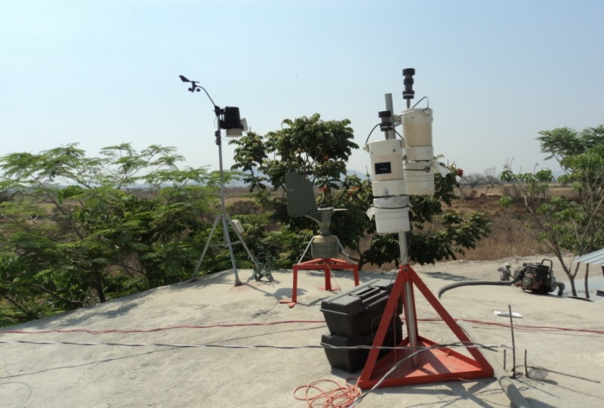
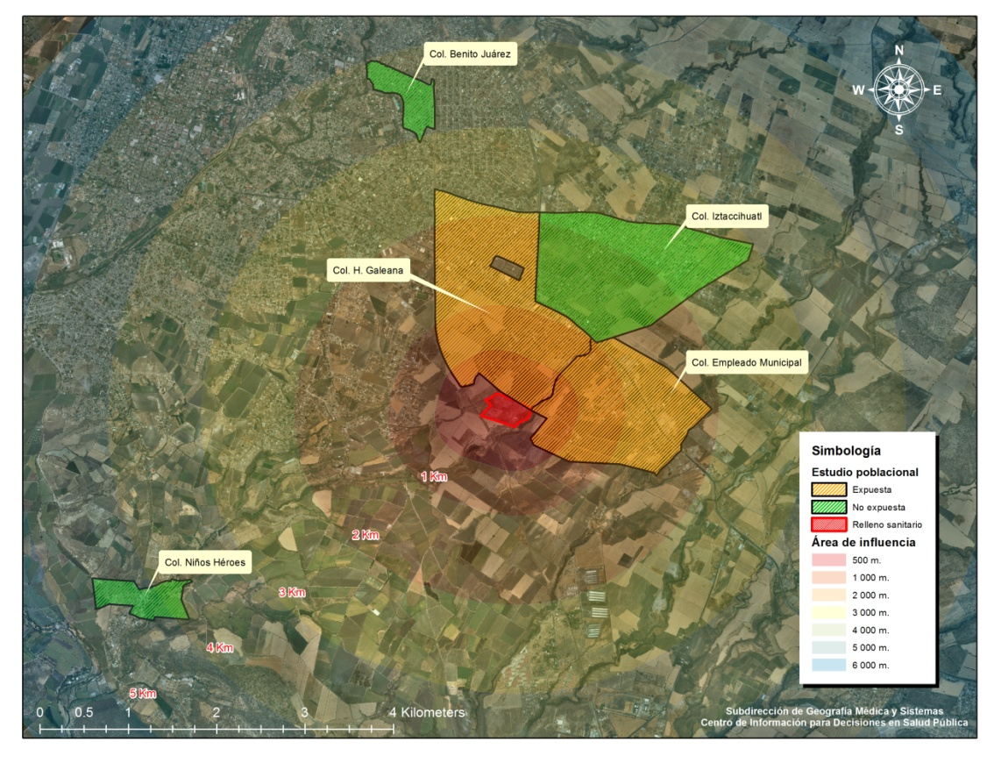

The meteorological parameters and airborne particles were measured in Landfill Facility on the roof of the office building.
Sampling equipmetn was installed in 5 places at upwind and downwind locations on the roof of a house
Limulus Amebocyte Lysate tests using Pyros Kinetix Flex
The assignment of exposure (PM10, endotoxin and (1→3)-ß-D-glucan) was obtained from the corresponding filters for each previous day when the blood sample was taken to the participants.

Slide 9
Statistical analysis
Wind Rose Plots for Meteorological Data (WRPlot View ©1998-2010 Lakes Environmental Software Version 6.5.1.
Stata® v.11
For bivariate analysis, we apply non-parametric tests (Kruskal Wallis), depending on the distribution of the variables; we used test of Chi² to analyze independence between out of rank data.

Slide 10
Regression models
To assess inflammation markers
  Tobit regression for censured data for IL-6 and IL-8;
  Lineal regression for TNFα lymphocytes, monocytes, neutrophils and leukocytes.
All models were adjusted by exposure zone (landfill and downwind with upwind like reference population), PM₁₀ concentration (µg/m³), endotoxin concentration (EU/m³), body mass index (kg/m²), age (years) and smoke habit (yes or not), inflammation markers were adjusted additionally by monocytes (%).

Slide 11
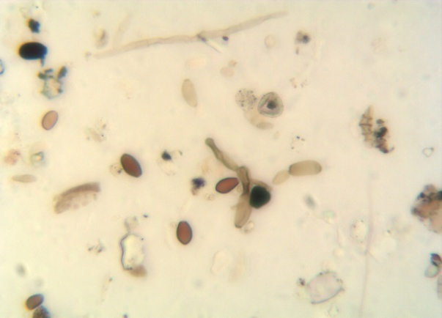
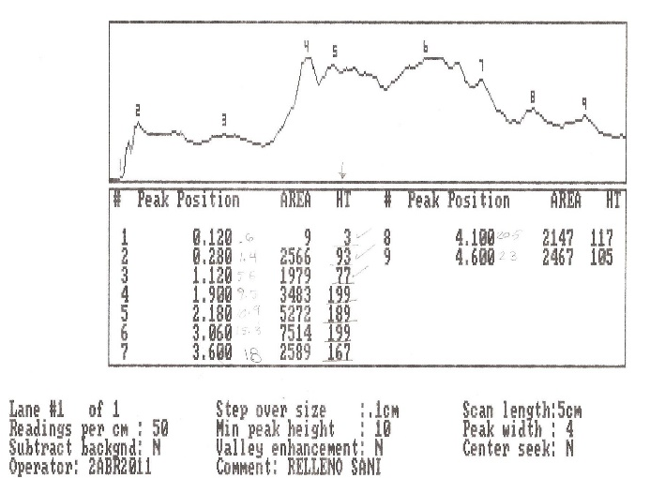
Results:
Landfill activities associated to hourly distribution of densitometrical maximum values of airborne particles (Burkard slides) and prevailing wind direction

Slide 12
Results:
Landfill activities associated to hourly distribution of densitometrical maximum values of airborne particles (Burkard slides) and prevailing wind direction
Command: twoway (scatter maximodia dirvientohorpicomax, msymbol(circle)), ytitle(Particles (OD)) yscale(range(0 360)) ylabel(, valuelabel) xtitle(Wind direction) xscale(range(0 360)) xline(0 45 90 135 180 225 270 315 360) xlabel(0 90 180 270 360, valuelabel) scheme(s2mono) by( Hours)

Slide 13
Sample concentration of PM₁₀, (1→3)-β-D-glucan and endotoxin by sampling site
Samples were obtained from a total of 108 days with an average concentration of 24-hour
During 25 days, the levels exceeded 120µg/m3, and more than half of concentrations were larger than 50µg/m3;
LF workers were exposed for approximately 12 hours per day, from 6:00 to 18:00 hours. PM10, endotoxin and (1→3)-β-D-glucan concentrations
Mueller-Anneling, (2004), propose a threshold level of 17 EU/m3 in 8 hours, we found that some days this level were highest in LF

Slide 14
Citokines
We compared the data of inflammation markers by performing a Tobit regression analysis because of we had censored data for IL-6 and IL-8.
We performed lineal regression for lymphocytes, neutrophils, monocytes and TNFα
The independent variable was the place of exposure (landfill, and downwind with upwind like reference population), adjusting for the endotoxin concentration in UE/m³, age (years old) body mass index and smoking habits (present/absence); also, we adjust the models by monocytes concentration
Command: tobit m_il8_uniform exp_2 exp_3 eum3p glucanngm3 m_imc edad fuma m_mon if workers<., ll(5)
outreg2 using modreg, excel sideway append stats(coef ci_low ci_high)

Slide 15
Whit the linear regression models we show the results of inflammation markers and leukocyte formula.
In regard to the immune system cells, leukocytes, monocytes and neutrophils are lower in the workers of LF in comparison with upwind, as opposed to the lymphocytes that are upper in this group. Similarly to the inflammation marker, monocytes and neutrophils will increase as endotoxin, except lymphocytes that shows a relationship significantly negative
Command: reg m_wbclx109 exp_2 exp_3 eum3p glucanngm3 m_imc edad fuma m_mon s_difpresp if workers<.
outreg2 using modreg1, excel sideway append stats(coef ci_low ci_high)

Slide 16
Findings
Inflammation markers decreased in landfill's workers comparing with other populations
Endotoxin concentration in air, had influence at biomarkers behavior
The exposure to particles is especially in the hours when there are more movement of the deposited waste.

Slide 17




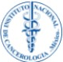
Working Group
UAEM
INSP
Dra. Maria Alejandra Terrazas Meraz
Dra. Natividad Sara García Jiménez
Tesista
Biol. Luis Obed Ocampo
Dr. Horacio Riojas Rodríguez
M.C. Margarita Sánchez Arias
Dra. Sonia Patricia Romano Riquer
L.E. Rosario Guevara Santillan
Ing. René Santos Luna
Encuestadores
L.A.P. Emiliano Acosta Márquez
L.E. Luis Antonio Rico Velázquez
Enf. María Guadalupe Chávez Castillo
Estudiante
Michael Tsang
UNAM
Centro de Ciencias de la Atmósfera
Dra. Irma Rosas Pérez
M.C. María Eva Salinas Cortés
M. En C. Leticia Martínez Romero
Laboratorio Nacional de las Ciencias de la Sostenibilidad
Dra. Ana Cecilia Espinosa García
Rosa Solano Ortiz
Ma. Alejandra Fonseca Salazar
Tesista
Erick R. Hjort Colunga
Instituto de Geología
Dra. Christina Siebe Graba
Dra. Lucy Mora Palomino
Estudiantes
Henriette Hartkopp
Karolin Woitke
INER
M.C. Minerva Catalán Vázquez (INER/INSP)
INCAN
Dr. Ernesto Alfaro Moreno
Dra. Angélica Montiel Dávalos

Slide 18
Acknowledgements
We thank to the participants in the study, the municipal authorities, the landfill managers and the representatives of the population.
Special thanks to Dr. Alvaro Osornio Vargas
Our thankfull to laboratory staff to analyze serum and blood levels: Natividad Sara García Jímenez, Ph.D. (UAEM);
To analyze particles in filters (PM10, endotoxin and (1→3)-ß-D-glucan: María Eva Salinas Cortés, M.Sc. and Leticia Martínez Romero M.Sc. (UNAM);
To analyze interleukins and TNFα: Angélica Montiel Dávalos, Ph.D. (INCAN);
To make maps: René Santos Luna, M.Sc. (INSP);
To standardize in anthropometry: Edith Yañez Marquez, B.Nut.;
This project was funded by National Council of Science and Technology Health Sectorial (CONACyT-Salud) Project #115486 and approved by the Ethical, Research and Bio-security Commissions of National Institute of Public Health (SIID Register #907).

Slide 19
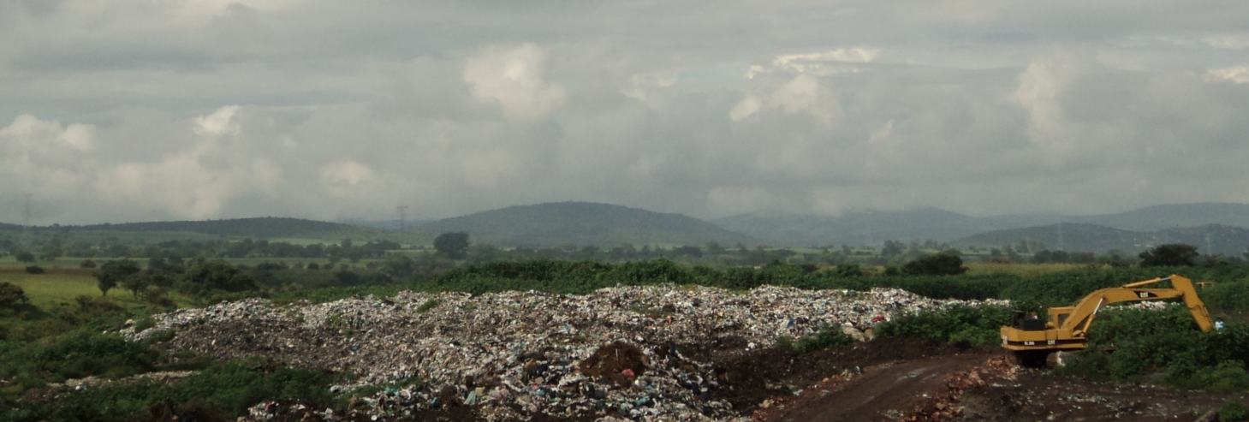
THANK YOU FOR YOUR ATTENTION
MAY 18, 2016

