Slide 1
Use of tobbaco in rural secondary students
Ortega-Ceballos PA, M en C; Terrazas-Meraz MA, Dr; Arizmendi-Jaime ER, Dr; Tapia-Domínguez M, MSC,

Slide 2
Introduction
The World Health Organization (WHO) reported that overall, the prevalence of use of tobacco is declining in many developed countries, but increasing in developing countries, in addition to about 1.3 billion people worldwide smoke¹ and 47.5% of men smoke compared to 10.3% of women.²
1.-World Health Organization: The WHO Reports on the Global Tobacco Epidemic. Geneva: WHO; 2008.
2.-World Health Organization: The world health report 2002.reducing risks, promoting healthy life. Geneva: WHO; 2002

Slide 3
In the book review for Cigarette Century, Hall said that "Since the publication of the Report of the Surgeon General on Smoking and Health in 1964, the health workers around the world have highlighted smoking as a risk to major health ".³
3.-Hall W: (Book Review) cigarette century: the rise, fall and deadly persistence of the product that defined America. Tob Control 2007, 16:360.

Slide 4
Smoking is the leading preventable cause of morbidity and mortality in developed countries, is related deaths due to lung cancer, chronic obstructive pulmonary disease, ischemic heart disease and brainvascular disease.

Slide 5
The Global Survey of Youth Tobacco (GYTS) reported that about 25% of all adolescents who experiment with cigarette smoking become regular smokers, and among smokers, about a third die from a disease related to use of tobacco; It stresses that only half of the participants reported they had been taught in school about the dangers of smoking during the year preceding the survey.⁴
4.-Global Youth Tobacco Survey Collaborative Group. Tobacco use among youth: a cross country comparison. Tob Control 2002; 11:252-70.

Slide 6
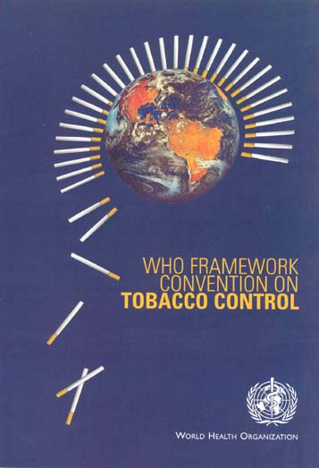
CMCT
In 2003, the World Health Organization (WHO) adopted the Framework Convention on Tobacco Control (FCTC)*
*Organización Mundial de la Salud. Convenio Marco de la OMS para el Control del Tabaco. Ginebra, 2004. Disponible en: http://www.paho.org/Spanish/DD/PUB/sa56r1.pdf
Notes:
En un esfuerzo por disminuir la exposición de la población a los efectos nocivos del HTA en el 2003, la Organización Mundial de la Salud (OMS) aprueba el Convenio Marco para el Control del Tabaco (CMCT)³, el cual en su artículo 8 estimula a cada Parte a adoptar y aplicar medidas legislativas, ejecutivas, administrativas para la protección contra la exposición al humo de tabaco en lugares públicos.

Slide 7
Article 8 encourages each party to adopt and implement effective legislative, executive, administrative for protection against exposure to smoking in public places measures.
Notes:
En un esfuerzo por disminuir la exposición de la población a los efectos nocivos del HTA en el 2003, la Organización Mundial de la Salud (OMS) aprueba el Convenio Marco para el Control del Tabaco (CMCT)³, el cual en su artículo 8 estimula a cada Parte a adoptar y aplicar medidas legislativas, ejecutivas, administrativas para la protección contra la exposición al humo de tabaco en lugares públicos.

Slide 8
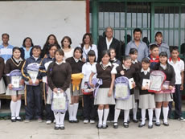
The study of smoking in students who are undergoing training is important, taking into account future risks of chronic diseases.

Slide 9
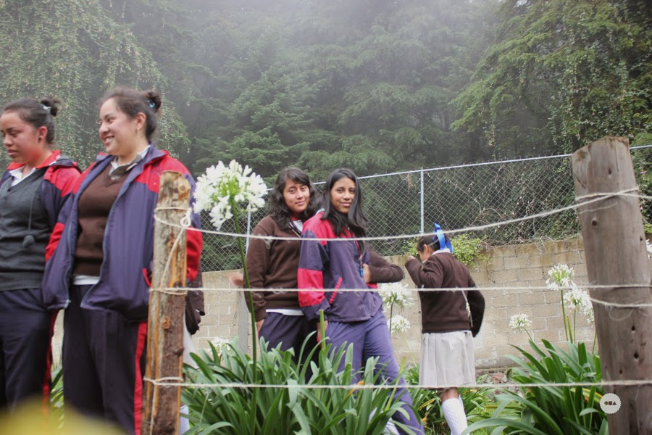
Objective
Determine factors associated with use of tobacco in adolescents in secondary level of northern Morelos.

Slide 10
Material y methods
Study Design:
This is a cross-sectional epidemiological study.
The project is part of the research "Promotion and self-care"
Our Academic team: "Nursing: education, care and health" is in the School of Nursing at the Universidad Autónoma del Estado de Morelos.

Slide 11
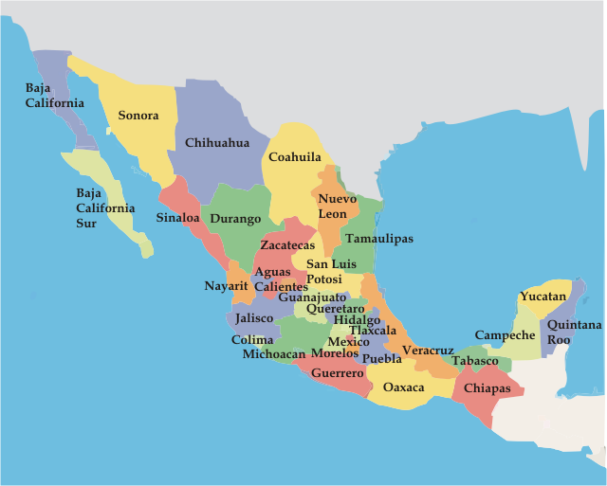
Material y methods
Universe study
Students were invited to participate assigned to a North Morelos State secondary school .

Slide 12
Material y methods
Sampling
The sampling method used is not probabilistic for convenience.
The sample was composed of 269 students who answered a self-administered questionnaire in November 2014.

Slide 13
Selection criteria:
Students enrolled during the 2014-2015 period.
Students who want to participate
Exclusion criteria:
Students not assigned to the secondary level.
Elimination criteria:
Participants with less than 80% of the questionnaire responses.

Slide 14
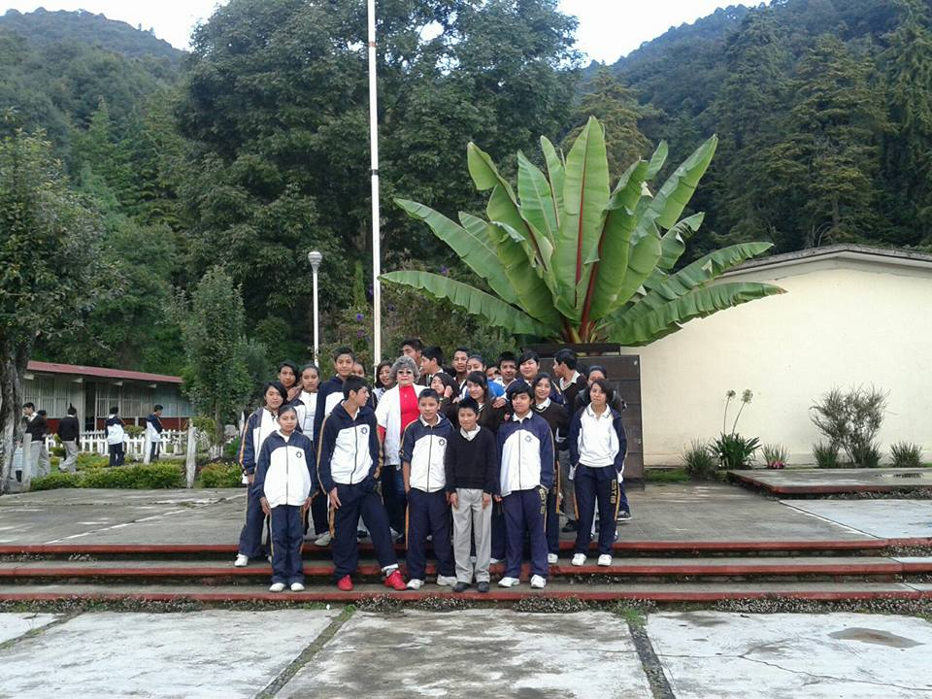
Material y methods
Instrument
Sociodemographic characteristics (age, sex, degree), use of tobacco, attitudes and knowledge about smoking were detailed.

Slide 15
Statistical analysis
Measures of central tendency and frequencies were obtained.
The measure of association used was the prevalence , odds ratio with confidence intervals of 95% (95% CI OR).

Slide 16

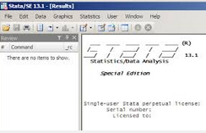
Statistical analysis
The statistical analysis was performed with the statistical package STATA 14.0.

Slide 17
Sociodemographic characteristics. Secondary level students, Mexico, 2014.
. tab sexo
sexo | Freq. Percent Cum.
------------+-----------------------------------
Hombre | 144 53.53 53.53
Mujer | 125 46.47 100.00
------------+-----------------------------------
Total | 269 100.00
. sum edad,d
edad
-------------------------------------------------------------
Percentiles Smallest
1% 11 11
5% 12 11
10% 12 11 Obs 250
25% 12 11 Sum of Wgt. 250
50% 13 Mean 13.068
Largest Std. Dev. 1.005695
75% 14 15
90% 14 15 Variance 1.011422
95% 15 15 Skewness .2909558
99% 15 16 Kurtosis 2.309813

Slide 18
Experimenters and current smokers. Secondary level students, Mexico, 2014.
. tab probar
probar | Freq. Percent Cum.
------------+-----------------------------------
No | 176 66.67 66.67
Sí | 88 33.33 100.00
------------+-----------------------------------
Total | 264 100.00
. tab fumador
fumador | Freq. Percent Cum.
------------+-----------------------------------
No fumador | 202 83.47 83.47
Fumador | 40 16.53 100.00
------------+-----------------------------------
Total | 242 100.00

Slide 19
Susceptible population. Secondary level students, Mexico, 2014.
. tab var68 sexo2,col
| sexo2
var68 | 1=Hombre 2=Mujer | Total
-----------+----------------------+----------
Sí | 23 16 | 39
| 15.97 13.01 | 14.61
-----------+----------------------+----------
No | 121 107 | 228
| 84.03 86.99 | 85.39
-----------+----------------------+----------
Total | 144 123 | 267
| 100.00 100.00 | 100.00
They smoke if your best friend
offered him a cigar
. tab var69 sexo2,col
| sexo2
var69 | 1=Hombre 2=Mujer | Total
-----------+----------------------+----------
Sí | 24 25 | 49
| 16.67 20.66 | 18.49
-----------+----------------------+----------
No | 120 96 | 216
| 83.33 79.34 | 81.51
-----------+----------------------+----------
Total | 144 121 | 265
| 100.00 100.00 | 100.00
They believe that in the next 12 months cigar smoking

Slide 20
Susceptible population. Secondary level students, Mexico, 2014.
gen susceptible=.
replace susceptible=1 if var68==1 & var69==1
replace susceptible=0 if var68==2 & var69==2
replace susceptible=0 if var68==2 | var69==2
graph bar (count), over (sexo) over (susceptible) bargap(-30) legend( label(1 "Mujer") label(2 "Hombre") ) title("Figure I. Susceptibility to use of tobacco by sex..") subtitle(" Secondary level students. Morelos, Mexico, 2014-2015.")note("Source: Survey on self-care in adolescents.") blabel(bar, position(inside) format(%9.1f) color(white))

Slide 22
Prevalence of smoking by gender and grade. Secondary level students, Mexico, 2014.
. sort fumador
. by fumador:tab sexo grado
----------------------------------------------------------------------------
-> fumador = 0
| grado
sexo | 1 2 3 | Total
-----------+---------------------------------+----------
1=Hombre | 41 38 31 | 110
2=Mujer | 35 36 21 | 92
-----------+---------------------------------+----------
Total | 76 74 52 | 202
----------------------------------------------------------------------------
-> fumador = 1
| grado
sexo | 1 2 3 | Total
-----------+---------------------------------+----------
1=Hombre | 5 8 10 | 23
2=Mujer | 5 7 5 | 17
-----------+---------------------------------+----------
Total | 10 15 15 | 40

Slide 23
graph bar (count), over (p1) over (fumador) over( grado) bargap(-30) legend( label(1 “Girls") label(2 “Boys") ) title(" Figure II. Smoking prevalence by sex and grade.") subtitle(" Secondary level students. Morelos, Mexico, 2014-2015.") note(" Source: Survey on self-care in adolescents.") blabel(bar, position(inside) format(%9.1f) color(black)) bar(1, fcolor(Light khaki)) bar(2, fcolor(navy))

Slide 25
 | fumador
VARIABLES | coefEform | ci_lowEform | ci_highEform
fumador
sexo2 | 0.987 | 0.425 | 2.292
_Iofrecer_1 | 5.166*** | 1.98 | 13.48
_Ifumar_fut_1 | 2.412* | 0.927 | 6.278
_Iamigos_1 | 2.805* | 0.939 | 8.376
OH | 2.511** | 1.014 | 6.223
_Iexp_lp_2 | 2.442** | 1.023 | 5.829
Constant | 0.0359*** | 0.00804 | 0.16
Observations | 236
seEform in parentheses
*** p<0.01, ** p<0.05, * p<0.1
*Estadísticamente significativo

Slide 26
Table1. Factors associated with use of tobacco. Secondary level students. Morelos, Mexico, 2014-2015.
VARIABLES | OR | IC 95%
Sex | 0.987 | 0.425 | 2.292
Would smoke if a friend offered him a cigar | 5.166*** | 1.98 | 13.48
They believe smoking in the next 12 months | 2.412* | 0.927 | 6.278
Some of his best friends smoke | 2.805* | 0.939 | 8.376
Alcohol consume | 2.511** | 1.014 | 6.223
Tobbaco smoke exposure in public places | 2.442** | 1.023 | 5.829

Slide 27
Conclusions
Associated factors were marginally students, who are smoking in the future and those with smoking friends.
The significantly associated factors were the smoking aceptance if they were offered, those who consume alcohol and the smoke expossure in public places

Slide 28
Conclusions
The statistical package STATA is a statistical tool that facilitates the organization, preparation and presentation of the research.
It allows easily spread the results of research conducted in the area of health.
It is based on the foundation of inference and serves to identify which students focused interventions needed to promote quit and prevent initiation of consumption of tobacco.

