Slide 1
2013 Mexican Stata Users Group meeting
Presentation
Deep analysis of Progressivity for taxes or transfers using cprog and cprogbt DASP modules for Stata.
Topic:
Comparisons of Stata to other software or use of Stata together with other software.
Luis Huesca ±
Arturo Robles-Valencia *
± Department of Regional Economics, CIAD / lhuesca@ciad.mx
* Ph.D Student, CIAD / artrovbal@gmail.com
Centro de Investigación y Docencia Económicas (CIDE), Mexico, City, May 3.

Slide 2
Our goal
This presentation shows the benefits offered by the modules cprog and cprogbt in STATA using Distributive Analysis Stata Package (DASP).
The goal is to compute progressivity curves checking whether taxes or transfers are progressive as well as whether a given transfer is more progressive than a given tax.
An empirical case for both taxes and transfers is shown for the current Mexican situation.

Slide 3
Overview
Distributive Analysis Stata Package (DASP) has been created by Duclos and Araar (2009) under CIRPEE-Universite Laval, PEP, World Bank and UNDP joint Project.
DASP is mainly designed to assist those (serious) researchers and policy analysts that are interested in conducting distributive analysis with Stata.
DASP uses Stata for two main reasons:
1. Stata is a powerful tool to store and manage household data surveys.
2. Stata easily allows adding specialized programs, making it possible for programmers to add to its power and flexibility.

Slide 4
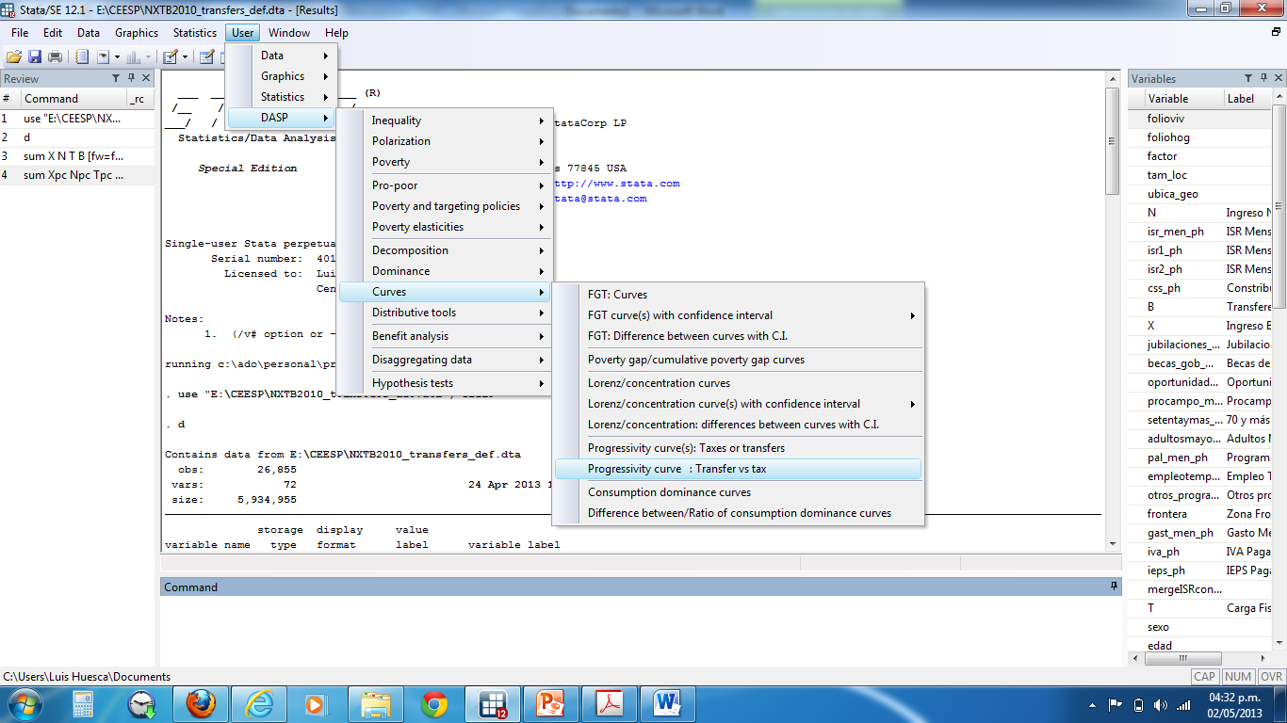
DASP environment in Stata

Slide 5
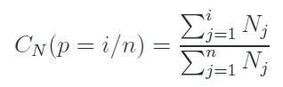
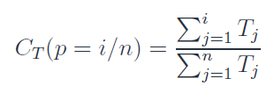

Methodology to compute progressivity
Suppose gross incomes (X) are ranked in ascending order
such that: X1 ≤ X2 ≤ ... ≤ Xn.
Suppose that taxes Tj (and transfers) are ranked according to the size of their associated gross income.
The concentration curve of net incomes N is:
The concentration curve of a tax T at percentile p is:
We can thus compare the concentration curve of N to the Lorenz curve
for X to assess the net progressivity of the tax and transfer system:

Slide 6
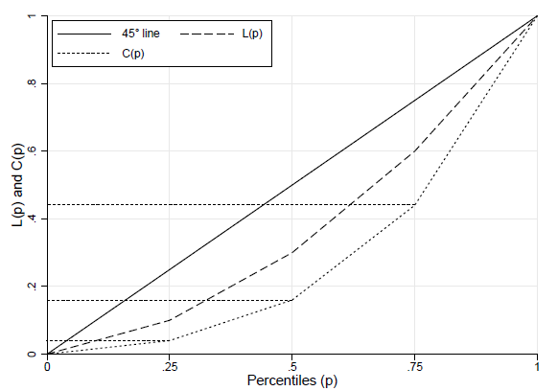
Scheme for computation of progressivity
An important descriptive and normative tool for capturing the impact of tax and transfer policies is the concentration curve. That shows the proportion of total taxes paid by the bottom p proportion of the population.
Araar, Bibi and Duclos, (2009)

Slide 7
Methodology
Using microdata from ENIGH 2010 we compute the next expression
Where X is the gross income of all households
N is the net income of all households
T stands for total taxes (direct + indirect) paid by the households
CSS are the social security payments paid by the households
B as the transfers received by the households
From the survey ENIGH 2010 direct taxes were imputed from 81 inputs of income, the indirect taxes were imputed from 726 consumption basket of goods, social security payments were imputed from all the individuals with social security system, and the transfers are the amount of all 17 inputs of transfers included in ENIGH.

Slide 8
Means for Taxes and Transfers
(ENIGH 2010)
T |  | B
ISR (direct tax) | 883.848 (2,719.790) | Pensions | 5,198.608 (6,322.830)
IVA (indirect tax) | 755.320 (1,061.733) | Government grants | 621.203 (1,358.627)
IEPS (indirect tax) | 318.855 (378.648) | Program “Oportunidades” | 683.2705 (470.408)
 |  | Program “Procampo” | 830.854 (1,599.344)
 |  | Program “70 y más” | 601.869 (256.083)
 |  | Program “Adultos mayores” | 774.956 (369.708)
 |  | Program “Apoyo Alimentario PAL” | 413.977 (213.365)
 |  | Program “Empleo temporal” | 333.444 (412.586)
 |  | Other government programs | 495.369 (2,134.292)
Standard deviation between paranthesis.

Slide 9
Sintaxis and Help for cprog:
cprog produces progressivity curves (PR(p)) for a given list of variables (components).
Let X be gross income.
. A tax T is Tax Redistribution (TR) progressive if:
. PR(p) = L_X(p) - C_T(p) > 0 for all p in ]0, 1[
. A transfer B is Tax Redistribution (TR) progressive if:
. PR(p) = C_B(p) - L_X(p) > 0 for all p in ]0, 1[
. A tax T is Income Redistribution (IR) progressive if:
. PR(p) = C_X-T(p) - L_X(p) > 0 for all p in ]0, 1[
. A transfer B is Income Redistribution (IR) progressive
. PR(p) = C_X+B(p) - L_X(p) > 0 for all p in ]0, 1[
cprog varlist, [ HSize(varname) HGroup(varname) RANK(varname) TYPE(string) MIN(real) MAX(real) APPR(string) LRES(int) SRES(string) DGRA(string) SGRA(string) EGRA(string)]
Y-Axis, X-Axis, Title, Caption, Legend, Overall
twoway_options any of the options documented in G] twoway_options
Example with cprog

Slide 12
Sintaxis and Help for cprogbt:
cprogbt produces progressivity curves to check if a tranfer B is more progressive that a tax T (components)
Let X be a gross income.
. A transfer B is more Tax-Redistribution (TR) progressive than a tax T if:
. PR(p) = C_B(p) + C_T(p)- 2L_X(p) > 0 for all p in ]0, 1[
. A transfer B is more Income-Redistribution (IR) progressive than a tax T if:
. PR(p) = C_X+B(p) - C_X-T(p) > 0 for all p in ]0, 1[
cprogbt varlist[min=2, max=2], [ HSize(varname) HGroup(varname) RANK(varname) TYPE(string) MIN(real) MAX(real) APPR(string) LRES(int) SRES(string) DGRA(string) SGRA(string) EGRA(string)]
Y-Axis, X-Axis, Title, Caption, Legend, Overall twoway_options any of the options documented in [G] twoway_options
Example with cprogbt

Slide 14
Conclusions :
Cprog, cprogbt commands are useful tools to estimate progressivity for both taxes and transfers figures in a pretty fast way.
Computation for upper and lower bound are allowed, as well as putting together many curves in the same graph.
The empirical application confirms for the Mexican case that a progressive direct taxation system is found;
Despite indirect tax (VAT and IEPS) was found to be less progressive, the Mexican fiscal system is redistributive when adding transfers.

Slide 15
Basic references
Araar, Abdelkrim y Jean-Yves Duclos (2009), “DASP: Distribuvitve Analysis Stata Package” in USER MANUAL, CIRPÉE, Université Laval, Quebéc.
Duclos, Jean Yves (1993), “Progressivity, redistribution and equity with the application to the British tax benefit system”, Public Finance, Vol. 48(3), pp. 350-65.
---------, (2001), Poverty and Equity: Theory and Estimation, in: Topics In the analysis of income distributions. Doctorat Applied Economics, Universitat Autonoma de Barcelona, mimeo.
INEGI. (2011). Encuesta Nacional de Ingresos y Gastos de los Hogares (ENIGH). 2010, Instituto Nacional de Estadística Geografía e Informática.
Kakwani, Nanak. (1977), “Measurement of tax progressivity: An international comparison”, The Economic Journal, 87, pp. 71-80.
Reynolds, M. y E. Smolensky (1977), Public Expenditure, Taxes and the Distribution of Income: The United States. 1950, 1961, 1970. Academic Press, New York.

