Slide 1
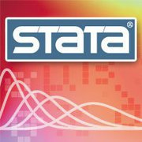
Report to Users
Gustavo Sánchez
Senior Statistician
StataCorp
2011 Mexican Stata Users Group Meeting 2011

Slide 2
Outline
Stata 11.1
Meetings and Conferences
Trainings
Stata Press
Other
    Internships
    Keeping in touch

Slide 3
Stata 11.1

Slide 4
Stata 11.1
Released on June 3rd 2010
Multiple imputation. mi command now supports panel-data and multilevel models
Truncated count-data models. New commands tpoisson and tnbreg fit models of count-data outcomes with any form of left truncation, including truncation that varies by observations.
Mixed models. Linear mixed (multilevel) models have new covariance structures for these residuals: exponential, banded, and Toeplitz.
Probability predictions. predict after count-data models, such as poisson and nbreg, can now predict the probability of any count or any count range
Survey bootstrap. Estimation commands can now estimate survey bootstrap standard errors (SEs) using user-supplied bootstrap replicate weights

Slide 5
Stata 11.1
Released on June 3rd 2010
Survey SDR weights. Successive difference replicate (SDR) weights are now supported when estimating with survey data. These weights are supplied with many datasets from the United States Census Bureau
Concordance. estat concordance adds a new measure of concordance, Gönen and Heller’s K, that is robust in the presence of censoring.
Survey GOF. Goodness-of-fit (GOF) tests are now available after probit and logistic estimates on survey data Mixed models.
Robust SEs. Cluster–robust SEs have been added to xtpoisson, fe.
Survey CV. The coefficient of variation (CV) is now available after estimation with survey data.

Slide 6
Stata 11.1
Released on June 3rd 2010
Estimation formatting. Numerical formats can now be customized on regression results.
Stata/MP performance. Stata/MP, the parallel version of Stata, has several performance improvements, including even more parallelized panel-data estimators, improved parallelization of estimations with more than 200 covariates, and improved tuning of MP on large numbers of processors/cores.
Clipboard improvements. Clipboard support in the Data Editor has been enhanced. Copies to the Clipboard now retain variable formats and other characteristics of the data when pasted from within Stata.
Windows XP. The amount of memory available to Stata has been increased on 32-bit Windows XP.
Do-file Editor. Syntax highlighting, bookmarks, and other Do-file Editor features have been added to Stata for Mac.
Dialog boxes. Dialog boxes on Unix now have varlist controls that allow you to select variables from a list of variables in your dataset.
… and see more at: http://www.stata.com/news/statanews.25.2.pdf

Slide 7
Meetings and Conferences

Slide 8
Users Group Meetings and Conferences 2011
Mexican Stata Users Group meeting (May 12)
German Stata Users Group meeting(July 1)
Stata Conference in Chicago (July 14-15)
UK Stata Users Group meeting (September 15-16)
Spanish Stata Users Group meeting(September 22)
Nordic and Baltic Stata Users Group meeting (November 11)

Slide 9
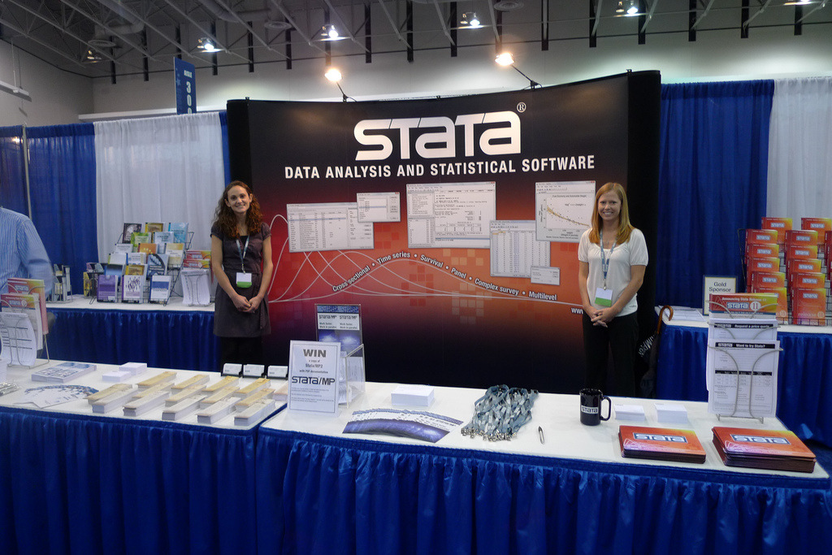
Conference Booths
Allied Social Science Association (ASSA) Meeting
January 7-9, 2011 Denver.
Joint Statistical Meetings (JSM). Miami,
July 30-Aug 3
American Public Health Association (APHA) Meeting
Washington DC. Oct 29-Nov 2

Slide 10
Trainings

Slide 11
Public Trainings Sessions 2011
Using Stata Effectively
  July 12–1 Chicago, IL3
  August 04–05 Miami, FL
  September 07–08 Washington, DC
  October 13–14 San Francisco, CA
  November 03–04 New York City, NY
Multilevel/Mixed Models Using Stata
  October 05–06 Washington, DC

Slide 12
Other Trainings
NetCourses
  NetCourse 101 Introduction to Stata
  NetCourse 151 Introduction to Stata Programming
    July 8–August 19, 2011
  NetCourse 152 Advanced Stata Programming
  NetCourse 461 Introduction to Time Series
  with Stata
    October 7–November 25, 2011
  NetCourseNow
On-site training

Slide 13
Stata Press

Slide 14

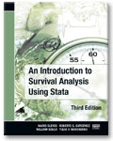
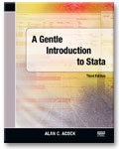

Recent Books
Maximum Likelihood Estimation with Stata, 4th Edition
William Gould, Jeffery Pitblado and Brian Poi.
An Introduction to Survival Analysis Using Stata, 3rd Edition
Mario Cleves, William Gould, Roberto G. Gutierrez, and
Yulia V. Marchenko
A Gentle Introduction to Stata, 3rd Edition
Alan C. Acock
An Introduction to Stata for Health Researchers, 3rd Edition
Svend Juul and Morten Frydenberg

Slide 15
Upcoming Books
Flexible Parametric Survival Analysis Using Stata:
Beyond the Cox Model
Patrick Royston and Paul Lambert
Causal Inference: Measuring the Effect of x on y
Austin Nichols
A Gentle Guide to Advanced Statistics Using Stata
Alan C. Acock and Peter Lachenbruch
… and see more at:
http://www.stata-press.com/forthcoming.html

Slide 16
Upcoming Books
Aplicaciones Económicas y Sociales con Stata
Contenido
1. Comandos básicos y manejo de bases económicas en STATA
Dr. Ignacio Ibarra López
Centro de Investigación e Inteligencia Económica, UPAEP
2. Estadística Descriptiva y Análisis de Regresión
Dr. Alfonso Mendoza-Velázquez
Centro de Investigación e Inteligencia Económica, UPAEP
3. Migración y Distribución de Salarios en México
Dr. Alfredo Cuecuecha
Universidad Iberoamericana, Campus Puebla
4. Introducción a la Valoración Contingente usando STATA
Dr. Alejandro López Feldman
Centro de Investigación y Docencia Económica (CIDE)

Slide 17
Upcoming Books
Aplicaciones Económicas y Sociales con Stata
Contenido
5. Análisis de las preferencias electorales en la contienda presidencial 2006
Dr. Ignacio Ibarra López
Centro de Investigación e Inteligencia Económica, UPAEP
6. Técnicas de Medición de Calidad de Vida
Dr. Maikol Elizondo
Merck Serono – Mexico
7. Medición de Igualdad de Oportunidades
Dr. Isidro Soloaga
El Colegio de México
8. Riesgo Crediticio de las Finanzas Públicas de Gobiernos Locales
Dr. Afonso Mendoza-Velázquez
Centro de Investigación e Inteligencia Económica, UPAEP.
9. Medición del Ciclo Económico en México
Dr. Carlo Alcara
Banco de México

Slide 18
Author Support Program
Stata professionals review your Stata code and output
• Stata production specialists help you format
Stata output, including graphs
• Stata editors and statisticians review the
accuracy of Stata-related content
• It’s free and open to all

Slide 19
Other Items

Slide 20
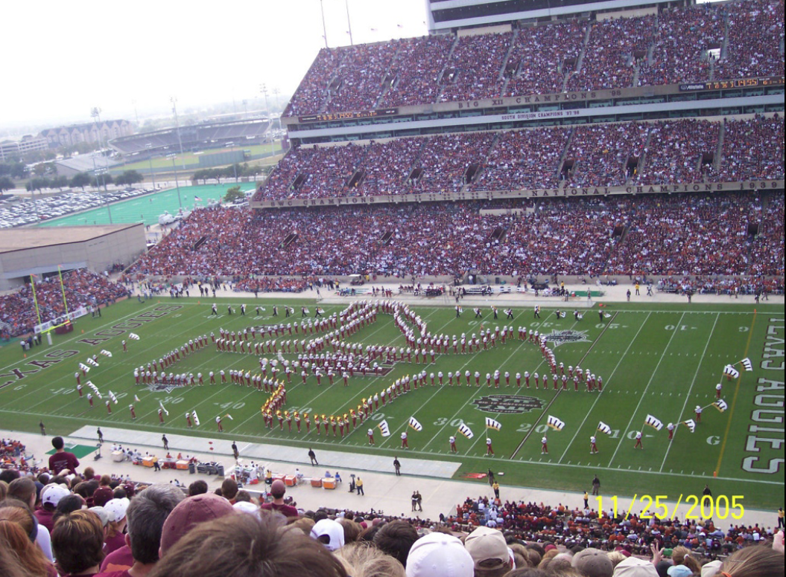
Internship Program
Has been in existence since 2007
Gives experience in software development and support
Open to the world
Go to http://www.stata.com/internships

Slide 21
Keeping in Touch
Subscribe to our RSS feed
Sign up for email alerts at
www.stata.com/customerservice/alerts.html
  New releases
  Stata Press books
  Stata Conferences and User Group meetings
Facebook
Twiter
Blog

Slide 22
QUESTIONS?

