Slide 1




Topic
: Spatial market integration and price transmission analysis of egg markets in India
Abstract :
The present study analyses the spatial integration of 10 major wholesale egg markets in India, which altogether cater to 90% of egg volume and trade in the country, utilizing the monthly egg price data from January 2009 to December 2022
Presented By
Dr. B. Swaminathan
Assistant Professor
Junagadh Agricultural University, Gujarat

Slide 2
Spatial market integration and price transmission analysis of egg markets in India
Dr. B. Swaminathan
Assistant Professor (Agril. Economics)
Junagadh Agricultural University, Gujarat E-mail: bswaminathan@jau.in

Slide 3
Introduction
India is the world’s third-largest poultry egg producer, producing 129.62 billion nos. (67.10 lakh tonnes) as of 2021-22 (FAOSTAT, 2022).
As India’s egg production turn out to be only around 6% of the global output, still there is immense potential for higher production.
But higher production need to go side-by-side with remunerative prices.
And, eggs happen to be one of the few commodities where the difference between price received by farmers and price paid by consumers is only around 35-40%, giving further impetus for poultry farmers to engage in production.
National Egg Coordination Committee (NECC), established in 1982, has played a
huger role in improving egg production, trade and price fixation.
In this study, top 10 wholesale egg markets are selected – which cater to almost 90% of domestic egg trade in India – to explore integration & price transmission.
Apart from confirming spatial integration among markets through Engle-Granger Method and Johansen’s cointegration, the study also envisaged the existence of short-term disequilibria with the help of Vector Error Correction Model (VECM).
Apart from analyzing the direction of price formation using Granger causality,
Impulse Response Function and Variance Decomposition are also attempted.
2

Slide 4
Analytical tools
Sl. No. | OBJECTIVES | ANALYTICAL TOOLS
1 | Long run market integration | Engle granger test Johansen co-integration test
2 | Short run market integration | Error correction model
3 | Direction of price formation | Granger causality test
4 | Relative contribution of markets to the price changes in other markets. | Impulse response function Variance decomposition
Study period | Monthly egg price data, from Jan. 2009 to Dec. 2022 (n=168)
Study Area | Markets selected (10 nos.) Production centres (06): Namakkal (Tamil Nadu), Hyderabad (Telangana), Vishakapatnam (Andhra Pradesh), Kolkata (West Bengal), Barwala (Haryana), & Ahmedabad (Gujarat). Consumption centres (04): Bengaluru, Delhi, Chennai & Mumbai.
Data source | NECC ( https://www.e2necc.com/)

Slide 5
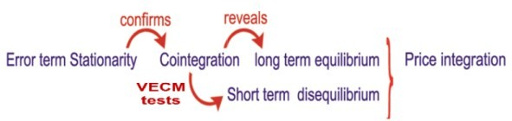
Research framework of the study (Objectives & Methods)
Engle-Granger test
Johansen Cointegration test
ADF and PP tests
Granger Causality Test
IRF
Variance Decomposition
Direction of price formation using VAR framework
Lag selection test

Slide 6
Egg market integration
Test for stationarity
a) Augmented Dickey Fuller test (ADF test)
The price series of major egg markets in India is tested for stationarity as:
𝒑
∆𝒀 = 𝛂 + 𝜷 𝐓 + 𝜹 𝒀 + 𝒃 σ
^{∆𝒀}𝐢𝐭−𝟏 ^{+ 𝒆}𝒕
𝒊𝒕
𝒊
𝒊 𝐢𝐭−𝟏
𝒊
𝐢=𝟏
Where:
^{Y}it
ΔY t-i = Y_{t-1} – Y_{t-2} (t-i – lagged prices and Δ – differenced series);
T = Time trend;
α =
p =
= Egg prices in a given market ‘i’ at a time ‘t’;
Drift parameter;
Number of lag length selected based on SIC;
α,δ and b_{i} =
Coefficients; and
et = Pure white noise error-term
Null hypothesis that δ= 0 and the alternative hypothesis for the test is δ< 0. If Y_{t} is found non-stationary at levels i.e. I(0) then it will be be determined whether it is stationary at ‘n’ differences.

Slide 7
Egg market integration (Contd.)
Lag selection test
Deriving optimal length is an essential part of co-integration analysis. The two most commonly used lag length selection criteria viz. Akaike Information Criteria (AIC) and the Schawartz Information Criteria (SIC) is employed here.
AIC = T ln (sum of squared residuals) + 2n
SIC = T ln (Sum of squared residuals) + n ln (T)
Where:
n = number of parameters estimated
T = number of usable observations
SIC is preferred as a more appropriate lag length than the AIC.

Slide 8
Egg market integration (Contd.)
Co-integration testing depicts the long-term relationship between variables.
Both Engle-Granger approach and Johansen's procedure is used to depict long run relationship depending upon the level of data stationarity.
a) Engle-Granger test
𝒀_{𝒊𝒕} = 𝜷_{𝟎} + 𝜷_{𝟏}𝑿_{𝒋𝒕} + 𝒆_{𝒕}
Where:
^{Y}it ^{X}jt
= Egg prices in the market ‘i’ at a time ‘t’;
= Egg prices in the market ‘j’ at a time ‘t’;
β₀ | = | Constant term;
β₁ | = | Long-run elasticity of price transmission; and
et | = | Error-term.

Slide 9
Egg market integration (Contd.)
b) Johansen Co-integration test
Johansen’s co integration test relies on maximum likelihood method. This method is based on the relationship between the rank of a matrix and its characteristic roots.
∆𝐘_{𝐭} = 𝛍 + σ^{𝐤−𝟏} Γ_{𝐢} ∆𝐘_{𝐭−𝐢} + 𝛑𝐘_{𝐭−𝐤} + 𝛃_{𝐭} + 𝐞_{𝐭}
𝐢=𝟏
Where,
Y_{t}, is the price, ∆Y_{t-1} is the first difference operator (Y_{t} – Y_{t-1}) and matrix Π = 𝛼β'is (n x n) with rank r (0 ≤ r ≤n)which represents the number of linear independent cointegration relations in the vectors of matrix The rank of
Π can be determined by λ trace test statistics and maximum Eigen value test
(λ max).
^{𝛌}𝐭𝐫𝐚𝐜𝐞 ^{= −𝐍 σ𝐤}
𝐥𝐨𝐠(𝟏 − 𝛌_{𝐢})
𝐢=𝐫+𝟏
𝛌_{𝐦𝐚𝐱} = −𝐍 𝐥𝐨𝐠(𝟏 − 𝛌_{𝐫+𝟏})
Where, 𝛌_{𝐢} are the Eigen values that represents the strength of
correlation between the first difference and error correction portion; and T is
the total number of observations.
In testing for efficiency of two spatially (necessary condition) separated markets the null hypothesis should be tested for r=0 and r=1. If r=0 cannot be rejected, it is concluded that there is no co-integration, if r=1 cannot be
rejected then it can be concluded that is a co-integrating relationship.
8

Slide 10
Egg market integration (Contd.)
Error correction model
After confirming the long-term equilibrium in the market pairs, there is a possibility of short-run disequilibrium, due to which the price change in one market may not get transmitted immediately to the other market and takes some time for such transmission. The short-run disequilibria is tested using:
𝚫𝐘_{𝒕−𝒊} = 𝛂_{𝟎} + 𝛂_{𝟏}∆𝐗_{𝐭−𝐢} + 𝛂_{𝟐} + 𝐞_{𝐭−𝟏} + 𝛆_{𝐭}
Where:
= Egg prices in the market ‘Y’;
= Egg prices in the market ‘X’;
= Constant term;
= Speed of price transmission;
= Lagged error term of the co-integration model; and
ε_{t} = White noise error-term.
^{ΔY}t-i
^{ΔX} t-i
α₀
α₁, α₂
^{e}t-1
The magnitude of α2 explains the speed at which the price approaches equilibrium and it is expected to be negative, so that the equilibrium is restored in the long-run.

Slide 11
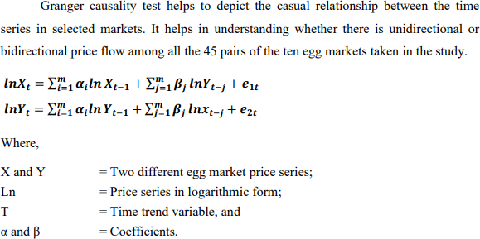
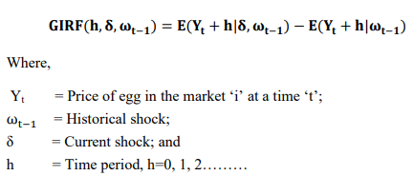
Direction of price formation
Granger Causality Test, IRF and Variance Decomposition
Impulse Response Function
(i) The expected variance of Y market with respect to X market, and (ii) The variance of the expected variance of Y
Variance Decomposition
market with respect to X market.

Slide 12
Results and Discussions

Slide 13
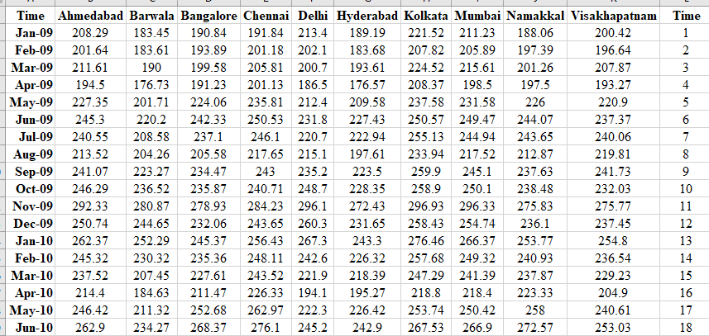
Dataset employed for analysis
As monthly data of egg prices across the major wholesale markets in India were taken, the dataset had to be formatted in STATA before further analysis.
Set monthly data
. gen month = tm(2009m1)+_n-1
. format %tm month
. tsset month
12

Slide 14
Transforming data into log form
ds, has(type numeric)
local variables `r(varlist)'
foreach var of local variables {
gen log_`var' = log(`var')
}
All variables are transformed simultaneously to log form using this command.
Twoway graph
. twoway (tsline ahm barwala bangalore chennai delhi hyderabad kolkata
mumbai namakkal visakhapatnam)
. twoway (tsline log_ahmedabad log_barwala log_bangalore log_chennai log_delhi log_hyderabad log_kolkata log_mumbai log_namakkal log_visakhapatnam )
13

Slide 15
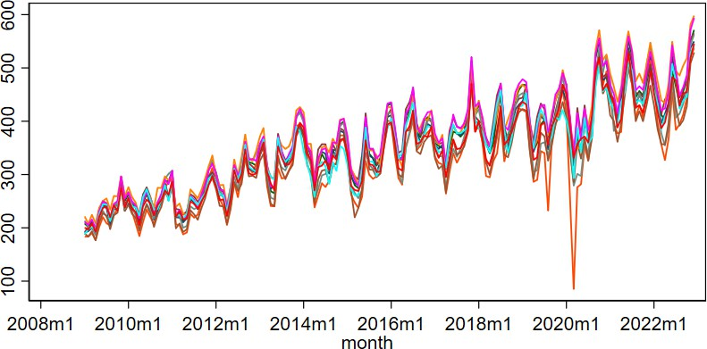
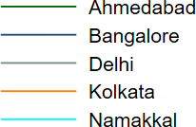
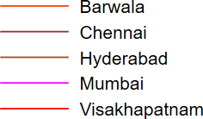
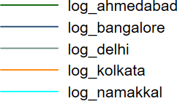
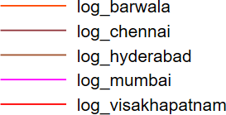
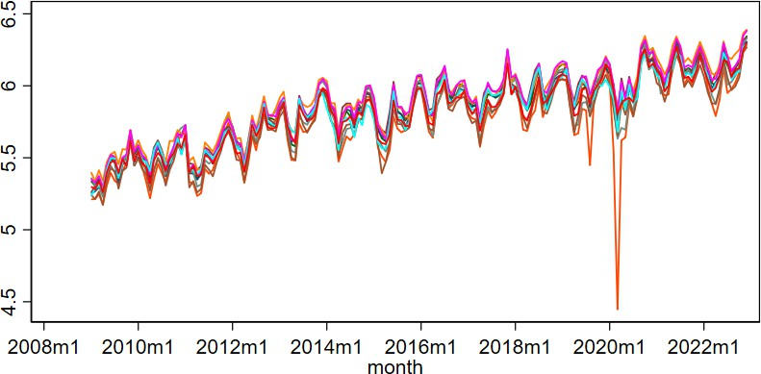
Time plot of original dataset
Time plot of transformed dataset
reg log_ahmedabad log_barwala log_bangalore log_chennai log_delhi log_hyderabad log_kolkata log_mumbai log_namakkal log_Visakhapatnam
estat dwatson
Note: Stationarity is not ensured
merely by log transformation.
DW d-statistic ( 10, 168) = 1.71
14

Slide 16
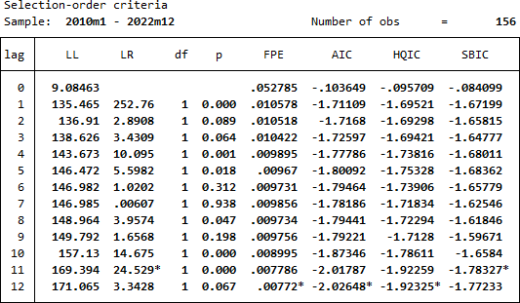
Optimal lag length
Before running for stationarity, optimal lag length needs to be ascertained.
varsoc log_ahmedabad , maxlag(12)

Slide 17
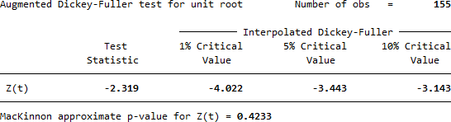
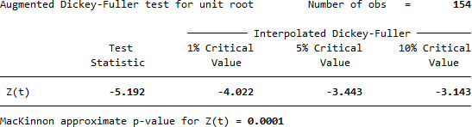
ADF test for stationarity confirmation
dfuller log_ahmedabad, lags(12) trend
**Generating a differenced series** gen dlog_ahm = d.log_ahm
dfuller dlog_ahm , lags(12) trend

Slide 18
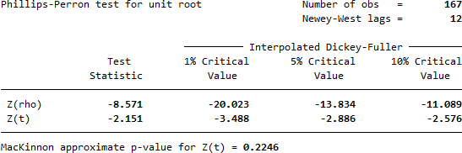
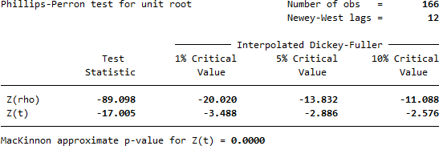
Phillips-Perron test for stationarity confirmation
pperron log_ahmedabad, lags(12)
pperron dlog_ahm, lags(12)

Slide 19
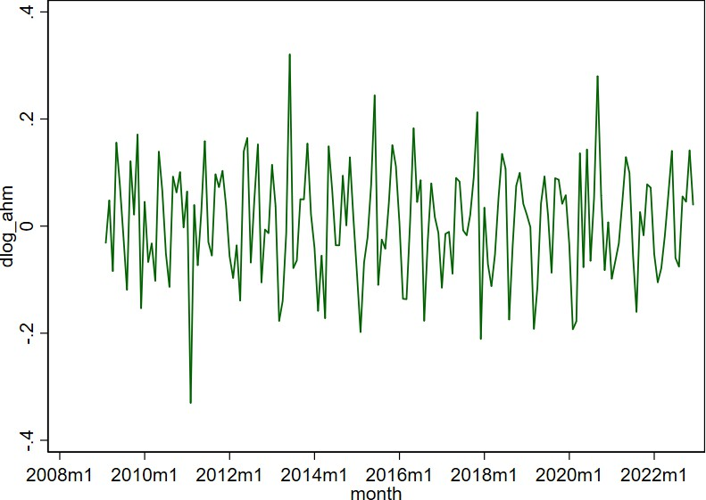
twoway (tsline d.log_ahmedabad)
Figure 1: Time-plot of the first differences of the log of Ahmedabad
egg market prices displaying stationarity
Time-plots of the log transformed data series of all the markets at levels (I=0)
and first differencing (I=1) displayed the possibility of stationarity only at the
latter, which was confirmed eventually using ADF and PP tests for unit root.
18

Slide 20
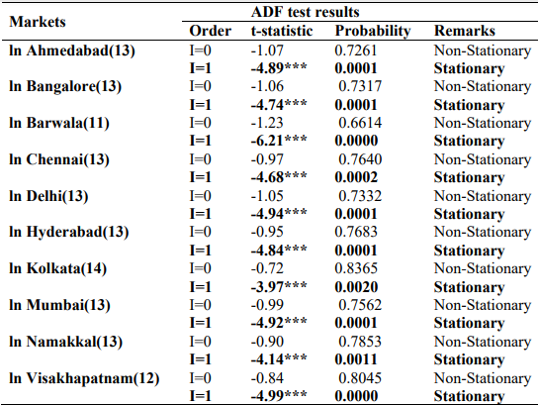

Unit root test results for stationarity, using Augmented Dickey- Fuller Test, of egg market prices at first differences (I=1)
Inference: Log levels (I=0) are non-stationary, but log first differences (I=1) are free from unit roots in all the markets.

Slide 21
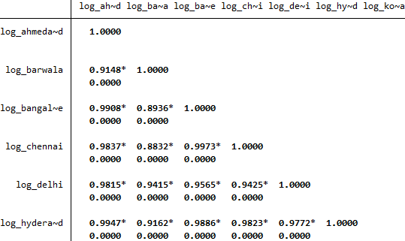
Zero-order correlation matrix
pwcorr log_ahmedabad log_barwala log_bangalore log_chennai log_delhi log_hyderabad log_kolkata log_mumbai log_namakkal log_visakhapatnam, sig star(.05)
All the market pairs display highly significant positive relationships.
So, existence of long-term integration looks certain.
But the presence of short- term disequilibria of prices among markets cannot be ruled out either.

Slide 22
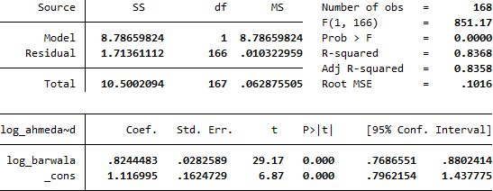
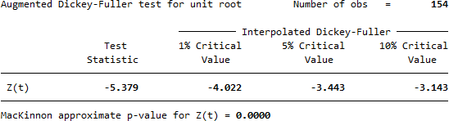
Engle-Granger Method (EGM) for long-term bi-variate cointegration
Engle-Granger Method:
varsoc log_ahmedabad log_barwala, maxlag(20)
regress log_ahmedabad log_barwala
predict residual, res
dfuller d.residual, trend lags(14)
The results of the ADF test on the residual series showed the rejection of non- stationarity (Ho) in all 45 combinations of market pairs from the 10 markets, thereby confirming the existence of pair- wise long-term integration.

Slide 23
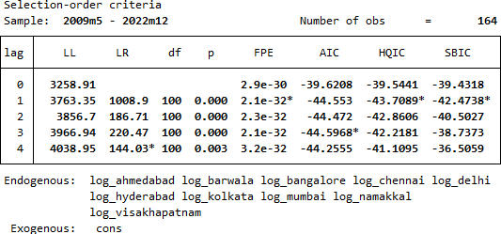
Johansen Cointegration Test
varsoc log_ahmedabad log_barwala log_bangalore log_chennai log_delhi log_hyderabad log_kolkata log_mumbai log_namakkal log_visakhapatnam
The lag order of three was decided for further analysis based on AIC selection criterion
vecrank log_ahmedabad log_barwala log_bangalore log_chennai log_delhi log_hyderabad log_kolkata log_mumbai log_namakkal log_visakhapatnam, lags(3) trend (constant)max
STATA command for
Johansen Cointegration Test

Slide 24
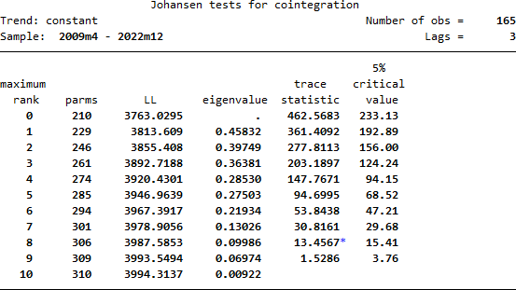
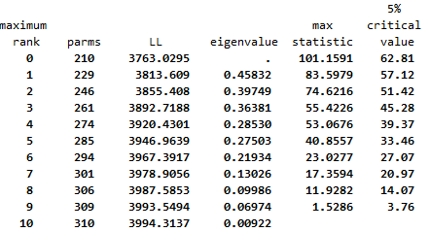
STATA estimates for Johansen’s
Cointegration Method
Long-term integration among the markets is confirmed with both Engle-Granger and Johansen Cointegration methods.
The values of trace statistics and max- eigen statistics are found larger than the critical values for more than one number of cointegrating equations.

Slide 25
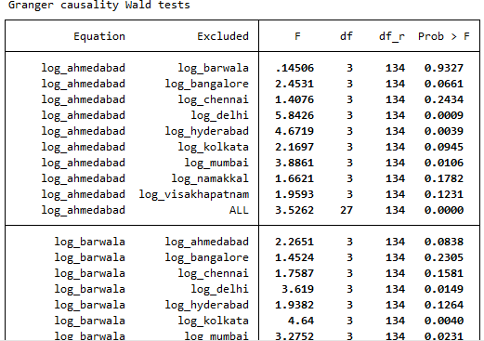
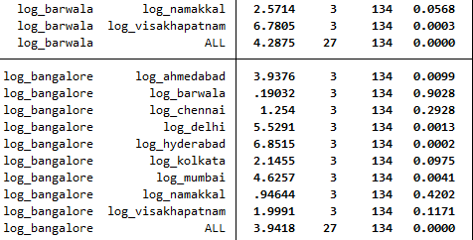
Granger Causality Test (Direction of price formation)
quietly var log_ahmedabad log_barwala log_bangalore log_chennai log_delhi log_hyderabad log_kolkata log_mumbai log_namakkal log_visakhapatnam,lags(1/3) dfk small
vargranger
Inference: AHM does not Granger cause (influence) BAR, but the latter Granger cause the former revealing
unidirectional price formation.
24

Slide 26
STATA commands for Impulse Response Function
varsoc log_ahmedabad log_barwala log_bangalore log_chennai log_delhi log_hyderabad log_kolkata log_mumbai log_namakkal log_visakhapatnam
quietly var log_ahmedabad log_barwala log_bangalore log_chennai log_delhi log_hyderabad log_kolkata log_mumbai log_namakkal log_visakhapatnam,lags(1/3) dfk small
irf create order1, step(10) set(myirf1) replace
irf graph oirf, impulse(log_ahmedabad log_barwala) response(log_ahmedabad log_barwala) yline (0,lcolor(black)) xlabel(0(4)20) byopts(yrescale)

Slide 27
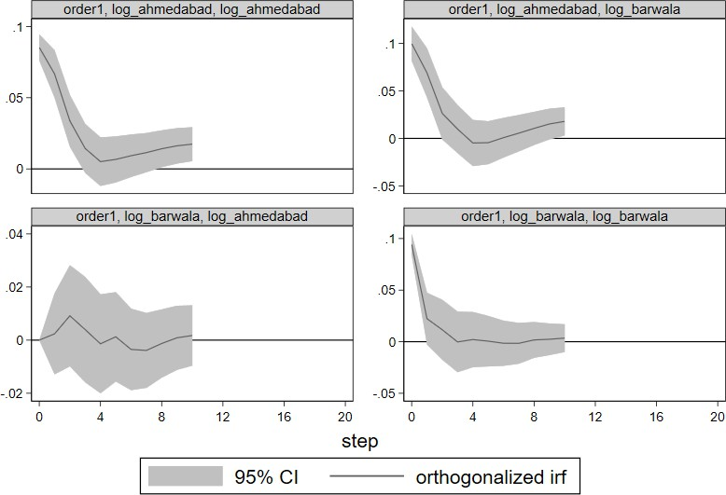
IRF graphs and inference

