Slide 1




:
Topic : Understanding Missing Data in COVID-19 Medical Records and its impact on Prognostic Modeling
Abstract :
Multiple imputation was done with the Chained Equations method. Further, convergence, stability and other diagnostics of the imputation were done to identify its appropriateness for model building. Analysis was conducted in Stata software
Presented By
JITU SHARMA
PhD Scholar & UGC SRF
Amity University Uttar Pradesh, Noida

Slide 2

2023 Indian Stata Conference
Jitu Sharma
PhD Scholar & UGC SRF Amity University Uttar Pradesh, Noida jitu.sharma@s.amity.edu
Bhudev C. Das
Chairman, AIMMSCR Dean, Health & Allied Sci. Amity University Uttar Pradesh, Noida bcdas@amity.edu
M U M BA I
30 ^{TH} NOV 2 0 2 3
Understanding Missing Data in COVID-19 Medical Records and its Impact on Prognostic Modeling

Slide 3
Introduction
Medical records are invaluable resources for understanding the epidemiology of diseases and the
clinical outcomes of hospitalizations.
A major challenge in studying these records and analyzing them is the presence of missing
values.
Estimating a model based on data containing large proportion of missing values, may not be feasible.
Ordinary approaches to deal with missing values possess threat of creating bias in estimation.
Multiple imputation is widely accepted as a good practice to handle such situation.
Nov 2023

Slide 4
Introduction
We wanted to study the association of various bio-medical parameters with the prognosis of the
COVID-19 patients.
For which we collected data for 131 parameters at the time of hospitalization due to COVID-19
infection.
There were only 32 variables with completely observed values.
Nov 2023

Slide 5
Introduction
100
>50%
50-30%
30-10%
<10%
Fig: Percentage of observed values in variables under consideration
Nov 2023

Slide 6
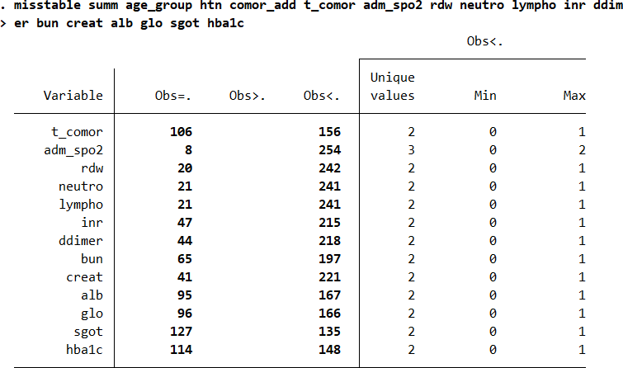
Introduction
Removed variables having >50%
missing values.
Removed derived, constant or lab standard etc. variables from the dataset.
Included variables found significant in the Univariate Logistic Regression with P ≤ 0.1 for imputation.
Maximum missing information was present in the variable “sgot” (48.5%).
Table: Variables to be imputed with their respective missing information.
Nov 2023

Slide 7
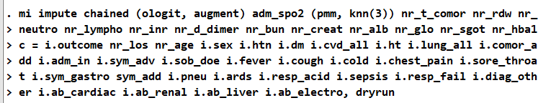
Imputation Model
We checked 15 more variables related to diagnosis of complication of COVID-19 severity for
inclusion in the imputation model as “Regular Variables”.
Nov 2023

Slide 8
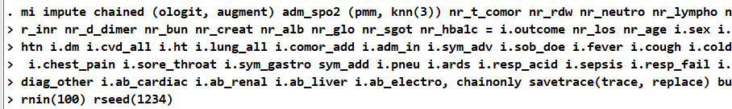
Convergence of MICE
Use “chainonly” and “savetrace” options to examine the convergence of the chains before
actually imputing the values.
Nov 2023

Slide 9


Convergence of MICE
Convergence was determined visually with 100 iterations where we looked for the presence of stationarity of the series.
We also checked the results for Phillips-Perron test to determine the burn-in period for the iterations.
We looked for the convergence and stability of the traces from separate chains.
Fig: Trace Plots of summaries of imputed values of “nr_glo”
Nov 2023

Slide 10
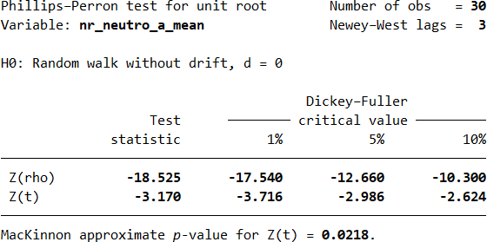
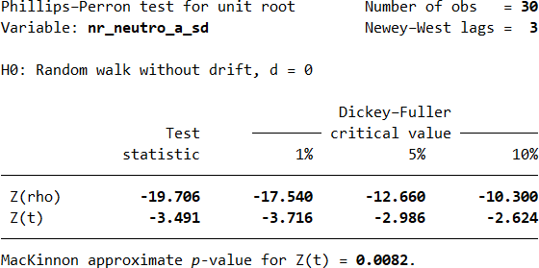


Convergence of MICE
Fig: Trace Plots of summaries of imputed values of “nr_neuto_a”
Nov 2023

Slide 11




Convergence of MICE
Fig: Trace Plots of summaries of imputed values of
“nr_bun”
Fig: Trace Plots of summaries of imputed values of
“nr_creat”
Nov 2023

Slide 12
Stability of MICE
Three independent chains were combinedly plotted to look for whether they were following similar paths with convergent series.
Chains were found to be satisfactorily stable for all the variables to be imputed.
Fig: Trace Plots of summaries of imputed values of “nr_neutron_a”
from 3 independent chains
Nov 2023

Slide 13




Stability of MICE
Fig: Trace Plots of summaries of imputed values of
“nr_bun” from 3 independent chains
Fig: Trace Plots of summaries of imputed values of
“nr_creat” from 3 independent chains
Nov 2023

Slide 14
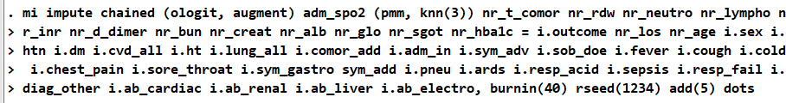
Imputing Missing Values
Start small then add more as required.
Nov 2023

Slide 15
Imputation Diagnostics before Estimation
We used the package “st0263” for investigating the imputations before estimating the model [1].
For continuous variables, we can do cumulative distribution functions, kernel density estimates and histograms; for categorical variables, we can conduct proportions or frequencies graphs and tables.
Here, we look for any major deviation in the probability distribution of the observed, imputed and complete cases.
Nov 2023

Slide 16
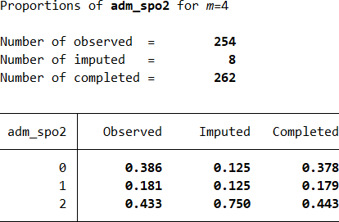

Imputation Diagnostics before Estimation
Nov 2023

Slide 17
Imputation Diagnostics before Estimation
Fig: K-density plot of “nr_rdw”
Fig: Cumulative distribution function of “nr_rdw”
“nr_rdw” had 20 (7.6%) missing information.
Nov 2023

Slide 18
Imputation Diagnostics before Estimation
Fig: K-density plot of “nr_sgot”
Fig: Cumulative distribution function of “nr_sgot”
“nr_sgot” had 127 (48.5%) missing information.
Nov 2023

Slide 19
Imputation Diagnostics before Estimation
Fig: K-density plot of “nr_hba1c”
Fig: Cummulative distribution function of “nr_hba1c”
“nr_hba1c” had 114 (43.5%) missing information.
Nov 2023

Slide 20
Imputation Diagnostics before Estimation
Fig: K-density plot of “nr_alb”
“nr_alb” had 95 (36.3%) missing information.
Don’t worry much!
Fig: Cummulative distribution function of “nr_alb”
Nov 2023

Slide 21
Updating Passive Variables and deciding the number of imputations
As our final estimation model is based on the categorical passive variables derived from the
imputed variables, we updated the passive variables and then estimated the model.
The number of imputation (M) required to obtain a reliable model is not only dependent on the
amount of missing information but also on the analysis model and the quality of data.
A rule of thumb:
M ≥ 100* FMI,
Where FMI is the largest fraction of missing information about coefficient estimates due to non-
response.
Nov 2023

Slide 22

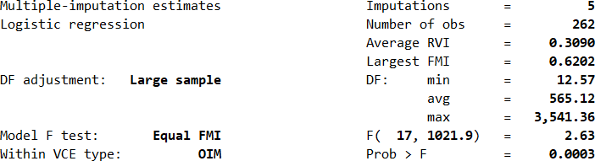
Estimating the desired model
Nov 2023

Slide 23
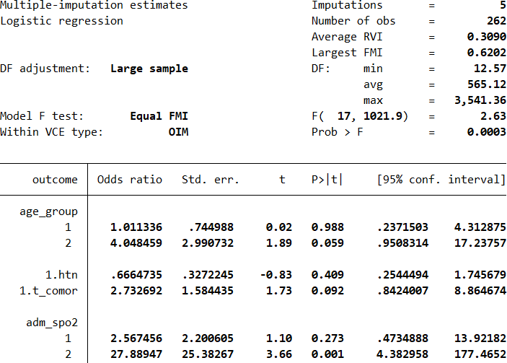
Imputation Diagnostics after Estimation
Table: Estimates of co-efficient and other statistics with M=5 imputations
Nov 2023

Slide 24
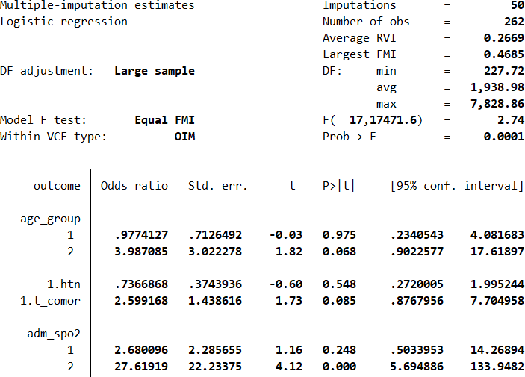
Imputation Diagnostics after Estimation
Table: Estimates of co-efficient and other statistics with M=50 imputations
Nov 2023

Slide 25
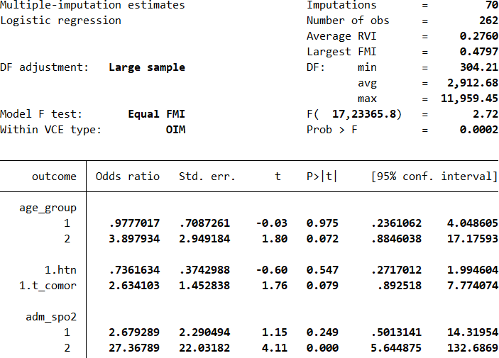
Imputation Diagnostics after Estimation
Table: Estimates of co-efficient and other statistics with M=70 imputations
Nov 2023

Slide 26
Reproducibility
It has been suggested in the literature that for reliable results, we need to evaluate the Monte
Carlo error estimates for parameter estimates and for other statistics.
According to the rule of thumb of White, Royston and Wood [2]:
  MCE of coefficient need to be < 10% of its standard error.
  MCE of the test statistic /se() < 0.1, and
  MCE of the P-value < 0.01 when the true P-value is 0.05, and < 0.02 when the true P-
value is 0.1.
Nov 2023

Slide 27
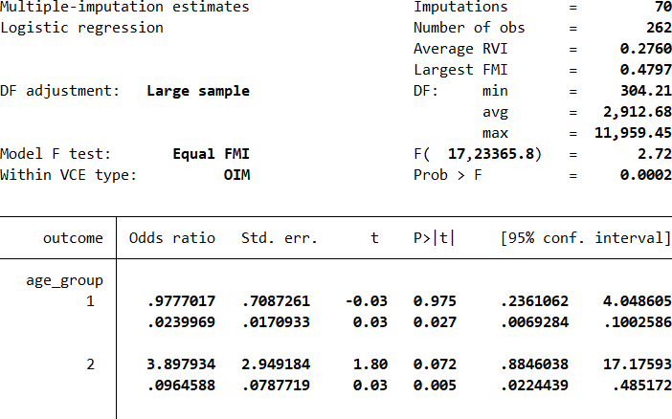
Reproducibility
Table: Estimates of co-efficient and other statistics with M=70 imputations
Nov 2023

Slide 28
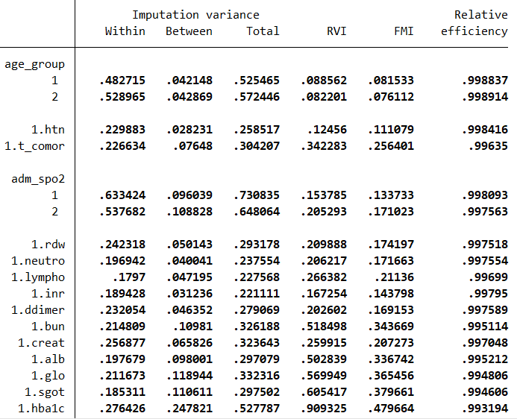
Imputation Diagnostics after Estimation
Table: Variances in the model (M=70)
Nov 2023

Slide 29
Model Performance & Conclusion
Based on the analysis that we have done; the model performed satisfactorily. However, we should
do post-estimation for the goodness of model fit.
We included variables with almost 50% missing information.
Certainly, % of missing information affects the convergence and stability of the imputation model, but the relationship is not that straightforward.
Based on the Phillips-Perron test results, the variable “nr_neutro_a” showed the slowest
convergence for the series of traces of iterations, while it had just 8% missing values.
Nov 2023

Slide 30
Model Performance & Conclusion
Similar observations can be noted in the case of probability distribution as “nr_rdw” (8% missing values) performed not better than “nr_sgot” (49% missing values) or “nr_hba1c” (44% missing values).
These findings indicate the importance of the posterior distribution of the imputation model. Variables for which MCAR or MAR assumptions are better satisfied are likely to perform better, irrespective of a higher proportion of missing values.
Nov 2023

Slide 31
References
Eddings W, Marchenko Y. Diagnostics for multiple imputation in Stata. The Stata Journal.
2012 Sep;12(3):353-67.
White IR, Royston P, Wood AM. Multiple imputation using chained equations: issues and
guidance for practice. Statistics in medicine. 2011 Feb 20;30(4):377-99.
Nov 2023

Slide 32

Acknowledgement
I would like to acknowledge my external co-guide Prof. (Dr.) B. L. Sherwal (Director), Dr. Namrata Makkar (M.S.) and other staffs from Rajiv Gandhi Super Speciality Hospital, New Delhi, for their help and constant support during the data collection.
Thank You
Nov 2023

