Slide 1
Introduction to
Difference in Differences
Using Stata
Chuck Huber
StataCorp
chuber@stata.com
Indian Stata Conference
November 30, 2023

Slide 2
Download Website
You can download all of the slides, datasets and do-files here:
https://tinyurl.com/StataDID

Slide 3
Outline
The Question
An Intuitive Introduction
Two Period, Two Groups Model
Repeated Cross-Sectional Panel Data
Longitudinal Panel Data
Heterogeneous DiD
Panel Data Heterogeneous DiD
More Information

Slide 4
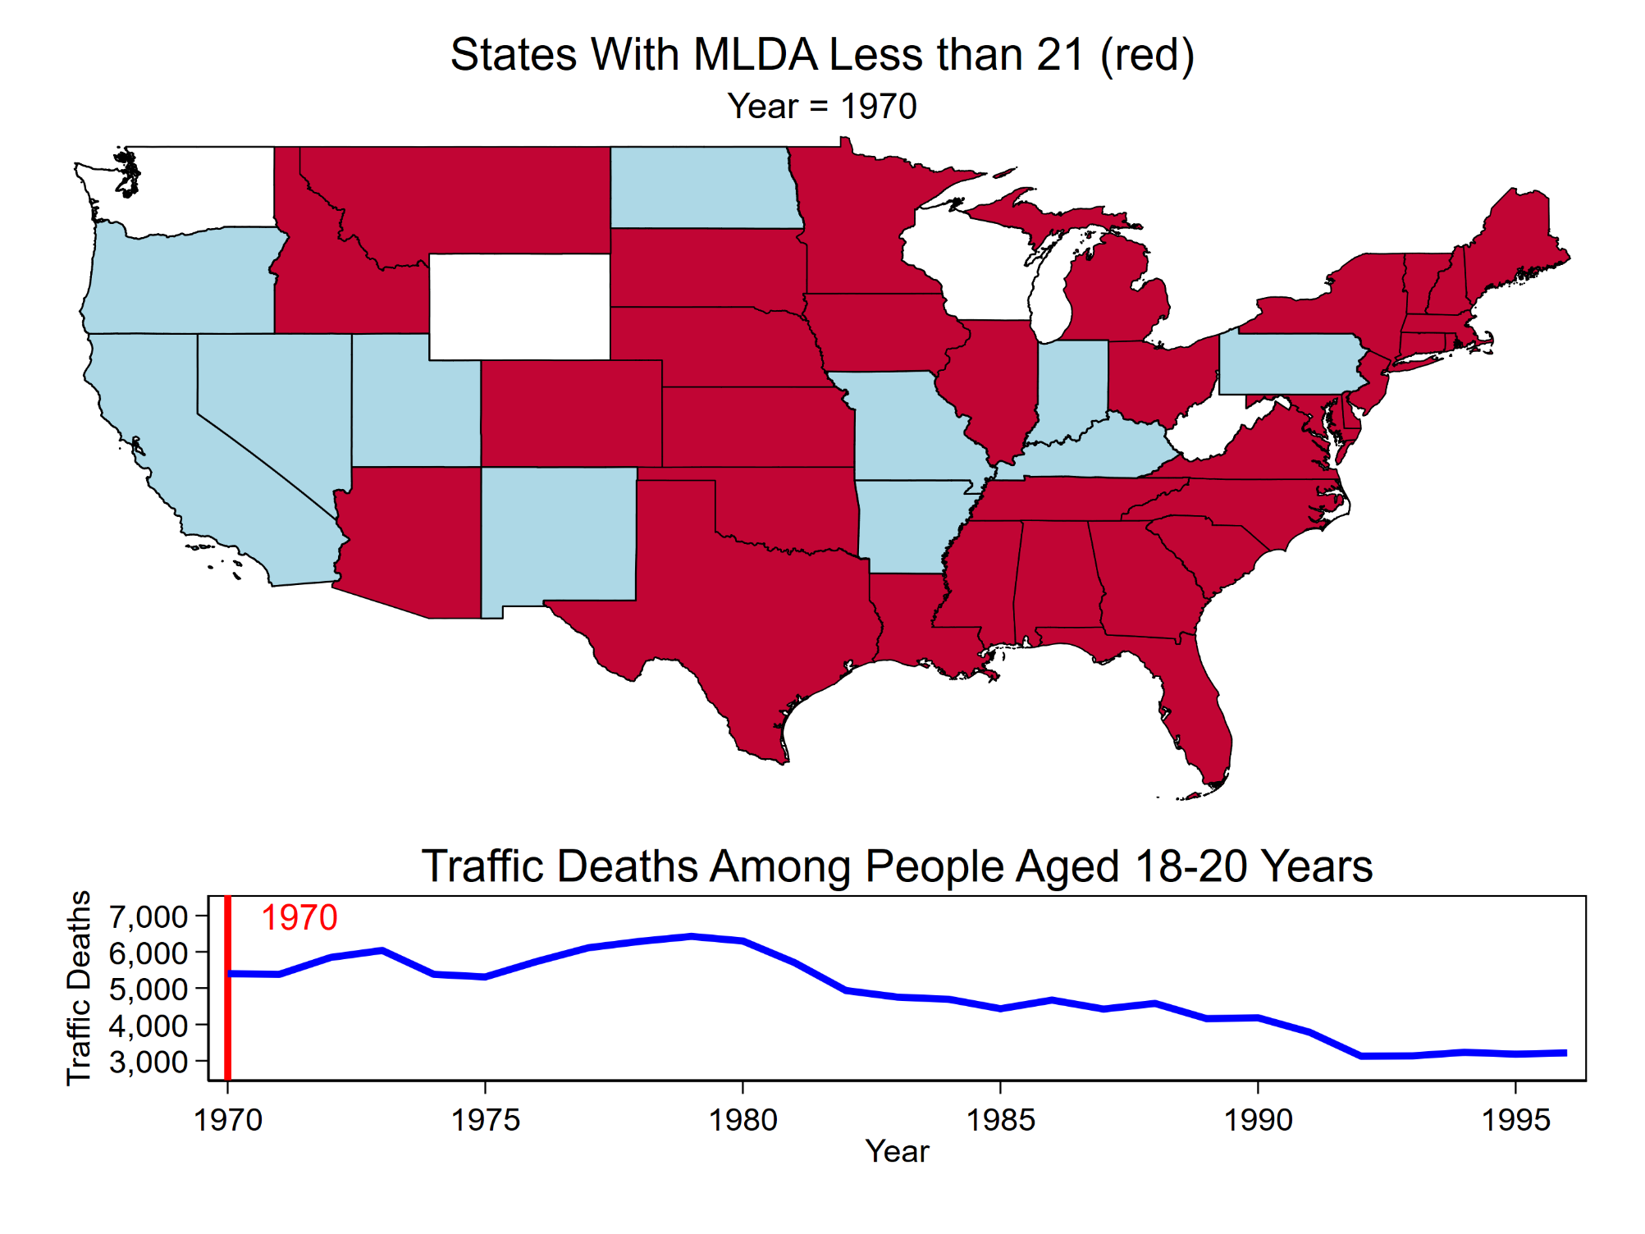
Notes:
In 1970, 35 out of the 50 United States had a minimum legal drinking age (MLDA) less than 21 year of age. At that time, there were over 5000 deaths per 100,000 people aged 18-20 years of age.

Slide 5
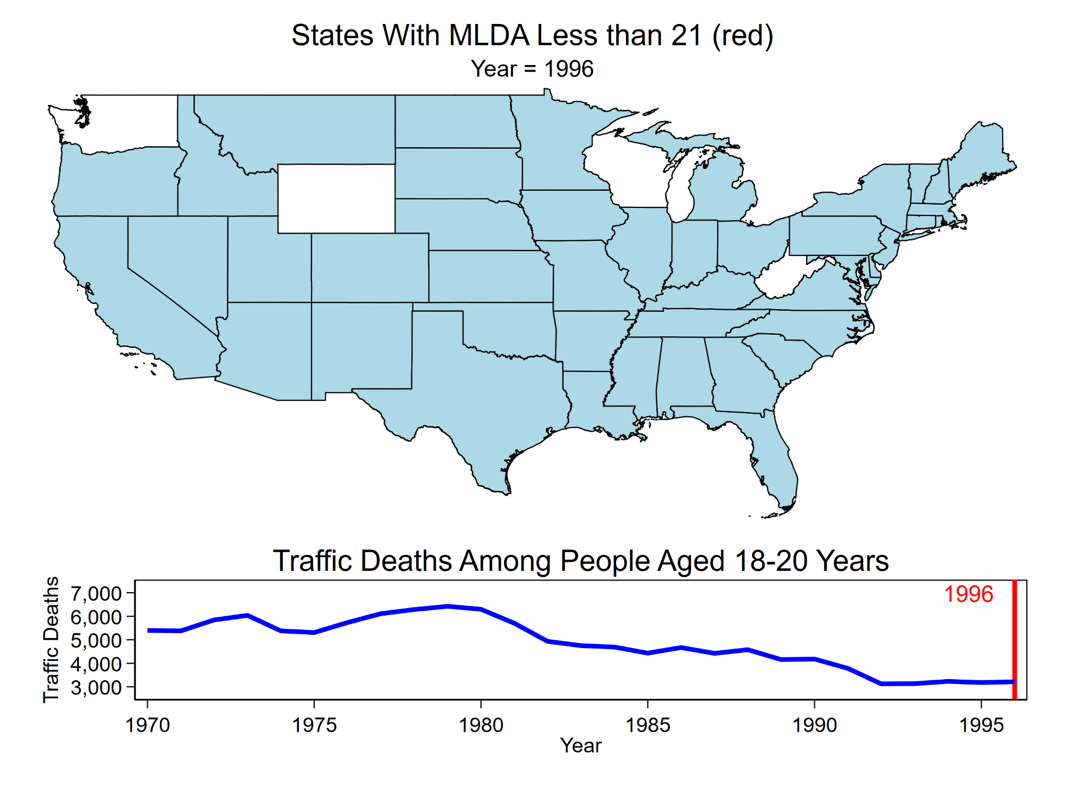
Notes:
By 1996, all 50 states had a MLDA of 21 years and traffic mortality in the 18-20 age group fell by almost half.

Slide 6
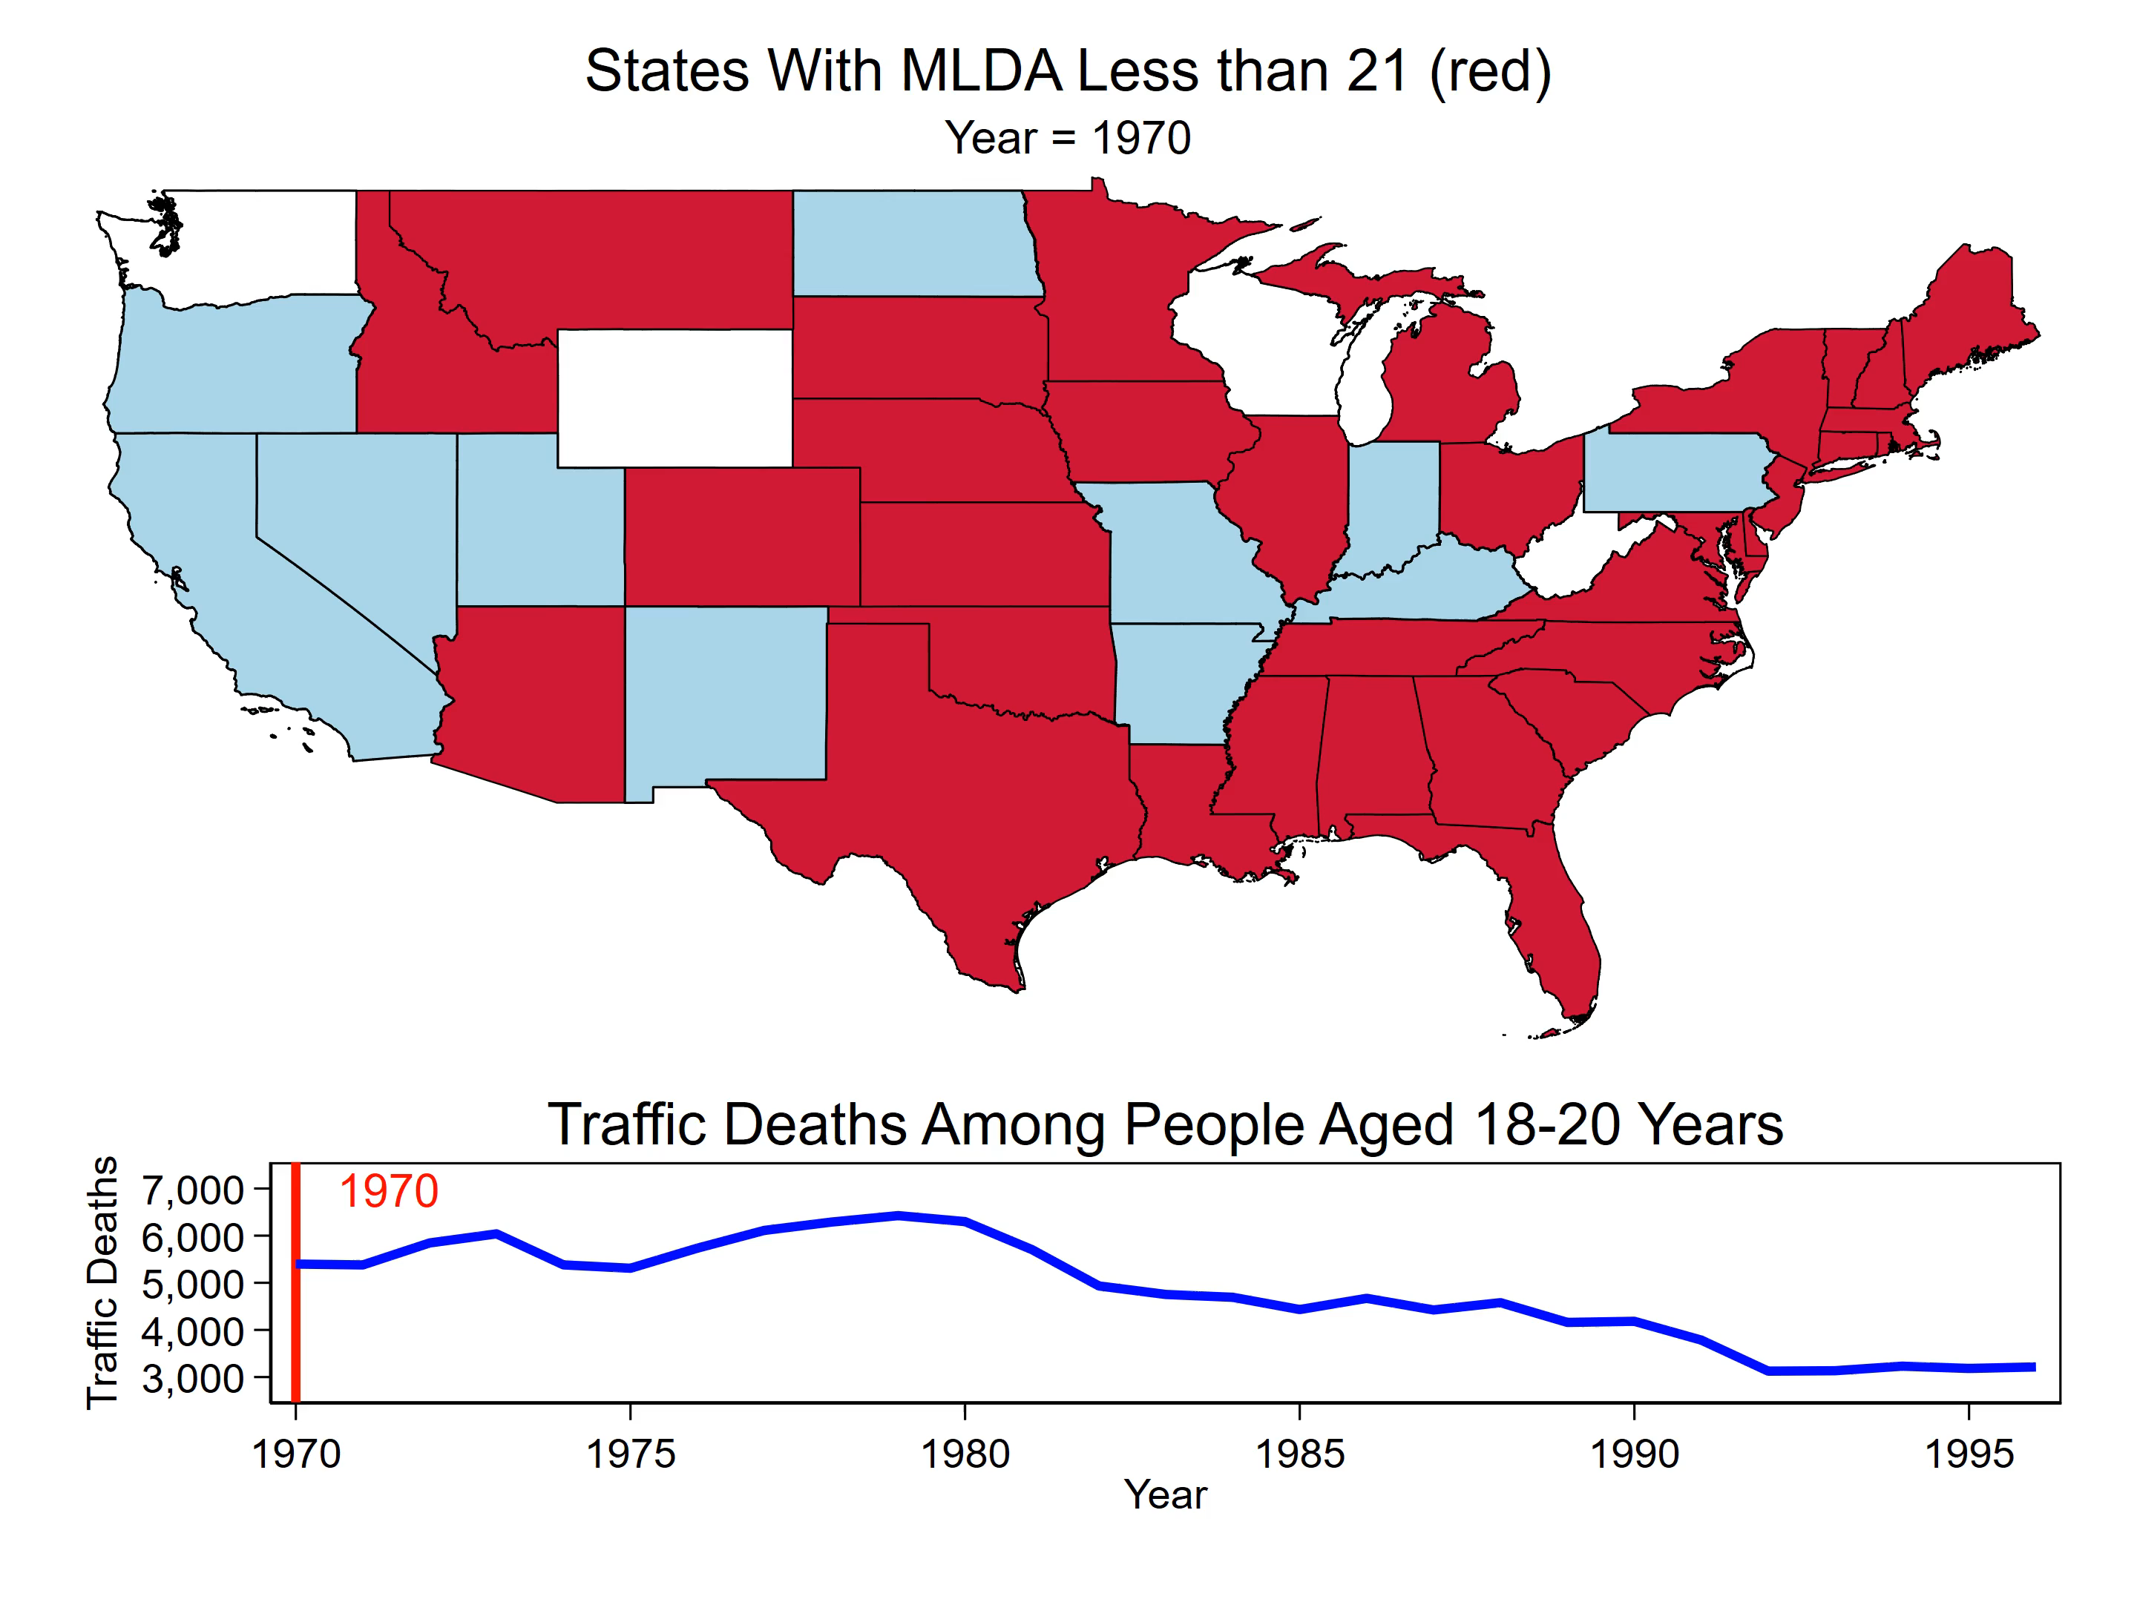
Notes:
The Question: Did the increase in the minimum legal drinking age cause a decrease in the rate of traffic deaths in the 18-20 year old age group?

Slide 7

Outline
The Question
An Intuitive Introduction
Two Period, Two Groups Model
Repeated Cross-Sectional Panel Data
Longitudinal Panel Data
Heterogeneous DiD
Panel Data Heterogeneous DiD
More information

Slide 8
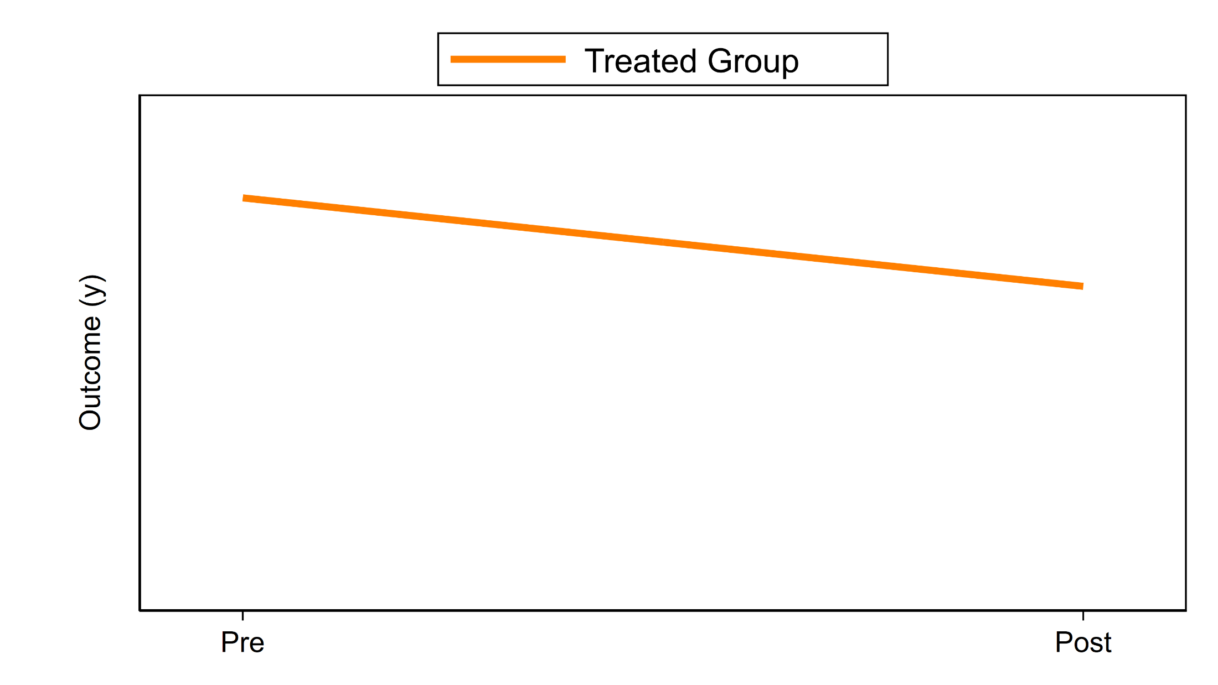
A Conceptual Introduction
Notes:
Let’s assume that we measure an outcome at two points in time: Pre and Post.

Slide 9
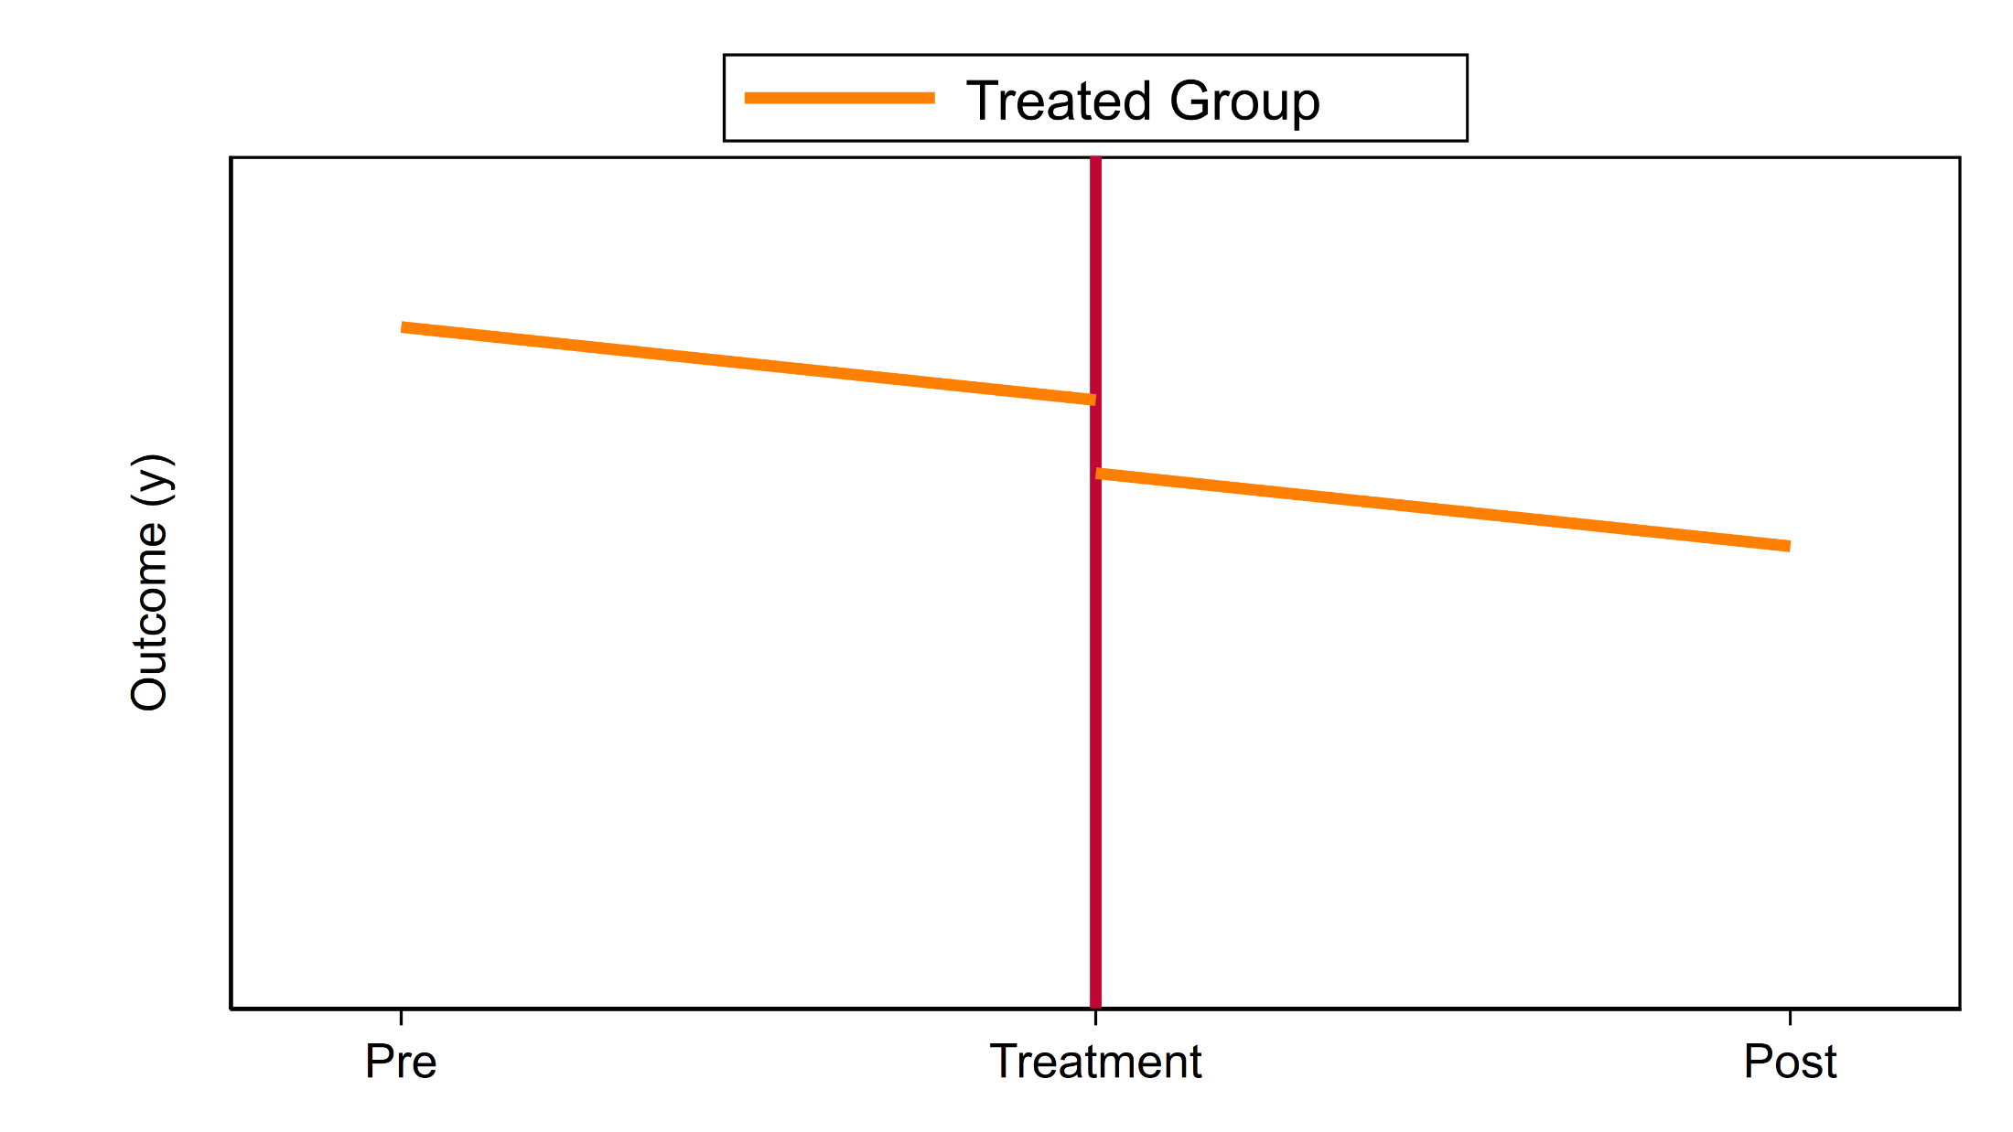
A Conceptual Introduction
Notes:
A treatment occurs between times Pre and Post and we believe the treatment changed the level of the outcome.

Slide 10
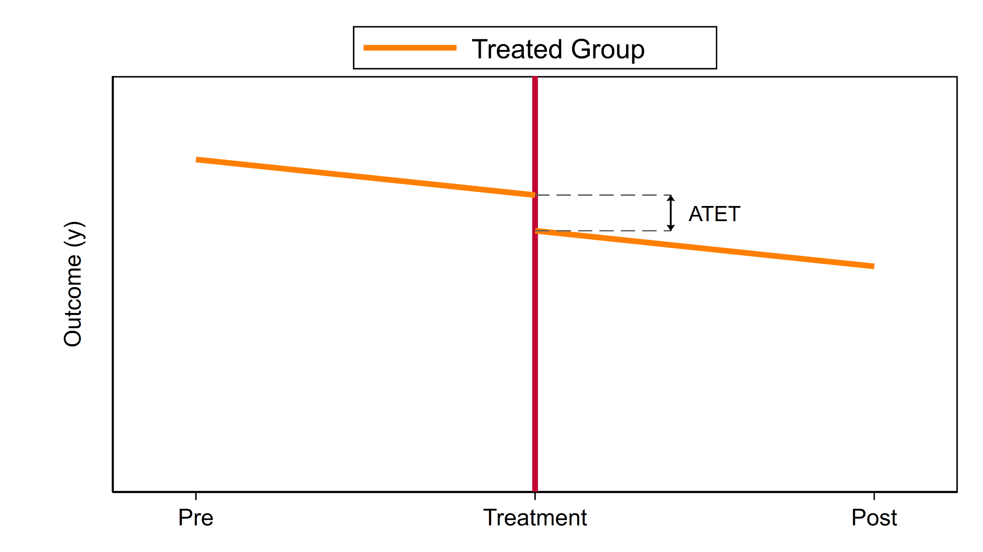
A Conceptual Introduction
Notes:
The change in the outcome due to the treatment is called the “Average Treatment Effect On The Treated Group” also known as the “ATET”.

Slide 11
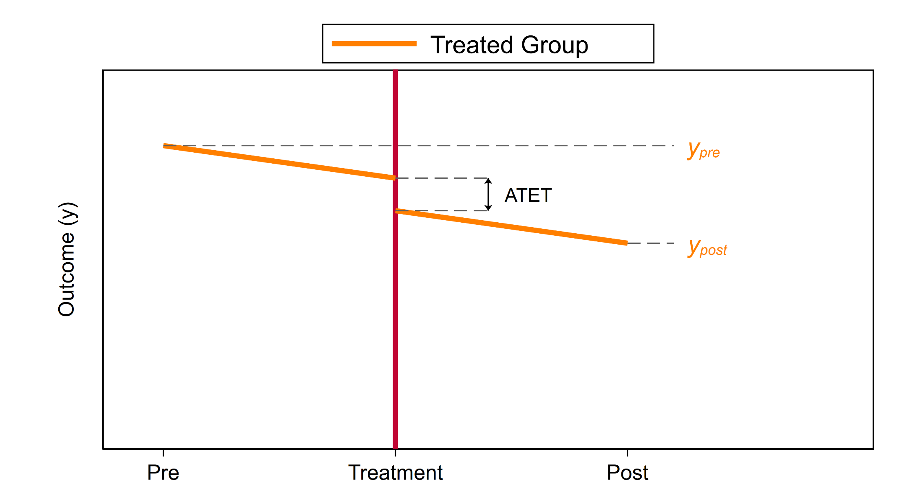
A Conceptual Introduction
Notes:
We don’t observe the ATET directly. We only observe the difference between y_{pre} and y_{post} .

Slide 12
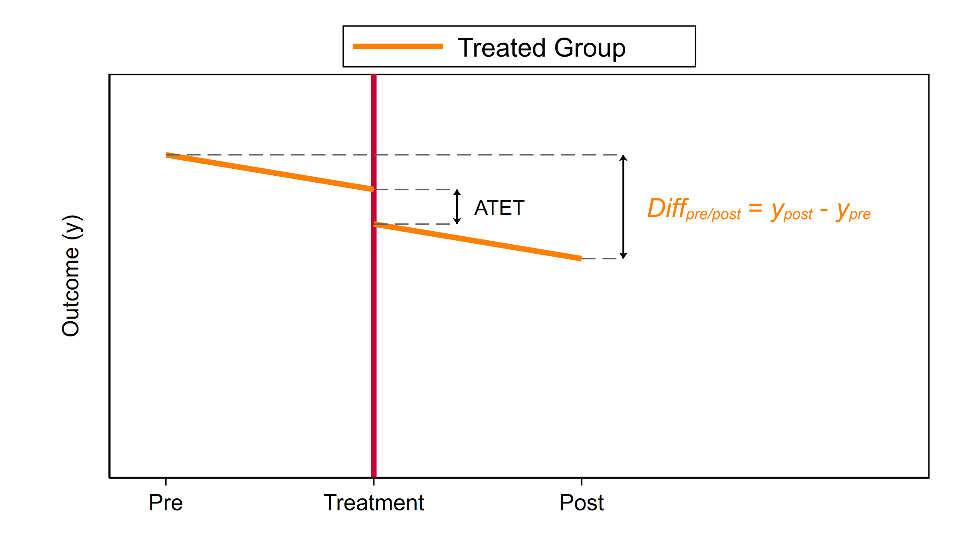
A Conceptual Introduction
Notes:
The difference between y_{pre} and y_{post} overestimates the ATET.

Slide 13
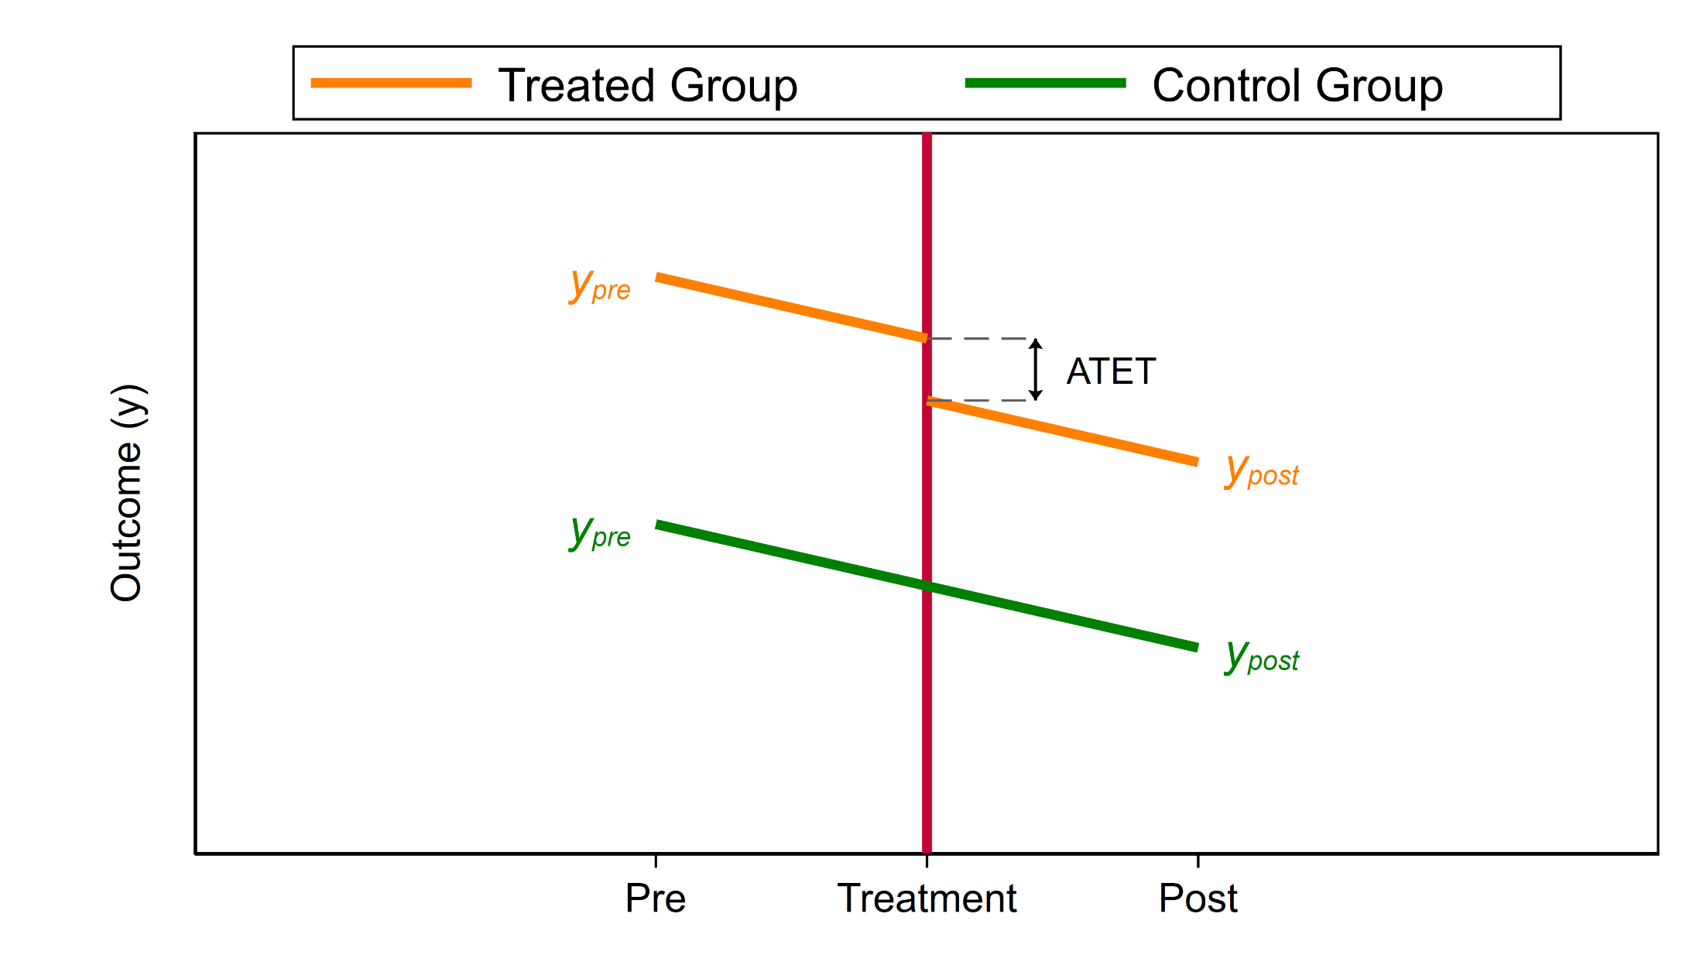
A Conceptual Introduction
Notes:
Let’s find a Control Group – a very similar group that was not exposed to the treatment.

Slide 14
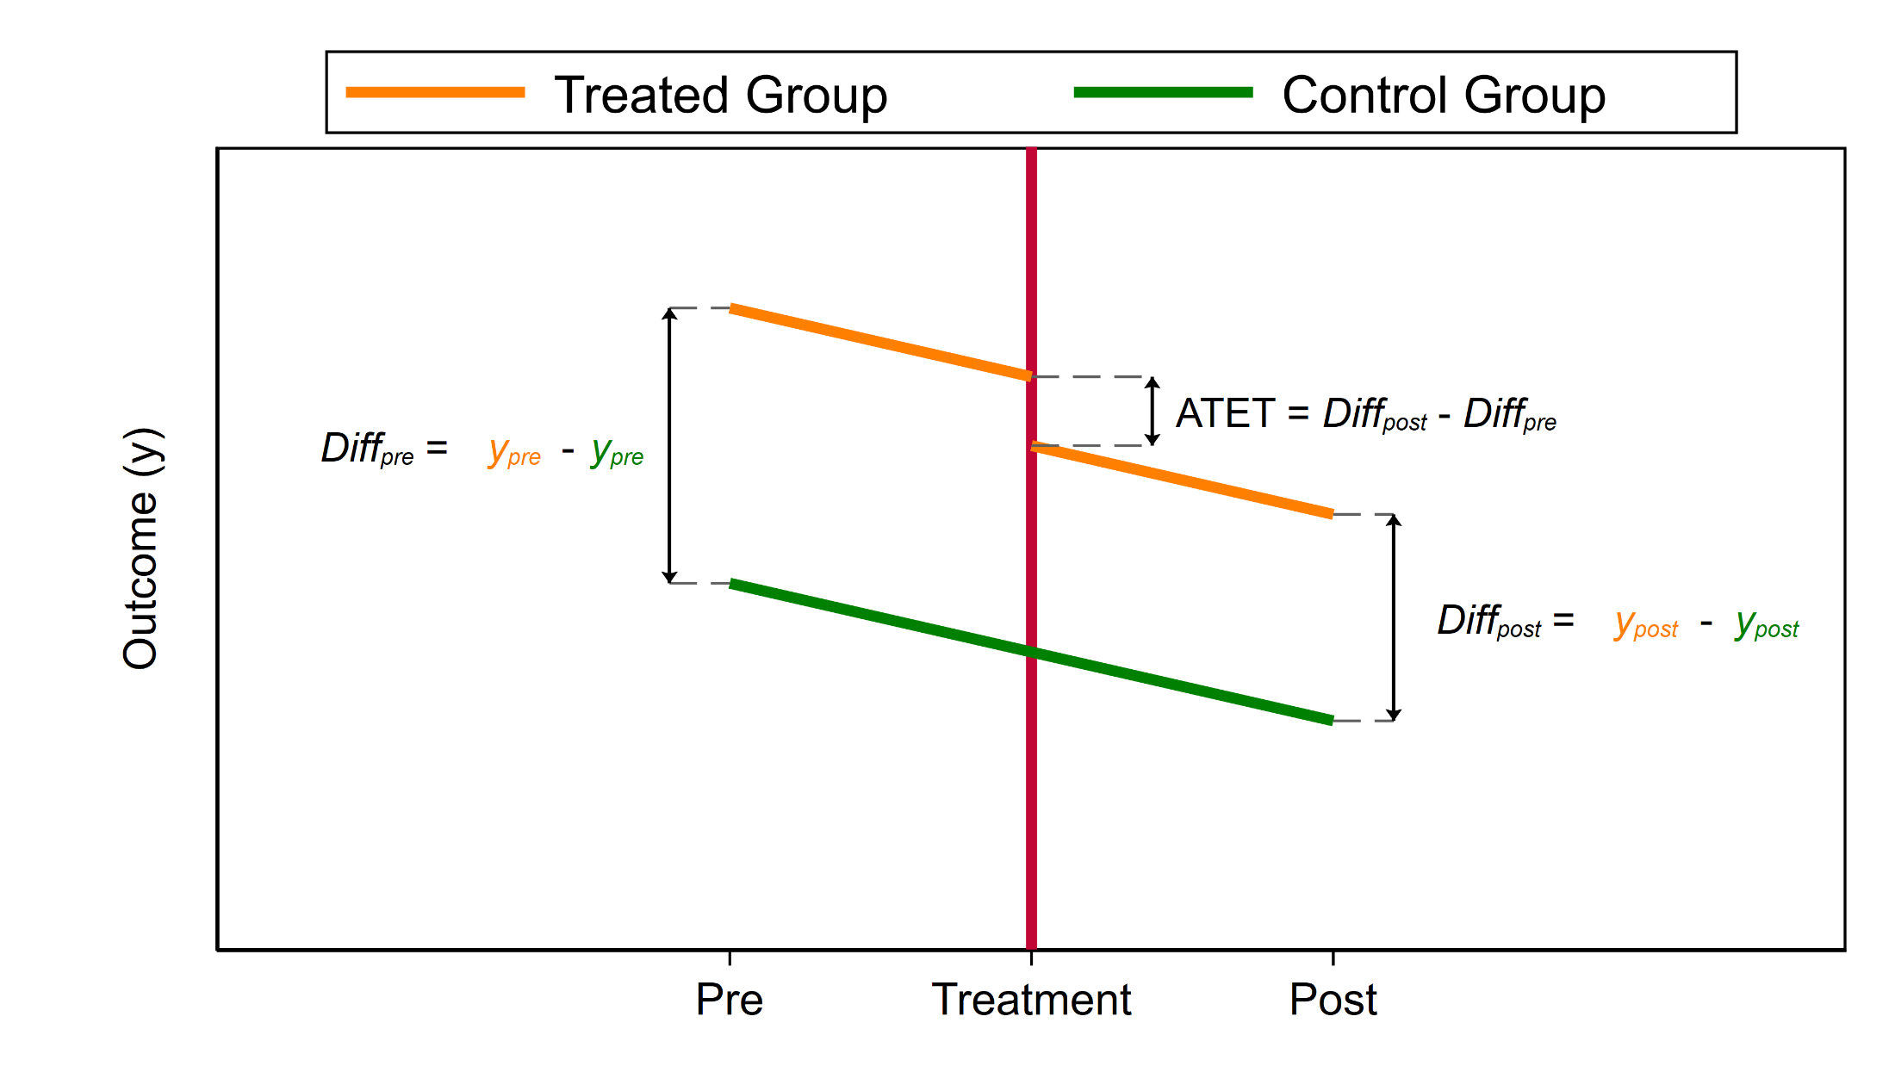
A Conceptual Introduction
Notes:
We can then estimate the difference between y_{pre} in the Treatment Group and y_{pre} in the Control Group. We can also estimate the difference between y_{post} in the Treatment Group and y_{post} in the Control Group. And we can estimate the ATET as the difference between the differences.

Slide 15
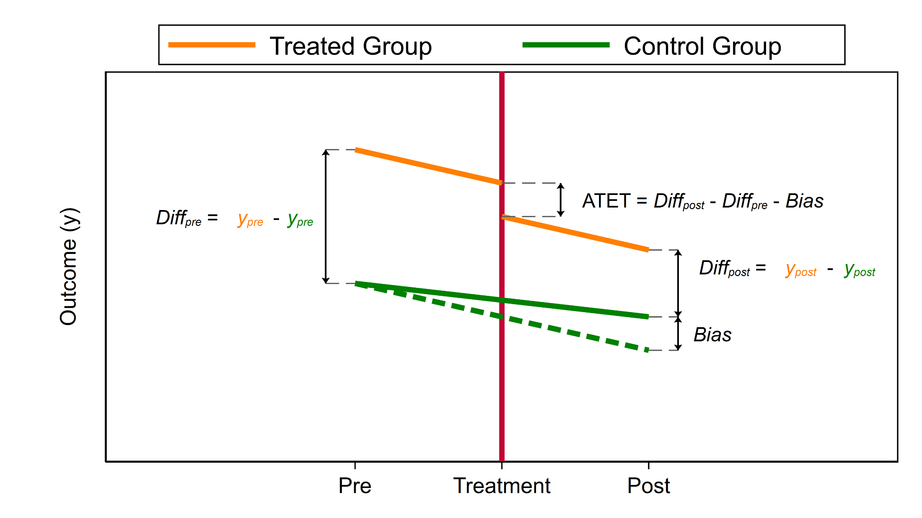
A Conceptual Introduction
The “Parallel Trends” Assumption
Notes:
Estimation of the ATET rests on the “Parallel Trends” Assumption

Slide 16
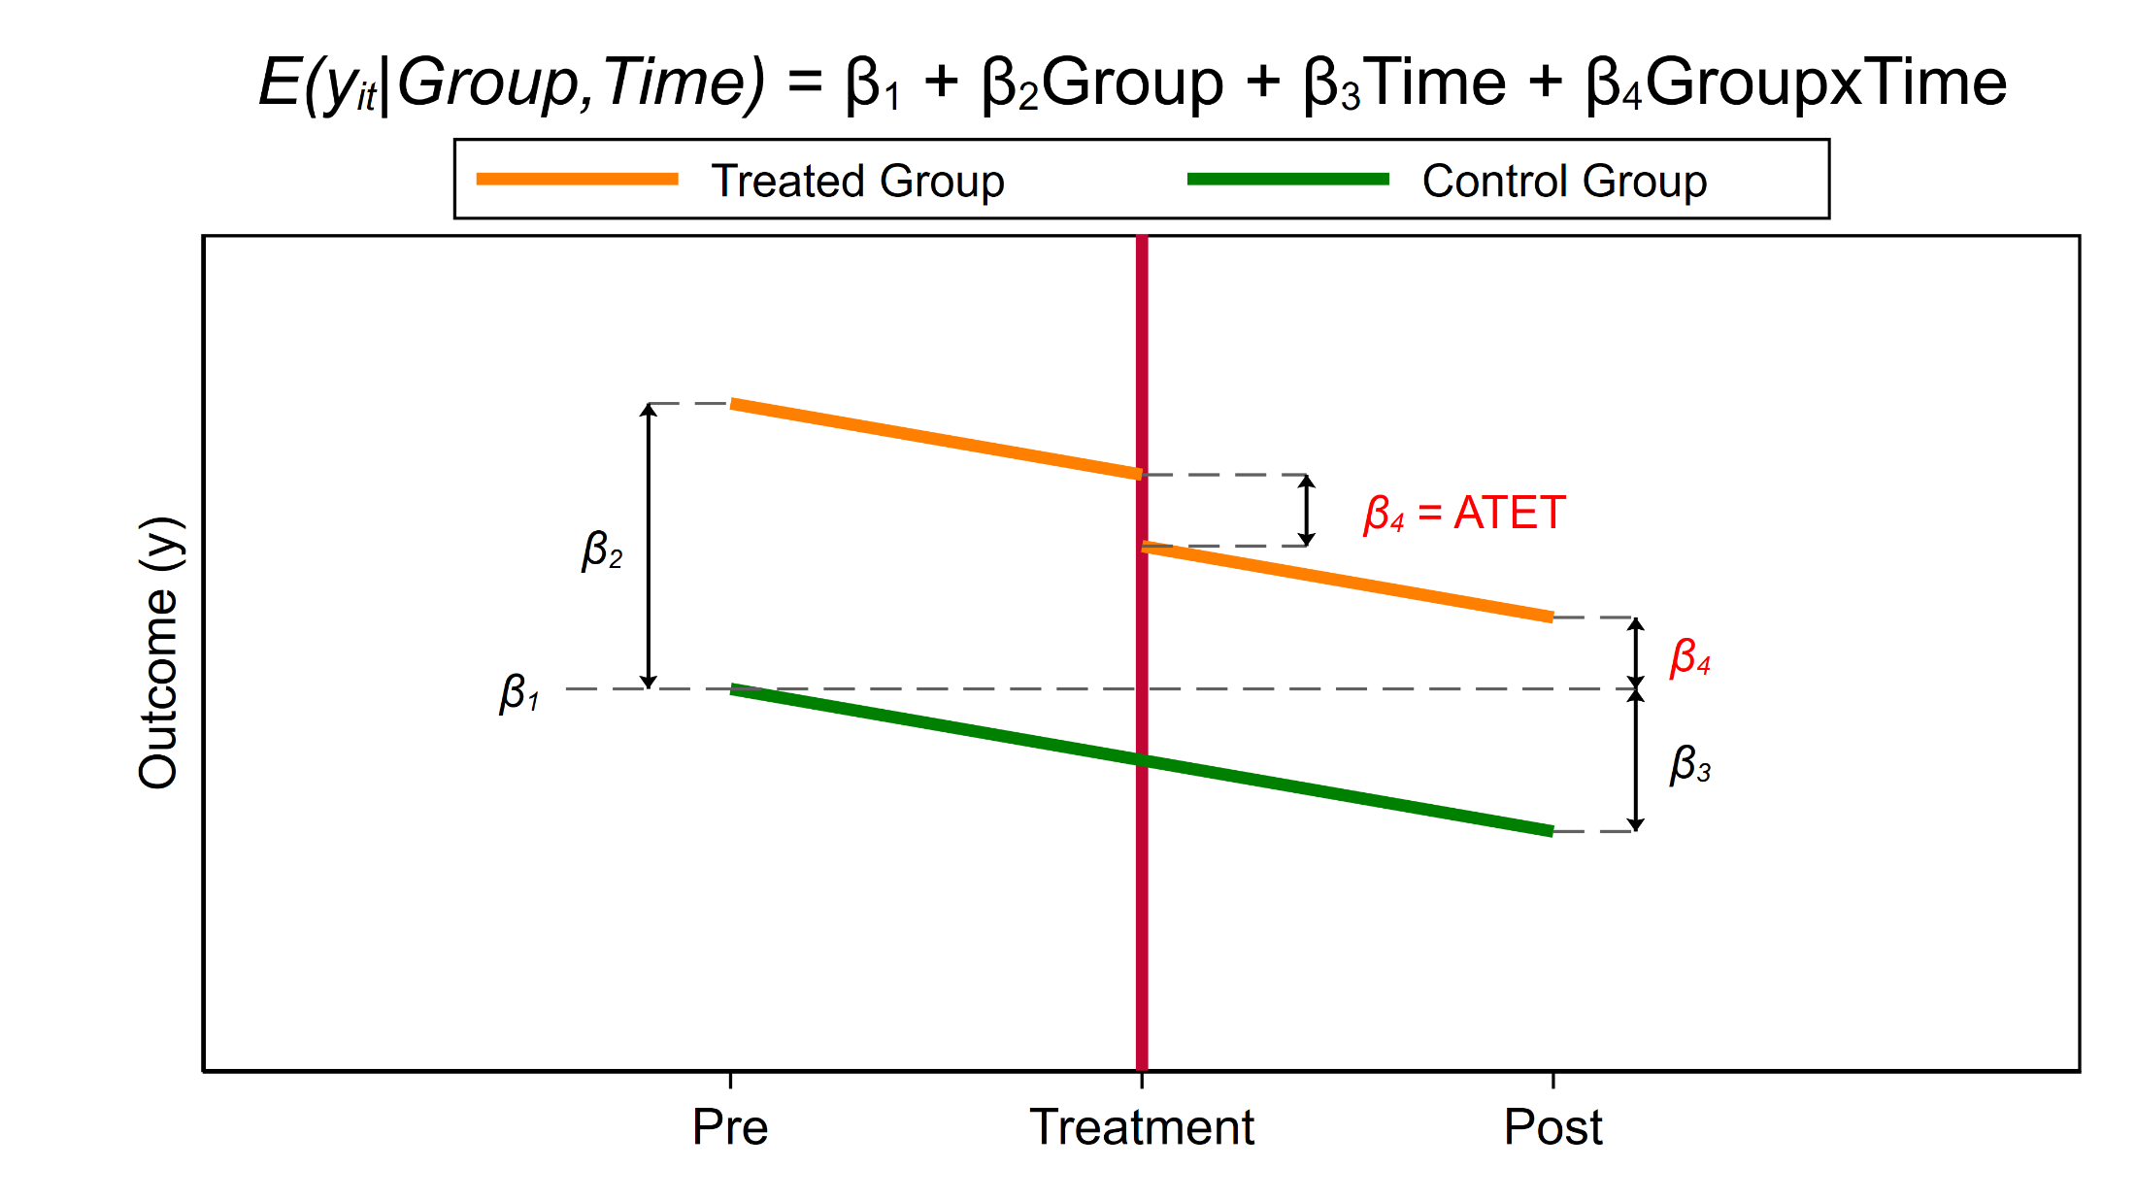
A Conceptual Introduction
Notes:
Beta1 estimates the outcome in the control group at time “Pre”. Beta2 estimates the difference between the outcome in the treated and control groups at time “Pre”. Beta3 estimates the difference between the outcome at time “Pre” and time “Post” in the treated group. And Beta4 estimates the difference between the control group outcome at time “Pre” and the treatment group outcome at time “Post”. Beta4 estimates the ATET.

Slide 17
Outline
The Question
An Intuitive Introduction
Two Period, Two Groups Model
Repeated Cross-Sectional Panel Data
Longitudinal Panel Data
Heterogeneous DiD
Panel Data Heterogeneous DiD
More information

Slide 18
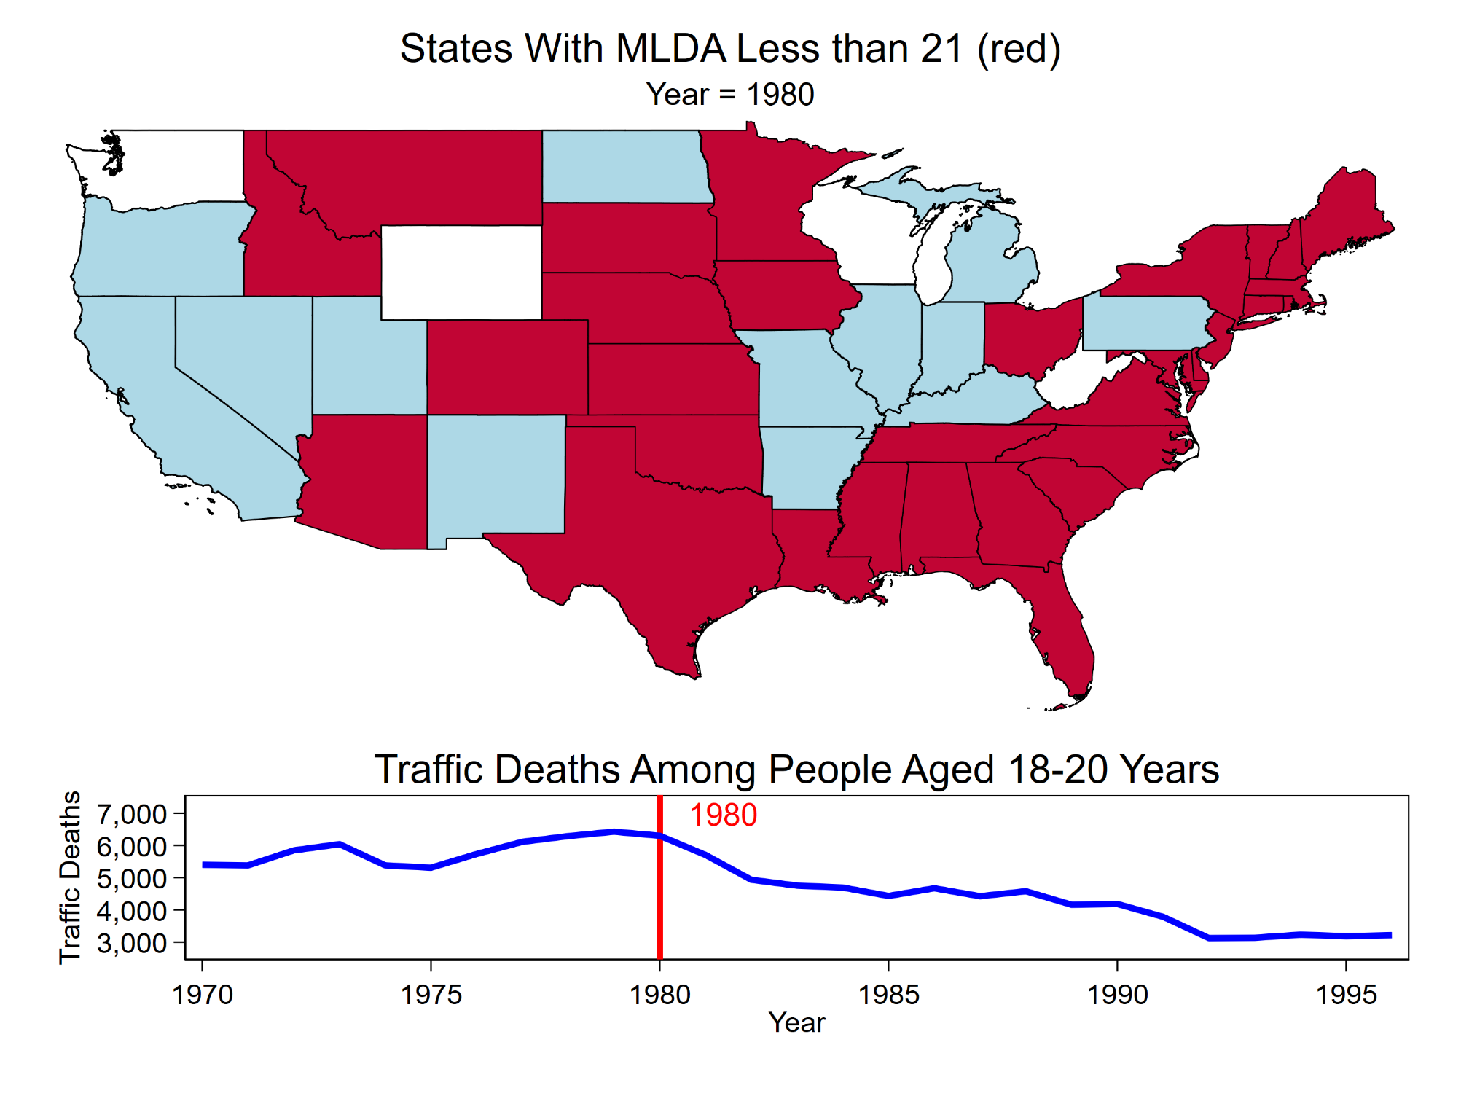

Slide 19
The Example Dataset
Notes:
We’re going to use a dataset from a 2014 study by Angrist and Pischke.

Slide 20
MLDA21 Law Not In Effect
MLDA21 Law Enacted
MLDA21 Law In Effect
Notes:
Let’s look at some data for Illinois. Illinois implemented its MLDA21 law in 1980 so Illinois is in the “treated” group.

Slide 21
MLDA21 Law Not In Effect
MLDA21 Law Enacted
MLDA21 Law In Effect
Notes:
Let’s look at some data for Illinois and Iowa. Illinois implemented its MLDA21 law in 1980 so Illinois is in the “treated” group. Iowa implemented it’s MLDA21 law in 1986 so Iowa is in the “control” group.

Slide 22
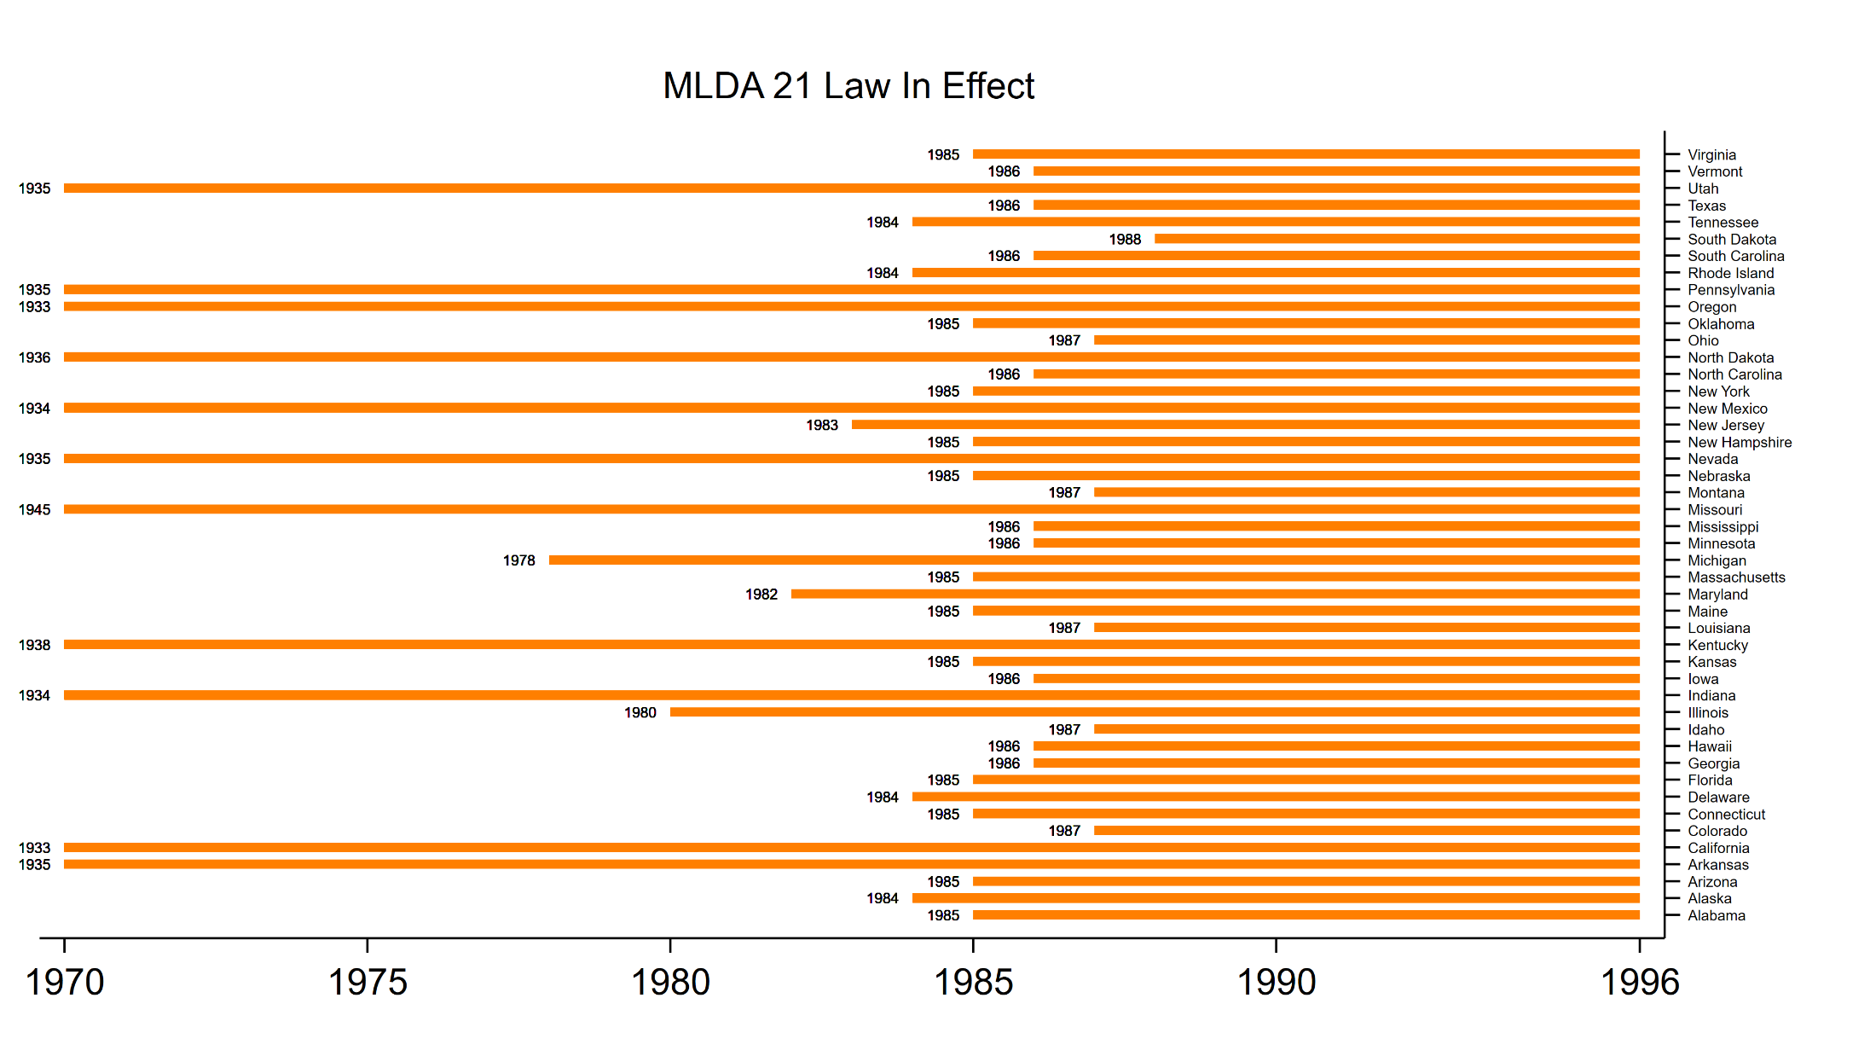
The Two Period, Two Group Model
Notes:
The states implemented their MLDA21 laws in different years.

Slide 23
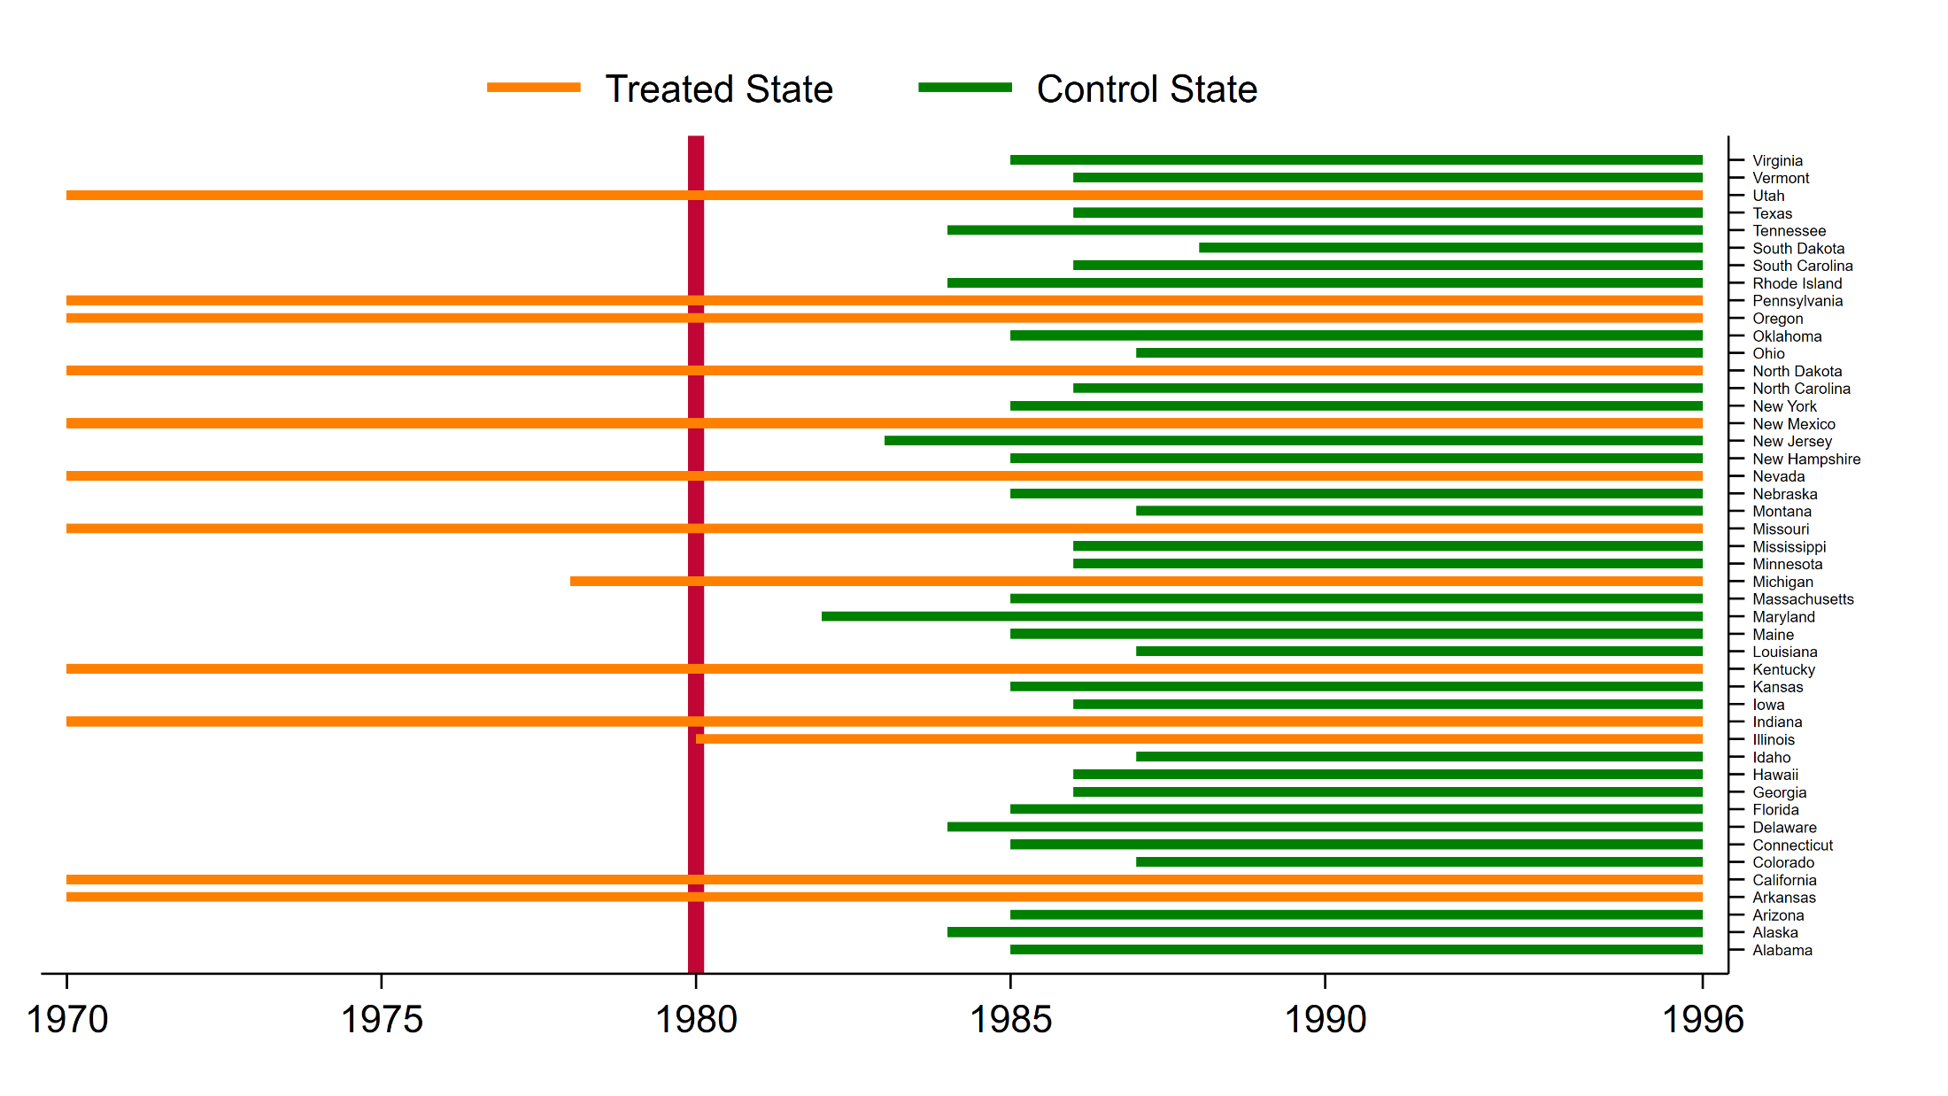
The Two Period, Two Group Model
Notes:
Let’s define the “treated” states as any state with an MLDA21 law implemented during, or before, 1980. The control group will be defined as any state that implemented their MLDA21 law after 1980.

Slide 24
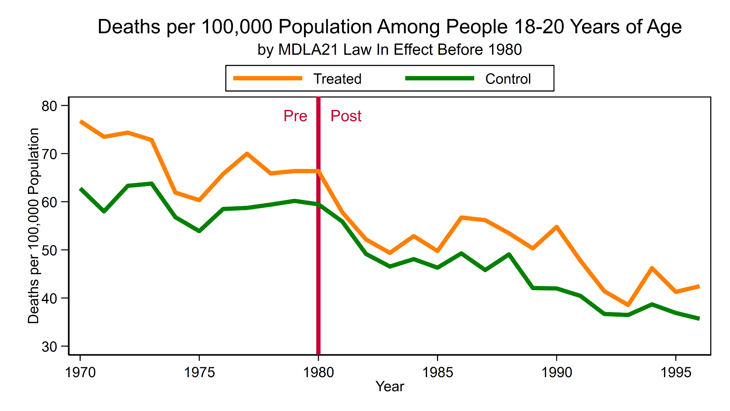
The Two Period, Two Group Model
Notes:
Then we can compare the death rate in the treated and control groups. Now we have two groups but we still have many measurements over time.

Slide 25
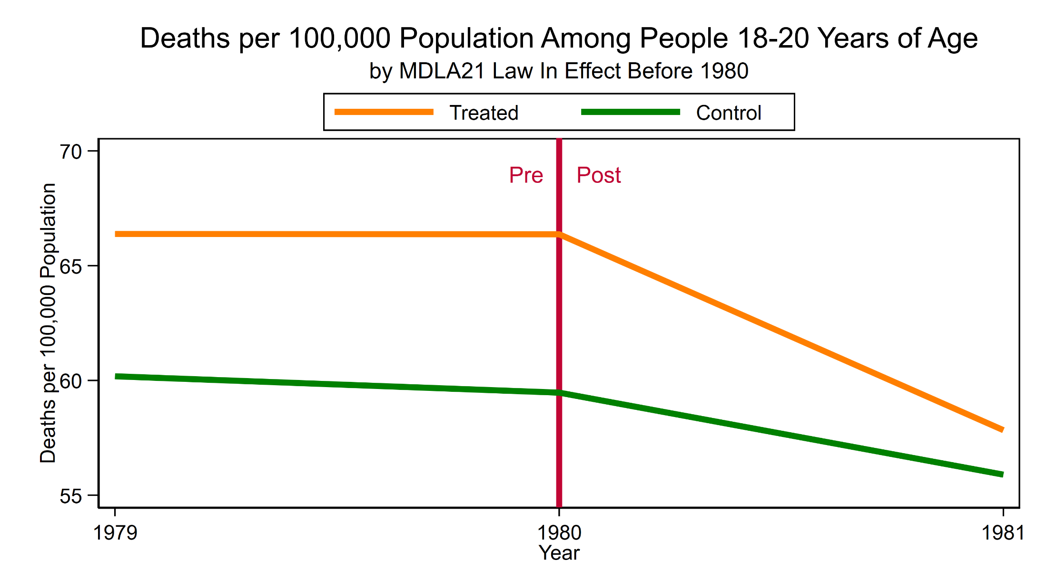
The Two Period, Two Group Model
Notes:
For the “two period, two group” model, we will define “pre” as 1979 and “post” as 1981. The treatment occurred in 1980.

Slide 26
Setting Up The Data
Keep the data for 1979, 1980, and 1981
1979 is Pre
1980 is Treatment
1981 is Post

Slide 27
Setting Up The Data
The law went into effect
during the time interval
The law was in effect
during the entire interval
The law was never in effect
during the entire interval

Slide 28
Setting Up The Data
Time equals 0 prior to
the intervention in 1980
and time equals 1 after
the intervention in 1980

Slide 29
Setting Up The Data
// Create a variable for treatment status
gen treated = .
replace treated = 0 if MLDA21_year >1980
replace treated = 0 if MLDA21_year <=1980 & year<1980
replace treated = 1 if MLDA21_year <=1980
Treated equals 1 if the
MLDA21 law was in effect
in that state during 1980 or
sooner. Treated equals 0
if the law went into effect
after 1980.

Slide 30
Setting Up The Data
TimeTreat equals time x treated.
It will be the interaction term when we use regress.
It will be the treatment variable when we use didregress!!!!

Slide 31
DiD Using regress
The Average Treatment Effect Among the Treated (ATET) is the coefficient for TimeTreat.
The MLDA21 law caused a decrease of 4.6 people per 100,000 population in the 18-20 year old age group between 1979 and 1981.

Slide 32
DiD Using regress

Slide 33
DiD Using regress
(FIPS output truncated)

Slide 34
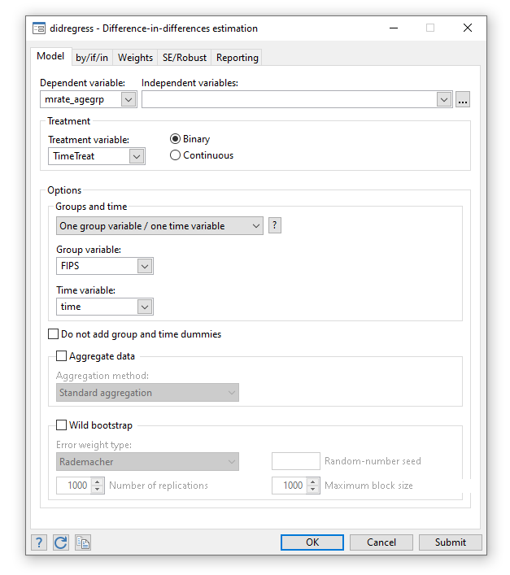
DiD Using didregress

Slide 35
DiD Using didregress
didregress (outcomevar outcomevarlist) ///
(treatmentvar[, continuous]), ///
group(groupvars) ///
[time(timevar) options]
didregress (mrate_agegrp) ///
(TimeTreat), ///
group(FIPS) ///
time(year)
TimeTreat = Time x Treat !!!!

Slide 36
DiD Using didregress

Slide 37
Checking the Parallel Trends Assumption

Slide 38
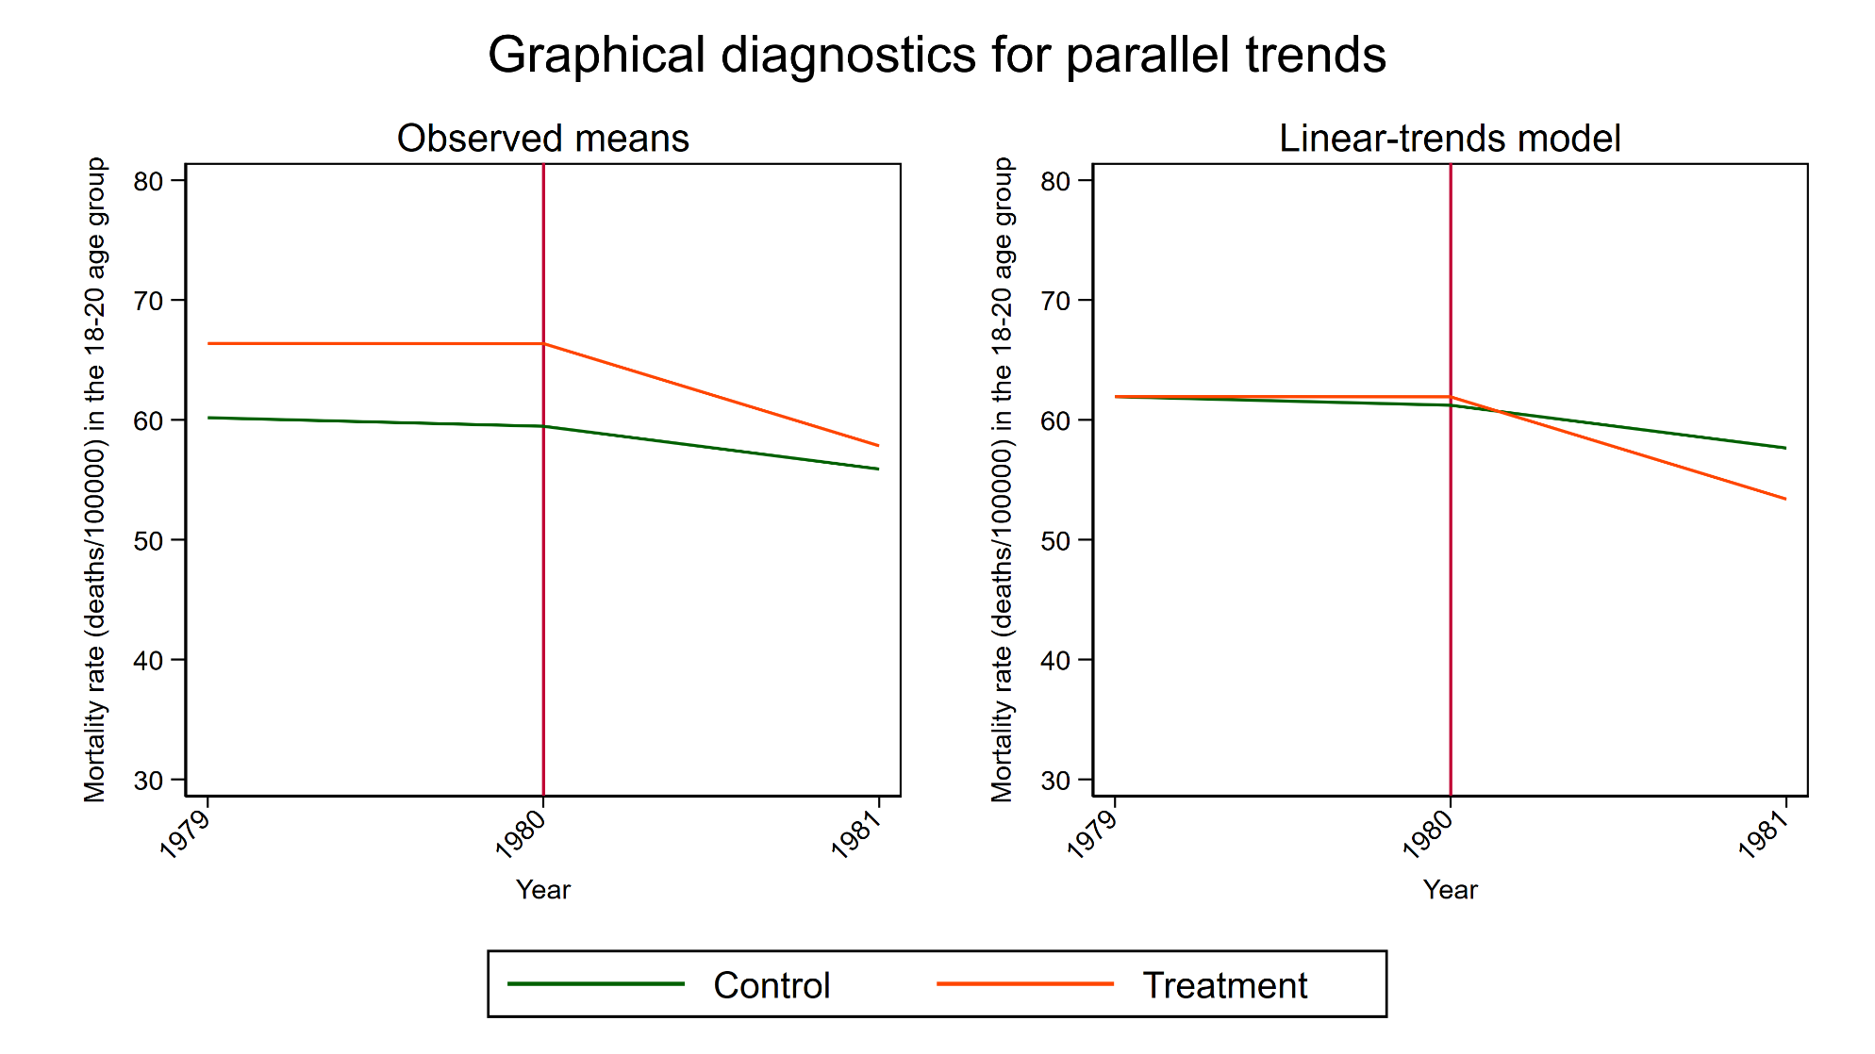
Checking the Parallel Trends Assumption
estat trendplots
Notes:
The first plot consists of two lines showing the mean of the outcome over time for the treatment and the control groups. The second plot augments the DID model to include interactions of time with an indicator of treatment and plots the predicted values of this augmented model for the treatment and control groups. Both plots include a vertical line one period before treatment.

Slide 39
didregress With Covariates

Slide 40
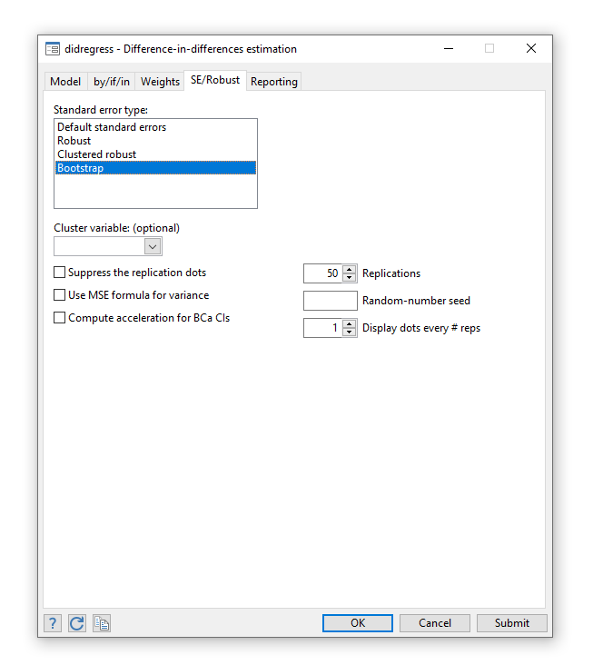
Estimation of Standard Errors

Slide 41
Estimation of Standard Errors
Must account for the serial correlation of the outcome.
For a large number of groups
By default, didregress uses cluster–robust standard
errors and uses critical values of a t distribution with
G − 1 degrees of freedom, where G is the number
of groups.
For more information: https://www.stata.com/manuals/tedidintro.pdf

Slide 42
Estimation of Standard Errors
For a small number of groups

Slide 43
Outline
The Question
An Intuitive Introduction
Two Period, Two Groups Model
Repeated Cross-Sectional Panel Data
Longitudinal Panel Data
Heterogeneous DiD
Panel Data Heterogeneous DiD
More information

Slide 44
DiD For Repeated Cross-Sectional Data

Slide 45
DiD For Repeated Cross-Sectional Data
use MLDA21, clear
// Create a variable for time
generate time = (year>1980)
// Create a variable for treatment status
gen treated = .
replace treated = 0 if MLDA21_year >1980
replace treated = 0 if MLDA21_year <=1980 & year<1980
replace treated = 1 if MLDA21_year <=1980
// Create a variable for the interaction of time and treatment
gen TimeTreat = time*treated

Slide 47
DiD For Repeated Cross-Sectional Data

Slide 48
DiD For Repeated Cross-Sectional Data

Slide 49
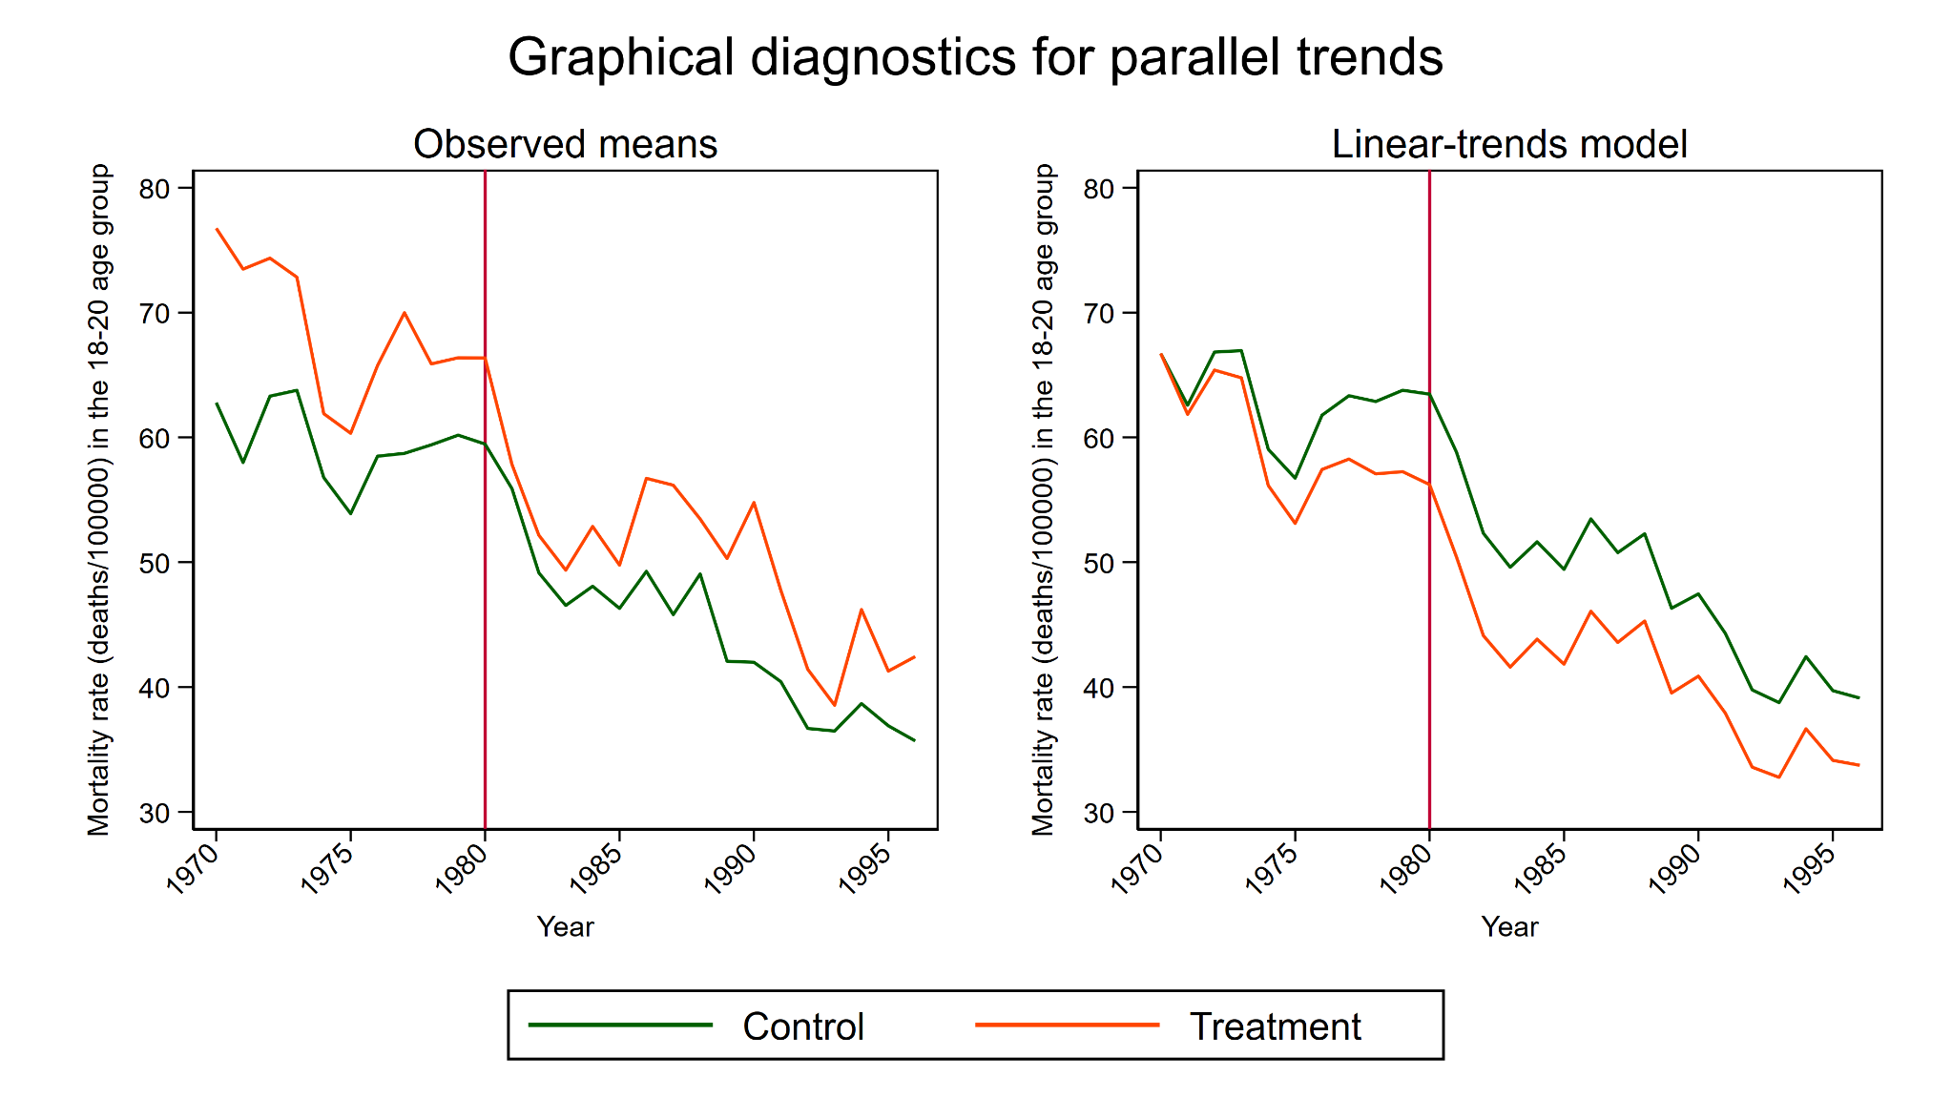
DiD For Repeated Cross-Sectional Data
estat trendplots
Notes:
The first plot consists of two lines showing the mean of the outcome over time for the treatment and the control groups. The second plot augments the DID model to include interactions of time with an indicator of treatment and plots the predicted values of this augmented model for the treatment and control groups. Both plots include a vertical line one period before treatment.

Slide 50
Outline
The Question
An Intuitive Introduction
Two Period, Two Groups Model
Repeated Cross-Sectional Panel Data
Longitudinal Panel Data
Heterogeneous DiD
Panel Data Heterogeneous DiD
More information

Slide 51
DiD For Longitudinal Panel Data

Slide 52
DiD For Longitudinal/Panel Data

Slide 53
DiD For Longitudinal/Panel Data

Slide 54
DiD For Longitudinal/Panel Data

Slide 55
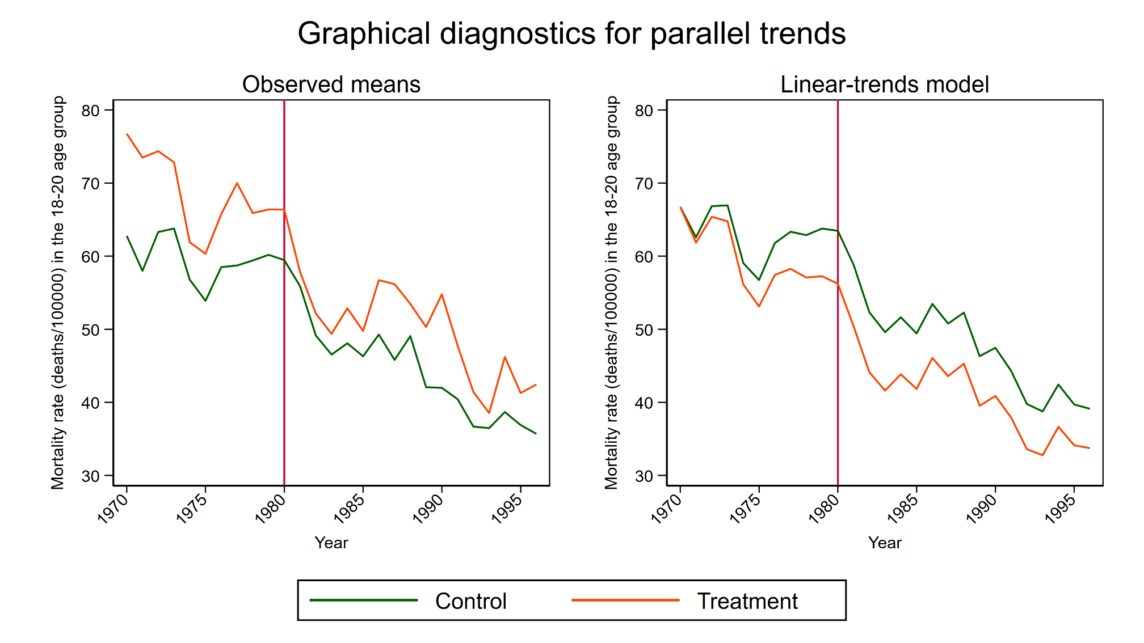
DiD For Longitudinal/Panel Data
estat trendplots

Slide 56
Outline
The Question
An Intuitive Introduction
Two Period, Two Groups Model
Repeated Cross-Sectional Panel Data
Longitudinal Panel Data
Heterogeneous DiD
Panel Data Heterogeneous DiD
More information

Slide 57
Heterogeneous DiD

Slide 58
MLDA21 Law Not In Effect
MLDA21 Law Enacted
MLDA21 Law In Effect
Notes:
Let’s look at some data for Illinois. Illinois implemented its MLDA21 law in 1980 so Illinois is in the “treated” group.

Slide 59
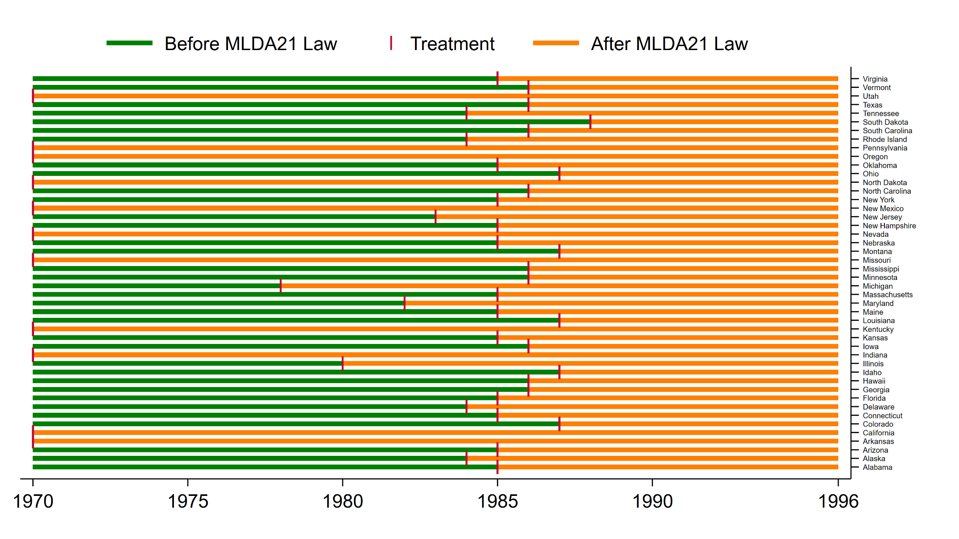
Heterogeneous DiD

Slide 60
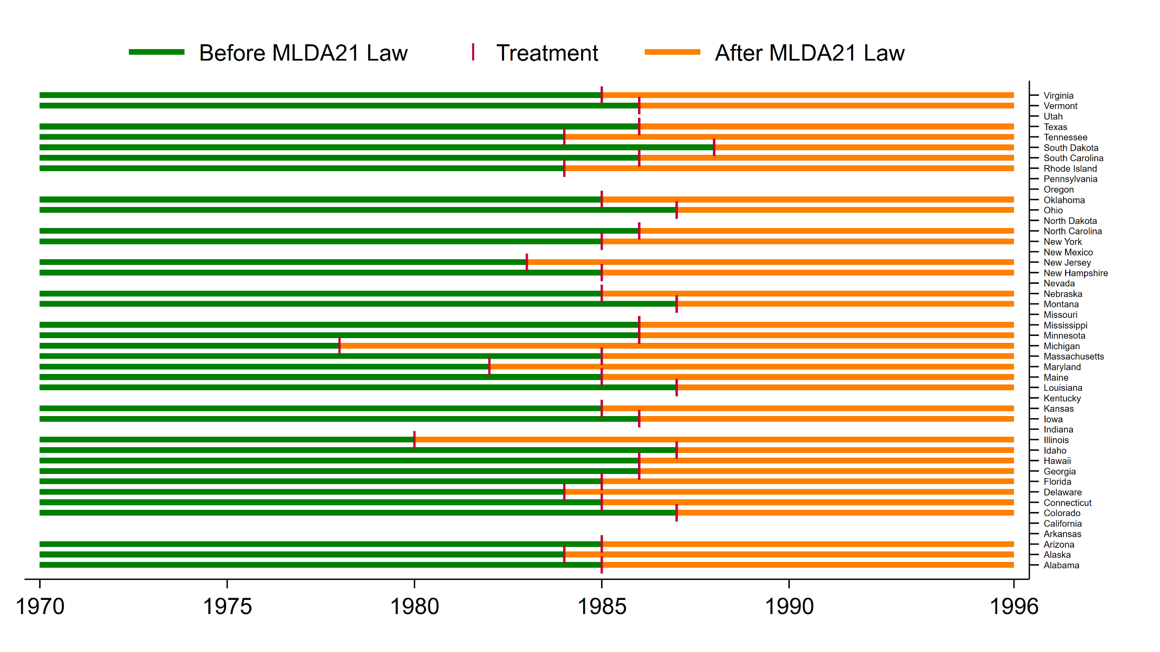
Heterogeneous DiD
drop if MLDA21_year < 1970

Slide 61
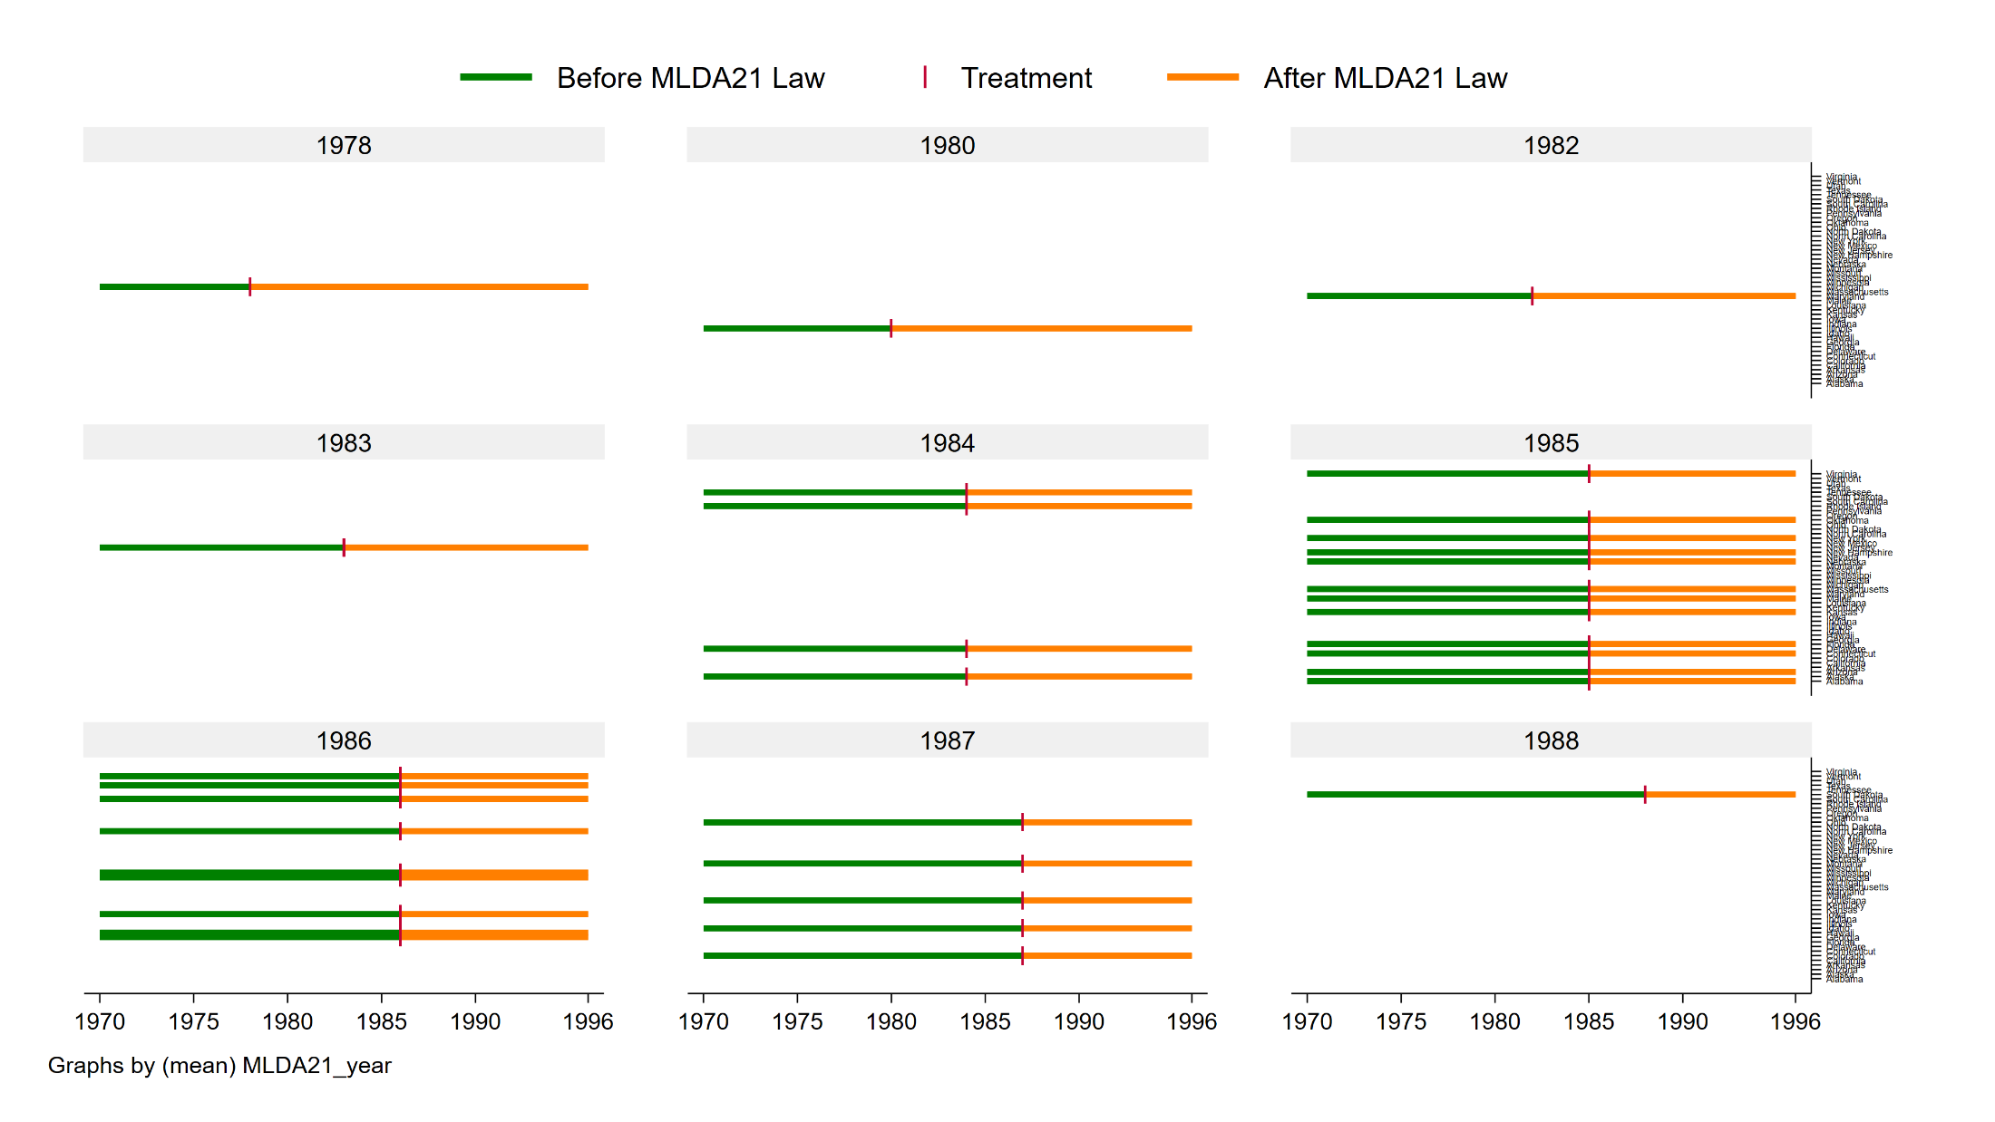
Heterogeneous DiD
Cohorts are defined by the year laws were implemented
Notes:
The treatment years define the cohorts.

Slide 62
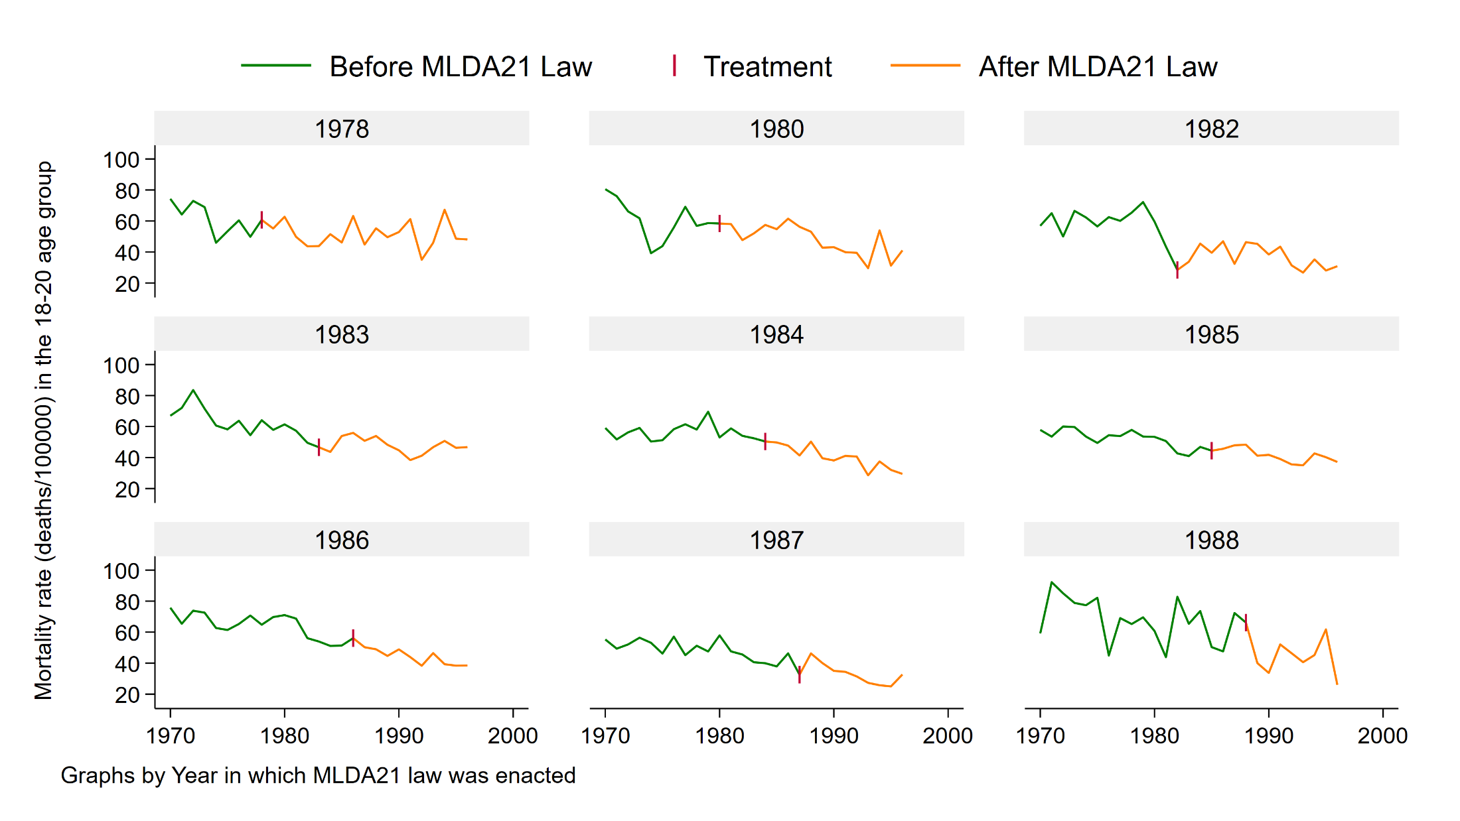
Heterogeneous DiD
Mortality rate over time by Cohort
Notes:
Outcome by time and cohort

Slide 63
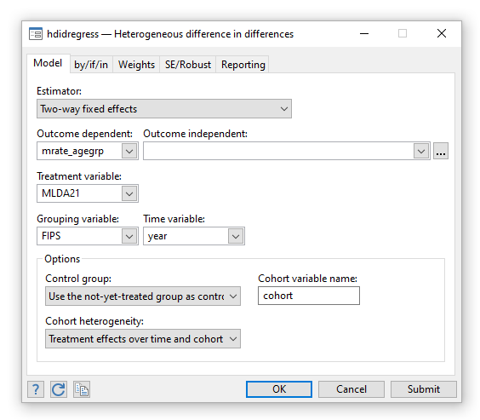
Heterogeneous DiD

Slide 64
Heterogeneous DiD
hdidregress twfe (outcomevar [omvarlist]) ///
(treatmentvar), ///
group(groupvar) ///
time(timevar)
hdidregress twfe (mrate_agegrp ) ///
(MLDA21), ///
group(FIPS) ///
time(year)

Slide 65
Heterogeneous DiD
Lots of output!

Slide 66
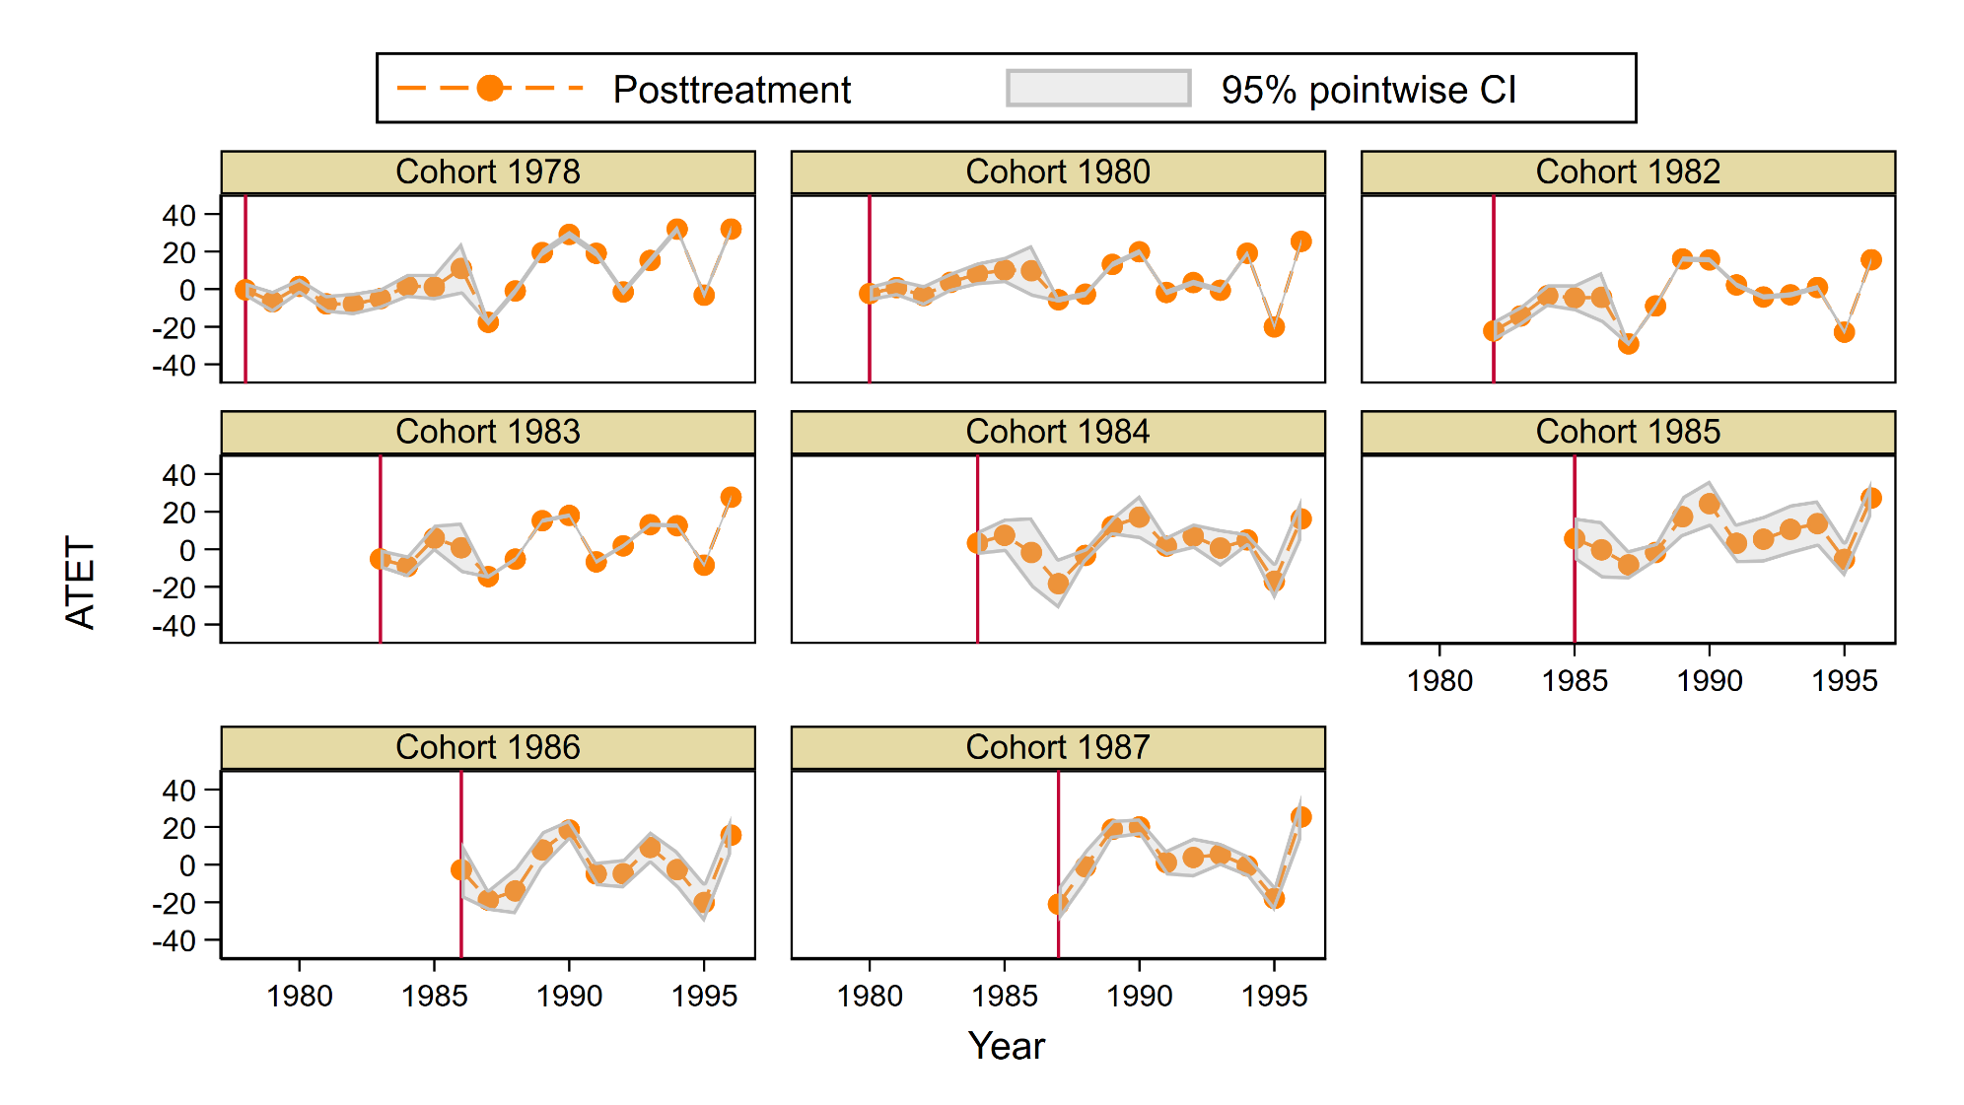
Heterogeneous DiD
estat atetplot

Slide 67
Heterogeneous DiD

Slide 68
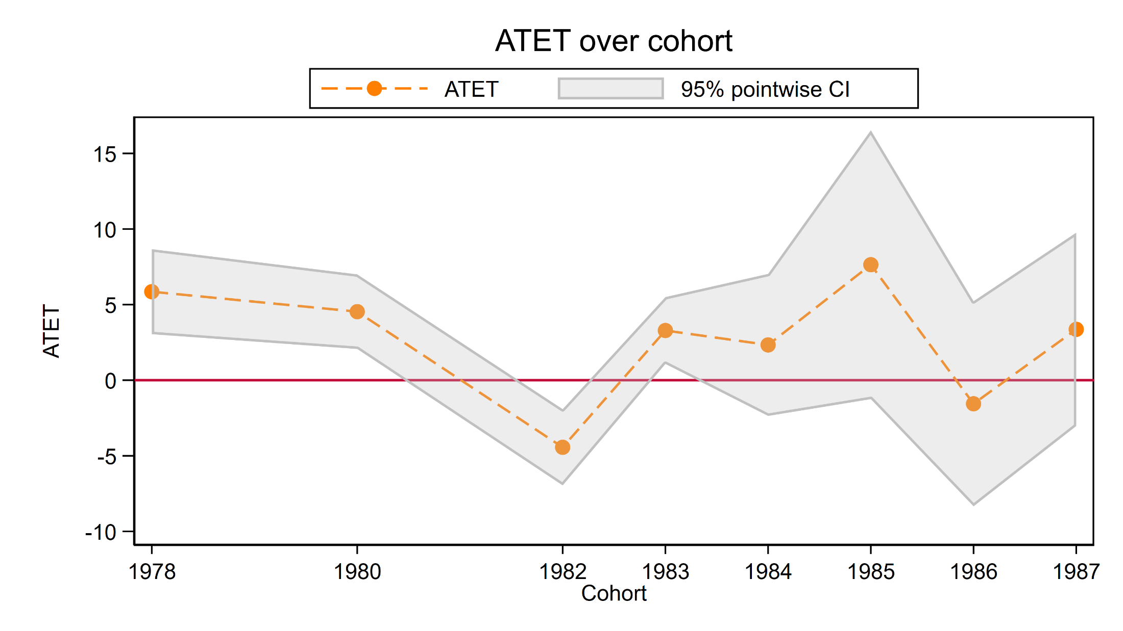
Heterogeneous DiD

Slide 69
Heterogeneous DiD

Slide 70
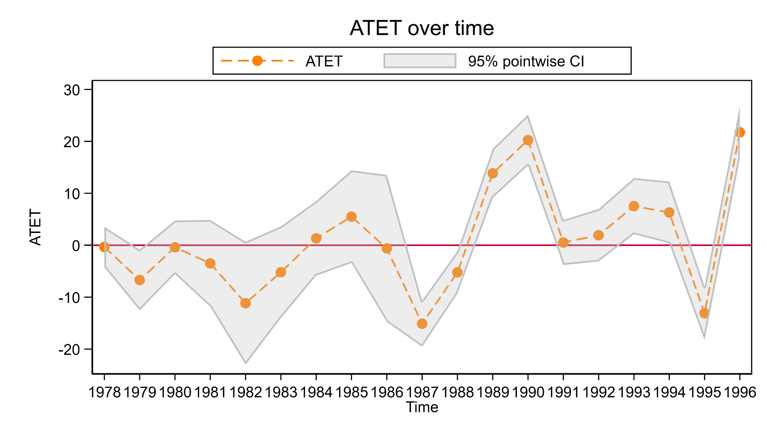
Heterogeneous DiD

Slide 71
Heterogeneous DiD

Slide 72
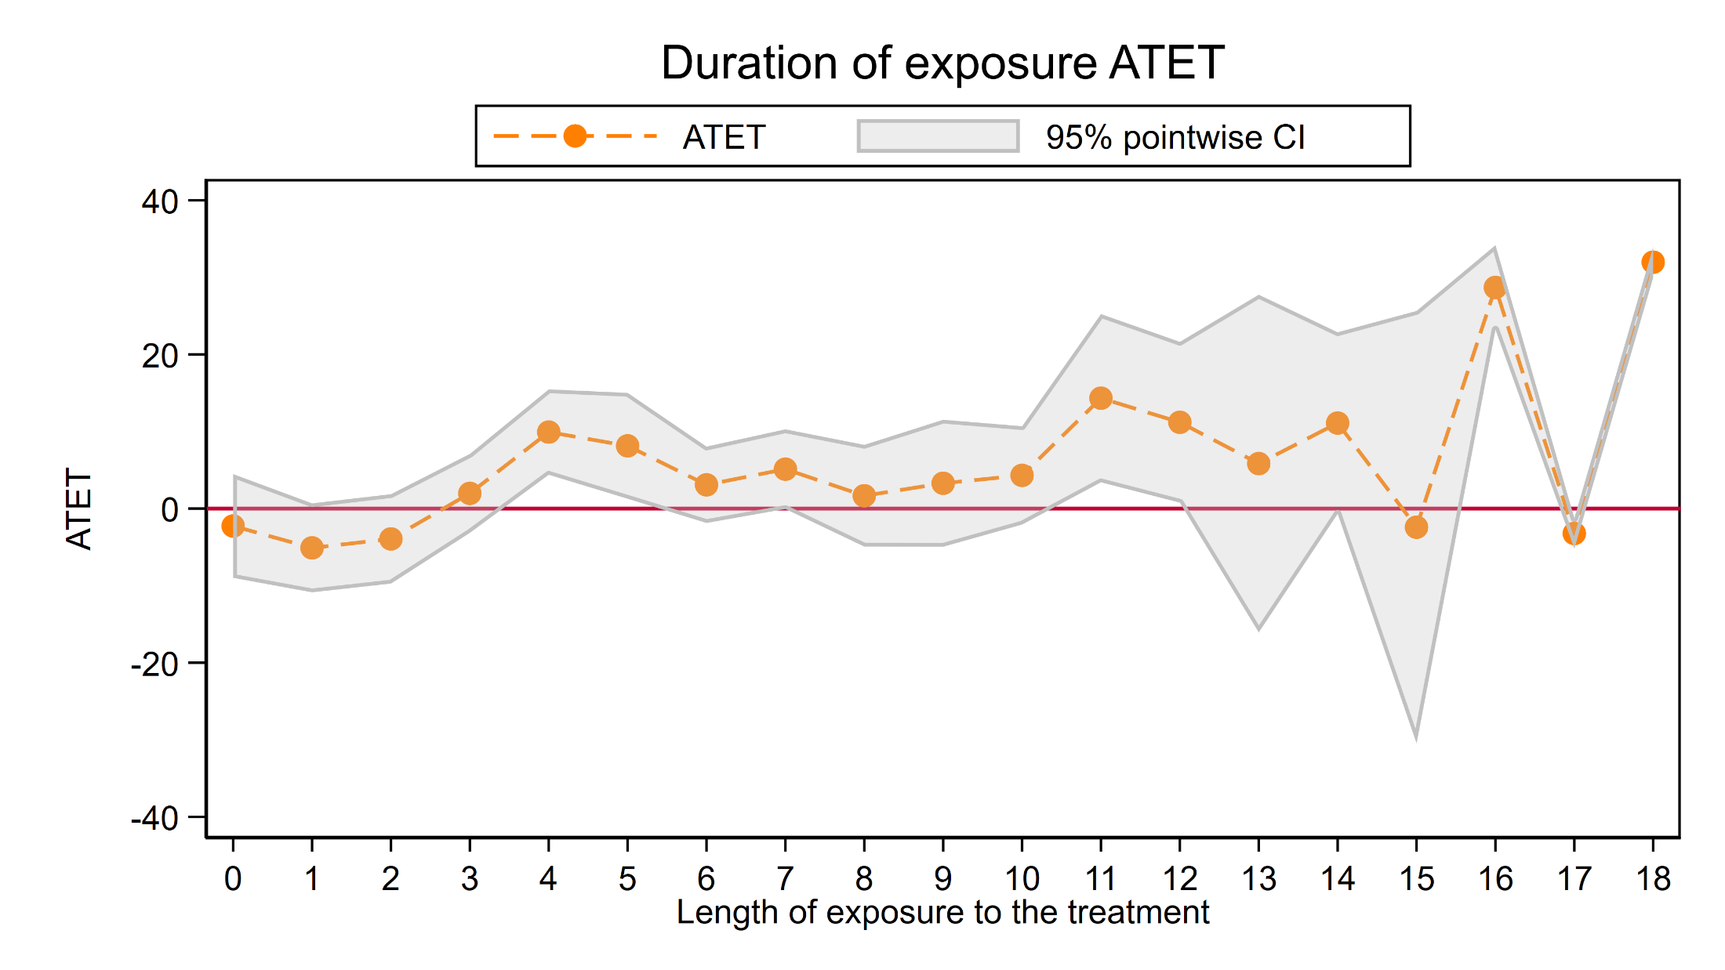
Heterogeneous DiD

Slide 73
Outline
The Question
An Intuitive Introduction
Two Period, Two Groups Model
Repeated Cross-Sectional Panel Data
Longitudinal Panel Data
Heterogeneous DiD
Panel Data Heterogeneous DiD
More information

Slide 74
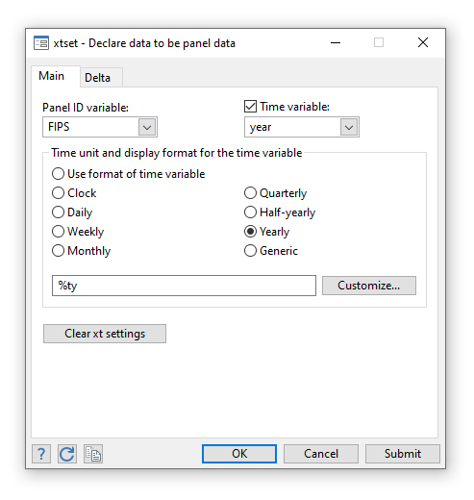
Panel Data Heterogeneous DiD

Slide 75
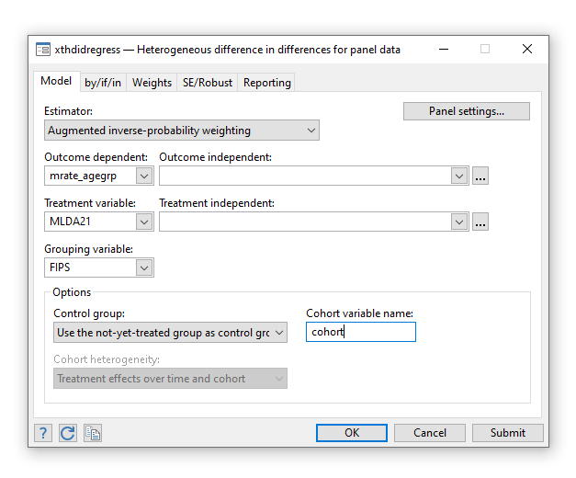
Panel Data Heterogeneous DiD

Slide 76
Panel Data Heterogeneous DiD
xtset panelvar timevar
xthdidregress aipw ///
(outcomevar [outcome covariates]) ///
(treatmentvar [treament covariates]) ///
, group(groupvar)

Slide 77
Panel Data Heterogeneous DiD
Lots more output not shown.

Slide 78
Panel Data Heterogeneous DiD

Slide 79
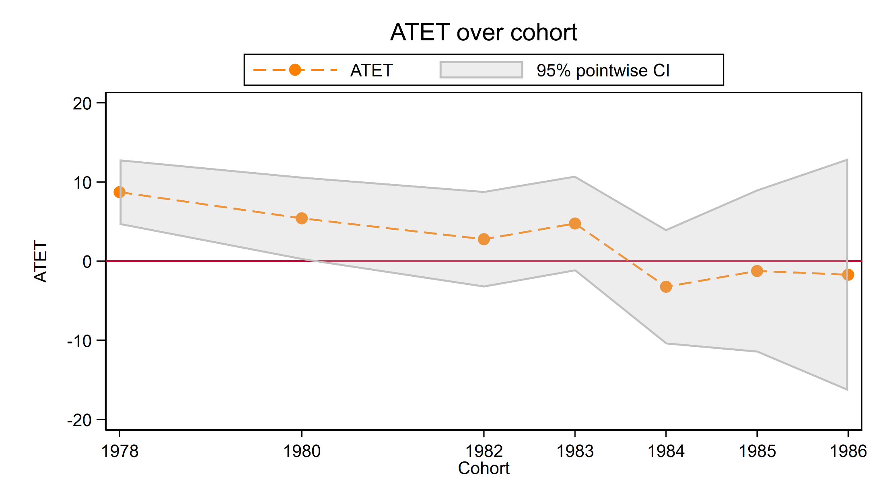
Panel Data Heterogeneous DiD

Slide 80
Panel Data Heterogeneous DiD

Slide 81
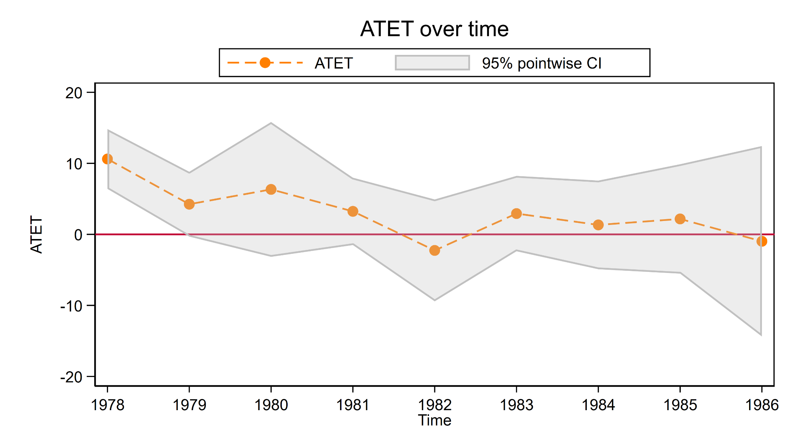
Panel Data Heterogeneous DiD

Slide 82
Panel Data Heterogeneous DiD

Slide 83
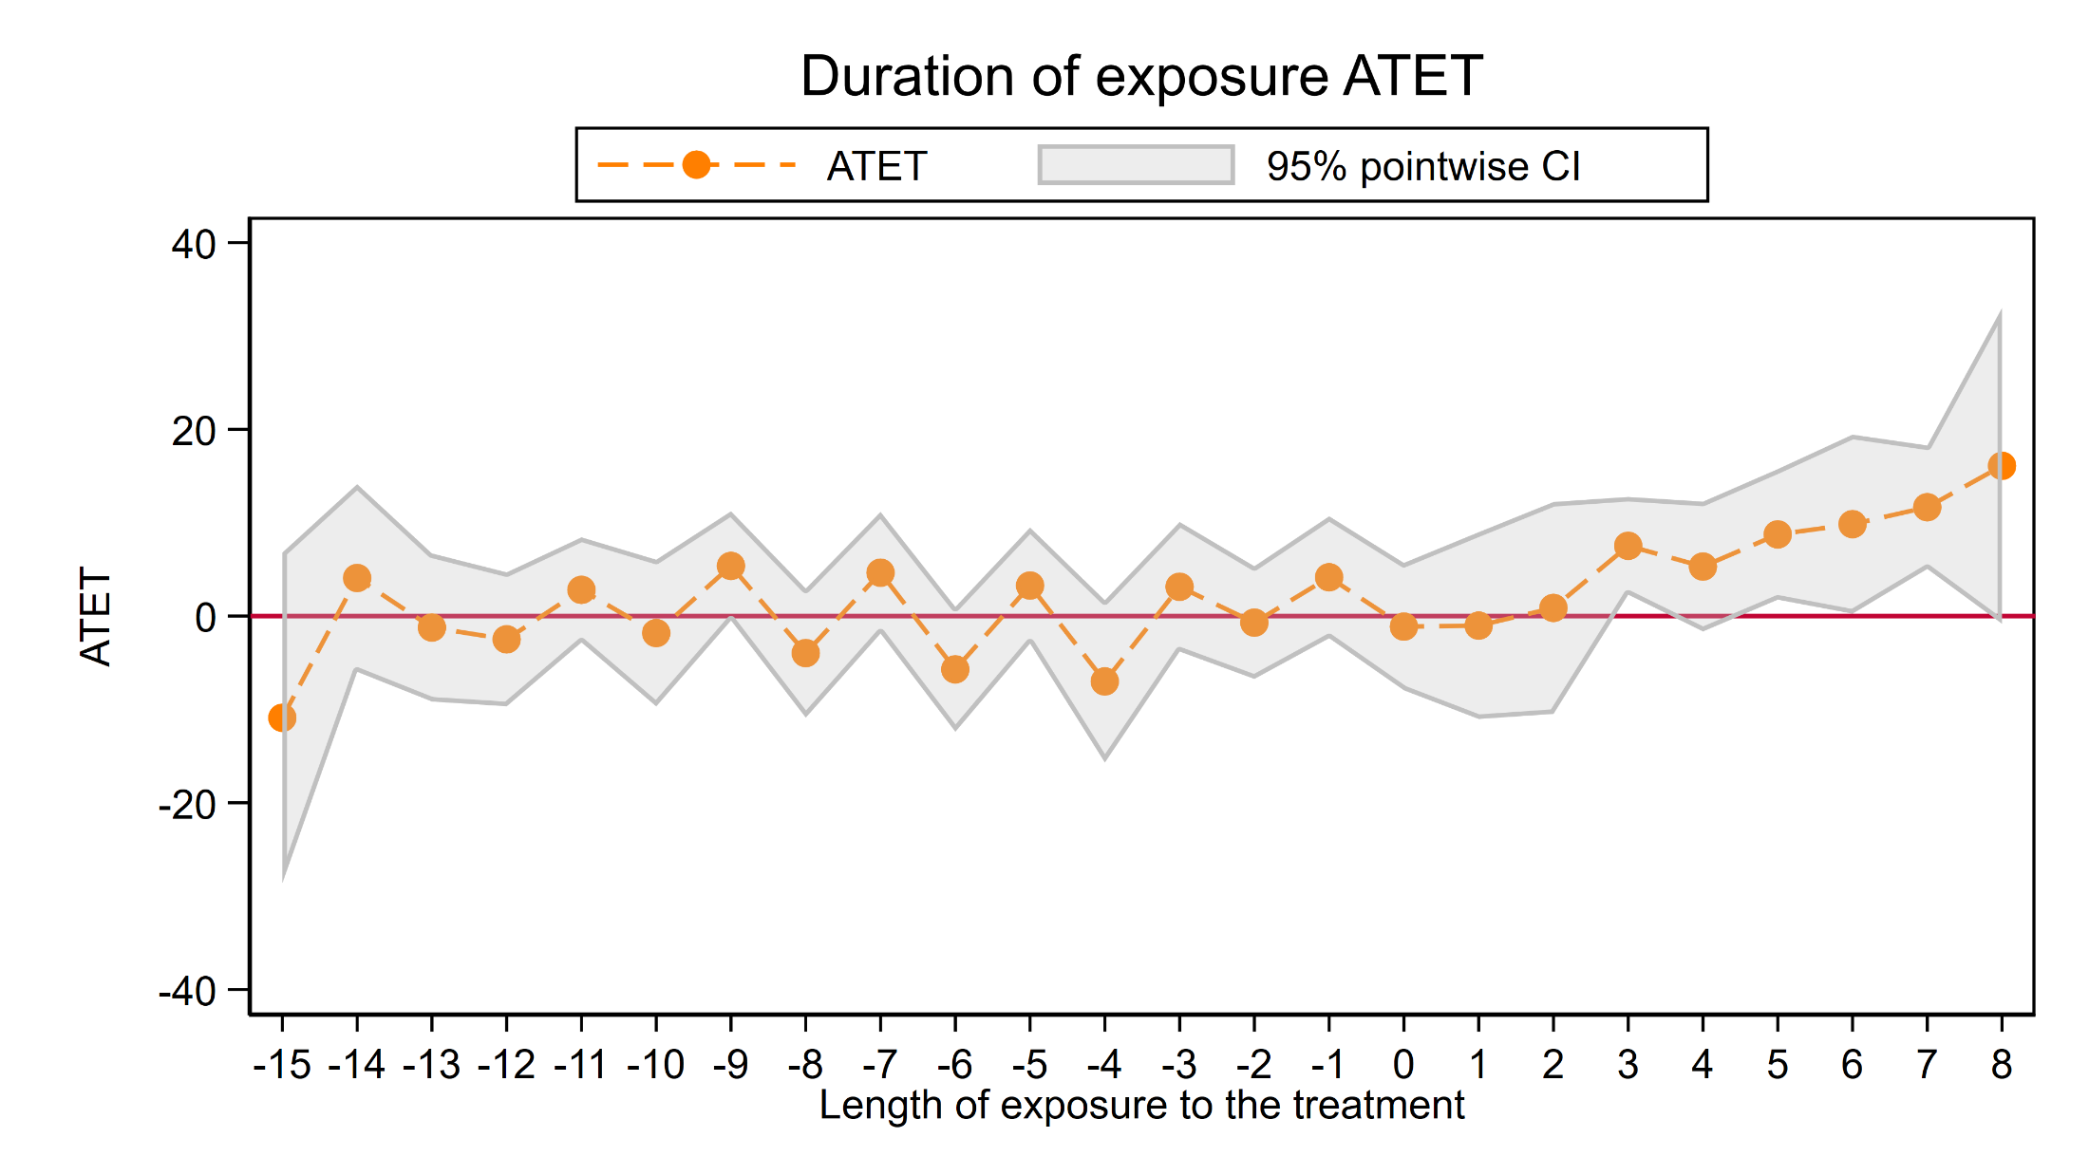
Panel Data Heterogeneous DiD

Slide 84
Panel Data Heterogeneous DiD
Estimators
  Two Way Fixed Effects (twfe)
  Regress Adjustment (ra)
  Inverse-Probability Weighting (ipw)
  Augmented Inverse-Probability Weighting (aipw)

Slide 85
Panel Data Heterogeneous DiD
Estimators (continued)
  If the model for the outcome is correctly specified, RA and TWFE are best, with TWFE being more efficient.
  If the treatment model is correctly specified, IPW should be best.
  AIPW models both treatment and outcome. If at least one of the models is correctly specified, it provides consistent estimates. Thus, it allows us to misspecify one of the models and still get consistent estimates, a property called double robustness.

Slide 86
Panel Data Heterogeneous DiD
Type of Heterogeneity (hettype(hetspec))
  Time and Cohort (timecohort)
  Cohort (cohort)
  Time (time)
Control Group (controlgroup(cgtype))
  Never Treated (never)
  Not-yet Treated (notyet)

Slide 87
Outline
The Question
An Intuitive Introduction
Two Period, Two Groups Model
Repeated Cross-Sectional Panel Data
Longitudinal Panel Data
Heterogeneous DiD
Panel Data Heterogeneous DiD
More information

Slide 88
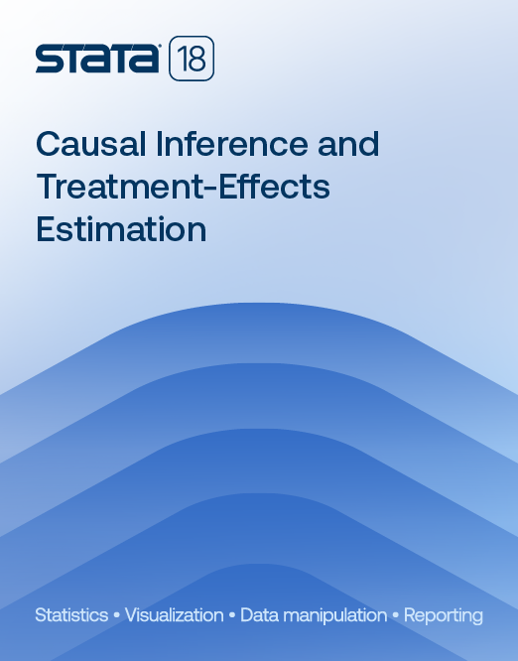

Read The Fine Manuals!
didregress
https://www.stata.com/manuals/te.pdf
xtdidregress
https://www.stata.com/manuals/xt.pdf

Slide 89
Read The Fine Manuals!
hdidregress
https://www.stata.com/manuals/causalhdidregress.pdf
xthdidregress
https://www.stata.com/manuals/causalxthdidregress.pdf

Slide 90
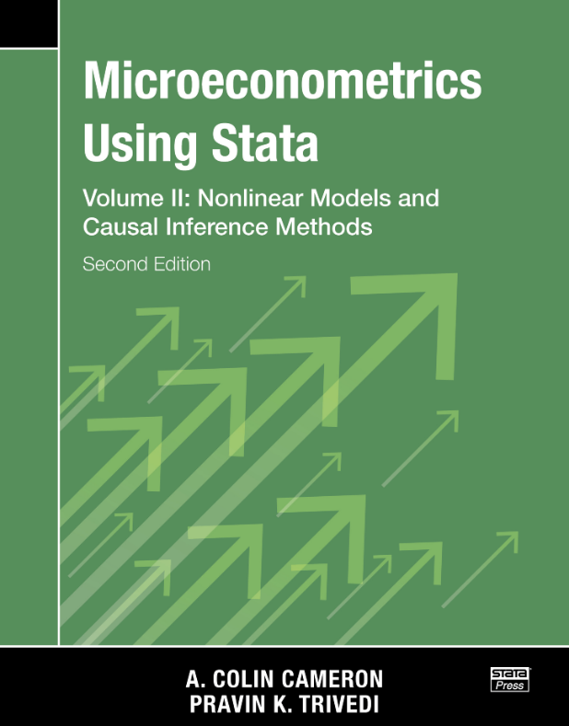


More Information

Slide 91
More Information
US National Highway Traffic Safety Administration Information
Miron and Tetelbaum, 2009
Callaway, B., and P. H. C. Sant’Anna. 2021. Difference-in-differences with multiple time periods. Journal of Econometrics 225: 200–230.
Wooldridge, J. M. 2021. Two-way fixed effects, the two-way Mundlak regression, and difference-in-differences estimators. Working paper, Department of Economics, Michigan State University, East Lansing, MI

Slide 92
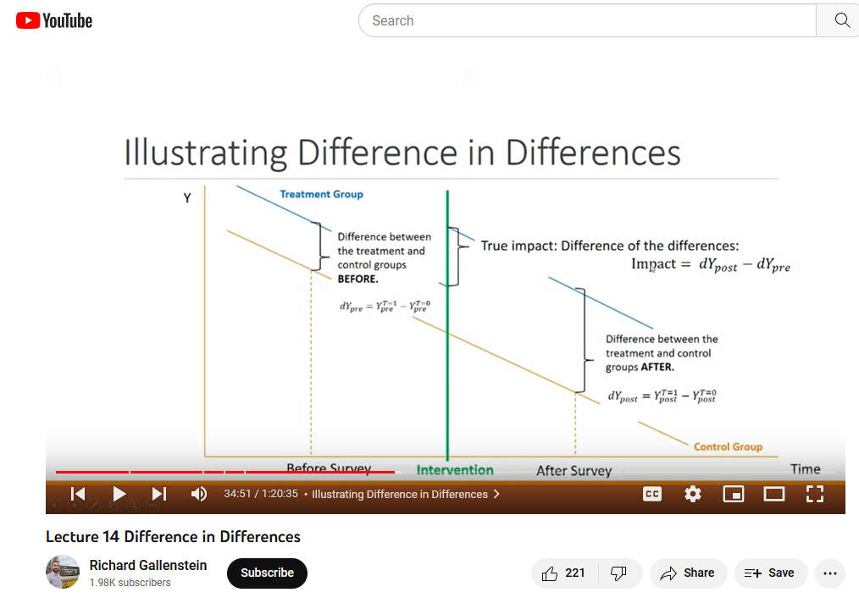
More Information
Richard Gallenstein’s YouTube video about DiD
https://www.youtube.com/watch?v=rrgxR97QBpc

Slide 93
Thank you!
Questions?
You can download the slides, datasets, and do-files here:
https://tinyurl.com/StataDID
You can contact me anytime at chuber@stata.com

