Slide 1




Topic: Stata’s Capabilities For Frontier Efficiency Assessment
Abstract :
The development of a comprehensive suite of packages and commands within Stata has empowered researchers to conduct frontier efficiency and productivity assessments effectively.
Presented By
Dr. Rachita Gulati
Associate Professor (Economics), Department of Humanities and Social Sciences
Indian Institute of Technology Roorkee Uttarakhand, India

Slide 2
Points to Discuss
Nonparametric approaches (DEA, FDH) Parametric approaches (SFA, TFA, RTFA) Technical efficiency (TE)
Radial vs. Non-radial TE measures
Orientations in DEA(Input and Output Orientations)
Returns-to-Scale Assumptions
Efficiency Measurement Approaches
Productivity Estimation and Decomposition
Malmquist Productivity Index (MPI)
Malmquist Luenberger Productivity Index (MLPI)

Slide 3
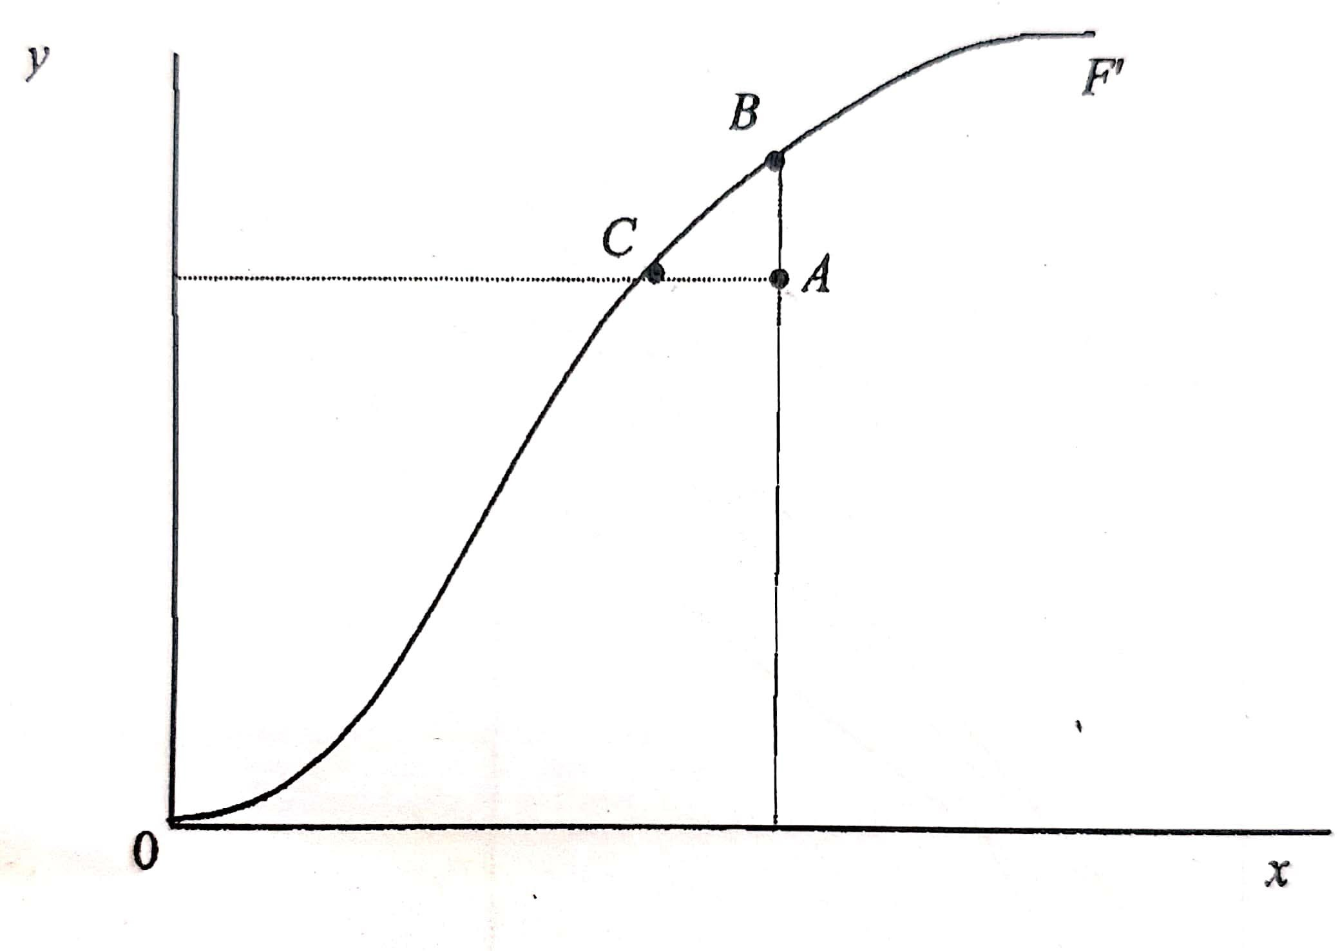
Production technology
Inputs:
x = (x₁, x₂ ,..., x_{m} )
Output:
y = ( y₁, y₂ ,..., y_{s} )
Feasible production plan, if y can be produced from x
T = {( x, y ) : y can be produced from x}
Single-input and single-output case
Orientations in efficiency measurement Input-oriented Output-oriented

Slide 4
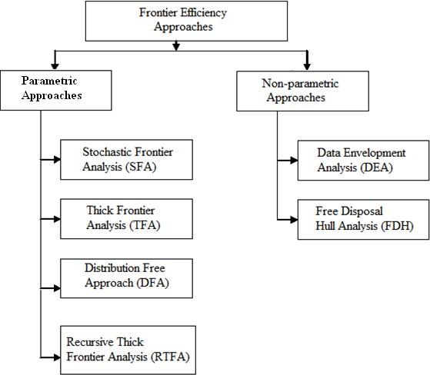
Two popular approaches
Here, we are trying to assess Stata’s capabilities in efficiency and productivity estimation using these two popular approaches.

Slide 5
Efficiency and Productivity Models
Technical Efficiency Models DEA-based
  Charnes, Cooper, Rhodes (CCR) (1978) Model
  Banker, Charnes, Cooper (BCC) (1984) Model
  Slacks and RTS-based Estimation
  Directional Distance Function (DDF) Model (Radial and Nonradial) (Chung et al., 1997)
SFA-based
  Stevenson (1980) Model
  Meeusen and Van den Broeck (MB) (1977)
  Aigner et al. (1977) Model
Productivity Change Models
  Malmquist Productivity Index (MPI)
  Malmquist Luenberger Productivity Index (MLPI)

Slide 6
Efficiency vs. Productivity
Decision making units (DMUs) are used to describe the production entity responsible for turning inputs into outputs in instances when the firm may not be entirely appropriate, like power plants, schools, banks, states or countries, etc.
j = 1, 2,..., n
Productivity is a ratio of output to input Productivity= output/input
Efficiency is a relative concept
Efficiency= productivity/maximum productivity

Slide 7
Data Envelopment Analysis (DEA)
DEA is a data-oriented and non-parametric based frontier approach
  First originated by Charnes, Cooper and Rhodes (CCR) (1978)
Charnes, A., Cooper, W.W., and Rhodes, E. (1978), “Measuring efficiency of decision making units”, European Journal of Operational Research, 2, 429-444.
CCR generalized Farrell’s (1957) radial measure of technical efficiency to multiple input, multiple-output cases.
Farrell, M. J., (1957), “The measurement of productive efficiency”, Journal of the Royal Statistical Society, Series A, Vol.120, No. 3, pp. 253-290.
DEA is a non-parametric, frontier-based approach for measurement of efficiency and productivity.

Slide 8
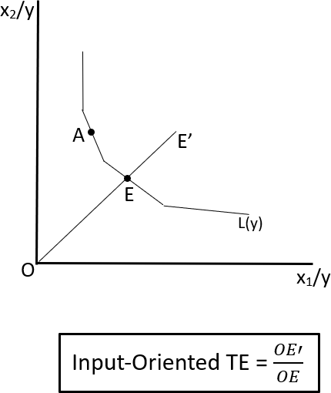
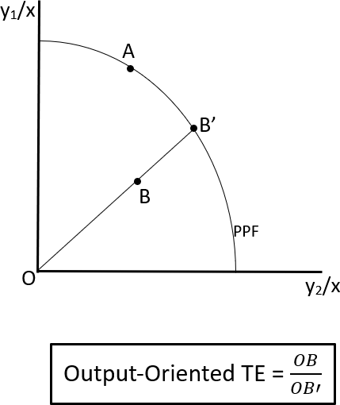
I. Charnes, Cooper and Rhodes (CCR) (1978)
CCR gives information on the technical efficiency (TE) of a unit using Shephard’s distance function
Assumptions:
  Constant Returns to Scale
  Strong disposability of inputs and outputs
  Convexity of Production Possibility Set
Two distinct variants of the CCR model-
Input-oriented CCR (CCR-I
Output-Oriented CCR (CCR-O)

Slide 9
CCR Model
Consider n production units (j=1,…..,n)
x vector of inputs (where x_{ij} is quantity of i_{th} input (i=1,….m)
y vector of outputs (where y_{rj} is the quantity of r_{th} output (r=1,….,s).
Input-Oriented CCR Model | Output-Oriented CCR Model
_{𝜃𝜃}∗𝐶𝐶𝑅 _{= min 𝜃𝜃}𝐶𝐶𝑅 ^{𝑜} 𝜆𝜆,𝜃𝜃 ^{𝑜} 𝑛 � 𝜆_{𝑗𝑗} 𝑥_{𝑖𝑖𝑗𝑗} ≤ 𝜃𝜃^{𝐶𝐶𝑅} 𝑥 𝑖𝑖 = 1, … . 𝑚 𝑜 𝑖𝑖𝑜 𝑗𝑗=1 𝑛 � 𝜆_{𝑗𝑗} 𝑦_{𝑟𝑗𝑗} ≥ 𝑦_{𝑟𝑜} 𝑟 = 1, … . 𝑠 𝑗𝑗=1 𝜆_{𝑗𝑗} ≥ 0 𝑗𝑗 = 1, … . 𝑛 𝜃𝜃^{∗𝐶𝐶𝑅} measures the input-oriented TE of 𝑜 production unit ‘o’ | _{𝜙𝜙}∗𝐶𝐶𝑅 _{= max 𝜙𝜙}𝐶𝐶𝑅 ^{𝑜} 𝜆𝜆,𝜙𝜙 ^{𝑜} 𝑛 � 𝜆_{𝑗𝑗} 𝑥_{𝑖𝑖𝑗𝑗} ≤ 𝑥_{𝑖𝑖𝑜} 𝑖𝑖 = 1, … . 𝑚 𝑗𝑗=1 𝑛 � 𝜆_{𝑗𝑗} 𝑦_{𝑟𝑗𝑗} ≥ 𝜙𝜙^{𝐶𝐶𝑅}𝑦 𝑟 = 1, … . 𝑠 𝑜 𝑟𝑜 𝑗𝑗=1 𝜆_{𝑗𝑗} ≥ 0 𝑗𝑗 = 1, … . 𝑛 𝜙𝜙^{∗𝐶𝐶𝑅} measures the output-oriented TE of 𝑜 production unit ‘o’
Maximum possible (radial) contraction in inputs

Slide 10
Software/Package/P rogramme | Frontier Methods | Reference
DEAP | DEA | Coelli (1996)
DEAFrontier | DEA | Zhu (2014)
Matlab | DEA | DEA Toolbox
R | DEA and SFA | additiveDEA (Soteriades, 2017); Benchmarking (Bogetoft and Otto, 2010, 2015); FEAR (Wilson, 2014); Frontier- Frontiles (Daouia and Laurent, 2015); Nonparaeff (Oh and Suh, 2013); npsf (Badunenko et al., 2017); Productivity (Dakpo et al., 2016); semsfa (Ferrara and Vidoli, 2015); SFA (Straub, 2015); spfrontier (Pavlyuk, 2016); SSFA (Fusco and Vidoli, 2015); TFDEA (Shott and Lim, 2015); rDEA (Simm and Besstremyannaya, 2016); DJL (Lim, 2016).
Stata | DEA and SFA | frontier, xtfrontier Kumbhakar and Wang (2015) Tauchmann (2012) Stata Packages: - DEA (Ji and Lee, 2010); SFA (Kumbhakar et al., 2015); sfcross (Belotti et al., 2013); sfpanel (Belotti et al., 2013); tenonradial, teradial, teradialbc, nptestind, and nptestrts; (Badunenko and Mozharovskyi, 2016);
Additional Software/Packages: Python, GAMS, SAS, DEAExcel, DEA-Solver-Pro, MaxDEA, DPIN, TFPIP, Frontier, LIMDEP, Inverse DEA, PIM Soft Source: Adapted from Daraio et al. (2019)

Slide 11
CCR Model: Application in Stata
Technical information:
Stata 11.2 and above installation required (Badunenko and Mozharovskyi, 2016))
Badunenko, O., and Mozharovskyi, P. (2016). Nonparametric frontier analysis using Stata. Stata Journal, 16(3), 550–589.
Syntax
teradial outputs = inputs (ref outputs = ref inputs) if in, rts (rtsassumption) base (basetype) ref(varname) tename(newvar) noprint
Specification
outputs = list of output variables inputs = list of input variables
rts (rtsassumption) = specifies the returns to scale assumption. Use rts(crs) for CRS, rts(nirs) for NIRS and rts(vrs)for VRS
base (basetype) = specifies the type of optimization. Use base(output)for output- oriented measure and base(input) for input-oriented measure
tename(newvar) = creates newvar containing the radial measures of technical efficiency

Slide 12
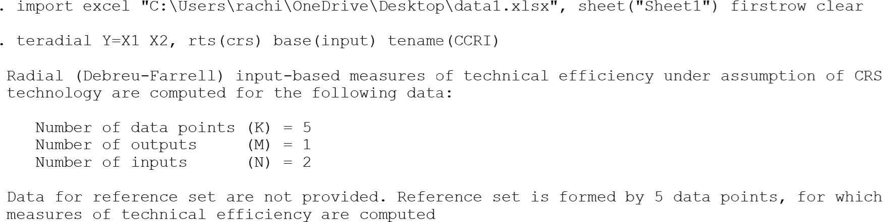
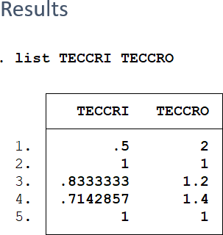
Contd…
Syntax for CCRI and CCRO
teradial outputs = inputs (ref outputs = ref inputs), rts (rtsassumption) base (basetype) tename(newvar)
. teradial Y=X1 X2, rts(crs) base(output) tename(CCRO)
Hypothetical Sample Data
X1 | X2 | Y
2 | 5 | 1
2 | 4 | 2
6 | 6 | 3
3 | 2 | 1
6 | 2 | 2

Slide 13
II. Banker, Charnes and Cooper (BCC) (1984) Model
Banker et al. (1984) as an extension of the CCR Model.
Based on the variable returns to scale
  Banker, R. D., Charnes, A., & Cooper, W. W. (1984). Some Models for Estimating Technical and Scale Inefficiencies in Data Envelopment Analysis. Management Science, 30(9), 1078– 1092.
Two variants: BCC-I and BCC-O
Input-Oriented BCC Model | Output-Oriented BCC Model
_{𝜃𝜃}∗𝐵𝐶𝐶 _{= min 𝜃𝜃}𝐵𝐶𝐶 ^{𝑜} 𝜆𝜆,𝜃𝜃 ^{𝑜} n � λ_{j}𝑥_{ij} ≤ 𝜃𝜃^{BCC} 𝑥 i = 1, … . m o io j=1 n � λ_{j}𝑦_{rj} ≥ 𝑦_{ro} r = 1, … . s j=1 𝑛 � 𝜆_{𝑗𝑗} = 1 𝑗𝑗 = 1, … . 𝑛 𝑗𝑗=1 λ_{j} ≥ 0 30/11/2023 India Stata User Meetin | _{𝜙𝜙}∗𝐵𝐶𝐶 _{= max 𝜙𝜙}𝐵𝐶𝐶 ^{𝑜} 𝜆𝜆,𝜙𝜙 ^{𝑜} n � λ_{j}𝑥_{ij} ≤ 𝑥_{io} i = 1, … . m
 | j=1 | Con | vexity
 | n � λ_{j}𝑦_{rj} ≥ 𝜙𝜙^{BCC}𝑦 r = 1, … . s o ro j=1 𝑛 � 𝜆_{𝑗𝑗} = 1 𝑗𝑗 = 1, … . 𝑛 𝑗𝑗=1 λ_{j} ≥ 0 g 2023_Rachita Gulati 13

Slide 14
BCC Model: Application in Stata
Syntax
teradial outputs = inputs (ref outputs = ref inputs) if in , rts (rtsassumption) base (basetype) ref(varname) tename(newvar) noprint
Here, specify ‘vrs’ in rts()
Specification
outputs = list of output variables inputs = list of input variables
rts (rtsassumption) = specifies the returns to scale assumption. Use rts(crs) for CRS, rts(nirs) for NIRS and rts(vrs)for VRS
base (basetype) = specifies the type of optimization. Use base(output)for output-
oriented measure and base(input) for input-oriented measure tename(newvar) = creates newvar containing the radial measures of technical efficiency

Slide 15
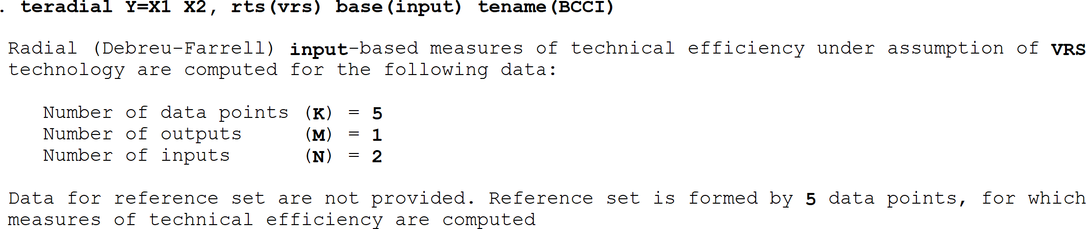
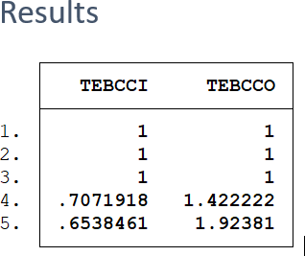
BCC Model: Application in Stata
. teradial Y=X1 X2, rts(vrs) base(output) tename(BCCO)
Hypothetical Sample Data
X1 | X2 | Y
4 | 9 | 10
7 | 3 | 8
12 | 8 | 16
10 | 6 | 9
9 | 8 | 7

Slide 16
Computation of slacks and RTS properties
θ * = θ
min (Objective)
o
θ ,λ ,s⁻ ,s⁺
j
subject to
∑λ_{j} x_{ij} + s⁻ = θ x_{io}
j =1
∑λ_{j} y_{rj} − s⁺ = y_{ro}
j =1
s⁻ , s⁺ , λ_{j} ≥ 0
n
i = 1, 2,..., m;
(Input)
n
r = 1, 2,..., s;
(Output)
j = 1, 2,..., n
(Non-negativity)

Slide 17
dea: command
Alternative command, to obtain efficiency and slacks
Ji, Yong-Bae and Choonjoo Lee (2010), “Data envelopment analysis”, Stata Journal 10(2): 267- 280.
st0193.pkg
dea ivars = ovars [if] [in] [, rts(crs | vrs | drs | nirs) ort(in | out) stage(1 | 2) trace saving(filename)]
where the options are:
rts(crs|vrs|drs|nirs) specifies the returns to scale. The default is rts(crs)
ort(in|out) specifies the orientation. The default is ort(in)
stage(1|2) specifies the way to identify all efficiency slacks. The default is stage(2) trace save all sequences and results from Results window to dea.log saving(filename) save results to filename.

Slide 18
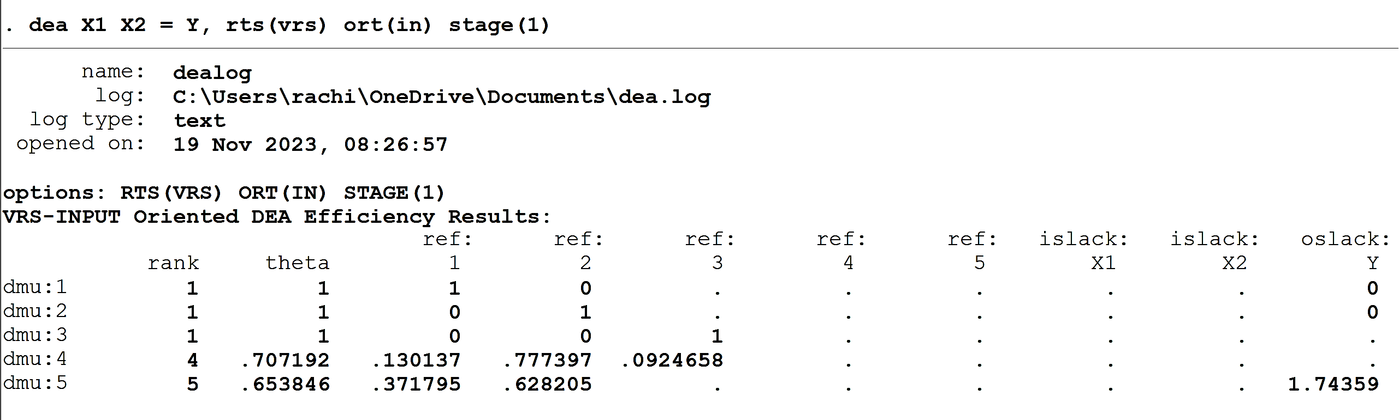
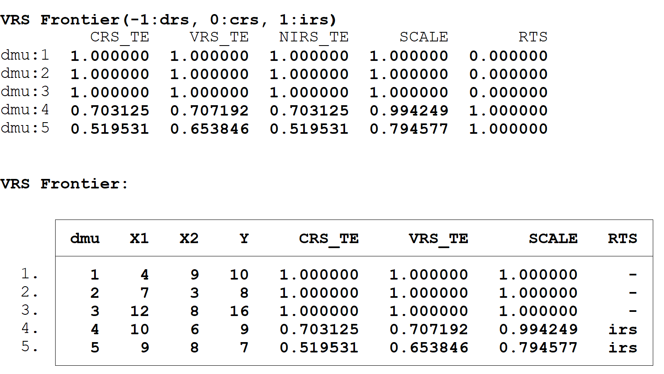
dea: command
dmu | X1 | X2 | Y
1 | 4 | 9 | 10
2 | 7 | 3 | 8
3 | 12 | 8 | 16
4 | 10 | 6 | 9
5 | 9 | 8 | 7

Slide 19
III. Directional Distance Function (DDF)
Chung et al. (1997) developed this model
Simultaneous adjustment of undesirable inputs and outputs along with the desirable inputs and outputs.
  Chung, Y. H., Fare, R., & Grosskopf, S. (1997). Productivity and undesirable outputs: a directional distance function approach. Journal of Environmental Management, 51, 229– 240.
Weak disposability of undesirable output.
Radial DDF Model
𝐷 𝑥, 𝑦, 𝑏, −𝑔_{𝑥}, 𝑔_{𝑦}, −𝑔_{𝑏} = 𝑚𝑎𝑥 𝛽 𝛽,𝜆𝜆 𝑛 � 𝜆_{𝑗𝑗} 𝑥_{𝑖𝑖𝑗𝑗} ≤ 𝑥_{𝑖𝑖𝑜} − 𝛽_{𝑜}𝑔_{𝑥} 𝑖𝑖 = 1, … … 𝑀 𝑗𝑗=1 𝑛 � 𝜆_{𝑗𝑗} 𝑦_{𝑟𝑗𝑗} ≥ 𝑦_{𝑟𝑜} + 𝛽_{𝑜}𝑔_{𝑦} 𝑟 = 1, … … 𝑆 𝑗𝑗=1 𝑛 � 𝜆_{𝑗𝑗} 𝑏_{𝑙𝑗𝑗} = 𝑏_{𝑙𝑜} − 𝛽_{𝑜}𝑔_{𝑏} 𝑙 = 1, … … 𝐿 𝑗𝑗=1 𝜆_{𝑗𝑗} ≥ 0 𝑗𝑗 = 1, … … … . . , 𝑛 | where ‘b’ is undesirable output, ‘o’ is the unit under consideration and (−𝑔_{𝑥}, 𝑔_{𝑦}, −𝑔_{𝑏}) is the directional vector.

Slide 20
DDF-DEA model: Application in Stata
Technical information: st0665.pkg, Available for Stata 16 and above installation required (Wang et al., 2022)
Wang, D., Du, K., & Zhang, N. (2022). Measuring technical efficiency and total factor productivity change with undesirable outputs in Stata. Stata Journal, 22(1), 103–124.
Syntax teddf: Directional distance function (DDF) with undesirable outputs for efficiency measurement teddf inputvars = desirable_outputvars: undesirable_outputvars [ if ] [ in ], dmu(varname) time (varname) gx (varlist) gy (varlist) gb (varlist) nonradial wmat (name) vrs rf (varname) window(#) biennial sequential global […other options] Specification
Inputvars = inputs data | (gx,gy,gb) = directional vector for input, good and bad output
desirable_outputvars = good output data | vrs = specify if variable returns required
undesirable_outputvars = Undesirable output data | reference technology options = bi, seq, glo
dmu = specifies name of DMUs | non-radial options = nonr, wmat

Slide 21
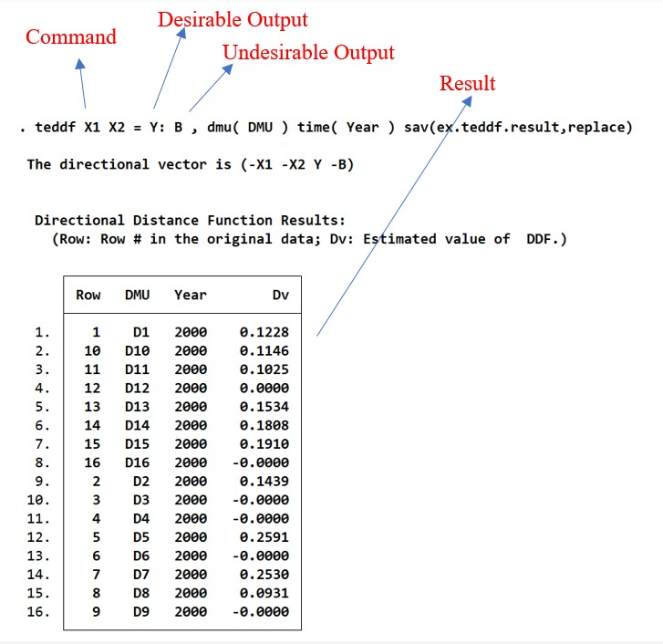
DDF-DEA Model: Application in Stata
DMU | X1 | X2 | Y | B | teddf X1 X2=Y:B,dmu(DMU) saving(ddf_result, replace)
D1 | 327 | 67 | 1097 | 1678
D2 | 521 | 98 | 1995 | 989
D3 | 227 | 105 | 1517 | 303
D4 | 1333 | 425 | 2817 | 21733
D5 | 1113 | 162 | 3124 | 1565
D6 | 530 | 111 | 2844 | 1009
D7 | 1104 | 194 | 3248 | 2221
D8 | 751 | 94 | 2404 | 2655
D9 | 164 | 66 | 1068 | 212
D10 | 669 | 210 | 2463 | 4470
D11 | 749 | 119 | 2976 | 1163
D12 | 1638 | 336 | 2103 | 18807
D13 | 208 | 83 | 915 | 652
D14 | 342 | 117 | 1245 | 1679
D15 | 354 | 81 | 1270 | 411
D16 | 482 | 6 | 1710 | 148

Slide 22
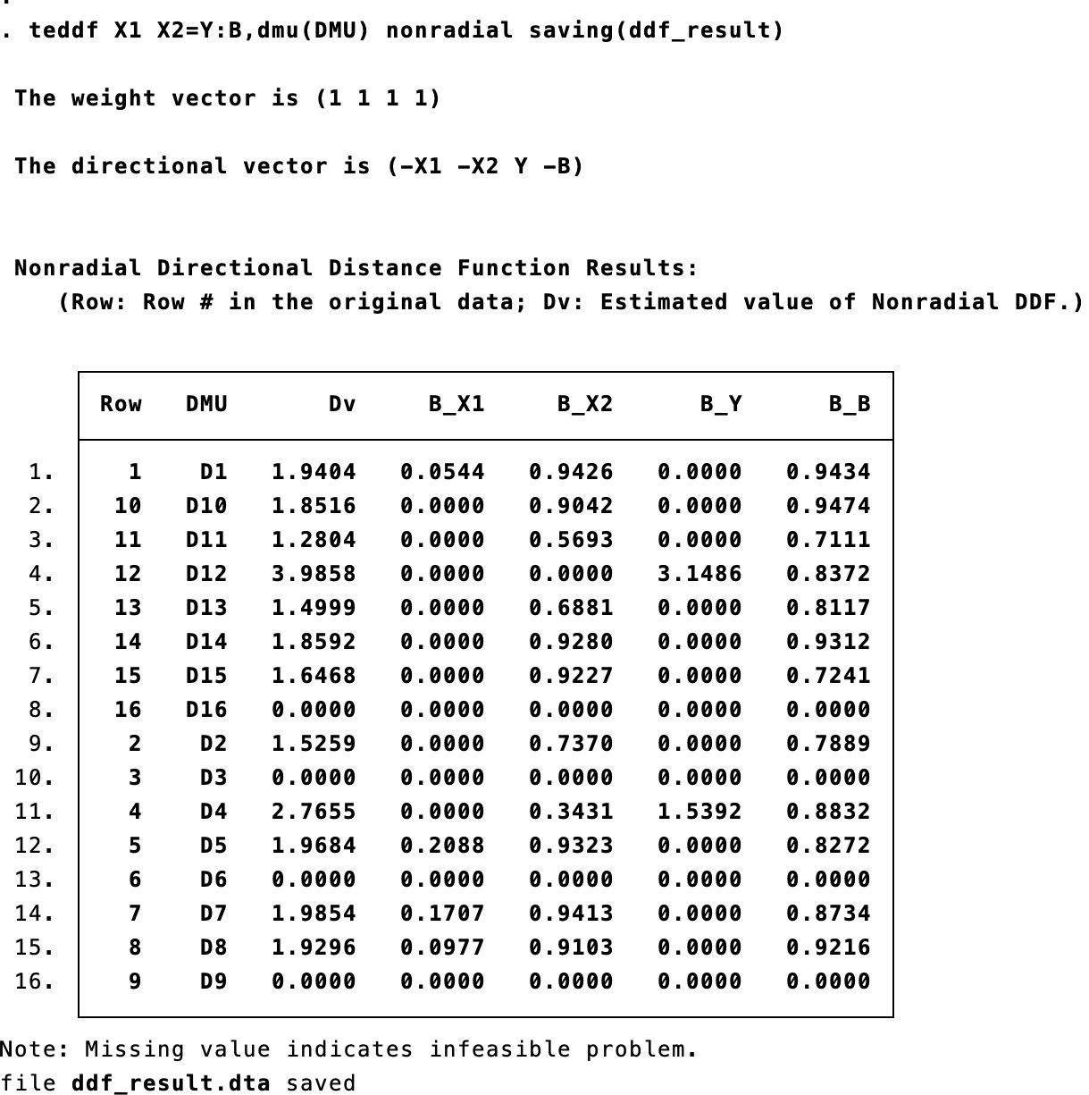
IV. Alternative variants: Non-radial DDF
Non-radial DDF with undesirables (Y2)(directional vector is (-X1 -X2 -X3 -X4 Y1 -Y2) and weight vector is (1 1 1 1 1 1))
teddf X1 X2=Y:B,dmu(DMU) time(Year) nonradial saving(ddf_result)
teddf X1 X2=Y:B, dmu(DMU) nonradial vrs saving(ddf_result, replace)
teddf X1 X2=Y:B, dmu(DMU) time(t) nonradial sequential saving(ddf_result,replace)

Slide 23
V. Malmquist Productivity Index
First proposed in Caves et al. (1982) and later modified by Fare et al.(1992) , Fare et al.(1994) and Ray & Desli (1997)
Based on Shephard’s distance function
It provides a decomposition of productivity change into its sources, i.e.; efficiency change and technology change
Assumption: Standard assumptions of DEA and Constant returns to scale
𝑑^{𝑡+1}(𝑦_{𝑡+1}, 𝑥_{𝑡+1}) 𝑑^{𝑡}(𝑦_{𝑡+1}, 𝑥_{𝑡+1})
𝑑^{𝑡}(𝑦_{𝑡}, 𝑥_{𝑡})
𝑀𝑃𝐼 =
_{𝑑}𝑡+1_{(𝑦}
∗
𝑑^{𝑡}(𝑦 , 𝑥 )
, 𝑥
𝑑^{𝑡+1}(𝑦 , 𝑥 )
𝑡 𝑡
𝑡+1 𝑡+1⁾
𝑡 𝑡
Efficiency Change
Technical Change

Slide 24
Malmquist Productivity Index
_{[𝑑}𝑡+𝑞 _{𝑥}𝑡+𝑝_{, 𝑦}𝑡+𝑝 ]−1_{= 𝑚𝑎𝑥𝜃𝜃,𝜆𝜆 𝜃𝜃} 𝑠𝑢𝑏𝑗𝑗𝑒𝑐𝑡 𝑡𝑜 𝑛 � 𝜆_{𝑗𝑗} 𝑦^{𝑡+𝑞} ≥ 𝜃𝜃𝑦^{𝑡+𝑝} 𝑟 = 1, … … 𝑆 𝑟𝑗𝑗 𝑟𝑜 𝑗𝑗=1 𝑛 � 𝜆_{𝑗𝑗} 𝑥^{𝑡+𝑞} ≤ 𝑥^{𝑡+𝑝} 𝑖𝑖 = 1, … … . 𝑀 𝑖𝑖𝑗𝑗 𝑖𝑖𝑜 𝑗𝑗=1 𝜆_{𝑗𝑗} ≥ 0 𝑗𝑗 = 1, … … … . . , 𝑛 | By (p pe f | alternatively, putting the values of , q), we can obtain the required own- riod and cross-period distance unctions as below: 𝑝, 𝑞 = (0,0) for solving 𝑑^{𝑡} 𝑦_{𝑡}, 𝑥_{𝑡} 𝑝, 𝑞 = (1,1) for solving 𝑑^{𝑡+1}(𝑦_{𝑡+1}, 𝑥_{𝑡+1}) 𝑝, 𝑞 = (0,1) for solving 𝑑^{𝑡+1}(𝑦_{𝑡}, 𝑥_{𝑡}) 𝑝, 𝑞 = (1,0) for solving ^{𝑑𝑡 𝑦}𝑡+1^{, 𝑥}𝑡+1

Slide 25
MPI and its Decomposition in STATA
Technical information: Available for Stata 16 and above (installation required - ssc install malmq2)
Syntax
malmq2 inputvars = outputvars [ if ] [ in ], ort(string) dmu(varname) window(#) biennial sequential global fgnz rd [..other options]
Specification
inputvars, outputvars = data for inputs and outputs
ort() = defines orientation, ort(output), ort(input), default is output dmu()= specifies DMU names
reference technology options = bi, seq, glo
decomposition =fgnz ((Fare et al., 1994)), rd ((Ray & Desli, 1997))

Slide 26
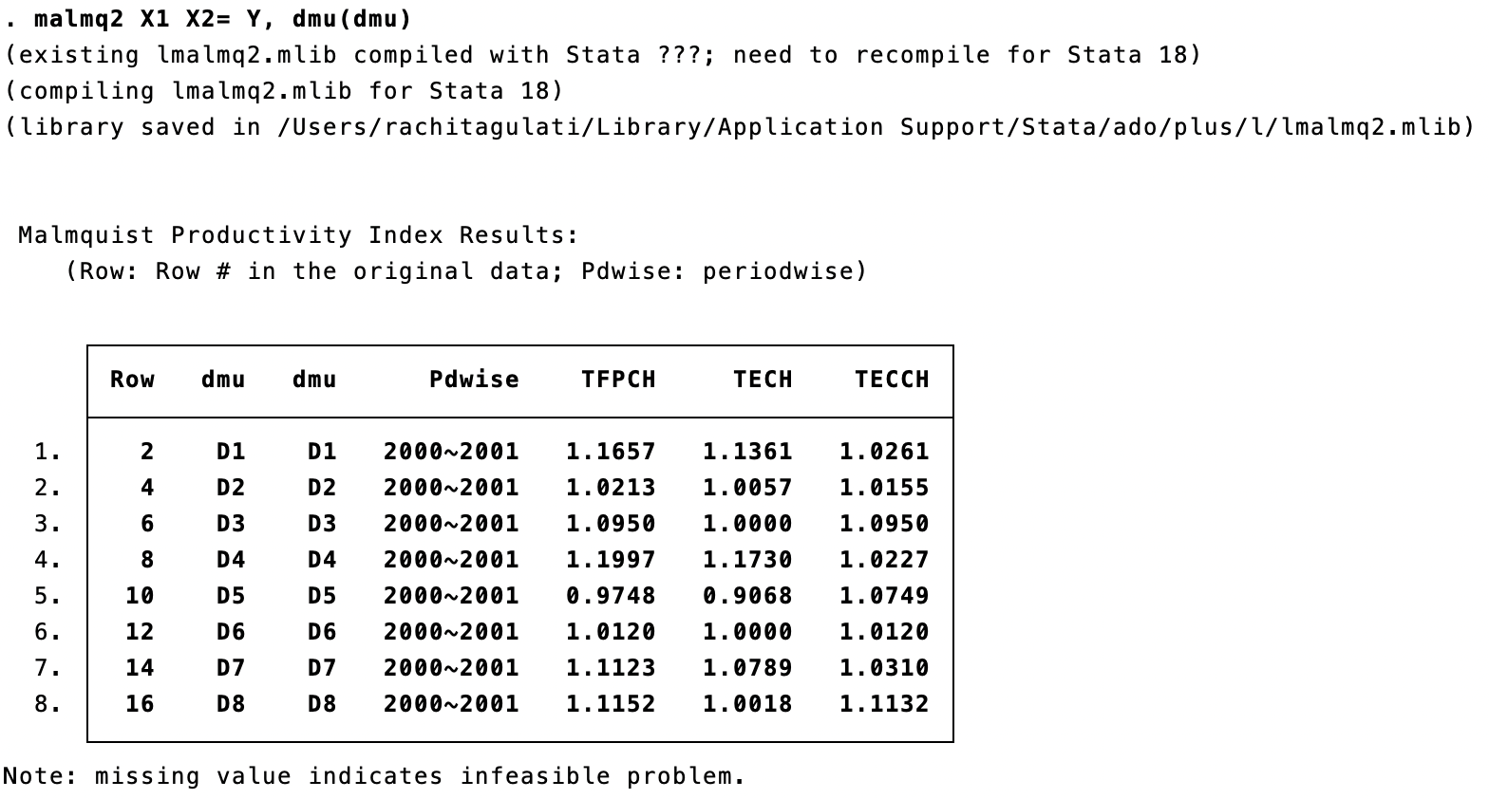
TFPCH using MPI: Application in Stata
Syntax
malmq2 inputvars = outputvars [ if ] [ in ], ort(string) dmu(varname) window(#) biennial sequential global fgnz rd [..other options]
DMU | Year | X1 | X2 | Y
D1 | 2000 | 327 | 67 | 1097
D2 | 2000 | 521 | 98 | 1995
D3 | 2000 | 227 | 105 | 1517
D4 | 2000 | 1333 | 425 | 2817
D5 | 2000 | 1113 | 162 | 3124
D6 | 2000 | 530 | 111 | 2844
D7 | 2000 | 1104 | 194 | 3248
D8 | 2000 | 751 | 94 | 2404
D1 | 2001 | 397 | 72 | 1403
D2 | 2001 | 499 | 105 | 2120
D3 | 2001 | 227 | 115 | 1698
D4 | 2001 | 1339 | 376 | 3261
D5 | 2001 | 1130 | 187 | 3476
D6 | 2001 | 605 | 119 | 3156
D7 | 2001 | 948 | 193 | 3520
D8 | 2001 | 746 | 96 | 2738
malmq2 X1 X2 = Y, dmu(dmu) global malmq2 X1 X2 = Y, dmu(dmu) seq ort(o) fgnz
malmq2 X1 X2 = Y, dmu(dmu) ort(o) rd sav(tfp_result,replace)

Slide 27
VI. Malmquist Luenberger Productivity Index (MLPI)
First proposed by Chung et al. (1997), MLPI allows to estimate productivity changes while accounting for generation of undesirable products (e.g., pollution) along with desirable products
  Chung, Y. H., Fare, R., & Grosskopf, S. (1997). Productivity and undesirable outputs: a directional distance function approach. Journal of Environmental Management, 51, 229–240.
Based on radial directional distance function (DDF)
Provides a decomposition of productivity change into its sources, i.e., efficiency change and technology change
Assumption: same as MPI, along with weak disposability of undesirable output
1+ 𝐷^{𝑡} 𝑥^{𝑡},𝑦^{𝑡},𝑏^{𝑡} 1+ 𝐷^{𝑡+1} 𝑥^{𝑡},𝑦^{𝑡},𝑏^{𝑡}
_{1+ 𝐷}𝑡+1 _{𝑥}𝑡+1_{,𝑦}𝑡+1_{,𝑏}𝑡+1
𝑀𝐿 =
∗
𝑡,𝑡+1
_{1+ 𝐷}𝑡+1 _{𝑥}𝑡+1_{,𝑦}𝑡+1_{,𝑏}𝑡+1
1+ 𝐷^{𝑡} 𝑥^{𝑡},𝑦^{𝑡},𝑏^{𝑡}
_{1+ 𝐷}𝑡 _{𝑥}𝑡+1_{,𝑦}𝑡+1_{,𝑏}𝑡+1
Efficiency
Change
Technical Change

Slide 28
Malmquist Luenberger Productivity Index
𝐷^{𝑡+𝑞} 𝑥^{𝑡+𝑝}, 𝑦^{𝑡+𝑝}, 𝑏^{𝑡+𝑝}, −𝑔_{𝑥}, 𝑔_{𝑦}, −𝑔_{𝑏} = 𝑚𝑎𝑥 𝛽 𝛽,𝜆𝜆 s. 𝑡. 𝑛 � 𝜆_{𝑗𝑗} 𝑥^{𝑡+𝑞} ≤ 𝑥^{𝑡+𝑝} − 𝛽_{𝑜}𝑥^{𝑡+𝑝} 𝑖𝑖 = 1, … … 𝑀 𝑖𝑖𝑗𝑗 𝑖𝑖𝑜 𝑖𝑖𝑜 𝑗𝑗=1 𝑛 � 𝜆_{𝑗𝑗} 𝑦^{𝑡+𝑞} ≥ 𝑦^{𝑡+𝑝} + 𝛽_{𝑜}𝑦^{𝑡+𝑝} 𝑟 = 1, … … 𝑆 𝑟𝑗𝑗 𝑟𝑜 𝑟𝑜 𝑗𝑗=1 𝑛 � 𝜆_{𝑗𝑗} 𝑏^{𝑡+𝑞} = 𝑏^{𝑡+𝑝} − 𝛽_{𝑜}𝑏^{𝑡+𝑝} 𝑙 = 1, … … 𝐿 𝑙𝑗𝑗 𝑙𝑜 𝑙𝑜 𝑗𝑗=1 𝜆_{𝑗𝑗} ≥ 0 𝑗𝑗 = 1, … … … . . , 𝑛 | The directional vector (−𝑔_{𝑥}, 𝑔_{𝑦}, −𝑔_{𝑏}) is taken as ( −𝑥_{𝑖𝑖𝑜}, 𝑦_{𝑟𝑜}, −𝑏_{𝑙𝑜}) . By alternatively, putting the values of (p, q), we can obtain the required own- period and cross-period DDFs as below: 𝑝, 𝑞 = (0,0) for solving 𝐷^{𝑡} 𝑥^{𝑡}, 𝑦^{𝑡}, 𝑏^{𝑡} 𝑝, 𝑞 = (1,1) for solving _{𝐷}𝑡+1 _{𝑥}𝑡+1_{, 𝑦}𝑡+1_{, 𝑏}𝑡+1 𝑝, 𝑞 = (0,1) for solving _{𝐷}𝑡+1 _{𝑥}𝑡_{, 𝑦}𝑡_{, 𝑏}𝑡 𝑝, 𝑞 = (1,0) for solving _{𝐷}𝑡 _{𝑥}𝑡+1_{, 𝑦}𝑡+1_{, 𝑏}𝑡+1

Slide 29
MLPI Model: Application in STATA
Technical information: Available for Stata 16 and above (installation required (Wang et al., 2022))
Syntax
gtfpch inputvars = desirable_outputvars: undesirable_outputvars [ if ] [ in ], dmu (varname) luenberger ort (string) gx (varlist) gy (varlist) gb (varlist) nonradial wmat (name) window(#) biennial sequential global fgnz rd […other options]
Specification: Same as for DDF model

Slide 30

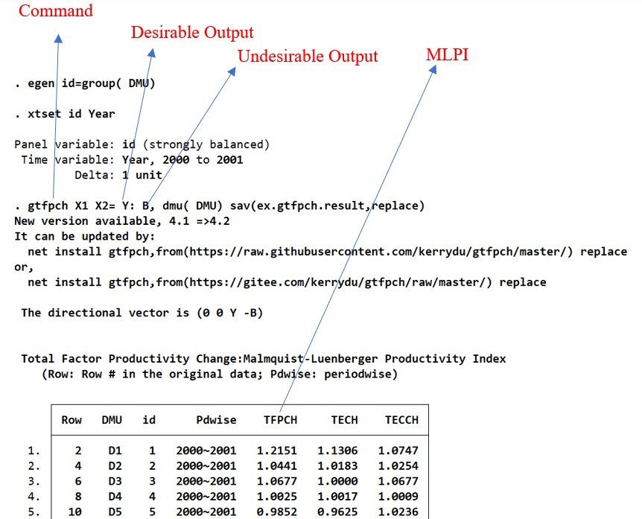
TFPCH using MLPI: Application in Stata
DMU | Year | X1 | X2 | Y | B
D1 | 2000 | 327 | 67 | 1097 | 1678
D2 | 2000 | 521 | 98 | 1995 | 989
D3 | 2000 | 227 | 105 | 1517 | 303
D4 | 2000 | 1333 | 425 | 2817 | 21733
D5 | 2000 | 1113 | 162 | 3124 | 1565
D6 | 2000 | 530 | 111 | 2844 | 1009
D7 | 2000 | 1104 | 194 | 3248 | 2221
D8 | 2000 | 751 | 94 | 2404 | 2655
D1 | 2001 | 397 | 72 | 1403 | 1813
D2 | 2001 | 499 | 105 | 2120 | 917
D3 | 2001 | 227 | 115 | 1698 | 337
D4 | 2001 | 1339 | 376 | 3261 | 27987
D5 | 2001 | 1130 | 187 | 3476 | 1784
D6 | 2001 | 605 | 119 | 3156 | 1054
D7 | 2001 | 948 | 193 | 3520 | 2486
D8 | 2001 | 746 | 96 | 2738 | 3073
gtfpch X1 X2 = Y:B, dmu(dmu) nonradial saving(ddf_result)
gtfpch X1 X2 = Y:B, dmu(dmu) seqential ort(input) leunberger saving(ddf_result, replace)

Slide 31
Parametric Approaches to Frontier Analysis
Stochastic Frontier Models
Cross-Sectional Models
Panel Data Models
Aigner et al. (1977) Model
Panel Data Time- invariant Models
Panel Data Time Variant Models
Meeusen and van den Broeck (1977) Model
Schmidt and Sickles (1984) FE Model
Kumbhakar (1990)
Stevenson (1980) Model
Schmidt and Sickles (1984) RE Model
Battese and Coelli (1992)
Pitt and Lee (1981)
Battese and Coelli (1995)
Greene (2003) Model
Battese and Coelli (1988)

Slide 32
Stochastic Frontier Analysis (SFA)
Popular parametric approach for estimating efficiency and productivity.
SFA allows the deviation from the frontier and decomposes as; one is the random error 𝑣_{𝑖𝑖} and other is technical inefficiency 𝑢_{𝑖𝑖 .}
Aigner, Lovell and Schmidt (1977) and Meeusen and van den Broeck (1977) independently proposed the stochastic frontier production function model of the form.
𝑙𝑛𝑦_{𝑖𝑖} = 𝛽₀ + 𝛽₁𝑙𝑛𝑥_{𝑖𝑖} + 𝑒_{𝑖𝑖} (Assuming Cobb-Douglas functional form )
l𝑛𝑦_{𝑖𝑖} = 𝛽₀ + 𝛽₁𝑙𝑛𝑥_{𝑖𝑖} +
Deterministic Component
𝑣_{𝑖𝑖} − 𝑢_{𝑖𝑖} (𝑒_{𝑖𝑖} = 𝑣_{𝑖𝑖} − 𝑢_{𝑖𝑖} )
noise inefficiency
Here, 𝑦_{𝑖𝑖} is the output, 𝑥_{𝑖𝑖} is the vector of inputs, β is vector of technological parameters to be estimated, 𝑒_{𝑖𝑖} = 𝑣_{𝑖𝑖} − 𝑢_{𝑖𝑖} is the composite error that has two components. 𝑣_{𝑖𝑖} that accounts for random disturbance and 𝑢_{𝑖𝑖} that accounts technical inefficiency.

Slide 33
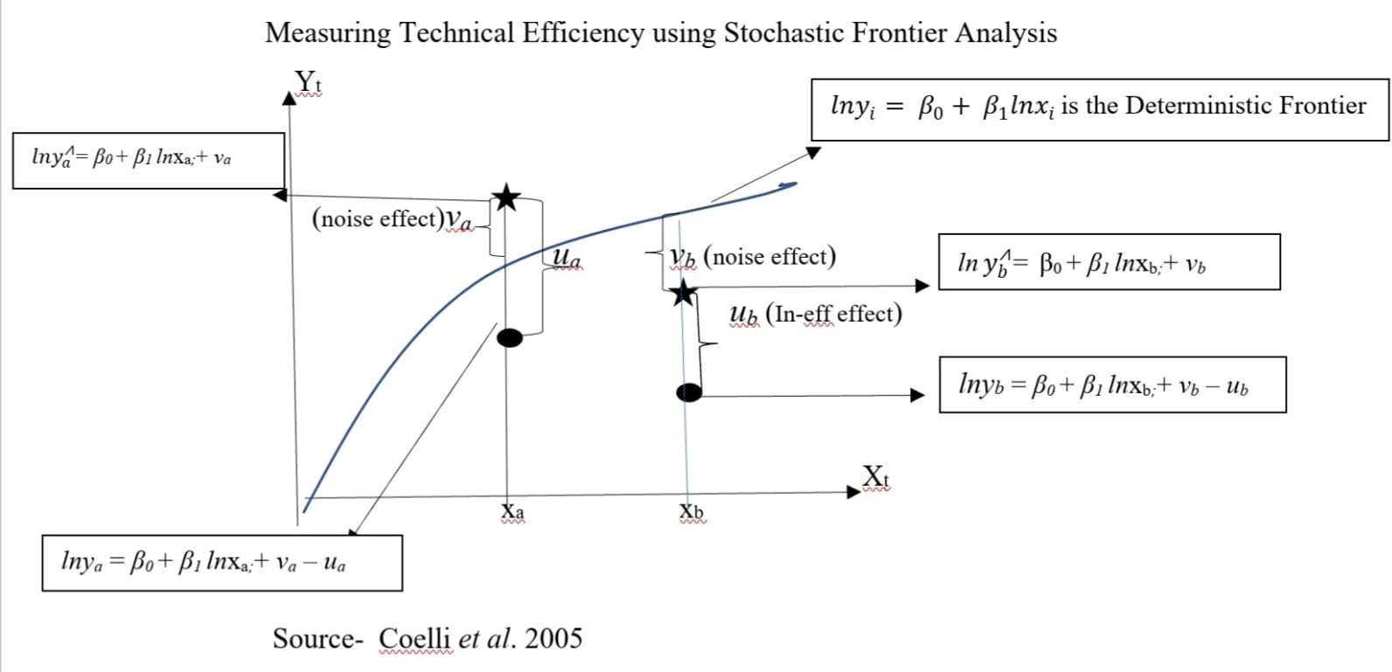
TE =
Observed Output
𝑀𝑎𝑥𝑖𝑖𝑚𝑢𝑚 𝑝𝑜𝑠𝑠𝑖𝑖𝑏𝑙𝑒 𝑜𝑢𝑡𝑝𝑢𝑡
𝑦_{𝑖𝑖} +
𝑙𝑛𝑥 + 𝑣 − 𝑢
( + 𝑙𝑛𝑥_{𝑖𝑖}) 𝑣_{𝑖𝑖} −𝑢𝑢_{𝑖𝑖}
₌𝑒 𝛽 𝛽 ∗𝑒 ∗𝑒 _{= 𝑒−𝑢}
0 1 𝑖𝑖
TE =
=
𝛽 𝛽
𝑖𝑖 𝑖𝑖
𝑖𝑖
_{𝑦}⩘
0 1
+ 𝑙𝑛𝑥 + 𝑣
_{𝑒}(_{𝛽} + _{𝛽} 𝑙𝑛𝑥_{𝑖𝑖})_{∗𝑒}𝑣_{𝑖𝑖}
𝑏
𝛽 𝛽
𝑖𝑖 𝑖𝑖
0 1
0 1

Slide 34
SFA: Cross-Sectional Models
I. Aigner et al. (1977) Model (Normal-Half Normal Model)
𝑙𝑛𝑦_{𝑖𝑖} = 𝛽₀ + 𝛽₁𝑙𝑛𝑥_{𝑖𝑖} + 𝑣_{𝑖𝑖} − 𝑢_{𝑖𝑖}
Assumptions
1. v_{i} (random error) is assumed to be normally distributed, v_{i} ~_{iid} N(0, 𝜎²)
𝑣
2. u (technical inefficiency) which is assumed to be half normally distributed, u ~
(0, 𝜎²)
i
3. v_{i} is independent of u_{i}
i iid _{𝑁+}
𝑢
4. Assuming Cobb-Douglas functional form, where 𝑦_{𝑖𝑖} is the output, 𝑥_{𝑖𝑖} is the vector of inputs, β is vector of technological parameters to be estimated.
To estimate β , Aigner et al. used maximum likelihood estimation and parametrized the log- likelihood function for the normal-half normal model.
ln L(𝑦|𝛽, 𝜎, 𝜆) = − ^{𝑁} ln
𝜋𝜎² 1
∑𝑁 _{𝑒}2
𝑖𝑖=1 𝑖𝑖
+ ∑^{𝑁} 𝑙𝑛𝑙(− ^{𝑒𝑖𝑖𝜆𝜆}) −
𝑖𝑖=1
2 2 𝜎 2𝜎²
where, 𝑒 = v - u
2
𝜎
𝑢𝑢
𝑖𝑖
, 𝜎 is variance of composite error term , 𝜆 =
, 𝜎² = 𝜎² + 𝜎² , and 𝑙. is
𝑒 𝑣 𝑢
i i
𝑒
𝜎_{𝑣}
the cumulative distributive function (cdf) of the standard normal variate.
Aigner, D., Lovell, C.K. and Schmidt, P., 1977. Formulation and estimation of stochastic frontier production function models. Journal of Econometrics, 6(1), pp.21-37.

Slide 35
SFA in Stata
Stata package- frontier
Technical Information: Available for Stata 15 and above (no installation required)
Syntax
frontier depvar [indepvars], [options]
Specification
depvar = dependent variable indepvars = independent variables
[options]
distribution(hnormal)- half-normal distribution for the inefficiency term distribution(exponential) -exponential distribution for the inefficiency term distribution(tnormal)- truncated-normal distribution for the inefficiency term
Post Estimation Commands for predicting inefficiency of each firm. predict (file_name), u (For predicting inefficiency of each firm) predict (file_name), te (For predicting efficiency of each firm)

Slide 36
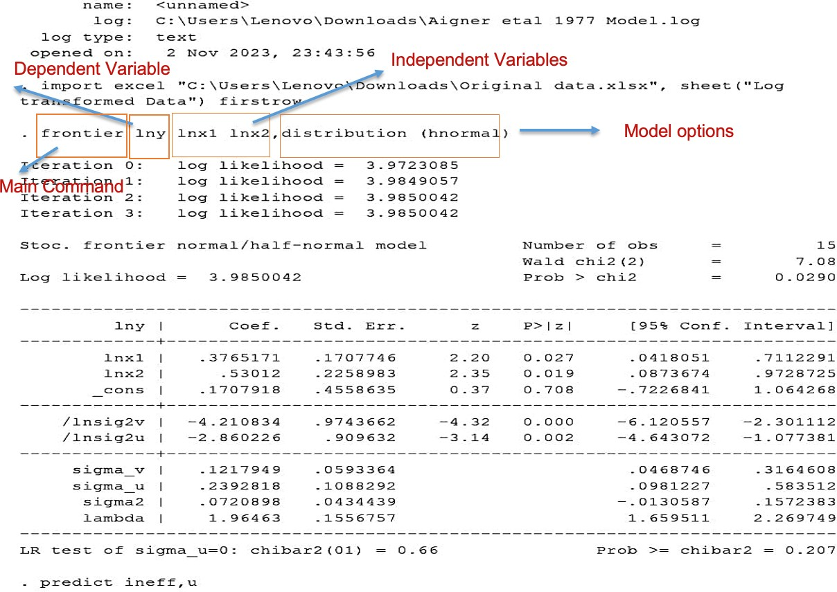
Results from Aigner et al. (1977) Model using frontier
i | t | y | x1 | x2 | ineff | te
1 | 1 | 15.131 | 9.416 | 35.134 | 0.161 | 0.855
2 | 1 | 26.309 | 4.643 | 77.297 | 0.087 | 0.918
3 | 1 | 6.886 | 5.095 | 89.799 | 0.504 | 0.608
4 | 1 | 11.168 | 4.935 | 35.698 | 0.179 | 0.840
5 | 1 | 16.605 | 8.717 | 27.878 | 0.110 | 0.898
6 | 1 | 10.897 | 1.066 | 92.174 | 0.166 | 0.851
7 | 1 | 8.239 | 0.258 | 97.907 | 0.278 | 0.762
8 | 1 | 19.203 | 6.334 | 82.084 | 0.177 | 0.841
9 | 1 | 16.032 | 2.35 | 38.876 | 0.073 | 0.931
10 | 1 | 12.434 | 1.076 | 81.761 | 0.123 | 0.887
11 | 1 | 2.676 | 3.432 | 9.476 | 0.368 | 0.696
12 | 1 | 29.232 | 4.033 | 55.096 | 0.056 | 0.947
13 | 1 | 16.58 | 7.975 | 73.13 | 0.227 | 0.801
14 | 1 | 12.903 | 7.604 | 24.35 | 0.135 | 0.877
15 | 1 | 10.618 | 0.344 | 65.38 | 0.205 | 0.819
Source: Coelli, T. (1996). A guide to Frontier 4.1: A computer program for stochastic frontier production function and cost function estimation. Department of Econometrics University of New England Armidale
NSW, 2351

Slide 37
Contd..
Stata package – sfcross by Belloti et al. (2013)
Belotti, F., Daidone, S., Ilardi, G. and Atella, V (2013), Stochastic frontier analysis using Stata, Stata Journal, 13, (4), 718-758
Technical Information: Available for Stata 15 and above (installation required)
Syntax
sfcross depvar [indepvars], [options]
Specification
depvar = Dependent Variable
Indepvars = List of independent variables
[options]
distribution(hnormal)-half-normal distribution for the inefficiency term distribution(exponential)-exponential distribution for the inefficiency term distribution(tnormal)-truncated-normal distribution for the inefficiency term
Post Estimation Commands for predicting efficiency and inefficiency of each firm. predict (file_name), u (For predicting inefficiency through Batesse and Coelli, 1988 Method) predict (file_name), bc (For predicting efficiency through Batesse and Coelli, 1988 Method ) predict (file_name), jlms (For predicting efficiency through Jondrow et al., 1982 Method)

Slide 38
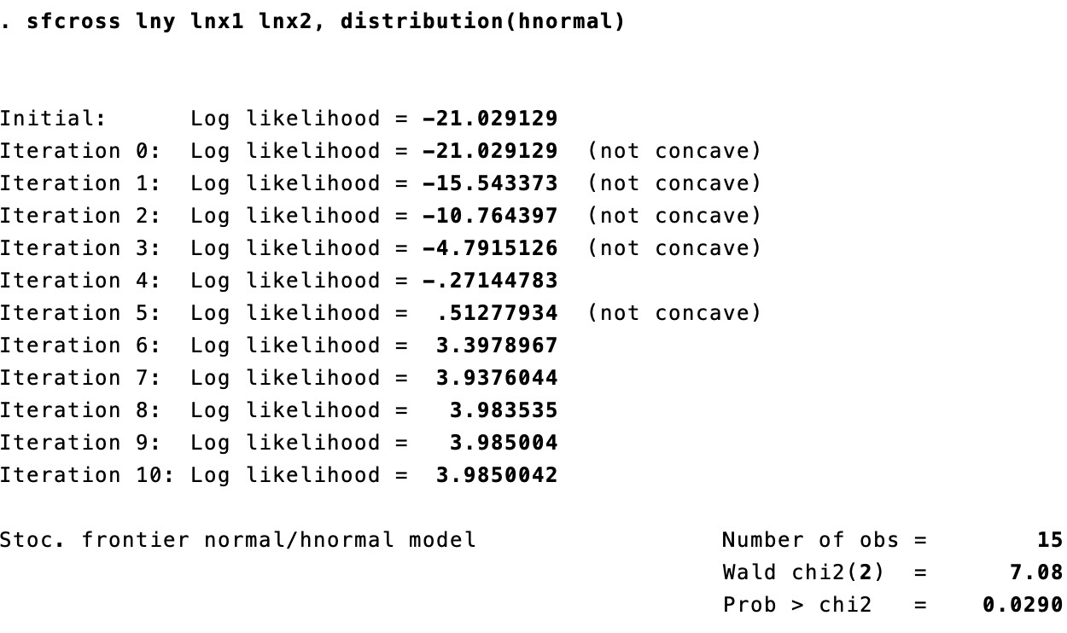
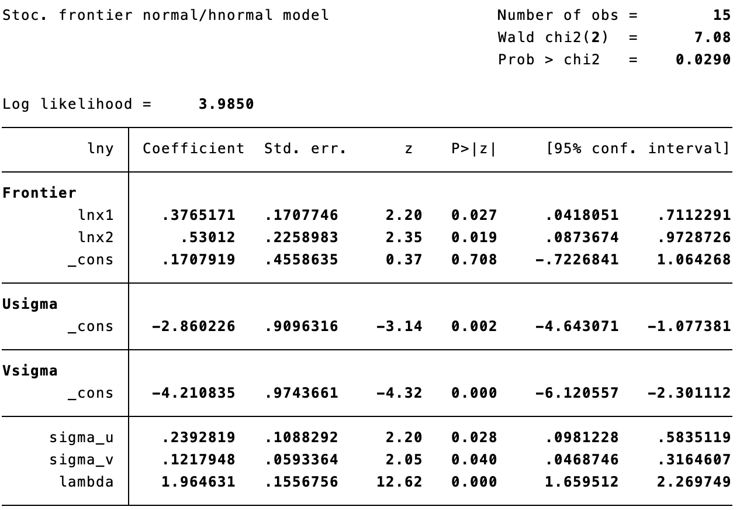
Results from Aigner et al. (1977) Model using sfcross
sfcross lny lnx1 lnx2, distribution(hnormal) predict ineff, u
predict eff_jlms, jlms predict eff_bc, bc

Slide 39
II. Meeusen and Van den Broeck (MB) (1977) (Normal- Exponential Model)
Meeusen and Van den Broeck (MB) (1977)
𝑙𝑛𝑦_{𝑖𝑖} = 𝛽₀ + 𝛽₁𝑙𝑛𝑥_{𝑖𝑖} +
𝑣_{𝑖𝑖} − 𝑢_{𝑖𝑖}
Assumptions
𝑢_{𝑖𝑖} (technical
inefficiency) which is assumed to be exponentially
distributed u ~𝑒𝑥𝑝𝑜𝑛(𝜃𝜃) 𝜎²)
i
𝑢
To estimate β, Meeusen and van den
Broeck (MB) used MLE and
parametrized the log-likelihood function for the Normal- Exponential model.
_{𝜎}2
𝑒
ln L = 𝑙𝑛𝐿 = −𝑁𝑙𝑛𝜎_{𝑢} + 𝑁
𝑣
+ ∑ 𝑙𝑛𝑙 −𝐴 + ∑
𝑖𝑖
𝑖𝑖 _{𝜎𝑢𝑢}
2𝜎²
𝑖𝑖
𝑢𝑢
where, 𝑒_{𝑖𝑖} = v - u , 𝜎² is variance of composite error term , 𝜎² = 𝜎² + 𝜎² , 𝑙.
i i
𝑒 𝑒 𝑣 𝑢
is the cumulative distributive function (cdf) of the standard normal variate,
_{𝐴 =} −𝜇�_{�𝜎}
, 𝜇� = −𝑒_{𝑖𝑖} − 𝜎²⁄𝜎 and N is number of producers.
𝑣
𝑣 𝑢
Meeusen, W. and van Den Broeck, J. (1977). Efficiency estimation from Cobb-Douglas production functions with composed error. International Economic Review, pp.435-444.

Slide 40
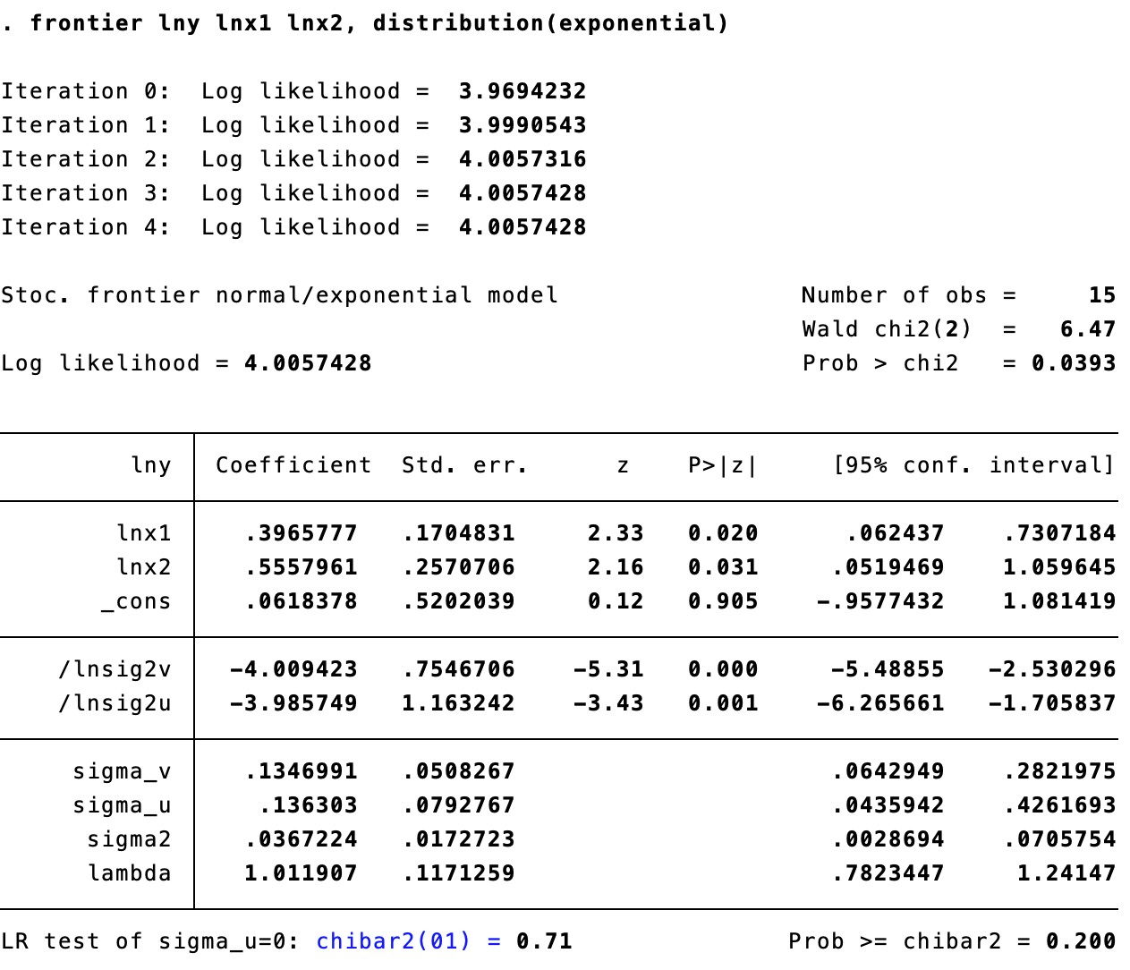
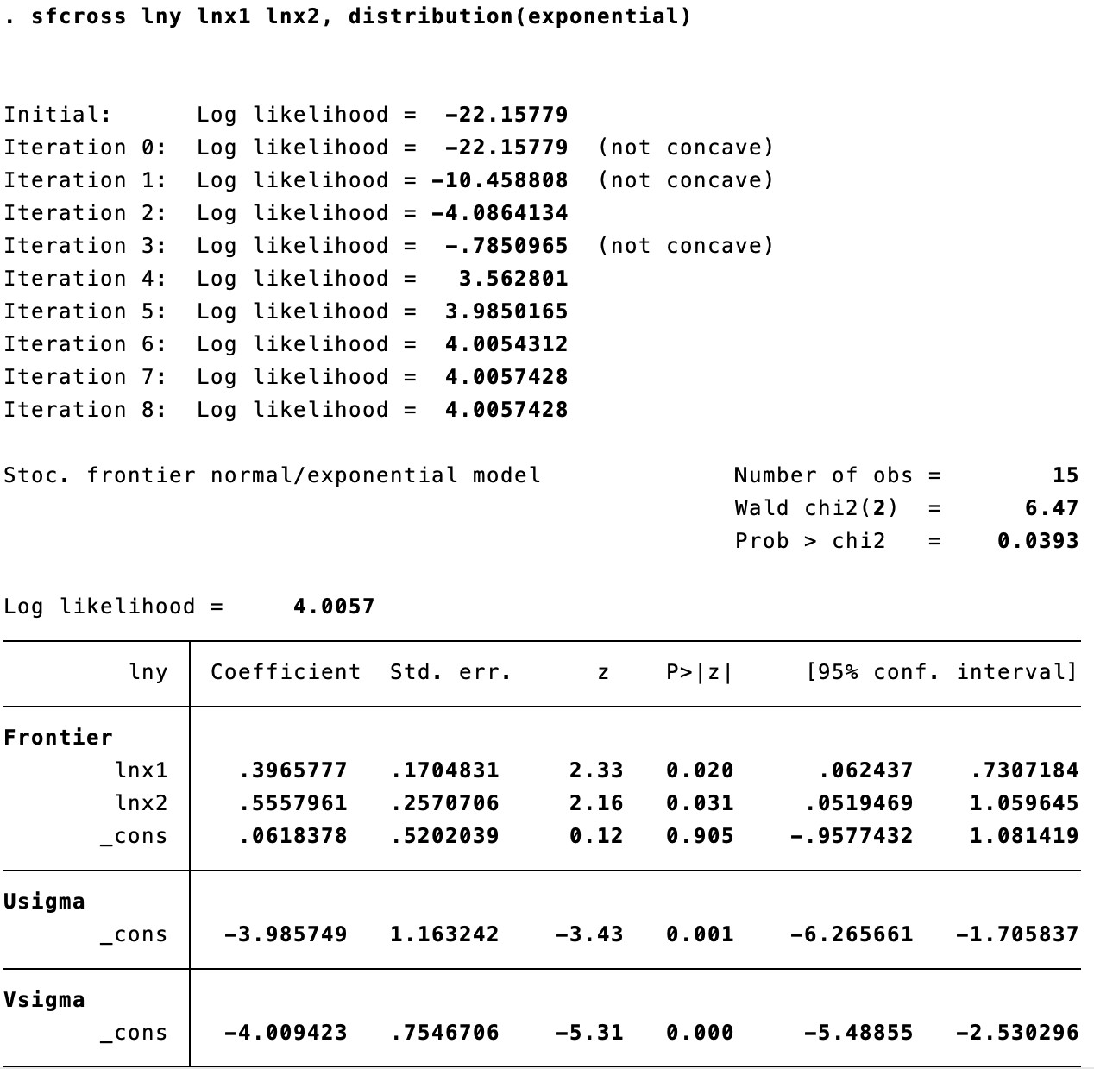
Results from Meeusen and Van den Broeck (MB) (1977)
predict eff, te
predict eff, bc

Slide 41
III. Stevenson (1980) Model (Normal-Truncated Model)
Model is formulated as
𝑙𝑛𝑦_{𝑖𝑖} = 𝛽₀ + 𝛽₁𝑙𝑛𝑥_{𝑖𝑖} +
𝑣_{𝑖𝑖} − 𝑢_{𝑖𝑖}
Assumptions
𝑢_{𝑖𝑖} (technical inefficiency) which is assumed to truncated normally distributed, u_{i}~_{iid}
(𝜇, 𝜎²)
𝑁+
𝑢
To estimate β , Stevenson (1980) Model used maximum likelihood estimation and parametrized the log-likelihood function for the Normal-Truncated Normal Model.
₋ 𝜇 𝜇 ₋ 𝑒_{𝑖𝑖}𝜆𝜆
𝑒_{𝑖𝑖}+𝜇
ln 𝐿 = −𝑁𝑙𝑛𝜎 − 𝑁𝑙𝑛𝑙
+ ∑ 𝑙𝑛𝑙 − ¹ ∑
𝑒
𝑖𝑖
𝑖𝑖
𝜎_{𝑢𝑢} 𝜎𝜆𝜆 𝜎 2
𝜎
where, μ (mode) is additional parameter to be estimated, 𝑒_{𝑖𝑖} = v - u
, 𝜎²is variance
i
i
𝑒
of composite error term ,
_{𝜎}2
= 𝜎² + 𝜎² , 𝑙. is the cumulative distributive function (cdf) of the standard
𝑒 𝑣 𝑢
normal variate, and N is number of producers.
Source: Stevenson, R.E., 1980. Likelihood functions for generalized stochastic frontier estimation. Journal of Econometrics, 13(1), pp.57-66.

Slide 42
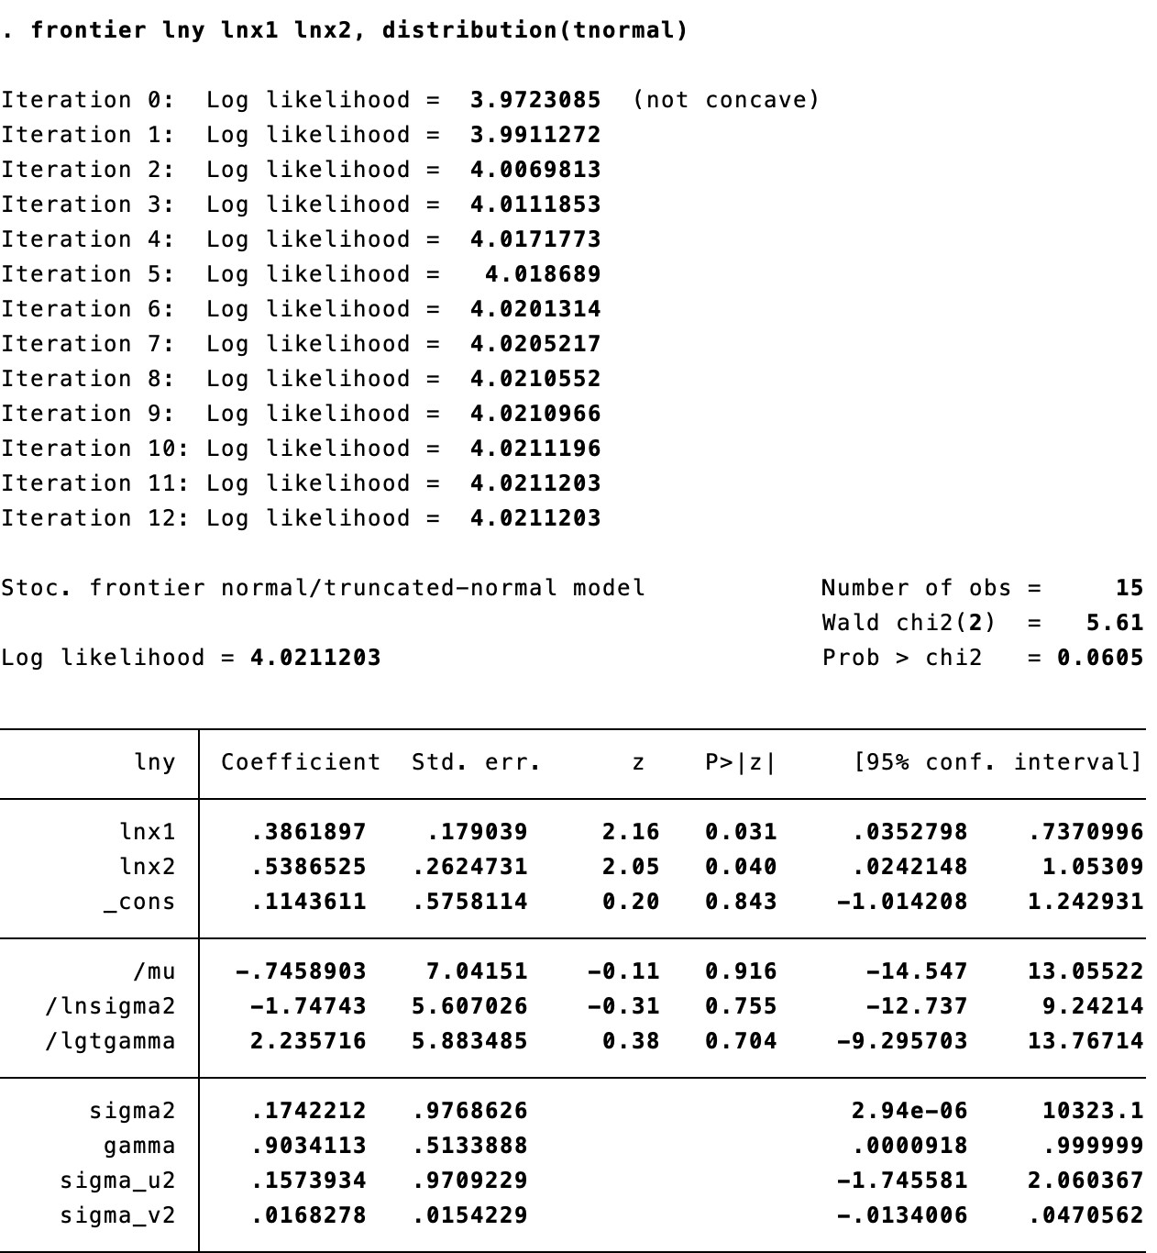
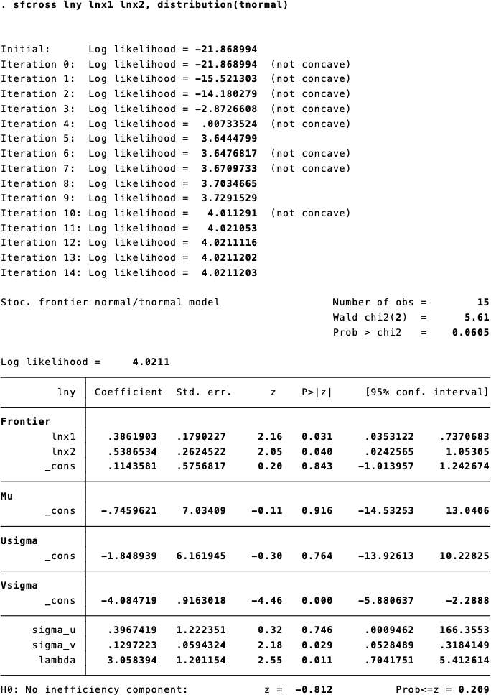
Results from Stevenson (1980) Model
predict eff, te
predict eff, bc

Slide 43
Results of BC, JLMS, MB, and Stevenson’s Models
i | t | lny | ln x1 | ln x2 | jlms | bc | eff_mb | stevenson
1 | 1 | 1.179868 | 0.973866 | 1.545728 | 0.8510 | 0.8546 | 0.9028 | 0.8880
2 | 1 | 1.420104 | 0.666799 | 1.888163 | 0.9163 | 0.9183 | 0.9404 | 0.9343
3 | 1 | 0.837967 | 0.707144 | 1.953272 | 0.6041 | 0.6077 | 0.6389 | 0.6288
4 | 1 | 1.047975 | 0.693287 | 1.552644 | 0.8360 | 0.8398 | 0.8949 | 0.8774
5 | 1 | 1.220239 | 0.940367 | 1.445262 | 0.8954 | 0.8979 | 0.9297 | 0.9203
6 | 1 | 1.037307 | 0.027757 | 1.964608 | 0.8469 | 0.8505 | 0.9027 | 0.8869
7 | 1 | 0.915875 | 0.099681 | 1.990814 | 0.7573 | 0.7616 | 0.8326 | 0.8075
8 | 1 | 1.283369 | 0.801678 | 1.914259 | 0.8375 | 0.8413 | 0.8919 | 0.8769
9 | 1 | 1.204988 | 0.371068 | 1.589682 | 0.9294 | 0.9309 | 0.9493 | 0.9439
10 | 1 | 1.094611 | 0.031812 | 1.912546 | 0.8838 | 0.8867 | 0.9246 | 0.9136
11 | 1 | 0.427486 | 0.535547 | 0.976625 | 0.6924 | 0.6965 | 0.7728 | 0.7392
12 | 1 | 1.465859 | 0.605628 | 1.74112 | 0.9457 | 0.9467 | 0.9576 | 0.9545
13 | 1 | 1.219585 | 0.901731 | 1.864096 | 0.7969 | 0.8011 | 0.8611 | 0.8419
14 | 1 | 1.110691 | 0.881042 | 1.386499 | 0.8738 | 0.8769 | 0.9182 | 0.9055
15 | 1 | 1.026043 | 0.369958 | 1.815445 | 0.8150 | 0.8190 | 0.8803 | 0.8606

Slide 44
IV. Time-Invariant Stochastic Frontier Models
Schmidt and Sickles (1984) proposed both Time invariant Stochastic Frontier Fixed effect and Random effect Models.
Fixed Effects Model
^{𝑦}𝑖𝑖𝑡 𝛽
+ 𝛽₁𝑥′ + 𝑣_{𝑖𝑖𝑡} − 𝑢_{𝑖𝑖}
=
it
′
^{𝑦}𝑖𝑖𝑡
0
_{𝛽} + 𝛽₁𝑥 + 𝑣_{𝑖𝑖𝑡}
=
𝑖𝑖
it
Here, β_{i} = β₀ - u_{i} is the individual effects of fixed-effects model. In FE-Model, 𝑢_{𝑖𝑖} is assumed to be correlated with the regressor or with 𝑣_{𝑖𝑖𝑡}
Random Effects Model
𝑙𝑛𝑦_{𝑖𝑖𝑡} = 𝛽₀ − 𝐸 𝑢_{𝑖𝑖} + ∑_{𝑛} 𝛽_{𝑛} 𝑙𝑛𝑥_{𝑛𝑖𝑖𝑡} + 𝑣_{𝑖𝑖𝑡} − [𝑢_{𝑖𝑖} − 𝐸 𝑢_{𝑖𝑖} ]
𝑙𝑛𝑦_{𝑖𝑖𝑡} = 𝛽∗ + ∑_{𝑛} 𝛽_{𝑛} 𝑙𝑛𝑥_{𝑛𝑖𝑖𝑡} + 𝑣_{𝑖𝑖𝑡} − 𝑢∗
0 𝑖𝑖
Source: Schmidt, P. and Sickles, R.C., 1984. Production frontiers and panel data. Journal of Business & Economic Statistics, 2(4), pp.367-374.

Slide 45
Panel Data SFA Models in STATA
Stata packages: xtfrontier and sfpanel
Technical Information: Available for STATA 15 and above (no installation required)
Syntax xtfrontier depvar [indepvars], ti [ti_options] Specification depvar = Dependent Variable indepvars = List of independent variables [options] ti - use time invariant model cost - fit cost frontier model no constant - suppress constant term. constraints- apply specific linear constraints Post Estimation Commands for predicting inefficiency of each firm. predict (file_name), u (inefficiency of each firm) predict (file_name), te (efficiency of each firm) | Syntax sfpanel depvar [indepvars], model () [model_options] Specification depvar = Dependent Variable indepvars = List of independent variables [model_options] fe- fixed effects model of SS (1984) regls – random effects model of SS (1984) pl81 - Pitt and Lee (1981) model bc88 - Battese and Coelli (1988) model Post Estimation Commands for predicting efficiency and inefficiency of each firm. predict (file_name), u (inefficiency through BS 1988) predict (file_name), bc (efficiency through BS 1988) predict (file_name), jlms (efficiency through Jondrow et al. 1982 )

Slide 46
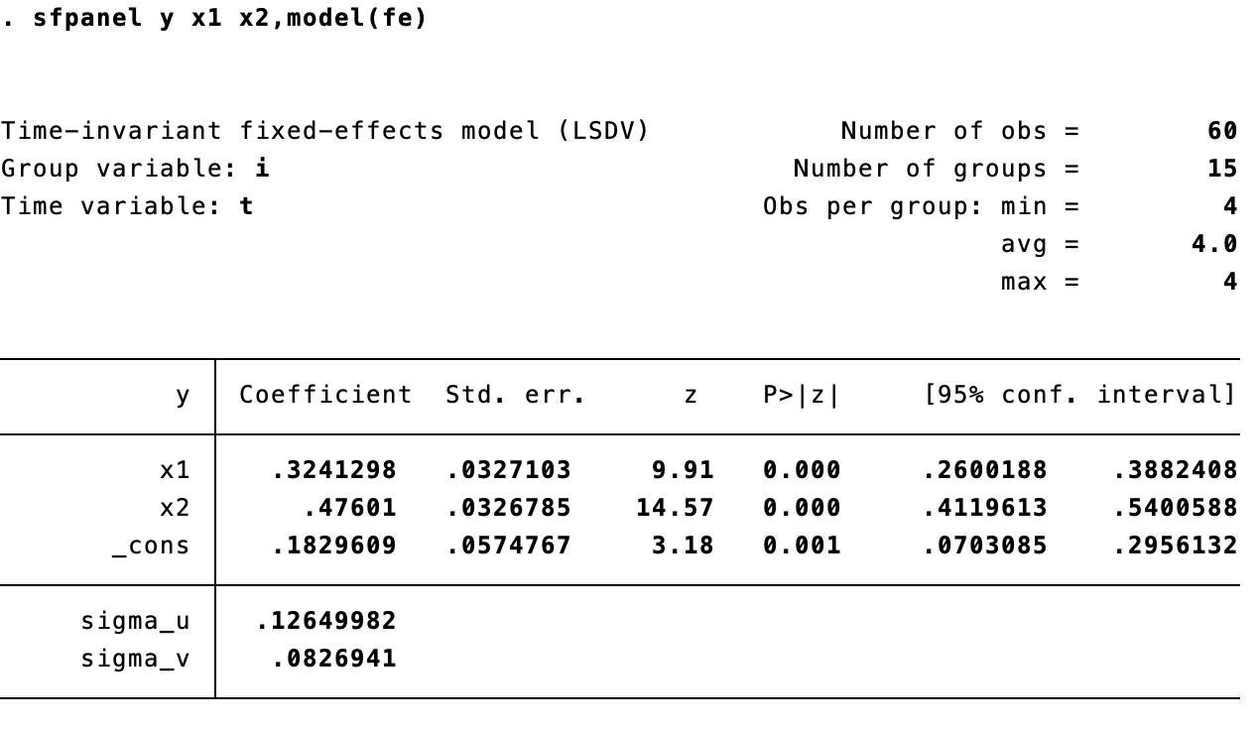
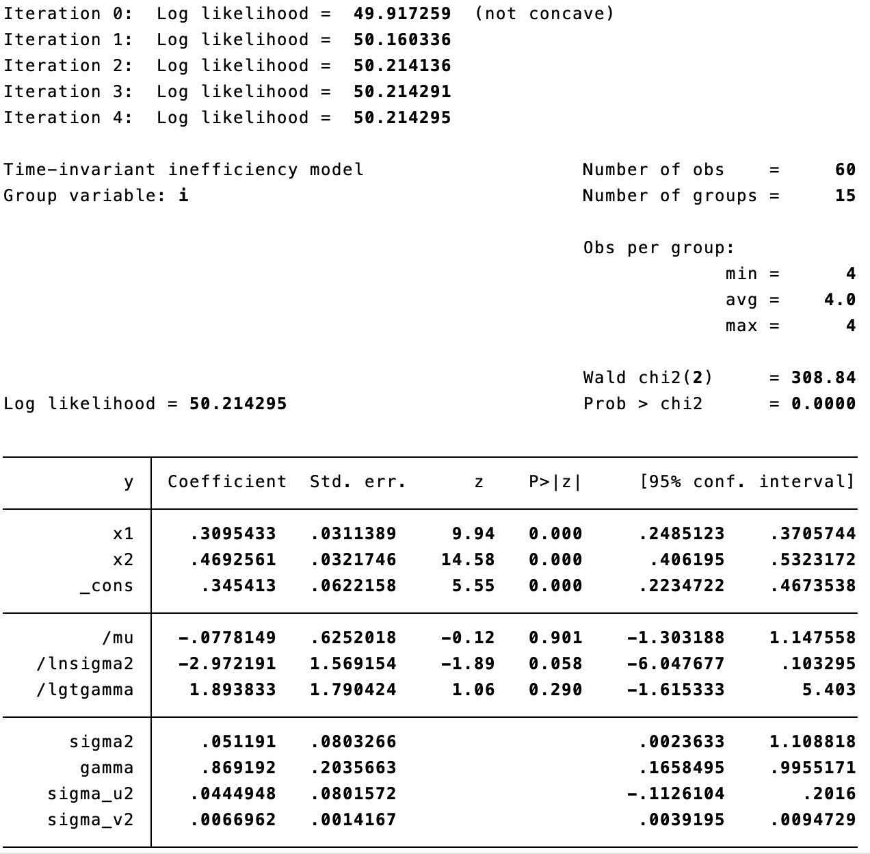
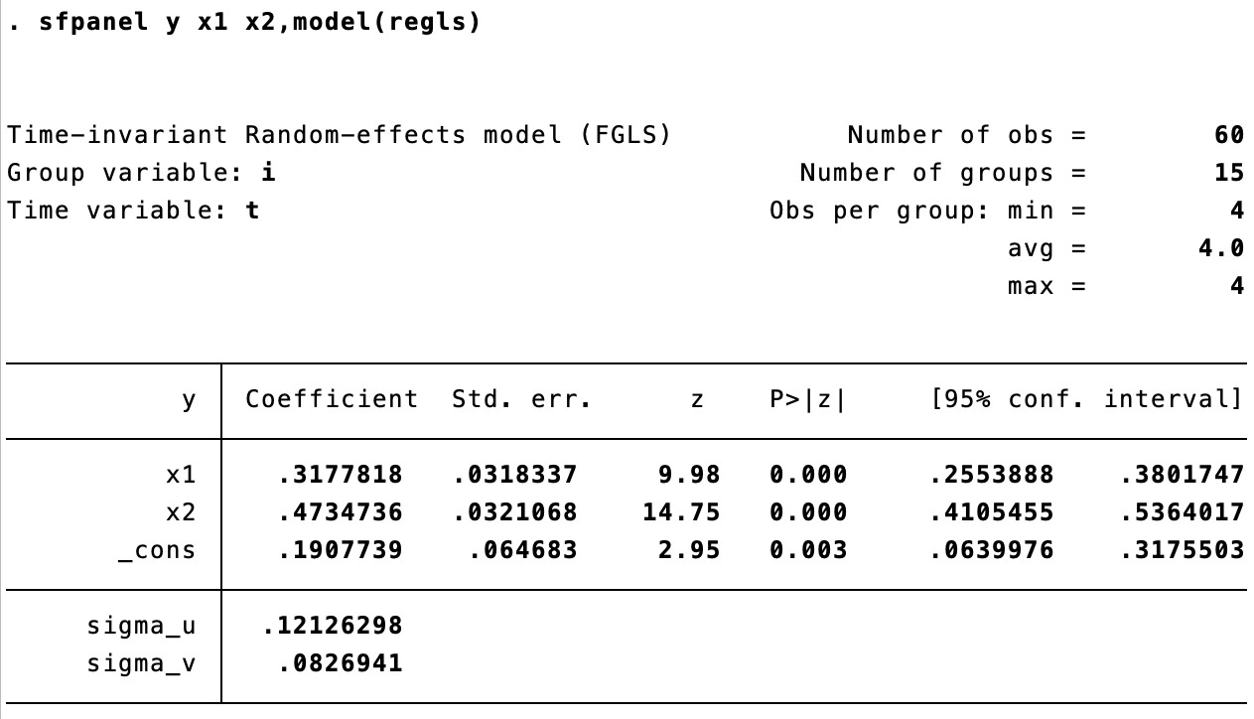
xtfrontier and sfpanel packages for time-invariant models: Schmidt and Sickles (1984)
xtset i t
xtfrontier y x1 x2, ti
predict ineff, jlms
predict eff, te

Slide 47
Other Stochastic Frontier Time-Invariant Models
Pitt and Lee (1981) Model
Battese and Coelli (1988) Model
y_{it =} β₀ + β₁ 𝑥′+ v_{it} - u_{i}
y_{it =} β₀ + β₁ 𝑥′+ v_{it} - u_{i}
it
it
Assumptions: u_{i} (technical inefficiency) which is assumed to be half normally
2
Assumptions: u_{i} (technical inefficiency) which is assumed to be truncated normal distributed,
distributed, u_{i}~_{iid}
over time
𝑁(𝑇 − 1)
(0, 𝜎_{𝑢} ) and constant
u ~ (0, 𝜎²) and constant over time.
i iid _{𝑁+}
𝑢
_{𝑁}+
𝑁(𝑇 − 1) 𝑁
𝜇
𝜎_{𝑢}
𝑁
𝑙𝑛𝐿 = −
𝜎² − ln 𝜎² + 𝑇𝜎² + 𝑁𝑙𝑛 1 − 𝑙 −
2 2
𝑣 𝑣 𝑢
𝑙𝑛𝐿 = −
𝜎² − ln 𝜎² + 𝑇𝜎²
+
2
𝜇̅_{𝑖𝑖}
𝜎
2
2
𝑣 𝑣 𝑢
𝜇̅_{𝑖𝑖}
−
∑_{𝑖𝑖} 𝑒_{𝑖𝑖} 𝑒́ _{𝑖𝑖} 𝑁 𝜇
− −
1
+ �
2
𝑖𝑖
2
+ � ln 1 − 𝑙
^{𝜇}∗𝑖𝑖
� ln 1 − 𝑙 −
𝜎∗
∑_{𝑖𝑖} 𝑒_{𝑖𝑖} 𝑒́ _{𝑖𝑖}
−
𝜎
∗
2𝜎² 2 𝜎
𝑖𝑖
𝑣
𝑢
∗
2𝜎²
𝑖𝑖
𝑣
́ 2
2
1 𝜇
2
where 𝜇̅_{𝑖𝑖}
_{𝜇}𝜎_{𝑣} −𝑇𝑒_{𝑖𝑖}𝜎_{𝑢𝑢}
+ �
∗𝑖𝑖
=
𝜎²+𝑇𝜎²
2
𝜎_{∗ 2}
𝑣 𝑢𝑢
𝑖𝑖
𝑇𝜎_{𝑢𝑢}𝑒_{𝑖𝑖}́ 1
where 𝜇 = −
, 𝑒́ = ∑ 𝑒 and
∗
𝑖𝑖 𝑖𝑖 𝑖𝑖𝑡
𝜎²+𝑇𝜎²
𝑇
𝜎 ² =
∗
_{𝜎}2_{𝜎}2
𝑣 𝑢𝑢
𝑣 𝑢 𝑢
𝜎²+𝑇𝜎²
𝑣 𝑢𝑢
Pitt, M.M. and Lee, L.F. (1981). The measurement and sources of technical inefficiency in the Indonesian weaving industry. Journal of Development
Economics, 9(1), pp.43-64.)
Battese, G.E. and Coelli, T.J., 1988. Prediction of firm- level technical efficiencies with a generalized frontier production function and panel data. Journal of econometrics, 38(3), pp.387-399)

Slide 48
Other Stochastic Frontier Time-Invariant Models
Model Name | Syntax | Main Command
Pitt and Lee (1981) half normally distributed | sfpanel depvar [indepvars], model () [model_options] | sfpanel depvar [indepvars], model (pl81)
Battese and Coelli (1988) truncated normal distributed | sfpanel depvar [indepvars], model () [model_options] | sfpanel depvar [indepvars], model (bc88)

Slide 49
V. Time-Variant Stochastic Frontier Models
Stochastic Frontier Time-Variant Models
Kumbhakar (1990) | sfpanel depvar [indepvars], model () [model_options] | sfpanel depvar [indepvars], model (kumb90)
Battese and Coelli (1992) | sfpanel depvar [indepvars], model () [model_options] | sfpanel depvar [indepvars], model (bc92)
Battese and Coelli (1995) | sfpanel depvar [indepvars], model () [model_options] | sfpanel depvar [indepvars], model (bc95)

Slide 50
Thanks

