Slide 1




:
Topic : Network, Exposure and Benefits of Short-Term Training
Abstract :
The MES training had a provision to be delivered through the Industrial Training Institutes (ITIs) which traditionally provide long-term training. It is observed the candidates who received MES training in an ITI setup tend to perform better than those who graduated from other private MES training providers.
Presented By
DR TUTAN AHMED
Assistant Professor
Indian Institute Of Technology, Kharagpur

Slide 2
Institution, Exposure and Returns from short term training: A Causal analysis
Tutan Ahmed IIT Kharagpur
30th November 2023 Stata India Conference
2

Slide 3
Presentation Plan
Slide 4: Background, Research Question, Data, Research Method, Summary of the Findings
Slide 5-6: Factors affecting returns from training
Slide 7-8: Setting the Context [ Modular Employability Scheme and PMKVY]
Slide 9-13: Data Sources [ Modular Employability Scheme and PMKVY]
Slide 14-23: Understanding the Selection Rules and Institutional variations to these Training Programs
Slide 24: Econometric Model and Propensity Score Method
Slides 25-28: Descriptive Statistics
Slides 29-37: DID Estimation Framework
Slides 38-40: DID Estimation Results
Slide 41: Results and Interpretation
3

Slide 4
Results are Provisional and May not be quoted now
4

Slide 5
Research Summary
Compared two almost similar training programs (MES and PMKVY)
– discontinuation of MES was necessitated after introduction of a similar short term training program PMKVY
These two policies targeted the same beneficiaries while some institutional shifts were unavoidable
These policy change and the institutional shifts are exploited with a causal framework to explain the role of - exposure, duration of short term of training, effect of network, effect of institutional supports, importance of long term training etc. on the returns to training
Data from two recall surveys are analyzed using propensity score and DID method
5

Slide 6
Brief Literature on factors influencing returns from training
Usually long term training is more beneficial than the short term training (Singh, Yadav & Pradhan, 2023)
It seems that these training programs have a life. The benefits from the short term training is to be reaped without a certain time frame (Chakravorty & Bedi, 2019)
Same is applicable for the long term training. For long term training, no immediate benefit is discernible. However, benefits could be reaped after a couple of years.
Lechner et al. (2011), based on an analysis of training programs in Germany, showed employment probability to be positive and significant (10 to 20 percentage points more) as compared to non-trainees even after eight years of training completion
6

Slide 7
Brief Literature on factors influencing returns from training
Role of skill development and returns from training (Mensch et al, 2004, Maitra and Mani, 2017)
Sustainability of the benefits of such training programs (Alfonsi et al. (2020), Honorati (2015)) vs (Acevedo et al, 2017; Azula et al, 2016; Hirshleifer et al, 2016; Chakravorty and Bedi, 2019).
Sustainability of the benefit for females (Ibarraran et al., 2019; Attanasio et al., 2017).
Network – job market information (Jensen, 2012, Chakravorty et al, 2022)
7

Slide 8
Similarity between Modular Employability Scheme (MES) & PMKVY
An elaboration of the institutional change
PMKVY scheme came as a replacement of the MES scheme whereas the guidelines of PMKVY was formulated from the learnings of MES
Both the training programs were flagship short term training program
The role of National Skill Development Agency (NSDA) in the above guideline development and scheme transformation
Curriculum and the process of development of curriculum – DGET ecosystem and NDSC/ NSDA ecosystem
Entry criteria, fees structure
Small additional placement incentives for both the programs
8

Slide 9
Similarity between Modular Employability Scheme (MES) & PMKVY
Types of training [particularly in the context of Delhi]
Role of National Skill Qualification Framework and the movement towards standardization of the training programs
Selection of the training providers for these two programs
Selection of the Assessment Agencies for these two programs
Both training programs focused on NSQF level 4 or below [demonstration of the course mapping]
Duration of the courses – a major difference
Institutional mode of delivery: PMKVY-N, PMKVY-I, MES-ITI, MES-Pvt. (other left out categories)
9

Slide 10
Source of Data
SDIS (Skill Development Initiative System)
- Database contains details of more than a million students since 2011 (date of access 6th October 2015)
- Accessed Data: For Delhi, 26607 candidates including phone numbers [ accessed from the “Profile” module of the database ], 90,000+ Vocational training provider (VTP) data, more than 1 million enrolment data. Placement summary details were accessed separately
SDMS (Skill Development Management System)
- Database contains details of 3 million students since 2013 that includes STAR scheme, PMKVY and Non- PMKVY training data (date of access 23rd January, 2016)
- Accessed Data: 3 million candidate data including basic details and phone number [accessed from “Candidate” module of PMKVY database]. Training center, course, placement summary details were accessed separately
A digression: NSQF and Central Data Coordination and Monitoring through SDMS [Ministry and Department Data]
10

Slide 11
Sample Selection for the multi-period “Recall Survey” for PMKVY
SDMS Database:
SDMS collated 2.4 million data in 2015-2016, actual PMKVY and non-PMKVY training done through NSDC was close to .73 million.
Delhi, PMKVY and non-PMKVY enrolment figure was 47348 and certified candidates were 33999. Enrolment in PMKVY alone was 31,253
NSDC conducted both training and certification (PMKVY) and only certification (non-PMKVY) through its SSCs and Training Partners
No of Training Partners 178 and the number of independent Training Centers 406
No of Training Partners with extended network (PMKVY – N): 197 and Number of Independent Training Centers without an extended Network (PMKVY– I): 387
10

Slide 12
Sample Selection for the multi-period “Recall Survey” for PMKVY
SDMS Database:
Every third phone number from the SDMS database was contacted during June 2019 to November 2019 [10418]
21% data duplication [7007]
The “desired age group” of 19-22 [3776]
64% of the candidates called didn’t pick up the call/switched off/invalid number [1202]
25% phone picked up by family/friend/ someone known and 4% didn’t ever receive PMKVY training and 43% not interested to participate in the survey [256]
105 Candidates from PMKVY-N and 151 candidates from PMKVY-I

Slide 13
Sample Selection for the multi-period “Recall Survey” for MES
SDIS Database
Data is maintained only from 2011. A total of above one million data was stored at the time of access to the database
All training centers were required to update the data on the platform. Aadhar based enrolment wasn’t mandatory
Types of Training Provides in MES Scheme in Delhi. Total number of training providers including all these categories
MES in private/ government ITI Setup (23%) through formation of Institute Management Committee (IMC)
MES training conducted by the private Vocational Training Providers (VTPs) in standalone training centers (68%)
MES training conducted by the employers (9%)

Slide 14
Sample Selection for the multi-period “Recall Survey” for MES
SDIS Database
A total of 26607 candidates enrolled in MES in 2014-2015 in Delhi
Every third phone number from the SDIS database was contacted during August 2018 to December 2018 [8869]
17% data duplication [7007]
The “desired age group” of 19-22 [2803]
67% of the candidates called didn’t pick up the call/switched off/invalid number [925]
Of the remaining, 35% phone picked up by family/friend/ someone known/ Unknown and 5% didn’t ever receive MES training and 34% not interested to participate in the survey [241]
148 Candidates from MES-Private and 93 candidates from MES-ITI

Slide 15
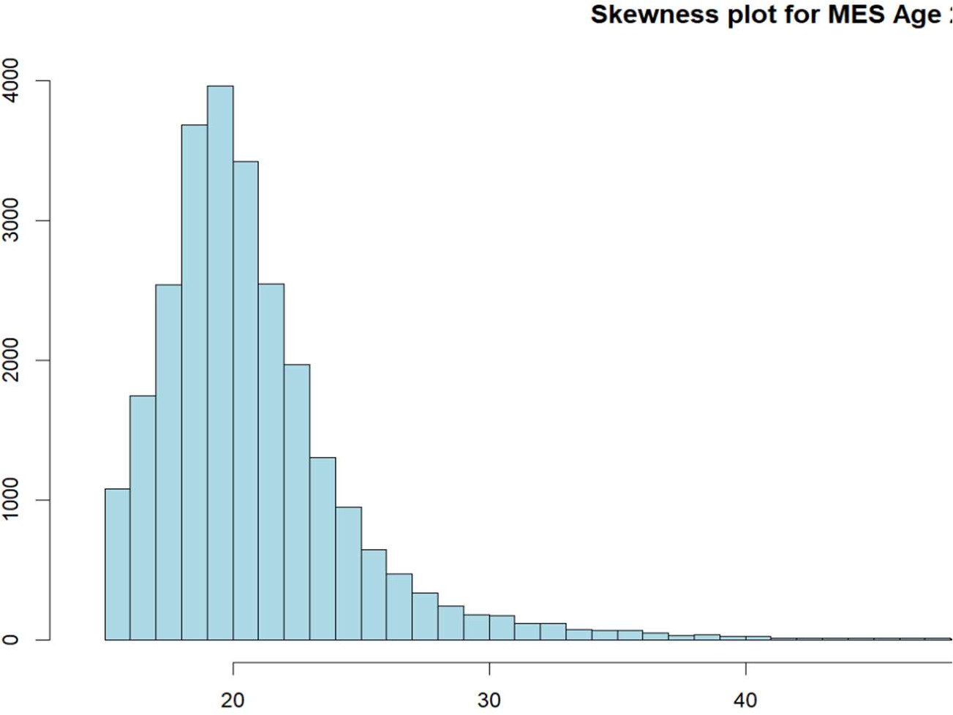
Skewness Plot for MES Age

Slide 16
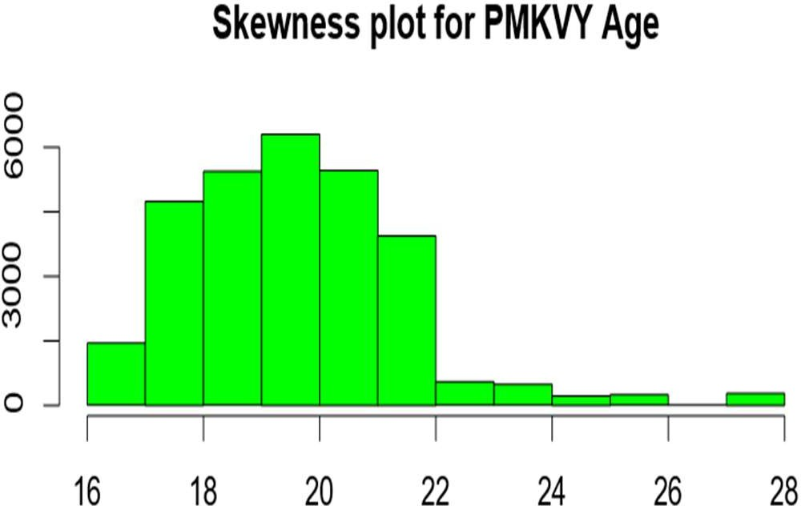
Skewness Plot for PMKVY Age
1. Such differences in age distribution --
PMKVY – no college students to be admitted
PMKVY – short term (very) allowed. Which made PMKVY a relatively easy to experiment
PMKVY – A huge budget with advertisement

Slide 17
Major Challenge in the Application of the DID Method:
A sufficient condition for identification is that selection for treatment does not depend on the individual-transitory shocks
Ashenfelter’s Dip: A period of uncertainty, exploration and search. This period is characterized by a temporary decline in real wages, followed by an upward trajectory as workers gain experience, skills, and seniority.
-- Selection of the Age Group
Another level of data complexity: If the candidates have received further higher education
– it is quite likely they would take further higher education (see: School Resources and Student Outcomes: An Overview of the Literature and New Evidence from North and South Carolina David Card and Alan B. Krueger, 1996)
-- Capturing Career Transition post the training

Slide 18
Selection of Control Group
Slightly different structure of capturing data in these two programs –
data on rolling/ waitlisted candidates in MES (possibility of use of oversubscription method)
b) data on dropout candidates in PMKVY (possibility of use of dropouts as a comparison group)
College students’ entry in PMKVY vs MES training
Use of “friendship network”: friend who showed some interest as control group
Violation of SUTVA: conditions for identification of control units using “loosely connected” friend
Total Control Group Sample: MES – 73, PMKVY – 87

Slide 19
Self-Selection into Training Programs
Reason for Selection of Training Center | MES | PMKVY
Nearness to Home | 64% | 71%
Form Advertisement | 5% | 13%
Referral from a Friend | 12% | 6%
Referral from relative/school/ community | 13% | 7%
Compared Centers based on Reputation | 4% | 2%
Any Other | 2% | 1%

Slide 20
Motivations for joining into the Training Programs
Motivations for Selection of Training | MES | PMKVY
Use the training as a stepping stone for career | 47% | 42%
Use the training/certificate as additional career avenue | 25% | 14%
Learning a new skill, not so much to use it as career option | 12% | 19%
No particular work at hand – so getting a certification | 8% | 13%
Friends have joined so I followed with no career interest in mind | 6% | 8%
Any Other | 2% | 4%

Slide 21

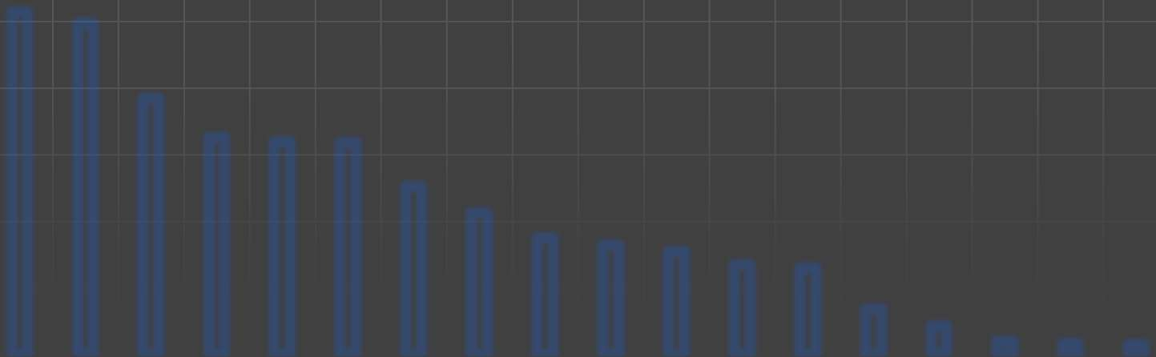

PMKVY Enrolment Distribution
PMKVY - Candidates Trained in Delhi (2015-2016)
12000
10000
8000
6000
4000
2000
0
20

Slide 22

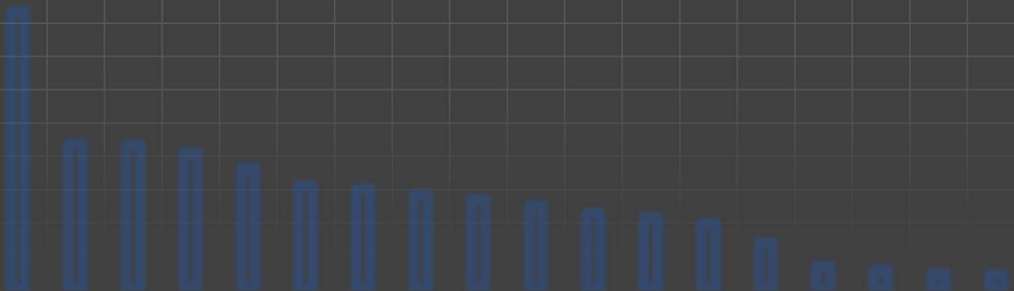

PMKVY Enrolment Distribution
PMKVY 2015-2016 (Delhi): Candidates Directly Trained & Certified by NSDC
4500
4000
3500
3000
2500
2000
1500
1000
500
0
4174
2180 2160 ₂₀₅₅
1823
1553 1502 ₁₄₁₀ ₁₃₄₃ ₁₂₄₀
1142 ₁₀₇₄
988
689 347 292 236 221

Slide 23


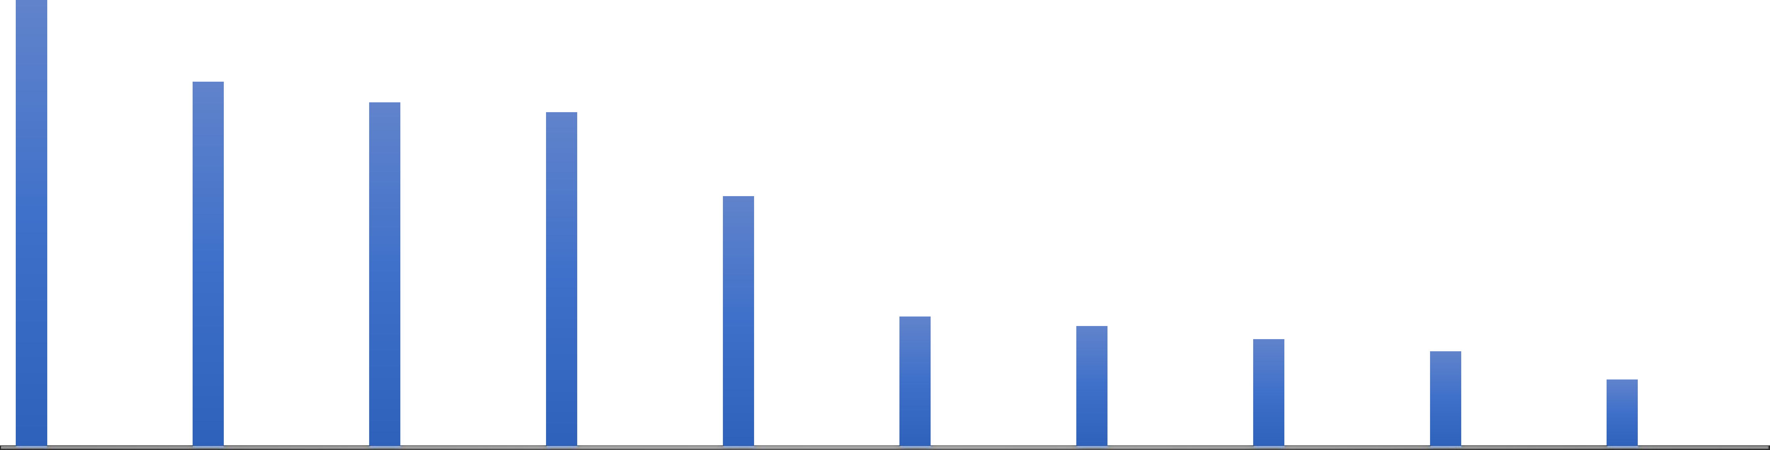
MES Enrolment Distribution
MES Enrolment Distribution in Delhi in 2014-2015
5000
4500
4000
3500
3000
2500
2000
1500
1000
500
0
Telecom
IT & ITeS
Retail
Apparel
Beauty & Wellness
Media
Construction
Electronics
Healthcare
Fabrication

Slide 24
Similarities and Dissimilarities of these two Training Programs: Course Specific Heterogeneity
Training Sector | Duration for MES | Duration for PMKVY
Automobile | 222.1 | 35
Retail | 165 | 28
Security | 126 | 27
Logistics | 172 | 42
Electronics | 200.5 | 38
Beautician | 184 | 32
Gems and Jewelry | 234 | 58
Healthcare | 276 | 64
Telecom | 110 | 26
Tourism | 102 | 29
IT & ITeS | 145 | 35
BFSI | 152 | 34
Media & Entertainment | 125 | 48
Construction | 162 | 42
Apparel | 170 | 31
Demonstration of Couse Mapping Between these two Programs
23

Slide 25
Estimation Strategy
E(Y|T= ITI-MES) – E(Y|T=MES-PVT) = Effect of MES training in ITI infrastructure ……(i) E(Y|T= ITI-MES) – E(Y|T=0) = Effect of MES training in ITI infrastructure + Effect of Short Term Training ……(ii)
E(Y|T=T MES PVT) – E(Y|T=0) = Effect of Short Term Training ……(iii)
E(Y|T=PMKVY-N) – E(Y|T=PMKVY-I) = Effect of PMKVY training with Infrastructure
……(iv)
E(Y|T= PMKVY-N) – E(Y|T=0) = Effect of PMKVY training with Infrastructure + Effect of Short Term training ……(v)
E(Y|T= PMKVY-I) – E(Y|T=0) = Effect of Short Term training ……(vi)
24

Slide 26
Descriptive Statistics for PMKVY and MES
 | PMKVY | MES
Average Salary | 106782 | 114913
St Dev | 19076.54 | 17036.86
Max | 265000 | 240000
Min | 42000 | 48000
Total Placed | 1985 | 2234
Percentage Employed | 6.24 | 8.63
Major Job Roles for Salaried Employment | CCE (18%), Drivers (8%), Reception/Back office (9%), BPO (21%), Security (14%), Healthcare (5%), Computer Operator (14%), DEO (10%) | DEO (25%), Computer Operator (27%), CCE (22%), Reception (5%), Tele caller (9%), Teleservice Officer (3%), Security (4%)
Source: MES unit level data on employment, PMKVY employment data from RTI (above details were₂₅
captured within six months of training)

Slide 27
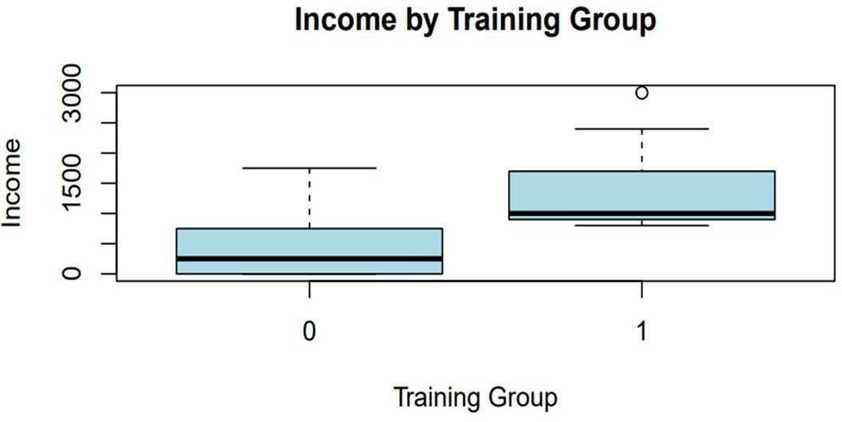
Income Difference for the Combined Treatment and Control Groups

Slide 28
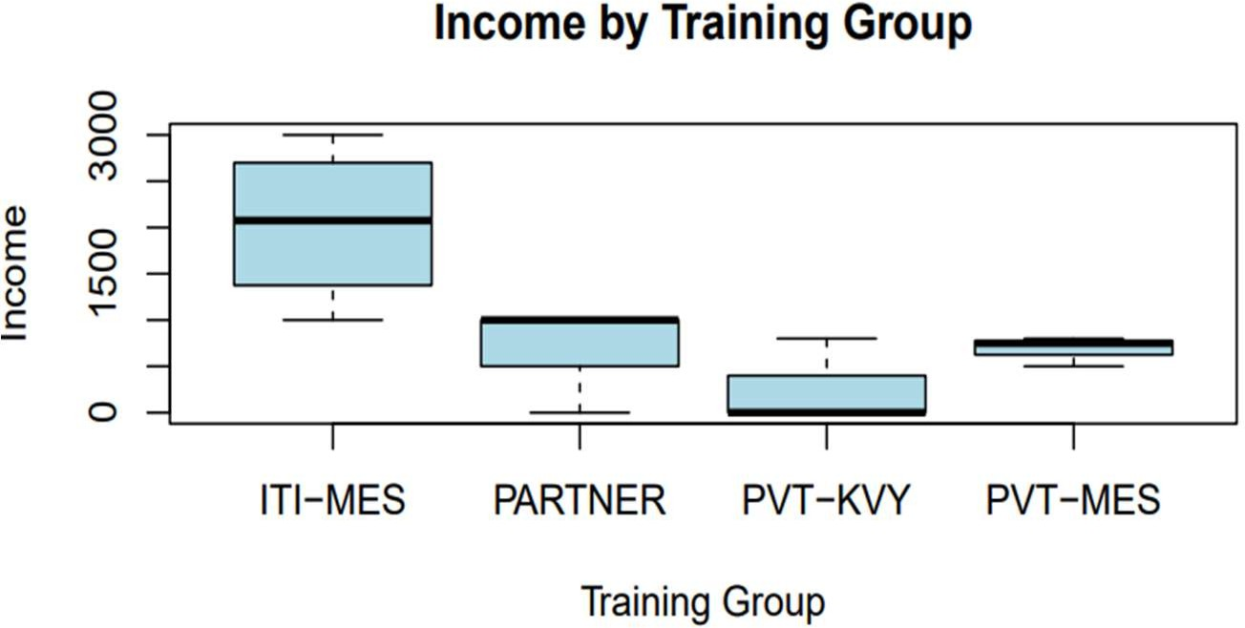
Income Difference for the four different Treatment Groups

Slide 29
Descriptive Statistics on Short/ Long Term Training – Pre & Post Intervention
Training Program | Prior Long Term Training | Posterior Long Term Training | Prior Short Term Training | Posterior Short Term Training
MES-ITI | 24% | 39% | 3% | 11%
MES-Pvt | 1.5% | 8% | 5% | 18%
MES-Control | 2% | 11% | 1.5% | 12%
PMKVY-Partner | 2% | 9% | 4% | 8%
PMKVY-Pvt | 3% | 6% | 2% | 5%
PMKVY-Control | 1% | 10% | 1% | 11%

Slide 30
Econometric Method
A combined application of Propensity Score Match using MDM method (King, 2015) and DID estimation method (Stuart et al, 2014)
PSM deals with the existing selection bias problem whereas DID is useful to address the time related confounders and unobserved heterogeneity
Improved precision of result as PSM creates a more comparable treatment and control groups
Robustness check with common support assumption and parallel trend assumptions
Improved validity of causal inference

Slide 31
Choice of the Matching Technique
NN: matching is simply a match between the closest P-Score between the treatment and the control group. No consideration for covariates and only scaler value matching
Caliper: It is similar to NN matching whereas an acceptable distance criteria parameter is also included
Kernel Density – considers the entire distribution of the propensity scores. Therefore, matching is done considering the estimated densities than just p- score. Difficult to apply for small sample
MDM: Is a relatively better approach as it looks into the covariate structure and not just the propensity score. In a sense, it takes into account the vector component while performing the sample pruning exercise. MDM could be robust to multicollinearity and less sensitive to outliers
30

Slide 32
Choice of the Matching Technique
MDM tends to be more robust to multicollinearity and outliers compared to nearest neighbor matching.
The p-score and the distance then multiplied to perform the matching operations.
D_{i}=[(X_{i}−Xˉ)′ S⁻¹ (X_{i}−Xˉ)]^{1/2}
Then, the p-score and the distance are combined together to perform the matching. Usually, the common way of combining the two measurements is as follows
Match Score =w⋅D_{i} + (1−w)⋅P_{i}
−1
31

Slide 33
Covariate Balancing with Propensity Score Method using Mahalanobis Distance Model (MDM) for MES-Pvt and MES Control Group
Training | Coef. | Std. Err. | z | P>z | [95% Conf. | Interval]
PriorWF_N | .2897652 | .2108213 | 1.37 | 0.169 | -.1234369 | .7029673
Prior_E | .0162846 | .0541668 | 0.30 | 0.764 | -.0898804 | .1224496
PriorScore | -.0061752 | .0080319 | -0.77 | 0.442 | -.0219174 | .0095669
Pr_LongTg | .046649 | .3015309 | 0.15 | 0.877 | -.5443407 | .6376386
PriorSt_Trg | -.3663379 | .2222392 | -1.65 | 0.099 | -.8019186 | .0692429
Muslim | .4983844 | .2146057 | 2.32 | 0.020 | .0777649 | .9190038
Age_trg | -.0063108 | .0503403 | -0.13 | 0.900 | -.104976 | .0923543
BPL | .1248784 | .2731212 | 0.46 | 0.648 | -.4104293 | .6601862
RELG_OT | -.517418 | .4213821 | -1.23 | 0.219 | -1.343312 | .3084757
OBC | .5999893 | .2992999 | 2.00 | 0.045 | .0133723 | 1.186606
SC | .7705039 | .3577788 | 2.15 | 0.031 | .0692704 | 1.471737
ST | .0838899 | .2931808 | 0.29 | 0.775 | -.4907339 | .6585137
Marital | -.0332164 | .3208898 | -0.10 | 0.918 | -.6621489 | .595716
_cons | .2100665 | 1.195365 | 0.18 | 0.861 | -2.132806 | 2.552939
32

Slide 34
Covariate Balancing with Propensity Score Method using Mahalanobis Distance Model (MDM) for MES-Pvt and MES Control Group
psmatch2: Treatment assignment | psmatch2: Common support Off support On support |  |  |  | Total
Untreated0 Treated | 73 | 25 | 132 | 73 | 157
Total |  | 25 | 205 |  | 230
Same Matching Process is used for the remaining other three treatment groups
33

Slide 35
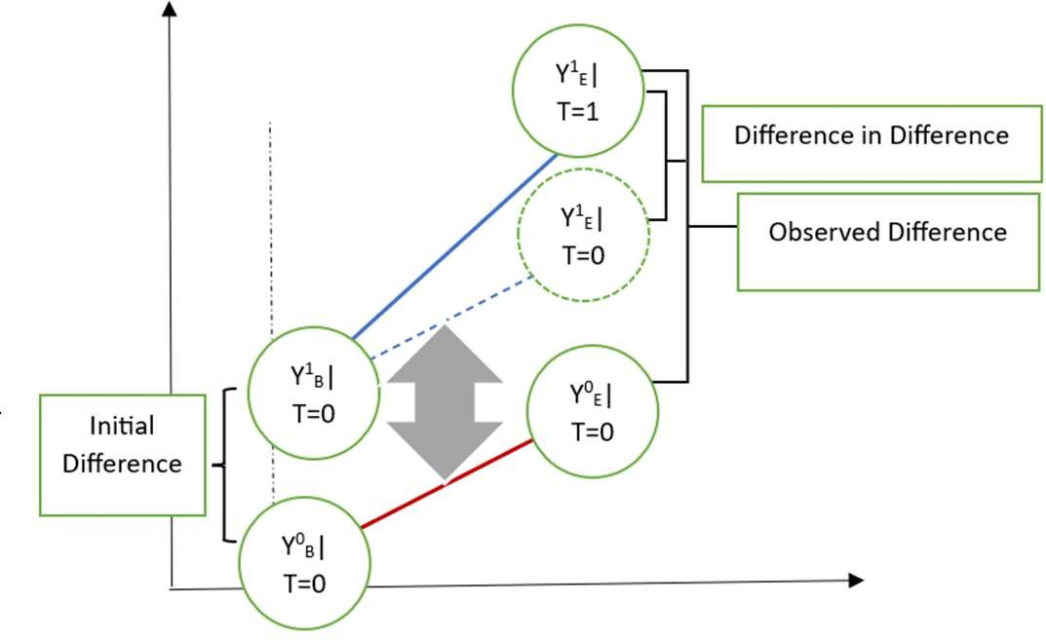
Difference-in-Difference Framework
Diff-in-Diff in a regression framework:
Y = β₀ + β₁E + β₂T + β₃E*T + u …
Where, β₁ is the initial difference (marginal difference of D at T=0
And β₂ is the baseline change over ti T
Whereas, β₃ is the treatment effect.
….(i)
me
34

Slide 36
Difference-in-Difference Framework
In its basic form, the DD model relies on an assumption that in the absence of the program or policy of interest, the treatment and comparison groups would have had the same trends across time.
Importance of validation of parallel trend assumption
Y = β₀ + β₁E + β₂T + β₃E*T + β₄ [Covariates] + β₅ E*[Pre-T]+ u
…….(ii)
35

Slide 37
Difference-in-Difference Framework for MES Training
Year | MES Training Govt Setup | MES Training Pvt Setup | MES Training Control
2014-2015 | ^{YPre}(i, MES-GOV =0) | ^{YPre}(i, MES-PVT =0) | ^{YPre}(i, MES-C)
2015-2016
2016-2017
2017-2018
2018-2019 | _{Y}Post (i, MES-GOV =1) | _{Y}Post (i, MES-PVT =1) | _{Y}Post (i, MES-C)
2019-2020
Difference | _{[Y}Post _{- Y}Pre (i, MES-GOV =1) (i, MES-GOV =0)^{] - [ YPost} i, MES-C) ⁻ ( ^{YPre}(i, MES-C) ] | _{[Y}Post _{- Y}Pre (i, MES-PVT =1) (i, MES-PVT =0)^{] - [ YPost} i, MES-C) ( ^{- YPre}(i, MES-C) ]
Y Variables | Income, Salaried Work, Further Long Term Training
36

Slide 38
Difference-in-Difference Framework for PMKVY Training
Year | PMKVY Extended Network Training Setup | PMKVY Independent Single Training Setup | PMKVY Training Control
2014-2015
2015-2016 | ^{YPre}(i, PMKVY-N = 0) | ^{YPre}(i, KVY-I = 0) | ^{YPre}(i, KVY-C)
2016-2017
2017-2018
2018-2019
2019-2020 | _{Y}Post (i, PMKVY-N= 1) | _{Y}Post (i, KVY-I = 1) | _{Y}Post (i, KVY-C)
Difference | _{[Y}Post _{- Y}Pre ] (i, PMKVY-N =1) (i, PMKVY-N =0) _{- [ Y}Post _{- Y}Pre ] (i, KVY-C) (i, KVY-C) | _{[Y}Post _{- Y}Pre _{] - [} (i, KVY-I =1) (i, KVY-I=0) _{Y}Post _{- Y}Pre ] (i, KVY-C) (i, KVY-C)
Y Variables | Income, Salaried Work, Further Long Term Training
37

Slide 39
DID Coefficients for Salaried Employment
 | Coefficient | Robust std. err. | t | P >|t| | 95% Conf. Interval
ATET (MES at ITI) | .73 | .043 | 21.2 | 0.00 | .73435 .92342
ATET (MES at Pvt.) | .29 | .21 | 1.37 | .21 | -.123 .702
ATET (PMKVY-N) | .62 | .311 | 2.00 | .048 | .012 1.13
ATET (PMKVY-I) | .13 | .27 | .46 | .648 | -.241 .876
ATET (PMKVY-P) | .30 | .08 | 3.75 | .022 | .2876 .3425
ATET (PMKVY- NP) | .77 | .35 | 2.15 | .03 | .069 1.472
38

Slide 40
DID Coefficients for Further Long Term Training
 | Coefficient | Robust std. err. | t | P >|t| | 95% Conf. Interval
ATET (MES at ITI) | .4983844 | .2146057 | 2.32 | 0.020 | .0778 .919
ATET (MES at Pvt) | .0162846 | .0541668 | 0.30 | 0.764 | -.089 .122
ATET (PMKVY- N) | .046649 | .3015309 | 0.15 | 0.877 | -.544 .637
ATET (PMKVY- I) | -.517418 | .4213821 | -1.23 | 0.219 | -1.343 .308
ATET (PMKVY- P) | .0838899 | .2931808 | 0.29 | 0.775 | -.497 .658
ATET (PMKVY- NP) | -.0332164 | .3208898 | -0.10 | 0.918 | -.662 .595
39

Slide 41
DID Coefficients for Wage/ Salary
 | Coefficient | Robust std. err. | t | P >|t| | 95% Conf. Interval
ATET (MES at ITI) | 882.9192 | 305.8812 | 2.89 | 0.004 | 279.87 1485.96
ATET (MES at pvt.) | 264.3605 | 144.6765 | 1.83 | 0.069 | -20.86 549.58
ATET (PMKVY-N) | 346.4935 | 185.6719 | 1.87 | 0.063 | -19.55 712.54
ATET (PMKVY-I) | 179.2276 | 131.0645 | 1.37 | 0.173 | -79.16 437.62
ATET (PMKVY-P) | 161.9935 | 33.85294 | 4.79 | 0.000 | 95.252 228.734
ATET (PMKVY-NP) | 248.2733 | 288.7556 | 0.86 | 0.391 | 321.01 817.55
40

Slide 42
Results & Interpretation
The “exposure effect” of the MES-ITI is quite prominent.
A significant correlation could be observed between placement support received after the short- term training and the present earnings.
Duration of the training matters to some extent
Extended network of training setup (PMKVY-N) has some positive impact. The positive impact sustains even when controlled for the placement setup
Lion’s share of training and employment is in Services or Utility sector. Hardly any training or employment in manufacturing sector
Not much variation in the NSQF levels - almost all courses are either level 3 or level 4
Take up of the future courses – more likely for MES-Govt and from the control group
Long term trainings have a distinct impact on salaried employment/ wage/salary vis-à-vis the short term training
41

Slide 43
Thank You! Questions?
42

