Slide 1
Bivariate probit

Slide 2
Bivariate probit

Slide 3
Bivariate probit

Slide 4
Bivariate probit

Slide 5
Bivariate probit

Slide 6
Mixed probit-uncensored

Slide 7
Mixed probit-uncensored

Slide 8
Bivariate ordered probit

Slide 9
Mixed probit-ordered probit

Slide 10
Likelihood for SUR models
Computed separately for each observation
  So model can vary by observation
  Different censoring structure, different # of eqs
For each obs, integral of multivariate normal distribution
Over some “Cartesian” region
  Point, line, ray, half-plane, quarter-plane, etc.
Core of cmp does this math

Slide 11
Two-stage probit

Slide 12
Same math!
  Still integrate normal distribution over Cartesian region
cmp automatically a multi-stage estimator
  Can do IV, Heckman selection, switching regressions…
By same token
  biprobit can be a two-stage estimator
Wasn’t widely appreciated
  Greene (1998): “surprisingly”…“seem not to be widely known”
  Wooldridge (e-mail 2009): “I came to this realization somewhat late, although I’ve known it for a couple of years now.”
Requires system to be “fully observed” and recursive.

Slide 13
Available models
Uncensored
Tobit
Probit
Ordered probit
Interval
Multinomial probit
Rank-ordered probit (new)
Truncation allowed in all but last two (new)

Slide 14
But wait! (three years)
…there’s more.
No longer need:
  fully observed
  recursive

Slide 15
Two-stage probit with latent determinant

Slide 16
I don’t know how to code that integral

Slide 17
Standard solution
Define:
Then the system is:
SUR system we know how to fit
Detail:

Slide 18
More abstractly…
Rewrite:
or:
Solve:
where:
and thus:

Slide 20
sysuse auto, clear
cmp setup
* Fully observed
cmp (price = foreign ) (foreign = mpg), ind($cmp_cont $cmp_probit)
* With latent determinant
cmp (price = foreign#) (foreign = mpg), ind($cmp_cont $cmp_probit)

Slide 21
Math still works if Γ not triangular…
Rewrite:
or:
References to linear functions need not be recursive
Full simultaneity OK
References to censored variables must still be recursive

Slide 22
webuse klein, clear
cmp setup
* similar:
reg3 (consump wagepriv wagegovt) ///
(wagepriv consump govt capital1)
cmp (consump = wagepriv# wagegovt) ///
(wagepriv = consump# govt capital1), ///
ind($cmp_cont $cmp_cont) nolr tech(dfp) qui

Slide 23
Random effects and coefficients
Hierarchical/multilevel
At each level, can be correlated within and across equations
  or not
Handled with simulation or (adaptive) quadrature

Slide 24
webuse union, clear
* Random efect:
xtprobit union age grade c.south##c.year
cmp (union = age grade c.south##c.year || idcode:), ///
ind($cmp_probit) tech(dfp) nolr
* Random coefficient too, potentially correlated with random effect:
cmp (union = age grade c.south##c.year || idcode: grade), ///
ind($cmp_probit) tech(dfp) nolr
* Random coefficient too, independent of random effect:
cmp (union = age grade c.south##c.year || idcode: grade, cov(ind)), ///
ind($cmp_probit) tech(dfp) nolr intpoints(8)
* Random coefficient only:
cmp (union = age grade c.south##c.year || idcode: grade, nocons), ///
ind($cmp_probit) tech(dfp) nolr intpoints(8)

Slide 25
Probit with random effect

Slide 26
Numerical method I: Quadrature
Evaluate integrand at ~4–16 special points with special weights
Traditional strength: computationally cheap
Inaccurate if integrand is a narrow bump between special points; Rabe-Hesketh, Skrondal, Pickles 2002)
Adaptive quadrature searches for the bump; slower
Evaluations increase exponentially in dimensions of integration
  Integrating over 3-D effect can take 4³–16³ evaluations
  BUT “sparse grids” can help (Heiss & Winschel 2008)

Slide 27
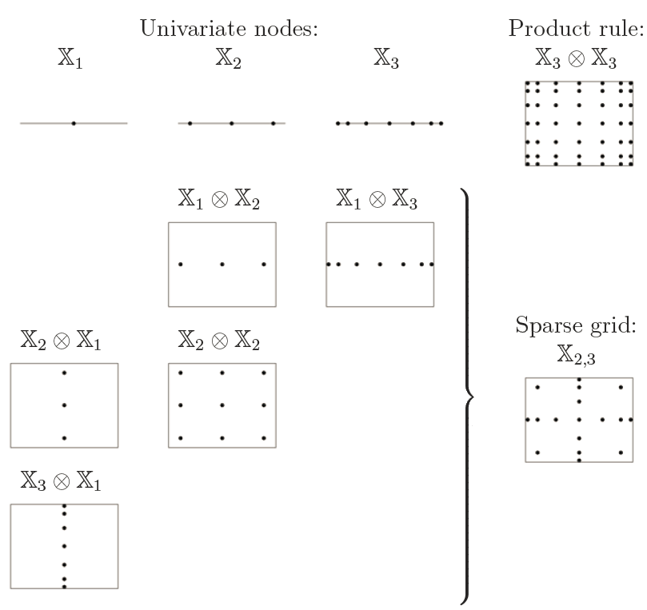
Source: Heiss & Winschel 2008

Slide 28
Numerical method I: Simulation
Sample integrand at 50, 100, 500 points…
Far more CPU time than quadrature
  Maybe not more than adaptive quadrature?
Extends naturally to higher dimensions
  Multidimensional Halton sequences (Cappellari & Jenkins 2006, Drukker & Gates 2006)
  Can “scramble” to improve uniformity (Kolenikov 2012)
  Can step: first estimate coarsely with 10 points, then refine with 20, 40…

Slide 29
cmp offers quadrature and simulation
But adaptive quadrature not ready for models with >2 levels

Slide 30
Innovation 1: improved binormal()
Should match, but don’t in Stata:
  normal(-10)*normal(-10) => 5.80622e-47
  binormal(-10, -10, 0) => 0
  New binormalGenz() more accurate
    based on Alan Genz (Statistics & Computing, 2004)
Likewise:
  normal(-10) => 7.620e-24
  1-normal(10) => 0
  Use first to calculate second
  Do analogous for binormal()
These small differences matter when taking logs

Slide 31
Innovation 2: pseudo-linear form

Slide 32
Needed calls to evaluator program
gllamm
  “d0” evaluator
  # of calls for 1st derivatives = # of parameters
  # of calls for 2nd derivatives = (# of parameters)²
cmp
  “lf1” evaluator
  # of calls for 1st derivatives = 1
  # of calls for 2nd derivatives = # of eqs + # of aux params
    (aux params=sigs and rhos of errors, ordered-probit cut points)

Slide 37
Parallelization efficiency
xtprobit: 98%
gllamm: 88%
cmp: 50% (adaptive quad); 56% (simulation)

