Slide 1
PISA (and PIAAC) Data analysis using Stata (July 2017)
Francois Keslair

Slide 2
Repest is a Stata routine (ado file), freely available at IDEAS, that:
Is specially designed for complex survey designs:
Accommodates final weights and uses replicate weights for the sampling variance;
Allows analysis with multiply imputed variables:
Accepts plausible values and incorporates imputation variance in the computation of total variance.
By Francesco Avvisati and Francois Keslair (OECD)

Slide 3
How to install repest
From the Stata command window (version 11.0 and above), type
ssc install repest, replace

Slide 4
Origins
One generic tool for all OECD skills surveys is better surveys than several specific ones.
Making life easier for internal and external users
Program core principle: Repest run any eclass command inside loops over plausible values and/or replicated weights

Slide 5
Use repest to compute simple means of variables
Table I.6.2A
repest PISA,estimate(means escs) by(cnt)
estimates correct sampling variance (accounting for clustering + stratification)

Slide 6
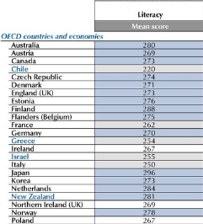
Use repest to compute simple means of performance variables
Figure I.1.1
repest PIAAC,est(means pvlit@) by(cntry_e)
Combines sampling and imputation variance in estimation of S.E.

Slide 7
Why REPlicate ESTimate?

Slide 8
Survey design entails two kinds of weights: PISA
FINAL STUDENT WEIGHTS
Students and schools in a particular country did not necessarily have the same probability of selection;
Differential participation rates according to certain types of school or student characteristics are required;
Some explicit strata were over-sampled for national reporting purposes;
Various non-response adjustments.
REPLICATE WEIGHTS (BRR)
Replicate weights are used to refine the calculation of standard errors in complex sampling designs:
There are many possible samples of schools and they do not necessarily yield the same estimates;
Each replicate weight represents one sample;
They take into account the error of selecting one school and not another (sampling error).
→ PISA gives a representative sample of 15 yo pupils

Slide 9
Why repest and not svyset …, vce(brr)… Multiply imputed variables

Slide 10
Plausible values serve two basic functions:
To account for the lack of precision (measurement error) of the instrument (i.e. the test items) used to measure the performance of the target population;
To provide a set of plausible scores for every student, overcoming the limitations of rotated booklet design.
Notes:
Especially in psychometric surveys

Slide 11
The variance $V\left(X^{∗}\right)$ for a statistic X* with plausible values is given by
$$\sum_{p=1}^{P}{\frac{f}{P}∗\sum_{r=1}^{R}{{\left({x^{∗}}_{r,p}−{x^{∗}}_{0,p}\right)}^{2}}}+\left[\left(1+\frac{1}{P}\right)∗\sum_{p=1}^{P}{\frac{{\left({x^{∗}}_{0,p}−\overline{{x^{∗}}_{0 }}\right)}^{2}}{P−1}}\right]$$
Sampling variance for each plausible value (80 replicates per PV)
Imputation variance (variability of estimates across PVs)
$x_{r,p}^{∗}$: r-th estimate for plausible value p
$x_{0,p}^{∗}$: final estimate (i.e. with final weights) for plausible value p
$\overline{{x^{∗}}_{0,}}$: average of the plausible values
$f$: variance factor (depends on replication method: BRR, jackknife-1, jk-2,…)

Slide 12
repest svyname [if] [in] , estimate(cmd [,cmd_options]) [options]

Slide 13
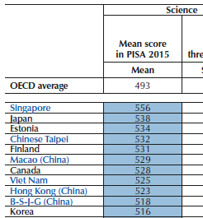
How repest outputs results: display, outfile, store
Figure I.1.1
repest PISA,est(means pv@scie) by(cnt) [display]
repest PISA,est(means pv@scie) by(cnt) outfile(means_scie)
repest PISA,est (means pv@scie) by(cnt) store(means_scie)

Slide 14
Outfile: stata dataset with point estimates and S.E.
use means_scie, clear
…list, export excel, etc.
simple post-estimation (e.g. trends, means…)
Simpler alternative for requesting country means: by(cnt, average(…))

Slide 15
store: stata estimation, can be used with estout/esttab
estimates list
estout …

Slide 16
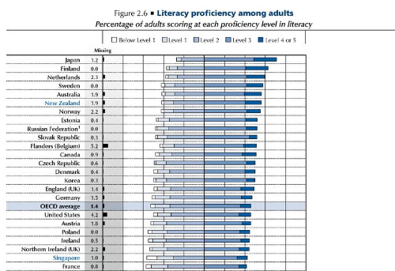
Derived variables with PVs: Adult’s proficiency in Numeracy
repest PIAAC,estimate(freq litlev@) by(cntry_e) outfile(freq)
Notes:
Define pvscielevel nel dofile

Slide 17
Using Stata e-class commmands (regressions,…) accessing saved scalars
Figure I.6.6
repest PISA,estimate(stata: reg pv@scie escs) results(add(r2)) by(cnt) outfile(reg)
Notes:
remark that the output also incluse the score point difference associated with a one-unit change in the index of ESCS

Slide 18
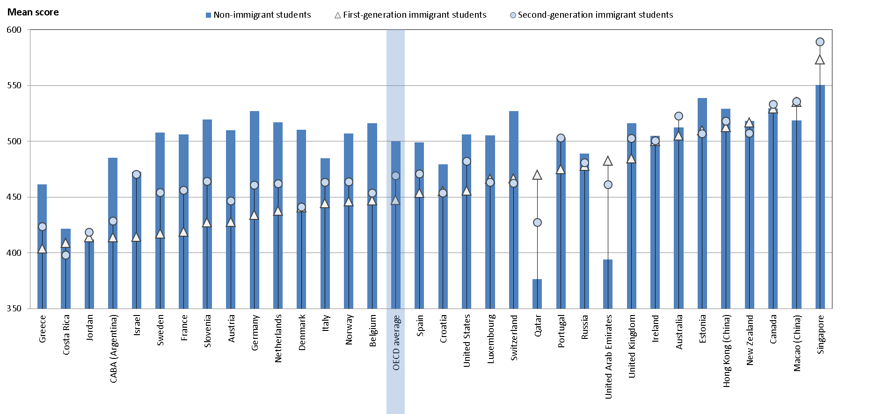
repest PISA,est(means pv@scie) over(immig,test) by(cnt) flag
Figure I.7.4
Testing differences across subpopulations
Implementing minimum cases rules

Slide 19
The “flag” option – to use or not to use?
PRO
Implements minimum cases rules automatically: The option flag in repest PISA ensures that reported statistics are always based at least 30 students and 5 schools with valid data.
Protects confidentiality of respondents, improves robustness of findings
Replaces results with a specific missing code (.f)
CON
Requires computation time.
Results need to be interpreted – it will flag also cases of missing by design
Not always needed: often there is no doubt that there are sufficient obs (e.g. country mean performance)
The reference population may be larger than considered by flag: freq

Slide 20
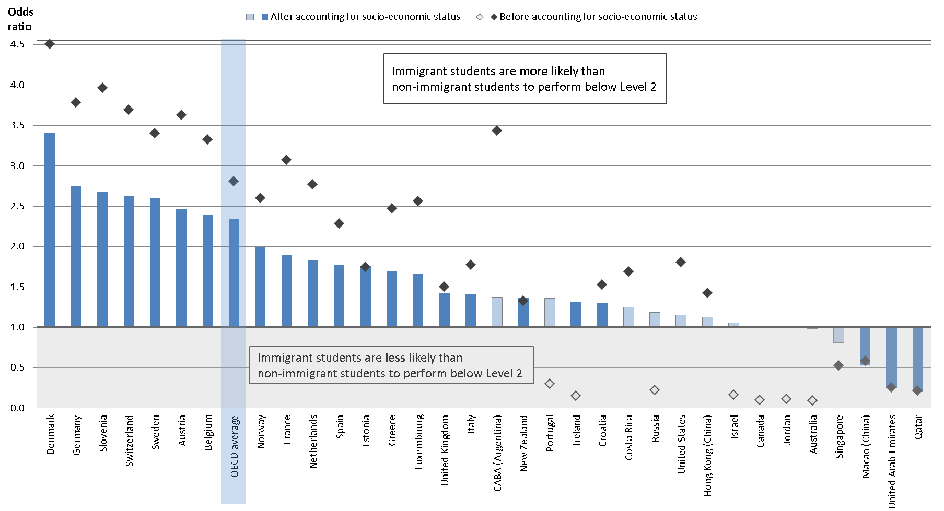
Before-after analysis (accounting for ESCS)
Figure I.7.7

Slide 21
When computing quantities before and after accounting for some controls, we ensure that we are comparing the same set of observations
Before accounting for ESCS
repest PISA if !missing(escs), est (stata: logit lp_pv@scie immback,or) by(cnt) flag
By requiring to run the “before” analysis only for observations with a non-missing value for ESCS, we are restricting the sample to that of the “after” analysis, shown below
After accounting for ESCS
repest PISA, estimate (stata: logit lp_pv@scie immback escs,or) by(cnt) flag

Slide 22
REPEST tips and tricks
Notes:
combine
Fast
Flags and freq
Programmi e debug
Over
(makes the program as flexible as possible)

Slide 23
Speeding up repest: the fast option (“an unbiased shortcut”)
$$\sum_{p=1}^{P}{(\frac{f}{P}∗\sum_{r=1}^{R}{{\left({x^{∗}}_{r,p}−{x^{∗}}_{0,p}\right)}^{2}}}+\left[\left(1+\frac{1}{P}\right)∗\sum_{p=1}^{P}{\frac{{\left({x^{∗}}_{0,p}−\overline{{x^{∗}}_{0 }}\right)}^{2}}{P−1}}\right]$$
Sampling variance for one plausible value only
Imputation variance (variability of estimates across PVs)
(almost) P times faster
repest PISA, estimate (stata: logit lp_pv@scie immback escs,or) by(cnt) flag fast

Slide 24
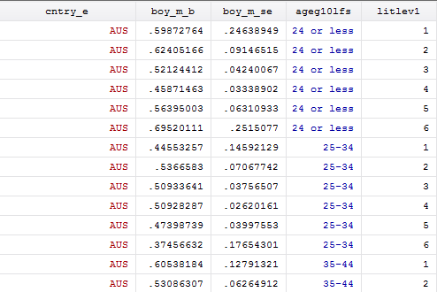
Looping over several population characteristics
repest PIAAC, estimate(means boy) over(ageg10lfs litlev@) by(cntry_e, levels(AUS) outfile(lit_by_age_gender, long_over)
Or if you want only high skilled individuals:
repest PIAAC if litlev@>3, estimate(means boy) over(ageg10lfs) by(cntry_e, levels(AUS))

Slide 25
Arithmetic operations on results: combine
You need to insert in brackets the column name of e(b) results vector (displayed!)
repest PISA, estimate(summarize escs, stats(p5 p95)) by(cnt) results(combine(escs_length: _b[escs_p95] - _b[escs_p5]))
Other applications:
Testing for multiple differences (native native vs 1st generation, native vs 2nd gen, 1st vs 2nd gen)
Limitations:
It is not compatible with the “over” option

Slide 26
Defining your own programs: Why?
You want to use an r-class command in repest
You want to use a two-line command in repest
(e.g. postestimation)
There is no Stata command for what you want to do
(e.g. simultaneous weighted quantile regression)

Slide 27
Defining your own programs: What?
Your program needs
to be defined as an estimation class command (eclass)
to have a syntax statement that accepts if/in statements, pweights or aweights
Your program needs to post a results vector (will become e(b))
ereturn post myvectorofstatistics
cap program drop mycorr
program define mycorr, eclass
syntax …. [if] [in] [pweight],…
…. (compute things, using regular stata commands)
…. (create a vector of results you want to keep, if it’s not there)
ereturn post myvectorofstatistics
end

Slide 28
Debugging your own programs: How?
Tips:
Check that your programme meets the minimum conditions (weights, eclass)
Test your programme outside of repest (with an explicit weight statement)
Trace your programme, block by block (set trace on… set trace off)
Ask the authors :
Francesco.avvisati@oecd.org
Francois.keslair@oecd.org

Slide 29
Thanks a lot for your attention!
Q&A

