Slide 1

Analysis of
surgical outcomes
in clustered data
Dmitry Tumin, PhD
Department of Anesthesiology and Pain Medicine, NCH
Department of Pediatrics, OSUCOM

Slide 2
Surgery in the US
>50 million inpatient procedures / year
~1-5% mortality rate for inpatients
OR time costs $36 / minute

Slide 3
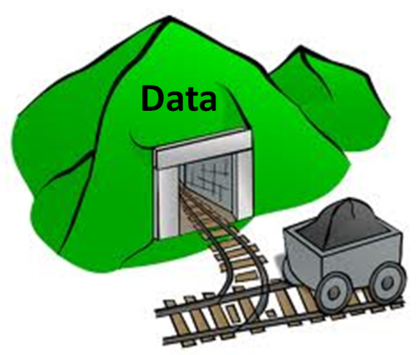
Surgical outcomes data
Hospital records
Clinical registries
Insurance claims

Slide 4

Clustering
Patient
Surgeon
Hospital
Geography

Slide 5

When things go horribly wrong
“Broken Hearts”
Journal retracts
paper over clustered
standard errors
Anesth Analg 2016;122:1231-3

Slide 6
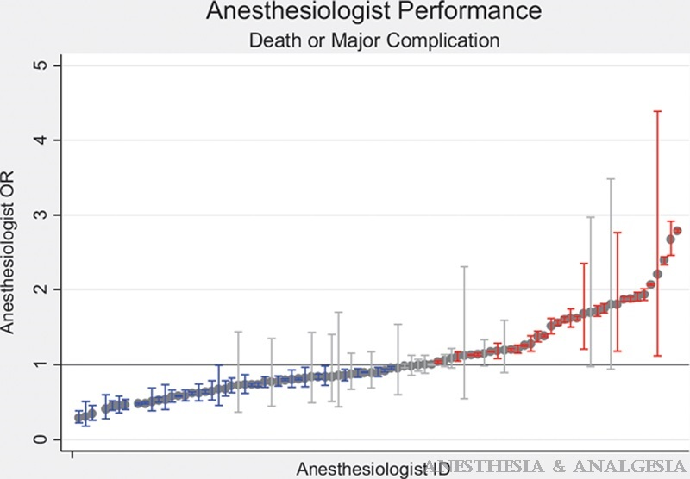
“The rate of death or major complications among patients undergoing coronary artery bypass surgery varies markedly across anesthesiologists.”
The article demonstrated something we have
always thought: some anesthesiologists are better than others.
The problem was subtle, the difference between “robust cluster (anes)” and “robust” in the Stata program code. It seemed to me and the reviewers that the analysis should be clustered, [but] “when fixed effects and clustering are specified at the same level, tests that involve the fixed effects themselves are inadvisable (the standard errors on fixed effects are likely to be substantially underestimated, though this will not affect the other variance estimates).”

Slide 7
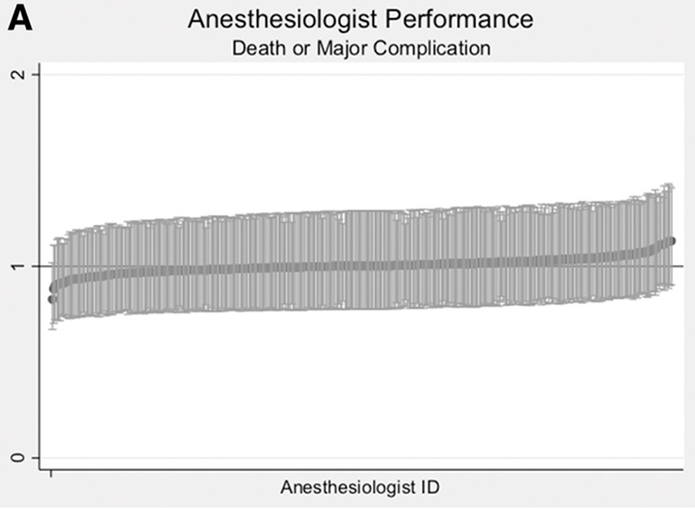
Retracted
article
Corrected
article

Slide 8
A slight misunderstanding…
Why should we adjust for clustering
→ How should we do it
  → What can we conclude

Slide 9
Scenario 1
Cases are not independently sampled
Cluster robust standard errors
Problem:
does not address biased coefficients

Slide 10
Scenario 2
Confounding by cluster, and differences between clusters are ignorable
Only care about correctly estimating
association between patient factor
and patient outcome
Fixed effects models

Slide 11

Example
Lung transplant
cold ischemia
Longer time =
worse outcomes?
But, hospitals willing to take lungs from
farther away tend to be more experienced

Slide 12
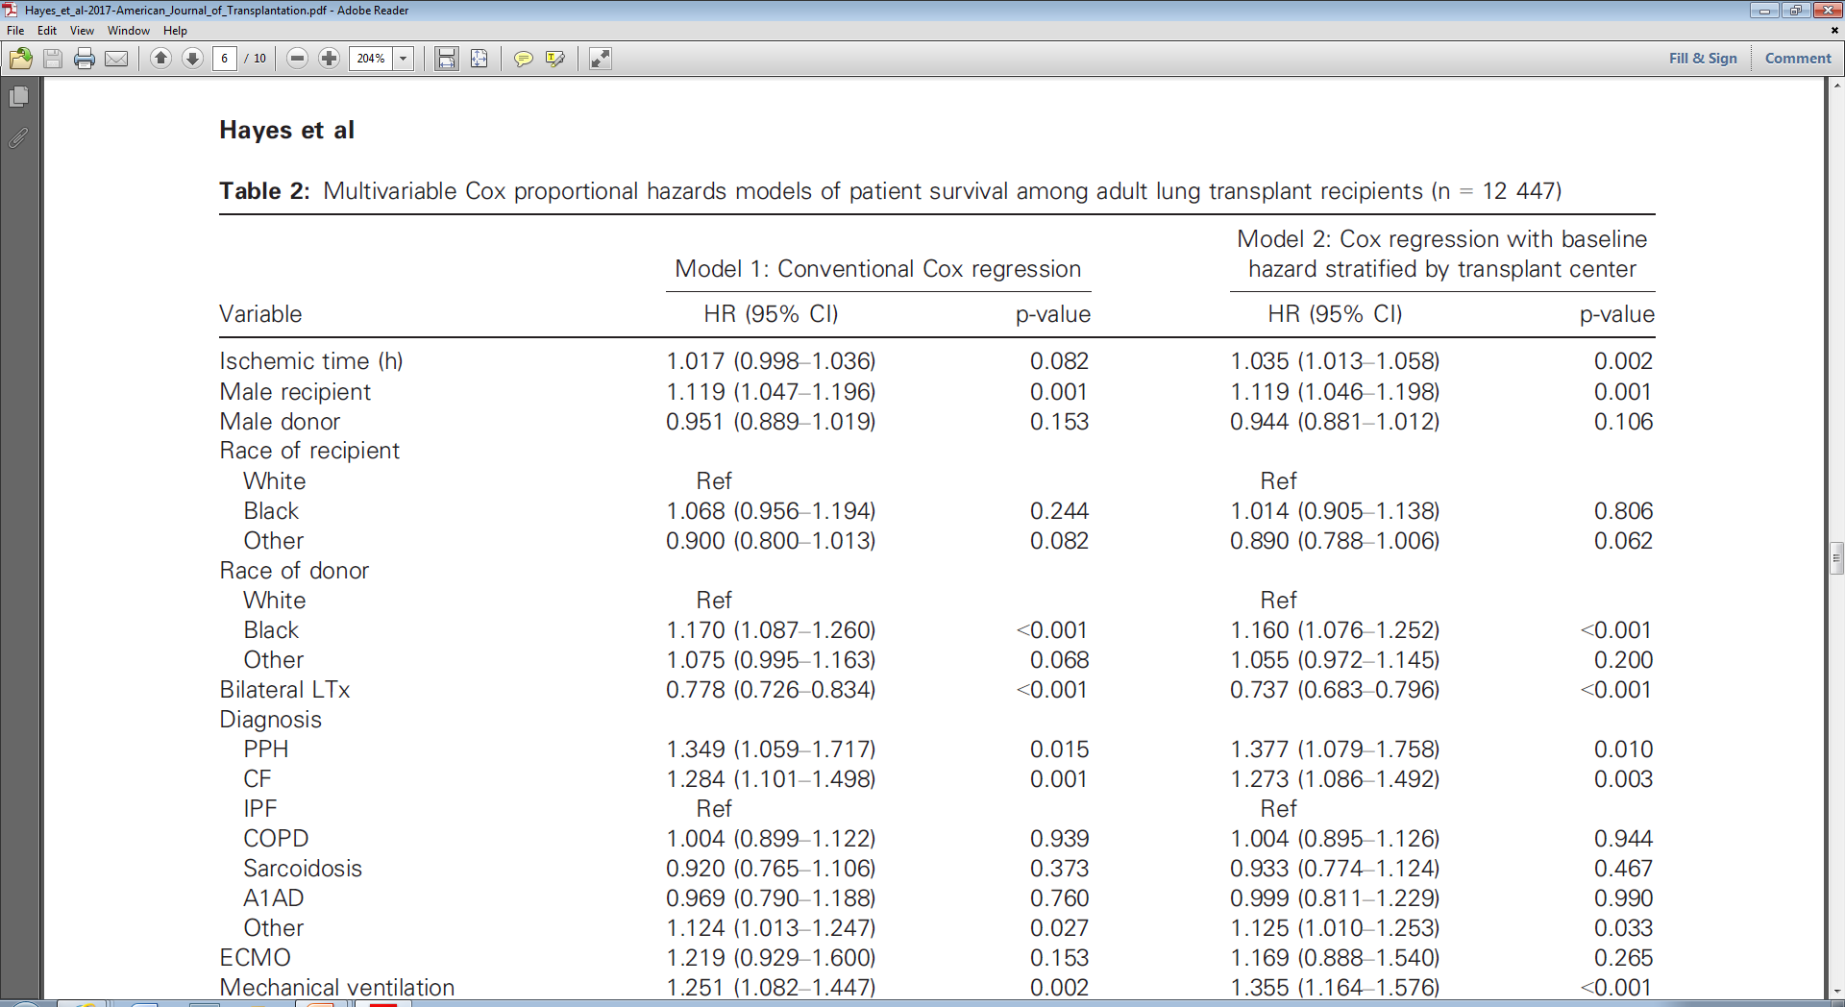
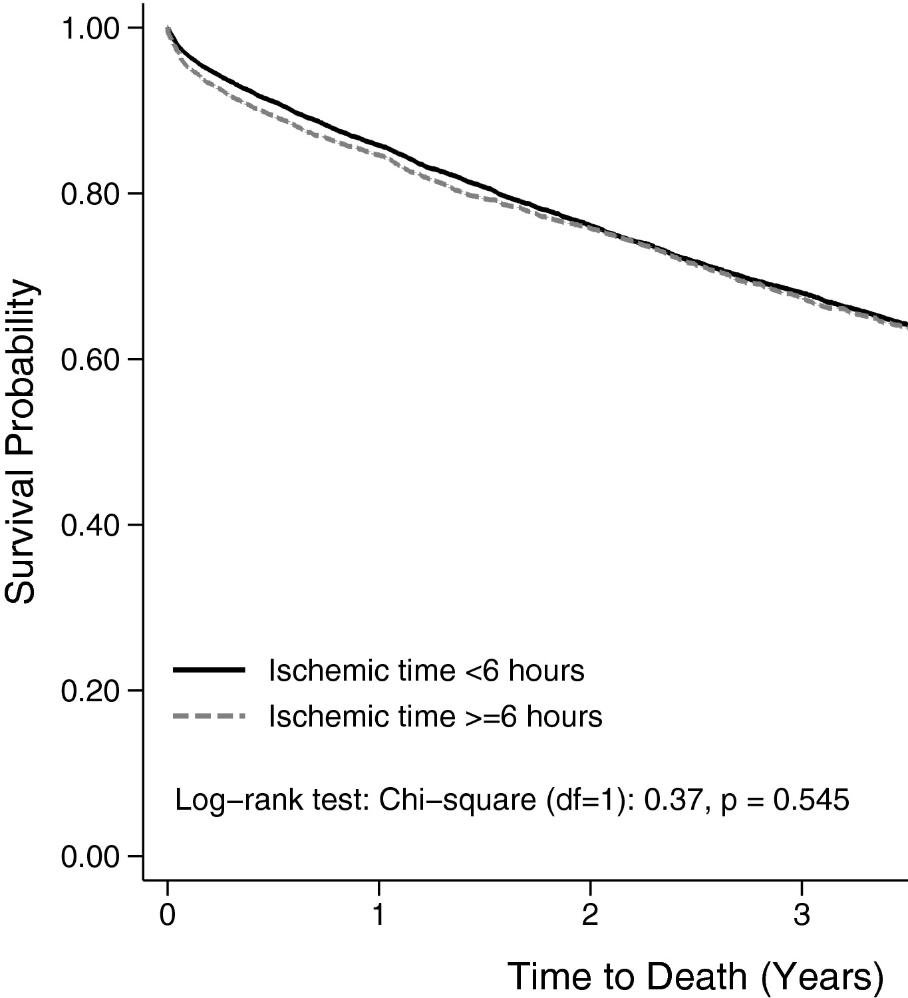
Stratified Cox =
comparing ischemia
time among patients
transplanted at the
same hospital
Increased HR
Hayes et al. Am J Transplant 2017

Slide 13
Scenario 3
Cluster differences NOT ignorable
Also care about identifying
“better/worse” clusters
Do we know what makes a cluster
better or worse?

Slide 14
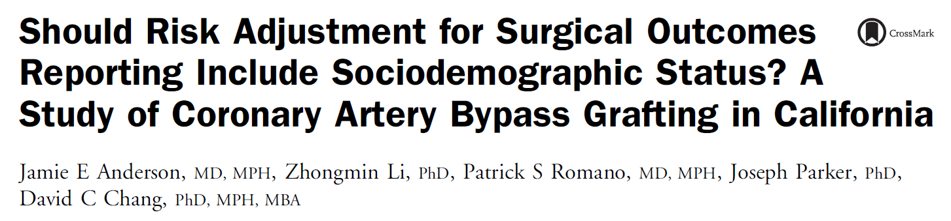
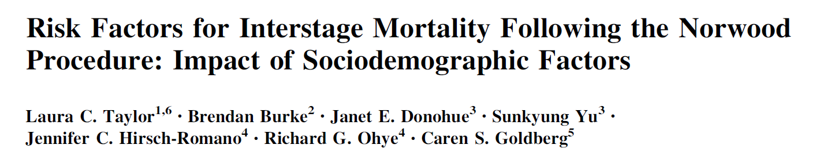
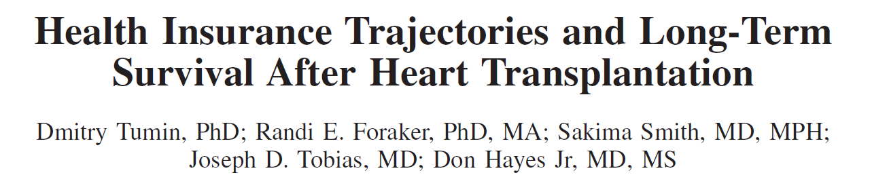
Example: median household income in geographic area (neighborhood, county)

Slide 15
What if...
Cluster-level measure
does not predict outcomes?
Other possible factors at the
cluster level cannot be measured?

Slide 16
Scenario 4 we do NOT know why some clusters have better/worse outcomes

Slide 17

Some options…
Cluster ID as covariate
Bayesian analysis
Random effects analysis, if overall variation among clusters is of interest

Slide 18
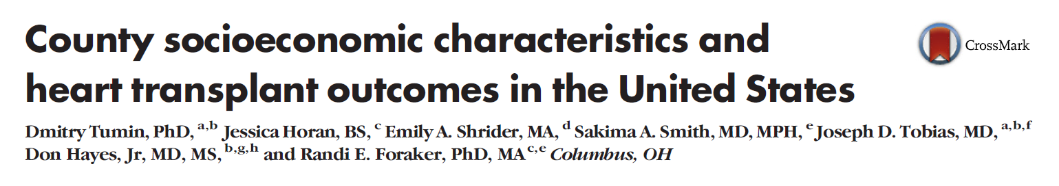
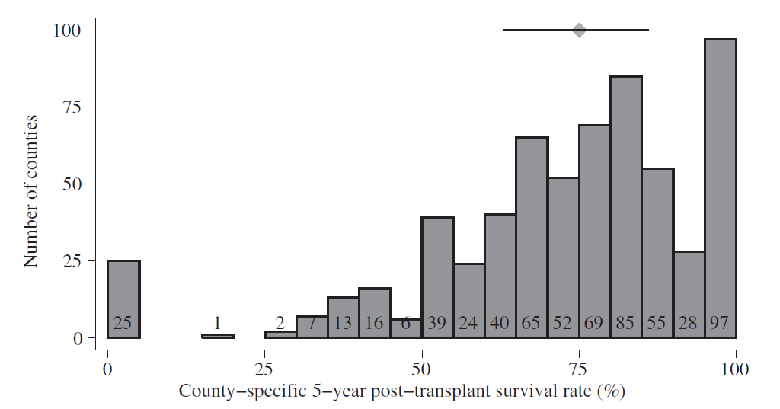
Example

Slide 19
Variance of shared frailty term
How different are clusters of patients
after controlling for observed covariates?
H0 = no residual difference between clusters
If fail to reject H0,
No reason for testing specific cluster measures
No reason for including clustering level (county)
  in risk-adjustment models

Slide 20
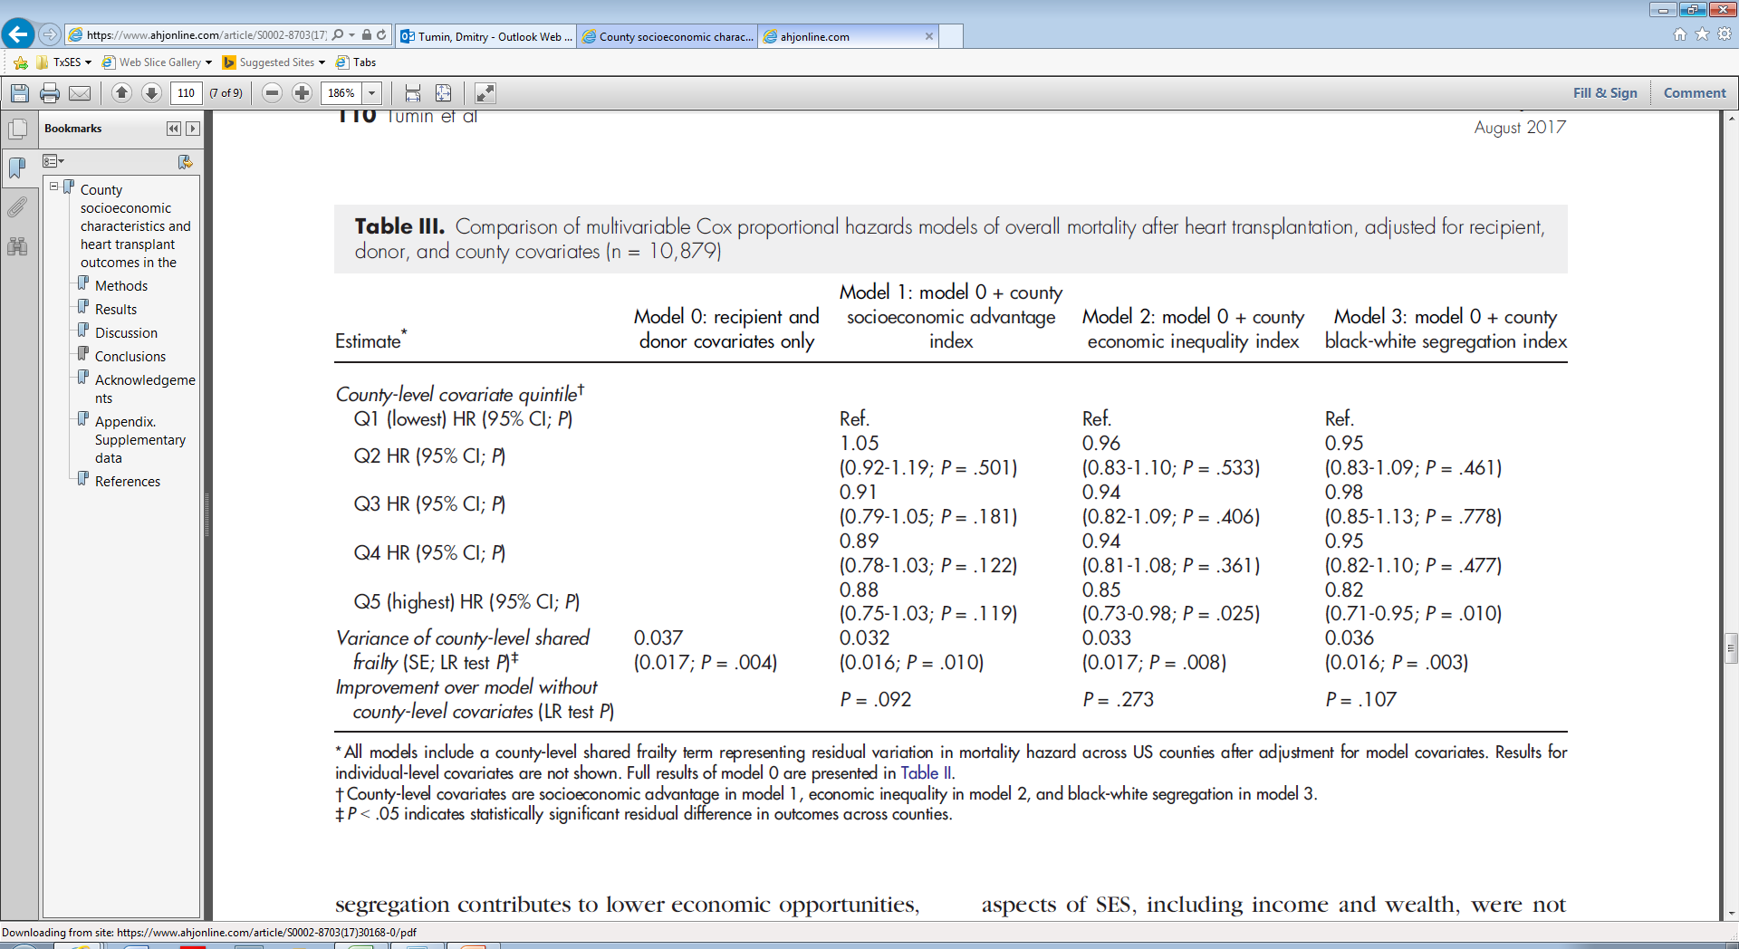
Heart transplant outcomes by county
After controlling for county SES:
Same variation in mortality across counties
No improvement in model fit

Slide 21
Visualizing shared frailty variance
Rarely done in surgical outcomes research
Variance estimate is often not even reported
But, easy to do using invgammap + gammaden

Slide 22
// HR for 80th percentile vs. median
di invgammap(1/`theta’, (0.8))*`theta’
// Density plot
tw function y=exp(gammaden(1/`theta1',`theta1',0,x)

Slide 23
Summary
Clustered observations are common in
surgical outcomes research
Need to account for confounding by cluster,
not just lack of independence in sampling
Analytic approach—“single out” outliers,
or capture overall variation among clusters?
Depends on clinical/administrative need

Slide 24
Questions / comments
Dmitry.Tumin@nationwidechildrens.org

