Slide 1

Disappearing Medicaid enrollment disparities for
U.S. citizen children in immigrant families
- Average Marginal Effects for Applied Research -
Eric Seiber, PhD
Evan Goldstein, MPP

Slide 2
Question?
Will coverage gains prove transient for Medicaid eligible children in immigrant families?
Partially funded by the Foundation for Child Development

Slide 3
Background
Who are the 19 million immigrant children?
  Non-citizen, first generation immigrants
  Naturalized, first generation immigrants
  Native born, at least one immigrant parent
Immigrant children in this presentation
  Groups #2 and #3
  Includes 26% of all citizen children (2015)
  Qualify for Medicaid if income eligible
  But, parent must enroll them

Slide 4

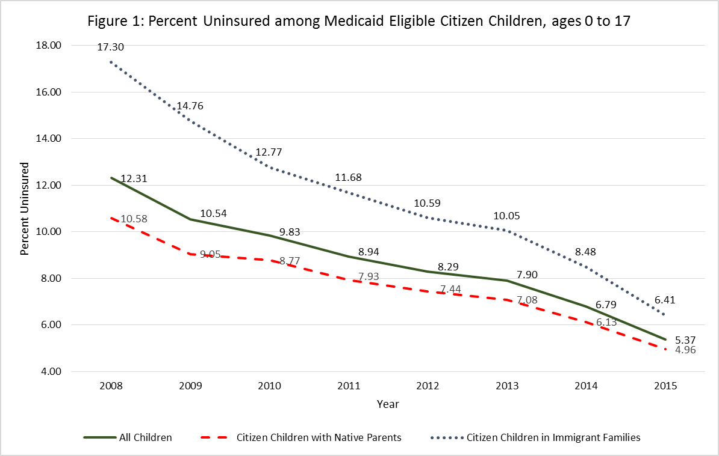
Trends in Child Coverage
National changes mask important state level differences

Slide 5
Methodology
2008-2015 American Community Survey
  3 million households per year
Sample:
  1.7 million Medicaid eligible children
  Including 443,000 immigrant children
  Only citizenship status, not documentation
Predicting probability of remaining uninsured
  Sample includes only Medicaid eligible children

Slide 6
Methodology
Probit model with State fixed effects, State*Immigrant Family interactions
  Fixed effects: usually imprecise, nuisance parameters
  Large ACS sample allows increased precision
Why might a state have more uninsured children in immigrant families?:
  Harder for all children to enroll in Medicaid?
    State fixed effects
  Harder to enroll for just children in immigrant families?
    State fixed effects * Immigrant Family interactions
  Harder immigrant population to enroll?
    Measures of the immigrant experience

Slide 7
Preliminary Findings
State*Immigrant Family Interaction Effects
Probability an immigrant child is uninsured in that state, compared to California
Five Top States | Coef. | Std. Error
Maine | -10.4% | 3.1%
Oregon | -5.9% | 2.7%
Massachusetts | -5.1% | 0.9%
Michigan | -4.1% | 2.0%
5. New York | -4.0% | 0.8%

Slide 8
Methodology: Average Marginal Effects
Example: Estimating Enrollment Disparities:
  Differentials are the average marginal effects of the State fixed effects * Immigrant Family interactions
Predicted Percent Uninsured but Medicaid Eligible
Example: Utah | 2009 | 2011 | 2013 | 2015
Citizen Children in Immigrant Families | 31.5% | 29.7% | 24.0% | 19.8%
Citizen Children with Two Native Parents | 13.0% | 12.3% | 10.7% | 9.3%
Enrollment Differential | 18.5% | 17.5% | 13.3% | 10.5%
Average Enrollment Differential (all states) | 5.2% | 3.2% | 2.4% | 1.9%
Median Enrollment Differential (all states) | 4.4% | 3.1% | 2.1% | 1.5%

Slide 9
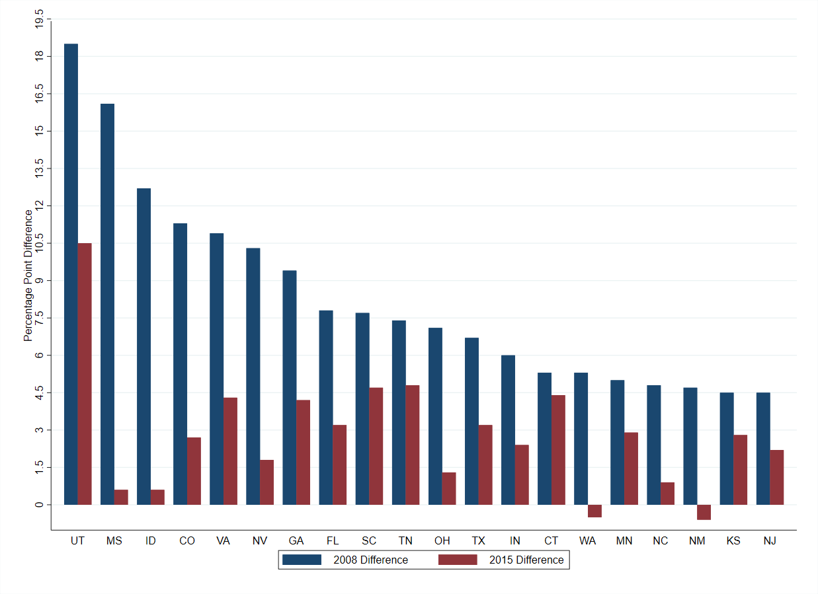
Results – 2008 vs 2015 Enrollment Differentials
Average reduction of 50%; some states eliminated their enrollment differential.

Slide 10
Results
Reductions in enrollment disparities of 50%-100% across almost all states from 2008-2015
Timing of reductions not consistent across states:
  Many states achieved their gains by 2011.

Slide 11
Results
Question:
  Do the reductions correlate with a particular legislative or policy change?
Potential Policy Levers:
  CHIPRA Medicaid Expansion
  ACA Adult Medicaid Expansion
  CHIPRA ICHIA Option
  CHIPRA Bonus Payments
Problems:
  Few policy changes in states with largest gains
  Even if a policy change, gains frequently predated the change

Slide 12
Policy Changes from 2008 - 2015 | 2009 States | 2015 States
ICHIA option under CHIPRA* | 17 | 28
CHIPRA Medicaid Expansion | 0 | 15
ACA Medicaid Expansion | 0 | 32
CHIPRA Bonus Payments (any year) | 26 states
- Asset test not required | 47 | 51
- Presumptive eligibility for children | 14 | 15
- No face-to-face interview (enrollment) | 48 | 51
- 12 month continuous eligibility for kids, Mcd | 18 | 21
- 12 month eligibility period (ACA required) | 44 | 51

Slide 13
Policy Adoption by States with 10 Largest Reductions
 | CHIPRA Medicaid Expansion | ACA Adult Medicaid Expansion | CHIPRA ICHIA Option | CHIPRA Bonus Payments | Joint Mcd/CHIP Application
Mississippi | No | No | No | No | Yes, 2000
Idaho | No | No | No | 2010-2013 | Yes, 2004
Colorado | Yes | Yes | Yes, 2015 | 2010-2013 | Yes, 2000
Nevada | No | Yes | No | No | Yes, 2002; No, 2005
Utah | No | No | No | 2012-2013 | Yes, 2009
Virginia | No | No | Yes, 2009 | 2010-2013 | Yes, 2000
Ohio | No | Yes | Yes, 2014 | 2010-2013 | N/A
Washington | Yes | Yes | Yes, 2009 | 2009-2013 | Yes, 2000
Georgia | No | No | No | 2010-2012 | Yes, 2000
Florida | No | No | No | No | Yes, 2000

Slide 14
Summary
Reductions in enrollment disparities of 50%-100% across almost all states from 2008-2015.
No legislative or policy change corresponds to the improvements
  Timing matches CHIPRA, but enrollment simplification changes predate by many years.
Will these gains prove transient in the current immigration environment?
  If not policy, is the cause regulatory or operational?
  If operational, gains may prove ephemeral.

Slide 15
Disappearing Medicaid enrollment disparities for
U.S. citizen children in immigrant families
- Average Marginal Effects for Applied Research -
Eric Seiber, PhD
Evan Goldstein, MPP

