Slide 1

New data cleaning command: assertlist improves speed & accuracy of collaborative correction
Dale Rhoda & Mary Kay Trimner
Stata Conference 2018

Slide 2
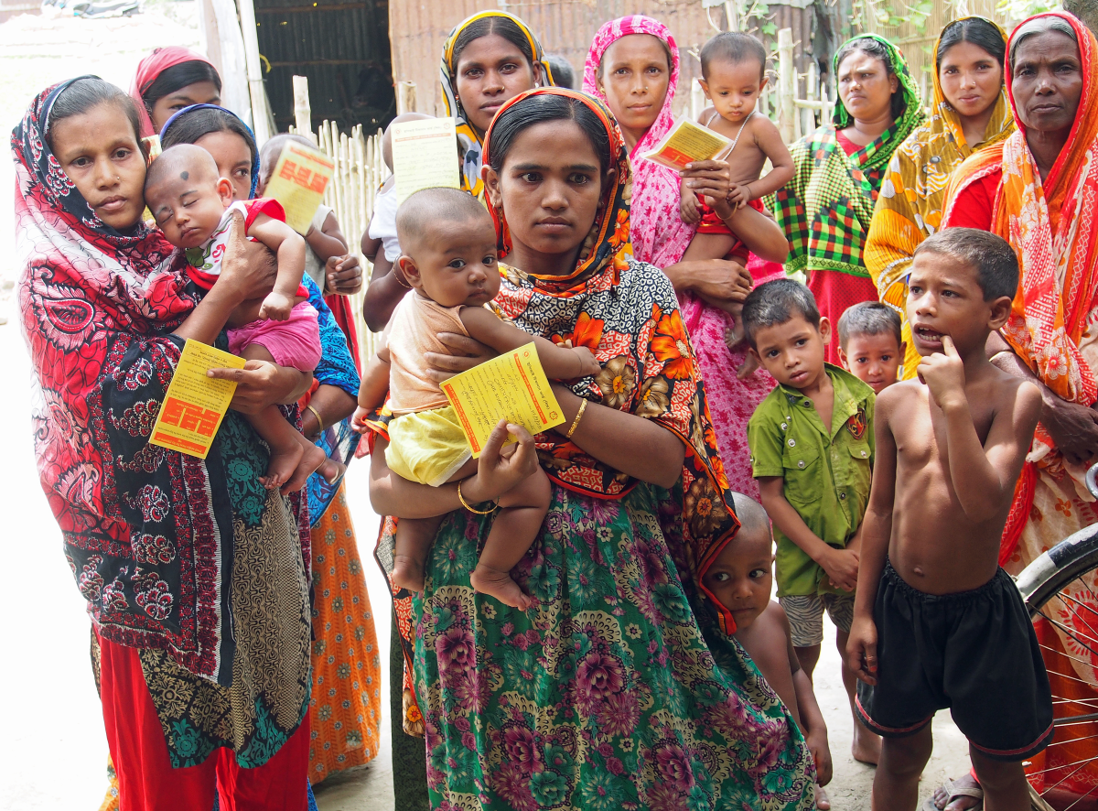
Context: Data Cleaning
Primary data collection, entry & cleaning (e.g., household survey)
There are artifacts (paper, photos, phone numbers) that might be used to confirm correct values
  Data sometimes stored on paper forms
  Or, with touchscreen, there is sometimes a photo of important docs
  (e.g., child’s vaccination record)
  Sometimes collect respondent’s mobile phone number to coordinate interview time & place or ask follow-up questions

Slide 3
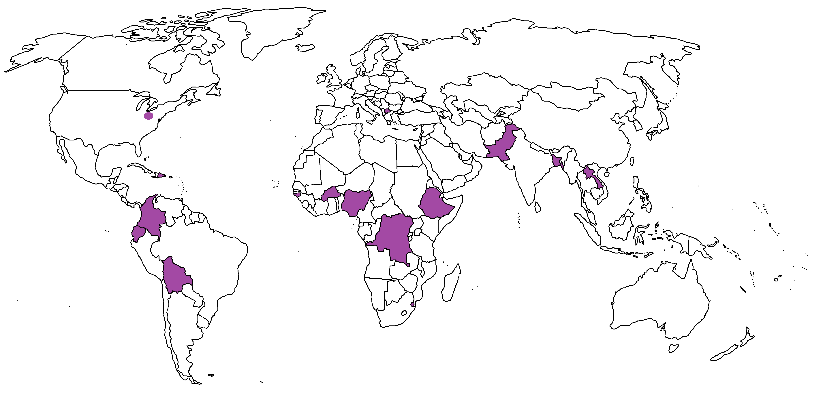
Where Do We Do It?

Slide 4

Distributed Data Cleaning
Team Constructing the Analysis Dataset
Check values for correctness, completeness, consistency
Flag disallowed or inconsistent values for review
Amend the dataset to include corrections; document as appropriate
(Sometimes) Change uncorrectable values to special missing
Team with Access to Survey Forms
Check flagged values (via paper form, photo, or phone call)
Identify corrected data values where possible

Slide 5
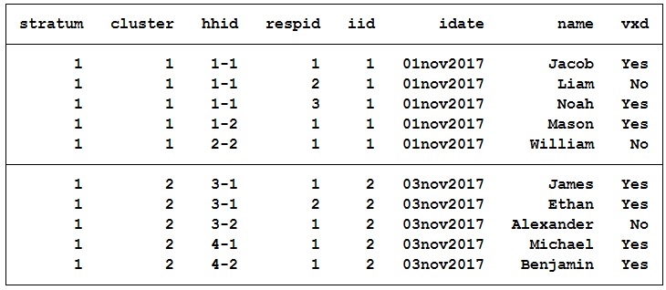
Example: Clean Dataset
Note: hhid = household ID; respid = respondent ID; iid = interviewer ID; idate = interview date; vxd = vaccinated

Slide 6
List of Expectations
No variable should be missing for any respondent
No duplicate combos of ID variables: stratum cluster hhid respid
The variable vxd holds only values of “Yes” and “No”
Hint: If there appear to be problems in the ID variables, make a variable named line that is never missing and always unique and use it for corrections to ID variables

Slide 7
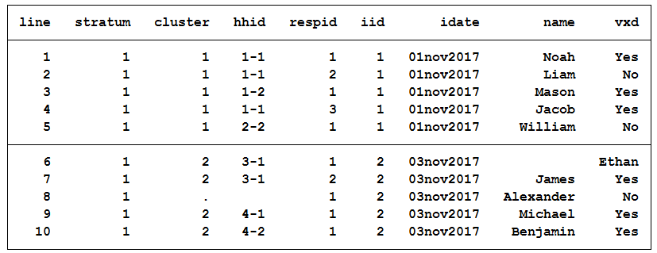
Example: Dataset with Problems

Slide 8
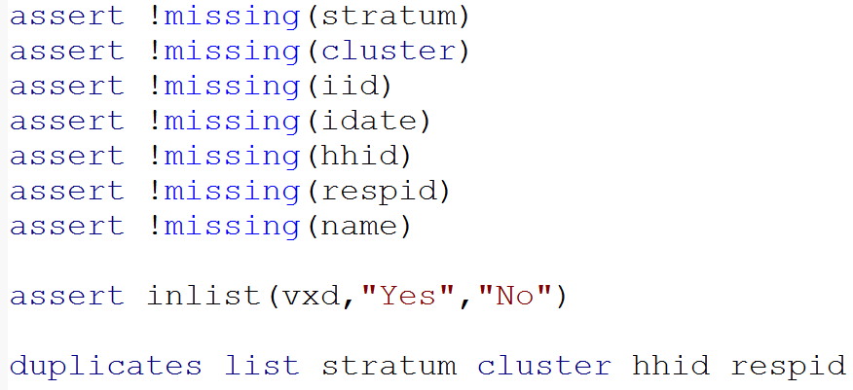
One Approach

Slide 9
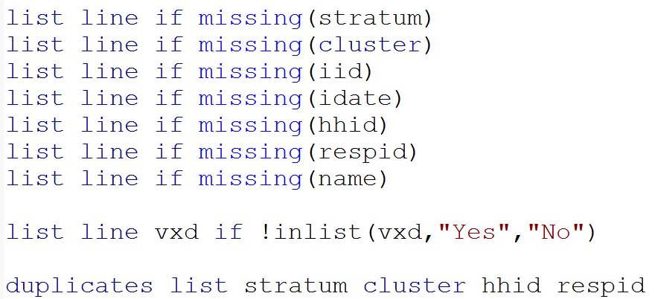
Another Approach

Slide 10
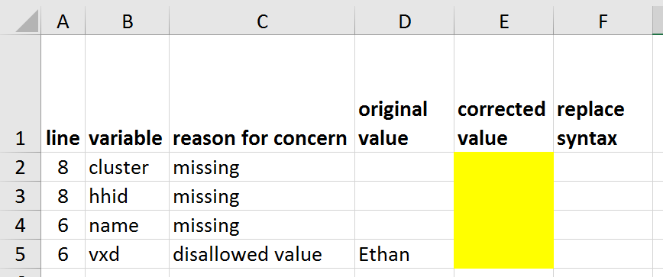
Conceptually, This Is What We Want

Slide 11
Stata Command Assertlist
Syntax: assertlist boolean_assertion [if] [in], options
boolean_assertion is syntax that resolves to either true (1) or false (0)
  Can involve the ‘and’ (&) or the ‘or’ (|) operators
  sex must be Male or Female:
    sex == “M” | sex == “F”
  response must be 1 or 2 or 99:
    response == 1 | response == 2 | response == 99

Slide 12
Assertlist Options
list(varlist) variables to list if expression is false
tag(string) description to list along with output
excel(filename) name of excel file for output
note: excel option requires sheet option
sheet(sheetname) name of worksheet for output
fix provide option to correct some values
note: fix requires idlist & checklist
idlist(varlist) variables that uniquely identify rows
checklist(varlist) variables to check & correct

Slide 13
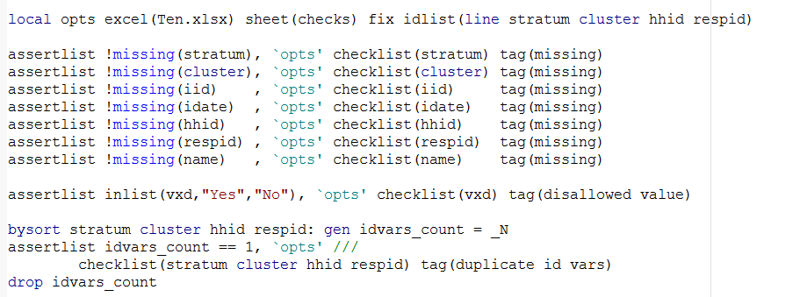
assertlist approach

Slide 14
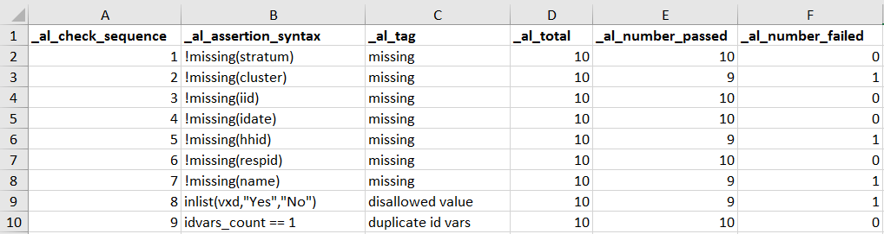
Output: Assertlist_Summary Tab
Includes one row for every check
Lists the boolean_assertion & tag
Lists # of observations checked, # passed and # failed

Slide 15
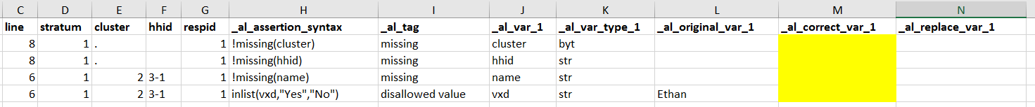

Output: Checks Sheet
The sheet named ‘checks_fix’ provides a space for making corrections
Column N here contains an Excel formula that writes Stata code as soon as you type a correction in Column M

Slide 16
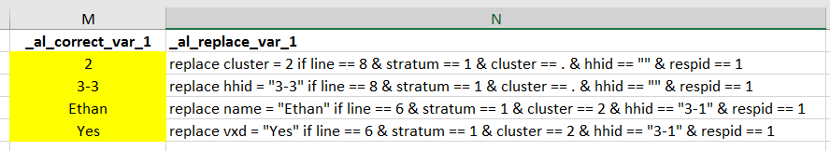
Output: checks_fix sheet
You can paste the Stata syntax into a downstream .do file
(and add some comments)

Slide 17
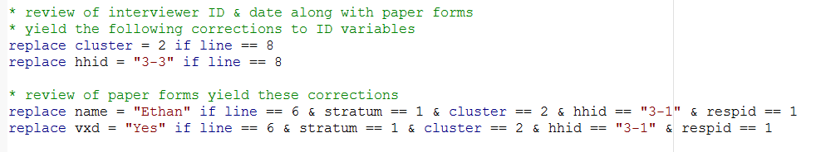
Data Corrections in Stata Program

Slide 18
Notes
We’re moving quickly thru this talk, but use a 2-stage approach
  Clean up the ID variables first, so they will serve as a unique key:
  a) to the dataset, and b) to the forms, photos or phone numbers
  Then clean up everything else, knowing you have a clean idlist
The boolean_assertion can be as complex as needs be
Both idlist and checklist can include numerous variables
(Example of correction columns when checklist holds two variables)

Slide 19
Workflow for Collaborative Correction
Establish list of expectations as soon as questionnaire is finalized
  Valid values
  Skip patterns
  No duplicates
  Responses internally consistent
  (i.e., date of birth ≤ vaccination dates ≤ interview date)
Convert to assertlist syntax
Run the job & send the spreadsheet to data managers
Receive back the spreadsheet populated with corrections
Copy replace syntax into .do file
[Repeat Steps 3-5 as needed]
Decide what to do with uncorrected violations of expectations

Slide 20
Companion Program to Clean Up Title Rows
When you are finished sending output to a particular Excel file, run assertlist_cleanup to switch to nicer column titles
(assertlist uses some nerdy variable names as column titles because it re-reads & writes its output if you send results from 2+ assertions to the same Excel worksheet)

Slide 21

Can Also Flag Problems in Near-Real-Time
When data are collected via touchscreen, they are often uploaded to a server on a daily basis
Assertlist can be wrapped inside a loop that makes a daily list of concerns for each survey team
E-mail the appropriate output to each supervisor to:
  Correct errors right away
  Coach (or replace) error-prone workers

Slide 22
Summary
Assertlist flags data elements that are illegal or illogical
Useful to document prevalence of problems
Useful for replacing those elements with corrected values
Many benefits:
  Facilitates clear communication
  Helps document corrections
  Saves time
  Prevents typing errors
Caution: Requires some care with ID variables

Slide 23
Where Do I Find It?
Today: Link to our GitHub page here: www.biostatglobal.com
Soon: Find it on SSC

Slide 24
Questions?
Dale.Rhoda@biostatglobal.com
MaryKay.Trimner@biostatglobal.com
Link to GitHub:
www.biostatglobal.com

