Slide 1
Estimating the Average Life of Non-Maturity Deposits
Calvin Price
Global Markets Division for the Americas
MUFG Bank
2018 Stata Conference
July 19-20, 2018

Slide 2
What are non-maturity deposits?
Banks use many deposit products, two basic types:
Term deposits
    There is a contractual ending point, the money goes back to the customer at a known date
Non-Maturity deposits (NMD)
    No contractual ending point, money can possibly stay with bank forever
    For a fixed set of customers we know NMD balances grow smaller over time
    Question: How long can we expect NMD to last?

Slide 3
Why is lifetime of deposits important?
Market value of the deposit (present value)
Longer lifetime, lower market value
    This is the reverse of more familiar future value calculation, longer lifetime, greater future value
    Key calculation for banks: MV(Loans) – MV(Deposits)
Computing market value of NMD requires some assumption about lifetime
    Banks have incentive to desire smaller MV(Deposits), longer lifetime

Slide 4

What is a decay rate?
A percentage of something dies per unit of time
  No fixed amount is dying, just a fixed proportion
  Any group where rate of change is proportional to size is necessarily exponential growth/decay
  Common examples: atomic particles, population, money (continuous compounding)
Functional form: $y=P_{o}e^{rt}$
    r positive = exponential growth
    r negative = exponential decay

Slide 5
What is a decay rate?
A percentage of something dies per unit of time
  No fixed amount is dying, just a fixed proportion
  Any group where rate of change is proportional to size is necessarily exponential growth/decay
  Common examples: atomic particles, population, money (continuous compounding)
Functional form: $y=P_{o}e^{rt}$
    r positive = exponential growth
    r negative = exponential decay

Slide 6

What is an average life?
Average time a member will exist without dying
  Assuming the group exhibits exponential decay
Same as expected value of any random variable
    We use probability density governing a particle remaining up to time t (cdf, function of decay rate r)
    Using the pdf and taking expectation, the mean lifetime is $τ=\frac{1}{r}$

Slide 7
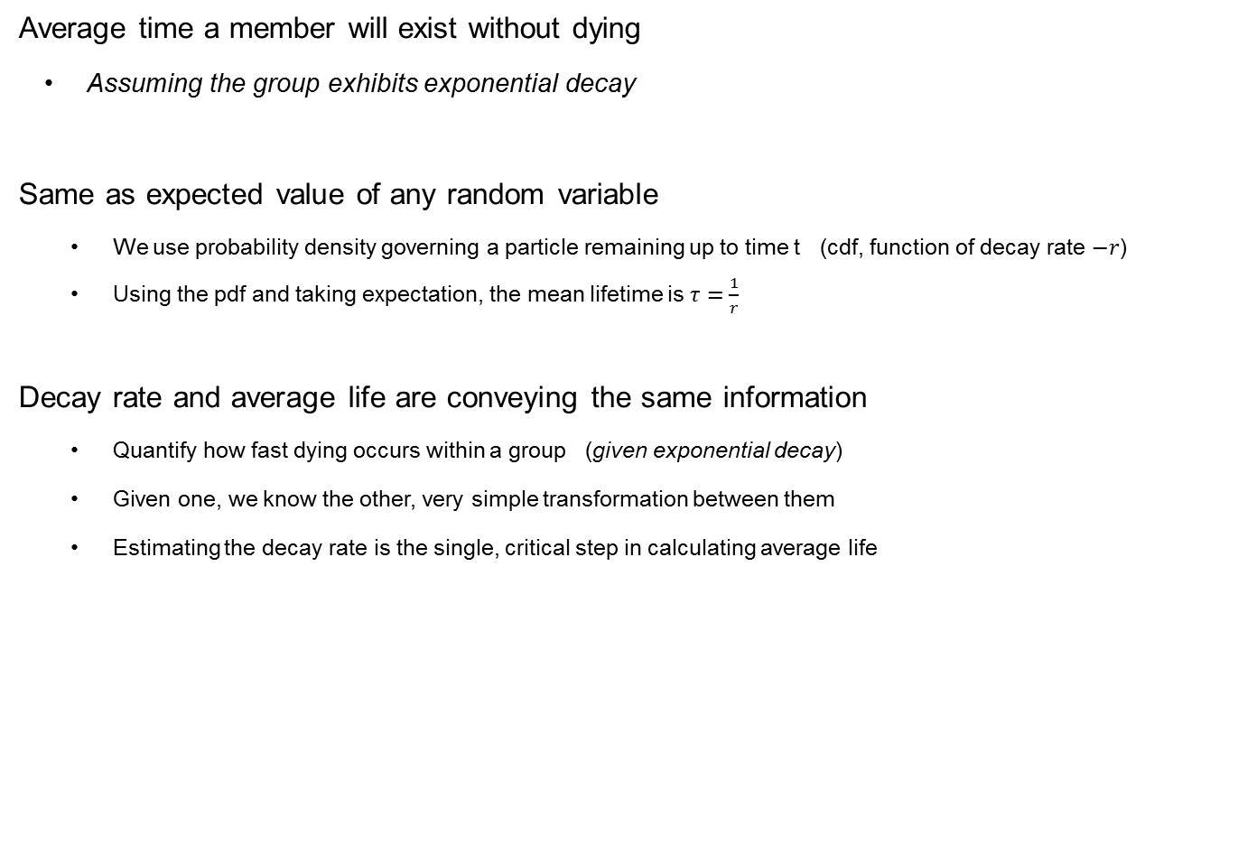
What is an average life?
Average time a member will exist without dying
  Assuming the group exhibits exponential decay
Same as expected value of any random variable
    We use probability density governing a particle remaining up to time t (cdf, function of decay rate $−r$)
    Using the pdf and taking expectation, the mean lifetime is $τ=\frac{1}{r}$
Decay rate and average life are conveying the same information
    Quantify how fast dying occurs within a group (given exponential decay)
    Given one, we know the other, very simple transformation between them
    Estimating the decay rate is the single, critical step in calculating average life

Slide 8
Switching to finance…
Application is to dollars instead of particles
Driving force is account closure, not balance behavior during individual lifetimes
Dollars leave (die) when an account closes
    Across large numbers of customers, the distribution of account ages has far greater impact than balance behavior

Slide 9
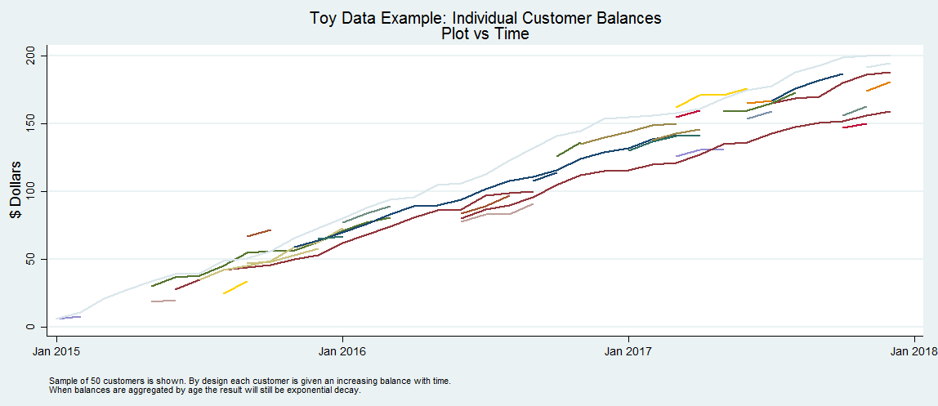
What drives average lifetime?
Distribution of account ages
Behavior during individual lifetimes doesn’t matter!
  EVERY single customer can have an INCREASING balance during entire lifetime and aggregate balance vs age will STILL show decay (see example for this scenario)
  Why? Because of how account ages are distributed, many are short, few are long

Slide 10
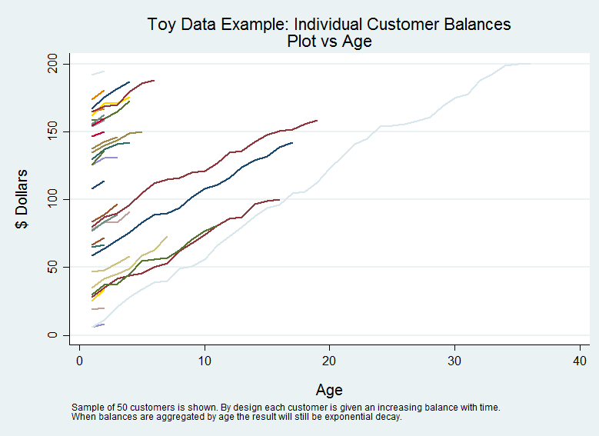
What drives average lifetime?
Distribution of account ages
Behavior during individual lifetimes doesn’t matter!
  EVERY single customer can have an INCREASING balance during entire lifetime and aggregate balance vs age will STILL show decay (see example for this scenario)
  Why? Because of how account ages are distributed, many are short, few are long

Slide 11
How to estimate decay rate
Step 1: Data prep
Step 2: Nonlinear regression

Slide 12
Data Prep
Methodology
  Want data in long format (multiple customers across rows, not columns)
  Then aggregate balances by age of account
    Sum up every customer balance of the same age (collapse command, by age, not by time period!)
    This is adding balances across many different time periods
    None of these data points are an actual portfolio balance at any point in time
  Caution: Only use customers with a known starting date, must filter and remove customers with unknown start

Slide 13
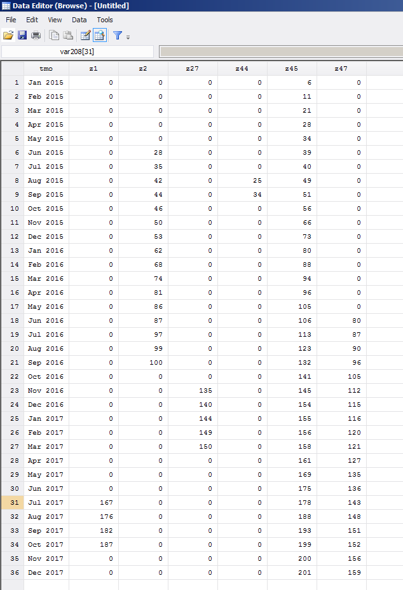
Data Prep
Methodology
  Want data in long format
  Example, start in wide format

Slide 14
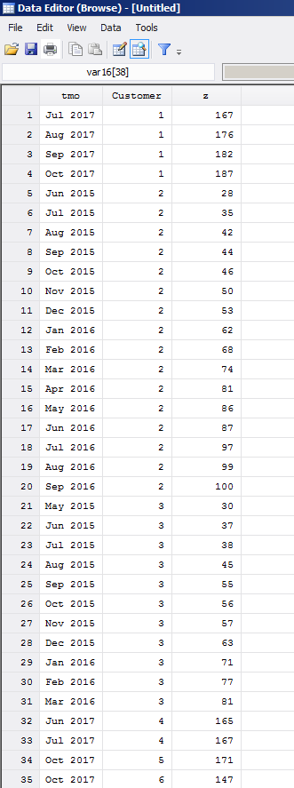
Data Prep
Methodology
  Want data in long format
  Example, start in wide format
  Reshape to long format

Slide 15
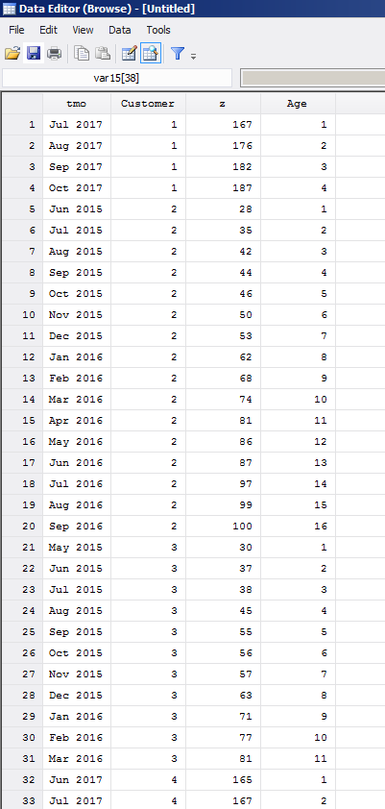
Data Prep
Methodology
  Want data in long format
  Example, start in wide format
  Reshape to long format
  Create age variable

Slide 16
Data Prep
Methodology
  Want data in long format
  Example, start in wide format
  Reshape to long format
  Create age variable
  Sum balance by age

Slide 17
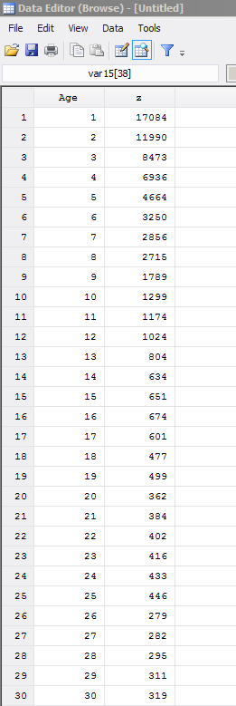
Data Prep
Methodology
  Want data in long format
  Example, start in wide format
  Reshape to long format
  Create age variable
  Sum balance by age

Slide 18
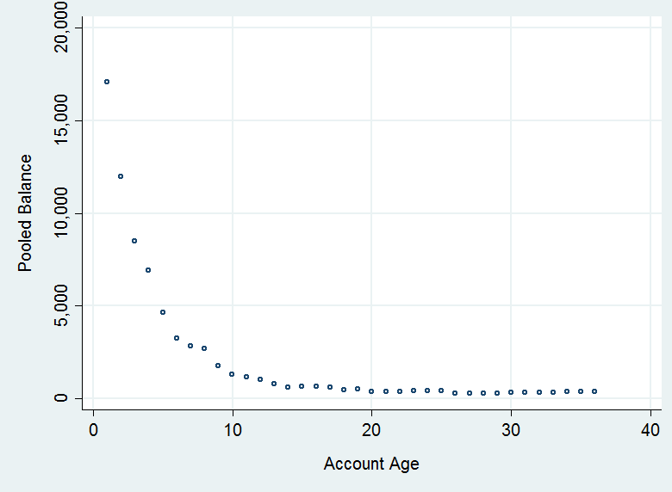
Data Prep
Methodology
  Plotting this grouped balance by age should reveal general decay pattern
  This is the data we use to estimate decay parameter
  See appendix for code to generate this toy dataset

Slide 19
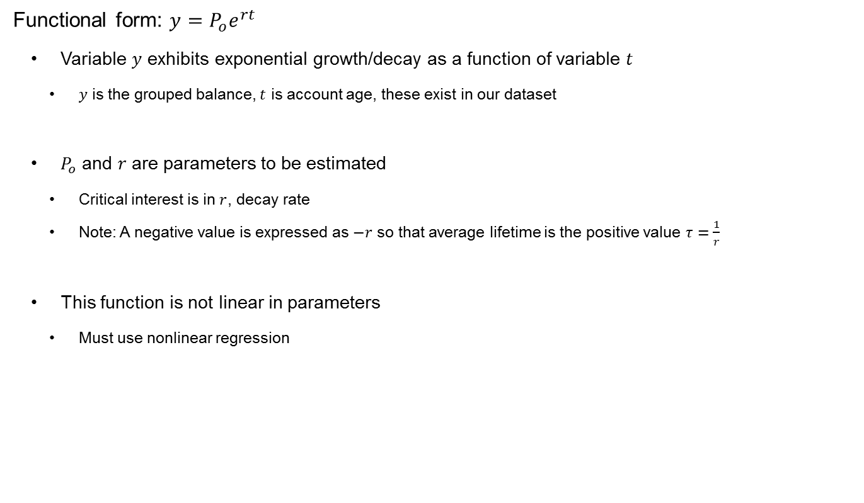
Nonlinear Regression
Functional form: $y=P_{o}e^{rt}$
  Variable $y$ exhibits exponential growth/decay as a function of variable $t$
    $y$ is the grouped balance, $t$ is account age, these exist in our dataset
  $P_{o}$ and $r$ are parameters to be estimated
    Critical interest is in $r$, decay rate
    Note: A negative value is expressed as $−r$ so that average lifetime is the positive value $τ=\frac{1}{r}$
  This function is not linear in parameters
    Must use nonlinear regression

Slide 20
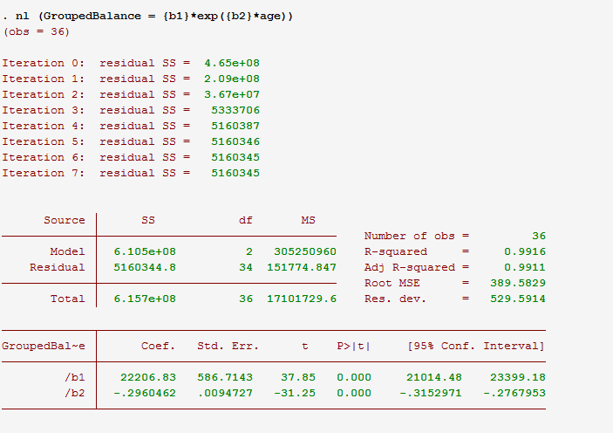

Nonlinear Regression
Stata nl command
  You write out the functional form
    You specify both (1) variables and (2) parameters (enclose parameters in brackets)
    Example: . nl (GroupedBalance = {b1}*exp({b2}*age))
  Estimates of parameters will be returned
$$−r$$

Slide 21

Nonlinear Regression
Stata nl command
  Estimates of parameters will be returned
  We see estimated decay rate is $−r=−.296$
  So estimate of average lifetime $τ=\frac{1}{r}=\frac{1}{.296}=3.38$
$$−r$$

Slide 22
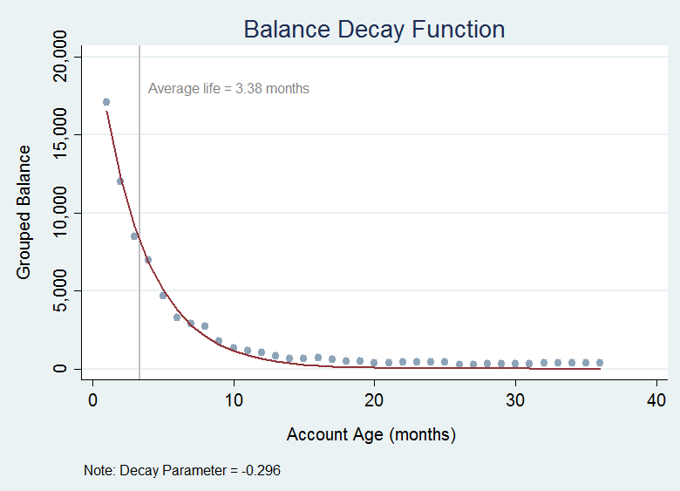
Nonlinear Regression
Stata nl command
  Estimates of parameters will be returned
  We see estimated decay rate is $−r=−.296$
  So estimate of average lifetime $τ=\frac{1}{r}=\frac{1}{.296}=3.38$

Slide 23
Questions?
Contact: Calvin Price
caprice@us.mufg.jp

Slide 24
Appendix – Assumptions of Decay Process
(1) Individual members within group die independently of one another
(2) Individual members within group die independent of age
What causes customers (individuals or corporates) to close a checking account?
Do these occur across people/corporates in a way that satisfies these two assumptions?
  Debatable, possibly yes
  Moving
  New job
  Divorce
  Death
  Merger/Acquisition
  Bankruptcy
  Corporate Use of Funds Policy
  Bank Credit Rating Downgrade

Slide 25
Appendix – Code to generate toy data
* Create customers
* ------------------------------
clear
set obs 36
generate tmo=tm(2015m1)+_n-1
format %tmm_CY tmo
tsset tmo
set seed 5678
foreach var of newlist z1-z200 { // number of customers
gen `var' = sum(round(10*runiform())) // increasing balance for every customer
local k1=36*runiform() // starting month of account
local k2=3*rchi2(1) // age of account, choosing this distribution is what really forces our result
replace `var' = 0 if !inrange(tmo, tmo[`k1'], tmo[`k1'+`k2'])
}
* To aggregate by account age, you need long shape data (panel data)
* Reshape from wide to long
reshape long z, i(tmo) j(Customer)
gsort Customer tmo
drop if z==0
bys Customer: gen Age = _n
* Group balances by age
* ------------------------------
collapse (sum) z , by(Age)
scatter z Age , ms(oh) $g2 ytitle("Grouped Balance" " ") ylabel( , format(%8.0fc)) xtitle(" " "Account Age")
* Do the nl estimation
* ------------------------------
rename (Age z) (age GroupedBalance)
nl (GroupedBalance = {b1}*exp({b2}*age))

Slide 26
Appendix – Code to generate toy data
  Full program available on RePEc (repec.org)

