Slide 1
Hepatobiliary-related Outcomes in U.S. Adults Exposed to Lead
Pb
Emmanuel Obeng-Gyasi MPH, Ph.D.

Slide 2
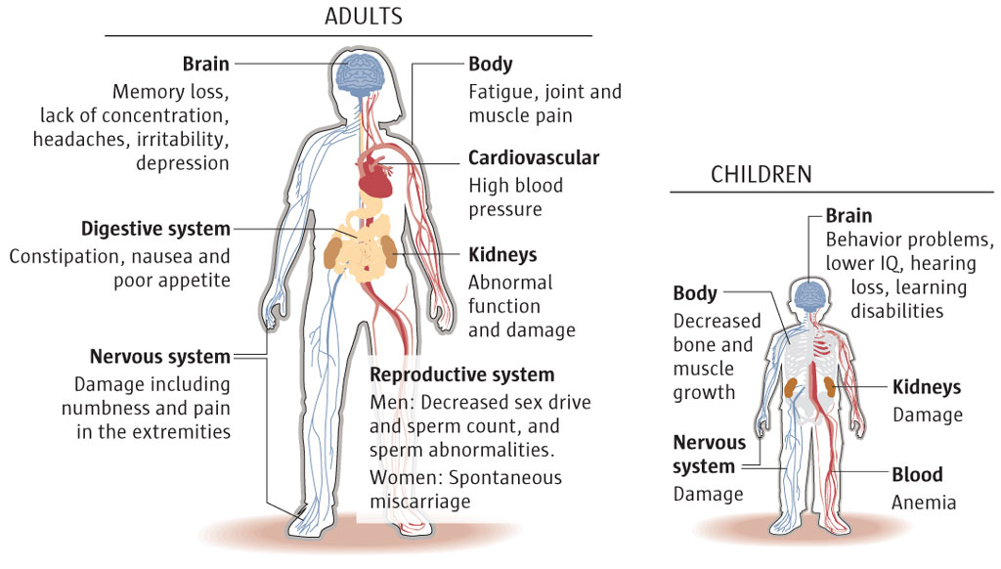
Source—National Institutes of Health

Slide 3
Background: Lead in gasoline
Major Source of Lead exposure
Belief lead had the ability to boost engine performance by:
Boosting octane ratings
Reducing engine knocking
Optimizing the performance of valve seats within motors
US motor vehicles used gasoline containing tetraethyl lead additives from the 1920s to 1995.
Nichols, Albert L. "Lead in gasoline." Economic Analyses at EPA: Assessing Regulatory Impact 49 (1997).

Slide 4

Background: Lead in Paint
Lead was used extensively in paint until 1978.
Added to paint due to:
Decreasing the time that paint takes to dry
Making paint moisture resistant
Ability to resist corrosion
Gooch, Jan W. Lead-based paint handbook. Springer Science & Business Media, 2006.

Slide 5
Lead from Industrial sources
Lead can also be emitted into the environment from industrial sources and contaminated sites.
While natural levels of lead in soil usually less than 50 PPM
Mining,
Smelting
Refining activities
Have resulted in substantial increases in lead levels in the environment
Reagan, P. L., and E. K. Silbergeld. "Establishing a health based standard for lead in residential soils." Hemphill and Cothern, eds. Trace substances in environmental health, Supplement to 12 (1990).

Slide 6
Lead Exposure Urban Environments: Soil
In an Urban city such as Baltimore, Maryland, impact of lead additives in gasoline reflected in garden soils (Mielke et al. 1983).
Soil acts as a reservoir for lead exposure due to lead being persistent.
California study on urban lead exposure → significant amount of lead put in the environment since 1950… Health at risk (Mielke, et al., 2010).
When lead is released to the air from industrial sources or vehicles, it may travel long distances before settling to the ground, where it usually sticks to soil particles.

Slide 7
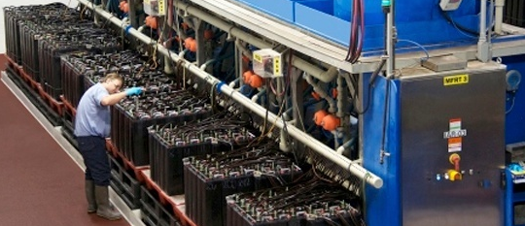
Lead Exposure Sources among Adult Populations
Adult exposure to lead is primarily encountered at the workplace - zinc ore mining, painting, and battery manufacturing industries.
In 2015, NIOSH reported 5 µg/dL of whole blood, in a venous blood sample, as the reference BLL for adults
An elevated BLL in adults is defined as a BLL ≥5 µg/dL. (CSTE, NNDSS, ABLES)
No level of lead exposure is deemed safe.
National Institute of Occupational Safety and Health. Adult Blood Lead Epidemiology & Surveillance (ABLES) Program Description 2015. Available from: http://www.cdc.gov/niosh/topics/ables/description.html

Slide 8
Lead exposure sources among children
Lead poisoning disproportionately affects children:
Behavioral patterns
Children’s bodies absorb a higher percentage of the lead that they ingest
The CDC’s upper limit of blood lead in children under 6 years of age is 5 μg/dL.
No level of lead exposure is deemed safe.

Slide 9
Epidemiology lead: United States
Historically, in the U.S., most lead exposures among adults have been occupational. Among the 3,616 adults with known exposures in 2014, 94.3% had occupational exposures.
The majority of these adults were employed in four main industry sectors: manufacturing, construction, and mining.
Overall, the national prevalence rate of BLLs ≥10 μg/dL declined from 26.6 adults per 100,000 employed in 2010 (among 37 states) to 19.1 in 2014 (among 26 reporting states).
Centers for Disease Control and Prevention, Adult Blood Lead Epidemiology and Surveillance (ABLES).
Notes:
AB

Slide 10
Epidemiology of Hepatobiliary disease in United states
Number of adults with diagnosed liver disease: 3.9 million
Percent of adults with diagnosed liver disease: 1.6%
Number of deaths: 38,170
Deaths per 100,000 population: 12.0
Source: Centers for Disease Control and Prevention

Slide 11
Lead and its effects on hepatobiliary health- Brief Review

Slide 12
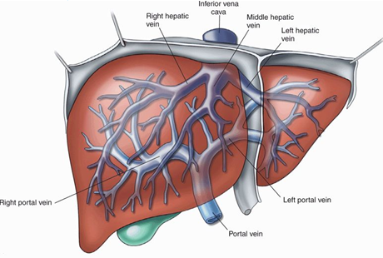
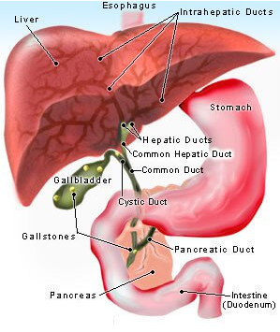
Liver, biliary tract and lead exposure
The liver, via the portal vein, is the first organ exposed to absorbed lead.
Composed of highly active metabolic tissue containing a huge complement of detoxification machinery referred to as phase I and phase II enzyme systems
The biliary tract, (biliary tree or biliary system) refers to the liver, gall bladder and bile ducts, and how they work together to make, store and secrete bile

Slide 13

Liver and lead exposure
xenobiotic
Studies on potential hepatotoxicity of lead in experimental animal systems reported alterations in:
Hepatic xenobiotic metabolism
Cholesterol metabolism
Liver cell proliferation
DNA synthesis (hyperplasia)
Mudipalli, Anuradha. "Lead hepatotoxicity & potential health effects." Indian Journal of Medical Research 126, no. 6 (2007): 518. Harvard

Slide 14
Liver and Lead exposure: Hepatotoxic effects of lead acetate in rats: histopathological and cytotoxic studies
- Histological studies have demonstrated that lead can induce several alterations such as:
1. Hypertrophy of hepatocytes.
2. Portal space and central vein dilatation.
3. Vacuolation and lymphocytic infiltration.
Haouas, Z., A. Sallem, I. Zidi, H. Hichri, I. Mzali, and M. Mehdi. "Hepatotoxic effects of lead acetate in rats: histopathological and cytotoxic studies." Journal of Cytology & Histology 5, no. 5 (2014): 1.

Slide 15
Introductory concepts

Slide 16
Aspartate Aminotransferase (AST)
Aminotransferases are used to detect and monitor the progression and resolution of hepatocellular injury.
AST is synthesized in the liver but is not specific to the liver; the kidney, heart, brain, and muscles cells also synthesize smaller amounts of AST.
AST is found in highest concentration in heart compared with other tissues of the body such as liver, skeletal muscle and kidney
AST used along with ALT to assess hepatic injury.
High AST is defined as levels above 48 U/L. A low level is defined as levels below 8 U/L. The normal range of AST is between 8 to 48 U/L
Mayo-Clinic. Liver function tests. 2015; https://www.mayoclinic.org/tests-procedures/liver-function-tests/basics/results/prc-20012602, 2017.
Notes:
Souce

Slide 17
Alanine Aminotransferase (ALT)
ALT is synthesized in the liver and is also usually present in low amounts in the blood.
ALT is found in kidney, heart, muscle
High concentration in liver compared with other tissues of the body
During damage to the liver, ALT tends to rise.
ALT is more specific to the liver than AST.
High‎ ALT is defined as levels above 55 U/L, a low level is one below 7 U/L. A normal‎ level is one between 7 – 55 U/L
Mayo-Clinic. Liver function tests. 2015; https://www.mayoclinic.org/tests-procedures/liver-function-tests/basics/results/prc-20012602, 2017.

Slide 18
Gamma-Glutamyl Transferase (GGT)
GGT is an enzyme that is present in biliary epithelial cells, hepatocytes, renal tubules, and the pancreas and intestine.
Its alteration can come about due to various liver diseases. It could be due to nonalcoholic fatty liver disease or chronic hepatitis C infection.
It can be elevated due to cholestasis
The mechanisms of alteration are similar to those of another liver enzyme, alkaline phosphatase
A high level of GGT is 48 U/L or above. Low levels are below 9 U/L. A normal range is between 9 to 48 U/L
Mayo-Clinic. Liver function tests. 2015; https://www.mayoclinic.org/tests-procedures/liver-function-tests/basics/results/prc-20012602, 2017.

Slide 19
Alkaline Phosphatase (ALP)
Alkaline phosphatase is found throughout the body including in the liver, kidney, bone and digestive system and is a good marker to test for hepatobiliary damage in addition to bone cell dysregulation.
Concentration of ALP is generally increased by cholestasis, injury to biliary epithelium, or damage to the intestinal epithelium.
Alkaline phosphatase, is often ordered in conjunction with a GGT test.
GGT tests are elevated in liver disorders but not in bone disorders; thus, a diminished GGT and elevated ALP may point to bone toxicity rather than hepatobiliary toxicity.
An ALP level above 115 U/L is considered high. Levels below 45 U/L are low, and 45 to 115 U/L, normal range
Mayo-Clinic. Liver function tests. 2015; https://www.mayoclinic.org/tests-procedures/liver-function-tests/basics/results/prc-20012602, 2017.

Slide 20
Total Bilirubin
Bilirubin is an orange-yellow pigment, a waste product primarily produced by the normal breakdown of heme.
Total Bilirubin: Unconjugated bilirubin + Conjugated bilirubin
Lipid-soluble, unconjugated bilirubin is conjugated in the liver, making it water-soluble, and then excreted into bile.
In liver cell or biliary pathology elevated bilirubin usually indicates hepatocellular or cholestatic pathology and possible abnormalities in liver synthetic function.
Elevated total bilirubin levels are 1.2 mg/dL or above.
Mayo-Clinic. Liver function tests. 2015; https://www.mayoclinic.org/tests-procedures/liver-function-tests/basics/results/prc-20012602, 2017.

Slide 21
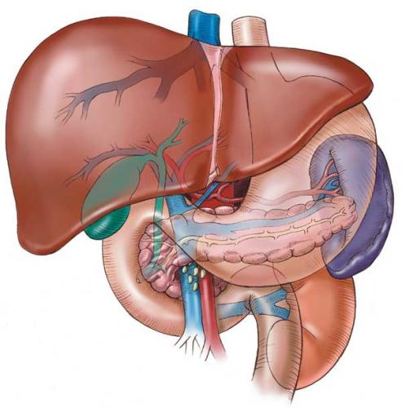
Hepatobiliary-related Outcomes in US Adults Exposed to Lead
Pb

Slide 22
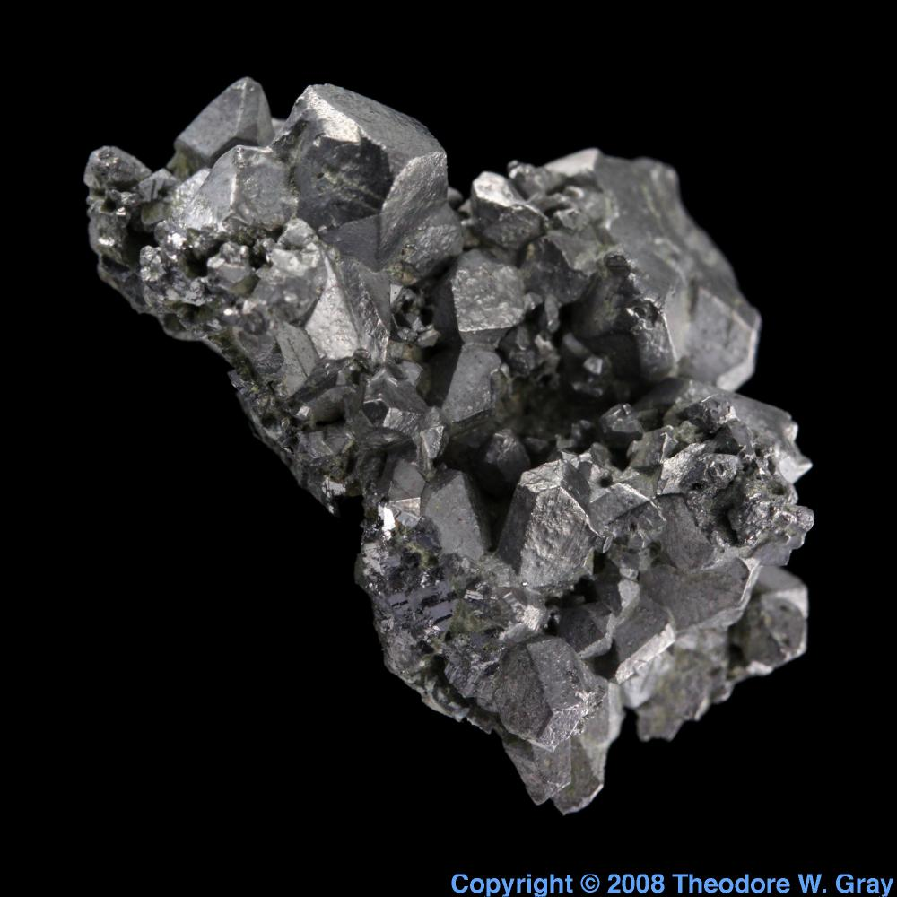
Study Question:
Hypothesis; lead exposure adversely affects hepatobiliary health at a specific time-point via affecting liver-gallbladder function and liver ‘function’ enzymes among adults exposed to lead at a specific time-point.
Objectives: Examine: AST, ALT, GGT, ALP and Total Bilirubin among adults.

Slide 23

NHANES
Complex Design
Source: https://www.cdcfoundation.org/blog-entry/behind-scenes-nhanes

Slide 24
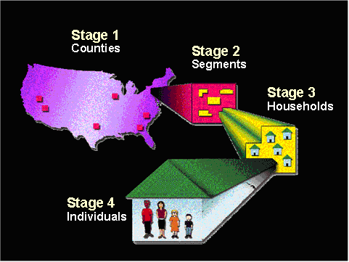
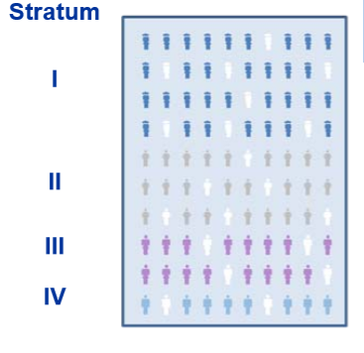
Elements of NHANES Complex sampling design
Multi-Stage
Stratification
Clustering
Weighting

Slide 25
Study Participants.
US noninstitutionalized general adult population.
Adults
Men
Women

Slide 26
Population data
Altogether, 12,153 adult subjects ≥20 were included in this complex multistage, stratified cluster survey in 2007–2010.
Blood lead was measured in 9781 adult subjects representing an estimated 182,052,299 people.
ALT values, 10,992 were measured; this represented 204,454,456 of the population.
AST value levels were measured for 10,991, representing 204,424,018 of the population.
GGT value levels were measured for 10,996, which represented 204,525,189 of the population.
Total bilirubin, the levels measured were for 9397, representing 170,044,349 of the population.
ALP was measured for 10,996 adults, which represented 204,523,110 of the population.

Slide 27
Design Cont.
Eligible for Participation
Hemophiliacs
Participants who received chemotherapy within the last 4 weeks
The presence of rashes, gauze dressings, casts, edema, paralysis, tubes, open sores or wounds, withered arms or limbs missing, damaged, sclerosed or occluded veins, allergies to cleansing reagents, burned or scarred tissue, shunt or intravenous lines on both arms.
For analysis:
Exclusion all tests that required blood specimens:
Adults ≥ 20 years old
Biomarkers/clinical markers of interest present.

Slide 28
Biomarkers in Study
Biomarker of interest is blood lead.
BLLs can help one determine the degree of exposure to lead at a snapshot in time.
Other biomarkers of interest are ALT, AST, GGT, ALP, Total Bilirubin.
These are Hepatobiliary markers.
* Biomarkers of exposure are not direct indicators of adverse health effects but may predict potential health issues.

Slide 29

Statistics and Analysis
This study analyzed results from adults aged 20 and older.
Exposure represented by BLLs in four quartiles; 0–2 µg/dL, 2–5 µg/dL, 5–10 µg/dL, 10+ µg/dL presented as quartile 1, quartile 2, quartile 3, and quartile 4.
Association between lead and hepatobiliary outcomes were explored using linear regression.
Since the variables of interest were not normally distributed, natural log transformation was used for dependent and independent variables in regression analysis.
Both continuous and categorical data were analyzed.
The covariates of interest (gender, BMI, ethnicity, and age), and consumption of alcohol (those who had taken at least 12 alcoholic drinks in the past year) and smoking habits, were adjusted for to determine leads impact on the clinical markers of interest.

Slide 30
Results

Slide 31
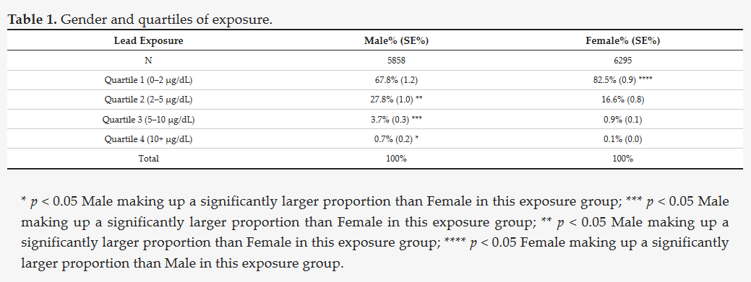
Gender

Slide 32
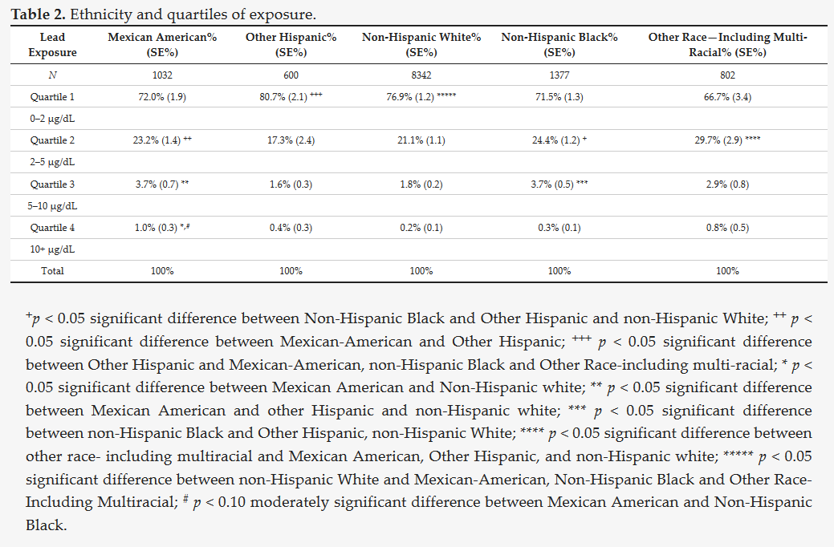
Ethnicity

Slide 33
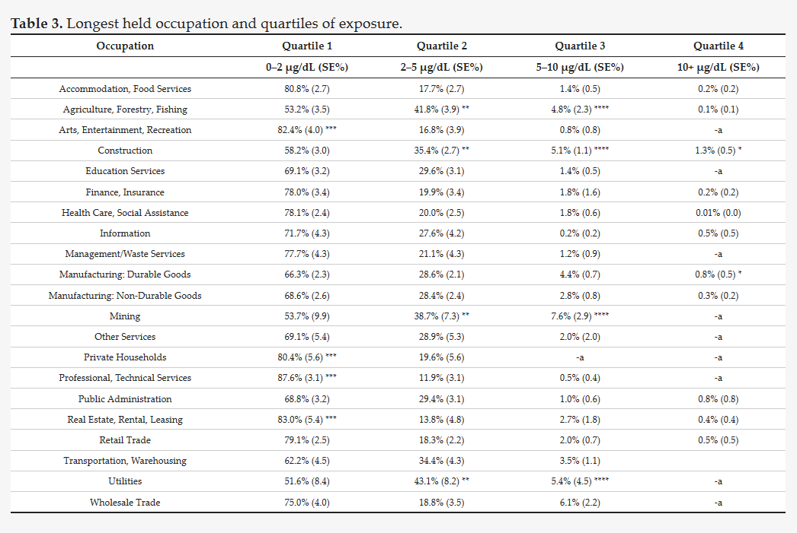
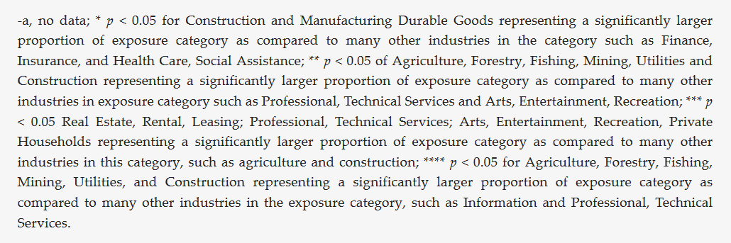
Longevity in Occupation

Slide 34
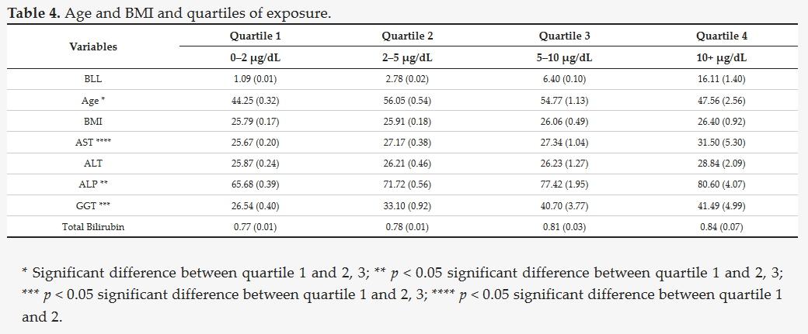
Age, BMI, and Clinical Variables
Notes:
Exposed males significantly higher than less exposed males

Slide 35
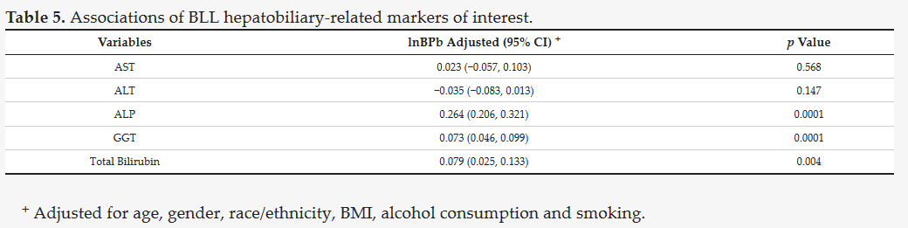
Hepatobiliary Assocations

Slide 36
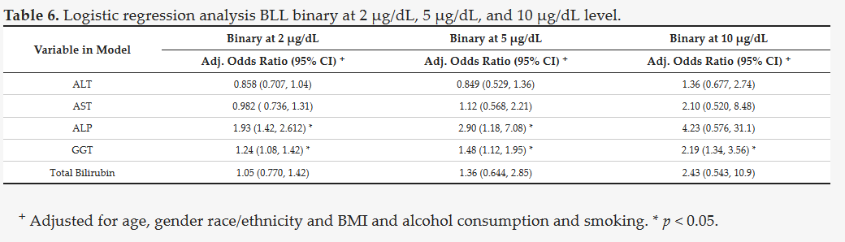

Slide 37
Occupational exposure: A different perspective- Part 1
Occupational exposure to lead was explored.
It was determined which three industrial groups have the highest and lowest BLLs at current exposure:
Highest Exposed
Agriculture, forestry, fishing
Mining
Construction
Lowest Exposed
Professional Scientific, Technical Services
Private Households
3. Arts, Entertainment, Recreation

Slide 38
Current Industry and Exposure

Slide 39
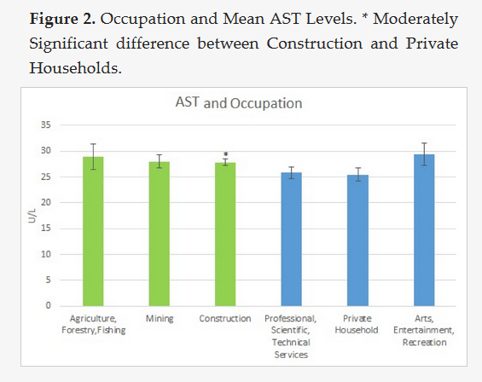
Notes:
Contruction P=0.61

Slide 40
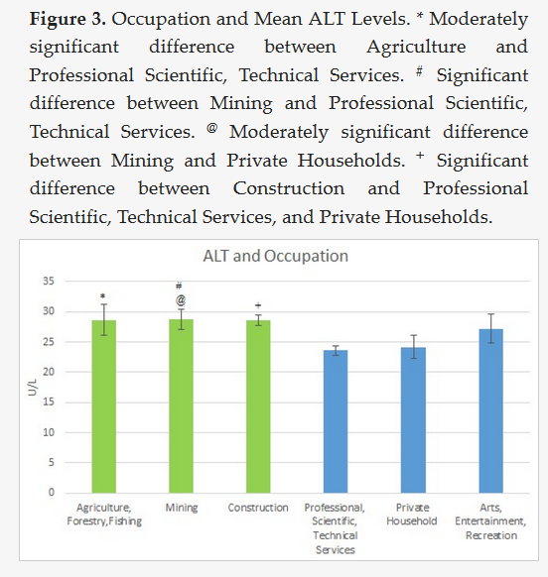

Slide 41
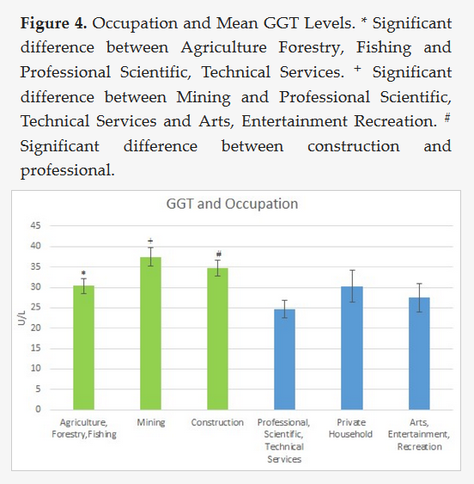

Slide 42
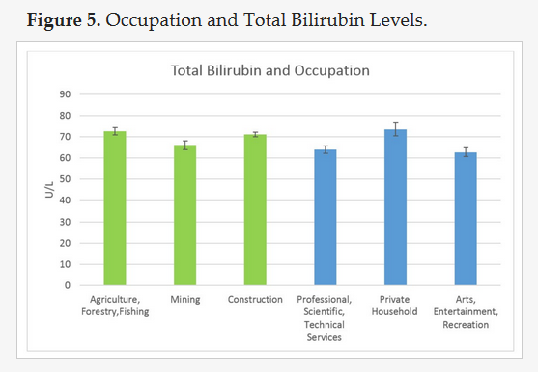

Slide 43
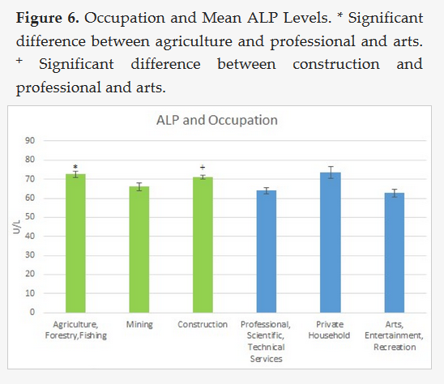

Slide 44
Occupational exposure: Longevity of exposure- Part 2
Compared 3 high exposure occupations to see if duration of exposure altered biomarkers of interest
Looked at the biomarkers at three intervals representing time spent at job.
0-5 years
5-10 years
over 10 years
Wanted to see how length of time at a lead exposed industry may alter biomarkers of interest.

Slide 45
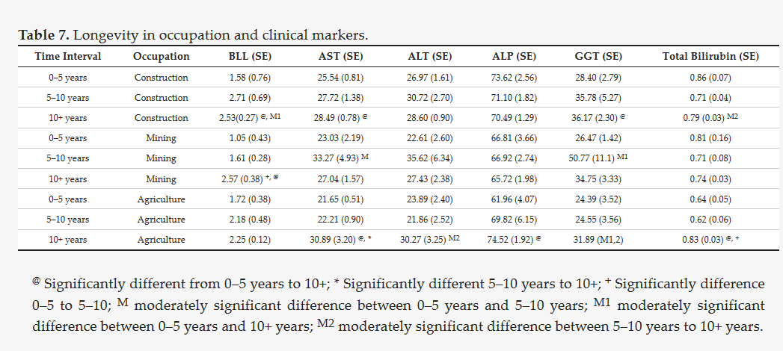
Mean Age and BMI

Slide 46
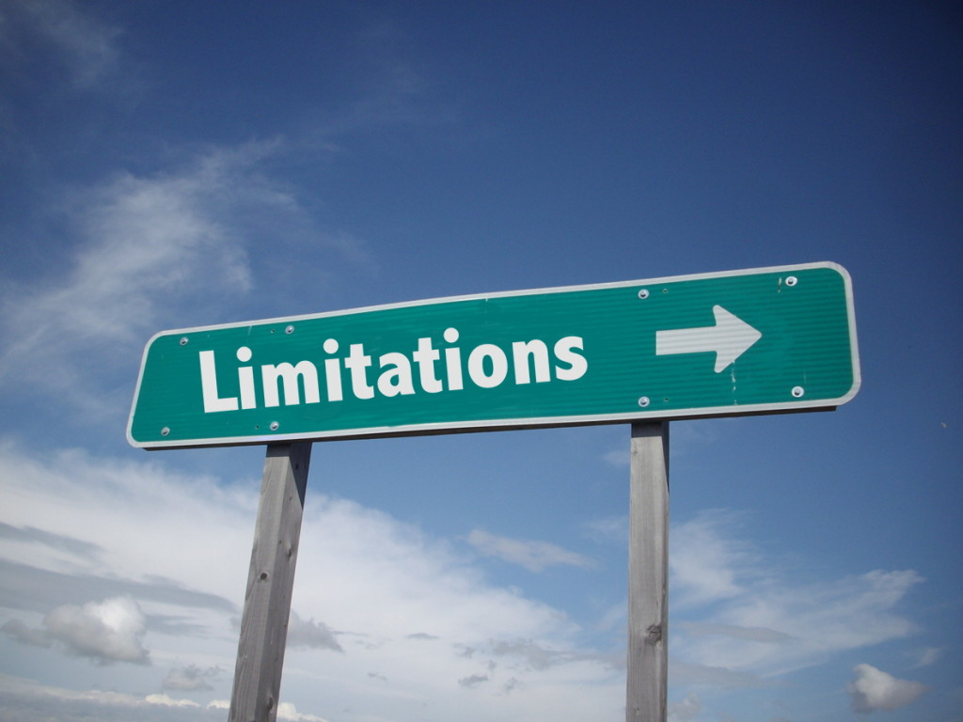
Limitations
  Given its cross-sectional design, we cannot demonstrate that lead exposure preceded health outcomes , nor can we distinguish the causal mechanisms.

Slide 47


