Slide 1




ABSTRACT
PRESENTATION
Marcus Vinicius Nascimento-Ferreira
marcus1986@usp.br

Slide 2


Ordinary least products regression is a simple and powerful statistical tool to identify systematic disagreement between two measures:
Fixed and proportional bias assessment
Marcus Vinicius Nascimento-Ferreira; Augusto César Ferreira De Moraes; Tara Rendo-Urteaga; Silvia Bel-Serrat; Francisco Leonardo Torres-Leal; Luis A. Moreno; Heráclito Barbosa Carvalho.
Marcus Vincius Nascimento-Ferreira
marcus1986@usp.br

Slide 3
INTRODUCTION
There are two reasons for wanting to compare measurers or methods of measurement. One is to calibrate one method or measurer against another; the other is to detect bias (Ludbrook, 2010).
Marcus Vincius Nascimento-Ferreira
marcus1986@usp.br

Slide 4
INTRODUCTION
Biostatisticians insist that what should be sought is not agreement between methods or measurers, but disagreement or bias (Ludbrook, 2002).
Marcus Vincius Nascimento-Ferreira
marcus1986@usp.br

Slide 5
INTRODUCTION
There are two potential sources of systematic disagreement
between methods of measurement: fixed and proportional
bias (Ludbrook, 1997).
Marcus Vincius Nascimento-Ferreira
marcus1986@usp.br

Slide 6
INTRODUCTION
Fixed bias is present when one method gives higher (or lower) values across the whole range of measurement (Ludbrook, 2010).
Proportional bias is present when one method gives values that diverge progressively from those of the other (Ludbrook, 2010).
Marcus Vincius Nascimento-Ferreira
marcus1986@usp.br

Slide 7
INTRODUCTION
If measurements have been made on a continuous scale, the most popular choice is the Bland-Altman method (Zaki et al., 2012).
Marcus Vincius Nascimento-Ferreira
marcus1986@usp.br

Slide 8
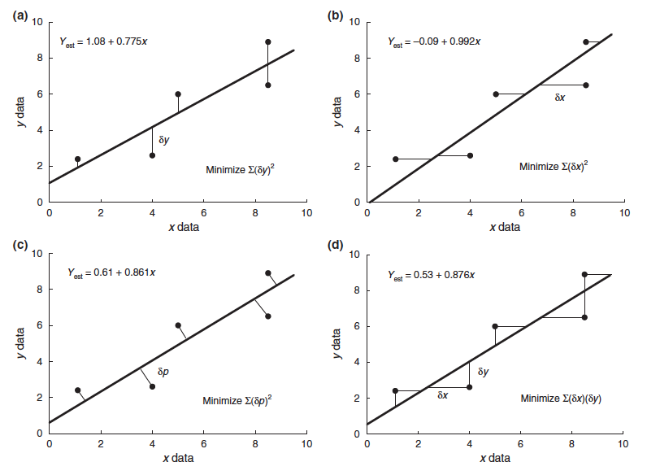
INTRODUCTION
However, the ordinary least products (OLP) regression is a technique designed to assess systematic disagreement obtained from two subjects or methods attended by random error (Ludbrook, 2002), especially when it is impossible to decide which should be regarded as dependent (Ludbrook, 1997).
Marcus Vincius Nascimento-Ferreira
marcus1986@usp.br

Slide 9
INTRODUCTION
Objective
We aimed to provide a statistical procedure to assess systematic disagreement between two measures assuming that measurements made by either method are attended by random error.
Marcus Vincius Nascimento-Ferreira
marcus1986@usp.br

Slide 10
METHODS
Sample
We simulated three pairs of samples of variables (N=100) using random normal distribution (SEED 010101). Mean and standard deviation were retrieved from the literature.
Simulated variables
Physical activity (questionnaire vs accelerometer) – minutes/day
Sedentary behavior (questionnaire vs accelerometer) – hour/day
Sleep time (questionnaire vs accelerometer) – hour/day
Marcus Vincius Nascimento-Ferreira
marcus1986@usp.br

Slide 11
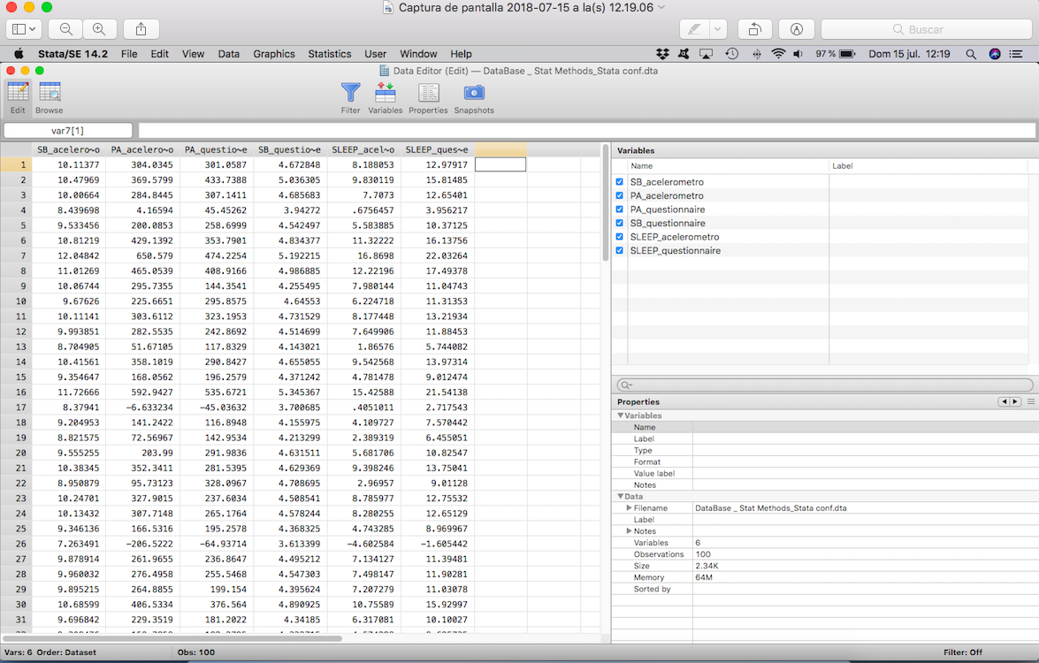
METHODS
Simulated variables
Marcus Vincius Nascimento-Ferreira
marcus1986@usp.br

Slide 12

METHODS
Statistical procedures
We applied Bland-Altman method (“baplot” command) and ordinary least products (OLP) regression (manually) (Ludbrook 2010).
(https://www.stata.com/stb/stb55/sbe33/baplot.hlp)
Marcus Vincius Nascimento-Ferreira
marcus1986@usp.br

Slide 13
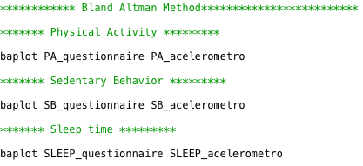
METHODS
In Stata, DO-file:
Marcus Vincius Nascimento-Ferreira
marcus1986@usp.br

Slide 14


METHODS
The general formula for the OLP regression line is
where E(Y) is the predicted value of y as a function of x. Initially, it is necessary to find values of b (slope) in the ordinary least square (OLS) models, where they are estimated by OLS regression of y on x, and x on y, respectively:
Marcus Vincius Nascimento-Ferreira
marcus1986@usp.br

Slide 15

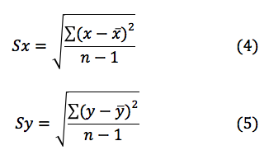
METHODS
So
In addition:
Marcus Vincius Nascimento-Ferreira
marcus1986@usp.br

Slide 16


METHODS
where r is the Pearson product-moment correlation coefficient (Pearson, 1896) obtained by
Secondly, the coefficient of the slope, b’, of the OLP regression is given by
Marcus Vincius Nascimento-Ferreira
marcus1986@usp.br

Slide 17



METHODS
Finally, because the OLP regression line passes through the point mean x and mean y, the intercept, a’, can be obtained from the formula (Ludbrook, 1997)
In order to calculate the OLP regression intercept, slope and their respective (95%) CIs, we used standard major axis (SMA) regression technique to assess the standard error (Kermack and Haldane, 1950)
Marcus Vincius Nascimento-Ferreira
marcus1986@usp.br

Slide 18


METHODS
and Student's-t distribution with n-2 degrees of freedom for CIs
Marcus Vincius Nascimento-Ferreira
marcus1986@usp.br

Slide 19
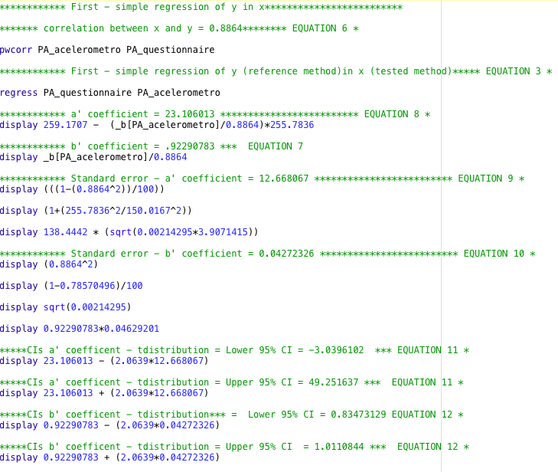
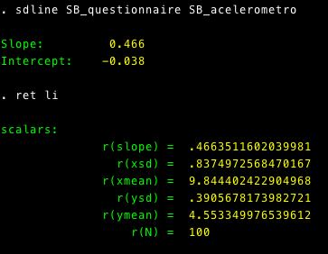
METHODS
In Stata, DO-file
(Sedentary Behavior)
Marcus Vincius Nascimento-Ferreira
marcus1986@usp.br

Slide 20
METHODS
OLP regression interpretation
Fixed bias was defined if 95% confidence interval (CI) of the intercept does not include 0. Proportional bias was defined if 95%CI of the slope does not include 1 (Ludbrook, 1997; Ludbrook, 2002; Ludbrook, 2010).
Marcus Vincius Nascimento-Ferreira
marcus1986@usp.br

Slide 21
RESULTS
Instruments comparison – Bland Altman method
Variable | Fixed bias |  | Proportional bias*
Physical activity | 3.4 minutes/day | 95%CI: -10.4 to 17.2 | r = -0.2 | p = 0.09
Sedentary Behavior | - 5.3 hour/day | 95%CI: -5.4 to -5.2 | r=-0.9 | p < 0.01
Sleep time | 4.5 hour/day | 95%CI: 4.3 to 4.7 | r = 0.7 | p < 0.01
* Pitman's Test of difference in variance
Marcus Vincius Nascimento-Ferreira
marcus1986@usp.br

Slide 22
RESULTS
Instruments comparison – OLP regression
Variable | Fixed bias |  | Proportional bias
Physical activity | Intercept = 23.11 | 95%CI: -3.04 to 49.25 | Slope = 0.92 | 95%CI: 0.83 to 1.01
Sedentary Behavior | Intercept = -0.04 | 95%CI: -0.45 to 0.38 | Slope = 0.47 | 95%CI: 0.38 to 0.55
Sleep time | Intercept = 3.14 | 95%CI: 2.82 to 3.45 | Slope = 1.20 | 95%CI: 1.16 to 1.24
Marcus Vincius Nascimento-Ferreira
marcus1986@usp.br

Slide 23
RESULTS
Instruments comparison – Interpretation
Variable | Fixed bias |  | Proportional bias
 | Bland Altman method | OLP regression | Bland Altman method | OLP regression
Physical activity | NO | NO | NO | NO
Sedentary Behavior | YES | NO | YES | YES
Sleep time | YES | YES | YES | YES
Marcus Vincius Nascimento-Ferreira
marcus1986@usp.br

Slide 24
DISCUSSION
OLP regression
Is a simple method to execute and interpret;
Provides assessment based on confidence intervals.
Values of the x variable (tested method) and y variable (reference method) are attended by random error.
Separates the effects: fixed and proportional bias.
Marcus Vincius Nascimento-Ferreira
marcus1986@usp.br

Slide 25
CONCLUSION
OLP regression is a simple and powerful tool for detecting fixed and proportional bias between two measures (or methods);
We suggest the inclusion of this command in Stata.
Marcus Vincius Nascimento-Ferreira
marcus1986@usp.br

Slide 26
REFERENCES
Ludbrook J. Linear regression analysis for comparing two measurers or methods of measurement: But which regression? Clinical and Experimental Pharmacology and Physiology. 2010; 37: 692–699.
Ludbrook J. Statistical techniques for comparing measurers and methods of measurement: a critical review. Clinical and Experimental Pharmacology and Physiology. 2002; 29: 527–536.
Ludbrook J. Comparing methods of measurement. Clinical and Experimental Pharmacology and Physiology. 1997; 24: 193-203.
Pearson, K. Mathematical contributions to the theory of evolution—III. Regression, heredity, and panmixia. Philosophical Transactions of the Royal Society of London, Series A. 1896; 187: 253–318.
Kermack K, Haldane J. Organic correlation and allometry. Biometrika 1950; 37:30–41.
Zaki R, Bulgiba A, Ismail R, Ismail N. Statistical Methods Used to Test for Agreement of Medical Instruments Measuring Continuous Variables in Method Comparison Studies: A Systematic Review. PLoS One. 2012; 7(5): e37908.
..
...........
Regina Célia Vilanova-Campelo
regina.vilanova-campelo@usp.br

Slide 27


Thank you!
/YcareRG • /YcareRG
Marcus V. Nascimento-Ferreira, PhD candidate
marcus1986@usp.br

