Slide 1
Automating Reports
using putdocx and putpdf
“Winnie” Dong Hua
July 2018, Stata Corp. Conference

Slide 2
Reporting at Corrona
Many subscribers, anywhere from 2 to more than 10 reports per subscriber depending on the types of drugs they manufacture
Multiple reports due over time, monthly, quarterly, and/or annually
That's a lot to change – and it used to be done through
-putexcel- !
As of Stata v15, we have putdocx and putpdf and we're so grateful
Will be talking today about how –putdocx-/-putpdf- has simplified our lives and also some suggestions for making it even better for reporting

Slide 3
Procedures for creating a report
generate descriptive or statistics contents
construct tables & format them
add standard cover page and text
cover page
standard text
descriptive tables, subscriber-specific statistical analyses

Slide 4
Workflow with -putdocx-
Beginning the call for .docx file creation
Generate and format table title
Create a table shell with # rows and # columns
Format header row and 1st column per analysis table shell
Read in data
Generate analysis dataset and/or do analysis and store the results when necessary
Assign analysis results to each cell and format them
Add footnote in the end
Save the output Word file
Combine with other Word tables/files

Slide 5
Components of reporting
putdocx paragraph, putdocx text:
paragraphs, table titles
2. putdocx image: figures
3. putdocx table:
2a) Stata output, Stata descriptive data in memory
2b) Demographic table
2c) Modeling tables
4. putdocx append: automate the report by combining several .docx files into one summary report

Slide 6
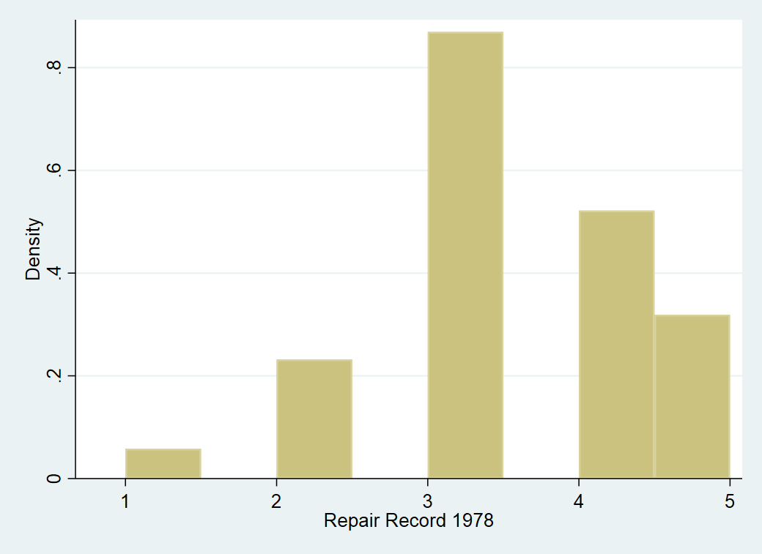
Word File
In this dataset, there are 74 models of automobiles. The maximum MPG among them is 41.
Histogram of Repair Record 1978

Slide 7
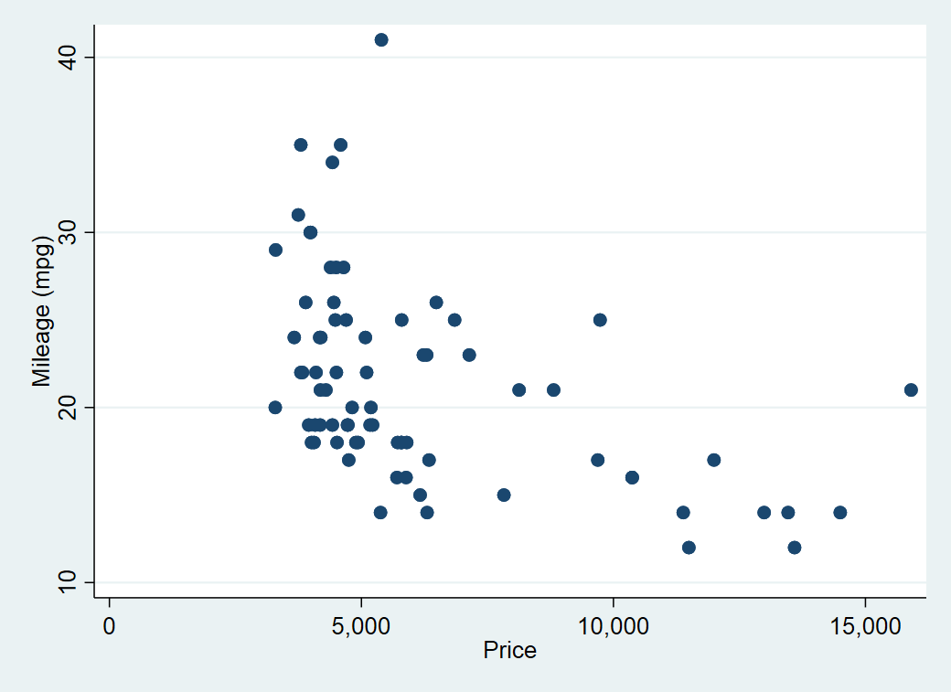
  Word File
  Plot of Mileage per Gallon by Price
where the highest price is $15906 and lowest is $3291.

Slide 8
Word File
Embed the output from a regression command into your docx file
mpg | Coef. | Std. Err. | t | P>|t| | [95% Conf. Interval]
price | -.0009192 | .0002042 | -4.50 | 0.000 | -.0013263 | -.0005121

Slide 9
Word File
Embed the data in Stata's memory into a table in your docx file
Origin | Total | Average MPG | Max MPG | Min MPG
Domestic | 52 | 19.83 | 34 | 12
Foreign | 22 | 24.77 | 41 | 14

Slide 10
2a. Creating Descriptive tables
Table 1. Demographic Table
 | Total N=74 | Domestic n=52 | Foreign n=22 | P-value
Mileage, mean±SD | 21.30± 5.79 | 19.83± 4.74 | 24.77± 6.61 | <0.001
Repair Record, n(%) | 69 | 48 | 21 | <0.001
One | 2 ( 2.9%) | 2 ( 4.2%) | 0 ( 0.0%)
Two | 8 ( 11.6%) | 8 ( 16.7%) | 0 ( 0.0%)
Three | 30 ( 43.5%) | 27 ( 56.3%) | 3 ( 14.3%)
Four | 18 ( 26.1%) | 9 ( 18.8%) | 9 ( 42.9%)
Five | 11 ( 15.9%) | 2 ( 4.2%) | 9 ( 42.9%)

Slide 11
2b. Survival Analysis Table
Table 2b. Adjusted Cox regression models
Parameter | Haz. Ratio | Std. Err. | z | p-value | [95% Conf. Interval]
Agegroup: ref.:47-48
49-55 | 1.66 | 1.80 | 0.47 | 0.64 | 0.20 | 13.96
56-62 | 2.67 | 2.83 | 0.92 | 0.36 | 0.33 | 21.38
63-69 | 14.32 | 16.79 | 2.27 | 0.02 | 1.44 | 142.62
Drug: Ref: investigational
Conventional | 8.90 | 4.13 | 4.71 | <0.01 | 3.58 | 22.10

Slide 12
2c. Logistic Regression Analysis
Table 2c. Logistic Regression Analysis
Parameter | Odds Ratio | %95 CI lower limit | %95 CI upper limit | p-value
age | 1.00 | 0.95 | 1.05 | 0.99
weight | 0.99 | 0.98 | 1.00 | 0.05
race: black(ref) | 1.00
Other | 2.88 | 1.10 | 7.52 | 0.03
White | 1.83 | 0.95 | 3.53 | 0.07

Slide 13
3. Combining Tables using -putdocx append-
Table 1. Demographic Table
 | Total N=74 | Domestic n=52 | Foreign n=22 | P-value
Mileage, mean±SD | 21.30± 5.79 | 19.83± 4.74 | 24.77± 6.61 | <0.001
Repair Record, n(%) | 69 | 48 | 21 | <0.001
One | 2 ( 2.9%) | 2 ( 4.2%) | 0 ( 0.0%)
Two | 8 ( 11.6%) | 8 ( 16.7%) | 0 ( 0.0%)
Three | 30 ( 43.5%) | 27 ( 56.3%) | 3 ( 14.3%)
Four | 18 ( 26.1%) | 9 ( 18.8%) | 9 ( 42.9%)
Five | 11 ( 15.9%) | 2 ( 4.2%) | 9 ( 42.9%)
Table 3. Logistic Regression Model
Parameter | Odds Ratio | %95 lower confidence limit | %95 upper confidence limit | p-value
age | 1.00 | 0.95 | 1.05 | 0.99
weight | 0.99 | 0.98 | 1.00 | 0.05
race: black(ref) | 1.00
Other | 2.88 | 1.10 | 7.52 | 0.03
White | 1.83 | 0.95 | 3.53 | 0.07

Slide 14
Summary
Pros:
Reproducing and automating report efficiently
Minimizing mapping procedures, verification of the mapping process, copy and paste work, as well as cosmetic refining work
Using -putpdf- to create pdf report file
Cons:
When adding new rows/columns to an existing table, needs to re-run the whole program instead of only the additional part
Pagination of the combined .docx file has to be done manually
Some cell format options applicable only using -putdocx- but not putpdf-, e.g. –border (start, double)-

Slide 15
References
https://www.stata.com/training/webinar_series/reproducible-documents/
http://www.stata.com/new-in-stata/create-word-documents/?utm_source=MailingList&utm_medium=email&utm_content=20170606+Stata+News+Stata+15
https://www.stata.com/links/video-tutorials/
http://www.stata.com/manuals/p.pdf

Slide 16
Questions ?
Automating Reports using putdocx and putpdf
Thank You !

Slide 17
Appendices - Add paragraphs
// 1a. Add paragraphs
putdocx clear
putdocx begin
putdocx paragraph, font(, 12) // default fontname is “calibri”
putdocx text ("In this dataset, there are ")
putdocx text (r(N)), bold
putdocx text (" models of automobiles. The maximum MPG among them is ")
putdocx text (r(max)), bold
putdocx text ("."), linebreak
putdocx text (""), linebreak

Slide 18
Appendices - Add a histogram with title
// 1b. Add a histogram with title
putdocx paragraph, font(,12) halign(center)
putdocx text ("Histogram of Repair Record 1978"), bold linebreak
putdocx text (""), linebreak
histogram rep78
graph export hist.png, replace // saved a graph under current drive path
putdocx paragraph, halign(center)
putdocx image hist.png
putdocx pagebreak

Slide 19
Appendices - Add a scatter plot with title and footnote
// 1c. Add a scatter plot with title and footnote
putdocx text ("Plot of Mileage per Gallon by Price"), bold //title
scatter mpg price
putdocx paragraph, halign(center)
putdocx image auto.png
sum price
putdocx text ("In this dataset, the highest price is $") // footnote
putdocx text (r(max)), bold
putdocx text (" and lowest is $")
putdocx text (r(min)), bold
putdocx text (".")
putdocx save figures, replace

Slide 20
Appendices - Embed Stata output
// Embed Stata output
putdocx paragraph
putdocx text ("Embed the output from a regression command into your docx file"), bold
regress mpg price , nocons
putdocx table mytable = etable
**********************************************************************
Embed the output from a regression command into your docx file
mpg | Coef. | Std. Err. | t | P>|t| | [95% Conf. Interval]
price | -.0009192 | .0002042 | -4.50 | 0.000 | -.0013263 | -.0005121

Slide 21
Appendices - Embed Stata dataset
// Embed Stata dataset
putdocx paragraph
putdocx text ("Embed the data in Stata's memory into a table in your docx file."), bold
preserve
statsby Total=r(N) Average=r(mean) Max=r(max) Min=r(min), by(foreign): summarize mpg
rename foreign Origin
putdocx table tbl1 = data("Origin Total Average Max Min"), varnames border(start, nil) // border(insideV, nil) border(end, nil)
forvalues row=1/3 {
  forvalues col=2/5 {
  putdocx table tbl1(‘row’,‘col’), halign(right) }
}
putdocx save myreport.docx, replace
Restore

Slide 22
Word File
**********************************************************************
Embed the data in Stata's memory into a table in your docx file
Origin | Total | Average MPG | Max MPG | Min MPG
Domestic | 52 | 19.83 | 34 | 12
Foreign | 22 | 24.77 | 41 | 14

Slide 23
Appendices – Descriptive Analysis
// 2a. Creating Descriptive tables
sysuse auto, clear
putdocx clear
putdocx begin
*first create a table with 1 row and 5 columns. Then fill in the content of each cell and set the styles for each cell.
putdocx table a = (1,5)
putdocx text (“Table 1. Demographic Table"), bold
ttest mpg, by(foreign)
putdocx table a(1,2) = ("Total"), linebreak
putdocx table a(1,2) = (“(N=“+strofreal (r(N_1)+r(N_2))+”)”), append
putdocx table a(1,3) = ("Domestic"), linebreak
putdocx table a(1,3) = (“(n=“ +strofreal(r(N_1))+”)”), append
putdocx table a(1,4) = ("Foreign"), linebreak
putdocx table a(1,4) = (“(n=“+strofreal(r(N_2))+”)”), append
putdocx table a(1,5) = ("P-value"), italic
putdocx table a(1,.), bold halign(center)

Slide 24
// 2a. Creating Descriptive tables (cont’d)
Appendices – Descriptive Analysis (cont’d)
local row 1
putdocx table a(`row',.), addrows(1)
local ++row
putdocx table a(`row',1) = ("Mileage, mean±SD")
putdocx table a(`row',5) = (cond(r(p)<0.001,"<0.001",string(r(p)))), nformat(%9.2f)
putdocx table a(`row',.), halign(center)
summarize mpg
putdocx table a(`row',2) = (r(mean)), nformat(%5.2f) append
putdocx table a(`row',2) = ("±"), append
putdocx table a(`row',2) = (r(sd)), nformat(%5.2f) append
summarize mpg if foreign==0
putdocx table a(`row',3) = (r(mean)), nformat(%5.2f) append
putdocx table a(`row',3) = ("±"), append
putdocx table a(`row',3) = (r(sd)), nformat(%5.2f) append

Slide 25
Appendices – Descriptive Analysis (cont’d)
// 2a. Creating Descriptive tables (cont’d)
summarize mpg if foreign==1
putdocx table a(`row',4) = (r(mean)), nformat(%5.2f) append
putdocx table a(`row',4) = ("±"), append
putdocx table a(`row',4) = (r(sd)), nformat(%5.2f) append
**********************************************************************
Table 1. Demographic Table
 | Total N=74 | Domestic n=52 | Foreign n=22 | P-value
Mileage, mean±SD | 21.30± 5.79 | 19.83± 4.74 | 24.77± 6.61 | <0.001

Slide 26
Appendices – Descriptive Analysis (cont’d)
// 2a. Creating Descriptive tables (cont’d)
tabulate rep78 foreign, chi2 matcell(tabrep78)
putdocx table a(`row',.), addrows(`=r(r)+1') // r(r)=5 here
local ++row
putdocx table a(`row',1) = ("Repair Record, n(%)")
putdocx table a(`row',2) = (r(N)), halign(center)
mata : st_matrix("tabrep78s", colsum(st_matrix("tabrep78")))
putdocx table a(`row',3) = (tabrep78s[1,1]), halign(center)
putdocx table a(`row',4) = (tabrep78s[1,2]), halign(center)
putdocx table a(`row',5) = =(cond(r(p)<0.001,"<0.001",string(r(p)))), nformat(%9.2f)

Slide 27
Appendices – Descriptive Analysis (cont’d)
// 2a. Creating Descriptive tables (cont’d)
* labels for the variable -
local labrep78 "One, Two, Three, Four, Five"
tokenize `"`labrep78'"', parse(" ,")
forvalues i=1/`=r(r)' {
local tmp = 2*`i'-1
local tmp2: display %5.1f (tabrep78[`i',1] + tabrep78[`i',2])/r(N)*100
local tmp3: display %5.1f (tabrep78[`i',1] / tabrep78s[1,1])*100
local tmp4: display %5.1f (tabrep78[`i',2] / tabrep78s[1,2])*100
local ++row
putdocx table a(`row',1) = (" "+`"``tmp''"') // label of each level
putdocx table a(`row',2) = (tabrep78[`i',1] + tabrep78[`i',2]), halign(center) append
putdocx table a(`row',2) = (" (" + "`tmp2'" + "%)"), append
putdocx table a(`row',3) = (tabrep78[`i',1]), halign(center) append
putdocx table a(`row',3) = (" (" + "`tmp3'" + "%)"), append
putdocx table a(`row',4) = (tabrep78[`i',2]), halign(center) append
putdocx table a(`row',4) = (" (" + "`tmp4'" + "%)"), append
}

Slide 28
2a. Creating Descriptive tables
Table 1. Demographic Table
 | Total N=74 | Domestic n=52 | Foreign n=22 | P-value
Mileage, mean±SD | 21.30± 5.79 | 19.83± 4.74 | 24.77± 6.61 | <0.001
Repair Record, n(%) | 69 | 48 | 21 | <0.001
One | 2 ( 2.9%) | 2 ( 4.2%) | 0 ( 0.0%)
Two | 8 ( 11.6%) | 8 ( 16.7%) | 0 ( 0.0%)
Three | 30 ( 43.5%) | 27 ( 56.3%) | 3 ( 14.3%)
Four | 18 ( 26.1%) | 9 ( 18.8%) | 9 ( 42.9%)
Five | 11 ( 15.9%) | 2 ( 4.2%) | 9 ( 42.9%)

Slide 29
Appendices – Survival Analysis
// 2b. Survival Analysis Table
webuse drugtr
studytime died drug age _st _d _t _t0
1 1 0 61 1 1 1 0
1 1 0 65 1 1 1 0
2 1 0 59 1 1 2 0
3 1 0 52 1 1 3 0
4 1 0 56 1 1 4 0
4 1 0 67 1 1 4 0
5 1 0 63 1 1 5 0
5 1 0 58 1 1 5 0
8 1 0 56 1 1 8 0
8 0 0 58 1 0 8 0
8 1 0 52 1 1 8 0
8 1 0 49 1 1 8 0

Slide 30
Appendices – Survival Analysis (cont’d)
// 2b. Survival Analysis Table (cont’d)
putdocx clear
putdocx begin
webuse drugtr, clear
gen agegroup = int(age/7) - 5
fvset base last drug
* Cox modeling
stcox i.agegroup i.drug
putdocx paragraph, spacing(after, 0.05)
putdocx text ("Table 2. Adjusted Cox regression models"), bold

Slide 31
Appendices – Survival Analysis (cont’d)
// 2b. Survival Analysis Table (cont’d)
putdocx table d = etable, border(all)
*formatting some cells to be more readable
putdocx table d(1,1)=("Parameter"), halign(center)
putdocx table d(6,1)=("Drug ref: investigational"), halign(center)
putdocx table d(7,1)=(“Conventional"), halign(right)
putdocx table d(1,5)=("p-value"), halign(right)
forvalues row=3/7 {
forvalues col=2/7 {
putdocx table d(`row',`col'), nformat(%9.2f)
}
}
* make 1st row and 1st column bold
putdocx table d(1,.), bold
putdocx table d(.,1), bold
putdocx save “survival", replace

Slide 32
2b. Survival Analysis Table
Table 2b. Adjusted Cox regression models
Parameter | Haz. Ratio | Std. Err. | z | p-value | [95% Conf. Interval]
Agegroup: ref.:47-48
49-55 | 1.66 | 1.80 | 0.47 | 0.64 | 0.20 | 13.96
56-62 | 2.67 | 2.83 | 0.92 | 0.36 | 0.33 | 21.38
63-69 | 14.32 | 16.79 | 2.27 | 0.02 | 1.44 | 142.62
Drug: Ref: investigational
Placebo | 8.90 | 4.13 | 4.71 | <0.01 | 3.58 | 22.10

Slide 33
Appendices - Logistic Regression
// 2c. Logistic Regression Analysis
putdocx clear
putdocx begin
webuse lbw, clear
Id low age lwt race smoke ptl ht ui bwt (g)
4 1 28 120 other smoker 1 0 1 709
10 1 29 130 white nonsmoker 0 0 1 1021
11 1 34 187 black smoker 0 1 0 1135
13 1 25 105 other nonsmoker 1 1 0 1330
85 0 19 182 black nonsmoker 0 0 1 2523

Slide 34
Appendices - Logistic Regression (cont’d)
// 2c. Logistic Regression Analysis (cont’d)
putdocx paragraph, spacing(after, 0.05)
putdocx text (“Table Logistic Regression Model”), bold halign(center)
logit low age lwt i.race, nocons or
putdocx table f = etable, border(all)
*add label column
putdocx table f(.,1), addcols(1)
local row 1
putdocx table f(`row',2) = ("Label"), halign(center)
foreach x of varlist age lwt race {
local ++row
local lbl: variable label `x'
putdocx table f(`row',2) = (`"`lbl'"'),
}
*formatting some cells
putdocx table f(1,1)=("Parameter"), halign(center)
putdocx table f(4,2)=("")
putdocx table f(1,6)=("p-value")

Slide 35
Appendices - Logistic Regression (cont’d)
// 2c. Logistic Regression Analysis (cont’d)
*limit 2 decimals
forvalues row=1/7 {
forvalues col=3/8 {
putdocx table f(`row',`col'), nformat(%9.2f)
}
}
* make 1st row and 2nd column bold
putdocx table f(1,.), bold
putdocx save “logistic", replace

Slide 36
2c. Logistic Regression Analysis
Table 2c. Logistic Regression Analysis
Parameter | Odds Ratio | %95 CI lower limit | %95 CI upper limit | p-value
age | 1.00 | 0.95 | 1.05 | 0.99
weight | 0.99 | 0.98 | 1.00 | 0.05
race: black(ref) | 1.00
Other | 2.88 | 1.10 | 7.52 | 0.03
White | 1.83 | 0.95 | 3.53 | 0.07

Slide 37
Appendices – combining .docx files
// 3. Combine Tables
putdocx append demographic logistic, saving(“sample report”)
**********************************************************************
Table 1. Demographic Table
 | Total N=74 | Domestic n=52 | Foreign n=22 | P-value
Mileage, mean±SD | 21.30± 5.79 | 19.83± 4.74 | 24.77± 6.61 | <0.001
Repair Record, n(%) | 69 | 48 | 21 | <0.001
One | 2 ( 2.9%) | 2 ( 4.2%) | 0 ( 0.0%)
Two | 8 ( 11.6%) | 8 ( 16.7%) | 0 ( 0.0%)
Three | 30 ( 43.5%) | 27 ( 56.3%) | 3 ( 14.3%)
Four | 18 ( 26.1%) | 9 ( 18.8%) | 9 ( 42.9%)
Five | 11 ( 15.9%) | 2 ( 4.2%) | 9 ( 42.9%)

Slide 38
Appendices – combining .docx files (cont’d)
Table 3. Logistic Regression Model
Parameter | Odds Ratio | %95 lower confidence limit | %95 upper confidence limit | p-value
age | 1.00 | 0.95 | 1.05 | 0.99
weight | 0.99 | 0.98 | 1.00 | 0.05
race: black(ref) | 1.00
Other | 2.88 | 1.10 | 7.52 | 0.03
White | 1.83 | 0.95 | 3.53 | 0.07

