Slide 1


Research Computing
University of Wisconsin – Madison

Slide 2
Doing Less with Stata Markdown
Doug Hemken
Stata Conference 2018

Slide 3
Wouldn’t it be great if your papers wrote themselves?

Slide 4
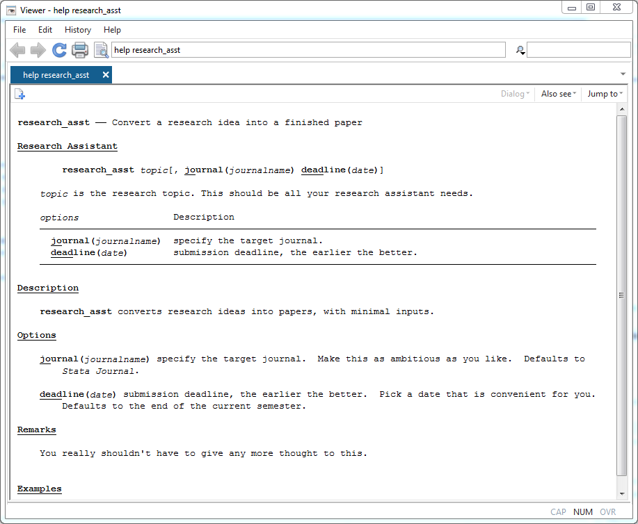
Notes:
There is a sysetm for this that promises to write your papers, but …
It’s similar to an Artificial Intelligence system: it needs extensive training, and you don’t always get the results you expect. If you do get good looking results, you may not be able to reproduce them.

Slide 5
Stata + Markdown is less ambitious
Goals:
  Reduce your work combining analysis and write-up
  Easy to read (and to write)
  You provide the code for analysis, and the text, Stata runs the code and assembles the final document.

Slide 6
What does this look like?
A simple example
What you write:
Examples\example0.stmd
The command you issue:
. stmd example0.stmd
What you get back:
Examples\example0.html

Slide 7
An Example File
===============
Some preliminary text.
A code block, evaluted:
```stata
sysuse auto
summarize weight
```
In-line text: the mean weight is `stata %9.1f r(mean)` pounds.
A list:
- N = `s r(N)`
- mean = `s %9.1f r(mean)`
- sd = `s % 9.2f r(sd)`
A graph:
```stata
histogram weight
```
More text.

Slide 8
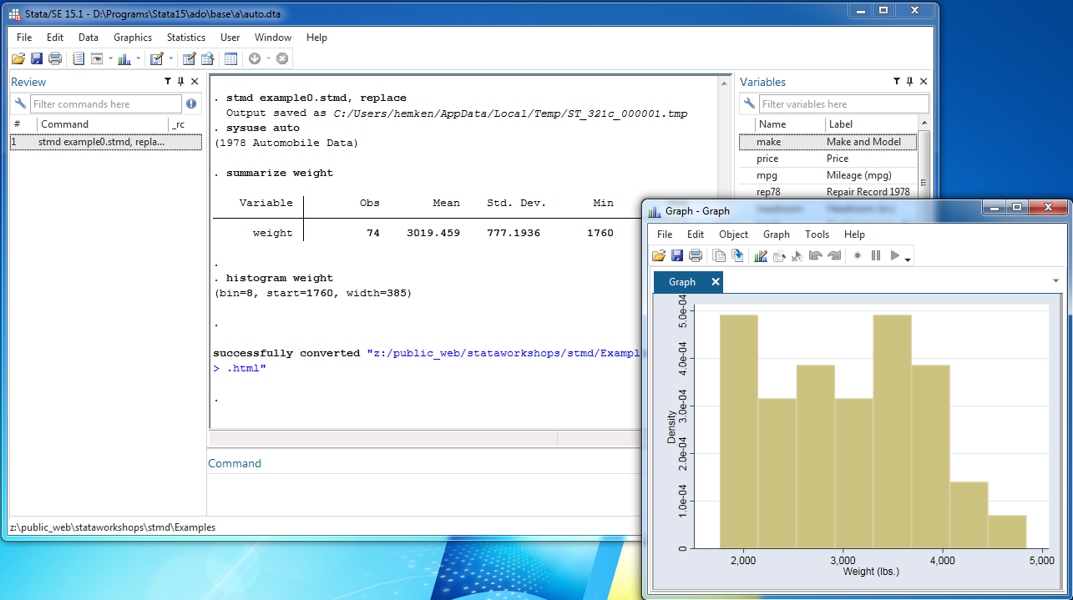
Processing in Stata

Slide 9
Two Conceptual Layers
Markdown
  Provides text formatting and document structure
Dynamic Stata code
  Provides results from the Results Viewer
  Stata codes these layers separately, but we can combine them

Slide 10
Markdown cheat sheet
(from Wikipedia)
What you write:
  Markdown/Wikipedia-markdown.md
What you get back (using Stata)
  Markdown/Wikipedia-markdown.html

Slide 11
Markdown
Simplicity – readability and writability are the central themes
There are many Markdown variants
    (None are documented in full detail)
  Stata implements two of these:
    Flexmark (default)
    Pegdown (an undocumented option)
  These are used with a few dozen of programming languages for dynamic code

Slide 12
Markdown and Dynamic code
Most implementations embed dynamic code in
  Fenced code blocks with information tags
  In-line code, also with an information tag
  Stata is much more flexible – dynamic code need not be formatted as <code>. The price of this flexibility, however, is readability.

Slide 13
What does this look like?
What you write:
Examples\example0.dyn

Slide 14
The Stata process
Dynamic Markdown
dyntext (to markdown)
Markdown
markdown
HTML
browser
dyndoc (to markdown, to HTML)

Slide 15
The stmd process
Standard dynamic Markdown
dyntext, dyndoc
Markdown
markdown
HTML
browser
Stata dynamic Markdown
stmd2dyn
stmd – dyndoc- HTML

Slide 16
Implications
Less writing, cleaner writing
Automate graphics links
Compatability (with markstat, R knitr)
  Raw dynamic tags (e.g. <<dd_remove>>, <<dd_skip_if>>) can be included, as can raw HTML (e.g. complicated <table> structures).

Slide 17
Code Block options
nocommands
nooutput
quietly
noprompt
Essentially the options for <<dd_do>>. There are alternative formulation for compatability with R knitr.

Slide 18
More examples
What you write:
  Examples/example-codeopts.stmd
What you get back:
  Examples/example-codeopts.html

Slide 19
stmd usage
stmd filename [, saving(filename2)
  replace dyndoc-options]

Slide 20
Download/ install
net from https://www.ssc.wisc.edu/~hemken/Stataworkshops
Tinker with the source code, suggest improvements:
  https://github.com/Hemken/stmd

