Slide 1
The Satisfaction with the Healthcare Services provided in the Emirate of Dubai among Dubai Residents. Dubai Household Survey - 2014: Inpatient Admission
Wafa Alnakhi, DrPH¹, Altijani Hussin, MSc²
Johns Hopkins Bloomberg School of Public Health
Health Policy and Management
Stata Conference 2018

Slide 2
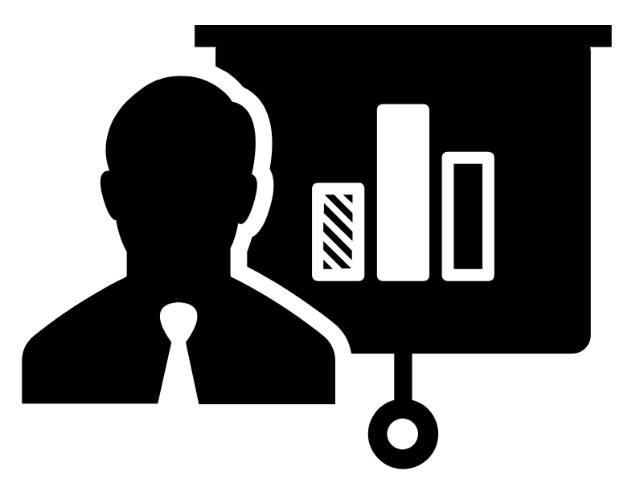
Overview
Background
Healthcare Services in Dubai
Methods
List of Commands
Descriptive Statistics
Question and Variables
Analysis
Conclusion
References

Slide 3
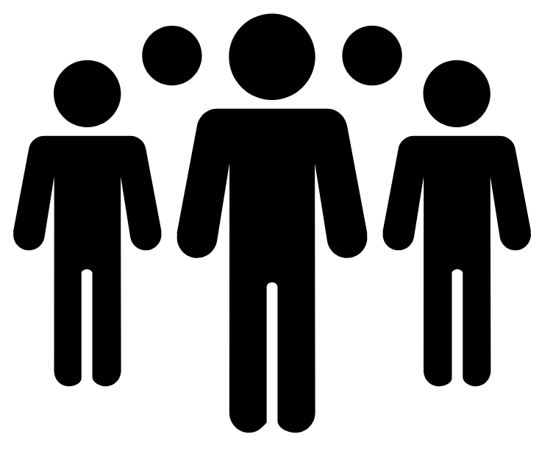
Background
Dubai is one of 7 Emirates in the United Arab Emirates
The population of Dubai is 2.8 Million
Dubai Health Authority (DHA) is the government entity that oversee healthcare in Dubai only (regulator and provider)
In November 2013, Health Insurance (MHI) Law 11 was passed , which states that all residents and visitors to Dubai must have a minimum of basic healthcare coverage. The implementation took effect across Dubai in stages and reached 99% universal coverage by end of 2017

Slide 4

Healthcare Services in Dubai
The health sector is comprised of government facilities, private facilities, and a free zone
DHA owns 4 hospitals, and 14 Primary Healthcare Centers (PHC)
Ministry of Health owns 2 hospitals, and 9 PHCs in Dubai
The private sector comprises of 22 hospitals, and over 1000 outpatient clinics and polyclinics
Total bed capacity in Dubai 2 beds per 1000 population
Notes:
Private & Public

Slide 5


Methods: Source of Data
Collaborative work between Dubai Health Authority and Dubai Statistics Center
Complex stratified (geographic area), multistage probability sampling
The survey is conducted every 4 years to identify the health status of the population: mortality, health expenditure, access to health services, health-related behaviors, etc
The design and methodology of the survey were adapted from those used in the World Bank’s Living Standards Measurement Surveys (LSMS), the World Health Organization’s World Health Surveys (WHS) and the US Centers for Disease Control’s National Health Interview Surveys (NHIS)

Slide 6
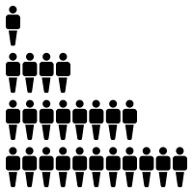
Methods: Sampling Design
The sample frame is the residents of Dubai. The Emirate of Dubai was divided into nine main sectors covering the entire area of ​​the Emirate of Dubai. Each sector is divided to areas, and each areas is divided to blocks that each block is given a number
Target population:
  UAE Nationals (2000 Household) – over sampled
  Non-UAE nationals (2000 Household and collective family)
  Blue collar 700 (18 years old and above)

Slide 7

List of Commands in Do-File
clear | gsort | svy
set more off | list | svyset
set mem 500m | merge | corr
set linesize 255 | gen | regress
log | rename | ologit
use | label | vif
replace | tab | mfx/margins
sort | sum | save

Slide 8
Descriptive Statistics
Notes:
Descriptive analysis Pie charts

Slide 9
Descriptive Statistics

Slide 10
Descriptive Statistics

Slide 11
Descriptive Statistics

Slide 12
Question & Variables
The satisfaction level of healthcare services provided in the Emirate of Dubai with inpatient admission during the last 12 months
Dependent Variable:
  Satisfaction level (ordinal)
Independent Variables:
  Chronic Condition (binary)
  Age (continuous)
  Gender (binary)
  Insurance Type (categorical)
  Nationality (categorical)
  Inpatient Admission during last 12 months (categorical)

Slide 13
Ordered Logit Regression Model
Satisfaction Level | Odds Ratio | Std. Err. | t | P>t | [95% Conf. | Interval]
CHRONIC
With Chronic Disease | 1.004 | 0.167 | 0.02 | 0.981 | 0.725 | 1.390
Age | 1.004 | 0.003 | 1.51 | 0.132 | 0.999 | 1.010
Gender
Female | 1.004 | 0.083 | 0.05 | 0.963 | 0.853 | 1.181
INSURANCE TYPE
Gov. Insurance | 0.651 | 0.076 | -3.67 | 0.000 | 0.517 | 0.818
Other Insurance | 3.19 | 2.334 | 1.59 | 0.112 | 0.763 | 13.38
Multiple Insurance | 0.608 | 0.080 | -3.79 | 0.000 | 0.470 | 0.786
No Coverage | 0.550 | 0.195 | -1.69 | 0.092 | 0.274 | 1.101

Slide 14
Order Logit Regression Model
Satisfaction Level | Odds Ratio | Std. Err. | t | P>t | [95% Conf. | Interval]
NATIONALITY
GCC & Arab Countries | 1.619 | 0.266 | 2.93 | 0.003 | 1.172 | 2.236
Asian Countries | 1.807 | 0.181 | 5.90 | 0.000 | 1.484 | 2.200
Western Countries | 1.507 | 0.290 | 2.13 | 0.033 | 1.033 | 2.199
Other Countries | 0.868 | 0.220 | -0.56 | 0.578 | 0.5277 | 1.428
Inpatient Admission Type
Private in Dubai | 3.489 | 2.246 | 1.94 | 0.052 | 0.988 | 12.327
Other Emirates & Abroad | 2.575 | 1.992 | 1.22 | 0.221 | 0.565 | 11.731
Not Being inpatient | 3.255 | 1.793 | 2.14 | 0.032 | 1.105 | 9.586
/cut1 | -1.286 | 0.565 | -2.27 | 0.023 | -2.394 | -.1776
/cut2 | -.2957 | 0.559 | -0.53 | 0.597 | -1.393 | 0.802

Slide 15

Marginal Effect for Satisfaction Level
 | Dissatisfaction | Neither Satisfied Nor Dissatisfied | Satisfied | P>|z|
Insurance Type
Gov. Insurance |  |  |  | <0.05
Other Insurance
Multiple Insurance |  |  |  | <0.05
No coverage
Nationality
GCC & Arab Nationality |  |  |  | <0.05
Asian Nationality
Western Nationality |  |  |  | <0.05
Other Nationality
Inpatient Admission Type
Private in Dubai |  |  |  | <0.05
Other Emirates & Abroad
Not Being Inpatient

Slide 16

Conclusion
Strengths
  Administrative strengths:
    Representation
    High response rate
    Sections for Utilization of healthcare Services: In patients, Outpatients
Limitations
  Administrative Limitations:
    Not representative to the UAE
    Languages
  Analysis Limitations:
    Education Level (2 variables)
    Satisfaction at individual and not the household
Future recommendations:
  Framework, demographic variables and model fitness
  Sensitivity Analysis
  Possibility of interaction to control for

Slide 17

References
Hussin, A.H., Ali, F.M., Reka, H. and Gjebrea, O., 2015. Tracking access, utilization and health system responsiveness to inform evidence-based health care policy: The case of Qatar. Journal of Local and Global Health Perspectives, p.2.
http://www.isahd.ae/Home/Reports: 1st Report - Health Accounts System of Dubai 2012 Report (EN)

Slide 18

THANK YOU wkalnakhi@gmail.com wkalnakh1@jhu.edu

