Slide 1
Development of a Project-Based Statistics Course for Applied Biostatistics Using Stata
7/31/15
Frank Snyder, PhD, MPH
Assistant Professor of Public Health
Department of Health and Kinesiology
College of Health and Human Sciences
fsnyder@purdue.edu
Notes:
15-minute presentation format.
Thank everyone for attending at the end of the last day of the conference
Fun talk, because I’m discussing pedagogy. Students rate the course as excellent (4.9 on a 5-point scale; N=7), and students strongly agree the course encourages learning (5 on a 5-point scale; N=7).
My training is in public health/heath behavior with a focus on statistics and research methodology
My intent is to share some ideas that people may want to use in their own courses.
Project-based learning is an instructional approach that is designed to build students skills and offer real-world activities, such as defining a research question and using nationally representative data to find an answer (Dierker et al., 2012). The purpose of this presentation is to describe an innovative, project-based statistics course for applied biostatistics using Stata. The semester-long course is designed as a graduate-level introductory biostatistics course; however, it could easily be adapted for use in an undergraduate public health program. The course combines two textbooks (Acock 2014; Bush, 2012) and traditional lecture and assessment with computer lab activities and a research project. The project-based course structure offers students the opportunity to directly apply course content to their unique research question, with the intent to increase students’ motivation and interest in statistics. Each student’s culminating experience is a 15-minute presentation or poster that explains their research and results to classmates or an alternative audience. Course evaluation data demonstrate that students rate the course as excellent, and students strongly agree the course encourages learning. A course syllabus, lab activities, Stata do-files, and a description of the research project and final presentation will be available upon request.

Slide 2
Outline
Project-based statistics
Course content
  Course description
  Textbooks
  Online resources for students
  Course format and philosophy
  Assignments, final project, portfolio
Conclusions
Notes:
Project-based learning is an instructional approach that is designed to build students skills and offer real-world activities, such as defining a research question and using nationally representative data to find an answer (Dierker et al., 2012). The purpose of this presentation is to describe an innovative, project-based statistics course for applied biostatistics using Stata. The semester-long course is designed as a graduate-level introductory biostatistics course; however, it could easily be adapted for use in an undergraduate public health program. The course combines two textbooks (Acock 2014; Bush, 2012) and traditional lecture and assessment with computer lab activities and a research project. The project-based course structure offers students the opportunity to directly apply course content to their unique research question, with the intent to increase students’ motivation and interest in statistics. Each student’s culminating experience is a 15-minute presentation or poster that explains their research and results to classmates or an alternative audience. Course evaluation data demonstrate that students rate the course as excellent, and students strongly agree the course encourages learning. A course syllabus, lab activities, Stata do-files, and a description of the research project and final presentation will be available upon request.

Slide 3
Project-based statistics
Workshop of Project-Based Statistics; Wesleyan University, 2012
Project-based learning is an instructional approach that is designed to build students skills and offer real-world activities (Dierker et al., 2012).
  Structured, yet board to encourage critical thinking
Notes:
Project-based learning is an instructional approach that is designed to build students skills and offer real-world activities, such as defining a research question and using nationally representative data to find an answer (Dierker et al., 2012). NSF-funded
“Learning materials and teaching strategies are designed to be structured to allow students to move forward with their research projects, yet broad to encourage students to creatively and independently explore their questions by actively driving the decisions involved in inquiry. The support each student receives is determined by their own research question and the results at each stage of their project.”
http://www.wesleyan.edu/qac/curriculum/index.html. The Passion Driven Statistics curriculum introduces students to statistics by allowing them to ask & answer statistical questions that they care about.
The Quantitative Analysis Center (QAC) is a collaborative effort of academic and administrative departments. It coordinates support for quantitative analysis across the curriculum, and provides an institutional framework for collaboration across departments and disciplines in the area of data analysis. Learn about and explore our core initiatives below.

Slide 4
Course description
Goals:
  Basic concepts and methods of statistics as used in public health
  Application
  Interpretation
  Basic terminology
  How to conduct analyses
  Quantify health relationships
  Compute and interpret inferential statistical techniques
  Use Stata to facilitate the storing, management, displaying, analysis, and interpretation of health research-related data
Notes:
The main goals of the course are to acquaint students with the basic concepts and methods of statistics, their applications, and their interpretation as used in public health. Students will learn basic terminology and its meaning, how to calculate various statistical measures and indices, how to quantify health relationships and how to compute and interpret inferential statistical techniques. Students will also acquire the ability to utilize the statistical software package Stata as a tool to facilitate the processing, editing, storing, displaying, analysis and interpretation of health research-related data.

Slide 5

Required
textbook:
Heather M. Bush. (2012). Biostatistics: An Applied Introduction for the Public Health Practitioner (1st Edition). Delmar, Cengage Learning
Notes:
Textbook is organized based on the research question. Chapters are organized by type of dependent variable: continuous data, categorical data, dichotomous data, count data.

Slide 6

Public Health Application
A study is conducted to better understand childhood obesity.
Children between the ages of 6 and 10 who attend public schools are given questionnaires and clinical exams.
Questionnaire: Participation in school lunch programs, activity level, the amount of television watched, and video games played.
Clinical exam: Height, weight, and body mass index (BMI) .
A total of 610 children participate in the study.
Notes:
Teaching note. This is the example that is used in the Bush text. It can be used to bring students back to the research question and the purpose of the statistical methods being discussed.

Slide 7

Required

Slide 8


Suggested

Slide 9
Online resources
UCLA Institute for Digital Research and Education:
http://www.ats.ucla.edu/stat/stata/
Carolina Population Center:
http://www.cpc.unc.edu/research/tools/data_analysis/statatutorial
Stata YouTube channel:
http://www.youtube.com/user/statacorp

Slide 10
Course Format/Structure
Lecture
  Introduce and cover course topics
Computer Lab
  Apply topics covered in lecture and course materials.
Notes:
Lecture is a time that I will introduce and cover course topics, while students are encouraged to participate in classroom discussion and ask questions before, during or after class. Computer Lab is dedicated to applying topics covered in lecture and course materials. Students will have the opportunity to acquire skills in data management, analysis, and interpretation.
Course Format/Structure:
Students are reminded that I will put great effort into assisting you develop a solid understanding of applied biostatistics and Stata. This course focuses on developing the skills needed to complete a data analysis project at a basic level. Overall, your goal is to empirically answer research questions and correctly interpret results. The major challenge is not mathematics, but focusing your time on course material and thinking critically to understand statistical concepts. In addition, data analysis using Stata (or any other statistical software) requires TIME AND CONTINUOUS EFFORT to become proficient.

Slide 11
Course Philosophy and Participation
Success depends upon understanding statistical concepts and using Stata.
Focus on gaining skills
Listen, share insights, ask questions, and participate in discussion
Work in groups to discuss issues
Brainstorming and thoughtful interaction
Notes:
I encourage interaction among students much like the dynamics of a research team/group.
Graduate education is largely a self-directed approach to learning
Success depends upon commitment to understanding statistical concepts and using Stata. You should understand the importance of quantitative methods in answering research questions.
Course affords the opportunity for you to gain skills that will greatly increase your success in future research projects and public health related jobs. Importance of applied skills!!
Please be willing to listen, share insights, ask questions, and participate in class discussion and activities.
In addition, I encourage you to work in groups to discuss issues and think critically about issues and assignments.
Much can be learned through brainstorming and thoughtful interaction.

Slide 12
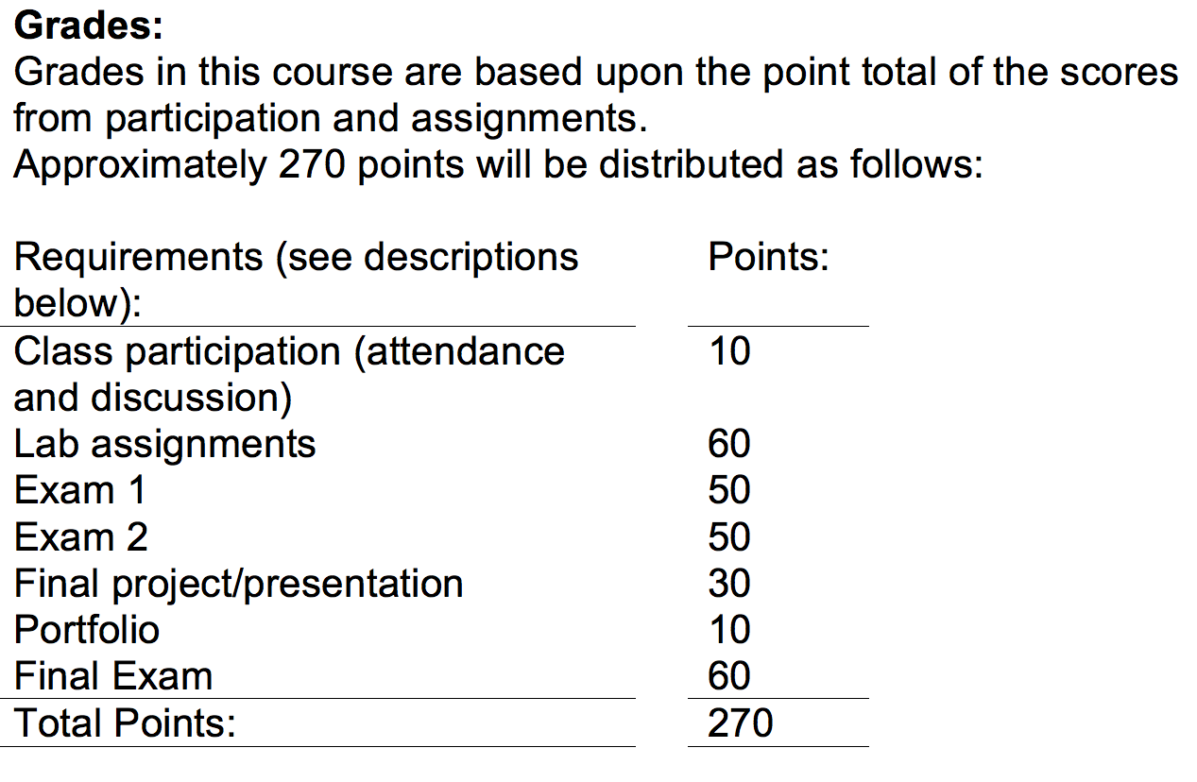
Course content and grades
Notes:
I will discuss each of these.
Exams: (3 traditional exams are assigned for evaluation:
Exams are cumulative due to the nature of the course.

Slide 13

Lab assignments
Nearly each week
Typed lab assignments due at the beginning of the next lab
Important part of course; feedback
Written in a professional style
Interpretations of statistical and substantive significance are expected
Notes:
The lab assignments are an important part of this course. These need to be written in a professional style. This will require you to do a revision of the assignment before it is due. You have to do your own work including everything from writing Stata Do-files to computing some things by hand. However, you are encouraged to solicit peer review of your first draft before you revise it and you are encouraged to help each other. Interpretations of statistical and substantive significance will be expected. Typed lab assignments are due at the beginning of the next lab. Assignments must be clearly written and easy to follow (so the instructor does not need to search for answers) to receive full credit.

Slide 14
Final project/oral presentation
Presentation during the final week of class
Can be an organized poster session
Students complete related lab assignments
Includes a research plan:
  Literature review on chosen research topic
  Evaluation of the importance of the research question
  Description of the study methods (i.e., study design, sampling procedures, and measures/variables).
At time of oral presentation student provides the instructor with:
  Hard copy of slides
  Hard copy of Stata log file
Notes:
Final project/oral presentation:
The course will lead to the completion of a final project that you will present during the final week of class as an oral research presentation. Leading up to this project, as part of lab, students will complete lab assignments that include a research plan. The research plan includes a literature review on your research topic and an evaluation of the importance of your research question, along with a description of the study methods (i.e., study design, sampling procedures, and measures/variables). At the time of your oral presentation, you must provide the instructor with a hard copy of your slides along with a hard copy (as a Word document) of your Stata log file (of ran Do-file) stapled together as one packet. More details about the final project will be given at a later date.

Slide 15

Final project/Presentation
Provide a publically available dataset (e.g., Health Behavior in School-aged Children)
Approximately 10-minute presentation
Presentation PowerPoint template provided (Power Point or poster)
Includes:
  Title
  Introduction
  Research question or questions
  Methods
  Results (including at least one graph)
  Discussion
Notes:
Research presentation to describe your research project (Presentation PowerPoint template is provided)
Your project will include the following components (You may present as a Power Point or poster [i.e., projected as a Power Point slide] and will have 8–10 minutes):
Title
Introduction
Research question or questions
Methods
Results (including at least one graph)
Discussion
Stata log file of ran do-file (nicely organized following the suggested template; first data file included should be the derived file)
I have provided a dataset (Health Behavior in School-aged Children: http://www.icpsr.umich.edu/icpsrweb/ICPSR/series/195) that can be used for the final project/presentation. I suggest that you use this as it provides a great opportunity for feedback. This project provides you with the opportunity to apply statistical analyses and skills that you have been introduced to in the course.
Familiarize yourself with the Health Behavior in School-aged Children (HBSC) dataset by exploring what variables it includes and any supplementary materials such as the questionnaire or codebook.
Please answer the following questions that are intended to help jumpstart your research project:
Please write below a brief description of the HBSC dataset.
Based on your dataset, list 2 outcome variables (i.e., dependent variables) that interest you (i.e., list the variable name and label). Indicate what type of variable each outcome is. That is, indicate if it’s continuous, nominal, ordinal, binary/dichotomous, or a count.
For each of your outcome variables, list at least 2 independent variables in the dataset that may be related to the outcome.
Based on your dependent and independent variables, propose 2 research questions (Please be sure to review course materials related to developing a research question). Please also think about the type of analysis you will use (e.g., regression). This will help guide the wording of your research question.

Slide 16

Portfolio
Intention
Hardcopy/three-ring binder
Digital format
Submitted near the end of the course
At a minimum, includes:
  Class notes
  Lecture slides
  Notes student records while reading the text
  Practice problems
  Assignments with Stata Do-files.
Organized
Notes:
Portfolio:
You will develop a portfolio (hardcopy/three-ring binder) that will be turned in near the end of the course at the beginning of class. At a minimum, this will contain the following sections, each marked by a divider: (a) your class notes, including lecture slides (b) notes you record while reading the text including any practice problems you solve on your own, (c) your assignments. Stata Do-files must be included for your assignments.

Slide 17
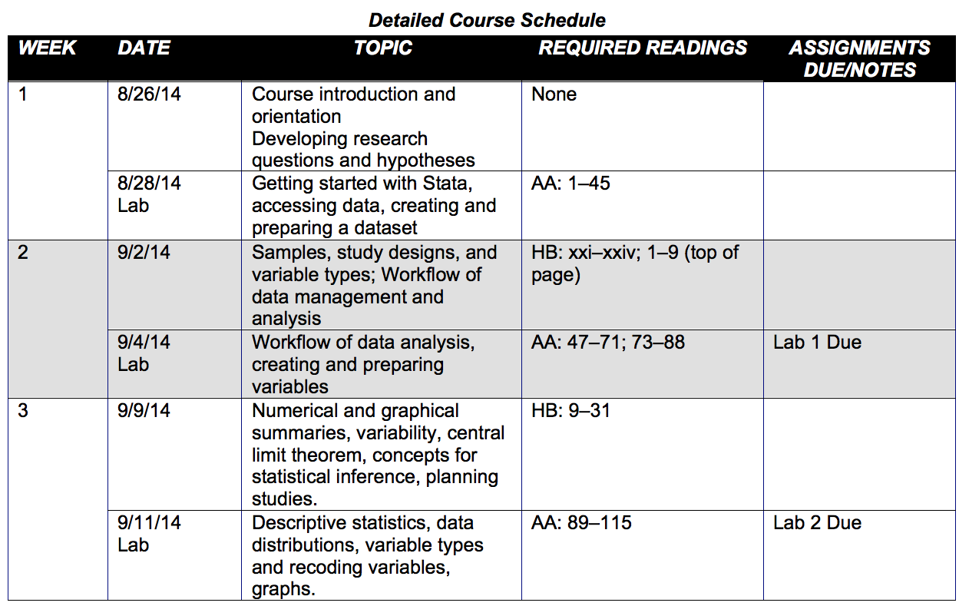
Detailed course schedule

Slide 18


acknowledgements
Dr. Lisa Dierker, Wesleyan University, Qualitative Analysis Center
Dr. Alan Acock, Oregon State University

Slide 19
Contact Information
Frank J. Snyder, Ph.D., M.P.H.
Assistant Professor
Department of Health and Kinesiology
College of Health and Human Sciences
Purdue University
800 West Stadium Ave.
West Lafayette, IN 47907
Ph: (765) 496-9486
Fax: (765) 496-1239
fsnyder@purdue.edu
Syllabus
Lab activities
State do-files
Research project description
Final presentation template
Notes:
You can email me and I will share the course syllabus, lab activities, Stata do-files, and a description of the research project and final presentation (“stata conference project-based statistics course” via dropbox).

