Slide 1

Colombian industrial structure behavior and its regions between 1974 and 2005.
Luis Fernando López Pineda
Director of Center of Research to Development and Competitiveness
Chief Economic Research
Columbus, Ohio, July 2015.

Slide 2
I am going to talk about:
Introduction
  Colombian economic
  Economic and industrial growth
Liberal reform
Econometric model

Slide 3
What was my goal:
I wanted to know what happened with colombian industrial growth after Liberal Reform (1990 – 2005)
Why does the industrial growth rate decrease after Liberal Reform
What is the Liberal Reform? It is a set of policy to reform the economy and democracy of the developing countries. For example, to open the markets (capital market, product market, financial market)
In Latin American countries, Liberal Reform is named like Neo-liberal Model or Washington Consensus.

Slide 4
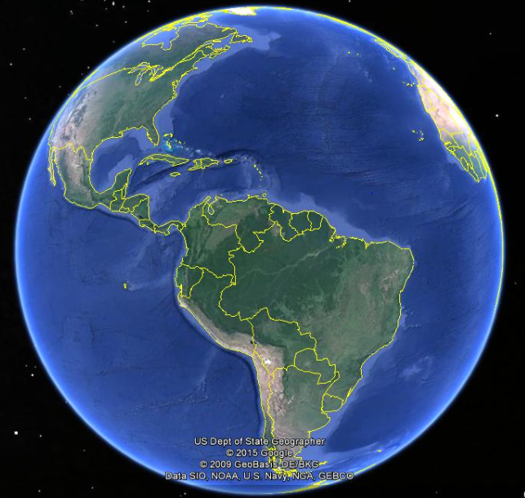
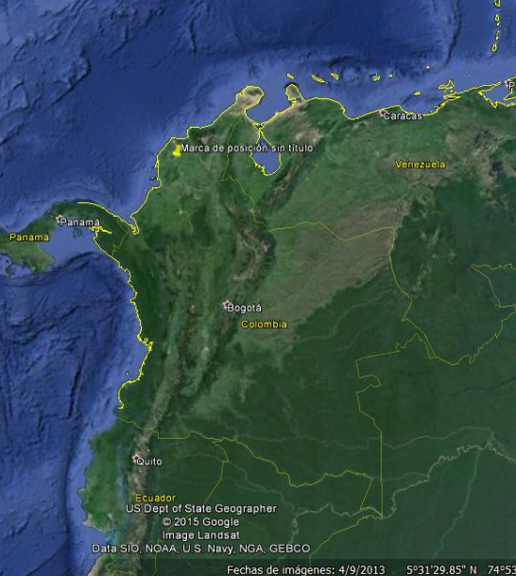
Where is Colombia?
Notes:
Colombia is a country placed in the north of South America

Slide 5
Introduction
Colombian Economic Indicators 2014
Indicators | Value
Population | 47.661.787
Gross Domestic Product (GDP)(current US$) | 377.739.622.866
GDP per capita (current US$) | 7.720
Average annual growth rate GDP per capita, 1960 – 2014 (constant 2005 US$) | 2.16%
Colombia GDP pc. with percent USA GDP pc | 14%
GINI Coeficient. | 0,538
Source: World Bank and DANE

Slide 6
Colombian Economic structure, 1965 - 2005
Source: DANE
Notes:
The colombian industry lost weight in the colombian economic in the last 40 years.

Slide 7
Colombian Economic structure, 1965 – 2005. Growth for sectors.
Source: DANE

Slide 8
Colombian industry growth rate,
1975 – 2005.
Source: DANE

Slide 9
Colombian industry growth rate,
1975 – 2005.
Departament | 1975-1980 | 1981-1985 | 1986-1990 | 1975-1989 | 1991-1995 | 1996-2000 | 2001-2005 | 1990-2005
Antioquia | 5,60% | 2,54% | 5,58% | 5,08% | -0,20% | 0,23% | 4,69% | 1,32%
Atlántico | 4,25% | 2,19% | 6,30% | 4,59% | -2,98% | -0,32% | 4,91% | 0,47%
Bogotá | 2,69% | 4,56% | 6,17% | 4,90% | -0,11% | -2,24% | 6,00% | 1,05%
Bolívar | 10,21% | 3,59% | 6,02% | 6,84% | 4,25% | 8,30% | 9,28% | 7,03%
Cundinamarca | 5,06% | 5,10% | 7,73% | 6,19% | 3,82% | 2,68% | 6,18% | 4,14%
Valle del Cauca | 3,56% | 3,85% | 6,86% | 5,00% | 0,26% | -1,60% | 2,22% | 0,36%
Promedio 6 dptos | 4,09% | 3,47% | 6,16% | 4,94% | 0,10% | -0,24% | 5,10% | 1,52%
Source: DANE

Slide 10
State of the art
There are many studies about industry growth in Colombia, but none use econometric model to explain the decrease of growth rate in the industry after the Liberal Reform.
I estimated a panel data econometric model to explain this situation.

Slide 11
The model using Stata

Slide 12
The model using Stata

Slide 13
Conclusion
The Reform Liberal in Colombia affects the industrial growth due to the increase of the imports, and to the appreciation of the Colombian currency (exchange rate ).

