Slide 1
StatTag:
A Reproducible Research Tool for Generating Dynamic Documents Using Microsoft Word and Stata
Stata Conference
July 29, 2016
Leah J. Welty, PhD
Luke V. Rasmussen, MS
Abigail S. Baldridge, MS
Presented to: Insert relevant presenter information Calibri 16pt
Presented on: Month day, Year
Presented by: Insert relevant presenter information here

Slide 2
What is reproducible research?
Reproducible vs Replicable
Reproducible vs Replicable
Notes:
Sometimes, it’s really difficult to verify scientific findings via replication. What about large, longitudinal cohort studies? You can’t draw another sample like that – too expensive.

Slide 3
What is reproducible research?
Reproducible vs Replicable
Reproducible vs Replicable
Using the same (raw) data and information about the analysis methods and choices, we can recreate the results.
Notes:
Sometimes, it’s really difficult to verify scientific findings via replication. What about large, longitudinal cohort studies? You can’t draw another sample like that – too expensive.

Slide 4
What is reproducible research?
Reproducible vs Replicable
Reproducible vs Replicable
Using the same (raw) data and information about the analysis methods and choices, we can recreate the results.
Scientific finding is verified or supported by independent experiment or study.
Notes:
Sometimes, it’s really difficult to verify scientific findings via replication. What about large, longitudinal cohort studies? You can’t draw another sample like that – too expensive.

Slide 5
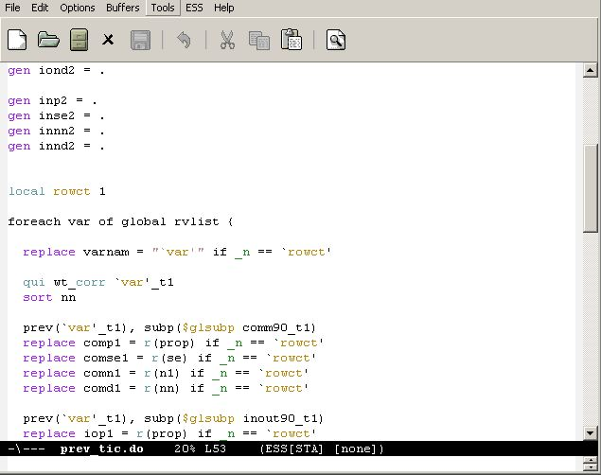
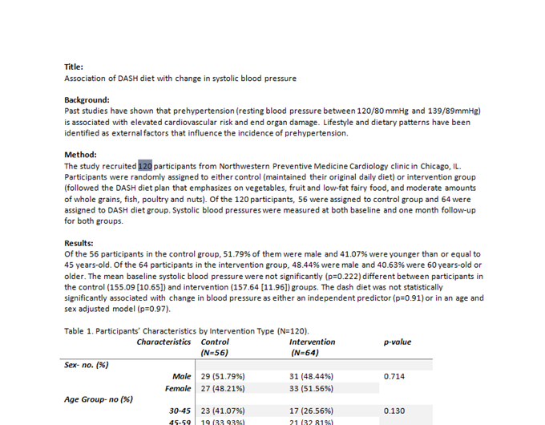
Dynamic Documents and Reproducible Research
Rather than results being hard coded in a manuscript, they can be updated automatically when data or models change. For example, rather than re-entering updated odds ratios into a manuscript or table, everything is updated automatically, either when the document is opened or compiled.

Slide 6

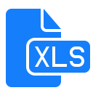








Some Existing Tools for Dynamic Documents and Stata
Methods and results are documented and reproducible
MarkDoc
Weaver
Ketchup
StatWeave
Markdown
Others …
evolving rapidly …
Notes:
Highlights for this slide:
Reproducibility is a one way street
The packages work independently
The output is generally not to a word document, and many of the finished documents are not editable

Slide 7
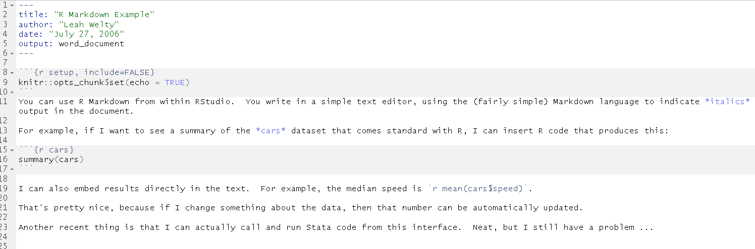
Text Files and Collaborators
A Problem with Dynamic Documents
Current tools require writing within a text editor. For example, a Markdown document looks something like this:

Slide 8
Text Files and Collaborators
A Problem with Dynamic Documents
Current tools require writing within a text editor. For example, a Markdown document looks something like this:
Do you have non-technical collaborators who are willing to work this way? My collaborators (primarily doctors and social scientists) are not.

Slide 9
Track Changes and Dynamic Documents
A Problem for Dynamic Documents
You create a dynamic document, generate the Word file and send it to collaborators.
They send back:

Slide 10
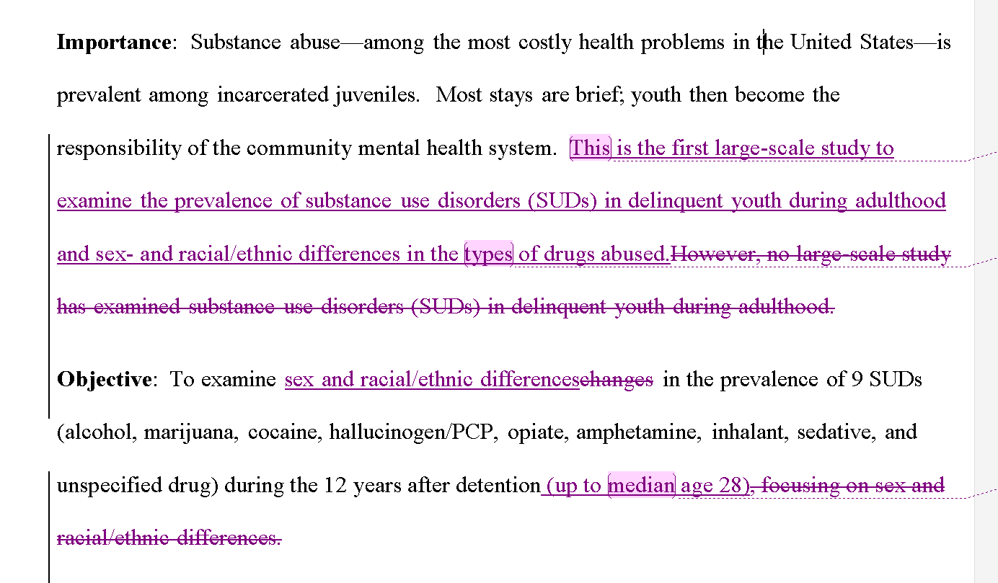
Track Changes and Dynamic Documents
A Problem for Dynamic Documents
You create a dynamic document, generate the Word file and send it to collaborators.
They send back:

Slide 11
Track Changes and Dynamic Documents
A Problem for Dynamic Documents
You create a dynamic document, generate the Word file and send it to collaborators.
They send back:
You have two (bad) choices:
Continue in Word, and loose the dynamic nature of the document.
Re-enter all of their changes in your source file.

Slide 12



Microsoft Word is Ubiquitous
A Problem for Dynamic Documents
“All text…should be in one double-spaced electronic document (preferably a Word Doc)”
“…acceptable manuscript file formats include Word and WordPerfect. Do not submit your manuscript in PDF format.”
“The manuscript must be submitted as a Word document. PDF is not accepted.”

Slide 13
Limitations of Existing Tools for Dynamic Documents
Methods and results are documented and reproducible
MarkDoc
Weaver
Ketchup
StatWeave
Markdown
Others …
Notes:
Highlights for this slide:
Reproducibility is a one way street
The packages work independently
The output is generally not to a word document, and many of the finished documents are not editable

Slide 14

Introducing ….

Slide 15

Introducing: StatTag
What makes StatTag different than other programs?
StatTag is a plug-in for Microsoft Word
  Connects Stata code and Word document
  You and your collaborators can work from the same Word document without breaking links between the code and data
  Can work separately on code and the Word document
User-friendly, easy learning curve
  StatTag menu consistent with Word layout
  EndNote:Citations as StatTag:Results
Notes:
Talk about weaving example here!

Slide 16
StatTag: An Introduction
Notes:
LUKE - VIDEO
SHOW THE FULL ABSTRACT
DROP 8 PEOPLE
UPDATE EVERYTHING

Slide 17
StatTag: An Introduction
Notes:
LUKE - VIDEO
SHOW THE FULL ABSTRACT
DROP 8 PEOPLE
UPDATE EVERYTHING

Slide 18
Getting to know StatTag
Can I use StatTag with multiple code files?
Yes! StatTag can connect to multiple “.do” files in Stata.
Future versions will connect to other statistical programs.

Slide 19
Getting to know StatTag
How does StatTag work when I share the Word document with collaborators?
If I have… | I can…
 | Review/edit manuscript text | View code associated with a tag | Insert or update a tag
Microsoft Word | ✓ | ✗ | ✗

Slide 20
Getting to know StatTag
How does StatTag work when I share the Word document with collaborators?
If I have… | I can…
 | Review/edit manuscript text | View code associated with a tag | Insert or update a tag
Microsoft Word | ✓ | ✗ | ✗
+ StatTag and Stata code | ✓ | ✓ | ✗

Slide 21
Getting to know StatTag
How does StatTag work when I share the Word document with collaborators?
If I have… | I can…
 | Review/edit manuscript text | View code associated with a tag | Insert or update a tag
Microsoft Word | ✓ | ✗ | ✗
+ StatTag and Stata code | ✓ | ✓ | ✗
+ Stata and Data | ✓ | ✓ | ✓

Slide 22
Getting to know StatTag
Is it only for Word and Stata on Windows?
No! The first public release is for Windows and Stata.
A Mac version of StatTag for Stata is coming soon.
 | Stata | SAS | R
Windows | Now | October 2016 | April 2017
Mac | Late 2016 | X | June 2017

Slide 23
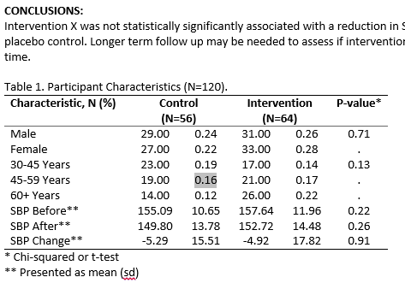
Getting to know StatTag
Can I see all the tags in a document?
Yes! Inserted tags are highlighted when they are clicked on.
Future versions will include a “highlight all tags” function to quickly find any inserted tags in a document.
Notes:
[SKIP/CUT IF NEEDED]

Slide 24
Getting to know StatTag
What about data security (e.g. PII, PHI)?
StatTag doesn’t store a copy of your data.
StatTag will eventually store a read-only copy of your code
Notes:
[SKIP/CUT IF NEEDED]

Slide 25
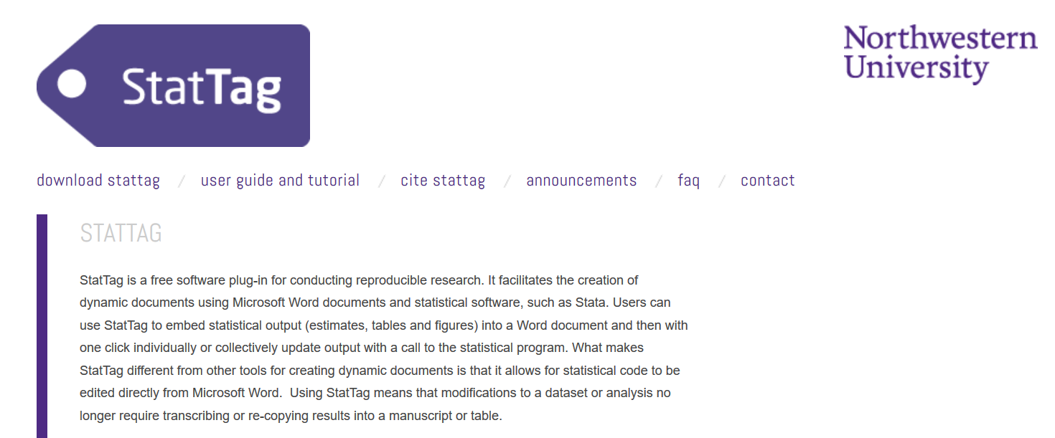
Getting to know StatTag
How do I get StatTag?
stattag.org

Slide 26


Getting to know StatTag
How do I cite StatTag?
We ask that anyone who uses StatTag as a part of their manuscript preparation cite StatTag:
  Welty, L.J., Rasmussen, L.V., & Baldridge, A.S. (2016). StatTag. Chicago, Illinois, United States: Galter Health Sciences Library. doi:10.18131/G3K76
StatTag was developed with funding through a Clinical Translational Sciences Award (CTSA) to Northwestern University. Tracking the impact of the award is a key metric in demonstrating effectiveness.
StatTag is distributed under the MIT License

Slide 27

Acknowledgements
StatTag Team
  Leah J. Welty, Biostatistician
  Luke V. Rasmussen, Lead Software Developer
  Abigail S. Baldridge, Senior Statistical Analyst
  Eric W. Whitley, Software Developer
Development of StatTag was supported, in part, by the National Institutes of Health's National Center for Advancing Translational Sciences, Grant Number UL1TR001422. The content is solely the responsibility of the developers and does not necessarily represent the official views of the National Institutes of Health.

Slide 28
Acknowledgements (continued)
StatTag was inspired in part by the Stata Automation Report project: Lo Magno, G.L. (2013). Sar: Automatic generation of statistical reports using Stata and Microsoft Word for Windows. The Stata Journal, 13(1); 39-64.
StatTag makes use of the following open source projects:
Scintilla - http://www.scintilla.org/
ScintillaNET - https://github.com/jacobslusser/ScintillaNET
Json.NET - http://www.newtonsoft.com/json
  Use of these projects does not imply endorsement of StatTag by the respective project owners, or endorsement of the use of these projects by Northwestern University.

Slide 29
Questions?
Visit stattag.org for more information
  Get involved! Contact us at stattag@northwestern.edu
  Questions
  Comments and suggestions
  Volunteer to test new releases

Slide 30
Thank you!

Slide 32
BACKUP SCREENSHOT SLIDES HERE (LUKE)

