Slide 1

Stata tweets and other API libraries: a practical guide
William Matsuoka
Stata Conference
Chicago, IL - July 28, 2016

Slide 2
Background – Obsessive Automation
Hot topic on Statalist for many years now
APIs can be very useful for automating your workflow
Request In & Data Out
But make sure to read the documentation

Slide 3
Output Formats: JSON, XML, and HTML
Stata is an excellent parser (Mata is even nicer but takes time)
Output commonly in JSON or XML formats. Sometimes CSV or even straight HTML.
JSON commonly handled with insheetjson
  jsonio perhaps

Slide 4
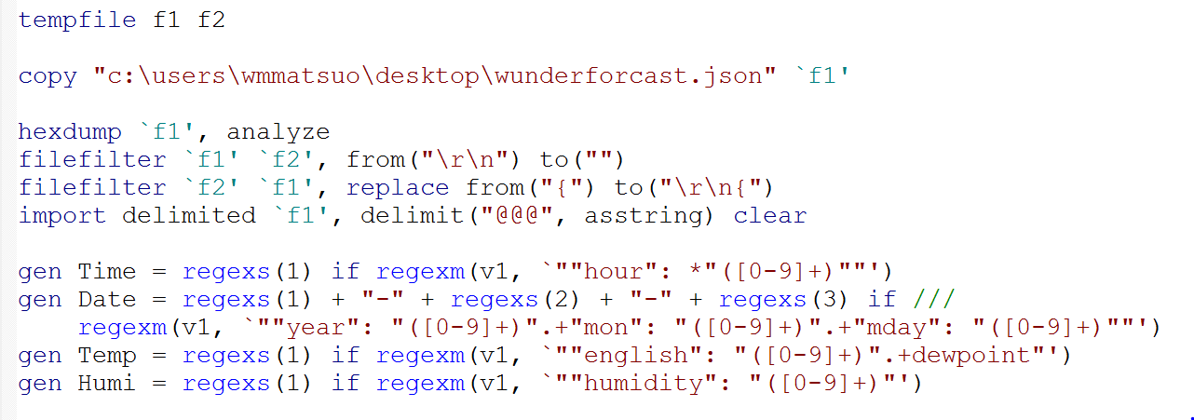
wunderexamp
http://api.wunderground.com/api/aaaAPIKEYbbb/hourly10day/q/CA/San_Diego_International-Lindbergh.json

Slide 5
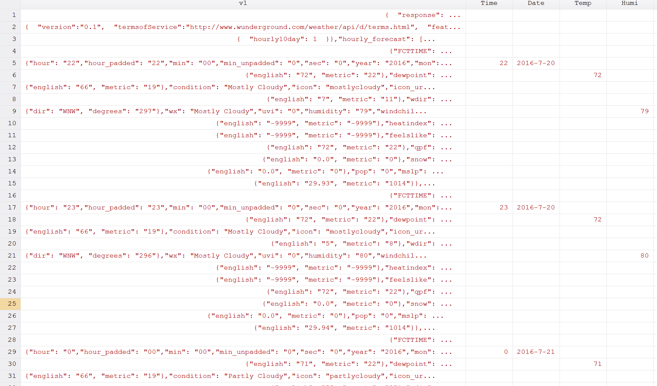
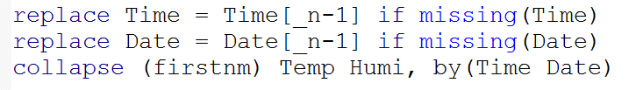
Parsing Made Easy

Slide 6
Elements of Common Web APIs
API “Key”
  Can be pricy
Variables
  http://www.api.com/req.aspx?date=20160728&word=Stata%27s+Awesome
Additional barriers to data
  Percent Encoding
  Base64 Encoding
  Hash Algorithms

Slide 7
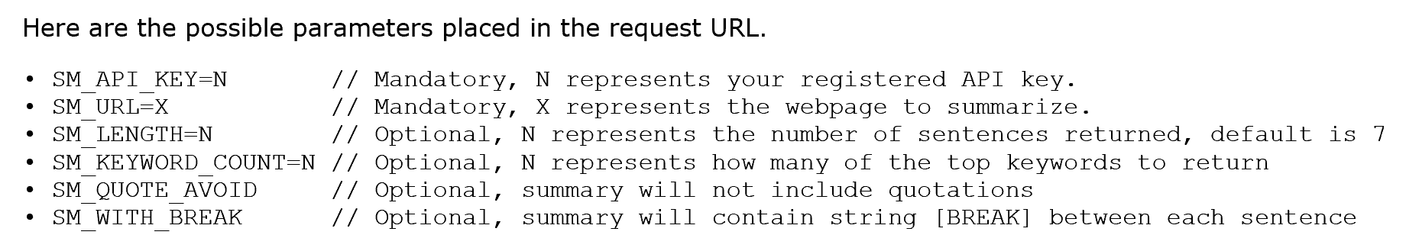
Simple GET - SMMRY
SMMRY is an API to summarize documents
Easy to send requests, up to 25 a day for free
http://api.smmry.com/&SM_API_KEY=APIKEY&SM_LENGTH=3&SM_URL=http%3A%2F%2Fsmmry.com%2Fapi

Slide 8
TL;DR
SMMRY API SMMRY is accessible via an API. Developers are able to implement SMMRY into applications that may require a summary of a webpage or block of text.
Get a free partner account here and an API key will be generated automatically.
Modes There are two active modes of the API, Limited and Full: Limited: A limit of 25 free API requests can be made daily, and each request must be at least 10 seconds apart.

Slide 9
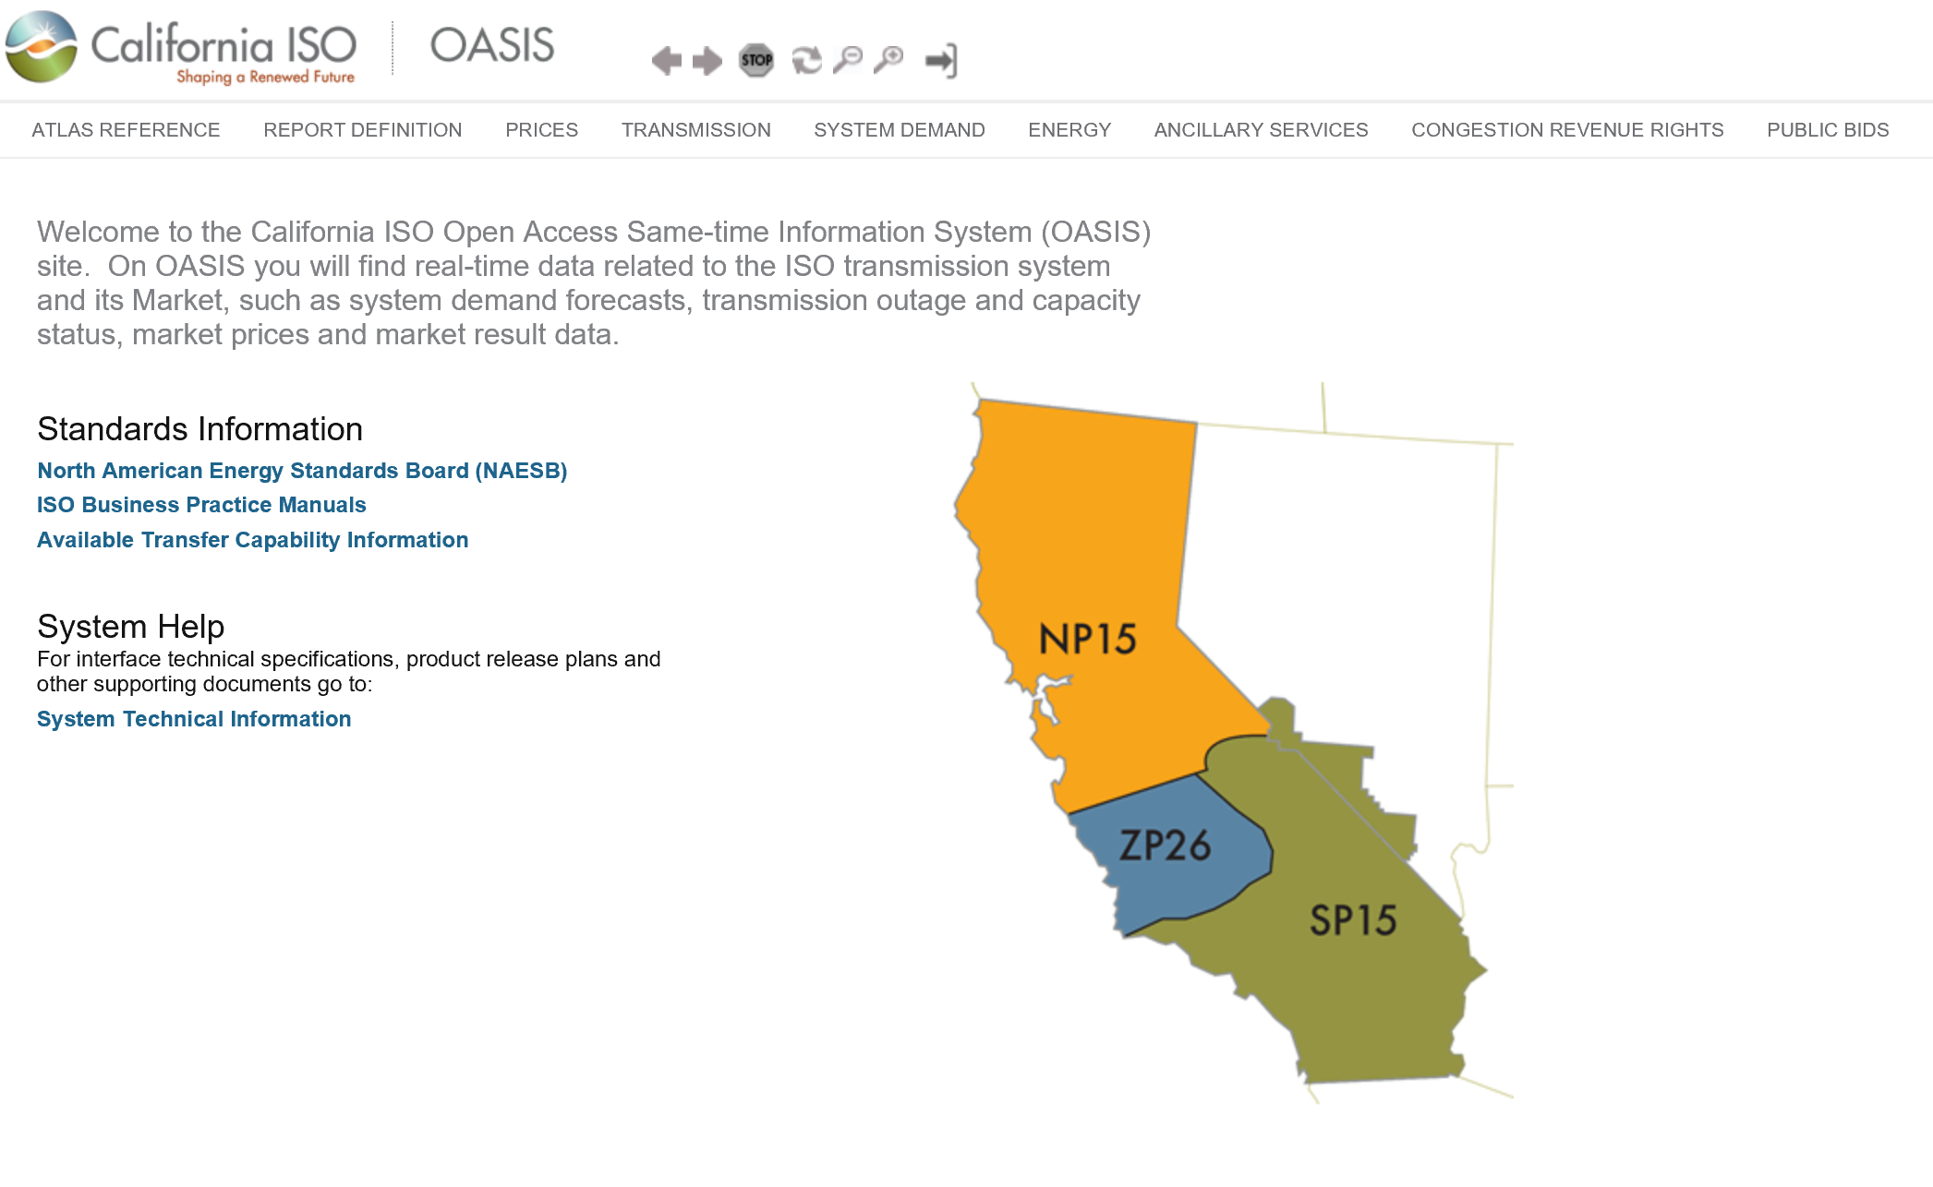
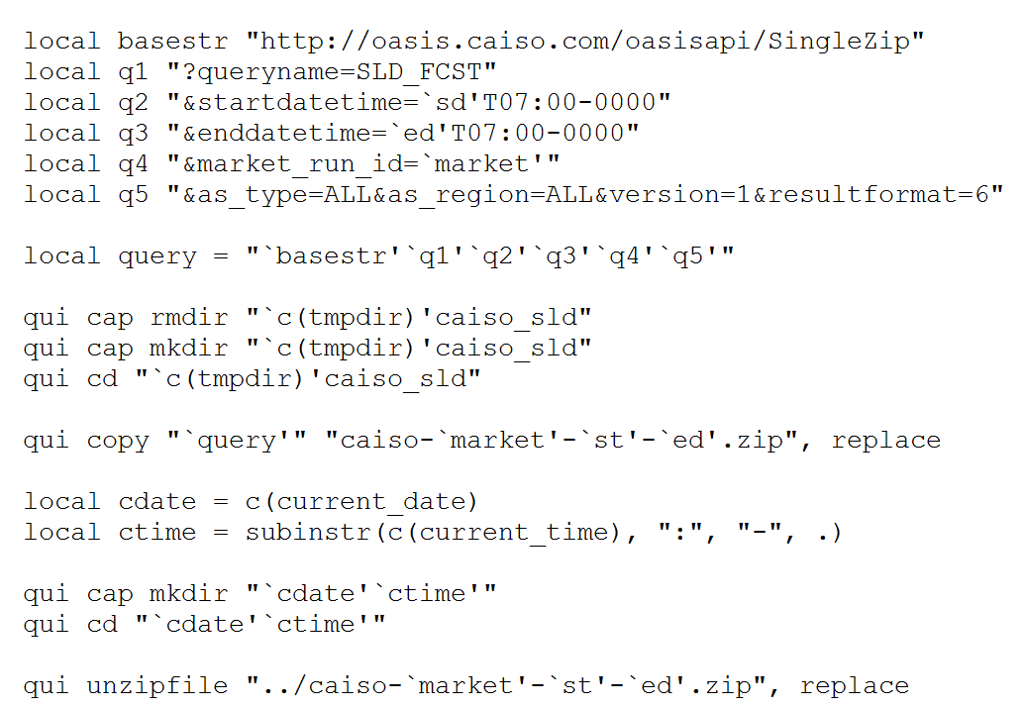
Zipped Files - CAISO
California Independent System Operator
  Electricity price and demand data from API returned in zip format
GET request built off of base string
unzipfile is key here

Slide 10
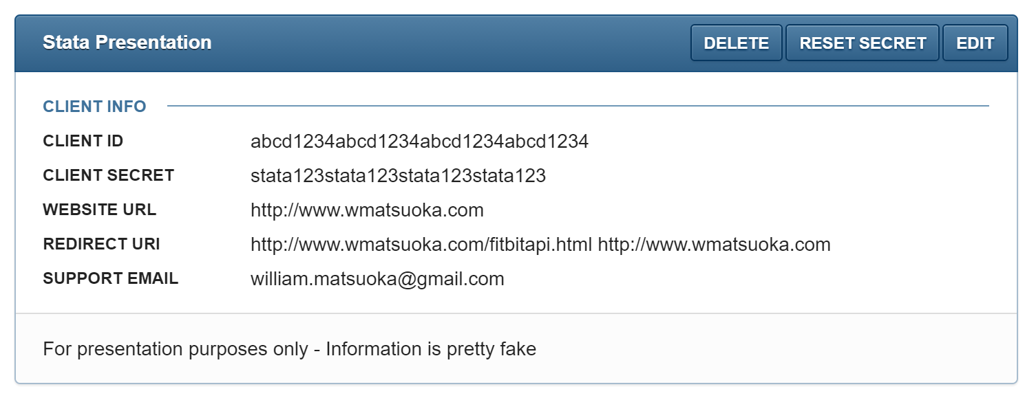
Instagram – Signing Up

Slide 11
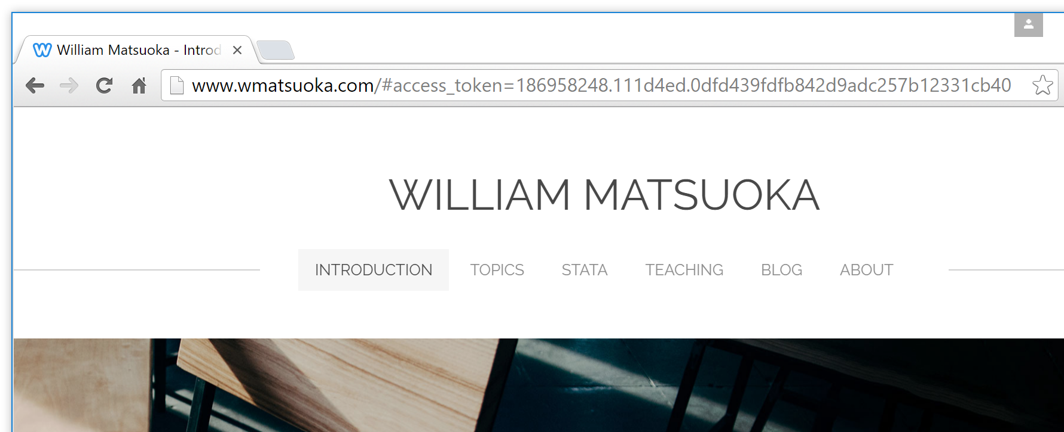
Authentication: Instagram
https://api.instagram.com/oauth/authorize/?client_id=Client-ID&redirect_uri=http%3A%2F%2Fwww.wmatsuoka.com&response_type=token&scope=public_content

Slide 12
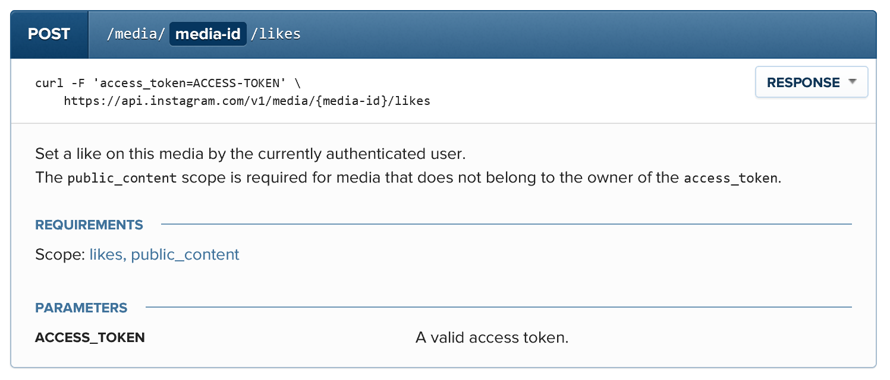
Instagram “Likes”
Looks like we need more HTTP methods

Slide 13

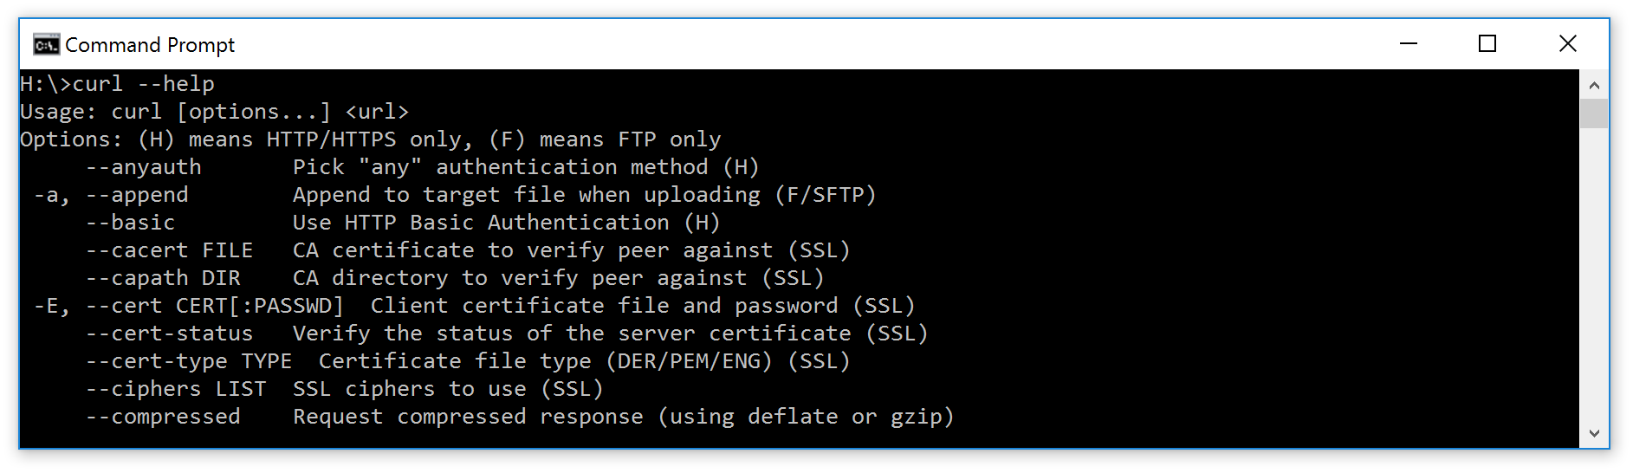
REST Easy with cURL
Free and fairly easy to download (may already be installed)
Shell (!)

Slide 14
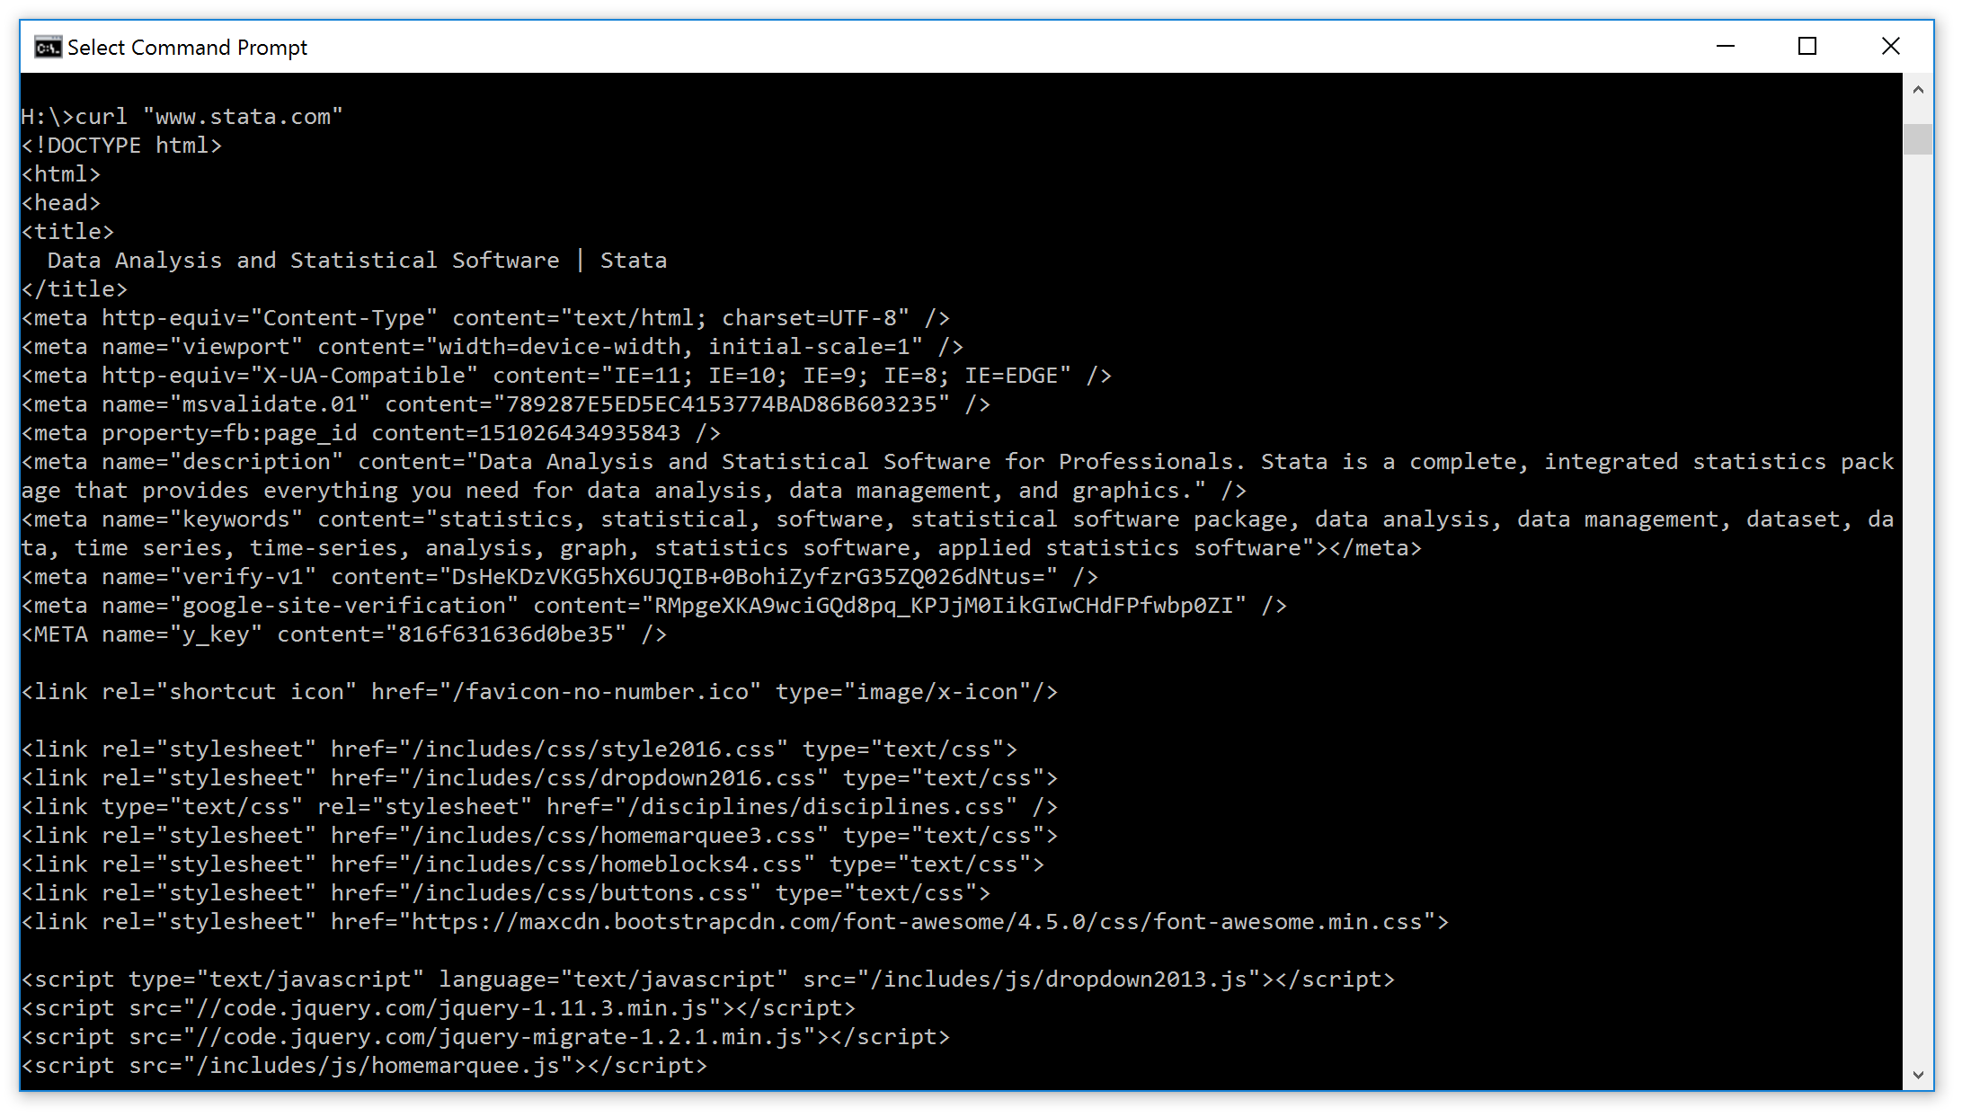
REST Easy with cURL

Slide 15
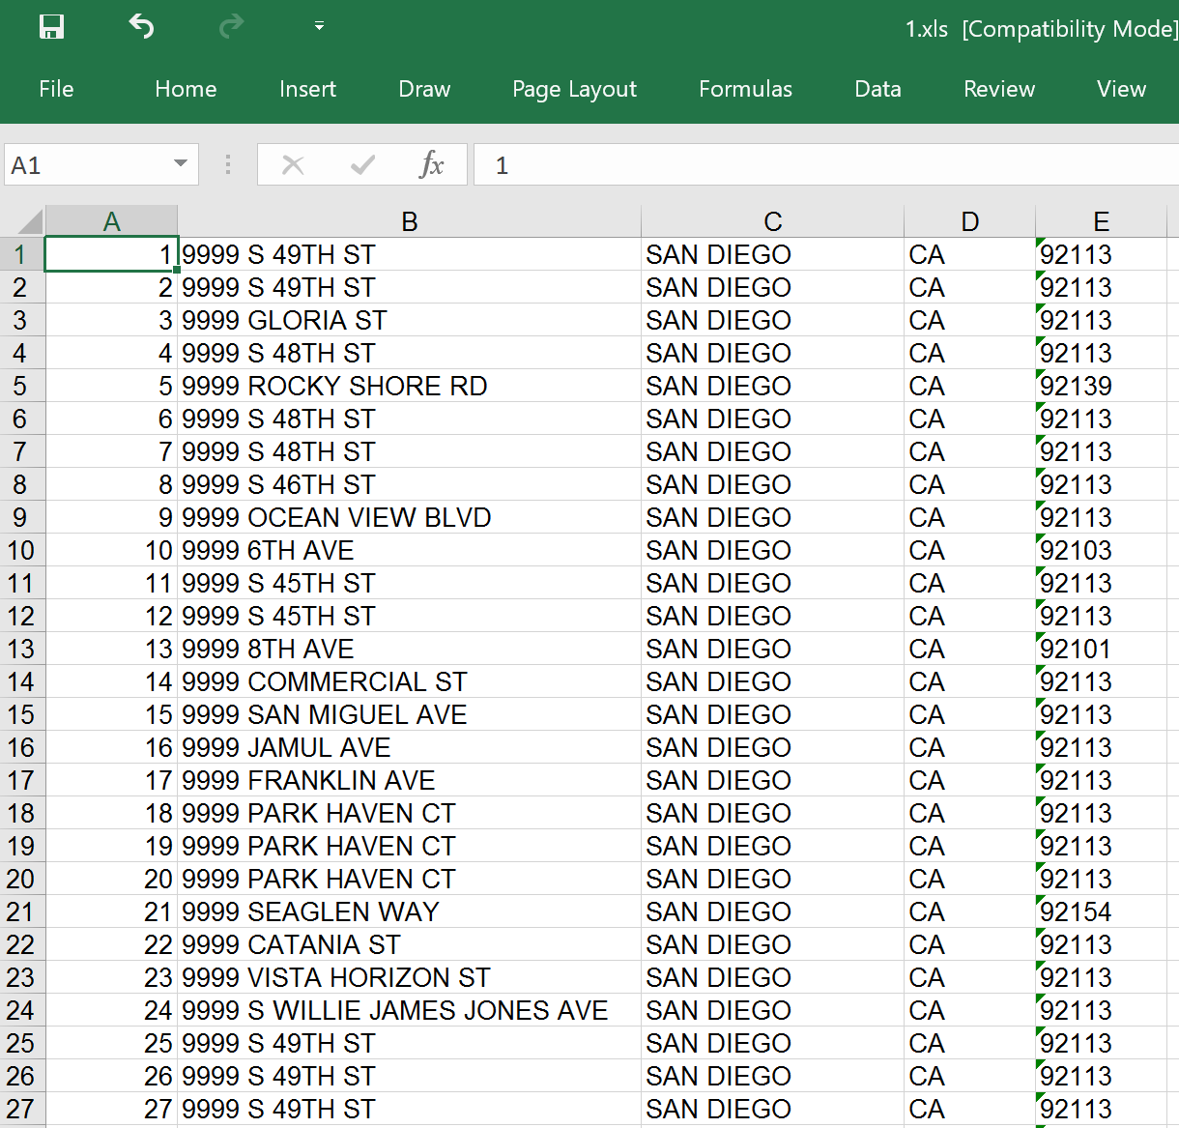
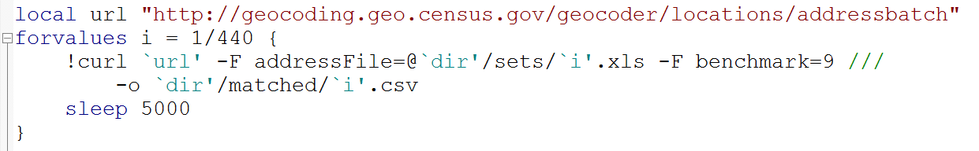
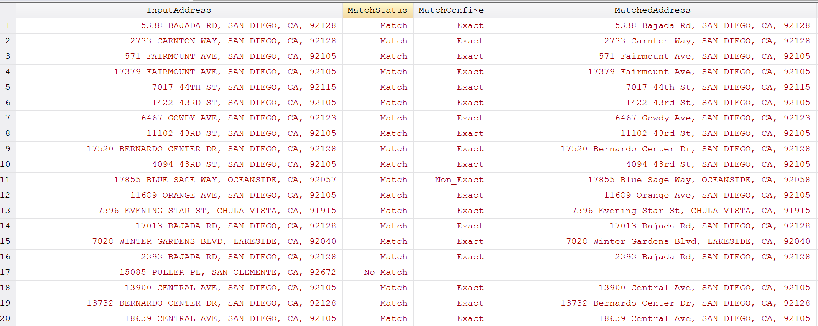
Census TIGER (mqgeocode, geocode3)
Batch geocode many addresses at once
  For San Diego County - 1 Million Households in 4 Hours

Slide 16
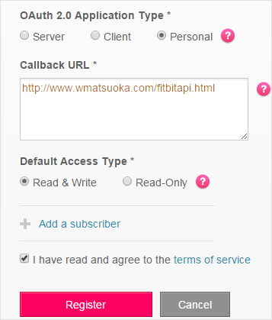
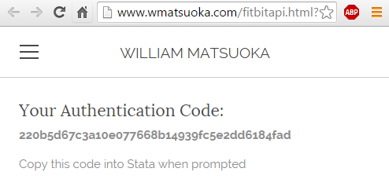
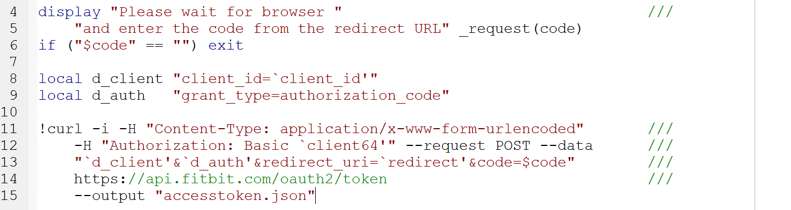
Callback URL - Fitbit
Some APIs require “Callback” URLs for authentication

Slide 17
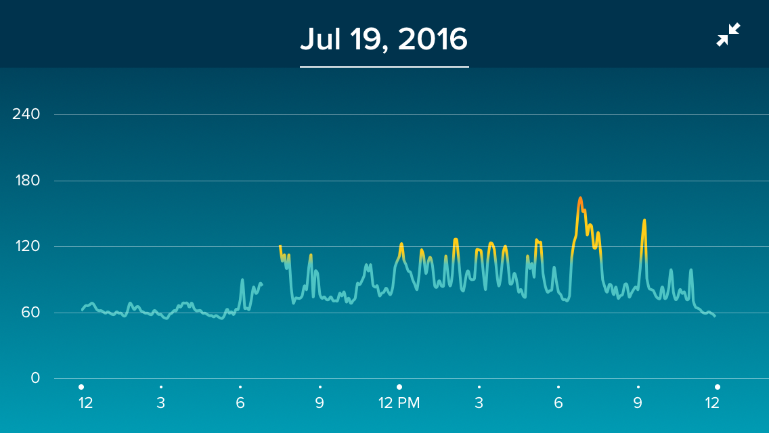
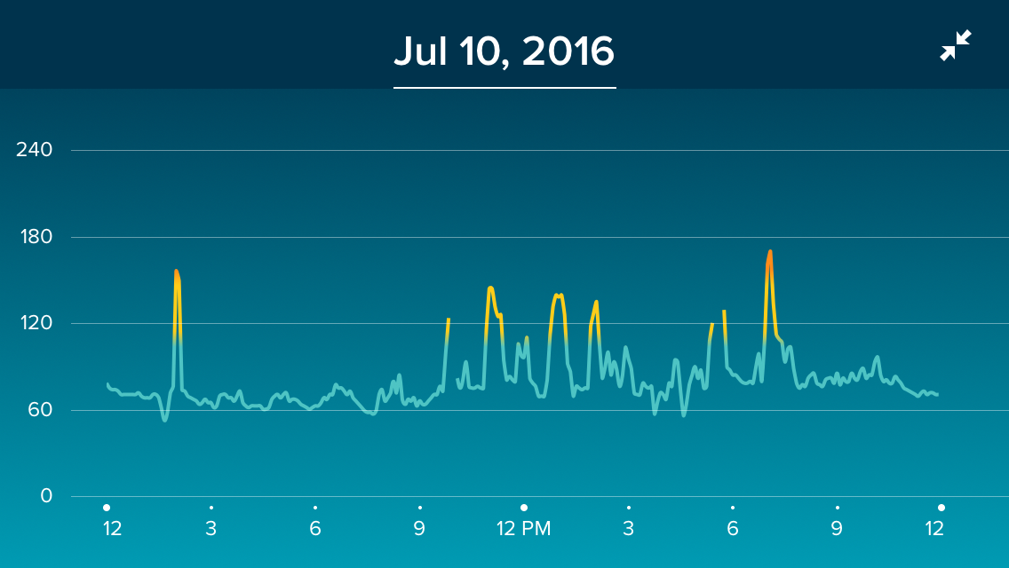
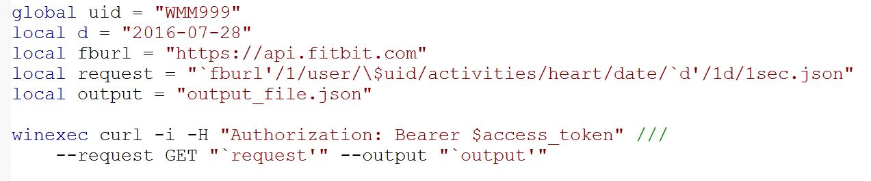
Finally we can make the request

Slide 18
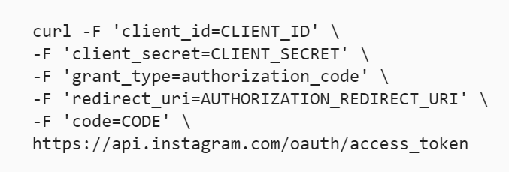
Instagram: now with more cURL!
Three Steps:
  Direct
  Callback Code
  Access Token
Quite a bit of work to like a photo

Slide 19
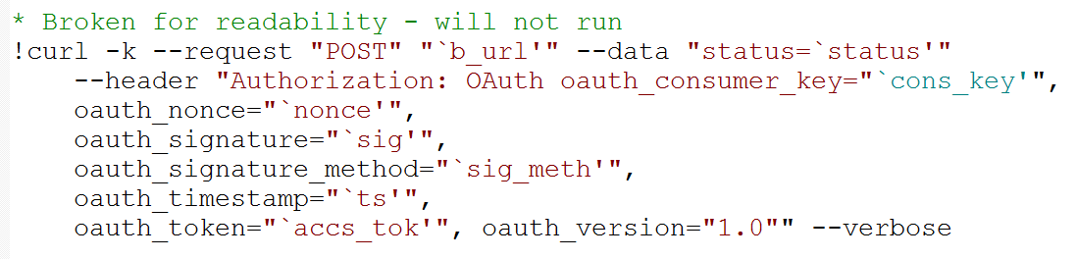
Twitter – under lock and key
Get statuses “Tweets”
Favorite statuses “Likes”
Send direct messages to yourself at the completion of do files!
  “… preceding a message with “D ” or “M ” and following it with a screen name can create a direct message to that user if the relationship allows for it.”
Emoji are allowed and are percent encoded: %F0%9F%93%88 (Chart)
See Joe Canner’s presentation on the topic or wmatsuoka.com for more details

Slide 20
Truth be told, APIs can be rather limiting
Odd return formats
Sometimes required to store secure information such as passwords, tokens, and API keys
Rate Limits
  Time between requests
  Maximum requests per hour
Contract/Account Management/Costs

Slide 21
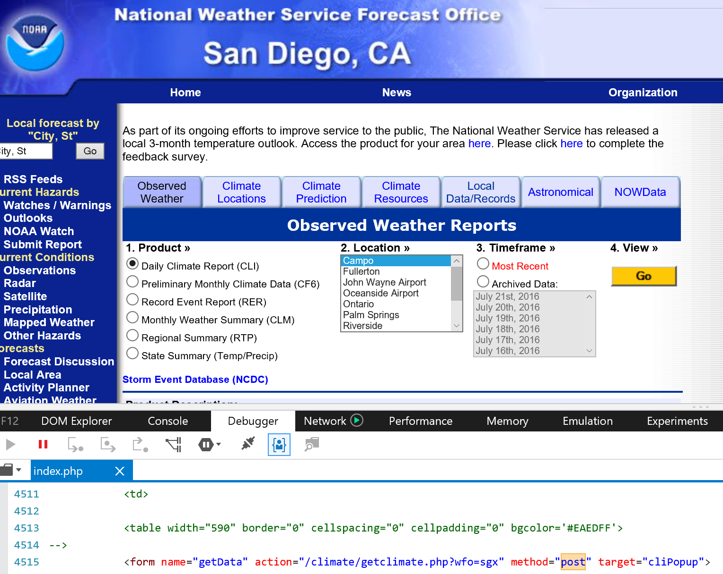
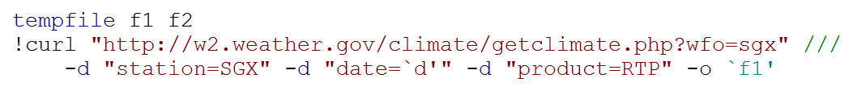
cURL to Circumvent APIs (Form Control)
Using forms with cURL: requires a bit of detective work
Change “post” methods to “get”
to see the variables sent
For those with intranet sites:
  --ntlm -u :

Slide 22
API Rate Limits (Scraping)
Sometimes best (not for the server) to scrape the information
Tread Lightly! Could be violation of terms of service
Stata enables scraping fairly easily
cURL allows you to login to websites and copy protected pages to be parsed directly from Stata and allows for stored cookie settings

Slide 23
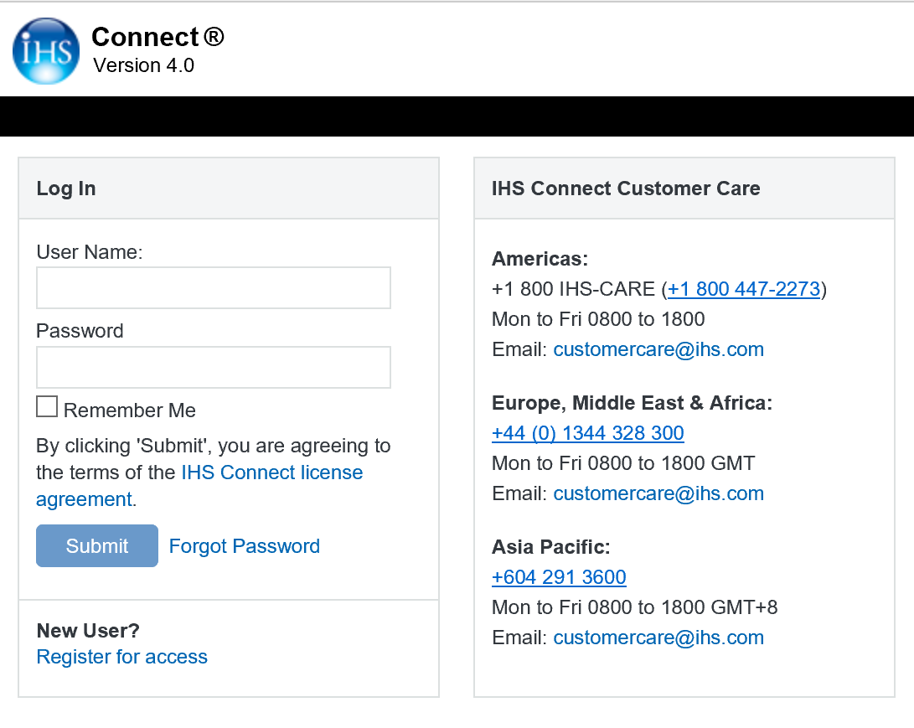
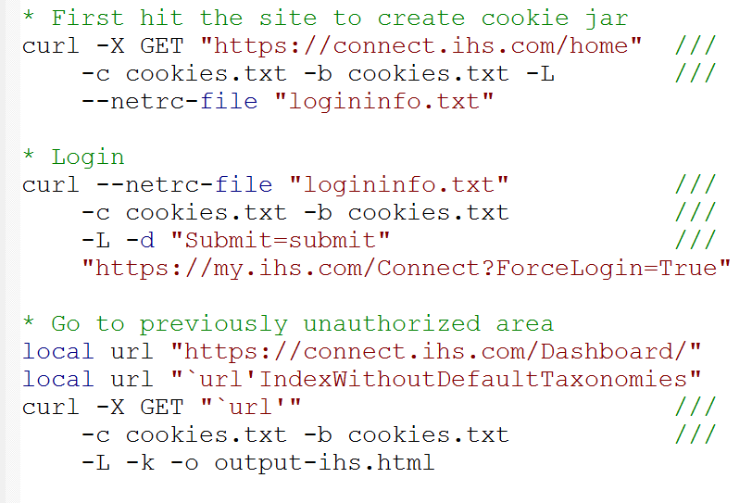
Cookies
Where logininfo.txt contains:

Slide 24
In SMMRY
Useful Stata commands: shell (!), winexec, filefilter, regexm, split
cURL allows Stata to easily obtain data from websites
  Send more HTTP Requests
  Access restricted sites
  Store cookies
Stata is a really good ad hoc parser
There are so many more APIs out there
APIs are an effective way to get the data you want
They can even improve Stata graphics…

Slide 25
www.wmatsuoka.com

