Slide 1
VERSATILE TESTS FOR COMPARING SURVIVAL CURVES BASED ON WEIGHTED LOG-RANK STATISTICS
Theodore Karrison
Department of Public Health Sciences
University of Chicago
Presented at the Stata Conference
Chicago 2016

Slide 2
Motivation
“Evaluation of a Novel Rash Scale and a Serum Proteomic Predictor in a Randomized Phase II Trial of Sequential or Concurrent Cetuximab and Pemetrexed in Previously Treated Non-small Cell Lung Cancer (NSCLC)”
-- Maitland, Levine, et al. (BMC Cancer, 2014)
Statistical analysis:
“In the comparison of overall survival between treatment arms, there was evidence of non-proportional hazards, and therefore the Prentice-Wilcoxon test (which assigns greater weight to earlier time-points) rather than the log-rank test is presented.”

Slide 3
Kaplan-Meier Estimates of Overall Survival
Prentice-Wilcoxon p=0.045
Blue: Sequential (n=20) Red: Concurrent (n=23)
The large difference is hard to ignore, but should the p-value have been adjusted?

Slide 4
OUTLINE
INTRODUCTION
METHODOLOGY
EXAMPLES
SIMULATION STUDY
SUMMARY

Slide 5
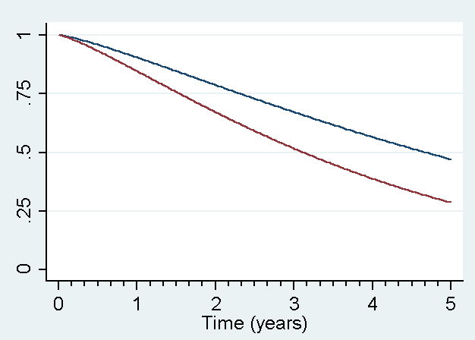
INTRODUCTION
The log-rank (LR) test is perhaps the most commonly used nonparametric procedure for comparing two survival curves.
Yields maximum power under proportional hazards (PH) alternatives.
While PH often holds, this need not be the case. Survival curves may separate early and then converge, or may be similar initially and diverge later in time.
Survival Curves Exhibiting Proportional Hazards

Slide 6
Several authors have therefore developed versatile tests based on combinations of weighted log-rank statistics that are more sensitive to non-PH alternatives.
Fleming and Harrington (1991) considered the family of G^{ρ} statistics and their supremum versions.
Lee, JW (1996) and Lee, S-H (2007) proposed tests based on the more extended family:
JW Lee (1996) evaluated the maximum over four z-statistics derived from
G^{0,0}, G^{2,0}, G^{0,2}, and G^{2,2} tests, as well as their average.
S-H Lee (2007) considered max(|Z₁|,|Z₂|), |Z₁+Z₂|/2, and (|Z₁|+|Z₂|)/2)
where Z₁ and Z₂ are z-statistics obtained from G^{1,0} and G^{0,1} tests, respectively.

Slide 7
In this talk we will focus on = max(|Z₁|,|Z₂|,|Z₃|), where Z₁, Z₂, and Z₃ are Z-statistics obtained from G^{0,0}, G^{1,0}, and G^{0,1} tests, respectively.
G^{0,0} corresponds to the log-rank test while G^{1,0} is the Prentice-Wilcoxon statistic, more sensitive to early differences. G^{0,1} places more weight at the later time points and is therefore sensitive to late difference alternatives.
The syntax for a Stata (College Station, TX) command to implement the method, verswlr, is described.
The particular combination, G^{0,0}, G^{1,0}, and G^{0,1}, should provide relatively good coverage across the range of likely possibilities, i.e., PH, early, and late difference alternatives.
However verswlr allows the user to specify a different family of tests.

Slide 8
Key Issues:
(1) We will have to allow for the fact that we are taking the maximum of three test statistics in order to maintain the type I error rate (α-level) at the nominal value (multiple comparisons issue).
(2) How much power is sacrificed if PH does, in fact, hold?
(3) How well does Z_{m} perform compared to the “more optimal” test?
(4) Implications for the design of clinical trials?

Slide 9
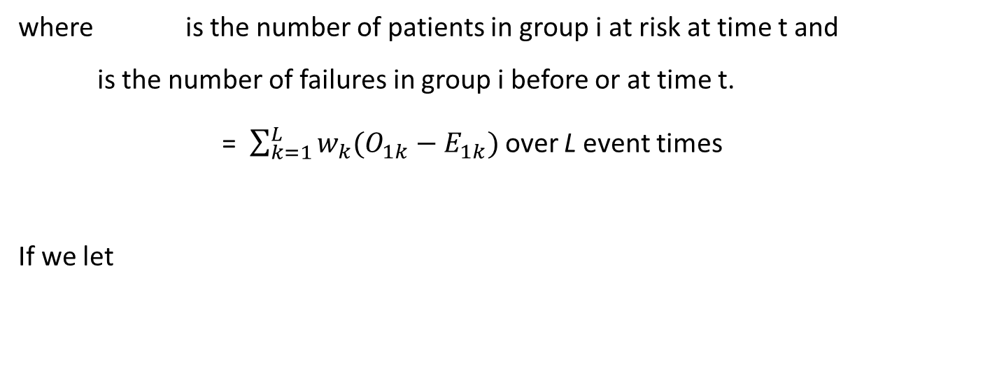
METHODOLOGY
The family of weighted logrank statistics can be expressed as
(1)
where is the number of patients in group i at risk at time t and
is the number of failures in group i before or at time t.
= $\sum_{k=1}^{L}{w_{k}(O_{1k}−E_{1k}) }$over L event times
If we let
denote a weighted LR-statistic with weight , then . . .

Slide 10
G^{0,0} corresponds to : Equal weights
G^{1,0} corresponds to : Greater weight at early time points
G^{0,1} corresponds to : Greater weight at later time points
The covariance between and is
(2)

Slide 11
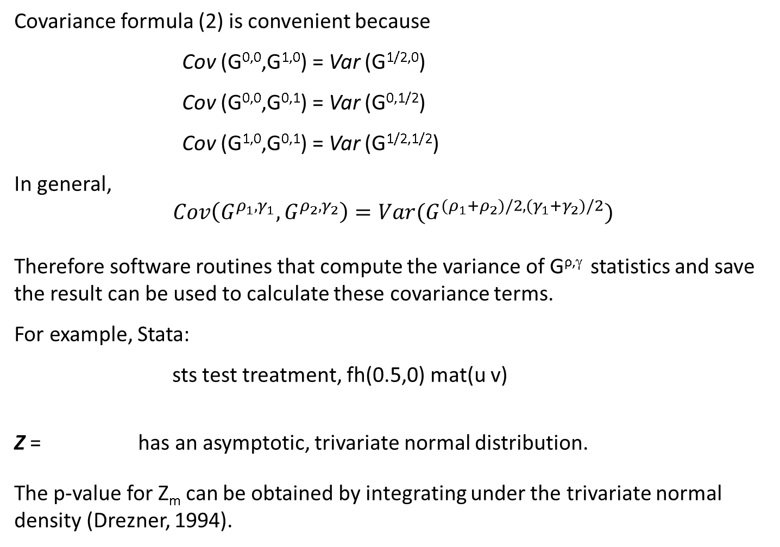
Covariance formula (2) is convenient because
Cov (G^{0,0},G^{1,0}) = Var (G^{1/2,0})
Cov (G^{0,0},G^{0,1}) = Var (G^{0,1/2})
Cov (G^{1,0},G^{0,1}) = Var (G^{1/2,1/2})
In general,
$$Cov\left(G^{ρ_{1}{,γ}_{1}},G^{ρ_{2}{,γ}_{2}}\right)=Var(G^{(ρ_{1}+ρ_{2})/2, (γ_{1}+γ_{2})/2})$$
Therefore software routines that compute the variance of G^{ρ,γ} statistics and save the result can be used to calculate these covariance terms.
For example, Stata:
sts test treatment, fh(0.5,0) mat(u v)
Z = has an asymptotic, trivariate normal distribution.
The p-value for Z_{m} can be obtained by integrating under the trivariate normal density (Drezner, 1994).

Slide 12
verswlr command:
stset failure_time, failure (indicator_var)
verswlr varname [if] [in] [, options]
Options
rho1(#) gamma1(#) -- Weights for first test
rho2(#) gamma2(#) -- Weights for second test
rho3(#) gamma3(#) -- Weights for third test
Default values are (0 0), (1 0), and (0 1), respectively.
Examples
verswlr treatment
- constructs max(G^{0,0}, G^{1,0}, and G^{0,1})
verswlr treatment, rho2(2) gamma3(2)
- constructs max(G^{0,0}, G^{2,0}, and G^{0,2})

Slide 13
EXAMPLES
Example 1: GTSG Gastric Carcinoma Study (Stablein et al., 1981)
LR: p=.251
G^{1,0}: p=.030
G^{0,1}: p=.606
Z_{m}: p=.056
Blue: Chemo+RT (n=45) Red: Chemo (n=45)

Slide 14
Example 2: NCOG Head-and-Neck Cancer Trial (Efron, 1988)
LR: p=.022
G^{1,0}: p=.062 G^{0,1}: p=.015 Z_{m}: p=.029
Blue: RT (n=51) Red: Chemo+RT (n=45)

Slide 15
Example 3: Cetuximab-Pemetrexed NSCLC Trial (Maitland et al., 2014)
LR: p=.190 G^{1,0}: p=.045 G^{0,1}: p=.938 Z_{m}: p=.082
Blue: Cetuximab (n=20) Red: Cetuximab + Pemetrexed (n=23)

Slide 16
SIMULATION STUDY
Compare the performance of the versatile method based on Z_{m} to the log-rank test and to the more “optimally” weighted test under the null hypothesis, PH, early difference, and late difference alternatives.
Data generated from two Weibull distributions:
Clinical trials were simulated with accrual period a and follow-up period f.

Slide 17
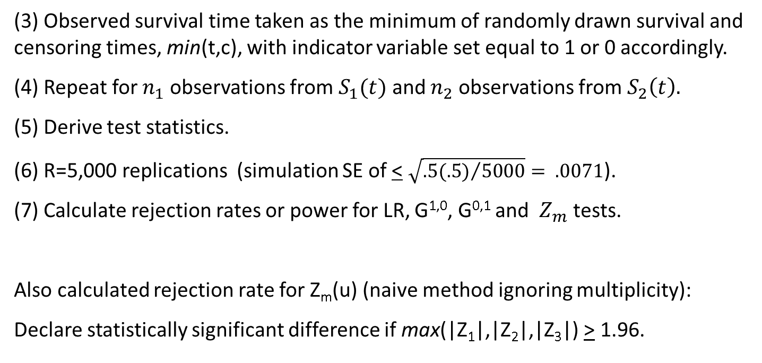
Steps:
(1) Draw random true survival time from specified Weibull distribution.
(2) Draw random study entry time e ~ Unif(0,a), giving c= a-e+f.
______________________________________________________
e
a
f
(3) Observed survival time taken as the minimum of randomly drawn survival and censoring times, min(t,c), with indicator variable set equal to 1 or 0 accordingly.
(4) Repeat for $n_{1}$ observations from $S_{1}(t)$ and $n_{2}$ observations from $S_{2}\left(t\right).$
(5) Derive test statistics.
(6) R=5,000 replications (simulation SE of < $\sqrt{{.5(.5)}/{5000}}= .0071$).
(7) Calculate rejection rates or power for LR, G^{1,0}, G^{0,1} and $Z_{m}$ tests.
Also calculated rejection rate for Z_{m}(u) (naive method ignoring multiplicity):
Declare statistically significant difference if max(|Z₁|,|Z₂|,|Z₃|) > 1.96.

Slide 18
Configurations
Null
PH
Early difference
Late difference
$${Null: λ}_{1}=λ_{2}=0.20, γ_{1}=γ_{2}=1.25; PH: λ_{1}=0.16, λ_{2}=0.24, γ_{1}=γ_{2}=1.25; HR=1.67$$
${Early:λ}_{1}=0.18, λ_{2}=0.20, γ_{1}=1.50, γ_{2}=0.75$; Late: $λ_{1}$ $=0.18, λ_{2}=0.28, γ_{1}=1.25,γ_{2}=1.65$
Case 1: (a=2, f=3) 41%-49% censored Case 2: (a=3, f=2) 49%-54% censored

Slide 19
Case 1 (a=2, f=3):

Slide 23
Case 2 (a=3, f=2):

Slide 27
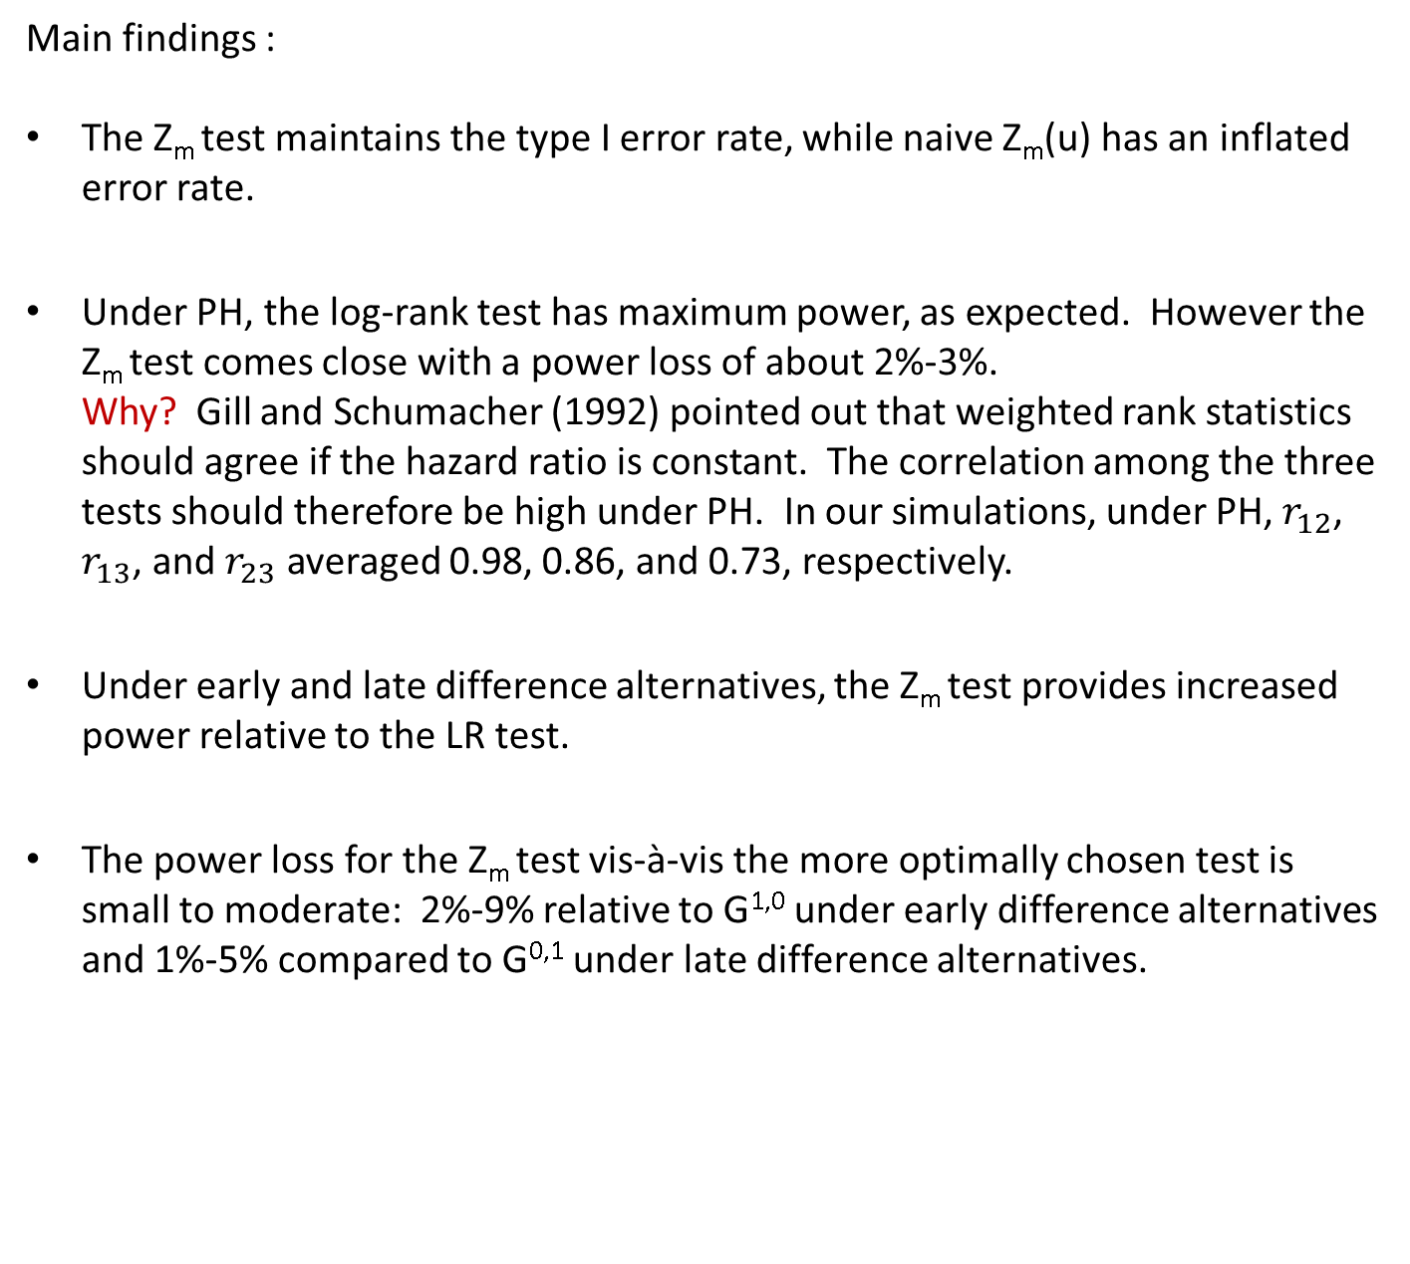
Main findings :
The Z_{m} test maintains the type I error rate, while naive Z_{m}(u) has an inflated error rate.
Under PH, the log-rank test has maximum power, as expected. However the Z_{m} test comes close with a power loss of about 2%-3%. Why? Gill and Schumacher (1992) pointed out that weighted rank statistics should agree if the hazard ratio is constant. The correlation among the three tests should therefore be high under PH. In our simulations, under PH, $r_{12}$, $r_{13}$, and $r_{23}$ averaged 0.98, 0.86, and 0.73, respectively.
Under early and late difference alternatives, the Z_{m} test provides increased power relative to the LR test.
The power loss for the Z_{m} test vis-à-vis the more optimally chosen test is small to moderate: 2%-9% relative to G^{1,0} under early difference alternatives and 1%-5% compared to G^{0,1} under late difference alternatives.

Slide 28
Additional observations:
The G^{0,1} test can have very low power under early difference alternatives. This is because it not only places more weight where the difference between the curves is least, but also where the variance is higher due to the censoring.
The G^{1,0} test under late difference alternatives exhibits an appreciable but less dramatic drop in power.
The verswlr procedure uses the maximum of G^{0,0}, G^{1,0}, and G^{0,1} tests as its default, but allows the user to specify other members from the G^{ρ,γ} family. However, the three tests should be specified a priori. If they are selected after inspection of the survival curves, inflation of the type I error can occur.

Slide 29
SUMMARY
Versatile weighted log-rank tests were developed to provide reasonably good power under PH as well as non-PH alternatives.
However, they are seldom used in practice (as far as I have seen).
Simulation results indicate that the Z_{m} test examined here maintains the type I error rate, provides increased power relative to the LR test under early difference and late difference alternatives, and is associated with only a small to moderate power loss relative to the more optimally chosen test.
From a design standpoint, one could increase the sample size by a modest amount (set the power at 85% rather than 80%, say, for a LR test) and use Z_{m} at time of analysis in order to provide “insurance” against non-PH alternatives.
Alternatively, simulations could be conducted under different scenarios to determine the sample size needed for any desired level of power (easy to accomplish with the verwslr command).

Slide 30
References:
Drezner, Z. 1994. Computation of the trivariate normal integral. Mathematics of Computation 62:289-294.
Efron, B. 1988. Logistic regression, survival analysis, and the Kaplan-Meier curve. Journal of the American Statistical Association 83:414-435.
Fleming, T.R., Harrington, D.P. 1991. Counting Processes and Survival Analysis. New York: Wiley.
Gill R., Schumacher M. 1987. A simple test of the proportional hazards assumption. Biometrika 74:289-300.
Karrison, TG. Versatile tests for comparing survival curves based on weighted logrank statistics. The Stata Journal, in press.
Lee, J.W. 1996. Some versatile tests based on the simultaneous use of weighted log-rank statistics. Biometrics 52:721-725.
Lee, S-H. 2007. On the versatility of the combination of the weighted log-rank statistics. Computational Statistics & Data Analysis 51:6557-6564.
Maitland ML, Levine MR, Lacouture ME, et al. 2014. Evaluation of a novel rash scale and a serum proteomic predictor in a randomized phase II trial of sequential or concurrent cetuximab and pemetrexed in previously treated non-small cell lung cancer. BMC Cancer 14:1-10.
Stablein, D. M., Carter, W. H. Jr., and Novak, J.W. 1981. Analysis of survival data with nonproportional hazard functions. Controlled Clinical Trials 2:149-159.

Slide 31
Thank you for your attention!

