Slide 1
Running MIXREGLS from within Stata: the runmixregls command
Stata Conference
Chicago, July 29 2016
Donald Hedeker - University of Chicago
George Leckie - University of Bristol

Slide 2
What is runmixregls?
runmixregls is a relatively new Stata command to run the MIXREGLS mixed-effects location scale software (Hedeker and Nordgren, 2013) seamlessly from within Stata; (Leckie, 2014)
The mixed-effects location scale model extends the standard two-level random-intercept multilevel model for continuous data by…
  Modelling the within- and between-subject variances as log linear functions of covariates
  Including a ‘random-scale effect’ in the within-subject variance function to account for unexplained heterogeneity of variance across subjects
This model cannot otherwise be fit in Stata or easily in any other software

Slide 3
Mixed-effects location scale model

Slide 4
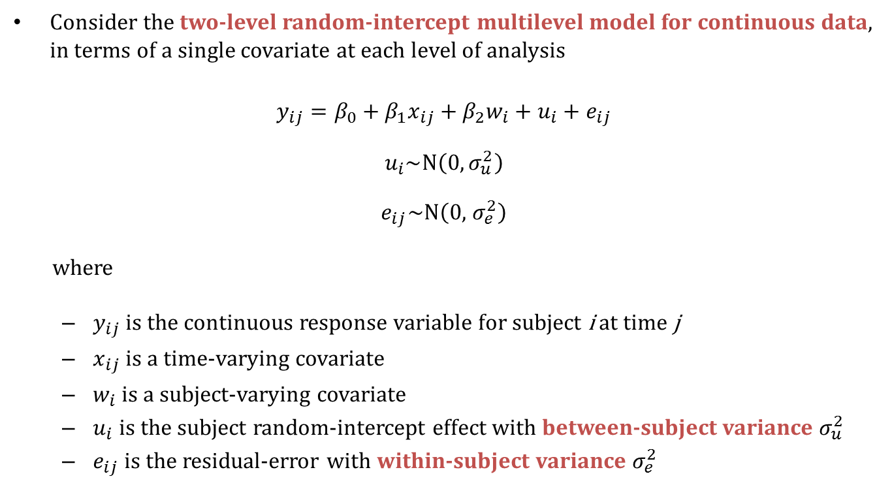
The standard two-level random-intercept multilevel model
Consider the two-level random-intercept multilevel model for continuous data, in terms of a single covariate at each level of analysis
$$y_{ij}=β_{0}+β_{1}x_{ij}+β_{2}w_{i}+u_{i}+e_{ij}$$
$$u_{i}\sim N\left(0,σ_{u}^{2}\right)$$
$$e_{ij}\sim N\left(0,{ σ}_{e}^{2}\right)$$
where
  $y_{ij}$ is the continuous response variable for subject i at time j
  $x_{ij}$ is a time-varying covariate
  $w_{i}$ is a subject-varying covariate
  $u_{i}$ is the subject random-intercept effect with between-subject variance $σ_{u}^{2}$
  $e_{ij}$ is the residual-error with within-subject variance $σ_{e}^{2}$

Slide 5
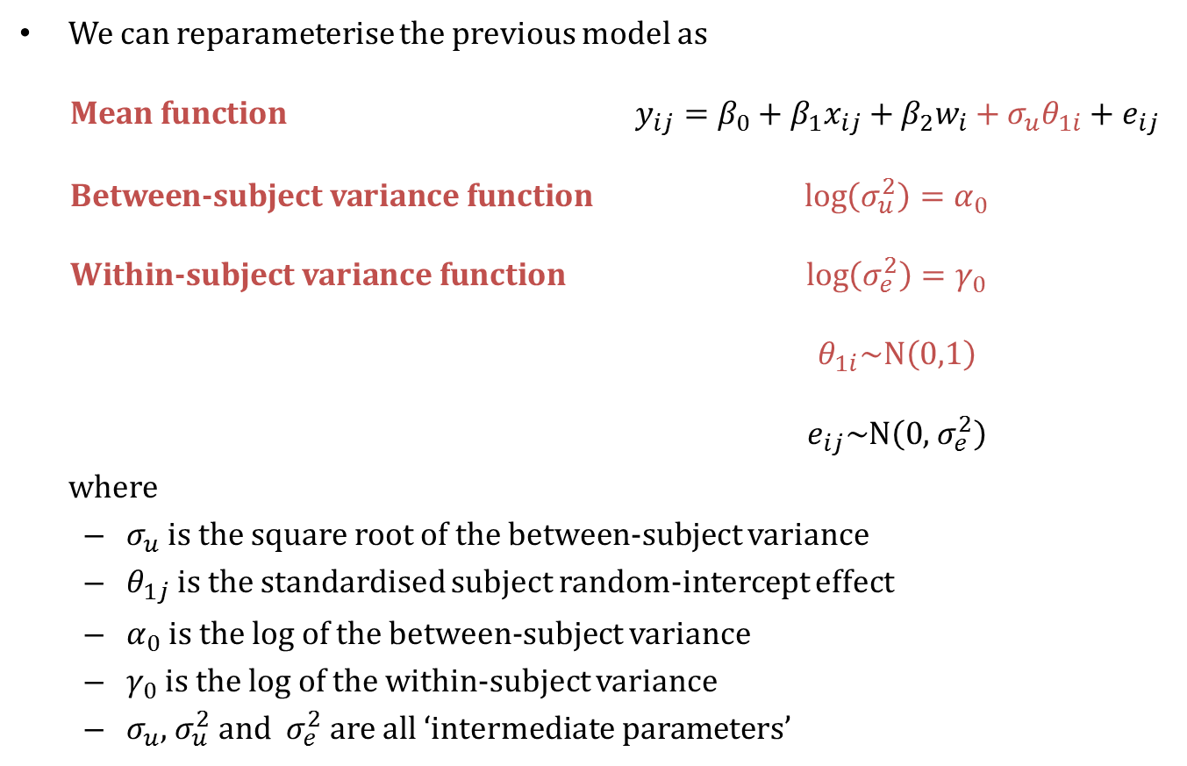
A reparameterization of the standard model
We can reparameterise the previous model as
Mean function $y_{ij}=β_{0}+β_{1}x_{ij}+β_{2}w_{i}+σ_{u}θ_{1i}+e_{ij}$
Between-subject variance function $\log\left(σ_{u}^{2}\right)=α_{0}$
Within-subject variance function $\log\left(σ_{e}^{2}\right)=γ_{0}$
$θ_{1i}\sim N\left(0,1\right)$
$e_{ij}\sim N\left(0,{ σ}_{e}^{2}\right)$
where
  $σ_{u}$ is the square root of the between-subject variance
  $θ_{1j}$ is the standardised subject random-intercept effect
  $α_{0}$ is the log of the between-subject variance
  $γ_{0}$ is the log of the within-subject variance
  $σ_{u}$, $σ_{u}^{2}$ and ${ σ}_{e}^{2}$ are all ‘intermediate parameters’

Slide 6
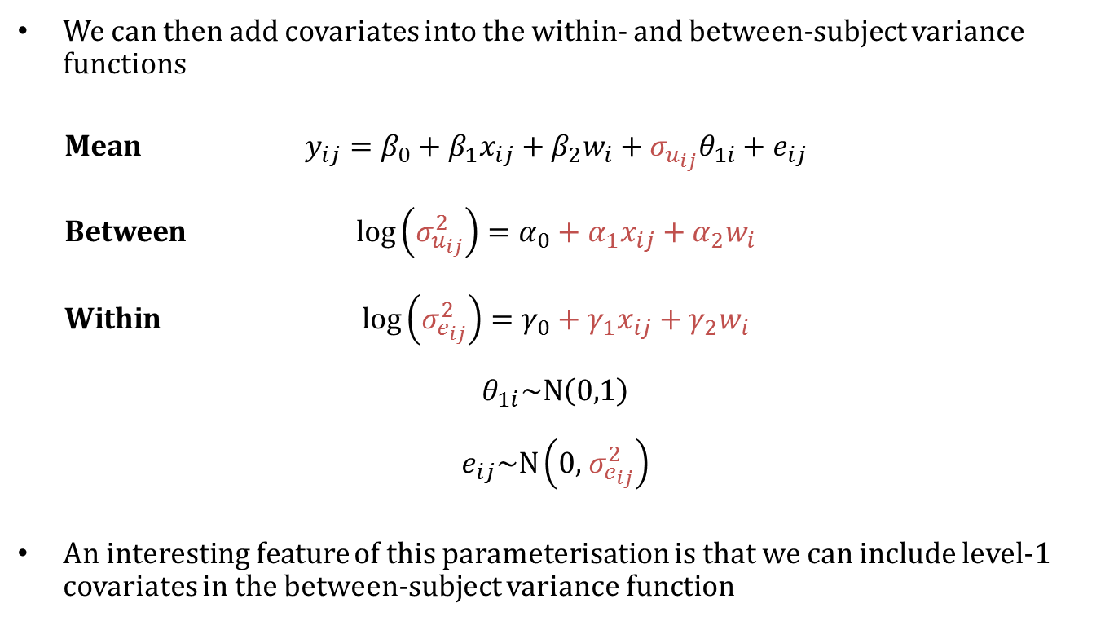
Including covariates in the variance functions
We can then add covariates into the within- and between-subject variance functions
Mean $y_{ij}=β_{0}+β_{1}x_{ij}+β_{2}w_{i}+σ_{u_{ij}}θ_{1i}+e_{ij}$
Between $\log\left(σ_{u_{ij}}^{2}\right)=α_{0}+α_{1}x_{ij}+α_{2}w_{i}$
Within $\log\left(σ_{e_{ij}}^{2}\right)=γ_{0}+γ_{1}x_{ij}+γ_{2}w_{i}$
$$θ_{1i}\sim N\left(0,1\right)$$
$$e_{ij}\sim N\left(0,{ σ}_{e_{ij}}^{2}\right)$$
An interesting feature of this parameterisation is that we can include level-1 covariates in the between-subject variance function

Slide 7
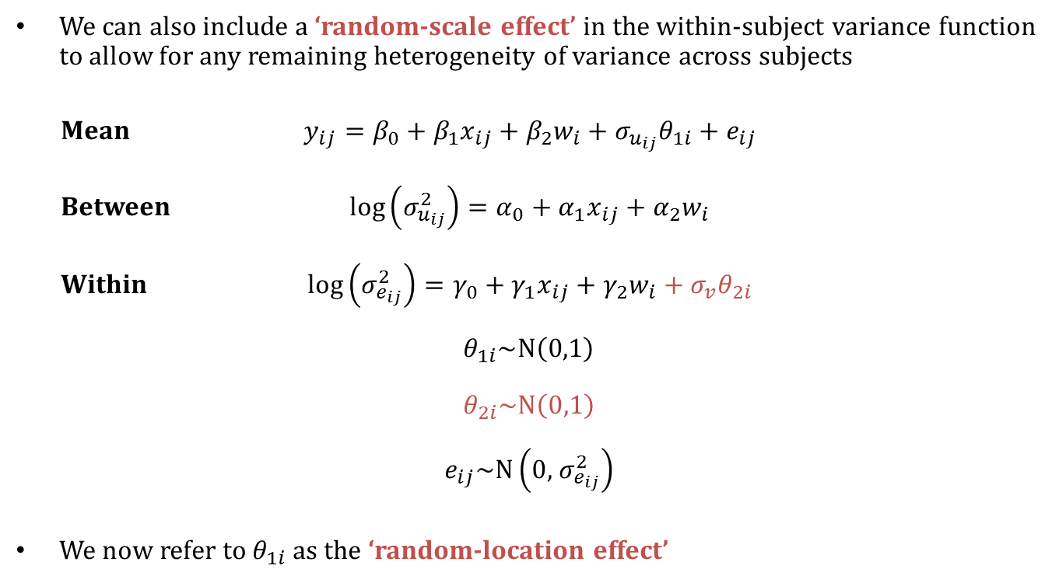
Including a random-scale effect
We can also include a ‘random-scale effect’ in the within-subject variance function to allow for any remaining heterogeneity of variance across subjects
Mean $y_{ij}=β_{0}+β_{1}x_{ij}+β_{2}w_{i}+σ_{u_{ij}}θ_{1i}+e_{ij}$
Between $\log\left(σ_{u_{ij}}^{2}\right)=α_{0}+α_{1}x_{ij}+α_{2}w_{i}$
Within $\log\left(σ_{e_{ij}}^{2}\right)=γ_{0}+γ_{1}x_{ij}+γ_{2}w_{i}+σ_{v}θ_{2i}$
$$θ_{1i}\sim N\left(0,1\right)$$
$$θ_{2i}\sim N\left(0,1\right)$$
$$e_{ij}\sim N\left(0,{ σ}_{e_{ij}}^{2}\right)$$
We now refer to $θ_{1i}$ as the ‘random-location effect’

Slide 8
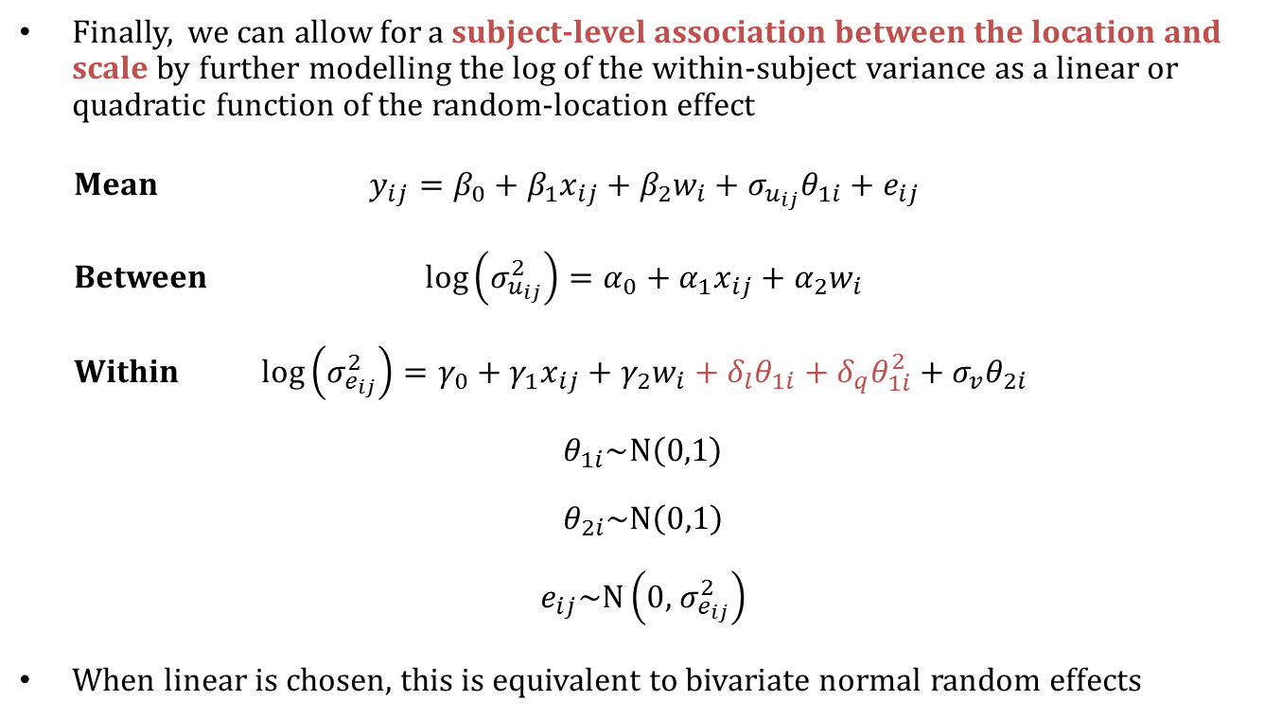
Allowing an association between the location and the scale
Finally, we can allow for a subject-level association between the location and scale by further modelling the log of the within-subject variance as a linear or quadratic function of the random-location effect
Mean $y_{ij}=β_{0}+β_{1}x_{ij}+β_{2}w_{i}+σ_{u_{ij}}θ_{1i}+e_{ij}$
Between $\log\left(σ_{u_{ij}}^{2}\right)=α_{0}+α_{1}x_{ij}+α_{2}w_{i}$
Within $\log\left(σ_{e_{ij}}^{2}\right)=γ_{0}+γ_{1}x_{ij}+γ_{2}w_{i}+δ_{l}θ_{1i}+δ_{q}θ_{1i}^{2}+σ_{v}θ_{2i}$
$$θ_{1i}\sim N\left(0,1\right)$$
$$θ_{2i}\sim N\left(0,1\right)$$
$$e_{ij}\sim N\left(0,{ σ}_{e_{ij}}^{2}\right)$$
When linear is chosen, this is equivalent to bivariate normal random effects

Slide 9
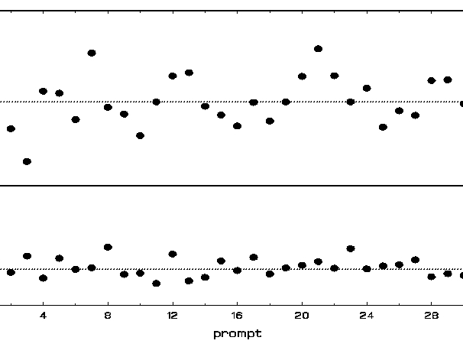
Model allows covariates to influence
mean: level of solid line
BS variance: dispersion of dotted lines
WS variance: dispersion of points
random subject effects on both mean and WS variance

Slide 10
Installing runmixregls
The runmixregls command requires Stata 12 or later and MIXREGLS.
MIXREGLS can be freely downloaded from
  https://hedeker-sites.uchicago.edu/page/mixregls-program
runmixregls can be installed from the Statistical Software Components (SSC) archive by typing the following command within a net-aware version of Stata
  . ssc install runmixregls
Next, you must declare the fully qualified path and filename for the MIXREGLS executable (the MIXREGLS .exe file) so that runmixregls knows where to find the software. You can do this by specifying a global macro called mixreglspath. For example
. global mixreglspath "C:\MIXREGLS\mixreglsb.exe"

Slide 11
Example:
Ecological momentary assessement (EMA) data

Slide 12
EMA (intensive longitudinal) data with random location and scale
Hedeker and Nordgren (2013) analyze data drawn from an EMA study on adolescents (Mermelstein, 2002)
8th or 10th graders carried hand-held computers during a 7 consecutive day data collection period
Responded to random prompts and event recorded smoking episodes
17,514 random prompts from 515 students; average of 34 prompts per student (range = 3 to 58).
Dependent variable is measure of the subject's positive mood (posmood mean=6.733, sd=2.117)
Of interest is the degree of heterogeneity in positive mood in both WS and BS variation
Covariates: genderf coded 0 for males and 1 for females; alone a prompt-varying covariate coded 0 if the subject was alone or 1 if with others

Slide 13
Do file
ssc install runmixregls, replace
global mixreglspath "C:\MixRegLS\MixRegLSb.exe"
infile id posmood alone genderf //
using "C:\MixRegLS\posmood_example.dat", clear
summ
xtset id
runmixregls posmood alone genderf, ///
between(alone genderf) within(alone genderf) ///
reffects(theta1 theta2)
scatter theta2 theta1

Slide 14
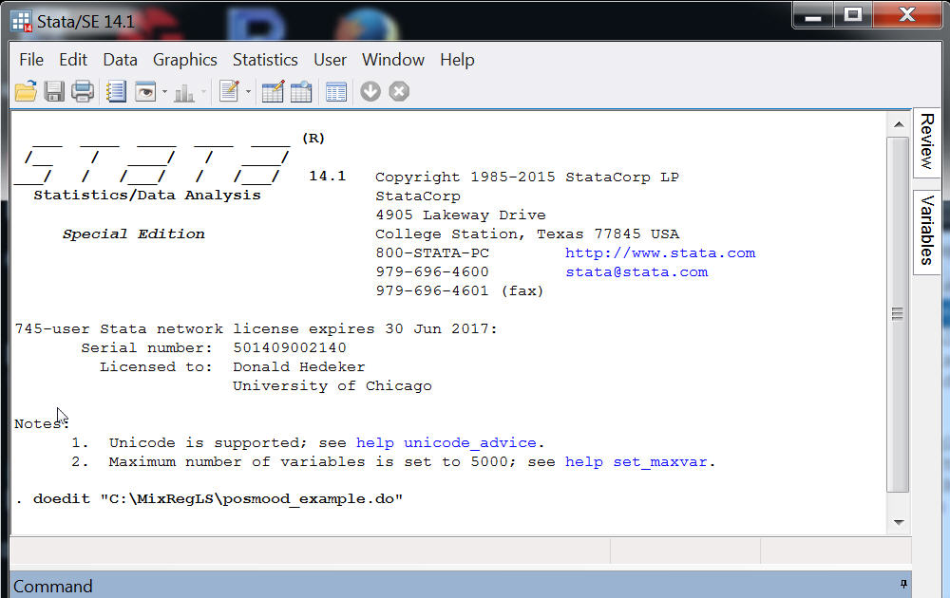

Slide 15
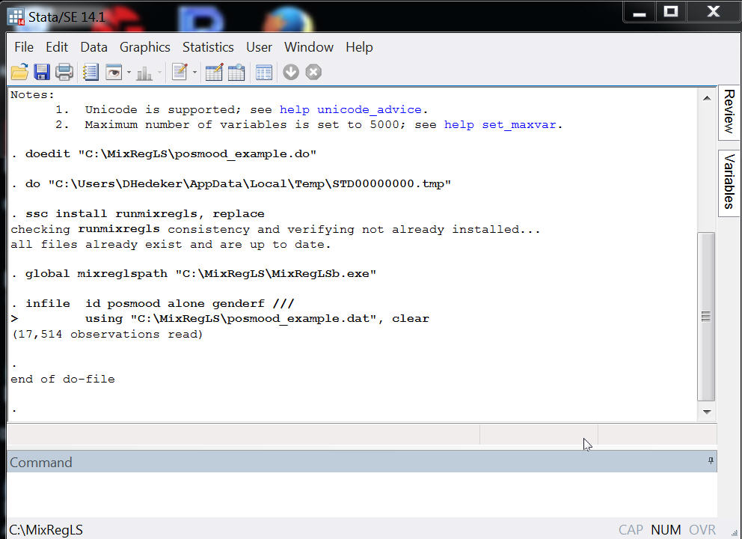

Slide 16
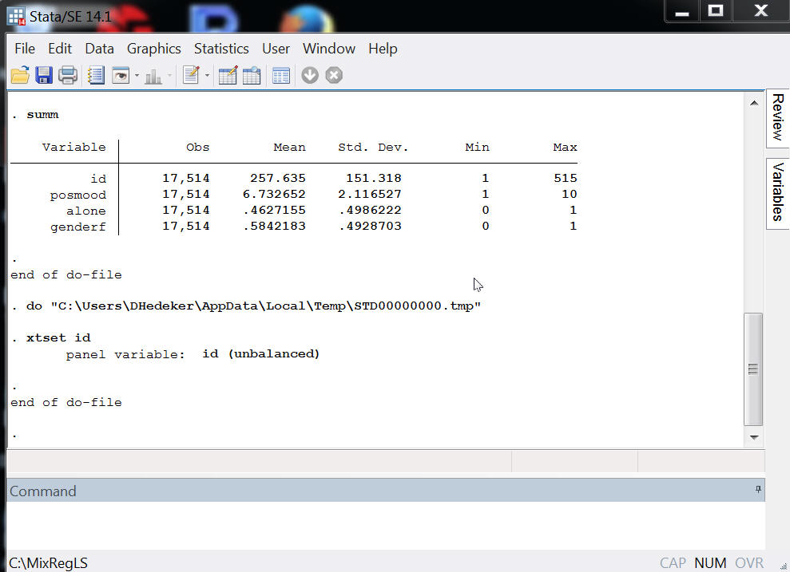

Slide 17
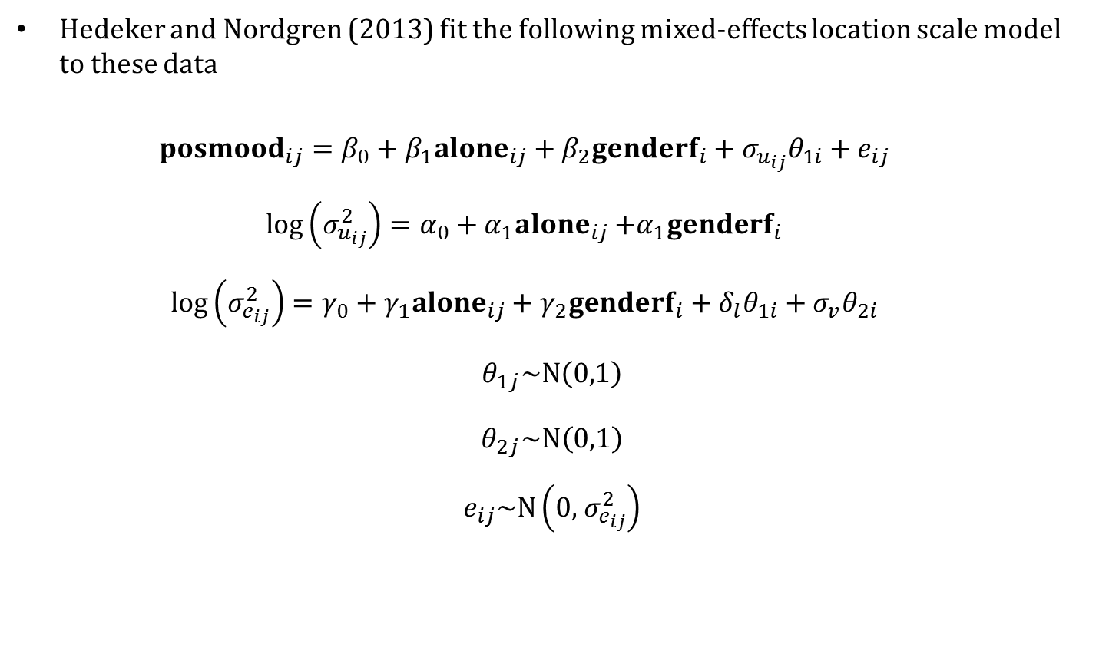
Mixed-effects location scale model
Hedeker and Nordgren (2013) fit the following mixed-effects location scale model to these data
${posmood}_{ij}=β_{0}+β_{1}{alone}_{ij}+β_{2}{genderf}_{i}+σ_{u_{ij}}θ_{1i}+e_{ij}$
$\log\left(σ_{u_{ij}}^{2}\right)=α_{0}+α_{1}{alone}_{ij}$ $+α_{1}{genderf}_{i}$
$\log\left(σ_{e_{ij}}^{2}\right)=γ_{0}+γ_{1}{alone}_{ij}+γ_{2}{genderf}_{i}+δ_{l}θ_{1i}+σ_{v}θ_{2i}$
$$θ_{1j}\sim N\left(0,1\right)$$
$$θ_{2j}\sim N\left(0,1\right)$$
$$e_{ij}\sim N\left(0,{ σ}_{e_{ij}}^{2}\right)$$

Slide 18
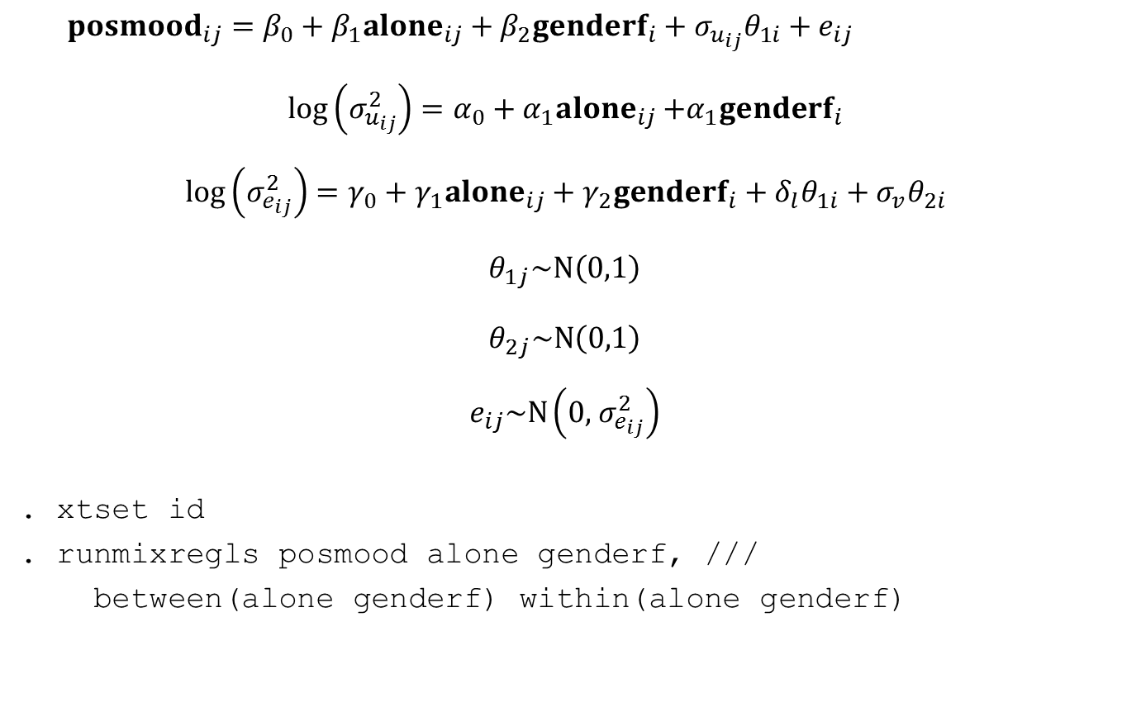
The runmixregls command syntax
${posmood}_{ij}=β_{0}+β_{1}{alone}_{ij}+β_{2}{genderf}_{i}+σ_{u_{ij}}θ_{1i}+e_{ij}$
$\log\left(σ_{u_{ij}}^{2}\right)=α_{0}+α_{1}{alone}_{ij}$ $+α_{1}{genderf}_{i}$
$\log\left(σ_{e_{ij}}^{2}\right)=γ_{0}+γ_{1}{alone}_{ij}+γ_{2}{genderf}_{i}+δ_{l}θ_{1i}+σ_{v}θ_{2i}$
$$θ_{1j}\sim N\left(0,1\right)$$
$$θ_{2j}\sim N\left(0,1\right)$$
$$e_{ij}\sim N\left(0,{ σ}_{e_{ij}}^{2}\right)$$
. xtset id
. runmixregls posmood alone genderf, ///
between(alone genderf) within(alone genderf)

Slide 19
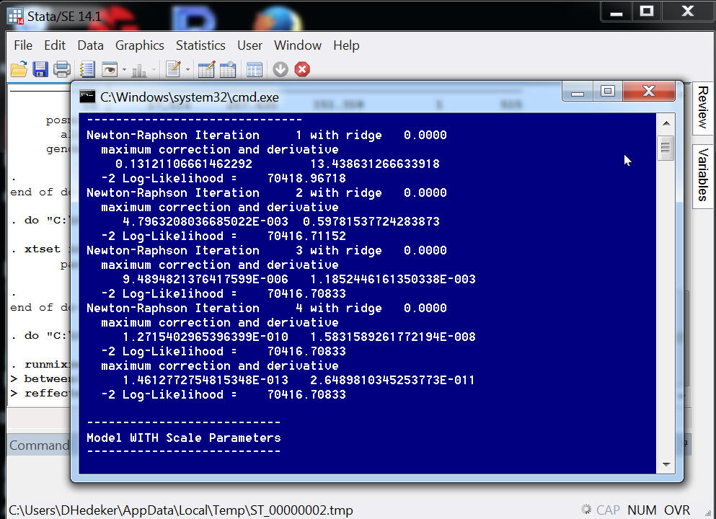

Slide 20
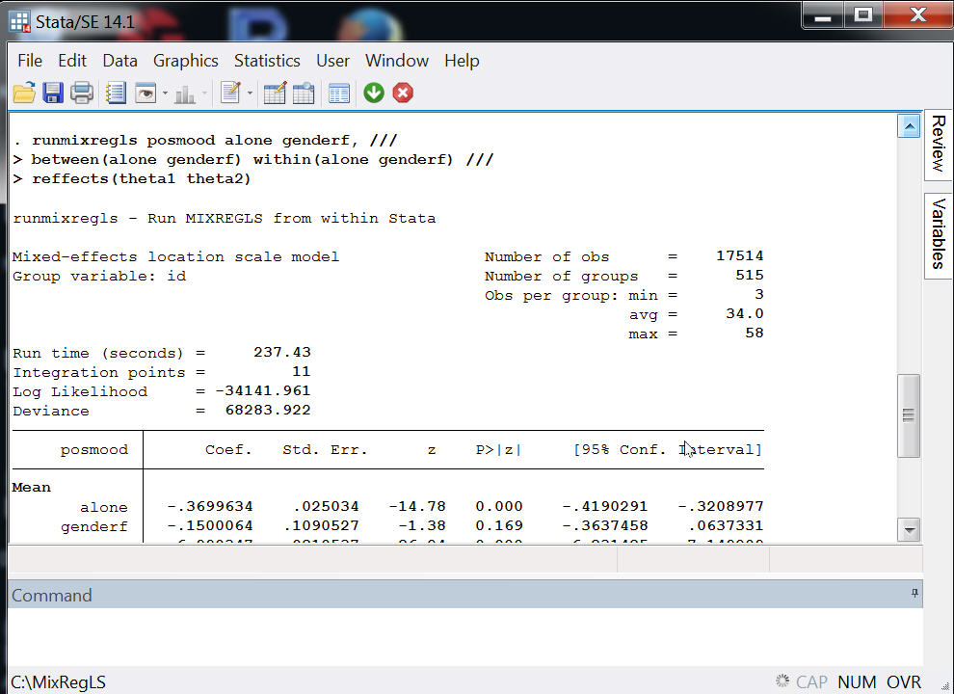

Slide 21
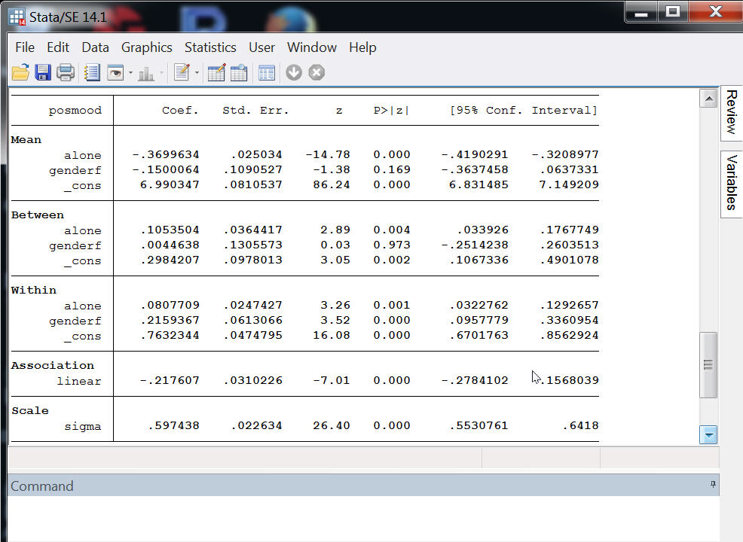
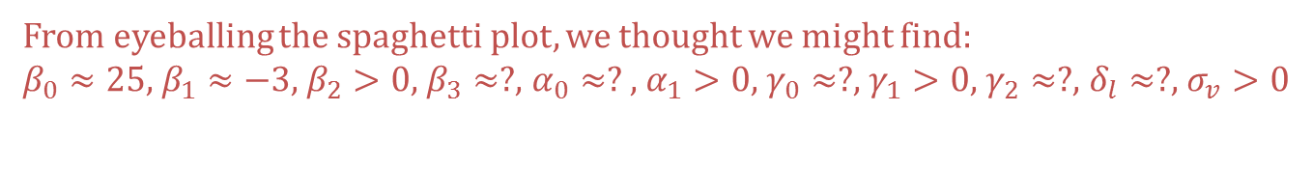
From eyeballing the spaghetti plot, we thought we might find:
$β_{0}≈25$, $β_{1}≈−3$, $β_{2}>0$, $β_{3}≈?$, $α_{0}≈?$ , $α_{1}>0$, $γ_{0}≈?$, $γ_{1}>0$, $γ_{2}≈?$, $δ_{l}≈?$, $σ_{v}>0$

Slide 22
reffects(theta1 theta2)
scatter theta2 theta1

Slide 23
Model options
We can remove the group-level linear association between the (log of the) within-group variance and the random-location effects.
. runmixregls posmood alone genderf, ///
between(alone genderf) ///
within(alone genderf) ///
association(none)
noconstant can be used to suppress the constant term (intercept) in each function.
association(quadratic) allows for a quadratic association

Slide 24
Random effects/Residuals options
We can retrieve the standardized random effects and residuals from MIXREGLS and place them in new variables
. runmixregls posmood alone genderf, ///
between(alone genderf) ///
within(alone genderf) ///
association(none) ///
reffects(theta1 theta2) ///
residuals(estd)

Slide 25
Integration and maximization options
We can change the maximum number of iterations. The default is iterate(200). This may be useful for simulation studies.
. runmixregls posmood alone genderf, ///
between(alone genderf) ///
within(alone genderf) ///
association(none) ///
reffects(theta1 theta2) ///
residuals(estd) ///
iterate(100)
noadapt prevents MIXREGLS from using adaptive Gaussian quadrature. MIXREGLS will use ordinary Gaussian quadrature instead.
intpoints(#) sets the number of integration points for (adaptive) Gaussian quadrature. The default is intpoints(11).

Slide 26
MIXREGLS model files and Reporting options
We can suppress the table header
. runmixregls posmood alone genderf, ///
between(alone genderf) ///
within(alone genderf) ///
association(none) ///
reffects(theta1 theta2) ///
residuals(estd)
iterate(100) ///
noheader
typedeffile displays the MIXREGLS model definition file in the results window
typeoutfile displays the MIXREGLS model output file in the results window

Slide 27
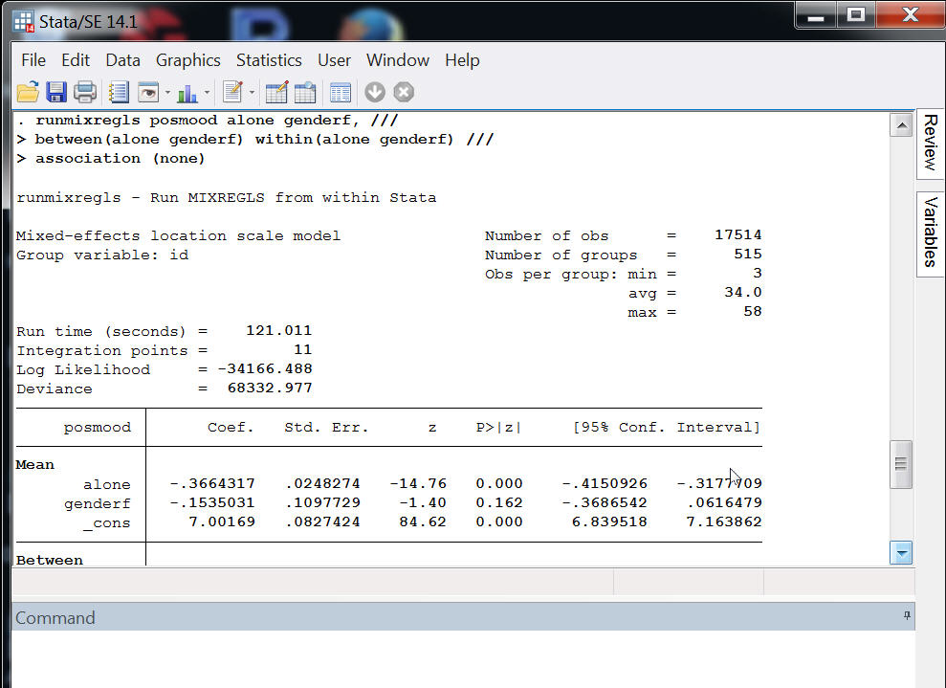

Slide 28
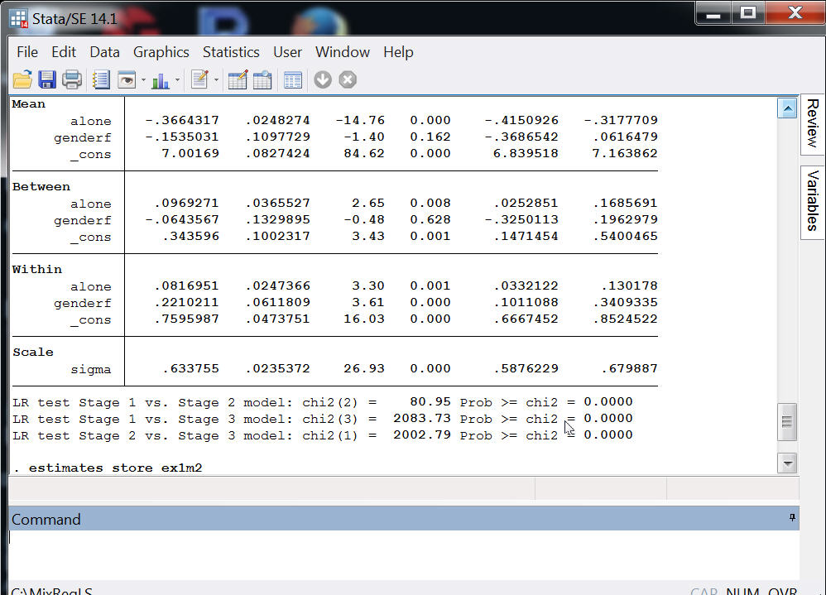

Slide 29
MIXREGLS – 3 model stages
The full model is fitted in three sequential stages:
  Standard random-intercept model + between-group variance function regression coefficients
  Stage 1 model + within-group variance function regression coefficients
  Stage 2 model + association between the (log of the) within-group variance and the random-location effects + random-scale effects
Estimates at each stage are used as starting values for the next stage, which improves the convergence of the final model.
runmixregls provides the results of each stage in the saved results.

Slide 30
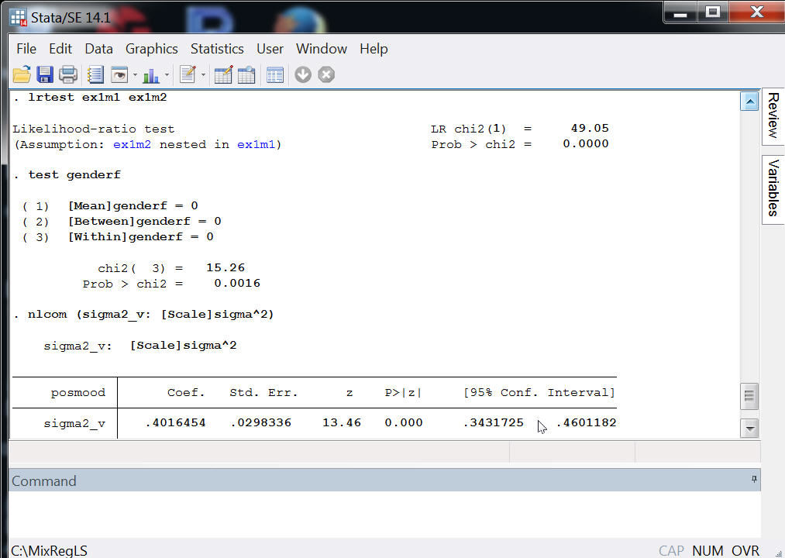

Slide 31
Consequences of ignoring clustered residual error variances

Slide 32
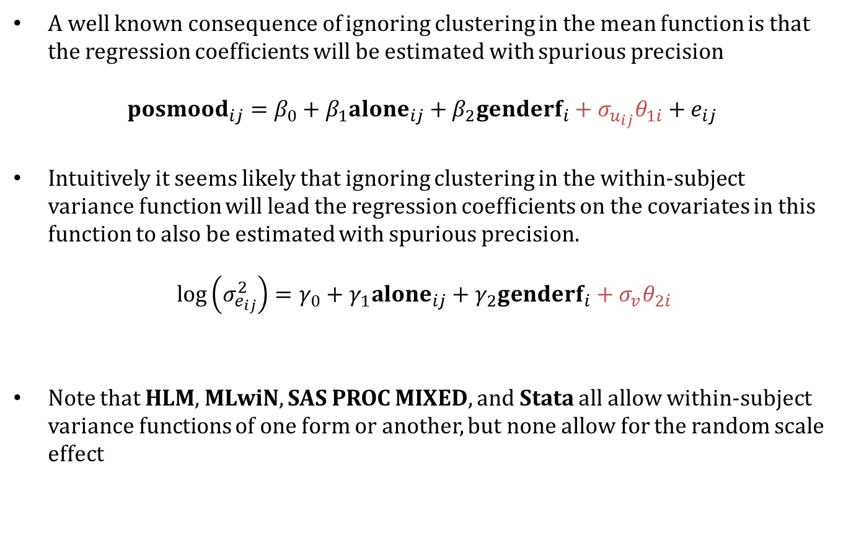
Clustered residual error variances
A well known consequence of ignoring clustering in the mean function is that the regression coefficients will be estimated with spurious precision
$${posmood}_{ij}=β_{0}+β_{1}{alone}_{ij}+β_{2}{genderf}_{i}+σ_{u_{ij}}θ_{1i}+e_{ij}$$
Intuitively it seems likely that ignoring clustering in the within-subject variance function will lead the regression coefficients on the covariates in this function to also be estimated with spurious precision.
$$\log\left(σ_{e_{ij}}^{2}\right)=γ_{0}+γ_{1}{alone}_{ij}+γ_{2}{genderf}_{i}+σ_{v}θ_{2i}$$
Note that HLM, MLwiN, SAS PROC MIXED, and Stata all allow within-subject variance functions of one form or another, but none allow for the random scale effect

Slide 33
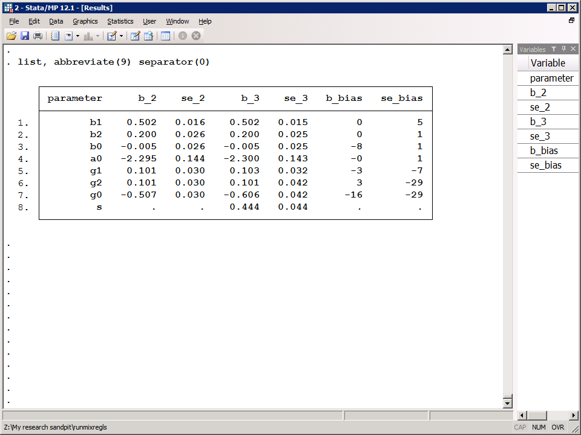

When we ignore the random scale effects…
The standard error of $γ_{1}$ (coefficient of $x_{ij}$) is biased downwards by 7%
The standard error of $γ_{2}$ (coefficient of $w_{i}$) is biased downwards by 29%
The parameter estimate of $γ_{0}$ is biased downwards by 16% reflecting its population-median interpretation as opposed to the population-averaged interpretation it has when the random scale effects are included

Slide 34
Help file

Slide 35
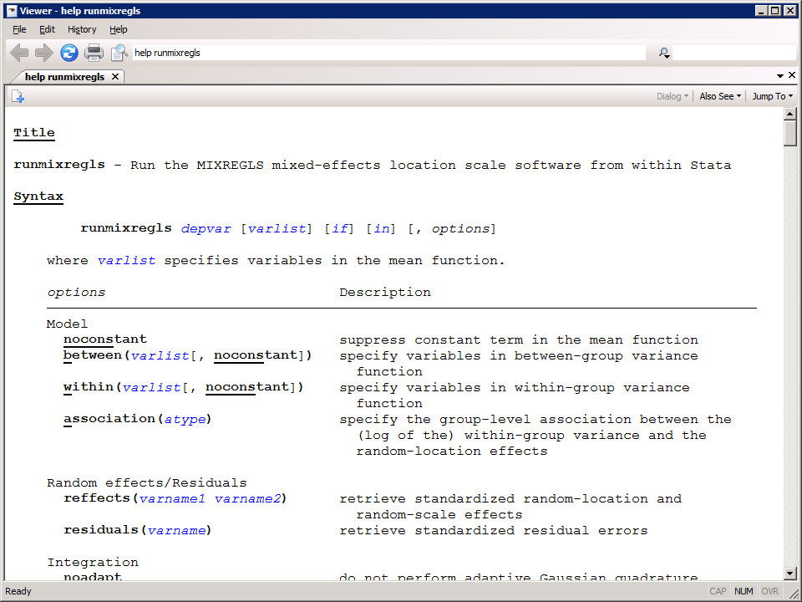

Slide 36
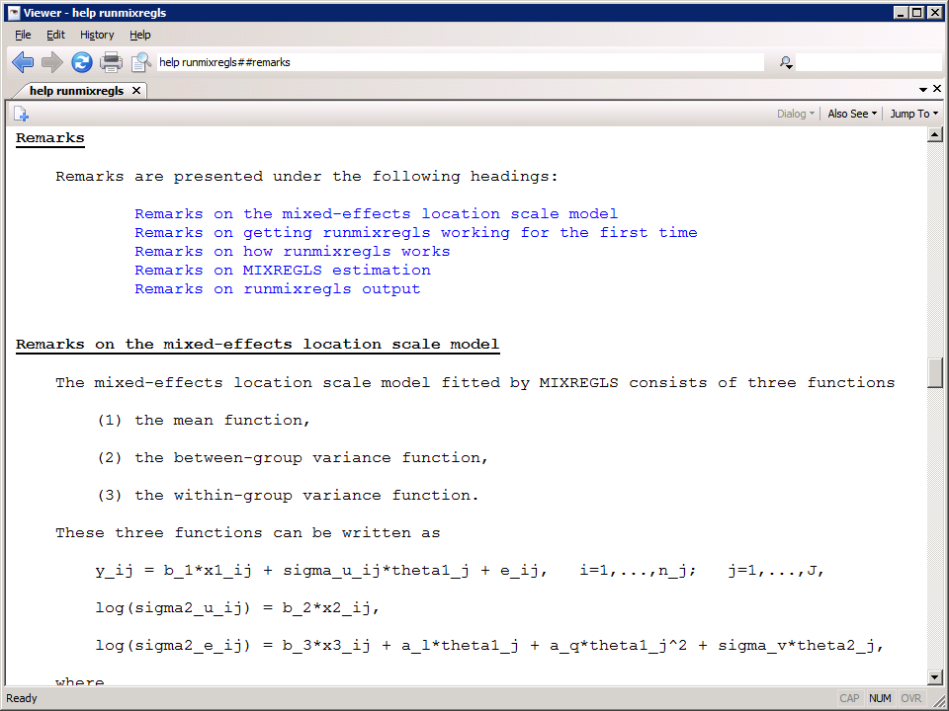

Slide 37
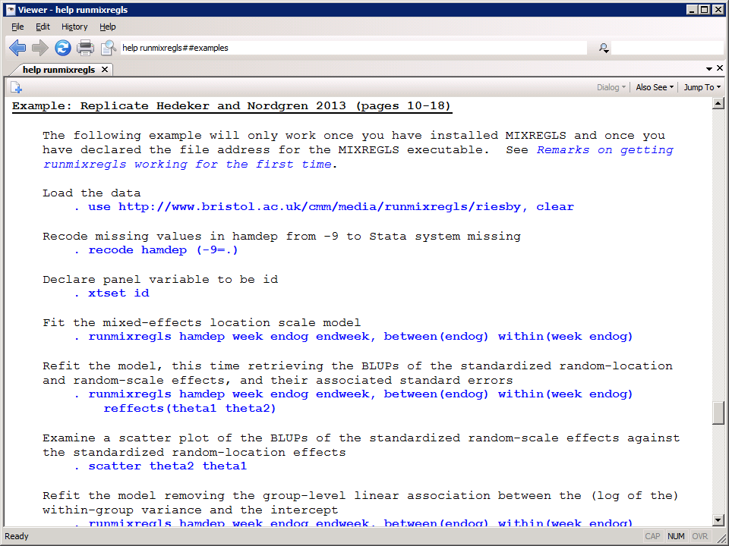

Slide 38
references

Slide 39
References
Hedeker, D., Mermelstein, R.J., & Demirtas, H. (2008). An application of a mixed-effects location scale model for analysis of Ecological Momentary Assessment (EMA) data. Biometrics, 64, 627-634.
Hedeker, D., Mermelstein, R.J., & Demirtas, H. (2012). Modeling between- and within-subject variance in EMA data using mixed-effects location scale models. Statistics in Medicine, 31, 3328-3336.
Hedeker, D, Nordgren, R (2013). MIXREGLS: A Program for Mixed-effects Location Scale Analysis. Journal of Statistical Software, 52, 12, 1-38. URL: http://www.jstatsoft.org/v52/i12.
Leckie, G (2014). runmixregls: A Program to Run the MIXREGLS Mixed-Effects Location Scale Software from within Stata. Journal of Statistical Software, 59, 1-41. URL: https://www.jstatsoft.org/article/view/v059c02
Leckie, G, French, R, Charlton, C & Browne, W. (2014). Modeling heterogeneous variance–Covariance components in two-level models’. Journal of Educational and Behavioral Statistics, 39:307-332

