Slide 1
Mining Twitter Data for Fun and Profit
Joseph Canner, MHS
Neeraja Nagarajan, MD, MPH
Johns Hopkins University
Stata Conference
Chicago, IL
July 28, 2016

Slide 2
Background
Various studies of Twitter feed data
  Surgical providers
  Surgical education
  Global surgery
  Breast Cancer
  Mammography
Objective: descriptive analysis of content, users, re-tweet patterns, etc.

Slide 3
Background (cont’d)
Real-time Twitter feed data (actual tweet content) using keyword filters: provided by collaborator in Computer Science Department at JHU
Researcher desired automated process for extracting user profile information

Slide 4
Desired workflow
Real-time feed data
Qualitative review of tweet content
User ID list
Twitter API
User Profile
Information
Data analysis

Slide 5
Twitter API History
Version 1.0 required only a very simple URL, e.g. http://search.twitter.com/search.json?q=stata
Stata users could grab Twitter feed data using a single insheetjson command:
  insheetjson tw_fu tw_uid tw_geo using "http://search.twitter.com/search.json?q=stata", table(results) col("from_user" "from_user_id_str" "geo:coordinates")
(Source: help insheetjson)

Slide 6
Twitter API History (cont’d)
Early in 2013, Twitter moved to API v1.1
  OAuth authentication required, e.g.:
  curl --request 'POST' 'https://api.twitter.com/1.1/users/lookup.json' --data 'screen_name=IntSurg%2CLVSelbs%...RuthBragaMSN' --header 'Authorization: OAuth oauth_consumer_key="kg0F5wu3660dMMTuLkyoWp7tx",oauth_nonce="ajBxdP7iwtFRfvms5f4xcIIY3IEOBYGC",oauth_signature="AFrOX11yGPMeohUU0sDHtj%2Bzyck%3D",oauth_signature_method="HMACSHA1",oauth_timestamp="1438002055",oauth_token="3112564480RVVmDmYZwunmAHfqhr1iDQYbjbCrAsRbEcnzYv",oauth_version="1.0"' --verbose > profiles1.txt

Slide 7
Twitter API History (cont’d)
Early in 2013, Twitter moved to API v1.1
  OAuth authentication required, e.g.:
  curl --request 'POST' 'https://api.twitter.com/1.1/users/lookup.json' --data 'screen_name=IntSurg%2CLVSelbs%...RuthBragaMSN' --header 'Authorization: OAuth oauth_consumer_key="kg0F5wu3660dMMTuLkyoWp7tx",oauth_nonce="ajBxdP7iwtFRfvms5f4xcIIY3IEOBYGC",oauth_signature="AFrOX11yGPMeohUU0sDHtj%2Bzyck%3D",oauth_signature_method="HMACSHA1",oauth_timestamp="1438002055",oauth_token="3112564480RVVmDmYZwunmAHfqhr1iDQYbjbCrAsRbEcnzYv",oauth_version="1.0"' --verbose > profiles1.txt

Slide 8
Twitter API History (cont’d)
Early in 2013, Twitter moved to API v1.1
  OAuth authentication required, e.g.:
  curl --request 'POST' 'https://api.twitter.com/1.1/users/lookup.json' --data 'screen_name=IntSurg%2CLVSelbs%...RuthBragaMSN'
  --header 'Authorization: OAuth oauth_consumer_key="kg0F5wu3660dMMTuLkyoWp7tx",oauth_nonce="ajBxdP7iwtFRfvms5f4xcIIY3IEOBYGC",oauth_signature="AFrOX11yGPMeohUU0sDHtj%2Bzyck%3D",oauth_signature_method="HMACSHA1",oauth_timestamp="1438002055",oauth_token="3112564480RVVmDmYZwunmAHfqhr1iDQYbjbCrAsRbEcnzYv",oauth_version="1.0"' --verbose > profiles1.txt

Slide 9
Twitter API Example
GET users/lookup
  100 users per request
  Requests per 15 minutes: 180
  Supply a comma separated list of screen names or user IDs
  JSON Output
  Example request: https://api.twitter.com/1.1/users/lookup.json?screen_name=twitterapi,twitter

Slide 10
User Profile Information
Personal URL
Image URLs
Location
Language
Date created
Description (bio)
Time Zone
Latest post
Number of:
  Favorites
  Followers/Followed
  Lists
  Posts
  Friends
Color schemes
Flags

Slide 11
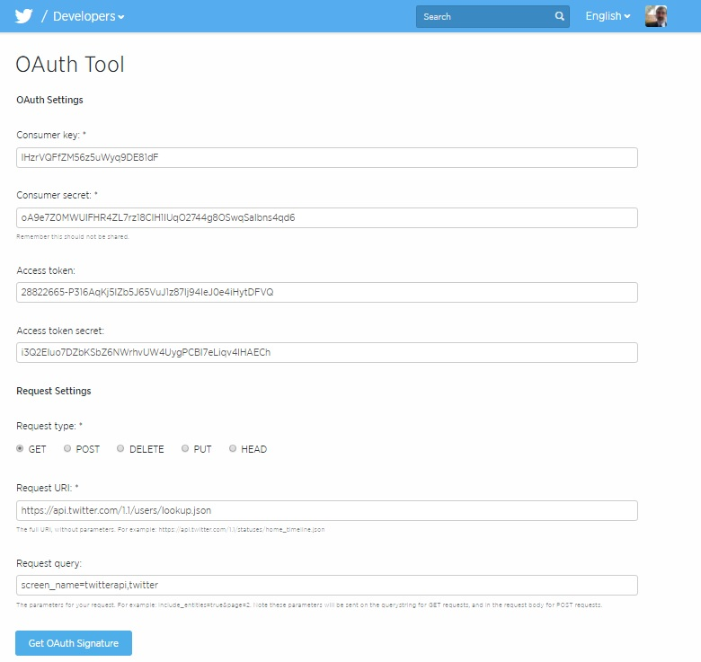
Twitter API OAuth Tool

Slide 12
Steps required in Stata (1)
Obtain the following from Twitter (once):
  Consumer key: lHzrVQFfZM56z5uWyq9DE81dF
  Consumer secret: oA9e7Z0MWUlFHR4ZL7rz18CIH1lUqO2744g8OSwqSalbns4qd6
  Access token: 28822665-P316AqKj5lZb5J65VuJ1z87lj94IeJ0e4iHytDFVQ
  Access token secret: i3Q2EIuo7DZbKSbZ6NWrhvUW4UygPCBI7eLiqv4lHAECh

Slide 13
Steps required in Stata (2)
Generate the following:
  Time stamp: current time (plus a few hours) in number of seconds since 1/1/1970 at midnight
  Random sequence of 32 characters (“nonce”)

Slide 14
Steps required in Stata (3)
Open a data set with list of users
Break up list into chunks of 100
Percent-encode each chunk:
  Characters A-Z, a-b, 0-9, period, underscore, tilde, dash stay the same
  All other characters replaced with “%” followed by ASCII representation
  IntSurg%2CLVSelbs%2C...

Slide 15
Steps required in Stata (4)
Percent-encode the Twitter API URL
  https://api.twitter.com/1.1/users/lookup.json
  ➔
  https%3A%2F%2Fapi.twitter.com%2F1.1%2Fusers%2Flookup.json

Slide 16
Steps required in Stata (5)
Create HMAC signature from the percent-encoded request string and the secrets
  HMAC=keyed-hash message authentication code
  Used to verify data integrity and authentication
  In general, any cryptographic hash function can be used (e.g., MD5, SHA1, etc.)

Slide 17
HMAC
HMAC(K,m)=
H((K’ ⊕ opad) || H((K’ ⊕ ipad) || m
  H is a cryptographic hash function (SHA-1 for Twitter)
  K is the secret key
  m is the message to be authenticated
  K' is another secret key, derived from the original key K
  || denotes concatenation
  ⊕ denotes exclusive or (XOR)
  opad is the outer padding (0x5c5c5c…5c5c, one-block-long hexadecimal constant)
  ipad is the inner padding (0x363636…3636, one-block-long hexadecimal constant)

Slide 18
SHA-1
Secure Hash Algorithm 1: cryptographic hash function designed by the NSA
Produces a 160-bit (20-byte) hash, known as a message digest, typically represented using 40 hex digits
Use discouraged as a security feature
Very good for maintaining data integrity

Slide 19
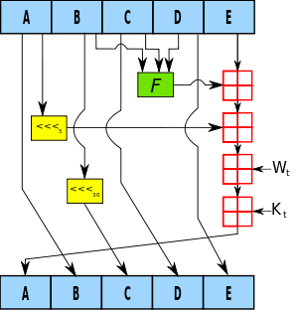
SHA-1 Algorithm
A, B, C, D and E are 32-bit words of the state;
F is a nonlinear function that varies;
<<<n denotes a left bit rotation by n places;
n varies for each operation;
W_{t} is the expanded message word of round t;
K_{t} is the round constant of round t;
denotes addition modulo 232.

Slide 20
Mata Functions Needed for
HMAC & SHA-1
inbase(b,x): convert real x to a string representation of x in base b
frombase(b,s): convert string s (base b) to a real
ascii(s): convert string s to a vector of ASCII numeric codes
char(c): convert vector c of ASCII numeric codes to a string

Slide 21
Other Tools needed for
HMAC & SHA-1
Bitwise exclusive OR
Bitwise AND
Bitwise OR
Bitwise NOT
Left Pad
Right Pad

Slide 22
Steps required in Stata (6)
Base64 encode the HMAC signature
  Convert signature to binary and divide into 6-bit chunks
    0-25 ➔ A-Z
    26-51 ➔ a-z
    52-61 ➔ 0-9
    62 ➔ +
    63 ➔ /

Slide 23
Steps required in Stata (7)
Submit request using cURL
  curl --request 'POST' 'https://api.twitter.com/1.1/users/lookup.json'
  --data 'screen_name=IntSurg%2CLVSelbs%...RuthBragaMSN'
  --header 'Authorization: OAuth oauth_consumer_key="kg0F5wu3660dMMTuLkyoWp7tx",
  oauth_nonce="ajBxdP7iwtFRfvms5f4xcIIY3IEOBYGC",
  oauth_signature="AFrOX11yGPMeohUU0sDHtj%2Bzyck%3D",
  oauth_signature_method="HMACSHA1",
  oauth_timestamp="1438002055",
  oauth_token="3112564480RVVmDmYZwunmAHfqhr1iDQYbjbCrAsRbEcnzYv",
  oauth_version="1.0"' > profiles1.txt

Slide 24
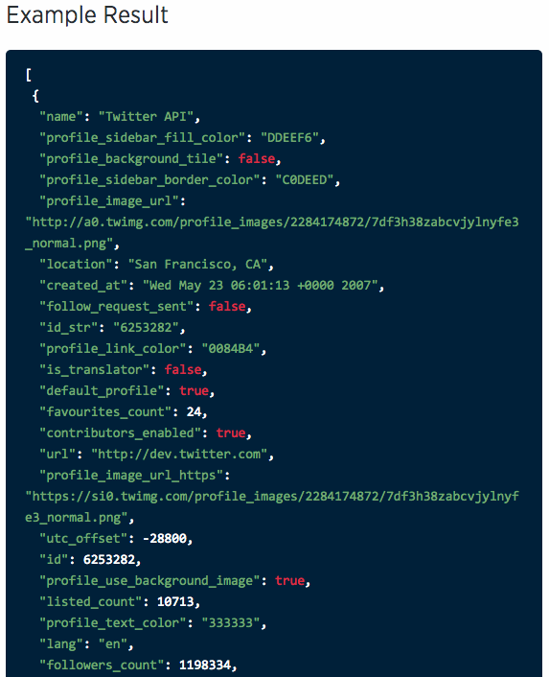
Sample JSON Output

Slide 25
Steps required in Stata (8)
Use insheetjson to convert JSON output to Stata
Re-assemble the chunks of 100 users
Get to work!

Slide 26
Next Steps
Publish a toolbox (next talk?)
Publish a command for user profile requests
Publish a command that is more general?

Slide 27
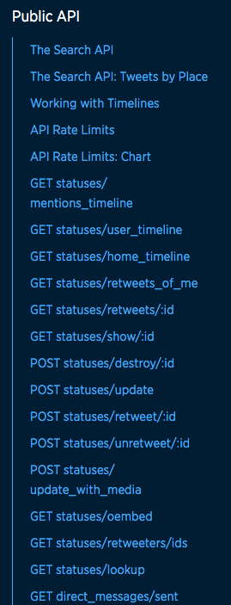
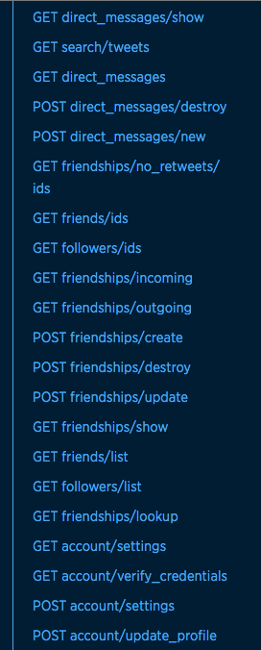
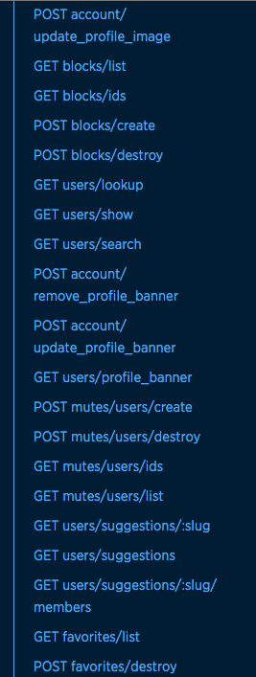
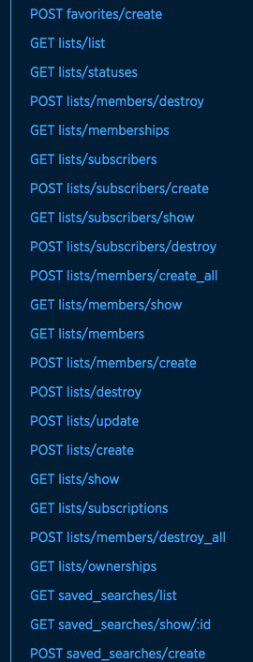
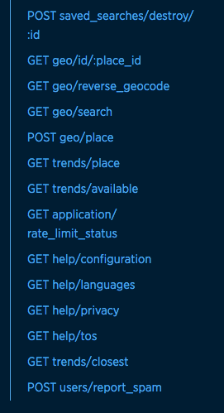
Twitter API requests

