Slide 1
Teaching Statistics with Stata in Emergency Medicine (EM) Journal Club
Muhammad Waseem, MD
Research Director
Emergency Medicine
Lincoln Medical & Mental Health Center
Bronx, New York

Slide 2
Disclosure
Financial disclosures: None

Slide 3
Background
Evidence based medicine has become an integral part of medical education and training
Critically reading and evaluating a research paper is an important skill learnt during emergency medicine (EM) residency training

Slide 4
EM Journal Club
In order to learn this skill the EM curriculum incorporates a journal club
The objective of the journal club is to learn necessary skills to find, appraise and implement practice changing advancements in the medical literature

Slide 5
EM Journal Club
It provides an opportunity to read, present and discuss some noteworthy papers in the field of emergency medicine
5
Notes:
5

Slide 6
EM Journal Club
To improve critical literature appraisal skills
To discuss controversies
To generate ideas for future research studies
6
Notes:
6

Slide 7
EM Journal Club
Appropriate research design
Appropriate tests & statistics

Slide 8
Objectives
Does introduction of a statistical program in EM journal club improve understanding of research paper?

Slide 9
Methods
Design: Observational
Setting: Emergency Department of an Urban Teaching Hospital
Participants: Emergency Medicine Residents

Slide 10
Methods
ACGME fully accredited 3 year Emergency Medicine Residency Training Program
33 EM residents (11 / year)

Slide 11
Methods
Journal club
  Every other month
  Duration: One hour

Slide 12
Methods
Research Question
  What is the question this study was designed to answer?
Study Design
  What type of study is this?
    Randomized clinical trial
    Cohort study
    Case-control study
    Cross-sectional study

Slide 13
Methods
Study Subjects
  Who was enrolled in the study?
  How were subjects selected?
  Are results valid? (internal validity)
  Are results generalizable? (external validity)

Slide 14
Methods
Results
  What did investigators find?
  Discuss findings which are statistically significant
Conclusions
  What do the investigators think the results mean?
  Provide conclusions independent of the investigators’ conclusions

Slide 15
Methods
Discuss the pros and cons
What would be the next important study to confirm, extend or refute the findings?

Slide 16
Methods
We supplement journal club with a program in statistics to support residents acquisition and use of skills required for critical review and clinical application of evidence from EM literature

Slide 17
Methods
We discussed the statistical tests and their application
Also showed how to perform those tests using stata

Slide 18
Methods
Only pull-down menus were shown
  No discussion on commands

Slide 19
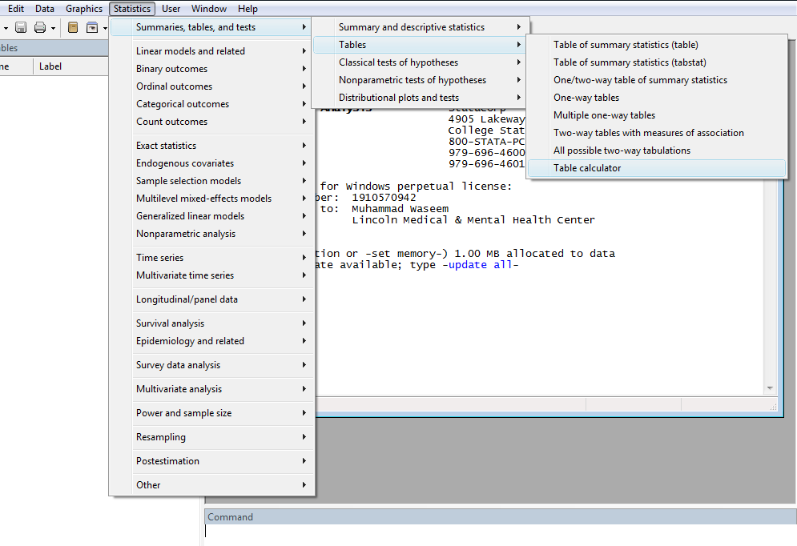

Slide 20
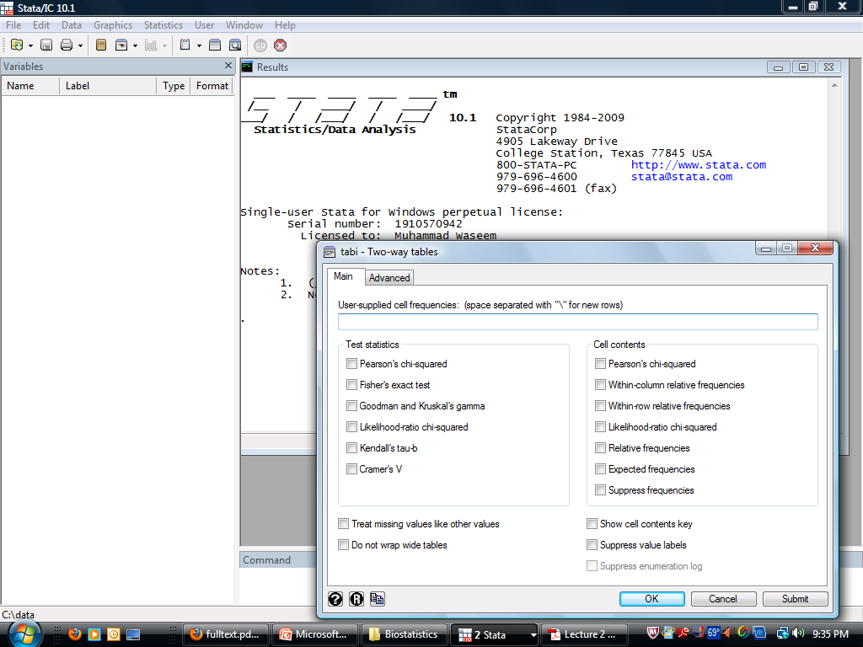

Slide 21
Results
This format was well received by both residents and faculty
This experience provided an opportunity to demonstrate and practice evidence- based skill

Slide 22
Conclusions
Integrating a statistical software program such as stata in journal club can serve as an important tool to enhance learning and understanding of statistical tests
A simple and effective measure promoted their awareness of research methods and statistical analysis

Slide 23
Limitations
Observational study
  No standardized method
Small sample
Single center study

Slide 24
Implications
Journal club (with statistical program) is an excellent opportunity for residents to gain experience presenting research papers and for learning statistics in an informal group setting

