Slide 1
Stata as a Data Entry Management Tool
Ryan Knight
Innovations for Poverty Action
Stata Conference 2011

Slide 2

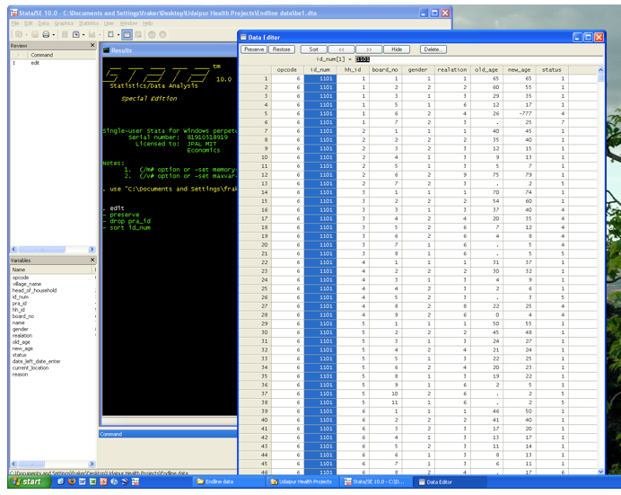
Why Pay Attention to Data Entry?
It sounds so easy…
Surveys
type, type, type…
Data!

Slide 3
…but it is not!
Excellent Opportunities for DISASTER
No one checked data quality. Turns out, there’s no unique ID variable. Lost data.
No one monitored data entry contractor. Turns out, they copy + pasted data and changed the IDs. Lost data.
RA didn’t know that append forces the string/numeric type of the master file onto the using file and deleted the originals. Lost data.
Records existed in multiple datasets and were different. Data lost in the merging process.
And many more!

Slide 4


Slide 5
Data Entry Quality Control
Use two unique identifiers for every survey
Extensive testing of data entry interface
Double entry
Double entry of first and second entry reconciliation
Independent Audit

Slide 6
Managing Double Entry
Questionnaire
1st Entry
2nd Entry
Stata
Discrepancies
1st Reconciliation
2nd Reconciliation
Stata
Discrepancies
Final Reconciliation
Stata
Final Dataset

Slide 7
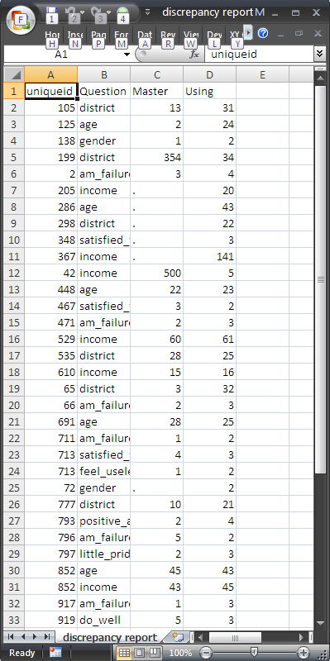
Generating a List of Discrepancies
cfout [varlist] using filename, id(varname) [options]
Compares dataset in memory to another dataset and outputs a list of discrepancies.
Can ignore differences in punctuation, spacing and case
Substantially faster than looping through observations

Slide 8
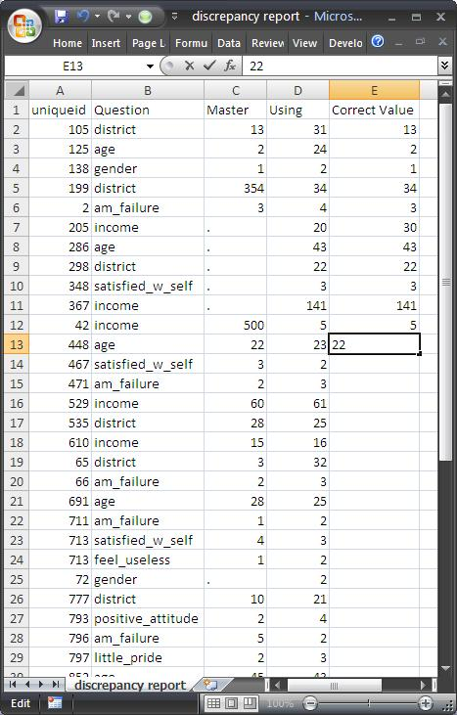
Correcting Discrepancies
March down the output from cfout, indicating which value is correct

Slide 9
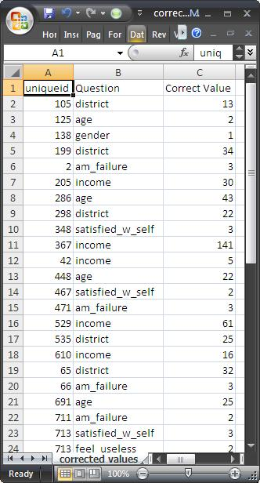
Replacing Discrepancies
readreplace using filename, id(varname)
Reads a 3 column .csv file:
ID, question, correct value
And makes all of the replacements in your dataset

Slide 10
The whole process
* Load the data
insheet using "raw first entry.csv"
save "first entry.dta", replace
insheet using "raw second entry.csv" , clear
save "second entry.dta" , replace
* compare the files
cfout region-no_good_at_all using "first entry.dta" , id(uniqueid)
* Make replacements using corrected data
readreplace using "corrected values.csv", id(uniqueid)

Slide 11
Other Useful Commands
mergeall merges all of the files in a folder, checking for string/numeric differences and duplicate IDs before merging
cfby calculates the number of discrepancies “by” a variable. Useful for calculating error rates.

Slide 12
Why Use Stata for Reconciliations Instead of Data Entry Software?
  Choose the best data entry best software for each project
Independent corrections of discrepancies is more accurate than checks against existing values
Synergy with physical workflow management
More control over merging
Reproducibility
Analyze errors and performance over time

