Slide 1


The market for Stata users: evidence from online job postings
p. Wesley Routon
2023 Canadian Stata conference
August 4, 2023

Slide 2
Data collection tool
Lightcast
This is a subscription service, web-based, online software tool used primarily by large employers, worker training institutions, and higher education administrators to study labor markets.
Since 2010, it has been capturing online job postings and worker profiles daily, from every known relevant website, and maintains those data as internal samples.
  Example job posting websites: Indeed.com, SimplyHired.com, & ZipRecruiter.com
  Example worker profile website: LinkedIn.com
It removes duplicate job listings and worker profiles.
  Employers often advertise open jobs on multiple sites, for example.
Like terms and phrases are categorized for better comparison (e.g., “lead a team,” “leadership,” “take the lead,” etc. are combined into “Leadership” as a job skill category).
Lightcast users are not granted access to the samples. They may only query the tool to reveal some simple statistics under set parameters.

Slide 3
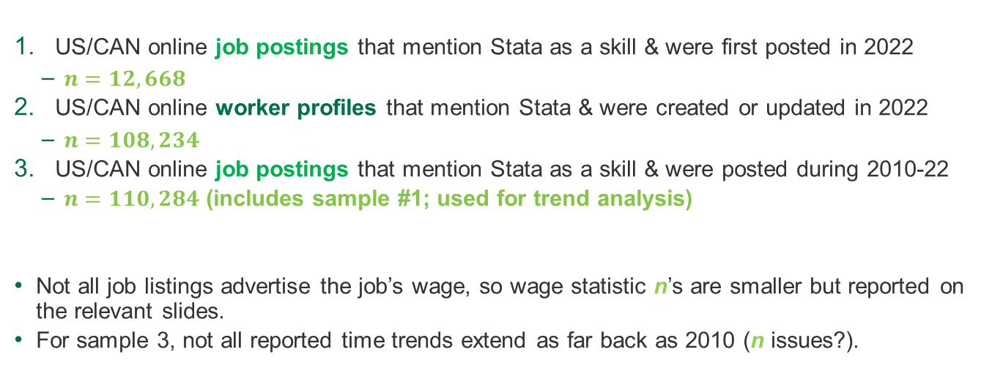
Samples used here
There are 3…
US/CAN online job postings that mention Stata as a skill & were first posted in 2022
  $n=12,668$
US/CAN online worker profiles that mention Stata & were created or updated in 2022
  $n=108,234$
US/CAN online job postings that mention Stata as a skill & were posted during 2010-22
  $n=110,284$ (includes sample #1; used for trend analysis)
Not all job listings advertise the job’s wage, so wage statistic n’s are smaller but reported on the relevant slides.
For sample 3, not all reported time trends extend as far back as 2010 (n issues?).

Slide 4
Available statistics
Here’s what Lightcast will report…
Job listing samples
Time trends for the count of new job listings
Wage distributions & mean wage time trends
Minimum education & experience distributions
Top 50 lists (with percent frequencies) for employers, cities, job titles, & requisite job skills
Worker profile samples
Top 50 lists (with percent frequencies) for cities, employers, job titles, schools, degree programs, & skills

Slide 5
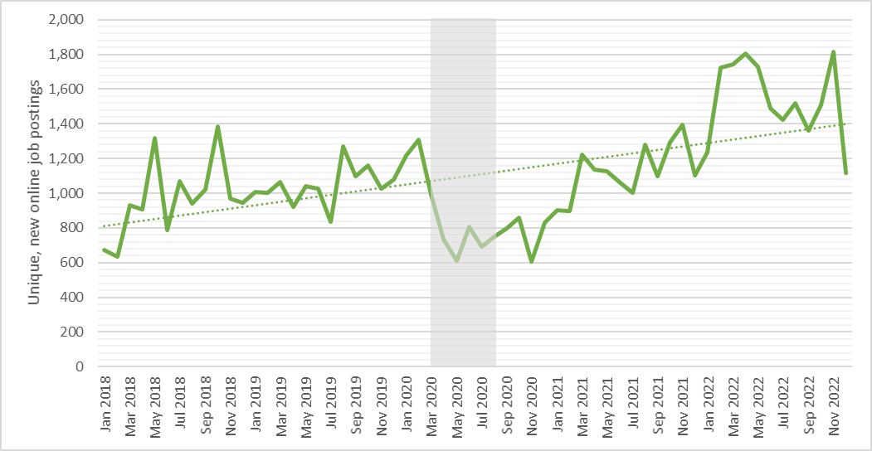

New “Stata jobs” posted online (monthly data, US/CAN, 2018-22)

Slide 6
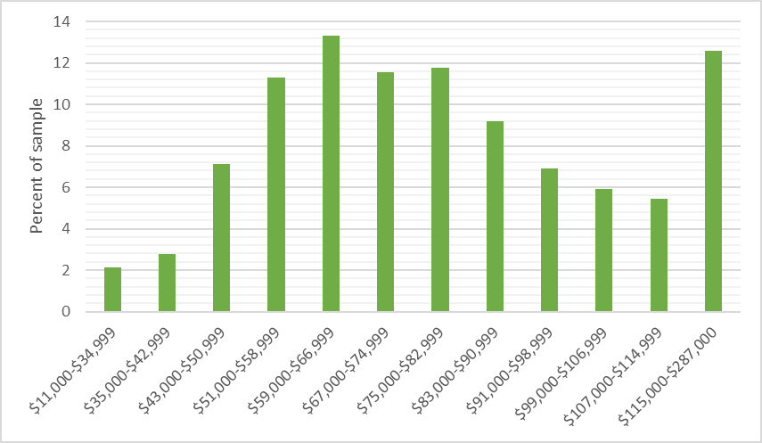
wage distribution of “Stata jobs” (2022, $n=3,303$, US/CAN, 2022 USD)

Slide 7
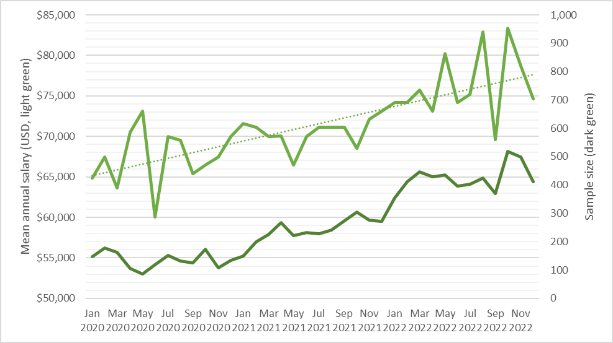
Mean advertised wage trend (2020-22, monthly, US/CAN, USD)

Slide 8
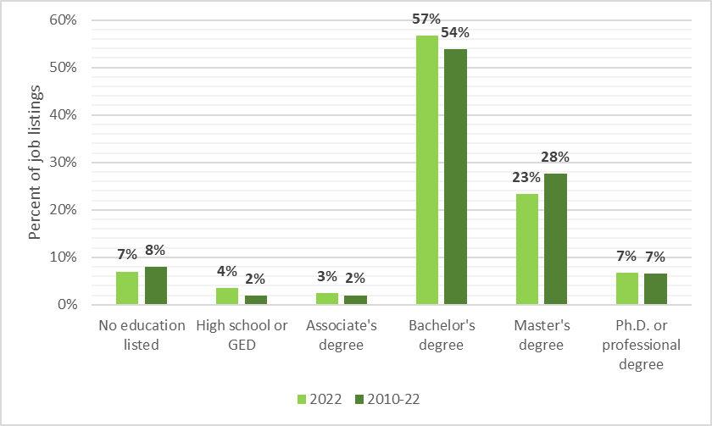
Minimum required education for “Stata jobs” (US/CAN)

Slide 9
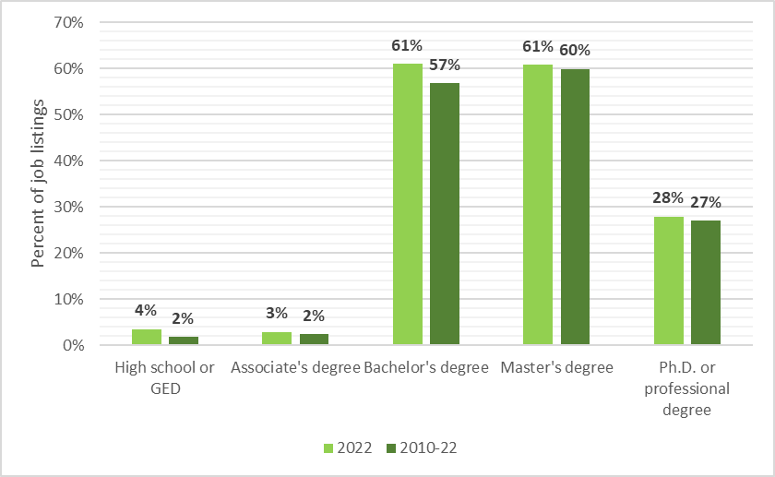
“mentioned at all” education for “Stata jobs” (US/CAN)

Slide 10
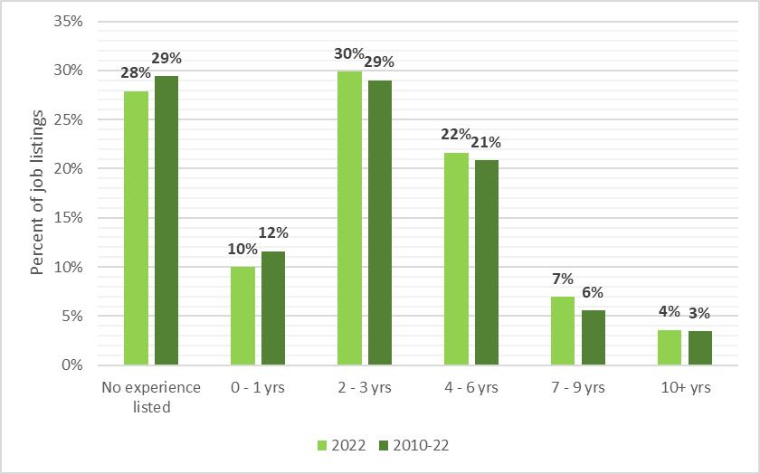
Required job experience for “Stata jobs” (US/CAN)

Slide 11
Top 20 job titles for “Stata jobs” (2022, US/CAN)
Rank | Job title | 2022 | % of | Median posting
(listings) |  | listings | listings | duration (days)
1 | Biostatistician | 477 | 3.8 | 28
2 | Data scientist | 473 | 3.7 | 25
3 | Data analyst | 383 | 3.0 | 32
4 | Research associate | 303 | 2.4 | 25
5 | Research scientist | 255 | 2.0 | 32
6 | Research assistant | 224 | 1.8 | 26
7 | Research analyst | 211 | 1.7 | 29
8 | Research data analyst | 126 | 1.0 | 29
9 | Economist | 107 | 0.8 | 28
10 | Epidemiologist | 104 | 0.8 | 30
11 | Quantitative researcher | 89 | 0.7 | 35
12 | Statistician | 84 | 0.7 | 30
13 | Postdoctoral fellow | 83 | 0.7 | 25
14 | Public sector consultant | 81 | 0.6 | 32
15 | Researcher | 76 | 0.6 | 31
16 | Research specialist | 75 | 0.6 | 17
17 | Data manager | 69 | 0.5 | 34
18 | Data analytics manager | 66 | 0.5 | 19
19 | Data analytics developer | 61 | 0.5 | 17
20 | Social science research analyst | 58 | 0.5 | 28
Slowest search
Tie for fastest
Tie for fastest

Slide 12
Top 20 job titles for Stata users (2022, US/CAN)
Rank | Job title | 2022 | % of
 |  | profiles | profiles
1 | Data scientist | 2,198 | 2.03
2 | Assistant professor | 1,969 | 1.82
3 | Associate | 1,414 | 1.31
4 | Economist | 1,111 | 1.03
5 | Data analyst | 1,107 | 1.02
6 | Research assistant | 1,076 | 0.99
7 | Associate professor | 1,021 | 0.94
8 | Software engineer | 932 | 0.86
9 | Consultant | 870 | 0.80
10 | Research associate | 822 | 0.76
11 | Product manager | 811 | 0.75
12 | Vice president | 785 | 0.73
13 | Analyst | 691 | 0.64
14 | Financial analyst | 684 | 0.63
15 | Founder | 630 | 0.58
16 | Research analyst | 594 | 0.55
17 | Labor economist | 582 | 0.54
18 | Professor | 580 | 0.54
19 | Chief executive officer | 558 | 0.52
20 | Director | 557 | 0.51

Slide 13
Top 20 degrees for Stata users (2022, US/CAN)
Rank | Program | Profiles | %
1 | Economics | 51,481 | 47.56
2 | Business Admin. (Management or Operations) | 10,764 | 9.95
3 | Political Science or Government | 8,727 | 8.06
4 | Mathematics | 7,308 | 6.75
5 | Public Policy Analysis | 7,240 | 6.69
6 | Philosophy | 6,409 | 5.92
7 | Finance | 5,687 | 5.25
8 | Ecology | 4,362 | 4.03
9 | Psychology | 4,043 | 3.74
10 | International Relations | 3,952 | 3.65
11 | Statistics | 3,606 | 3.33
12 | Biology | 3,486 | 3.22
13 | Sociology | 3,461 | 3.20
14 | Business Admin. (General) | 3,397 | 3.14
15 | Public Health | 3,328 | 3.07
16 | Education | 2,712 | 2.51
17 | Medicine | 2,541 | 2.35
18 | Legal Studies | 2,506 | 2.32
19 | Public Administration | 2,486 | 2.30
20 | Computer Science | 1,935 | 1.79

Slide 14
Top 20 qualifications for “Stata jobs” (2022, US/CAN)
Rank | Qualification (certification, clearance, or specific degree) | Listings | %
1 | Security clearance | 342 | 2.70
2 | Master of Business Administration (MBA) | 325 | 2.57
3 | Secret clearance | 149 | 1.18
4 | Chartered Financial Analyst | 116 | 0.92
5 | Certified Financial Risk Management | 90 | 0.71
6 | Top Secret-Sensitive Compartmented Information (TS/SCI Clearance) | 75 | 0.59
7 | SAS certification | 71 | 0.56
8 | Doctor of Public Health | 69 | 0.54
9 | Certified Public Accountant (CPA) | 47 | 0.37
10 | Basic Life Support (BLS) certification | 41 | 0.32
11 | Project Management Professional certification | 35 | 0.28
12 | Board Certified/Board Eligible | 19 | 0.15
13 | Top secret clearance | 19 | 0.15
14 | Advanced Cardiovascular Life Support (ACLS) certification | 17 | 0.13
15 | Certified Reliability Engineer | 16 | 0.13
16 | Nurse Practitioner (APRN-CNP) | 15 | 0.12
17 | Enterprise Desktop Administrator (Microsoft Certified IT Professional) | 14 | 0.11
18 | Microsoft Certified Professional | 14 | 0.11
19 | Certified Loss Control Specialist | 13 | 0.10
20 | Certified Software Tester (CSTE) | 12 | 0.09

Slide 15
Top 20 other software skills for “Stata jobs” (2022, US/CAN)
Rank | Skill | Postings (%) | Profiles (%) | Skill gap (%)
1 | R | 80.8 | 29.8 | 50.9
2 | SAS | 66.1 | 22.1 | 44.0
3 | SPSS | 44.6 | 25.7 | 18.9
4 | Python | 41.6 | 17.6 | 24.1
5 | SQL | 37.3 | 18.0 | 19.2
6 | Microsoft Excel | 28.9 | 53.9 | -25.0
7 | "Statistical software" | 26.1 | 2.8 | 23.3
8 | Tableau | 23.4 | 9.1 | 14.3
9 | Microsoft PowerPoint | 15.7 | 38.7 | -23.0
10 | Microsoft Office | 14.4 | 50.7 | -36.3
11 | MATLAB | 13.9 | 13.2 | 0.7
12 | Microsoft Access | 9.5 | 8.1 | 1.4
13 | Microsoft Word | 5.1 | 31.5 | -26.4
14 | ArcGIS | 4.9 | 5.2 | -0.3
15 | Qualtrics | 4.6 | 1.7 | 3.0
16 | NVivo | 4.4 | 1.3 | 3.2
17 | Microsoft Outlook | 4.4 | 4.4 | 0.0
18 | "Geographic information systems" | 4.0 | 4.6 | -0.5
19 | Amazon Web Services | 3.8 | 1.7 | 2.1
20 | Apache Hadoop | 3.6 | 1.3 | 2.3

Slide 16
Top 20 non-software skills for “Stata jobs” (2022, US/CAN)
Rank | Skill | Postings (%) | Profiles (%) | Skill gap (%)
1 | Research | 77.5 | 83.6 | -6.0
2 | Data analysis | 56.8 | 67.1 | -10.4
3 | Communication (general) | 52.6 | 22.5 | 30.1
4 | Writing | 43.5 | 17.4 | 26.1
5 | Giving presentations | 42.2 | 15.8 | 26.3
6 | Statistics | 39.8 | 28.5 | 11.3
7 | Economics | 36.3 | 38.7 | -2.4
8 | Management | 34.4 | 31.9 | 2.6
9 | Data collection | 29.4 | 11.5 | 17.9
10 | Leadership | 24.7 | 34.3 | -9.6
11 | Data management | 24.0 | 5.9 | 18.1
12 | Detail orientation | 24.0 | 1.2 | 22.7
13 | Mathematics | 23.6 | 7.6 | 16.0
14 | Data visualization | 23.1 | 6.4 | 16.8
15 | Computer science | 21.5 | 1.5 | 20.0
16 | Problem solving | 21.4 | 5.7 | 15.7
17 | Planning | 20.1 | 11.4 | 8.7
18 | Data science | 19.5 | 9.6 | 9.9
19 | Social science | 18.9 | 3.0 | 15.9
20 | Innovation | 16.4 | 9.8 | 6.6

Slide 17
conclusions
Primary findings…
“Stata jobs” are on the rise, with over 1,000 new postings each month.
About 85% of these jobs pay above-average wages, with wages trending upwards.
At least 87% of these jobs require a college degree, often a graduate degree.
About 68% of these jobs require 3 years of experience or less (good for entry level candidates).
The variety of jobs is large, with the Top 20 most common comprising only 29.1% of the total.
Slightly under half of Stata users (~48%) have an economics degree.
Jobs that use Stata rarely require certifications, clearances, or specific degrees.
~81% of job listings that mention Stata also mention R, this also having the largest software skill gap among Stata users.
  66% mention SAS.
Research is the most sought after non-software skill by employers of Stata users.
  Communication skills have the largest estimated non-software skill gap for Stata users.

