Slide 1



A population-based model for rationing COVID-19 vaccines.

Slide 2


Presenter: David Cawthorpe, PhD
Professor (Adjunct), Faculty of Medicine,
Departments of Psychiatry & Community Health Sciences
Institute for Child & Maternal Health
The University of Calgary
email: cawthord@ucalgary.ca
Research and Evaluation,
Mental Health and Addictions,
Child and Adolescent Mental Health and Psychiatry Program,
Alberta Health Services
Richmond Road Diagnostic and Treatment Center
2nd Floor, 1820 Richmond Road S.W.
Calgary, Alberta
T2T 5C7

Slide 3
Support
This study was made possible with support from:
The Palix Foundation,
The Alberta Children’s Hospital Research Institute, and
The University of Calgary.
Disclosures
16 books on Amazon 2 on Apple Books
No other disclosures
Ethics Approval
Data for this paper was collected under CHREB ethics ID-REB15-1057.

Slide 4
Overview
Introduction: Morbidity is Important
The temporal order of the data is complex.
This presentation will provide an orientation to the following:
  Basic concepts and constructs
  Levels of analytical development achieved to date
  Current limitations and future steps

Slide 5

Morbidity study is an emerging big data field!

Slide 6
Background
Research to date has led in part to the formation of a permanent morbidity section in the
World Psychiatry Association
www.wpanet.org/comorbidity

Slide 7
14 Published Analyses to Date
Cawthorpe D. (2021). A Population-Based Model for Rationing COVID-19 Vaccine. https://books.apple.com/us/book/a-population-based-model-for-rationing-covid-19-vaccine/id1559653861
Cawthorpe D. (2020). Influenza and Other Viral Respiratory Diseases: A 16-Year Comparative Epidemiology Model - Understanding and Planning Health System Pandemic Capacity and Response. https://books.apple.com/us/book/id1512888942
Cawthorpe D (2018). A 16-Year Cohort Analysis of Autism Spectrum Disorder-Associated Morbidity in a Pediatric Population. Front. Psychiatry, 29 November 2018. doi.org/10.3389/fpsyt.2018.00635.
Cawthorpe, D. Kerba, M. Narendran, A. Ghuttora, H. Chartier, G. & Sartorius, N. (2018). Temporal order of cancers and mental disorders in an adult population. BJPsych Open, 4(3)., 95-105. doi:10.1192/bjo.2018.5
Cawthorpe, D. (2017). Comprehensive Description of Comorbidity for Autism Spectrum Disorder in a General Population. Perm J 2017; 21:16-088. https://doi.org/10.7812/TPP/16-088 E-pub: 12/23/2016
Anwar S. Cawthorpe D. (2016). What “big population data” tells us about neurological disorders comorbidity. JHA, 5(6).: 1-8. (doi 10.5430/jha.v5n6p75).
Chartier G. Cawthorpe D. (2016). From 'Big 4' to 'Big 5': a review and epidemiological study on the relationship between psychiatric disorders and World Health Organization preventable diseases. Current Opinions in Psychiatry. September 2016; 29 (5).: 316-321.
Chartier G. Cawthorpe D. (2016). Distinction between Episodic Mood Disorder and Attention Deficit Disorder with Hyperactivity based on their Association with the Main Classes of International Classification of Disease in a Child and Adolescent Population. Ann Depress Anxiety. 3(1).: 1073.
Cawthorpe D. Davidson M. (2015). Temporal Comorbidity of Mental Disorder and Ulcerative Colitis. Perm J. Winter; 19(1).: 52-57.
Cawthorpe D. Chartier G. (2014). Population: Implications for Future Society. Review of Social Studies, Law and Psychology. Vol. 8: 48-54.
Ghuttora H. Cawthorpe D. (2013). Treatment of physical disorder in children with mental disorder: A health care utilization study. Journal of Hospital Administration. DOI: 10.5430/jha.v3n2p24 http://www.sciedu.ca/journal/index.php/jha/article/view/3131).
Lui J. Narendran A. Cawthorpe D. (2013). What can population-based physician billing data tell us about the prevalence, costs and disorders associated with different types of cancers based on the 16 year prevalence of cancer diagnosis? Journal of Hospital Administration. 2014, Vol. 3, No. 4: 9-19
Cawthorpe D. (2013). A Novel Population-Based Health Index for Mental Disorder. Perm J Spring; 17 (2).:50-54. (http://www.thepermanentejournal.org/issues/2013/spring/5101-mental-disorder.html).
Wilkes T. Guyn L. Li B. Lu M. Cawthorpe D. (2012). Association of child and adolescent psychiatric and biomedical/somatic disorders: Do population-based utilization study results support the Adverse Childhood Experiences study? The Permanente Journal Spring; 16 (2).: 21-24.

Slide 8
First study was hypothesis driven:
Can we see the long term results of the Adverse Childhood Experience Study in our administrative data?
Assumption: Early adversity is a gateway to later mental disorder, similar to the ACE study, so…
Those with mental disorder will have greater morbidity.
2. The question of temporal order naturally follows…

Slide 9
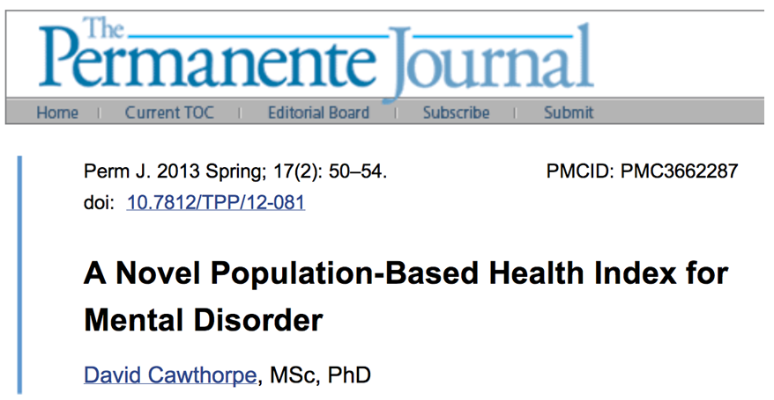

Slide 10
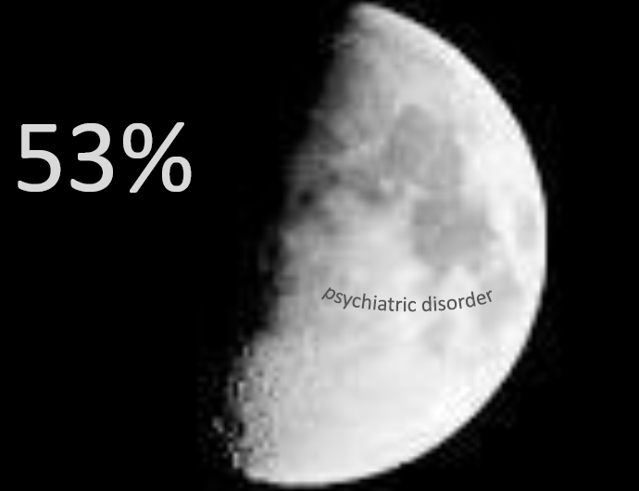
of the whole
population
Notes:
Unlike adults, were approximately 52% of the comparison group had a psychiatric diagnosis over the 16 year interval, only 37% percent of children at a psychiatric diagnosis

Slide 11


Slide 12
Most studies of morbidity examine comorbidity,
and at most usually consider only a few comorbid, generally these are concurrent disorders…
Big data studies can go beyond… accounting for temporal hyper-multi-morbidity…

Slide 13
Related peer reviewed published results

Slide 14

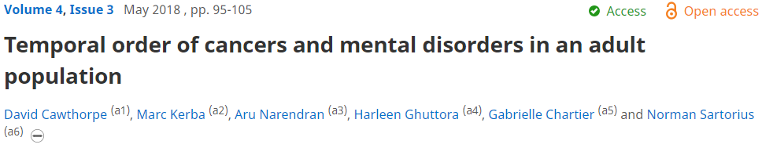
MENTAL DISORDER and CANCER
MENTAL DISORDERS precede CANCERS by 6 years on average

Slide 15
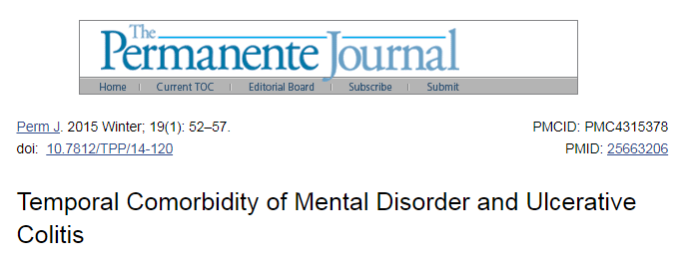
ONLY Neuroses & Depression
Significantly Precede
ULCERATIVE COLITIS on average by 5 years

Slide 16
In this study vulnerability to viral pneumonia was examined:
Focus on
pre-morbid temporal hyper-morbidity
in a prospective sample under the age of one year in the first year of the data over the next 16 years.

Slide 17
Any Viral Pneumonia Diagnosis
Index diagnosis date is pivot
BEFORE
Viral Pneumonia
AFTER
No Viral Pneumonia
TIME by Visit

Slide 18
All Data
Algorithm = Data Reduction
Data Representation
Data Interpretation
Independent Validation (Standardized Methods)
Clinical Utility?

Slide 19
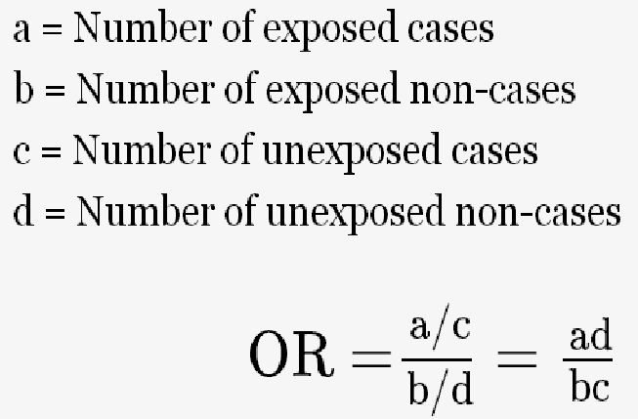
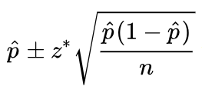

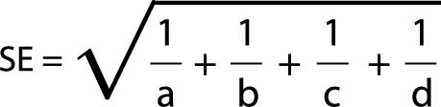
Simple ANALYSES: Counts of individuals
Type A
OVERALL differences between Groups having comorbid disorders based independent of time OR before and after Index Diagnosis
of dependent variable.
Type B
Temporal order: Comparison of Proportions within One Group having comorbid disorders based on index date of diagnoses.

Slide 20
Simple ANALYSES: Frequency of Diagnoses within Groups
Type C
OVERALL between groups comparison:
Intensity (frequency)
of diagnoses
under Odds Ratio conditions
Type D
Temporal order comparisons of intensity (frequency) of diagnoses within groups having comorbid disorders based on index date of diagnoses

Slide 21
Algorithms

Slide 22
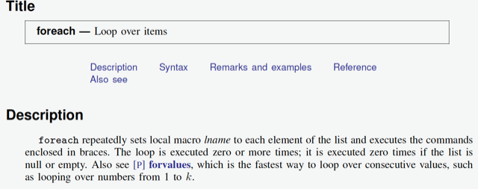
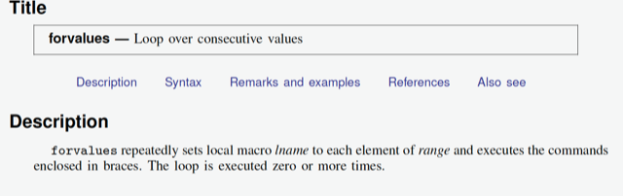

Slide 23
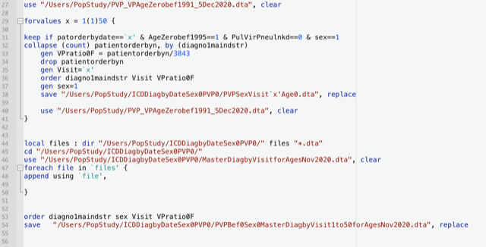
Example of endpoint code

Slide 24
METHODS & DATA
Case Series Design:
Specific ICD Disorders or Classes
vs. Other ICD Disorders or Classes
SAMPLE ~.75 Million (56% Female) Unique Individuals 0-108 Years of Age
~100 Million Dated Physician Diagnoses Between Spring 1993 and Autumn 2010

Slide 25
Sample Description
Groups |  | Female | Male
All Ages
VP- | UID | 304505 | 267498
 | Diagnoses* | 36510566 | 20255378
 | mean (SD) | 120 (125) | 76 (99)
VP+ | UID | 111821 | 84636
 | Diagnoses* | 25082428 | 13998139
 | mean (SD) | 224 (196) | 165 (181)
< 1 Year
VP- | UID | 12775 | 20326
 | Diagnoses* | 139689 | 249063
 | mean (SD) | 11 (9) | 13 (10)
VP+ | UID | 5125 | 8867
 | Diagnoses* | 69178 | 138234
 | mean (SD) | 14 (12) | 16 (19)

Slide 27
Limitations
A: Calculations are independent when examining different classes of specific disorders.
Next step under development:
To better understand the complex nature of comorbidity, an ideal algorithm would necessarily take into account the temporal order of all disorders within each patient and then compare the ordered groupings.
B: Bias related to over-diagnosis of common disorders and under-diagnosis of rare disorders.

Slide 28
Next Step EXAMPLE:
A different approach: 2930 Live births in YEAR1 of the dataset
over the next 16 years
994 developed VIRAL PNEUMONIA
One average at 6 years of age
and had a maximum of 735 diagnoses over the next 16 years
1,936 did not develop VIRAL PNEUMONIA
and had a maximum of 590 diagnoses
No significant sex differences

Slide 32
Discussion
Result Applications

Slide 33
Analysis of Temporal-Hyper-Morbidity provides useful clinical information.
Pre-morbid data predicts vulnerability to Viral Pneumonia and possibly those who may benefit most from vaccination.
Post-Morbid data helps plan services.
Pre-morbid patterns of disease may inform basic research.
Clinical
&
Research
Utility

Slide 34
Conclusions
The study of Bio-Medical Hyper-Morbidity is important.
The study of MULTI-MORBIDITY is a cornerstone of Precision Medicine METABOLOMICS, GENOMICS, PROTEOMICS, POOP(BIOM)-OMICS
The present study indicates that the we can identify vulnerability to VIRAL PNEUMONIA and therefore may apply the algorithm to COVID-19 data.

Slide 35
Thank you…

