Slide 1
Introduction to Bayesian Analysis
Using Stata
Chuck Huber
StataCorp
chuber@stata.com
2017 Canadian Stata Users Group Meeting
Bank of Canada, Ottawa
June 9, 2017

Slide 2
Introduction to the bayes Prefix in Stata 15
Chuck Huber
StataCorp
chuber@stata.com
2017 Canadian Stata Users Group Meeting
Bank of Canada, Ottawa
June 9, 2017

Slide 3
Outline
Introduction to Bayesian Analysis
Coin Toss Example
Priors, Likelihoods, and Posteriors
Markov Chain Monte Carlo (MCMC)
Bayesian Linear Regression
Bayesian Logistic Regression
Bayesian Ordinal Logistic Regression

Slide 4
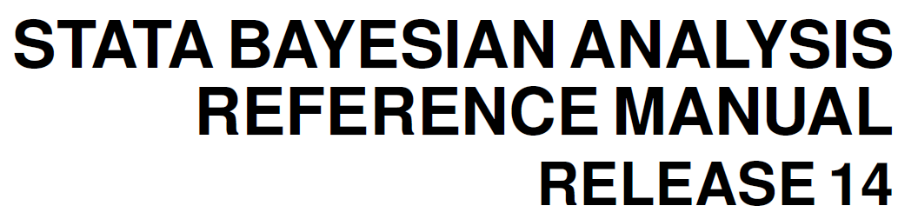
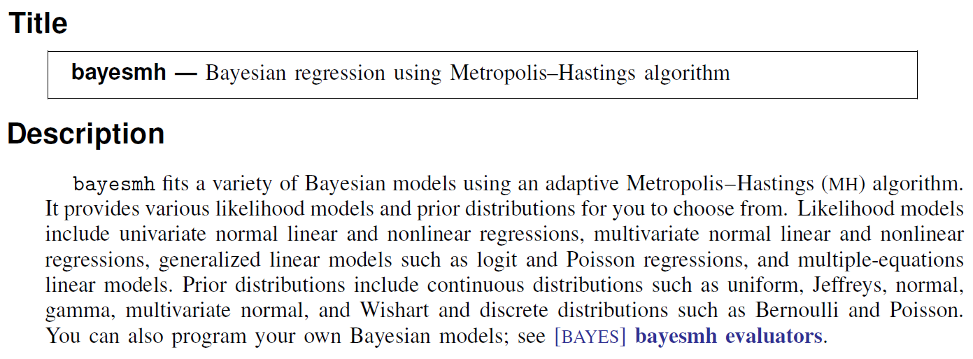

Slide 5
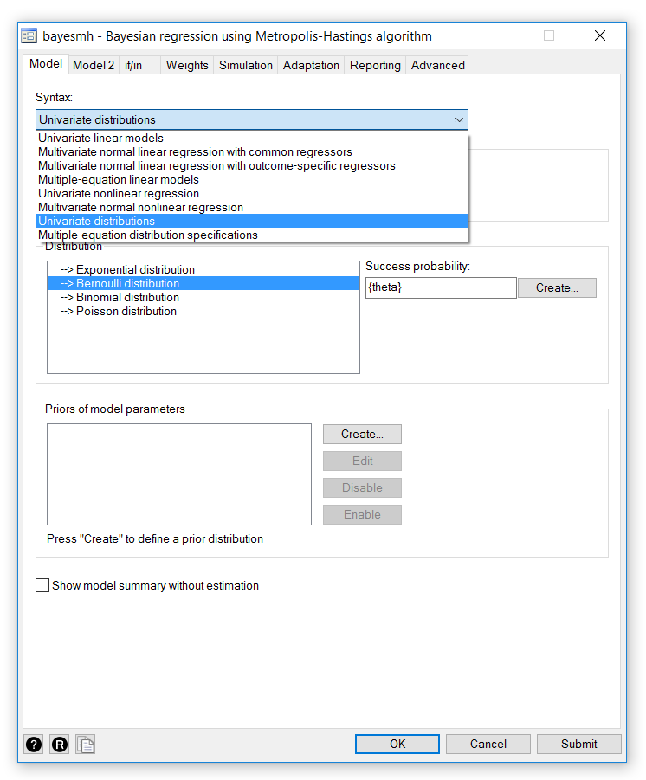

Slide 6
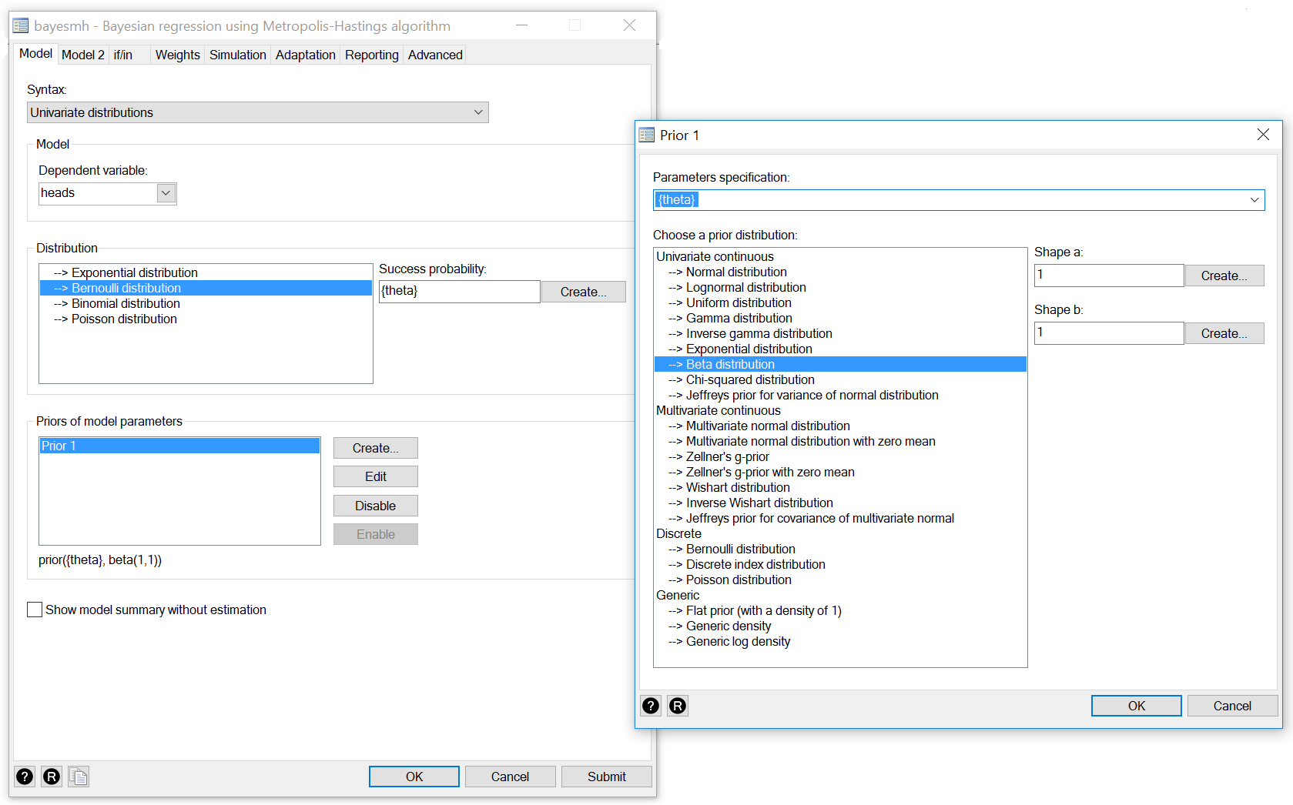

Slide 7
The bayesmh Command
bayesmh sbp age sex bmi, ///
likelihood(normal({sigma2})) ///
prior({sbp: _cons}, normal(0,100)) ///
prior({sbp: age}, normal(0,100)) ///
prior({sbp: sex}, normal(0,100)) ///
prior({sbp: bmi}, normal(0,100)) ///
prior({sigma2}, igamma(1,1))

Slide 8
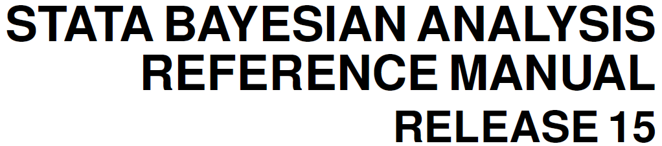
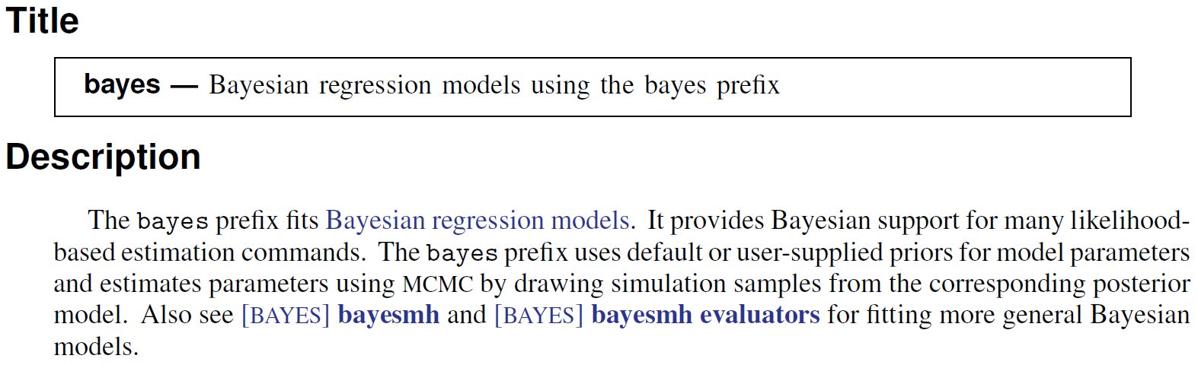

Slide 9
The bayes Prefix
regress bwt age smoke
bayes: regress bwt age smoke

Slide 10
Two Paradigms
Frequentist Statistics
Model parameters are considered to be unknown but fixed constants and the observed data are viewed as a repeatable random sample.
Bayesian Statistics
Model parameters are random quantities which have a posterior distribution formed by combining prior knowledge about parameters with the evidence from the observed data sample.

Slide 11
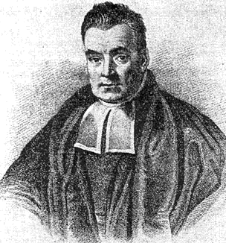
Reverend Thomas Bayes
1701 – born in London
Presbyterian Minister
Amateur Mathematician
Published one paper on theology and one on mathematics
1761 – died in Kent
1763 - “Bayes Theorem” paper published by friend Richard Price
https://bayesian.org/bayes

Slide 12
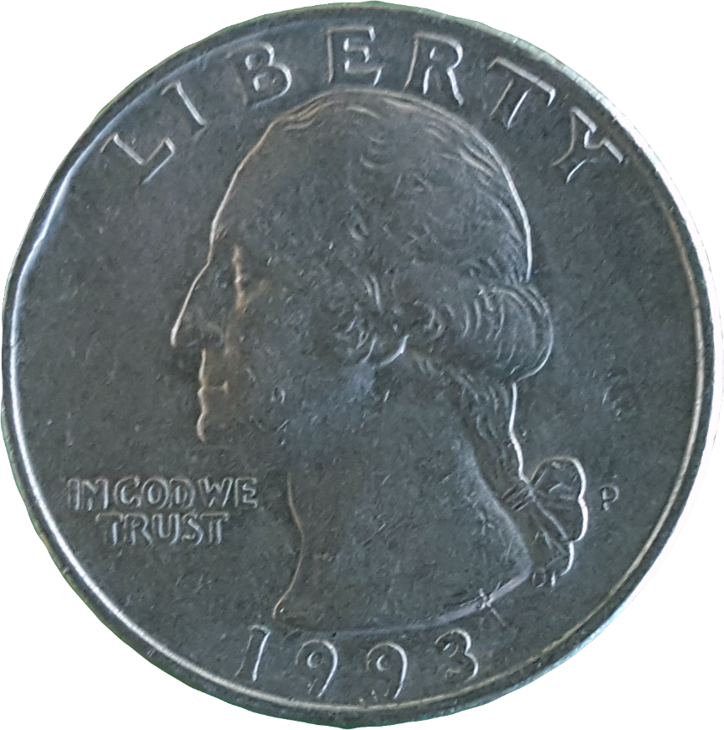
Coin Toss Example
What is the probability of heads (θ)?

Slide 13
Prior Distribution
Prior distributions are probability distributions of model parameters based on some a priori knowledge about the parameters.
Prior distributions are independent of the observed data.

Slide 14
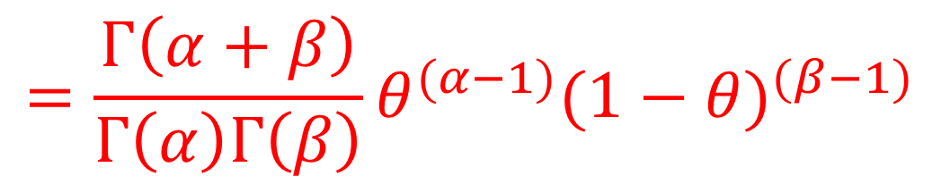
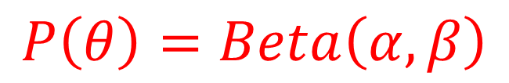
Beta Prior for θ
$$P\left(θ\right)=Beta\left(α,β\right)$$
$$=\frac{Γ\left(α+β\right)}{Γ\left(α\right)Γ\left(β\right)}θ^{(α−1)}{(1−θ)}^{(β−1)}$$

Slide 15
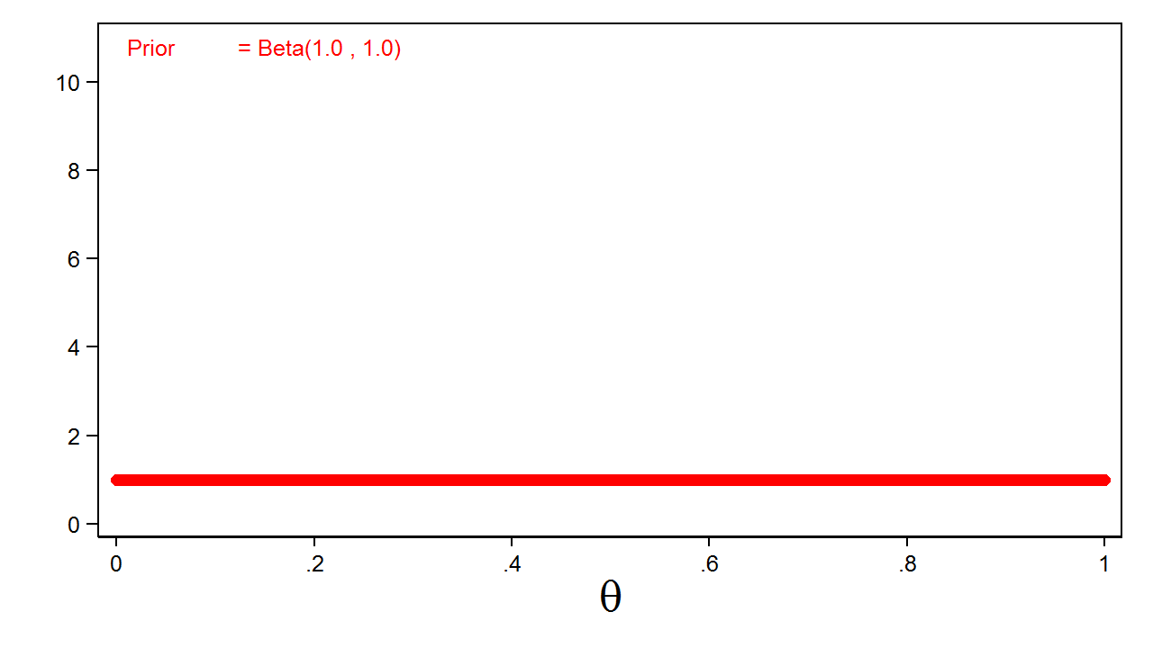
Uninformative Prior

Slide 16
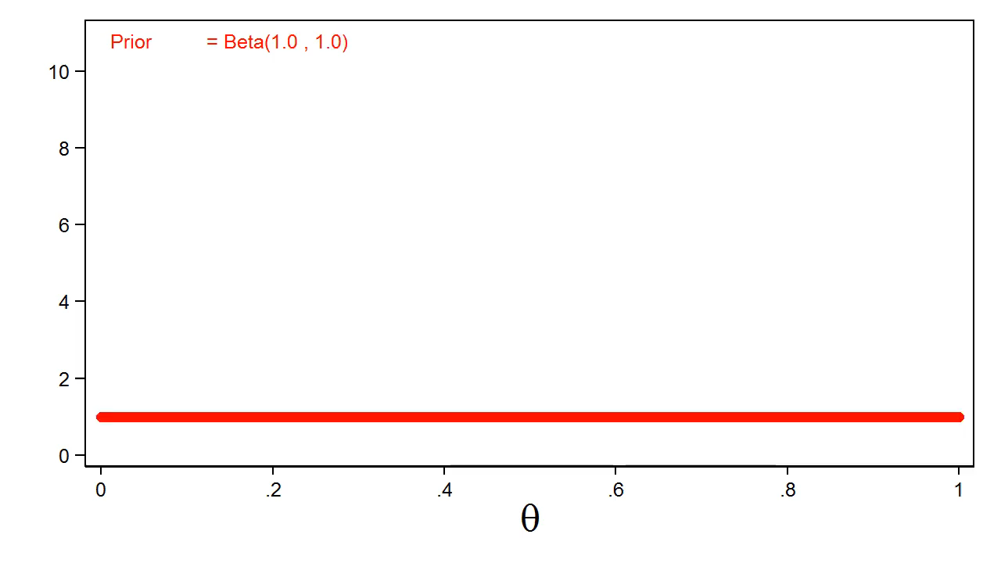
Different Priors

Slide 17
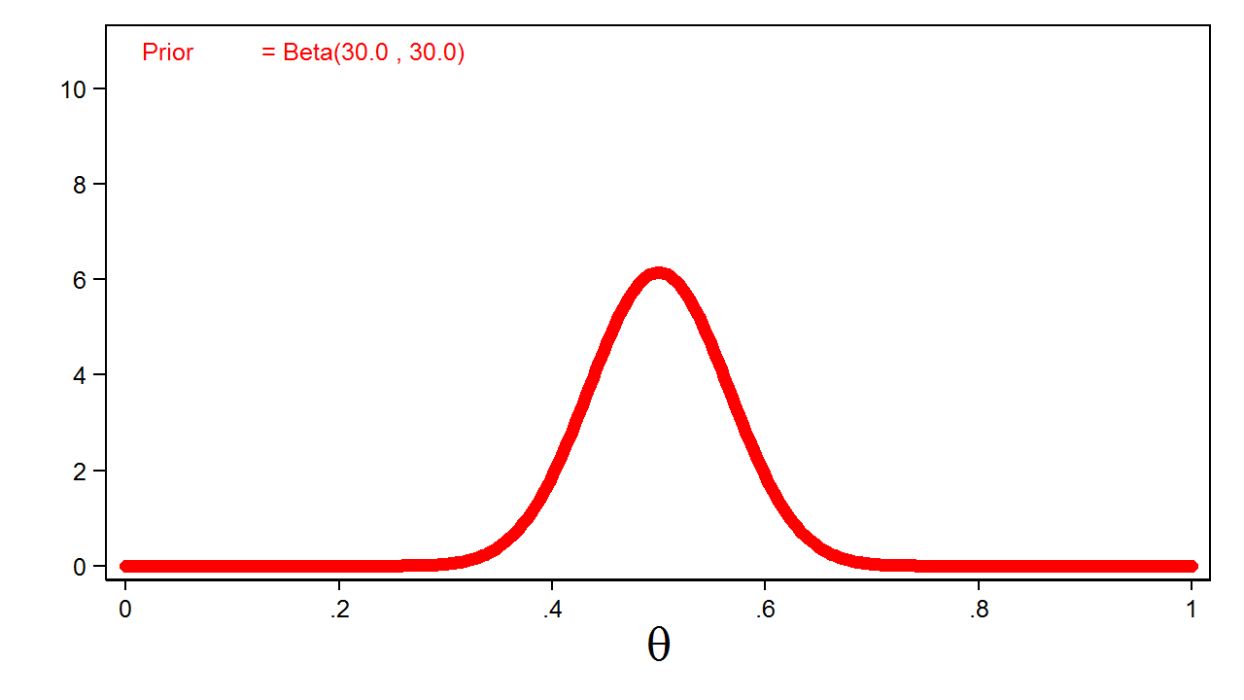
Informative Prior

Slide 18
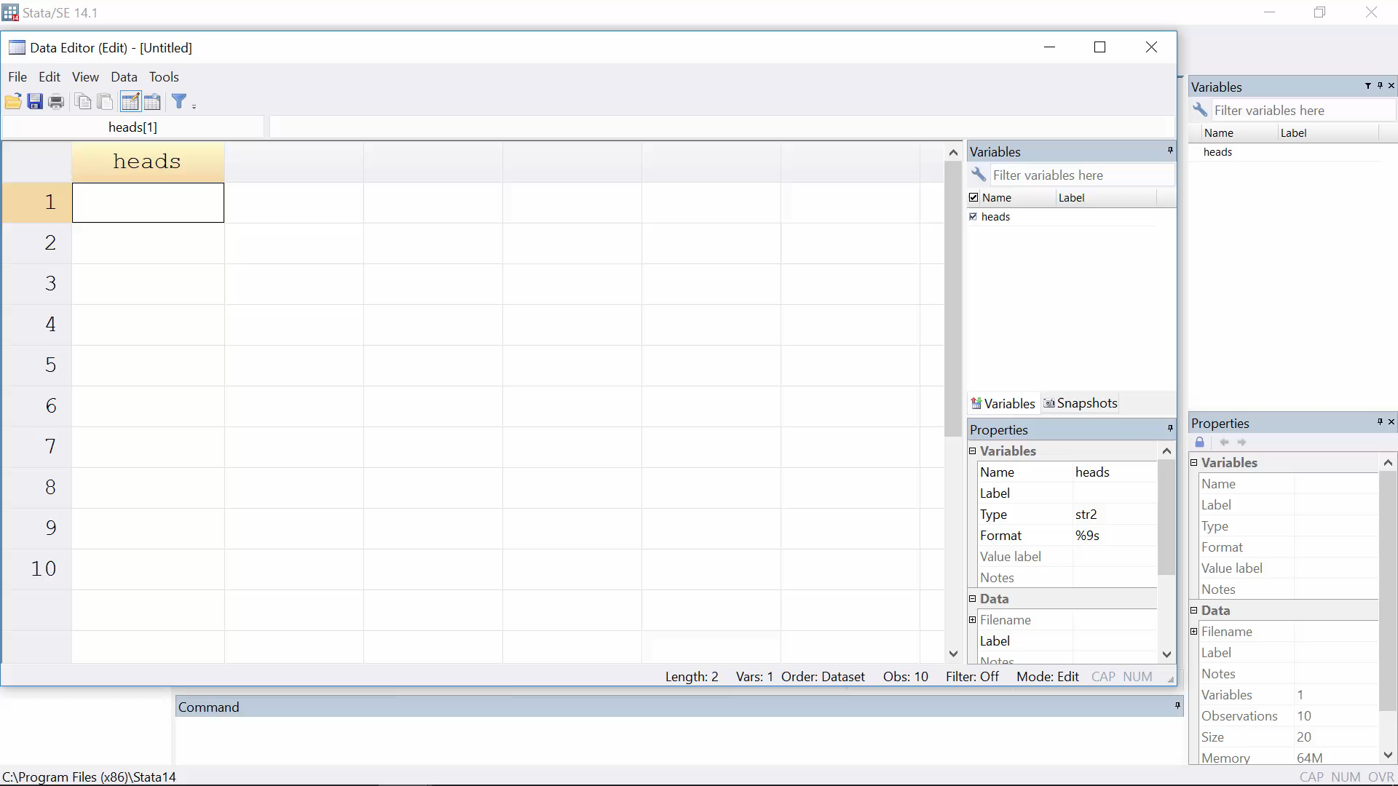
Coin Toss Experiment

Slide 19
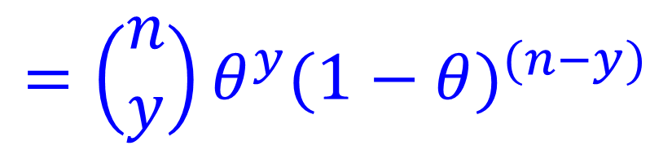
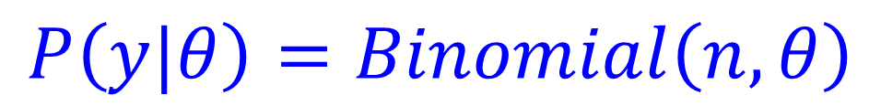
Likelihood Function for the Data
$$P\left(y|θ\right)=Binomial\left(n,θ\right)$$
$$=\left(\begin{matrix}n \\ y\end{matrix}\right)θ^{y}{(1−θ)}^{(n−y)}$$

Slide 20
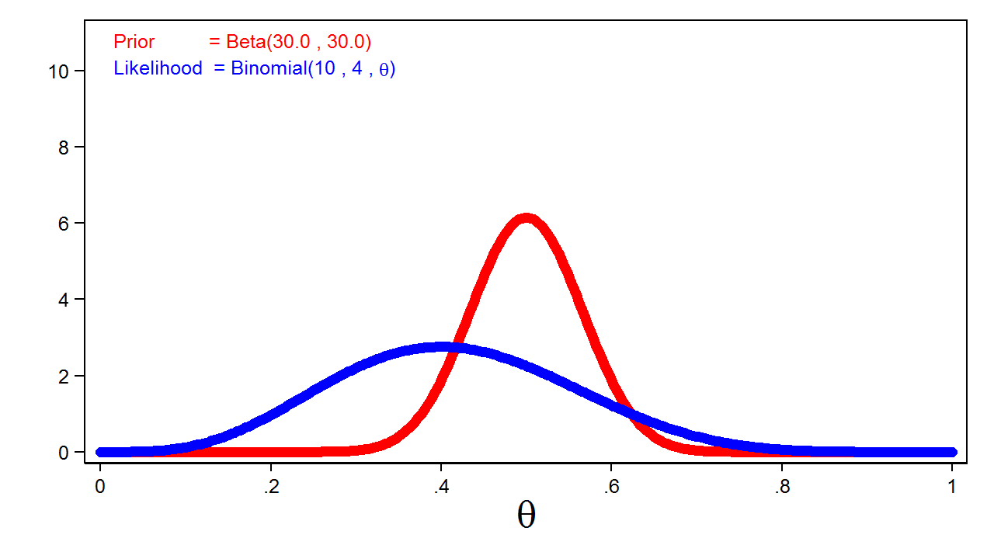
Prior and Likelihood

Slide 21


Posterior Distribution
$$Posterior=Prior×Likelihood$$
$$P\left(θ|y\right)=P\left(θ\right)P\left(y|θ\right)$$
$$P\left(θ|y\right)=Beta\left(α,β\right)×Binomial\left(n,θ\right)$$
$$=Beta\left(y+α,n−y+β\right)$$

Slide 22
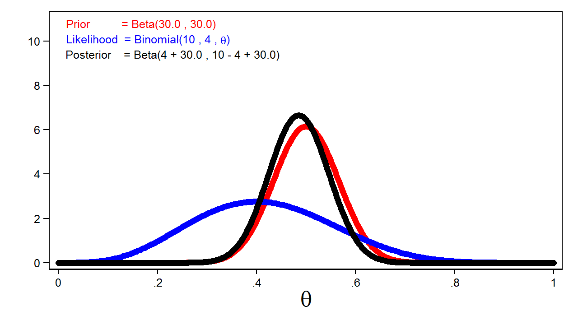
Posterior Distribution

Slide 23
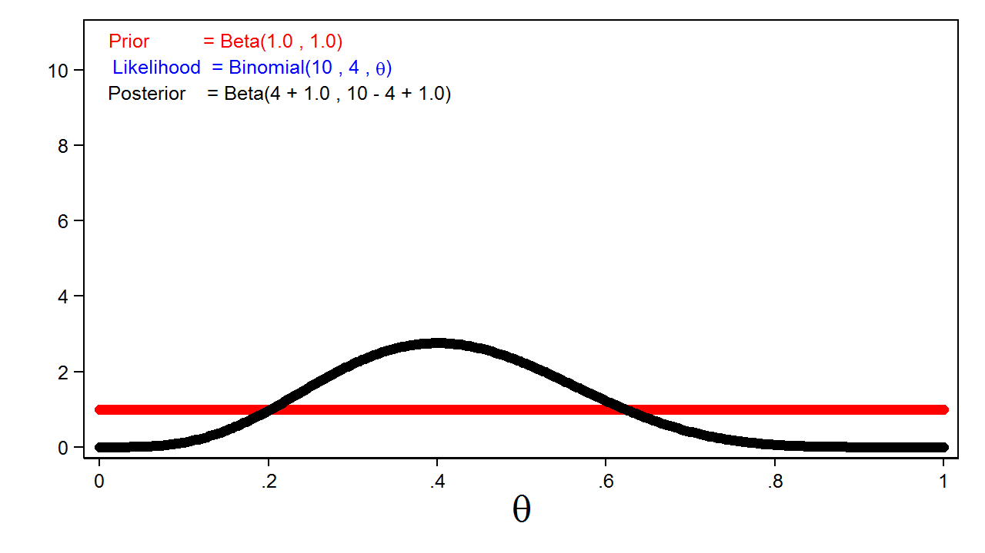
Effect of Uninformative Prior

Slide 24
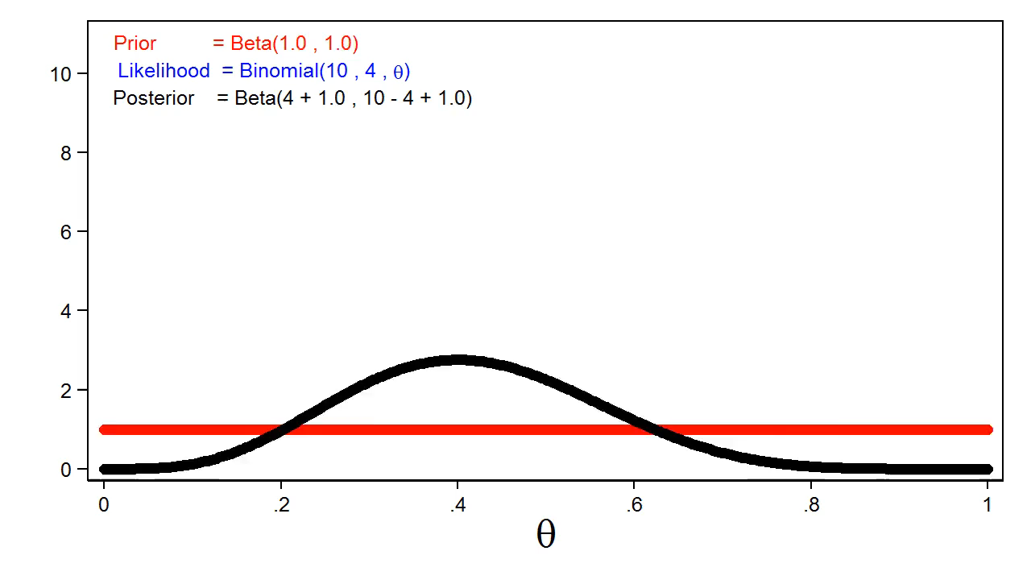
Effect of Informative Prior

Slide 25
Markov Chain Monte Carlo
Often the posterior distribution does not have a simple form. We can use Markov Chain Monte Carlo (MCMC) with the Metropolis-Hastings algorithm to generate a sample from the posterior distribution.

Slide 26
MCMC and Metropolis-Hastings
Monte Carlo
Markov Chains
Metropolis-Hastings

Slide 27
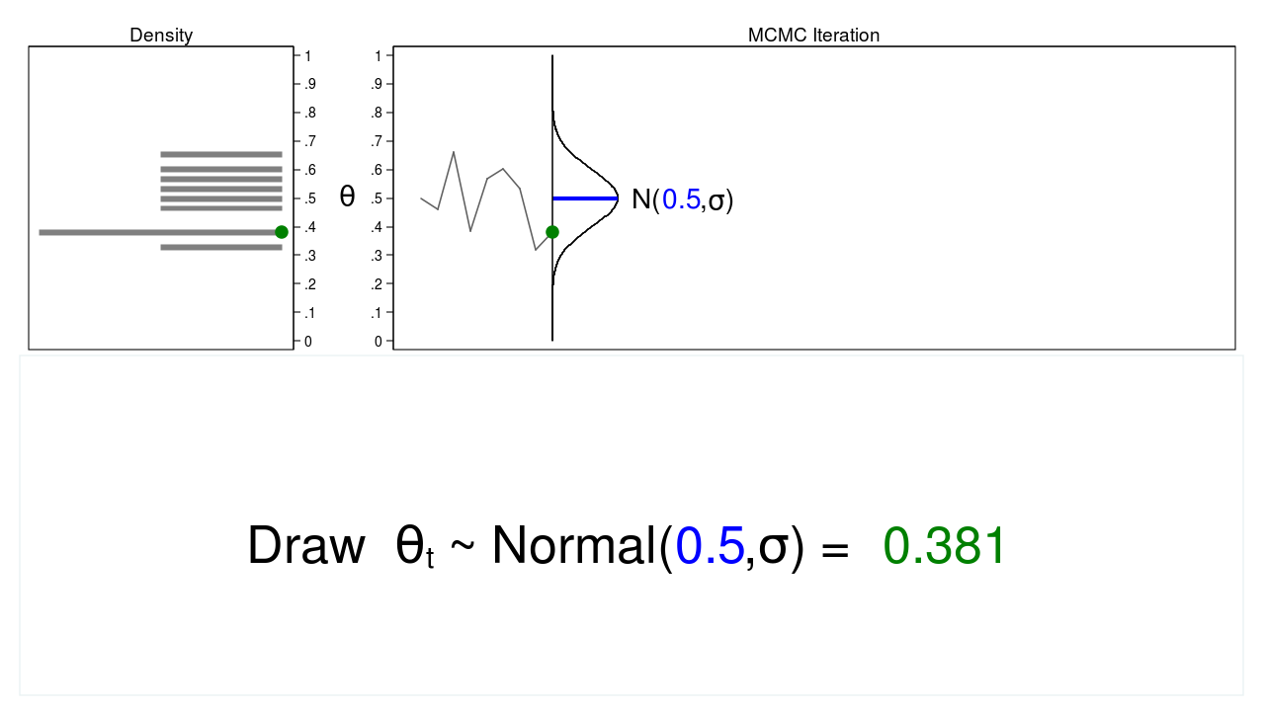
Monte Carlo
←Proposal Distribution

Slide 28
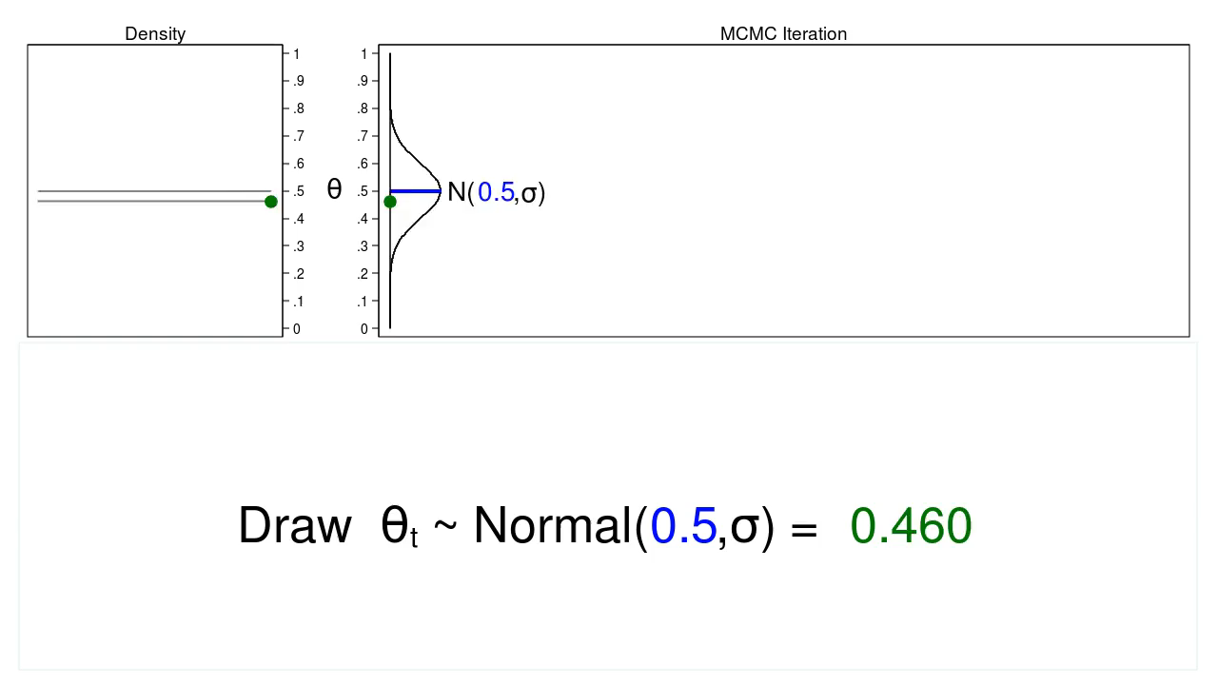
Monte Carlo

Slide 29
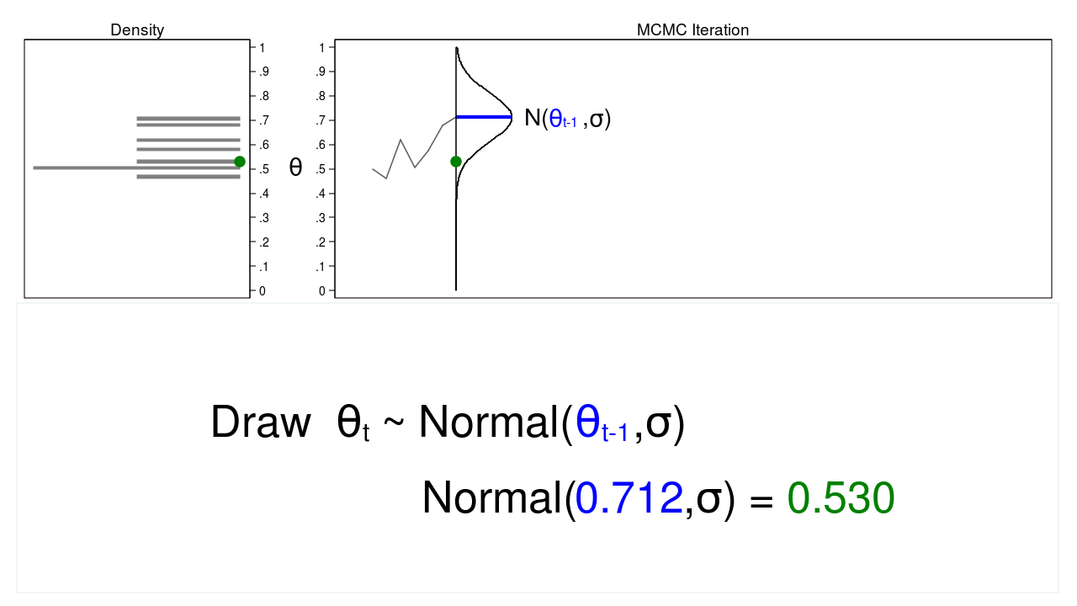
Markov Chain Monte Carlo

Slide 30
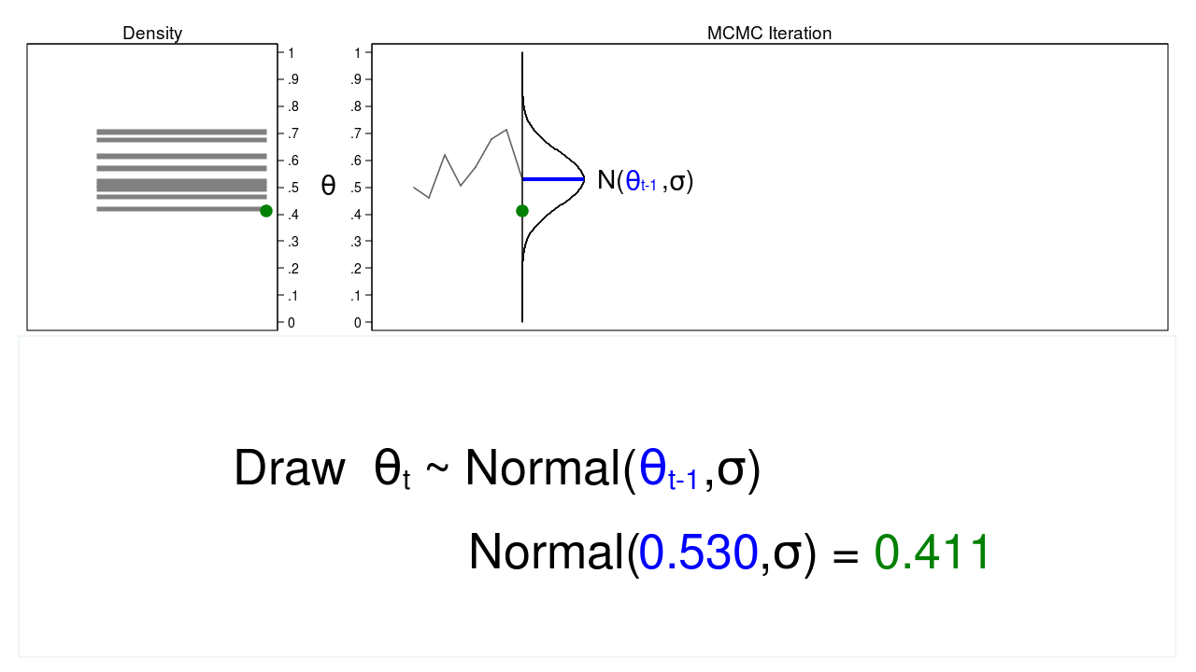
Markov Chain Monte Carlo

Slide 31
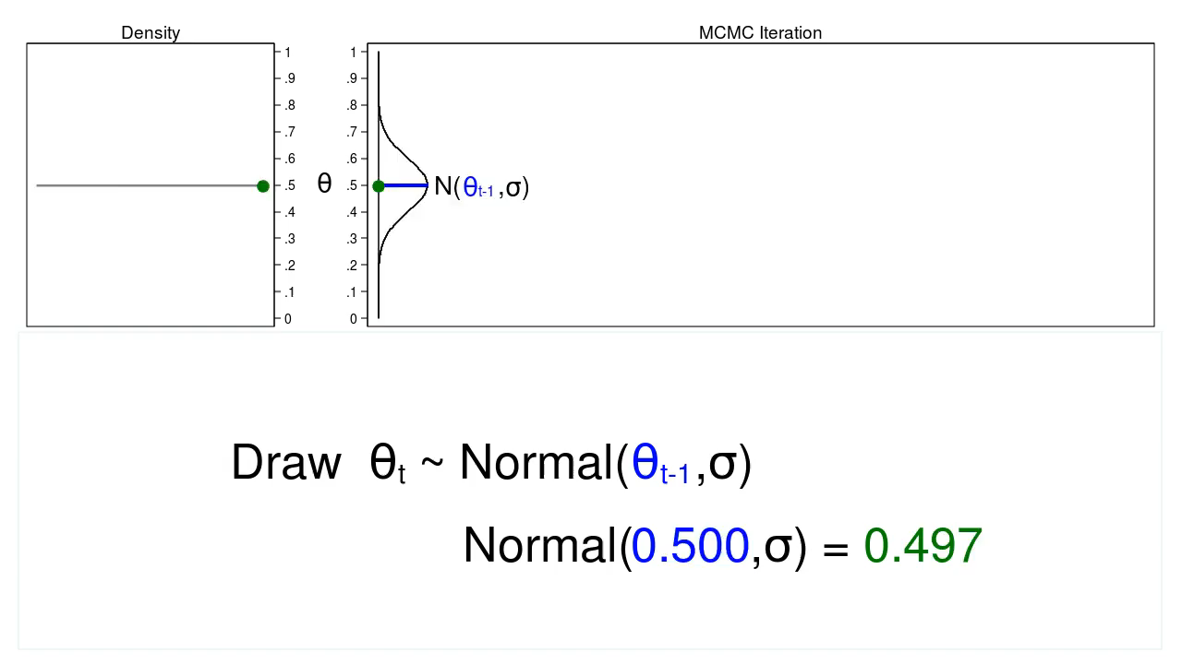
Markov Chain Monte Carlo

Slide 32
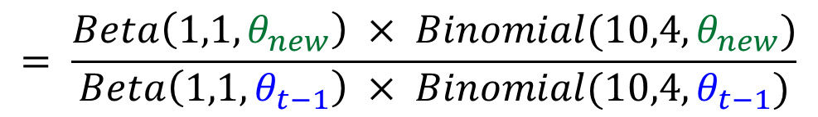
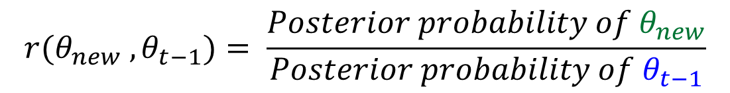
MCMC with Metropolis-Hastings
$$r(θ_{new} ,θ_{t−1})= \frac{Posterior probability of θ_{new}}{Posterior probability of θ_{t−1}}$$
$$= \frac{Beta\left(1,1,θ_{new}\right) × Binomial(10,4,θ_{new})}{Beta\left(1,1,θ_{t−1}\right) × Binomial(10,4,θ_{t−1})}$$

Slide 33

MCMC with Metropolis-Hastings
$$acceptance probability=α(θ_{new} ,θ_{t−1})$$
$$=min\left[ r(θ_{new},θ_{t−1}) , 1 \right]$$

Slide 34


MCMC with Metropolis-Hastings
$$Draw u \sim Uniform(0,1)$$
$$If u<α\left(θ_{new} ,θ_{t−1}\right) Then θ_{t}=θ_{new}$$
$$Otherwise θ_{t}=θ_{t−1}$$

Slide 35
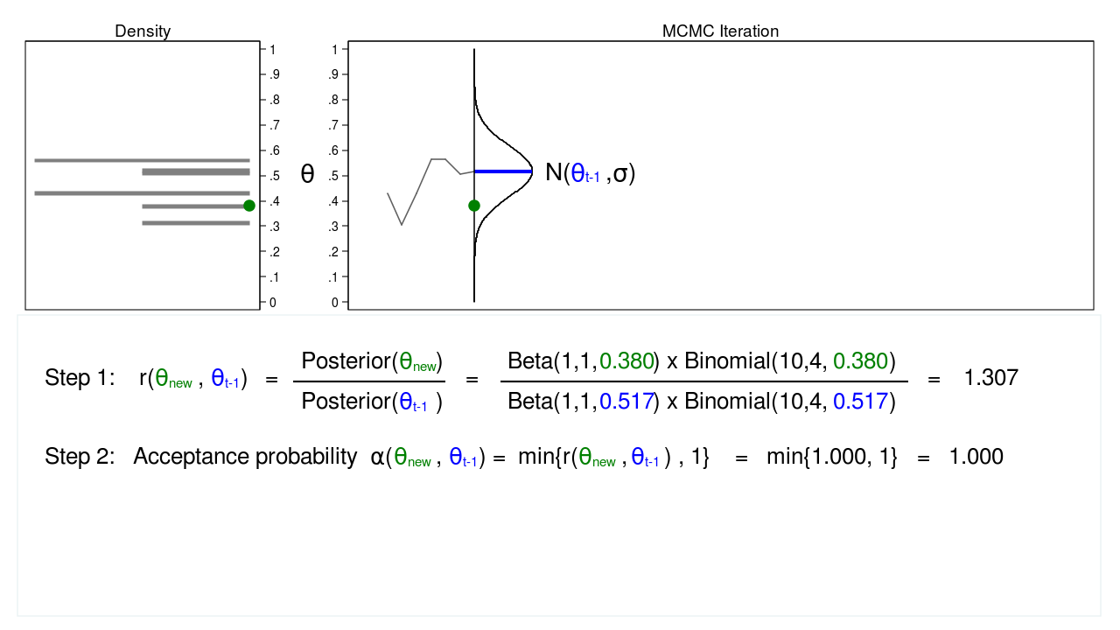
MCMC with Metropolis-Hastings

Slide 36
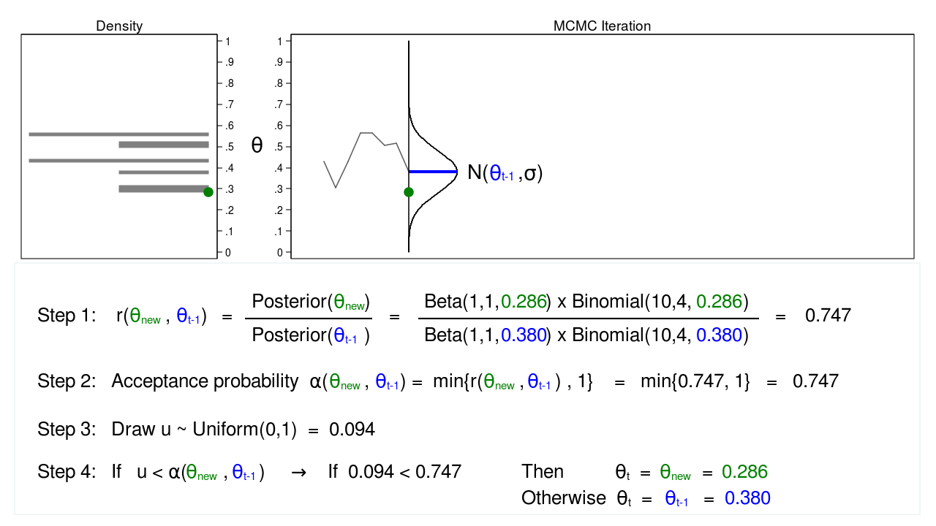
MCMC with Metropolis-Hastings

Slide 37
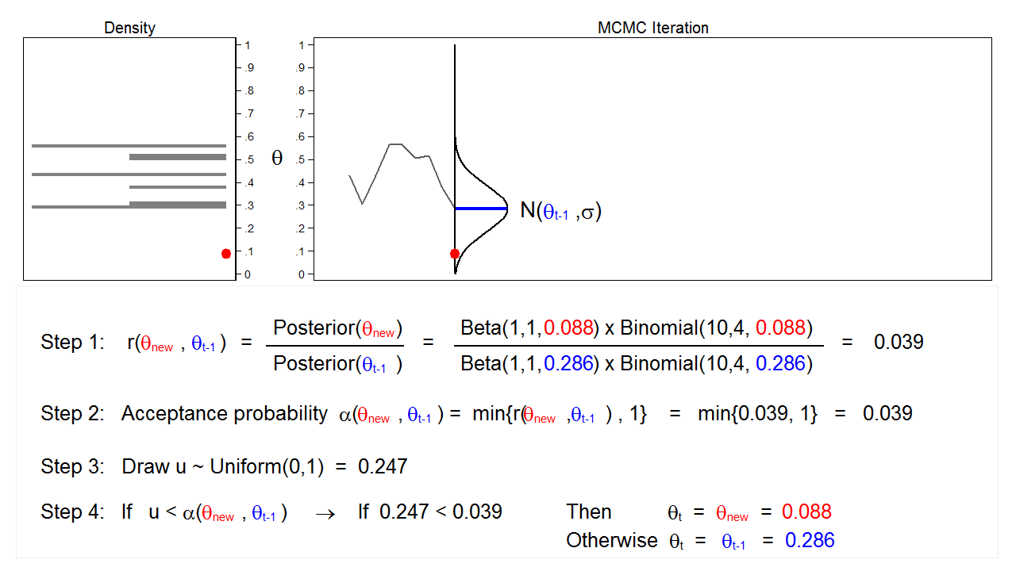
MCMC with Metropolis-Hastings

Slide 38
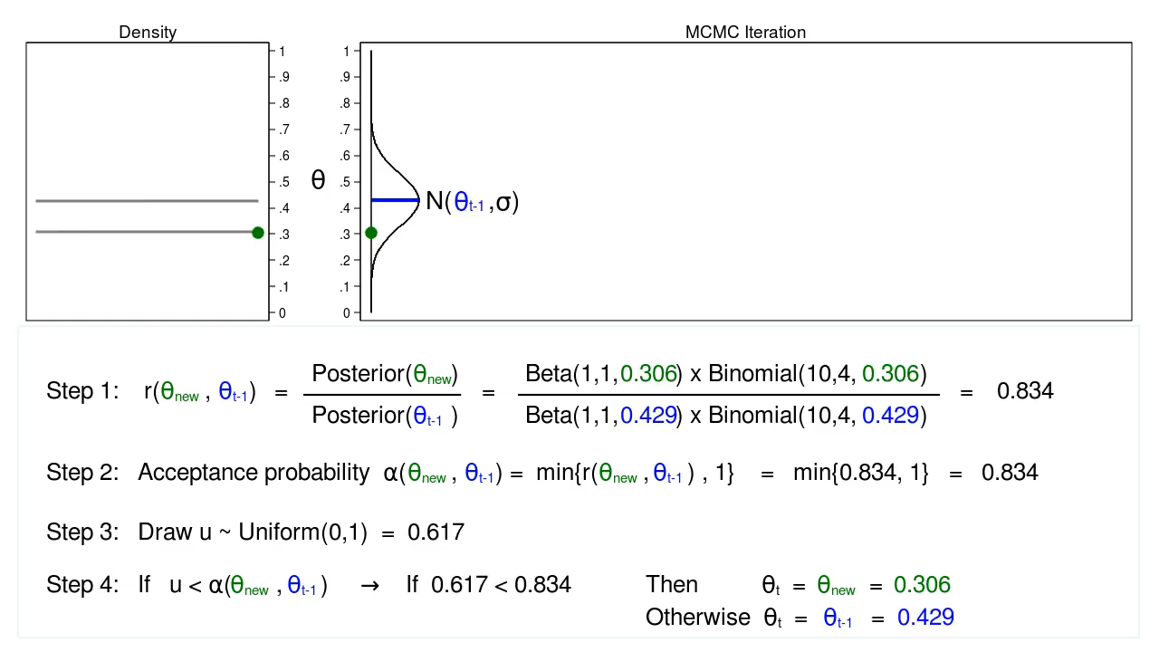
MCMC with Metropolis-Hastings

Slide 39
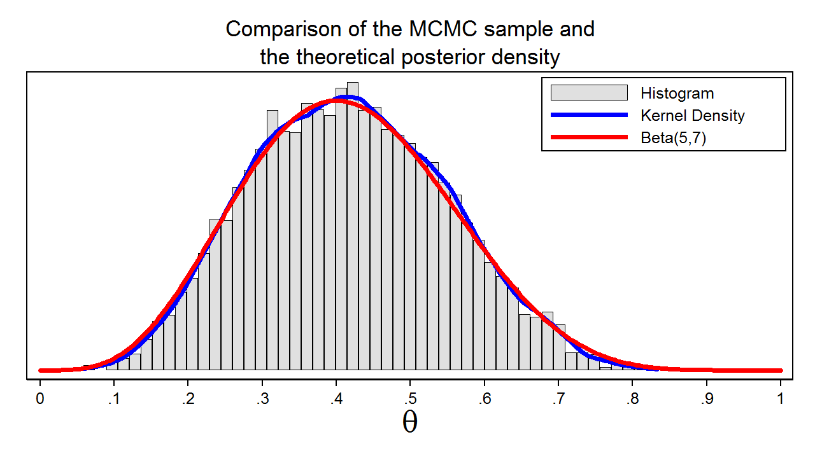
MCMC with Metropolis-Hastings

Slide 40
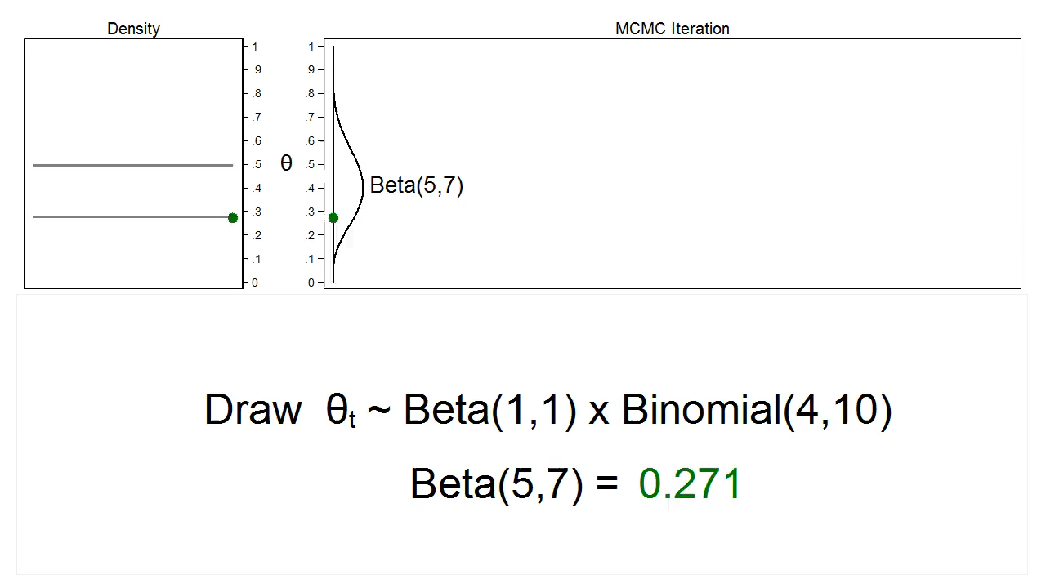
MCMC with Gibbs Sampling

Slide 41
The bayesmh command
bayesmh heads, ///
likelihood(dbernoulli({theta})) ///
prior({theta}, beta(1,1))

Slide 42
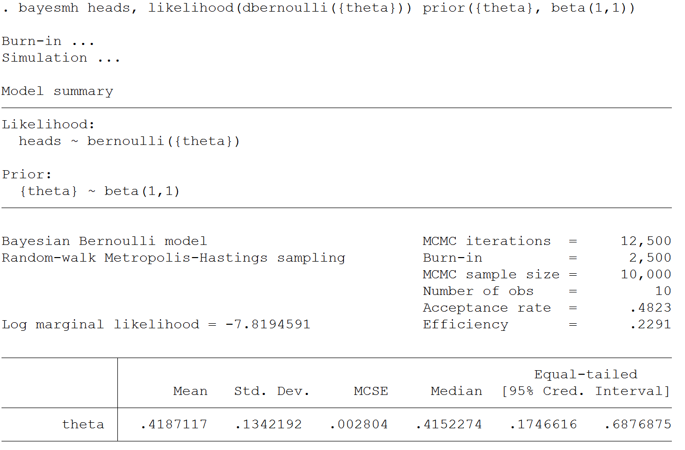

Slide 43
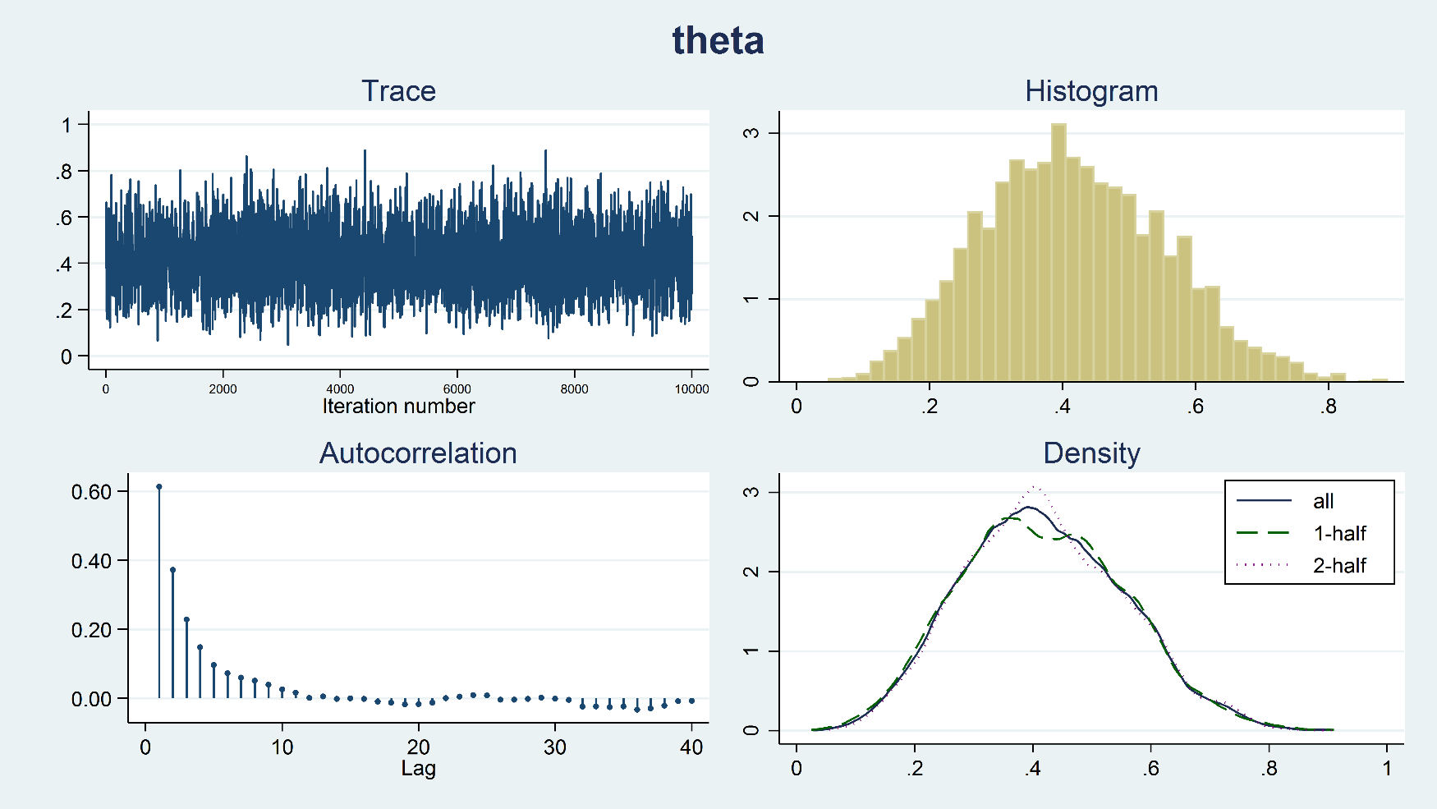
Diagnostic Plots
bayesgraph diagnostics {theta}

Slide 44
Outline
Introduction to Bayesian Analysis
Coin Toss Example
Priors, Likelihoods, and Posteriors
Markov Chain Monte Carlo (MCMC)
Bayesian Linear Regression
Bayesian Logistic Regression
Bayesian Ordinal Logistic Regression

Slide 45
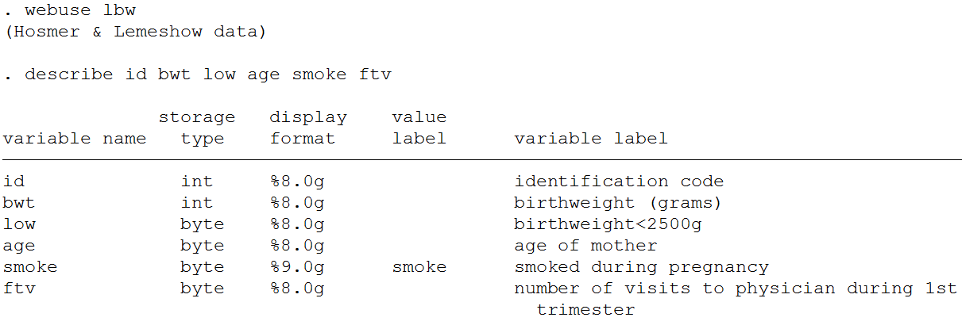
Bayesian Linear Regression

Slide 46
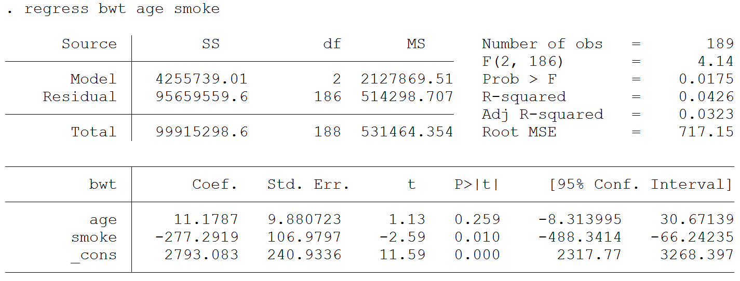
$${bwt}_{i}=β_{0}+β_{1}{age}_{i}+β_{2}{smoke}_{i}+e_{i}$$

Slide 47
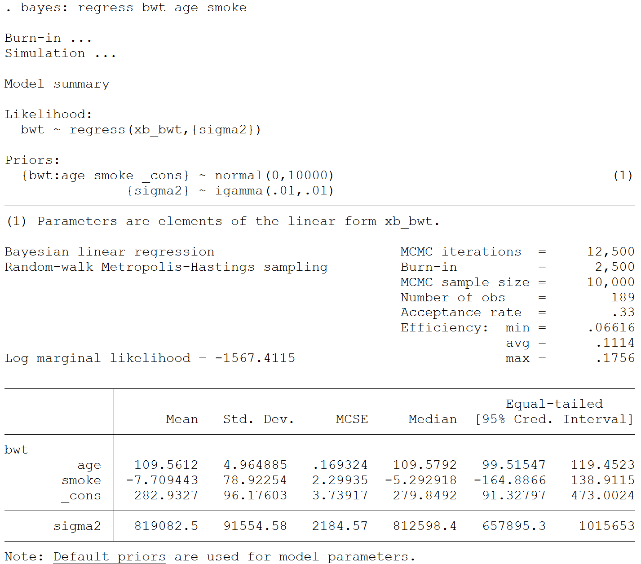

Slide 48
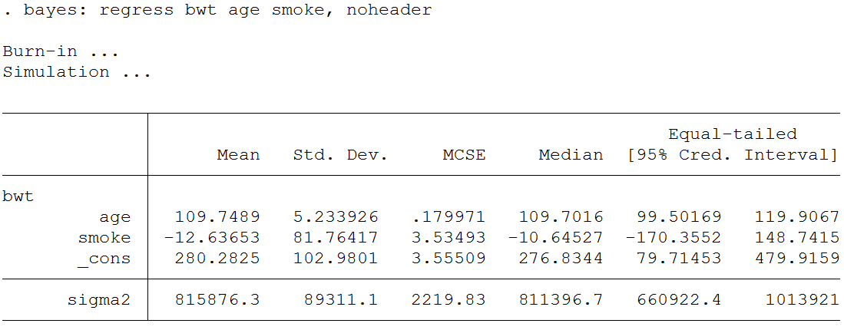
bayes options

Slide 49
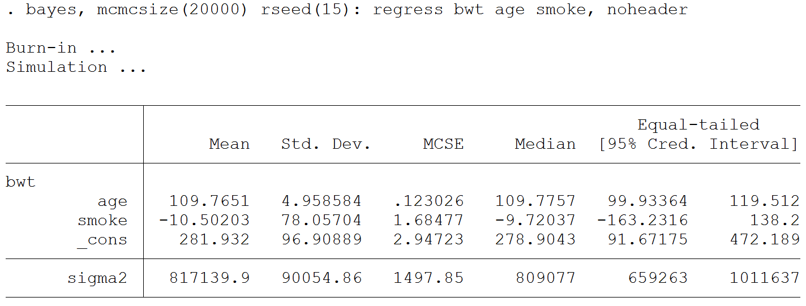
bayes options

Slide 50
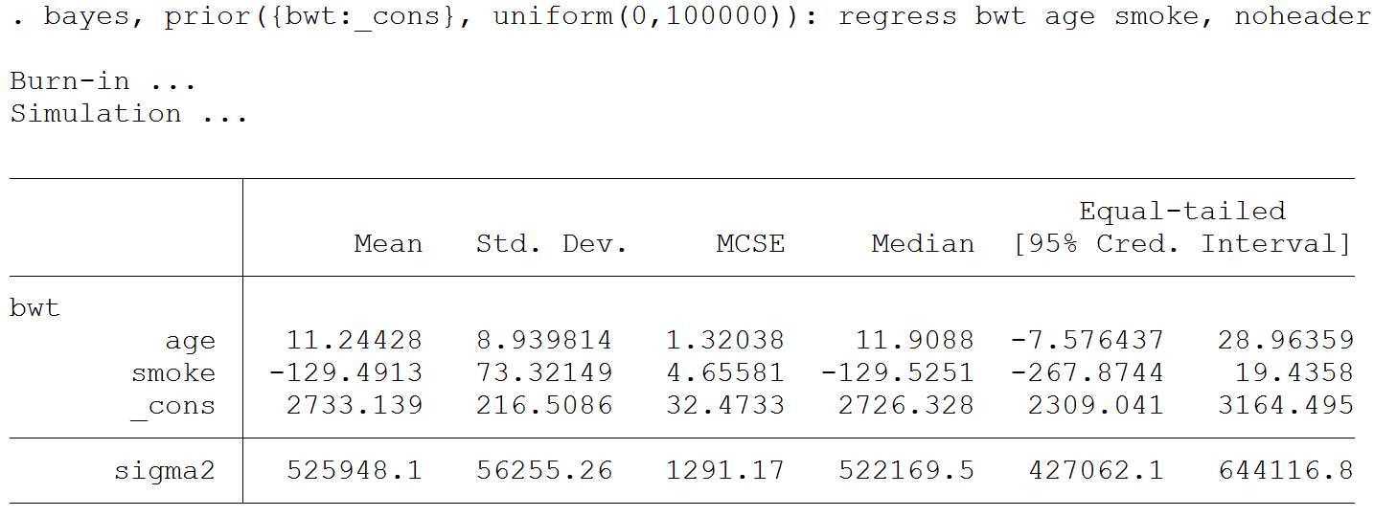
bayes options

Slide 51
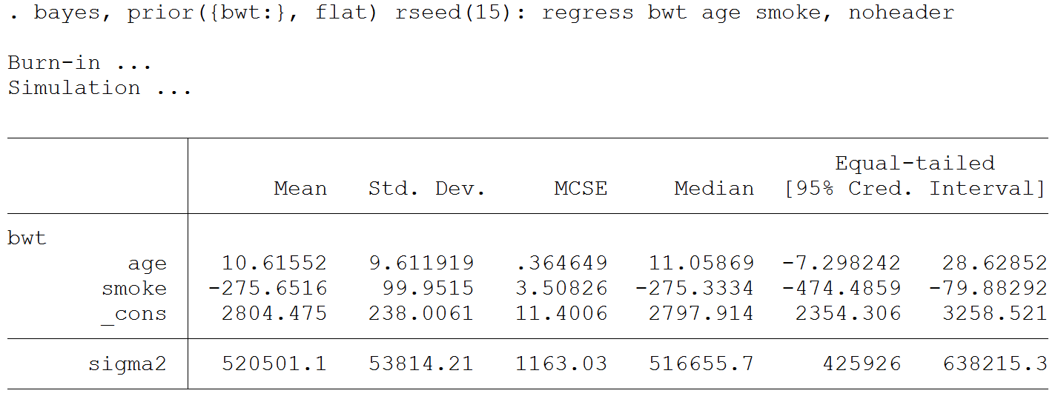
bayes options

Slide 52
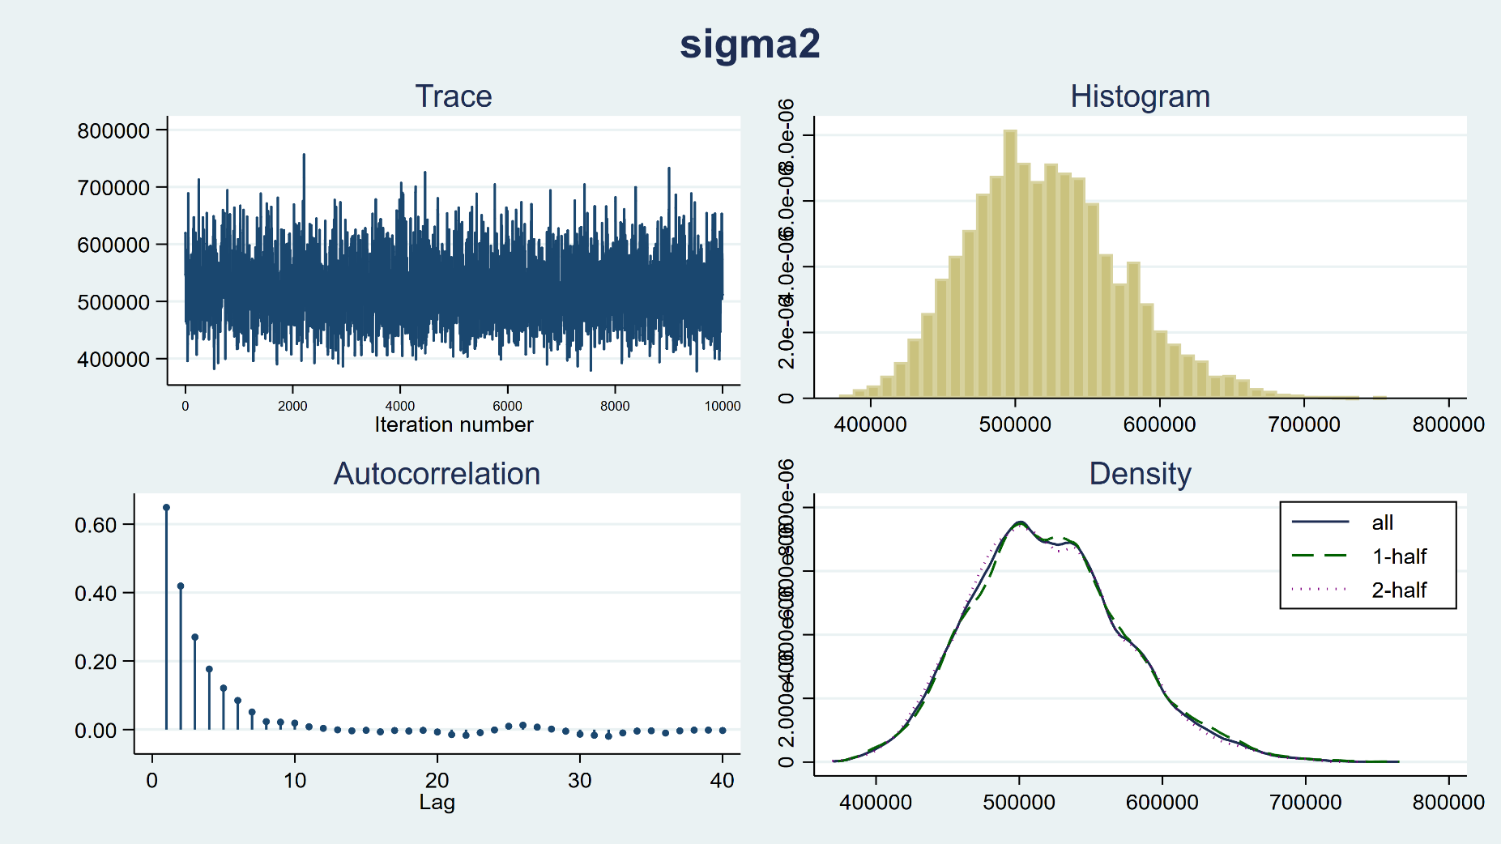
Diagnostics
bayesgraph diagnostics {sigma2}

Slide 53
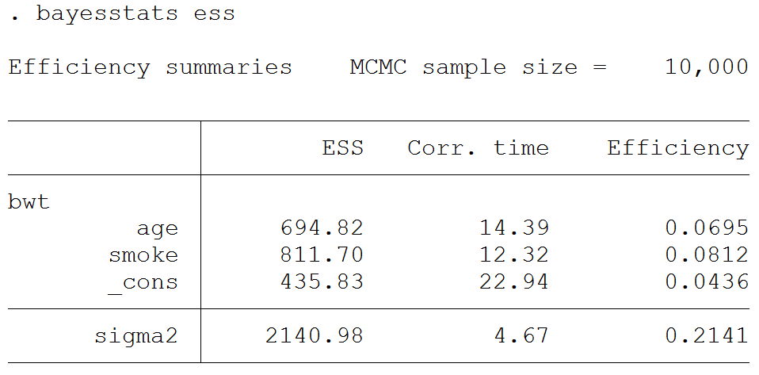
Diagnostics

Slide 54
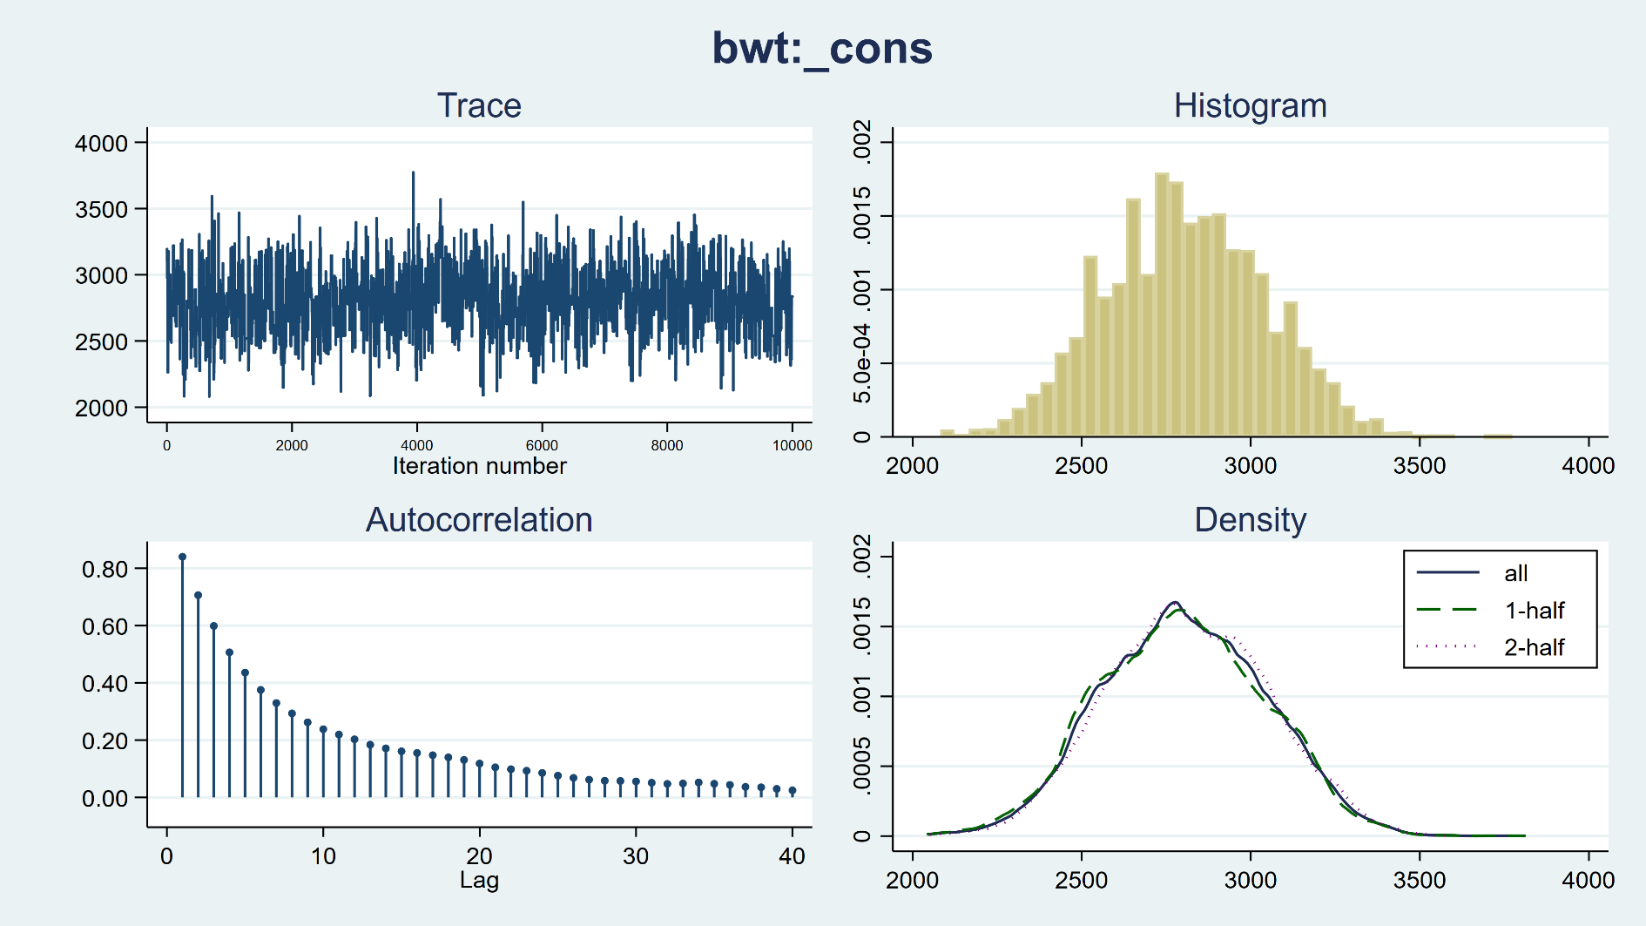
Diagnostics
bayesgraph diagnostics {bwt:_cons}

Slide 55
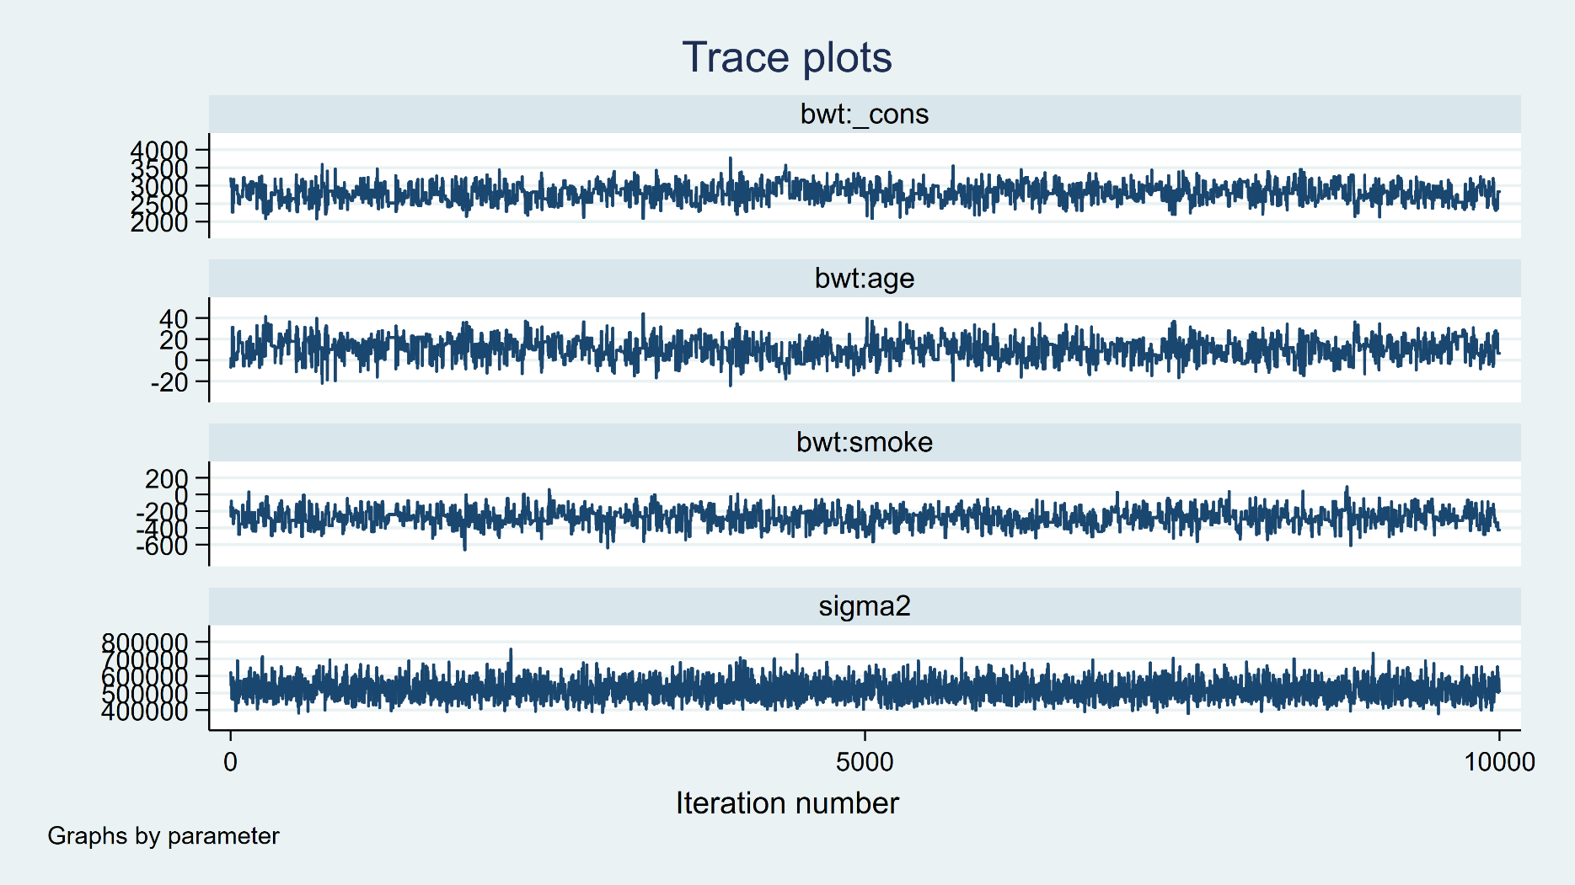
Diagnostics
bayesgraph trace {bwt: _cons age smoke} {sigma2}, byparm

Slide 56
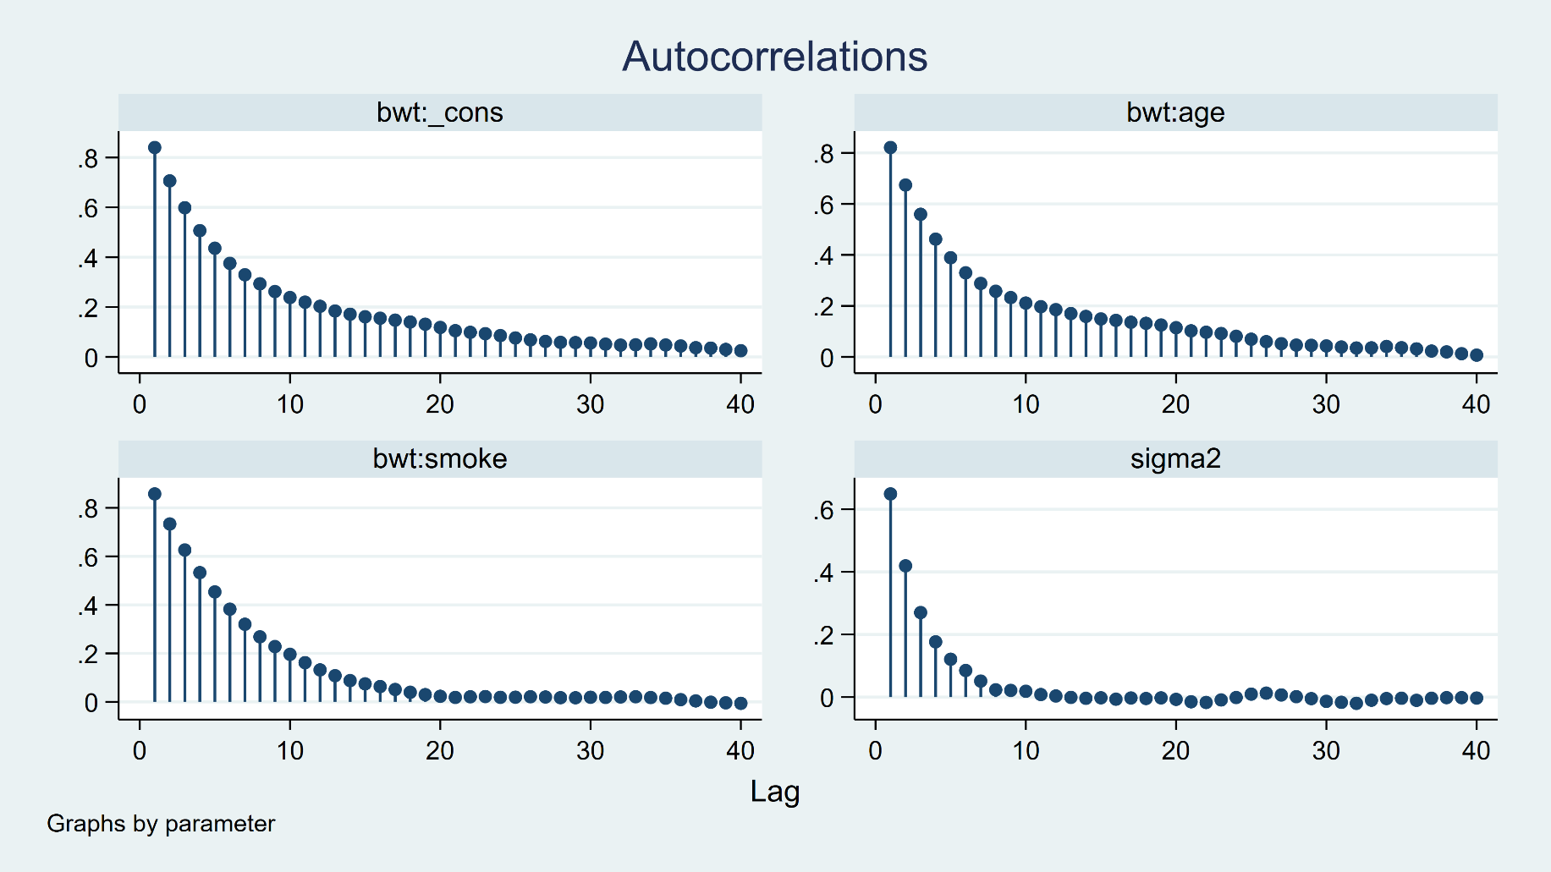
Diagnostics
bayesgraph ac {bwt: _cons age smoke} {sigma2}, byparm

Slide 57
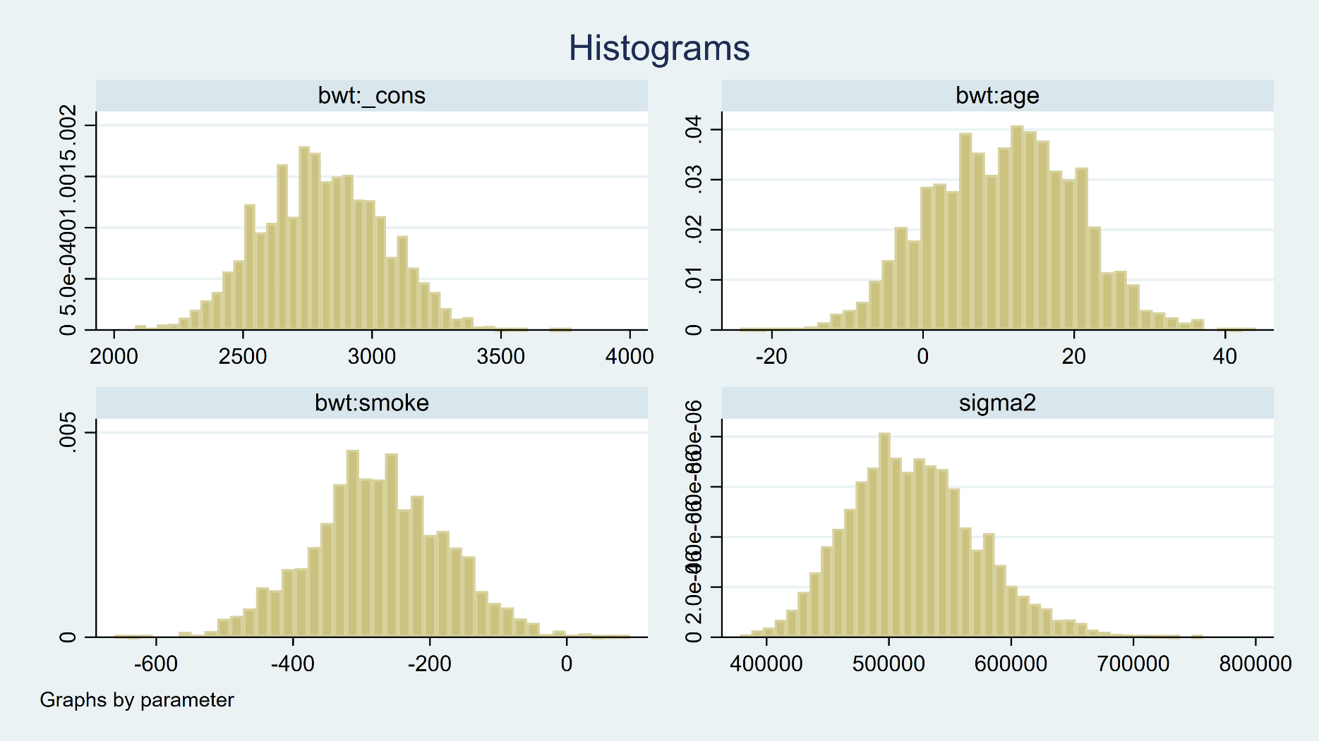
Diagnostics
bayesgraph histogram {bwt: _cons age smoke} {sigma2}, byparm

Slide 58
Bayesian Model Selection
quietly {
bayes, rseed(15): regress bwt age
estimates store age
bayes, rseed(15): regress bwt smoke
estimates store smoke
bayes, rseed(15): regress bwt age smoke
estimates store full
}

Slide 59
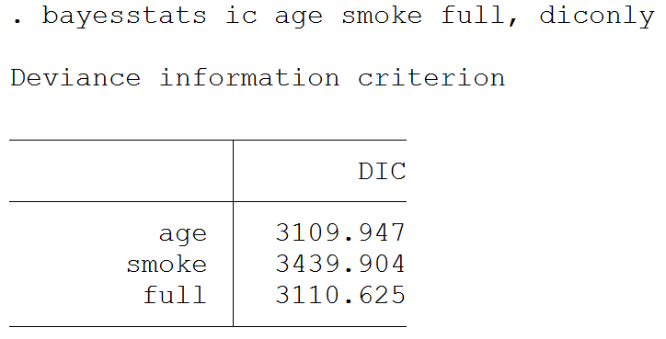
Bayesian Model Selection

Slide 60
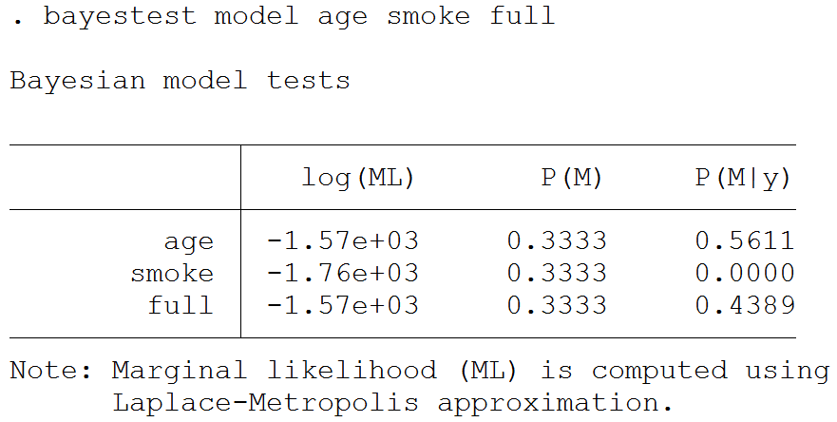
Bayesian Model Selection

Slide 61

Tests

Slide 62


Predictions
Frequentist
Bayesian

Slide 63
Outline
Introduction to Bayesian Analysis
Coin Toss Example
Priors, Likelihoods, and Posteriors
Markov Chain Monte Carlo (MCMC)
Bayesian Linear Regression
Bayesian Logistic Regression
Bayesian Ordinal Logistic Regression

Slide 64

Logistic Regression

Slide 65

Logistic Regression

Slide 66

Logistic Regression
Our model predicts that a 20 year old mother
who smoked during her pregnancy has a 0.44
probability of having a low birthweight baby.

Slide 67
Outline
Introduction to Bayesian Analysis
Coin Toss Example
Priors, Likelihoods, and Posteriors
Markov Chain Monte Carlo (MCMC)
Bayesian Linear Regression
Bayesian Logistic Regression
Bayesian Ordinal Logistic Regression

Slide 68

Ordinal Logistic Regression

Slide 69

Ordinal Logistic Regression

Slide 70


The bayes Prefix

Slide 71

The bayes Prefix

Slide 72


The bayes Prefix

Slide 73

The bayes Prefix

Slide 74
Outline
Introduction to Bayesian Analysis
Coin Toss Example
Priors, Likelihoods, and Posteriors
Markov Chain Monte Carlo (MCMC)
Bayesian Linear Regression
Bayesian Logistic Regression
Bayesian Ordinal Logistic Regression

Slide 75
Thank you!
Questions?
chuber@stata.com

