Slide 1
Using Stata with Statistics Canada data: Incorporating complex survey design into analysis
Presented: 2009 Canadian Users Stata Group Meeting
Leslie-Anne Keown, Ph.D.
&
Georgia Roberts, Ph.D.
Statistics Canada

Slide 2
Overview of Presentation
Statistics Canada- What we do
Survey Design at Statistics Canada: What makes it complex
Accounting for complex survey design in analysis
  Design based approach
  Survey weight
  Bootstrapped variance estimation

Slide 3
Statistics Canada: Our Mandate
In Canada, providing statistics is a federal responsibility. As Canada’s central statistical agency, Statistics Canada is legislated to serve this function for the whole of Canada and each of the provinces.
In addition to conducting a Census every five years, there are about 350 active surveys on virtually all aspects of Canadian life.
We at Statistics Canada are committed to protecting the confidentiality of all information entrusted to us and to ensuring that the information we deliver is timely and relevant to Canadians.

Slide 4
Survey Design at Statistics Canada
Our samples are not simple random samples (SRS) but rather complex survey designs
Many different sampling frames
Complicated by needing to protect confidentiality
Thus, we produce 'weights' to 'correct' for the fact that we do not have SRS and for non-response etc. in estimates
We produce bootstrap 'weights' or mean 'bootstrap weights' to calculate 'truer' variance estimates given the complex survey design

Slide 5
Complex Surveys
Features of complex surveys that can impact analysis:
- Stratification
- Multi-stage selection (choosing clusters)
- Unequal probabilities of selection
- Nonresponse
- Adjustments in survey weights
A complex survey
design

Slide 6
Design-based randomization
Finite Target Population
Sample 1
Survey Population
Sample i
Sampling Process

Slide 7
Infinite target population
Finite populations are generated from the infinite population.
Randomization for estimator is based on both the model and the design.
Infinite Target Population

Slide 8
DESIGN-BASED APPROACH
Survey (or sample) weighting is used to produce an estimate of each unknown quantity
Variance is measured by the variability in an estimate that would occur had different samples been selected by the same design
(called design-based variance)
    Statistics Canada uses survey bootstrapping to estimate variance for many of its household surveys.
    For more specifics see: Phillips, Owen. 2004. 'Using Bootstrap Weights with WesVar and SUDAAN.' The Research Data Centres Information and Technical Bulletin. (Fall) 1(2):1-10. Statistics Canada. Catalogue no. 12-002-XIE.

Slide 9
What is a survey weight and what type of weight should I use?
Sampling or survey weight of the i^{th} unit
≈
1 / (Probability of picking a sample containing that unit – for the particular survey design used)
[The survey weight usually also contains adjustments for nonresponse and other factors]
Stata uses the terminology 'sampling weight' or 'probability weight' or 'pweight'

Slide 10
What is a bootstrap variance estimate?
Let represent a weighted estimate of the quantity of interest using the sampling weight.
Let represent a weighted estimate of the quantity of interest using the b^{th} of B (mean) bootstrap weights.
Then the survey bootstrap estimate of variance of is
where C is the number of
bootstrap samples used for each (mean) bootstrap weight.

Slide 11
Design-based analysis with Stata : some essentials
Most commands that accept ‘pweights’ will correctly produce survey-weighted estimates of quantities of interest when using Statistics Canada data.
ONLY commands with the 'svy' prefix, combined with pweights and additional design information, will produce design-based variance estimates.
When the additional design information is in the form of ‘bootstrap weights’, particular options must be specified with the 'svy' prefix in order to produce survey bootstrap variance estimates.

Slide 12
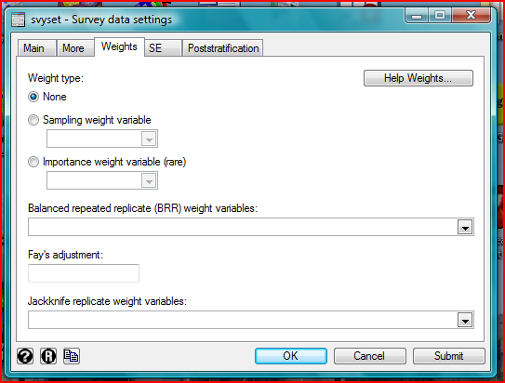

Slide 13
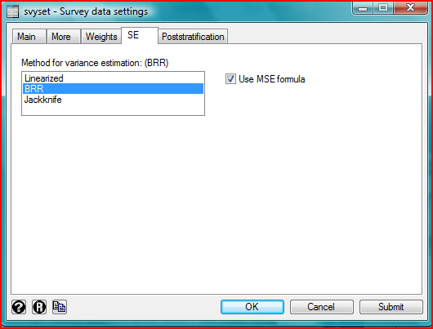

Slide 14
Specifying the correct options in svyset
Best practice is to use a svyset statement
  New users to this may want to use the dialog box to set options
Sampling weight variable : name of weight variable
BRR weight variables – usually something like wtsb_001- wtsb_500 (be careful here)
Fay’s adjustment – used if mean bootstrap weights provided (more later)
Method is BRR with MSE formula

Slide 15
Sample SVYSET statement
svyset [pweight=wght_per], brrweight(wtbs_001- wtbs_200) fay(0.8) vce(brr) mse
Element | Command Section
Sampling Weight | [pweight=wght_per]
BRR weights | brrweight(wtbs_001- wtbs_200)
Adjustment for mean bootstrap (if needed) | fay(0.8)
Variance Estimation Method | vce(brr) mse

Slide 16
Mean Bootstraps
Sometimes for confidentiality reasons and file size Statistics Canada produces ‘mean bootstrap weights’
Mean bootstrap weights (at their simplest) are a mean of a set number of bootstrap weights (e.g. – 5 bootstraps are calculated and the file shows the mean of these weights as a single weight)

Slide 17
Fay’s adjustment
Have to adjust for mean bootstraps and this is done using Fay’s adjustment
Calculate the value needed through the following formula:
1-C^{-½} where C is the number of bootstraps in each mean
Eg. C=25 so Fay’s adjustment is 0.8
Reference: Phillips, Owen. 2004. 'Using Bootstrap Weights with WesVar and SUDAAN.' The Research Data Centres Information and Technical Bulletin. (Fall) 1(2):1-10. Statistics Canada. Catalogue no. 12-002-XIE.

Slide 18
Now the analysis
Once the data is 'svyset', then analysis can be done
Need only to use the 'svy' prefix
  svy:logistic fert sex age hsdinc

Slide 19
Tips and tricks
Use a log and a do-file
'Svyset' the data at the beginning of each do-file
Do not use 'quietly' – you want to see in the output that it all went properly
Check a weighted estimate against a svy estimate
  The estimate should be the same
  The variance should be different (usually larger but not always)

Slide 20
Tips and Tricks – Check First
You can check the 'svyset' and 'svy' commands are working by using only 10 or so BRR weights to start
  Be careful: remember to reset using the full set of BRR weights

Slide 21
Tips and Tricks: Model Building
Don’t start using the 'svy' commands
  Run weighted models first using 'pweights'
Use this rule of thumb in models:
  if the p value for the estimate is .000 then it will likely remain significant
  Non-significant will remain non-significant
  ‘Marginally’ significant very likely to become non-significant

Slide 22
Tips and Tricks: Model Testing
Diagnostics and/or model testing after using Survey commands still a matter of some debate
  Do what you can
  Check to see how closely the 'weighted only' errors and 'svy' errors match. If there is not much change may consider running diagnostics on the non-svyset models
Remember – ‘Svy’ commands allow incorporation of complex survey information but do not correct for ‘operator’ error or substitute for due diligence

