Slide 1
Are Cryptocurrencies Suitable for Diversification? Cross-Country Evidence
Presenter: Prof. Jéfferson A. Colombo
Sao Paulo School of Economics, FGV
2019 Brazilian Meeting of Stata Users, December 5th 2019

Slide 2
Outline
Motivation and objectives
The Modern Portfolio Theory (mean-variance approach) in a nutshell
Stata commands to implement the core analyses of the paper
Final considerations
Notes:
Understand how returns of cryptocurrencies commove with returns of traditional assets (e.g., stocks) in a large sample of countries
Assess portfolio optimization under the mean-variance approach
- Recognize the differences in risk-return in portfolios across different countries and in a global portfolio
- Discuss the assumptions and the implications of risk-return models using traditional and non-traditional assets
- Summary and conclusions

Slide 3
Introduction – Why does it matter?
Cryptocurrencies became a major topic for individuals, researchers, and regulators in the last years
  Medium of exchange?
  Store of value?
Practical questions our project seeks to provide evidence for:
  How much should one investor hold (if so) of his/her portfolio in cryptocurrencies??
  If so, is it worth diversifying across cryptocurrencies?
  Are the optimal weights of cryptocurrencies stable over time?
Notes:
Understand how returns of cryptocurrencies commove with returns of traditional assets (e.g., stocks) in a large sample of countries
Assess portfolio optimization under the mean-variance approach
- Recognize the differences in risk-return in portfolios across different countries and in a global portfolio
- Discuss the assumptions and the implications of risk-return models using traditional and non-traditional assets
- Summary and conclusions

Slide 4
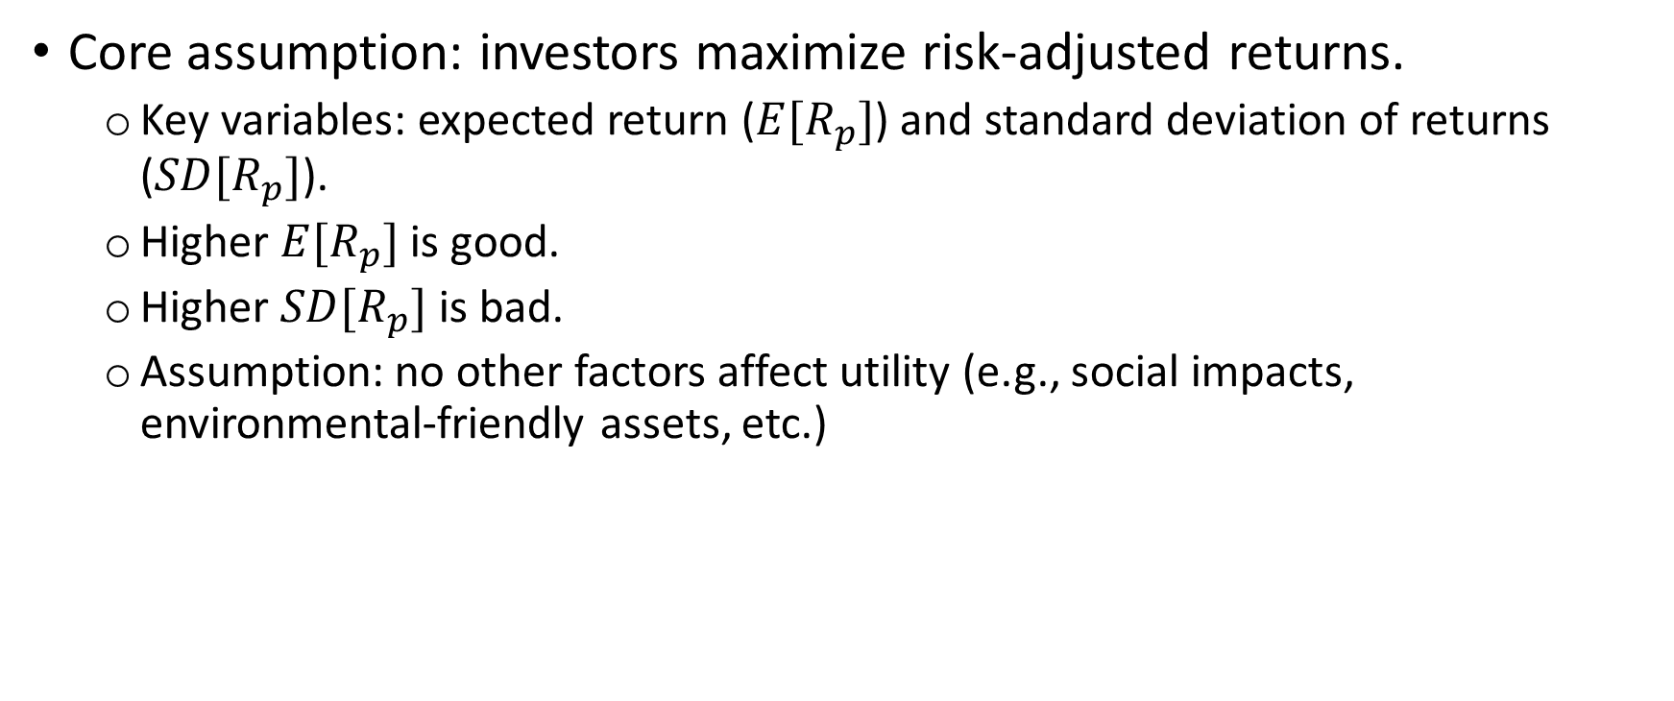
The Modern Portfolio Theory in a nutshell (1)
Core assumption: investors maximize risk-adjusted returns.
  Key variables: expected return ($E[R_{p}]$) and standard deviation of returns ($SD[R_{p}]$).
  Higher $E[R_{p}]$is good.
  Higher $SD[R_{p}]$is bad.
  Assumption: no other factors affect utility (e.g., social impacts, environmental-friendly assets, etc.)
Notes:
Understand how returns of cryptocurrencies commove with returns of traditional assets (e.g., stocks) in a large sample of countries
Assess portfolio optimization under the mean-variance approach
- Recognize the differences in risk-return in portfolios across different countries and in a global portfolio
- Discuss the assumptions and the implications of risk-return models using traditional and non-traditional assets
- Summary and conclusions

Slide 5
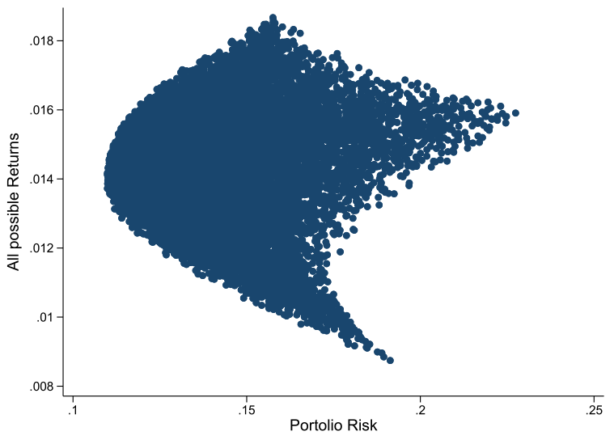
The Modern Portfolio Theory in a nutshell (2)
Figure: $E[R_{p}]$and $SD[R_{p}]$in 10,000 random allocations of XRP, BTC, ETH and LTC (weekly returns).
Higher Utility
Source: Colombo, Cruz, Cortes, and Paese (2019).
Notes:
Understand how returns of cryptocurrencies commove with returns of traditional assets (e.g., stocks) in a large sample of countries
Assess portfolio optimization under the mean-variance approach
- Recognize the differences in risk-return in portfolios across different countries and in a global portfolio
- Discuss the assumptions and the implications of risk-return models using traditional and non-traditional assets
- Summary and conclusions

Slide 6
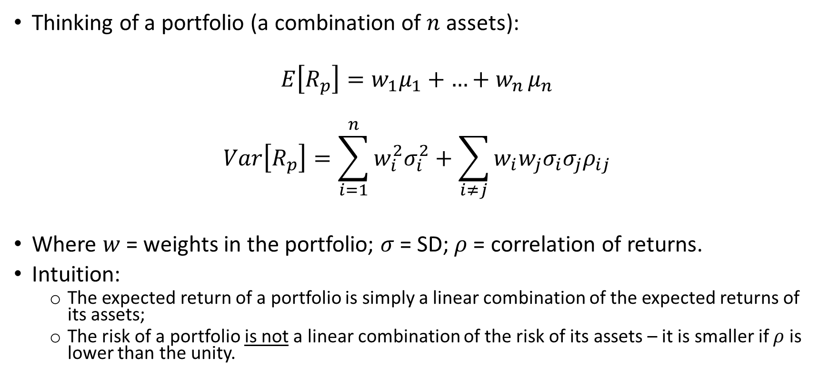
The Modern Portfolio Theory in a nutshell (3)
Thinking of a portfolio (a combination of $n$ assets):
$$E\left[R_{p}\right]=w_{1}μ_{1}+{…+w}_{n}μ_{n}$$
$$Var\left[R_{p}\right]=\sum_{i=1}^{n}{w_{i}^{2}σ_{i}^{2}}+\sum_{i≠j}{w_{i}w_{j}σ_{i}σ_{j}ρ_{ij}}$$
Where $w$ = weights in the portfolio; $σ$ = SD; $ρ$ = correlation of returns.
Intuition:
  The expected return of a portfolio is simply a linear combination of the expected returns of its assets;
  The risk of a portfolio is not a linear combination of the risk of its assets – it is smaller if $ρ$ is lower than the unity.
Notes:
Understand how returns of cryptocurrencies commove with returns of traditional assets (e.g., stocks) in a large sample of countries
Assess portfolio optimization under the mean-variance approach
- Recognize the differences in risk-return in portfolios across different countries and in a global portfolio
- Discuss the assumptions and the implications of risk-return models using traditional and non-traditional assets
- Summary and conclusions

Slide 7
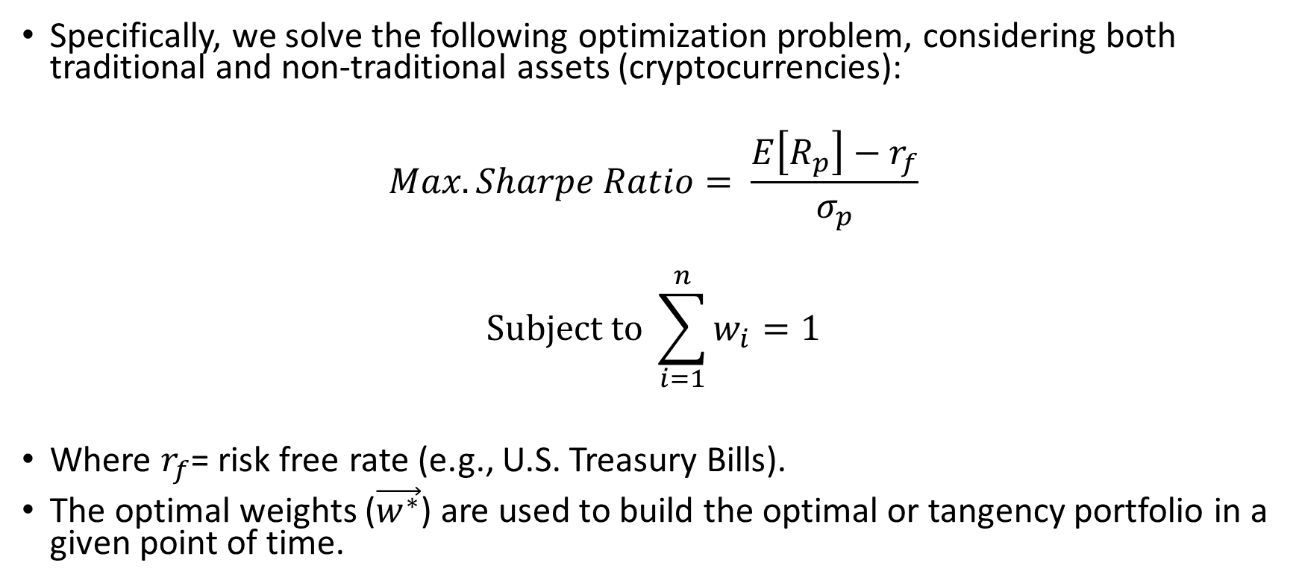
The Modern Portfolio Theory in a nutshell (4)
Specifically, we solve the following optimization problem, considering both traditional and non-traditional assets (cryptocurrencies):
$$Max. Sharpe Ratio= \frac{E\left[R_{p}\right]−r_{f}}{σ_{p}}$$
$$Subject to \sum_{i=1}^{n}{w_{i}=1}$$
Where $r_{f}$= risk free rate (e.g., U.S. Treasury Bills).
The optimal weights ($\vec{w^{∗}}$) are used to build the optimal or tangency portfolio in a given point of time.
Notes:
Understand how returns of cryptocurrencies commove with returns of traditional assets (e.g., stocks) in a large sample of countries
Assess portfolio optimization under the mean-variance approach
- Recognize the differences in risk-return in portfolios across different countries and in a global portfolio
- Discuss the assumptions and the implications of risk-return models using traditional and non-traditional assets
- Summary and conclusions

Slide 8
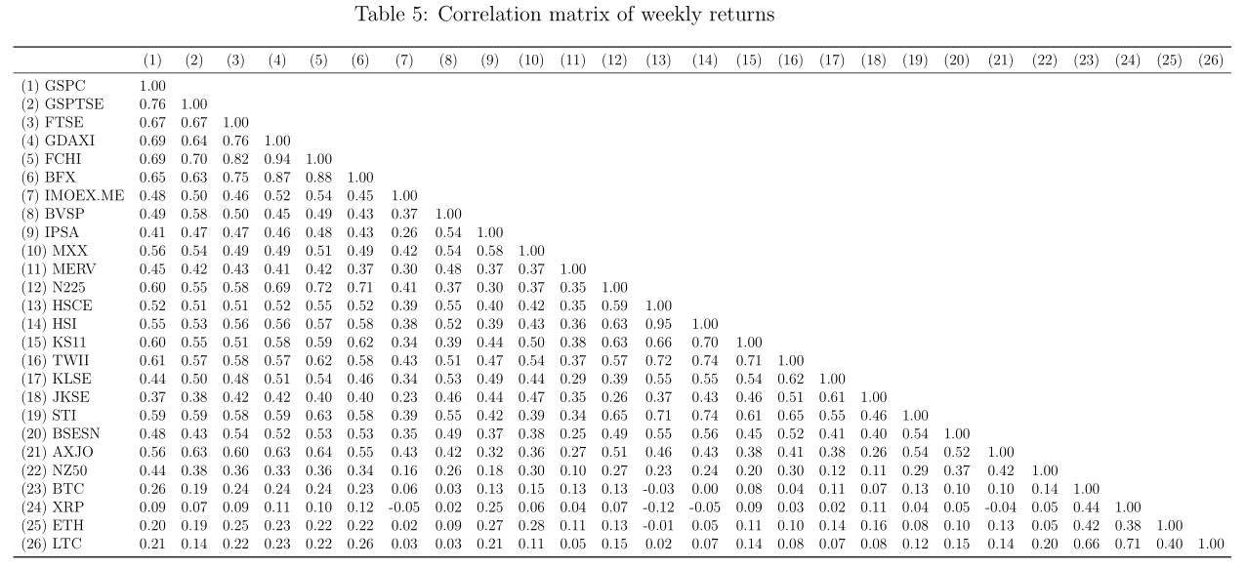
Correlation matrix: potential diversification benefits
Stock Market Indexes
Avg. = 0.49
Stock Market Indexes and Cryptocurrencies
Avg. = 0.11
Cryptocurrencies
Avg. = 0.50
Source: Colombo, Cruz, Cortes, and Paese (2019).
Notes:
Understand how returns of cryptocurrencies commove with returns of traditional assets (e.g., stocks) in a large sample of countries
Assess portfolio optimization under the mean-variance approach
- Recognize the differences in risk-return in portfolios across different countries and in a global portfolio
- Discuss the assumptions and the implications of risk-return models using traditional and non-traditional assets
- Summary and conclusions

Slide 9
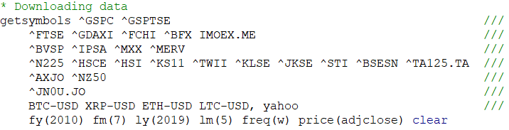
Stata code for implementation
Command: getsymbols – collects and integrates one or more time series from Quandl.com, Google Finance, Yahoo Finance, and Alpha Vantage.
  User written package: Alberto Dorantes (2017).
Source of data: Yahoo Finance.
  Gets data from both stock market indexes and cryptocurrencies:
Tickers should match those used in the source of data (e.g., Yahoo Finance)
Sample period
Frequency
Source of data
Type of information to be downloaded
Notes:
Understand how returns of cryptocurrencies commove with returns of traditional assets (e.g., stocks) in a large sample of countries
Assess portfolio optimization under the mean-variance approach
- Recognize the differences in risk-return in portfolios across different countries and in a global portfolio
- Discuss the assumptions and the implications of risk-return models using traditional and non-traditional assets
- Summary and conclusions

Slide 10
Stata code for implementation
Steps until the final sample
  Check availability of data
    Dropped Israel and South Africa
  Option “casewise” to keep only non-missing observations for all periods and assets
Portfolio optimization: package mvport
  User-written command: Alberto Dorantes (2013)
  ssc install mvport
    mvport: Calculates the Minimum Variance financial portfolio given a specific required rate of return and a set of financial returns.
Notes:
Understand how returns of cryptocurrencies commove with returns of traditional assets (e.g., stocks) in a large sample of countries
Assess portfolio optimization under the mean-variance approach
- Recognize the differences in risk-return in portfolios across different countries and in a global portfolio
- Discuss the assumptions and the implications of risk-return models using traditional and non-traditional assets
- Summary and conclusions

Slide 11
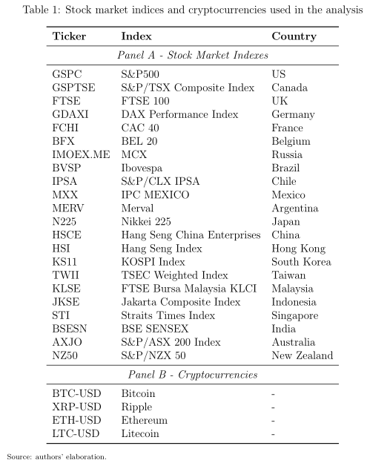
Sample
Notes:
Understand how returns of cryptocurrencies commove with returns of traditional assets (e.g., stocks) in a large sample of countries
Assess portfolio optimization under the mean-variance approach
- Recognize the differences in risk-return in portfolios across different countries and in a global portfolio
- Discuss the assumptions and the implications of risk-return models using traditional and non-traditional assets
- Summary and conclusions

Slide 12

a) Command simport
Simport: Simulates and makes a graph of random portfolios with non-negative weights given a set of stock returns.
Sets the number of portfolios
Source: Colombo, Cruz, Cortes, and Paese (2019).
Notes:
Understand how returns of cryptocurrencies commove with returns of traditional assets (e.g., stocks) in a large sample of countries
Assess portfolio optimization under the mean-variance approach
- Recognize the differences in risk-return in portfolios across different countries and in a global portfolio
- Discuss the assumptions and the implications of risk-return models using traditional and non-traditional assets
- Summary and conclusions

Slide 13
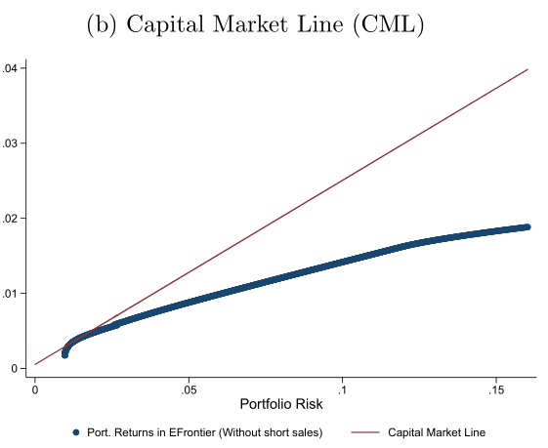
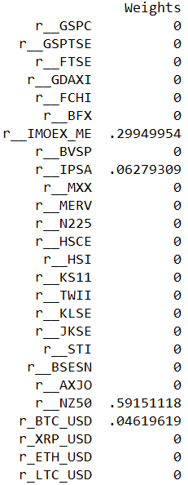
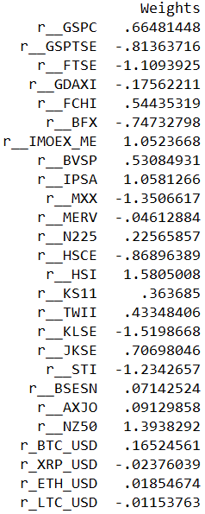
b) Command cmline
cmline - generates and graph the efficient frontier along with the capital market line when adding a risk-free asset.
a) No short sales
b) With Short Sales
Option: no short sales
Risk free rate
Source: Colombo, Cruz, Cortes, and Paese (2019).
Notes:
Understand how returns of cryptocurrencies commove with returns of traditional assets (e.g., stocks) in a large sample of countries
Assess portfolio optimization under the mean-variance approach
- Recognize the differences in risk-return in portfolios across different countries and in a global portfolio
- Discuss the assumptions and the implications of risk-return models using traditional and non-traditional assets
- Summary and conclusions

Slide 14
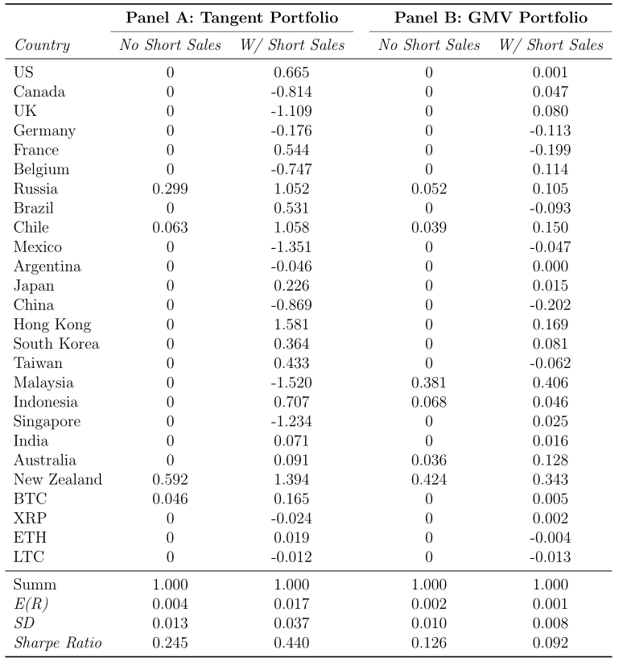
Source: Colombo, Cruz, Cortes, and Paese (2019) – Table 4 - Global optimal portfolio considering all stock market indices and crytocurrencies.
Notes:
Understand how returns of cryptocurrencies commove with returns of traditional assets (e.g., stocks) in a large sample of countries
Assess portfolio optimization under the mean-variance approach
- Recognize the differences in risk-return in portfolios across different countries and in a global portfolio
- Discuss the assumptions and the implications of risk-return models using traditional and non-traditional assets
- Summary and conclusions

Slide 15
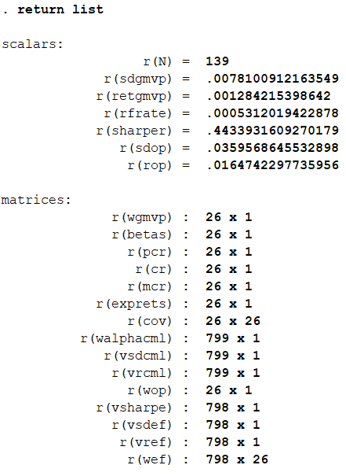
b) Command cmline
cmline stores the weights for both the weights of the optimal portfolio (tangent portfolio) and the global minimum variance portfolio (GMVP).
Other stored results:
  Return
  SD
  Sharpe ratio
  Betas
Optimal weights of the GMVP portfolio
Optimal weights of the tangent portfolio
Notes:
Understand how returns of cryptocurrencies commove with returns of traditional assets (e.g., stocks) in a large sample of countries
Assess portfolio optimization under the mean-variance approach
- Recognize the differences in risk-return in portfolios across different countries and in a global portfolio
- Discuss the assumptions and the implications of risk-return models using traditional and non-traditional assets
- Summary and conclusions

Slide 16
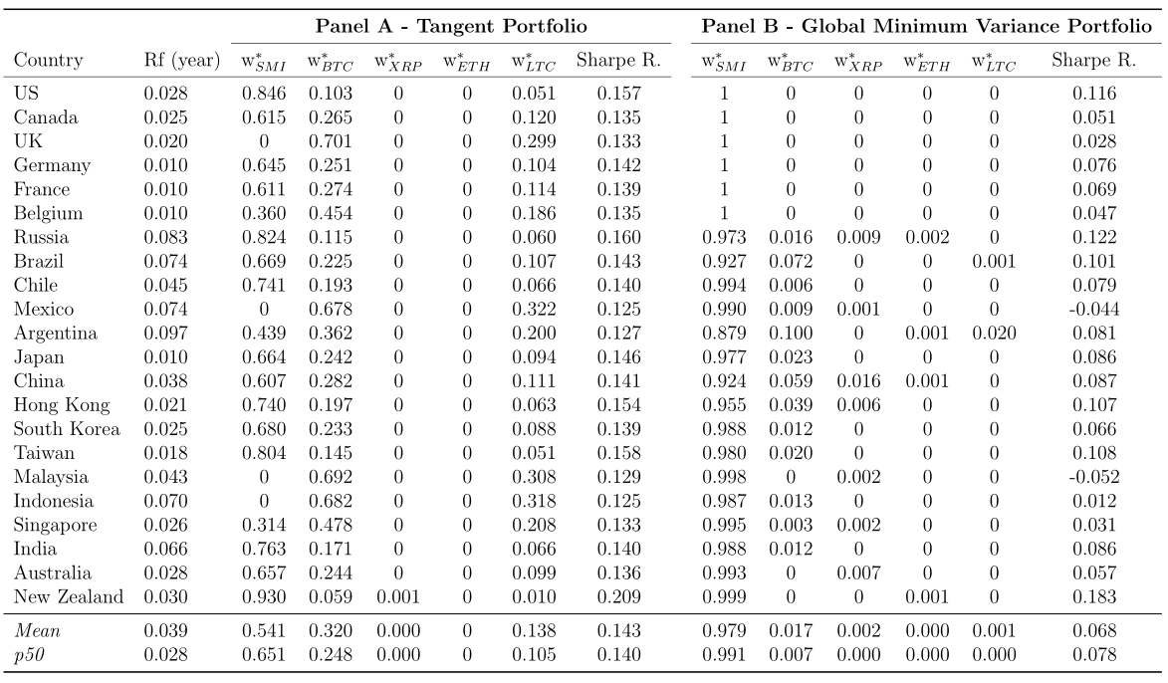
b) Command cmline
Source: Colombo, Cruz, Cortes, and Paese (2019) – Table 3 - Optimal weights for the tangent and the global minimum variance portfolios, by country.
Notes:
Understand how returns of cryptocurrencies commove with returns of traditional assets (e.g., stocks) in a large sample of countries
Assess portfolio optimization under the mean-variance approach
- Recognize the differences in risk-return in portfolios across different countries and in a global portfolio
- Discuss the assumptions and the implications of risk-return models using traditional and non-traditional assets
- Summary and conclusions

Slide 17
Important question: Are the optimal weights stable over time?
Rolling window optimizations
  Time-varying risk-free rates (U.S. 10y Treasury Bonds)
  Global portfolios (stock market indexes + cryptocurrencies)
  52 weeks rolling windows
  Period-by-period optimization using the cmline comand
Source: Colombo, Cruz, Cortes, and Paese (2019) – Table 4 - Global optimal portfolio considering all stock market indices and crytocurrencies.
Notes:
Understand how returns of cryptocurrencies commove with returns of traditional assets (e.g., stocks) in a large sample of countries
Assess portfolio optimization under the mean-variance approach
- Recognize the differences in risk-return in portfolios across different countries and in a global portfolio
- Discuss the assumptions and the implications of risk-return models using traditional and non-traditional assets
- Summary and conclusions

Slide 18
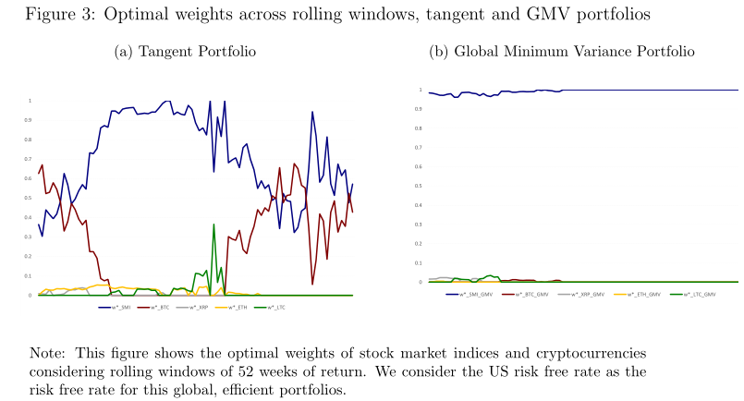
Important question: Are the optimal weights stable over time?
Source: Colombo, Cruz, Cortes, and Paese (2019) – Figure 3.
Notes:
Understand how returns of cryptocurrencies commove with returns of traditional assets (e.g., stocks) in a large sample of countries
Assess portfolio optimization under the mean-variance approach
- Recognize the differences in risk-return in portfolios across different countries and in a global portfolio
- Discuss the assumptions and the implications of risk-return models using traditional and non-traditional assets
- Summary and conclusions

Slide 19
Further commands for portfolio analysis in the MVPORT package
backtest - performs a backtest of a financial portfolio. It calculates the holding period return of a specific portfolio
cbacktest – performs a cumulative backtest of a financial portfolio.
gmvport - calculates the global minimum variance portfolio of a set of continuously compounded returns following Portfolio Theory.
Notes:
Understand how returns of cryptocurrencies commove with returns of traditional assets (e.g., stocks) in a large sample of countries
Assess portfolio optimization under the mean-variance approach
- Recognize the differences in risk-return in portfolios across different countries and in a global portfolio
- Discuss the assumptions and the implications of risk-return models using traditional and non-traditional assets
- Summary and conclusions

Slide 20
Final considerations
MVPORT: user-written Stata package for portfolio optimization
MVPORT + GETSYMBOLS: flexible way to download and analyze data for several asset classes
  Stock market indexes
  Cryptocurrencies
  Stocks
  Bonds
  Commodities, etc.
Makes portfolio optimization and analyses using Stata pretty easy
Notes:
Understand how returns of cryptocurrencies commove with returns of traditional assets (e.g., stocks) in a large sample of countries
Assess portfolio optimization under the mean-variance approach
- Recognize the differences in risk-return in portfolios across different countries and in a global portfolio
- Discuss the assumptions and the implications of risk-return models using traditional and non-traditional assets
- Summary and conclusions

Slide 21
Thank you!
Jefferson A. Colombo
Assistant Professor of Finance
Sao Paulo School of Economics
jefferson.colombo@fgv.br

Slide 22
References
Alberto Dorantes, 2013. "MVPORT: Stata module for Collection, Optimization and Backtest of Financial Portfolios," Statistical Software Components S457712, Boston College Department of Economics, revised 02 Sep 2016.
Alberto Dorantes, 2017. "GETSYMBOLS: Stata module to collect and integrate one or more series from Quandl.com, Google Finance, Yahoo Finance, and Alpha Vantage," Statistical Software Components S458421, Boston College Department of Economics.
Colombo, J. A.; Cruz, F. I. L.; Cortes, R. X.; Paese, L. H. Z. Are Cryptocurrencies Suitable for Portfolio Diversification? Cross-Country Evidence. Working paper. In: 47th Brazilian National Meeting of Economics (ANPEC). Available at: < https://www.anpec.org.br/encontro/2019/submissao/files_I/i8-a2719c2b29132625fa99c7f2b5ed47c3.pdf>. Retrieved November 23rd, 2019.
Notes:
Understand how returns of cryptocurrencies commove with returns of traditional assets (e.g., stocks) in a large sample of countries
Assess portfolio optimization under the mean-variance approach
- Recognize the differences in risk-return in portfolios across different countries and in a global portfolio
- Discuss the assumptions and the implications of risk-return models using traditional and non-traditional assets
- Summary and conclusions

