Slide 1
charon : A command to study the impact of different correction methods on cancer mortality trends and magnitude
Brazilian Stata Conference
São Paulo, December 5th 2019
Alessandro Bigoni
Epidemiology Department
University of São Paulo (USP)
School of Public Health (FSP)
alebigoni@usp.br

Slide 2
Background & Motivation
Department of Epidemiology
Thesis title: Trend and magnitude of cancer mortality in Brazil and its relationship with socioeconomic conditions and health care provision
Estimate
Describe
Analyze
A. Bigoni
charon : A command to study the impact of different correction methods on cancer mortality trends and magnitude
December 5th

Slide 3
Background & Motivation
Department of Epidemiology
Thesis title: Trend and magnitude of cancer mortality in Brazil and its relationship with socioeconomic conditions and health care provision
Estimate
Describe
Analyze
A. Bigoni
charon : A command to study the impact of different correction methods on cancer mortality trends and magnitude
December 5th

Slide 4
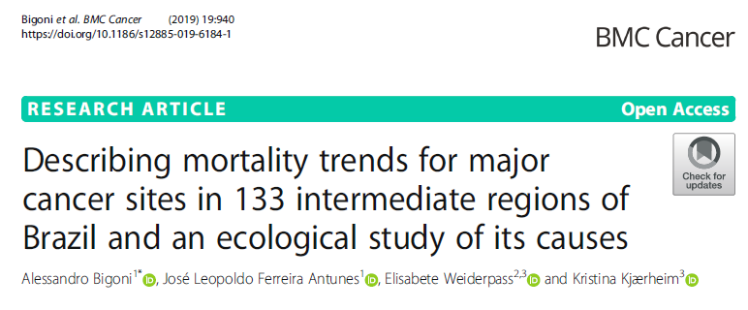
Background & Motivation
A. Bigoni
charon : A command to study the impact of different correction methods on cancer mortality trends and magnitude
December 5th

Slide 5
The problem
Underreporting
Low-quality death registration
Geographical differences
Improvement over time
No consensus on the use of correction methods
A. Bigoni
charon : A command to study the impact of different correction methods on cancer mortality trends and magnitude
December 5th

Slide 6
Methods used
A. Bigoni
charon : A command to study the impact of different correction methods on cancer mortality trends and magnitude
December 5th

Slide 7
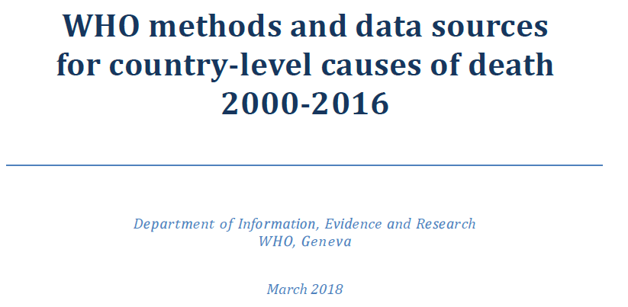
Method: WHO
A. Bigoni
charon : A command to study the impact of different correction methods on cancer mortality trends and magnitude
December 5th

Slide 8
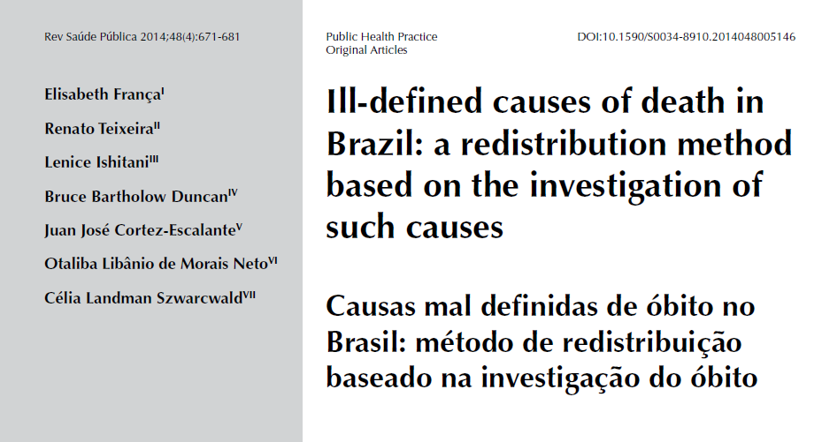
Method: Elisabete França
A. Bigoni
charon : A command to study the impact of different correction methods on cancer mortality trends and magnitude
December 5th

Slide 9
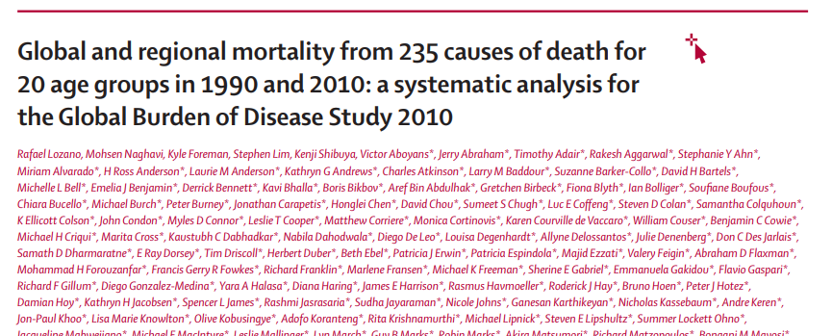
Method: GBD
A. Bigoni
charon : A command to study the impact of different correction methods on cancer mortality trends and magnitude
December 5th

Slide 10
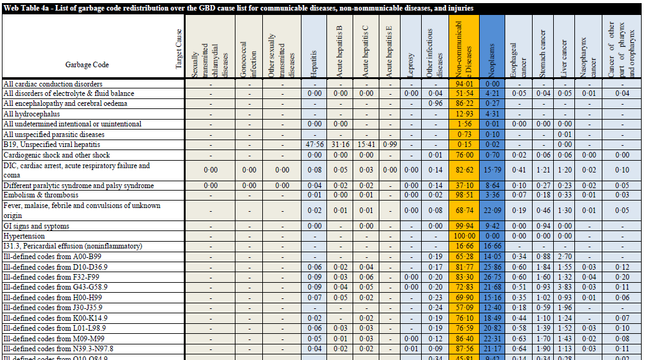
Method: GBD
A. Bigoni
charon : A command to study the impact of different correction methods on cancer mortality trends and magnitude
December 5th

Slide 11
charon
charon varname, cancer() doption() geolevel() adjust() steps() [tableupdate]
A. Bigoni
charon : A command to study the impact of different correction methods on cancer mortality trends and magnitude
December 5th

Slide 12

charon
A. Bigoni
charon : A command to study the impact of different correction methods on cancer mortality trends and magnitude
December 5th

Slide 13
charon varname, can() dop() geo() adj() steps()
causabas
causabas_o
linhaa
linhab
linhac
linhad
linhaii
A. Bigoni
charon : A command to study the impact of different correction methods on cancer mortality trends and magnitude
December 5th

Slide 14
charon varname, can() dop() geo() adj() steps()
All neoplasms | neopla
Lip and oral cavity cancer | lipora
Nasopharynx cancer | nasoph
Esophageal cancer | esopha
Stomach cancer | stomac
Colon and rectum cancer | colon
Liver cancer | liver
Leukemia | leukem
Chronic myeloid leukemia | chromy
Hodgkin lymphoma | hodgki
Non-Hodgkin lymphoma |nonhod
Thyroid cancer | thyroi
Prostate cancer |prosta
Cervical cancer | cervic
[...]+27
A. Bigoni
charon : A command to study the impact of different correction methods on cancer mortality trends and magnitude
December 5th

Slide 15
charon varname, can() dop() geo() adj() steps()
can( ) | dop( withdcodes ) | dop( nodcodes )
lipora | C00-C089 D100-D105 D11-D119 | C00-C089
nasoph | C11-C119 D106 | C11-C119
esoph | C15-C159 D001-D130 | C15-C159
stomac | C16-C169 D002 D131 D371 | C16-C169
colon | C18-C219 D010-D013 D12-D129 D373-D375 | C18-C219
liver | C22-C229 D134 | C22-C229
leukem | C53-C539 D06-D069 D260 | C53-C539
prosta | C61-C619 D075 D291 D400 | C61-C619
cervic | C53-C539 D06-D069 D260 | C53-C539
[…] | […] | […]
A. Bigoni
charon : A command to study the impact of different correction methods on cancer mortality trends and magnitude
December 5th

Slide 16
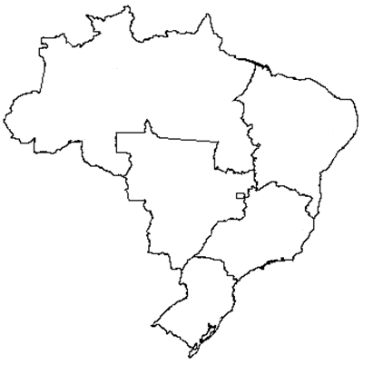
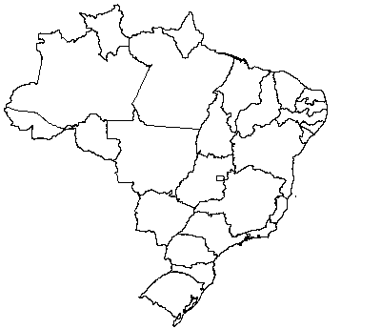
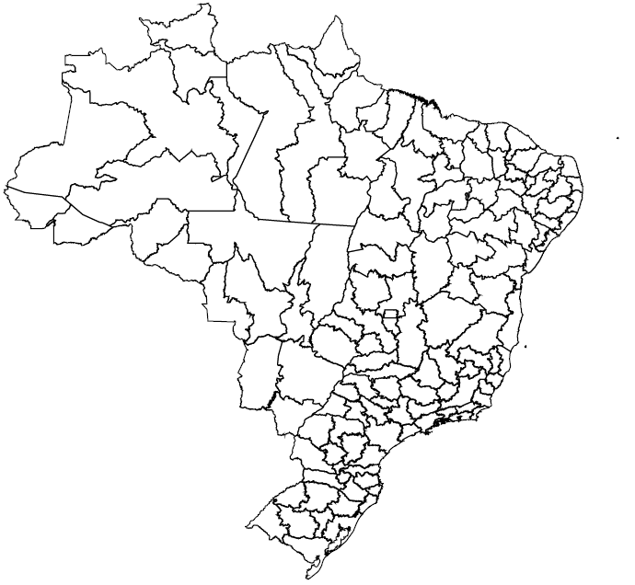
charon varname, can() dop() geo() adj() steps()
geo( macroreg )
geo( state )
geo( reginter )
A. Bigoni
charon : A command to study the impact of different correction methods on cancer mortality trends and magnitude
December 5th

Slide 17
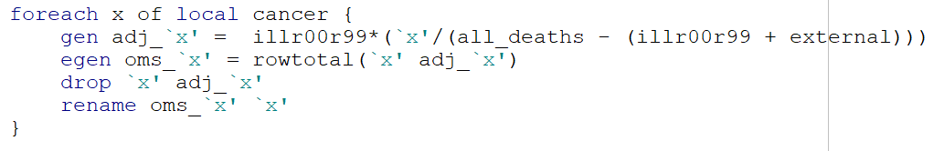
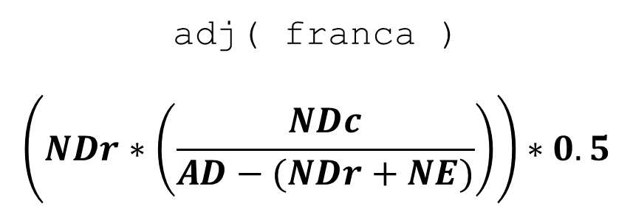
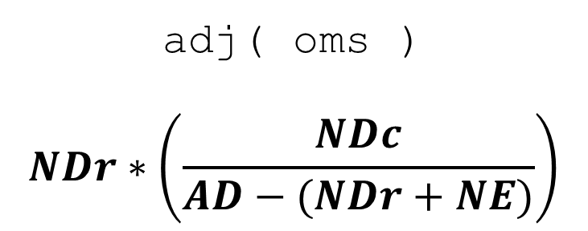
charon varname, can() dop() geo() adj() steps()
adj( oms )
$$NDr∗\left(\frac{NDc}{AD−(NDr+NE)}\right)$$
adj( franca )
$$\left(NDr∗\left(\frac{NDc}{AD−(NDr+NE)}\right)\right)∗0.5$$
A. Bigoni
charon : A command to study the impact of different correction methods on cancer mortality trends and magnitude
December 5th

Slide 18
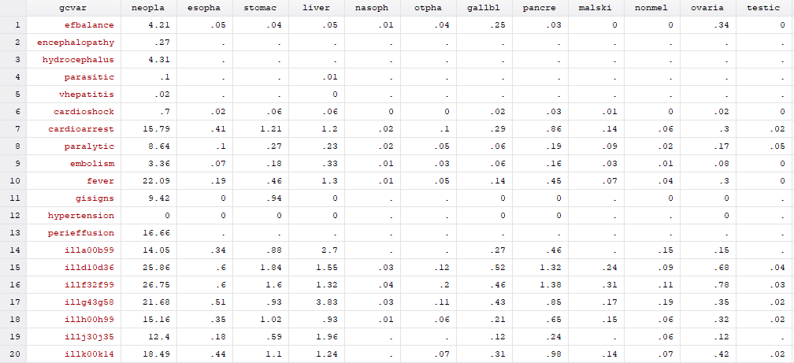
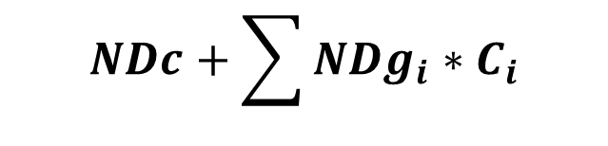
charon varname, can() dop() geo() adj() steps()
$$NDc+\sum{{NDg}_{i}∗C_{i}}$$
adj( GBD ) [tableupdate]
A. Bigoni
charon : A command to study the impact of different correction methods on cancer mortality trends and magnitude
December 5th

Slide 19
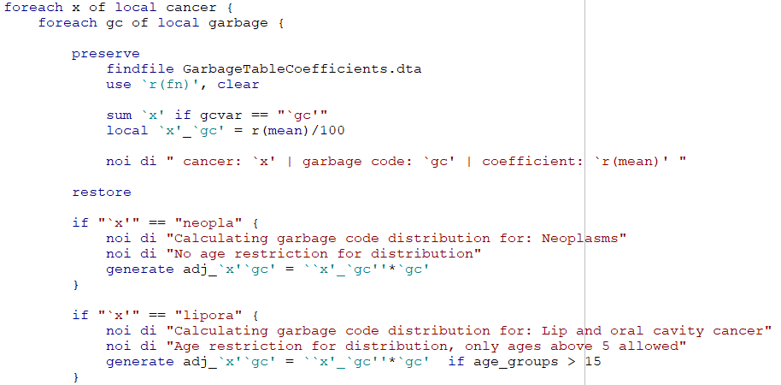
charon varname, can() dop() geo() adj() steps()
$$NDc+\sum{{NDg}_{i}∗C_{i}}$$
adj( GBD ) [tableupdate]
A. Bigoni
charon : A command to study the impact of different correction methods on cancer mortality trends and magnitude
December 5th

Slide 20
charon varname, can() dop() geo() adj() steps()
steps(All)
steps(Rates)
A. Bigoni
charon : A command to study the impact of different correction methods on cancer mortality trends and magnitude
December 5th

Slide 21
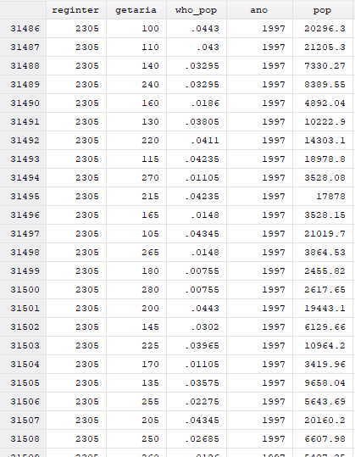
charonrates
Standardized Mortality Rate
WHO population reference
A. Bigoni
charon : A command to study the impact of different correction methods on cancer mortality trends and magnitude
December 5th

Slide 22
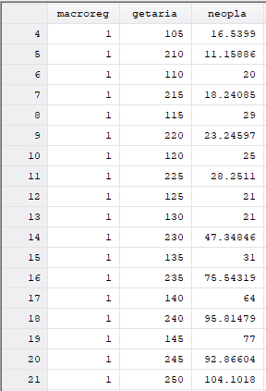
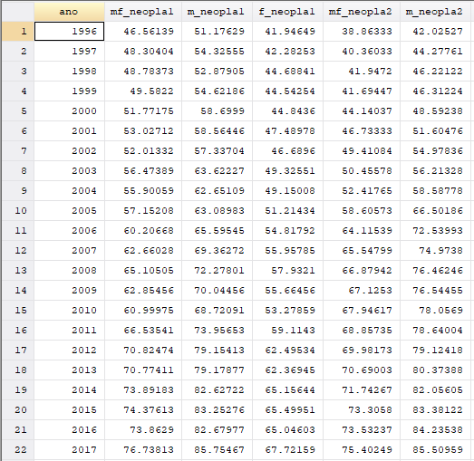
charon varname, can() dop() geo() adj() steps()
A. Bigoni
charon : A command to study the impact of different correction methods on cancer mortality trends and magnitude
December 5th

Slide 23
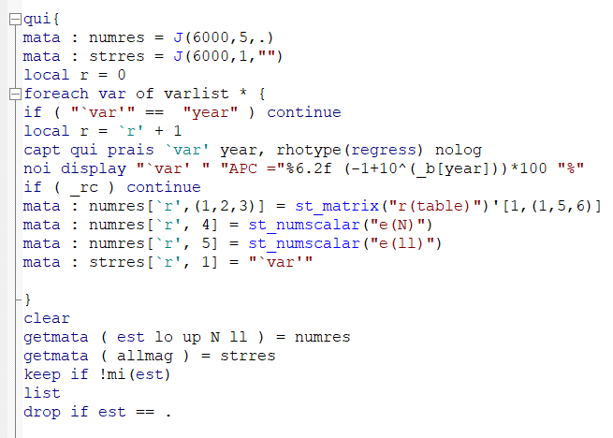
charontimes
A. Bigoni
charon : A command to study the impact of different correction methods on cancer mortality trends and magnitude
December 5th

Slide 24
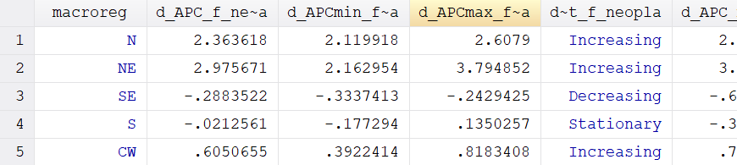
charon varname, can() dop() geo() adj() steps()
A. Bigoni
charon : A command to study the impact of different correction methods on cancer mortality trends and magnitude
December 5th

Slide 25
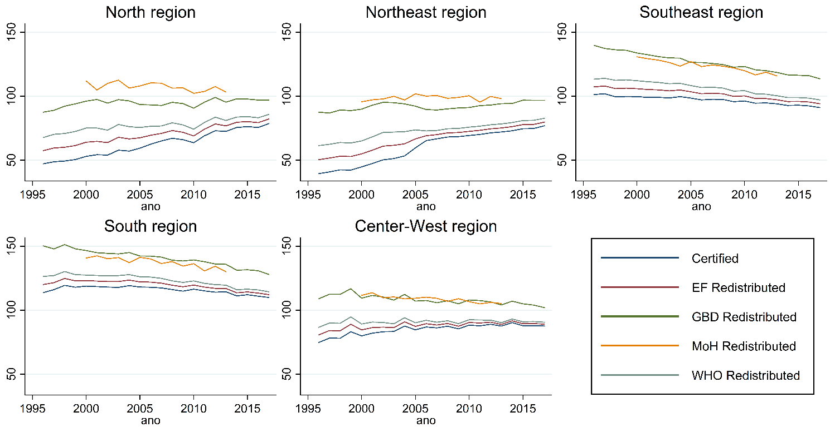
Results
A. Bigoni
charon : A command to study the impact of different correction methods on cancer mortality trends and magnitude
December 5th

