Slide 1
Consequences of extending paid maternity leave
The Programa Empresa Cidadã experience

Slide 2
Sumário
Introduction
Database
Summary Statistics
Preliminary Results
Literature
Institutional Setting

Slide 3
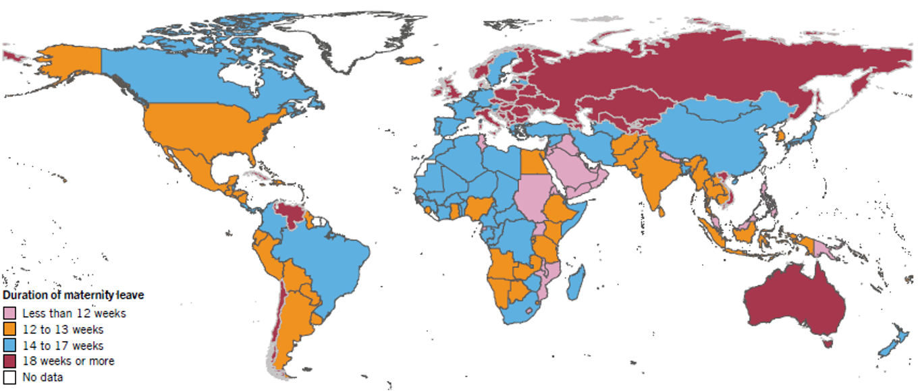
Introduction
Introduction
Database
Summary Statistics
Preliminary Results
Literature
Institutional Setting
Virtually, all countries provide maternity leave. However, only 40% of women in the workforce have access to this benefit.
Source: ILO Working Conditions Laws Database - Maternity Protection. Available at: <http://www.ilo.org/dyn/travail/travmain.home>.

Slide 4
Introduction
Introduction
Database
Summary Statistics
Preliminary Results
Literature
Institutional Setting
Literature demonstrates that maternity leave policies produce mixed effects
Positive Effects
Attract women to labor market
Negative Effects
Increase in birth rate
Reduction of ppd
Increase in breastfeeding time
Higher development of child’s abilities
Reduction of flexibility in the labor market
Decrease women's participation in formal work
Increase inequity (only formal workers have access)
Women become more onerous

Slide 5
Introduction
Introduction
Database
Summary Statistics
Preliminary Results
Literature
Institutional Setting
This research aims to investigate the effects on women’s careers of paid maternity leave extension from 120 to 180 days on firms that have joined the Empresa Cidadã Program.
Specifically, effects on extended leave take-up, wage and employment of women in participant firms are explored.
Motivations:
  There are few papers on this subject in developing countries;
  There is lack of consensus on the effects of maternity leave extensions;
  Bill from 2017 in Congress to extend maternity leave to 6 months in all formal work, with the possibility of sharing up to 60 days with the father.

Slide 6
Institutional Setting | pEC
Introduction
Database
Summary Statistics
Preliminary Results
Literature
Institutional Setting
PEC was approved in 2010 and extends maternity leave period to 180 days in participant firms (mothers who were already on leave were elegible).
The take-up of extended leave is optional. Very few companies already had this benefit before joining the PEC.
The leave is paid by the employer and can be deducted from tax payment.
Only firms taxed over Lucro Real are eligible for tax deduction of leave payment.

Slide 7
Institutional Setting | pEC
Introduction
Database
Summary Statistics
Preliminary Results
Literature
Institutional Setting
Simulation of tax deductions of maternity wage
 | Cenário 1 | Cenário 2 | Cenário 3 | Cenário 4 | Cenário 5
Lucro Contábil no ano | R$ 200,000.00 | R$ 100,000.00 | R$ 10,000.00 | R$ - | -R$ 5,000.00
(+) Gastos relativos ao PEC | R$ 15,000.00 | R$ 10,000.00 | R$ 10,000.00 | R$ 10,000.00 | R$ 10,000.00
(=) Lucro Real para Cálculo do IRPJ | R$ 215,000.00 | R$ 110,000.00 | R$ 20,000.00 | R$ 10,000.00 | R$ 5,000.00
(x) Alíquota imposto de renda | 15% | 15% | 15% | 15% | 15%
(=) IRPJ Calculado | R$ 32,250.00 | R$ 16,500.00 | R$ 3,000.00 | R$ 1,500.00 | R$ 750.00
(-) Gastos relativos ao PEC | R$ 15,000.00 | R$ 10,000.00 | R$ 10,000.00 | R$ 10,000.00 | R$ 10,000.00
(=) IRPJ Devido | R$ 17,250.00 | R$ 6,500.00 | -R$ 7,000.00 | -R$ 8,500.00 | -R$ 9,250.00
If profit is low, firms will not have acesss to tax deduction.
This is why most of the firms in PEC are big

Slide 8
Literature
Introduction
Database
Summary Statistics
Preliminary Results
Literature
Institutional Setting
Effects of maternity leave expansion on: | Articles:
Wage and unemployement | SCHÖNBERG; LUDSTECK, 2014; ROSSIN-SLATER; RUHM; WALDFOGEL, 2013; LALIVE; ZWEIMÜLLER, 2009; SPIESS; WROHLICH, 2008; CARVALHO; FIRPO; GONZAGA, 2006
Having another child | LALIVE; ZWEIMÜLLER, 2009
Child’s health | TANAKA, 2005; BERGER; HILL; WALDFOGEL, 2005; RUHM, 2000
Mother’s health | BAKER; MILLIGAN, 2008; STAEHELIN; BERTEA; STUTZ, 2007; HYDE et al., 1995
LT: Performance at school | DANZER; LAVY, 2017; DAHL et al., 2016; CARNEIRO; LØKEN; SALVANES, 2015; DUSTMANN; SCHÖNBERG, 2012; RASMUSSEN, 2010; LIU; SKANS, 2010
LT: Wages in adulthood | CARNEIRO; LØKEN; SALVANES, 2015; DUSTMANN; SCHÖNBERG, 2012

Slide 9
Literature| In brazil
Introduction
Database
Summary Statistics
Preliminary Results
Literature
Institutional Setting
Authors | Type | Reforma | Mét. | Interesse | Impact
CARVALHO; FIRPO; GONZAGA, 2006 | Paper | Expansion of 84 to 120 dias (1988) | DID | Income e employment level | Zero
MENDES, 2010 | Diss. | Expansion of 84 to 120 dias (1988) | DID | Saúde infantil | Reduction on low birthweight
MALAFAIA, 2008 | Thesis | Ceiling on maternity wage (1998) | DID | Renda | Negative (even after discontinuation of policy)
MELLO, 2013 | Thesis | Expansion from 120 to 180 days in public offices (2007) | DID | Salário, renda e fertilidade | Zero
SANTOS, 2017 | Diss. | Expansion from 120 to 180 days in public offices (2007) | RDD | Salário, emprego e educação infantil | Positive effect on labor market for high income mothers
MACHADO; NETO, 2016 | Working Paper | Expansion from 120 to 180 days in public offices (2007) | DID | Emprego | Almost 50% of women is not at formal workforce 47 months after childbirth

Slide 10
Database
Introduction
Database
Summary Statistics
Preliminary Results
Literature
Institutional Setting
Receita Federal
Database with firms in ECP, containing accession dates
RAIS
From 2007 to 2016
No info available for leave taking in 2011
Updated in july/2016

Slide 11
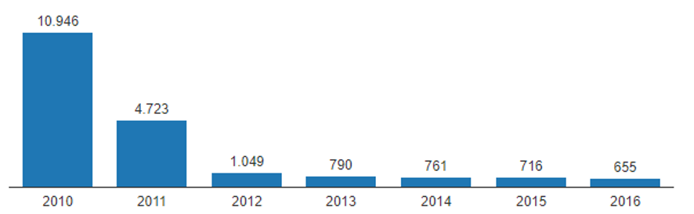
Summary statistics| Receita Federal
Introduction
Database
Summary Statistics
Preliminary Results
Literature
Institutional Setting
Most firms joined the program in 2010 (when it was launched);
Accession increased in 2016 due to the expansion on paternity leave;
SP is the state with the highest concentration of firms in ECP (34.1%);
SP+RJ+MG concentrate over 50% of firms in ECP.
Evolution of firms joining ECP

Slide 12
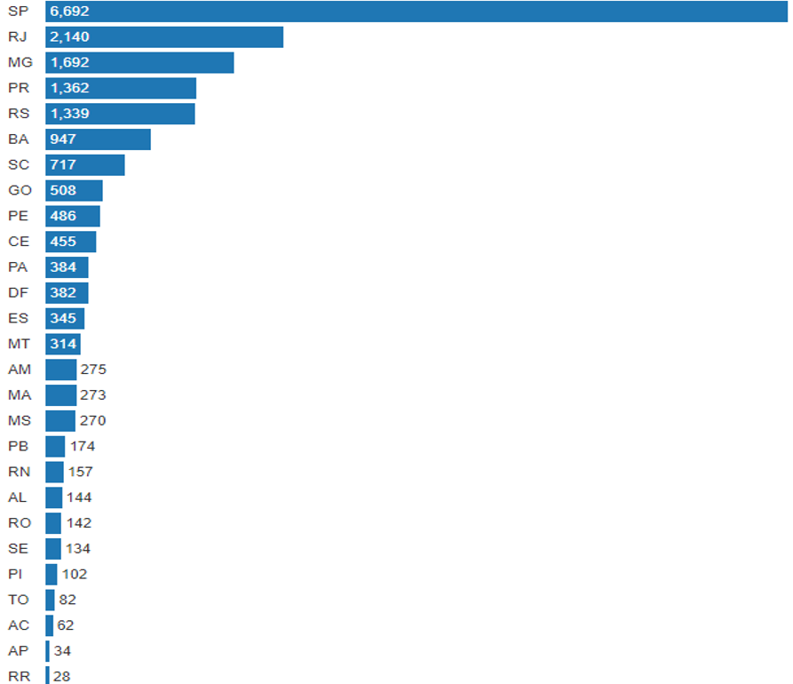
Introduction
Database
Summary Statistics
Preliminary Results
Literature
Institutional Setting
PEC – BY STATES

Slide 13
Introduction
Database
Summary Statistics
Preliminary Results
Literature
Institutional Setting
Summary statistics
Histogram of elegibility dates in firms
Distribution of elebigility
 | Percentiles | Smallest
1% | 25-jan-10 | 25-jan-10
5% | 27-jan-10 | 25-jan-10
10% | 1-fev-10 | 25-jan-10 | Obs | 19,640
25% | 15-mar-10 | 25-jan-10 | Sum of Wgt. | 19,640
50% | 18-out-10 |  | Mean | 19-mai-11
 |  | Largest | Std. Dev. | 598.9367
75% | 9-ago-11 | 1-jul-16
90% | 9-abr-14 | 1-jul-16 | Variance | 358725.2
95% | 14-jul-15 | 1-jul-16 | Skewness | 1.685156
99% | 29-abr-16 | 1-jul-16 | Kurtosis | 4.916582

Slide 14
Introduction
Database
Summary Statistics
Preliminary Results
Literature
Institutional Setting
Summary statistics | PEC Vs. Others
On average, ECP firms are very different from firms that are not in the program, except for percentage of black and illiterate employees.

Slide 15
Introduction
Database
Summary Statistics
Preliminary Results
Literature
Institutional Setting
Summary statistics | PEC Vs. Others
On average, ECP firms are larger and have higher wages than other firms.

Slide 16
Introduction
Database
Summary Statistics
Preliminary Results
Literature
Institutional Setting
Summary statistics | Early Vs. Late adopters
Variable | Late | Early | p-value
Number of employees | 248.5 | 239.2 | 0.79
% Women | 39.7% | 40.6% | 0.41
% Maternity leave | 5.3% | 4.3% | 0.01
Avg. age | 36.4 | 37.9 | 0.00
Avg. age - women | 35.0 | 36.5 | 0.00
Avg. wage | 5203.5 | 4354.7 | 0.00
Avg. wage - women | 4459.9 | 3922.3 | 0.00
% Women secretary | 12.7% | 12.5% | 0.82
% Women VP | 0.7% | 1.1% | 0.09
% Black employees | 4.0% | 4.0% | 0.88
% Black employees – women | 3.2% | 3.2% | 0.80
% Illiterate | 0.1% | 0.2% | 0.03
% Illiterate - women | 0.1% | 0.0% | 0.61
% Complete basic education | 40.0% | 43.1% | 0.01
% Complete basic education – women | 36.1% | 40.2% | 0.00
% Incomplete higher education | 7.1% | 5.6% | 0.00
% Incomplete higher education – women | 8.6% | 7.1% | 0.00
% Complete higher education | 37.5% | 29.2% | 0.00
% Complete higher education – women | 45.1% | 37.4% | 0.00
N | 1679 | 1217

Slide 17
Preliminary Results
Introduction
Database
Empirical Strategy
Summary Statistics
Preliminary Results
Literature
Institutional Setting
PSM, comparing early adopters and late adopters:
Level of analysis:firm
Follow the same cohort: fertile age in 2007
2007: from 15 to 49
2008: from 16 to 50
2009: from 17 to 51
...
Variables: ln(avg_wage) and dismissal_rate of women in fertile age of the firm

Slide 18
Preliminary Results
Introduction
Database
Empirical Strategy
Summary Statistics
Preliminary Results
Literature
Institutional Setting
PSM, comparing early adopters and late adopters
Variable | Sample | Treated | Controls | Difference | S.E. | T-stat
lwage12m | Unmatched | 7.333 | 7.467 | -0.133 | 0.036 | -3.710
 | ATT | 7.337 | 7.351 | -0.014 | 0.049 | -0.290
dismiss12m | Unmatched | 0.239 | 0.233 | 0.006 | 0.010 | 0.570
 | ATT | 0.238 | 0.228 | 0.010 | 0.014 | 0.750
lwage24m | Unmatched | 7.423 | 7.670 | -0.247 | 0.033 | 7.370
 | ATT | 7.425 | 7.460 | -0.036 | 0.044 | 0.800
dismiss24m | Unmatched | 0.246 | 0.219 | 0.027 | 0.009 | 2.870
 | ATT | 0.245 | 0.226 | 0.020 | 0.013 | 1.570
lwage36m | Unmatched | 7.546 | 7.814 | -0.268 | 0.036 | 7.390
 | ATT | 7.544 | 7.618 | -0.075 | 0.047 | 1.600
dismiss36m | Unmatched | 0.266 | 0.226 | 0.040 | 0.011 | 3.670
 | ATT | 0.266 | 0.248 | 0.018 | 0.013 | 1.370
lwage48m | Unmatched | 7.697 | 7.886 | -0.189 | 0.040 | 4.720
 | ATT | 7.702 | 7.746 | -0.044 | 0.051 | 0.860
dismiss48m | Unmatched | 0.252 | 0.235 | 0.016 | 0.012 | 1.380
 | ATT | 0.252 | 0.245 | 0.007 | 0.014 | 0.490

Slide 19
Preliminary Results
Introduction
Database
Empirical Strategy
Summary Statistics
Preliminary Results
Literature
Institutional Setting
 |  | Off support | On support | Total
12m | Untreated | 0 | 1,598 | 1,598
 | Treated | 2 | 717 | 719
24m | Untreated | 0 | 924 | 924
 | Treated | 11 | 1,302 | 1,313
36m | Untreated | 0 | 630 | 630
 | Treated | 3 | 1,518 | 1,521
48m | Untreated | 0 | 461 | 461
 | Treated | 7 | 1588 | 1595

Slide 20
Preliminary Results
Introduction
Database
Empirical Strategy
Summary Statistics
Preliminary Results
Literature
Institutional Setting

