Slide 1

Application of the MIMIC model to detect and predict differential item functioning
Kevin Krost, M.A.
Josh Cohen, Ph.D.
Virginia Tech, Educational Research and Evaluation

Slide 2
Research Questions
RQ1 – Is there differential item functioning between gender on this assessment?
RQ2 – What attitudinal factors predict or mediate differential item functioning and/or gender differences among mathematics?

Slide 3
Differential Item Functioning
Differences in probability of endorsing an item between two groups after controlling for ability
  Can indicate item bias
  Difficult to explain and determine cause

Slide 4
MIMIC Model
Generalized SEM which incorporates covariates on items and latent traits
  Family and link function for items
Effect of grouping variable on latent trait indicates group differences
  Items indicate DIF
  Covariates can predict item and mediate DIF

Slide 5

MIMIC Model
Proven to be related to the 2-parameter normal ogive IRT model (McDonald, 1967)
Effect sizes based on signed area under IRT for practical significance (Raju, 1988)
  Signed Area = -$\frac{\text{β}\text{i}}{\text{λ}\text{i}}$

Slide 6
MIMIC Model

Slide 7
Scale Purification
Items used to measure latent trait might exhibit DIF and should be removed from scale (Wang, Shih, & Yang, 2009)
  Iterative procedure
  Items detected as exhibiting DIF removed from scale and modeled again
Time-consuming!

Slide 8
Purified Model

Slide 9
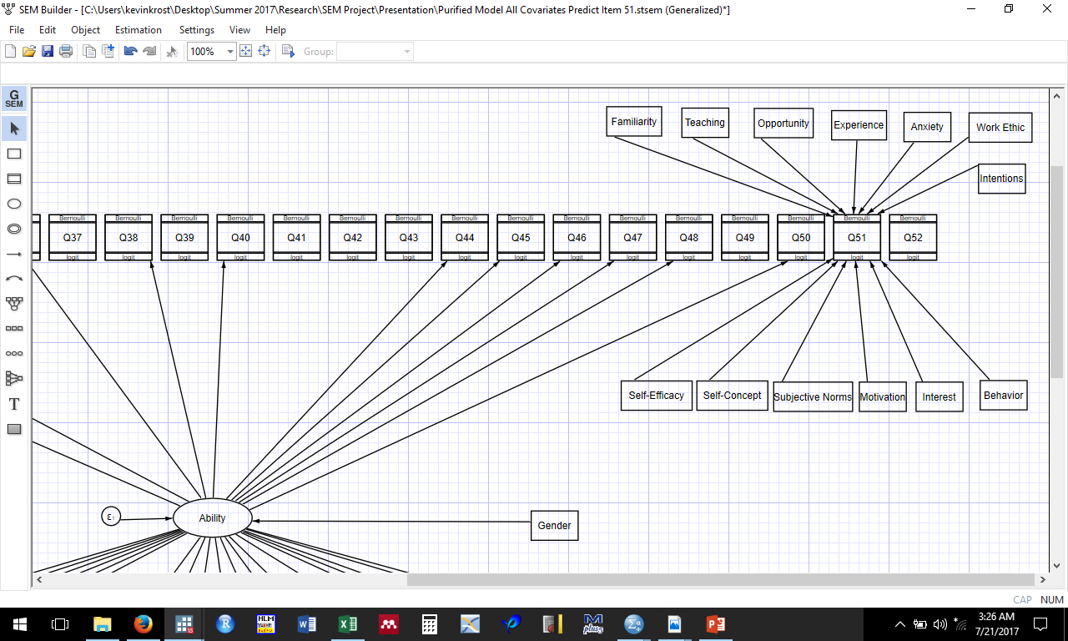
Predictive Model

Slide 10
Predictive Model
Interested in items exhibiting largest DIF based on effect size
Enter all covariates to predict item and mediate DIF
  Based on results, drop non-significant covariates to create more parsimonious model
  Drop all non-significant variables or one at a time?

Slide 11
Judgment Time
Within items, interested in largest absolute drop in effect size from model to model
  Most interested when grouping variable becomes non-significant
After most parsimonious models obtained, interested in covariates significantly predicting item
  Again, interested in full mediation

Slide 12
Judgment Time
Depends on your interest as a researcher
  Substantive, focused on relationship of covariates and mediation of DIF
  Professional/test developer, interested in determining if DIF indicates item bias or simply spurious
  Both, depending on research interests

Slide 13
Any questions?
Thank you!

