Slide 1
Using theory to define a computationally tractable specification space in confirmatory factor models
Geoff B. Dougherty, MPH
PhD candidate
Johns Hopkins Epidemiology
Director of Health Services Research
U.S. News & World Report
Lorraine T. Dean, ScD
Assistant Professor
Johns Hopkins Epidemiology
Notes:
Two common purposes: To understand the association of various items or indicators to a latent variable, and to accurately measure a latent construct. Available with -SEM- command

Slide 2
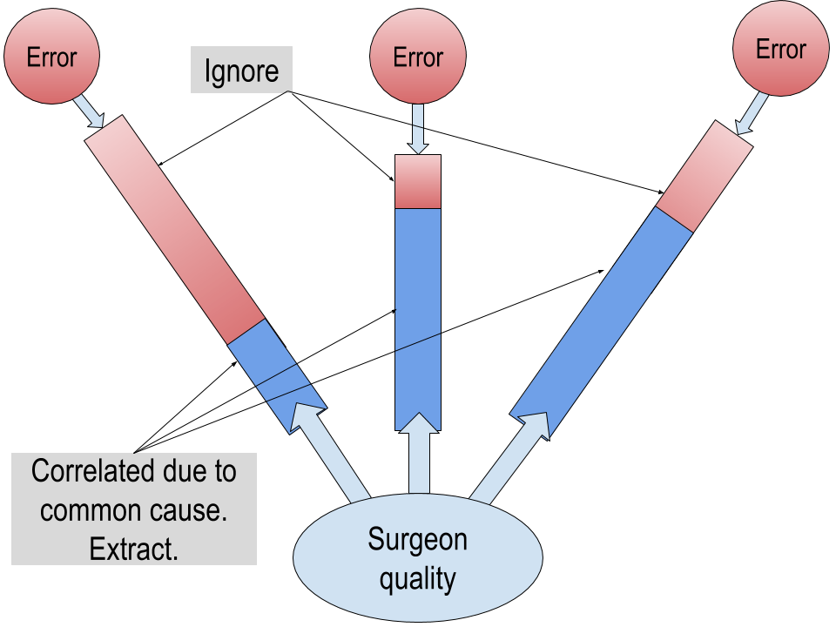
Confirmatory factor analysis: The basic idea
Notes:
Two common purposes: To understand the association of various items or indicators to a latent variable, and to accurately measure a latent construct. Available with -SEM- command. Fit function minimizes difference between observed and model-based correlation matrices

Slide 3
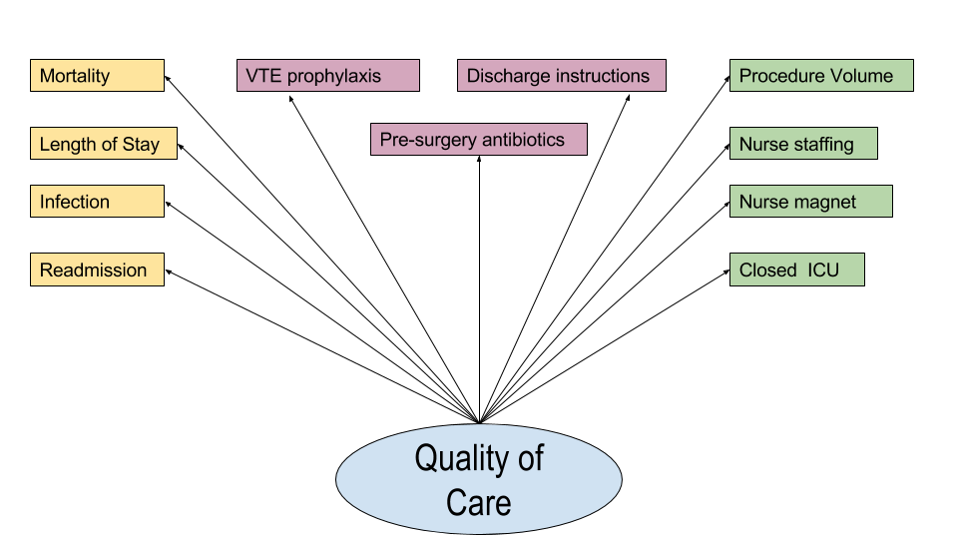
From theory to model
Donabedian, Avedis. "Evaluating the quality of medical care." The Milbank memorial fund quarterly 44.3 (1966): 166-206.
Notes:
CFA starts with a theory about the latent variable, its indicators, and the relationships between them. Often the theory will include information about content domains or other variable-specific detais. Even a good theory typically will not lead to a good-fitting model. Thus, the investigator needs to re-specify the initial model. How this is accomplished is the key topic of my talk.

Slide 4
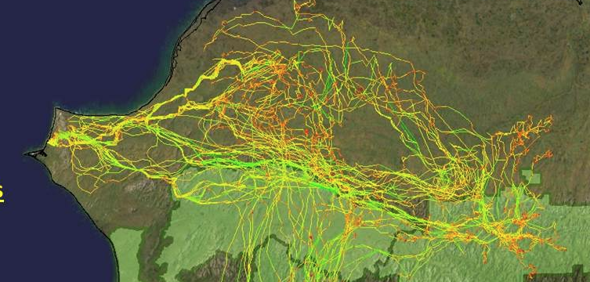
Respecification
https://eros.usgs.gov/lir/sites/all/files/lir/lir/nps/nps3.jpg
Notes:
Typically the researcher will iterate through some combination of removing items with poor loadings, allowing error correlations, and other model modifications, evaluating fit with each group of changes. NOT reproducible

Slide 5


Challenges to finding the right model
https://pixabay.com/p-1706106/?no_redirect
https://upload.wikimedia.org/wikipedia/commons/7/7c/Needle_exchange_supplies.jpg

Slide 6
Specification searches
Fast
May not identify all appropriate models
Sensitive to starting values
May be hindered by locally optimal solutions
May identify good-fitting model inconsistent with theory
What if we can run all models?

Slide 7
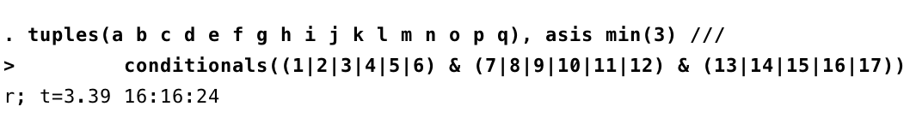
The benefit of having a theory
21 indicators, choose 3 or more
21!/(3!*18!) … 21!/(20!*1!)
= 2,096,920, 1+ days
= 123,039, 1+ hours

Slide 8
The process
Identify indicators that are reasonably well correlated with others
Identify pairs of indicators that should not appear in combinations together
Identify indicators that must occur in all combinations
Compile list of combinations
Run models
Log fit statistics to post file
Select final model
Validate

Slide 9
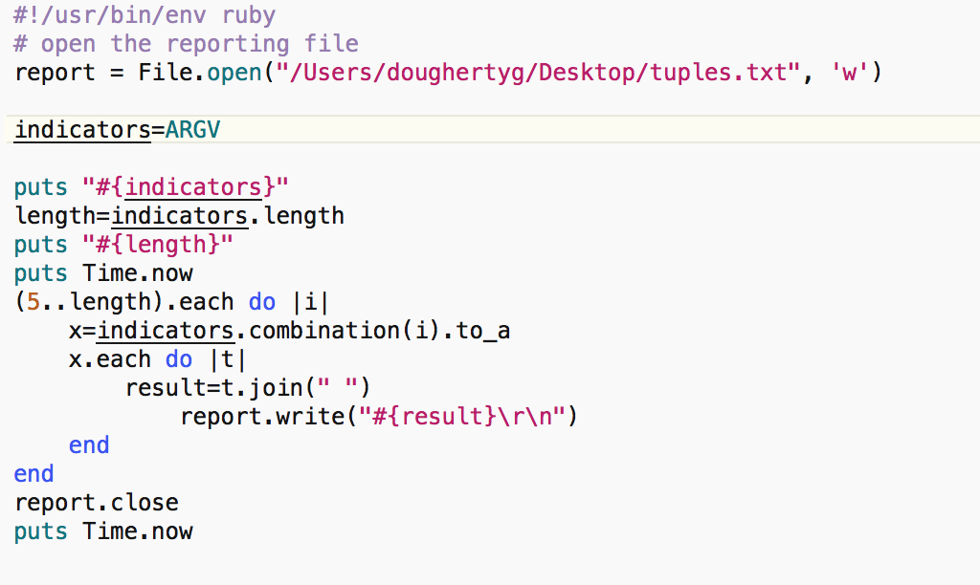
Getting the tuples

Slide 10
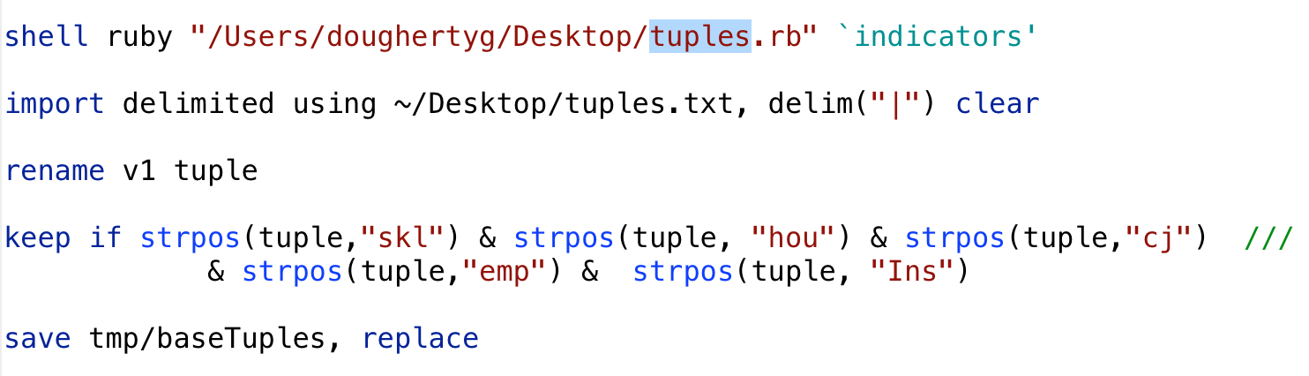
Implementing the theory

Slide 11
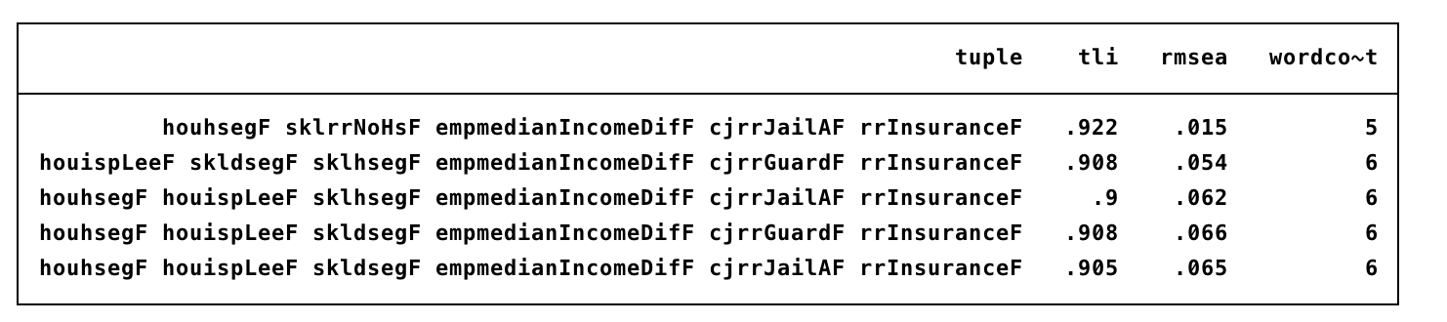
Needle in haystack

Slide 12
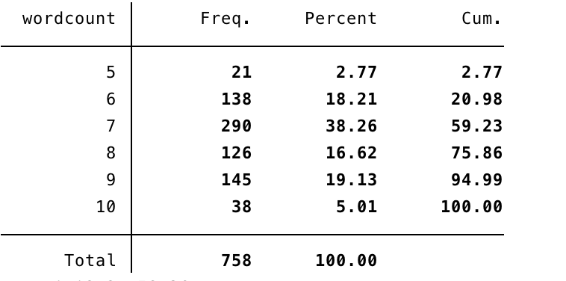
Needle exchange

Slide 13
Which model to choose?
“The choice, then, is not whether to build models; it's whether to build explicit ones. In explicit models, assumptions are laid out in detail, so we can study exactly what they entail… By writing explicit models, you let others replicate your results.”
Epstein, Joshua M. "Why model?." Journal of Artificial Societies and Social Simulation 11.4 (2008): 12.

Slide 14
One algorithm for model selection
Identify models with acceptable fit statistics (TLI>.9, RMSEA <.06, etc)
Rank by number of indicators
Among those with highest # of indicators, pick one with highest minimum loading
Or specify as a multiobjective optimization problem, etc.

Slide 15
Additional considerations
Validation
What about modification indices/correlated errors?
Doesn’t address more complicated CFA variants
Make an .ado?

