Slide 1

Complementing Stata with Geovisualisation
2009 Australian and New Zealand Stata Users Group meeting
5 November 2009
The University of Sydney, The Darlington Centre, NSW 2008
Australia
Philip S. Morrison,
Professor of Human Geography,
School of Geography, Environment and Earth Sciences,
Victoria University of Wellington, New Zealand
http://www.victoria.ac.nz/geo/people/philip-morrison/index.html

Slide 2

Outline
What is Geovisualisation?
Background
Visualisation in Stata
Mapping in Stata
Spatial statistics (in Stata)
Geovisualisation – in Stata?

Slide 3
What is geovisualisation?
Geovisualisation refers to the visual display of data which is geo-referenced.
Its purpose is threefold:
To aid exploration of data, especially complicated, large or multivariate datasets
To supplement statistical analysis which may or may not involve spatial statistics
Assist in the presentation of patterns and relationships over the geographic domain

Slide 4

2.Background
“Geovisualisation and policy: exploring the links”.
A report prepared for Statistics New Zealand 2009
Geovisualisation workshop Victoria University of Wellington, New Zealand (July 09)
Report: Official Statistics Research Series 2010 (Feb).
http://www.statisphere.govt.nz/official-statistics-research.aspx

Slide 5
2.Background continued
Around 70-80 percent of all official statistics are now geo-referenced i.e. linked digitally to a location.
Without geovisualisation (display over the geographic domain) we fail to extract the full value from geo-referenced data which is otherwise expensive to collect and maintain.
Key is to remove impediments to geovisualisation

Slide 6
No statistical package I’m aware of links a full range of statistical software with a highly flexible mapping and geovisualisation capacity.
THIS IS A BIG GAP IN THE MARKET
Stata has a limited thematic mapping capacity and a limited user written suite of spatial statistics.

Slide 7
Stata offers considerable flexibility in exploring data non-geographically.
Example: Decomposing urban population density
3. Geovisualisation in Stata
P/H = D/H * P/D
(census area unit subscript is implicit throughout)
P/H is population density
D/H is dwelling density, and
P/D is the occupancy rate
ln (P/H) = ln (P/D) + ln (D/H)

Slide 8
Figure 1. Population density, dwelling density and the occupancy rate.
Auckland Region 2001
ln (P/H) = ln (P/D) + ln (D/H)
P/D
P/H
Log of population density
Log of the occupancy rate
e¹=2.7
e²=7.4
e³=20
e⁴=54.6
Log of dwelling density
D/H

Slide 9
Figure 2. The population density impact of changes in dwelling density and occupancy rates. Auckland, 1991=2001
ln (P/H) = ln (P/D) + ln (D/H)
P/D
P/H
1991
Log of population density
2001
Log of the occupancy rate
e¹=2.7
e²=7.4
e³=20
e⁴=54.6
Log of dwelling density
Note: applies to area units with dwelling densities > = 1 in 1991

Slide 10
Figure 3. The population density impact of negatively correlated changes in dwelling density and occupancy rates. Auckland, New Zealand
P/D
P/H
Log of population density
Log of the occupancy rate
e¹=2.7
e²=7.4
e³=20
e⁴=54.6
Log of dwelling density
10

Slide 11
Figure 4. The population density impact of positively correlated changes in dwelling density and occupancy rates. Auckland, New Zealand
P/D
P/H
Log of population density
Log of the occupancy rate
e¹=2.7
e²=7.4
e³=20
e⁴=54.6
Log of dwelling density

Slide 12
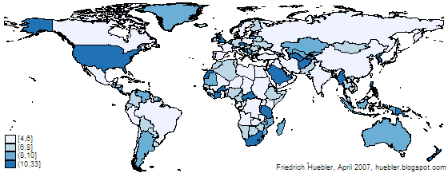
3. Mapping in Stata
International Education Statistics
Analysis by Friedrich Huebler
Tuesday, June 30, 2009
Updated "Guide to creating maps with Stata"
The guide to creating maps with Stata has been updated with new links to third-party software.
Map created with spmap in Stata: length of country names
Reference
Pisati, M. 2004. Simple thematic mapping. Stata Journal 4: 361–378.
http://huebler.blogspot.com/2009/06/stata-maps.html

Slide 13
Figure 5. Affluent census area units in the Auckland Region, 2001 and 2006
Auckland Region
Source: Barry Martin, Magnus Consulting (personal communication)

Slide 14
Figure 6. Affluent census area units in Auckland Metro area , 2001 and 2006
Source: Barry Martin, Magnus Consulting (personal communication)

Slide 15
Figure 7. Employment density in Auckland Metro area , 2001 and 2006
Source: D.C.Maré Labour productivity in Auckland firms Motu Working paper 08-12

Slide 16
4. Spatial statistics
in Stata
Spatial autocorrelation exists if the sum of values at all the j sites within radius d of i is not more (or less) than one would expect by chance given all the values in the entire study area (within and beyond d). If spatial autocorrelation exists, it will be exhibited by a spatial clustering of high or low values of x
Source: Soldera, P. 1998 Mapping social exclusion : the geography of unemployment. Proceedings of the eighth conference on Labour, employment and work 1998 p 221-230

Slide 17
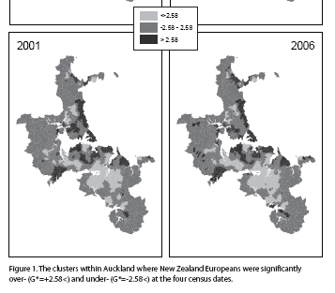
4. Spatial statistics in Stata continued
Segregation ‘Hot-spots’ : areas of clustering significantly different across mapped space.
For each meshblock the mapped value G* indicates the degree to which European have a similar share of the area population as neighbouring areas, relative to the city wide average.
Source: ArcGIS
Source: Johnston, R.; M. Pousen and J. Forrest 2009 Evaluating changing residential segregation in Auckland, New Zealand, using spatial statistics. Centre for Market and Public Organisation, Bristol Institute of Public Affairs, Working paper No. 09/214

Slide 18
5. Geovisualisation in Stata?
Not yet. The two primary sources of ‘geovisualisation’ software are (free):
The GeoViz Toolkit supports systematic analysis of spatial, temporal, and attribute data sets. Components are automatically coordinated across multiple views to enable insight into highly multivariate data, especially geographically organized data. The Toolkit was developed by Frank Hardisty, Aaron Myers, and Ke Liao at the University of South Carolina. In the GeoViz Toolkit,
http://www.geovista.psu.edu/geoviztoolkit/index.html
The GeoDa Center for Geospatial Analysis and Computation develops state-of-the-art methods for geospatial analysis, geovisualization, geosimulation, and spatial process modeling, implements them through software tools, applies them to policy-relevant research in the social and environmental sciences, and disseminates them through training and support to a growing worldwide community. Luc Anselin Foundation Professor and Director
http://geodacenter.asu.edu/
The key lies in the ‘brushing’, the linkage through multiple displays…..

Slide 19
Figure 1. Population density, dwelling density and the occupancy rate.
Auckland Region 2001
ln (P/H) = ln (P/D) + ln (D/H)
P/D
P/H
Log of population density
Log of the occupancy rate
e¹=2.7
e²=7.4
e³=20
e⁴=54.6
Log of dwelling density
D/H
Take into GeoViz….

Slide 20
Occupancy Rate (P/D)
Dwelling Density D/H
Figure 8. The geography of combinations of dwelling density and occupancy rate components of population density. Auckland, New Zealand, 2001

Slide 21
Three quantiles per variable
Unemployment rate
(x 1000)
Metropolitan
New Zealand
Labour force participation rate
(x 1000)
Figure 9. Applications of GeoViz to analysis of local labour markets

Slide 22
Figure 10. A classification of local labour market clearing in four dimensions

Slide 23
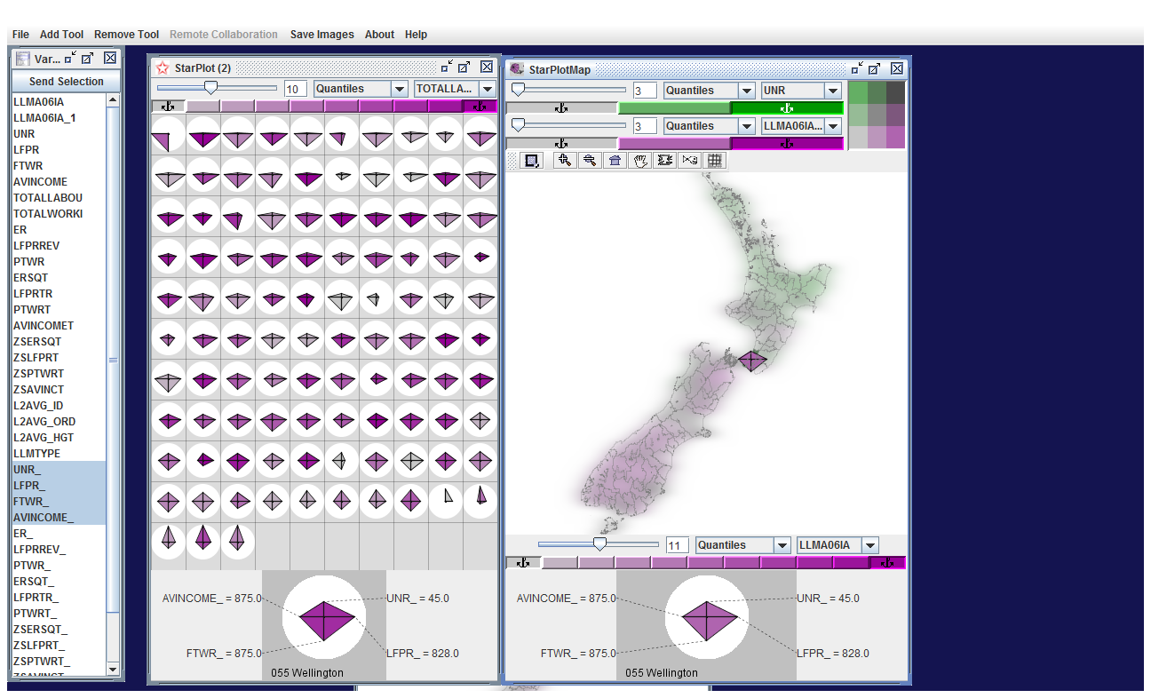

Slide 24
10 clusters
Light……………….Dark
Labour market types are spatially clustered
Llm clusters 2006
Metro & integrated – clearing markets
Rural small town agricultural
Tiny isolated locations scattered
8,& 9 weakly clearing markets

Slide 25
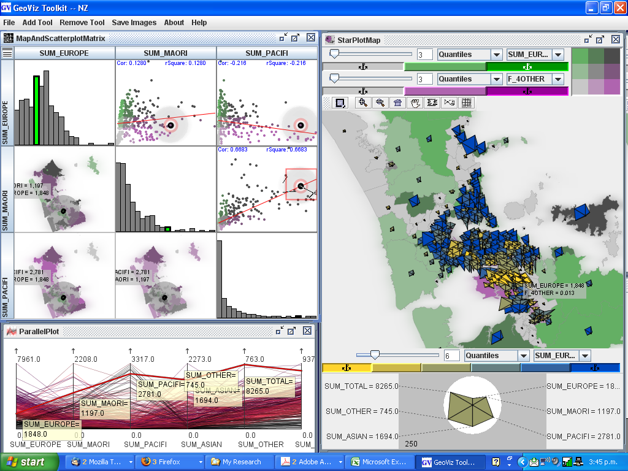
Figure 13. Applications in GeoViz. Ethnicity in Auckland 1

Slide 26
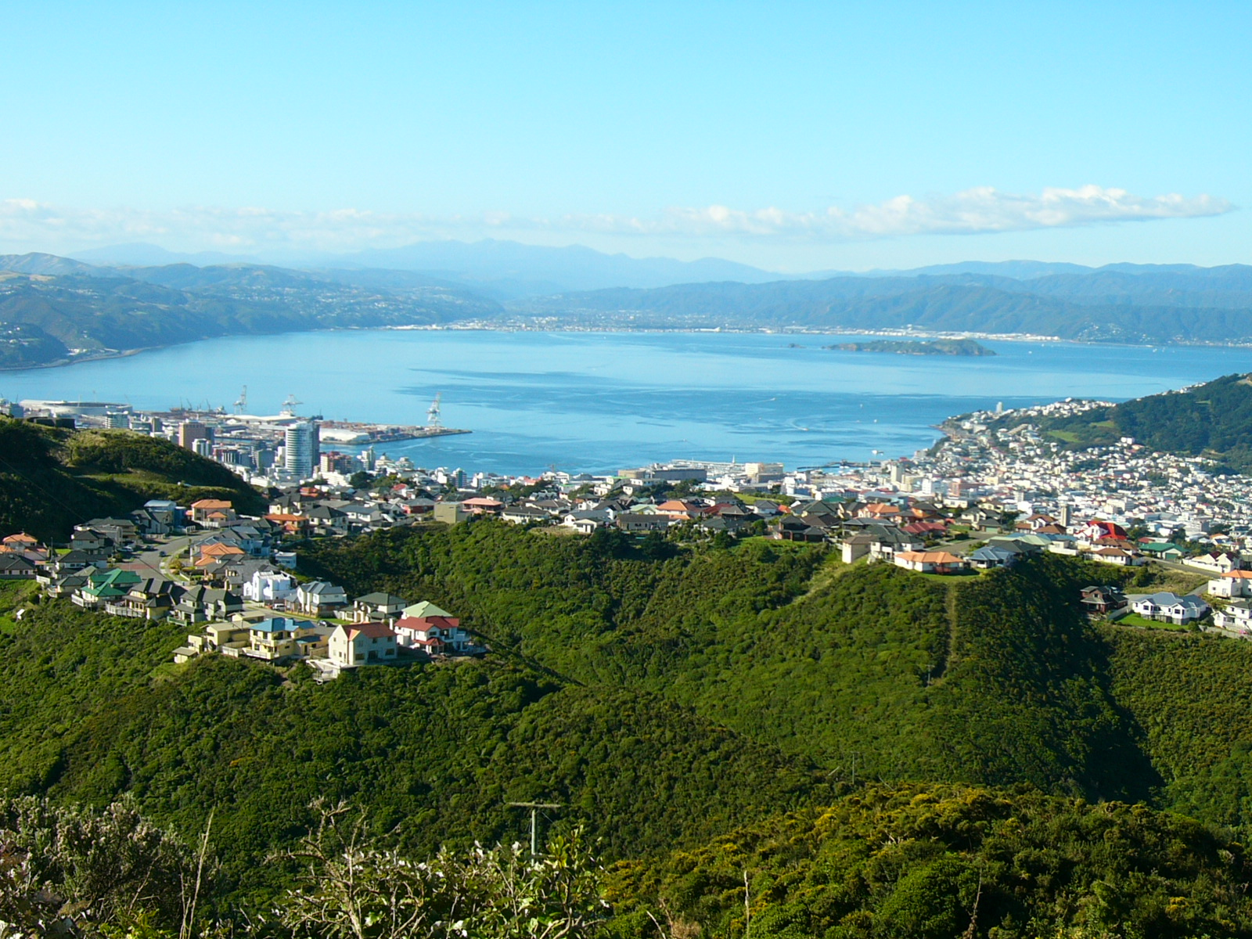
Comments and questions….

Slide 27
Example 1. The choropleth (thematic) map distorts
As in quantiles (20) of population density. Average population per hectare (P/H) across census area unit of the Wellington Regional Council, 2001.

Slide 28
Geovisualisation allows the map to be transformed e.g. from area to density

Slide 29
CrimeStat III is a spatial statistics program for the analysis of crime incident locations, developed by Ned Levine & Associates under the direction of Ned Levine, PhD. The program is Windows-based and interfaces with most desktop GIS programs. The purpose is to provide supplemental statistical tools to aid law enforcement agencies and criminal justice researchers in their crime mapping efforts. The program inputs incident locations (e.g., robbery locations) in 'dbf', 'shp', ASCII or ODBC-compliant formats using either spherical or projected coordinates. It calculates various spatial statistics and writes graphical objects to ArcGIS®, MapInfo®, Surfer for Windows®, and other GIS packages.
http://www.icpsr.umich.edu/CRIMESTAT/about.html

Slide 30
3. Stata, mapping and geovisualisation continued
Figure 1. Affluent census area units in Wellington City, 2001 and 2006
Source: Barry Martin, Magnus Consulting (personal communication). Index based on income of individuals, source of income, occupation and education

Slide 31
Figure 2. Affluent census area units in Wellington City, 2001 and 2006
Source: Barry Martin, Magnus Consulting (personal communication)

Slide 32
2.Background continued
Project priorities
1. “Investigate the potential for acquiring an enhanced geospatial capability across the OSS”
2. “Investigate the possibilities and techniques for geospatial innovation to enhance accessibility of official statistics and generate more interest in and knowledge of these statistics”
3. “Contribute to the understanding of social and economic change, including dynamics and transitions, through the development and application of techniques …”

Slide 33
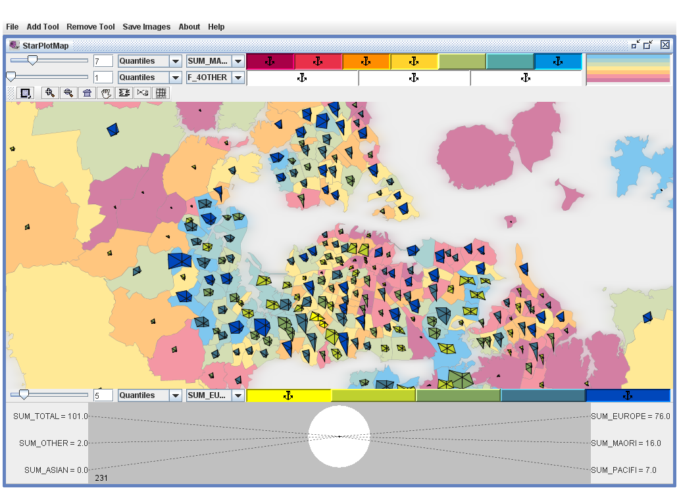
Figure 11. Applications in GeoViz. Ethnicity in Auckland 2.

Slide 34
Linking the scatter and the map
One can generate scatters and maps in Stata and they can be positioned on the same page as output BUT they cannot be linked internally.
Internal linking of aspatial and spatial displays (brushing) can help integrate the geography rather than treating it as a separated dimension

