Slide 1
WEIGHTING SUB-POPULATIONS IN MORTALITY LONGEVITY RESEARCH: A PRACTICAL APPROACH Adam Szulc Institute of Statistics and Demography Warsaw School of Economics
The 5th Polish Stata Users Group Meeting
Warsaw School of Economics, November 27, 2017

Slide 2
THE GOAL: to develop sub-population weights for life expectancy research, using popular software (here: STATA and Excel)
MOTIVATION: population structure assumed in life tables is different from the actual (e. g. due to migrations), hence using both types of population weights yields different average life expectancies (in the present study differences vary from 0.2 to 0.38 years)
THE IDEA: to construct a set of weights holding two conditions:
weighted average group-specific life expectancies yield overall life expectancy derived from life tables
ensuring a “minimum distance” (will be defined formally later) from the actual population shares
PROBLEM: scarcity of optimisation tools in STATA

Slide 3
POSSIBLE APPLICATIONS:
in construction of aggregate life tables (e. g. world life tables)
in calculation of mortality inequality indicators (between countries, regions etc.)
EXISTING SOLUTIONS:
based on specialised software (e. g. MatLab)
matrix algebra by Anand, Shkolnikov et al (hereafter A & S)
In both cases a solution to a quadratic programming problem is obtained
DRAWBACKS:
MatLab price and availability
time consuming solutions (especially, when have to be repeated for ages from 0 to 110 for both sexes or to produce trends) and possibility of obtaining negative weights in the second solution

Slide 4
PROPOSED SOLUTIONS:
1. Applying STATA (or other popular software) constrained regressions to utilise the least squares minimisation algorithms:
the solution is time effective, once the codes are written
virtually has no restrictions on the dataset size
negative weights are still possible (though less likely)
2. Using Excel Solver minimisation algorithms:
the solution ensures weights’ positivity
is time consuming and is restricted to small and medium dataset (from 50 to 100 sub-groups, depending on the optimisation method)

Slide 5
AN EMPIRICAL ILLUSTRATION:
12 countries selected from Human Mortality Database (intentionally characterised by large disparities in life expectancy and size): men and women separately
80 regions of Russia: men and women together
THE CALCULATIONS:
estimation of weights using group-specific life expectancies, population shares and overall life expectancies
ranges, Gini and Theil inequality indices for the whole populations (i. e. 12 countries altogether and Russia as a whole)
decomposition of Theil indices between country groups for 12 countries

Slide 6
1. ESTIMATION OF THE WEIGHTS
1.1 The algorithms for minimising sum of deviation squares.
The weights by which life-expectancies of n population sub-groups at age x ($e_{ix})$are weighted together to an average life-expectancy ($e_{x}$), may be written as a system of two equations:
$\sum_{i=1}^{n}{e_{ix}\frac{l_{ix}}{l_{x}}=e_{x}}$ (1)
$\sum_{i=1}^{n}{\frac{l_{ix}}{l_{x}}=1}$ (2)
where:
$l_{ix}$ - a number of the people at age x in i-th group (i = 1, 2, …, n), $l_{x}$ - a total number of the people at age x.
For the present purposes it is not necessary to know both $l_{ix}$ and $l_{x}$ , therefore the weights $\frac{l_{ix}}{l_{x}}$, being a sufficient solution (also in inequality calculations), are denoted hereafter as $w_{ix}$.

Slide 7
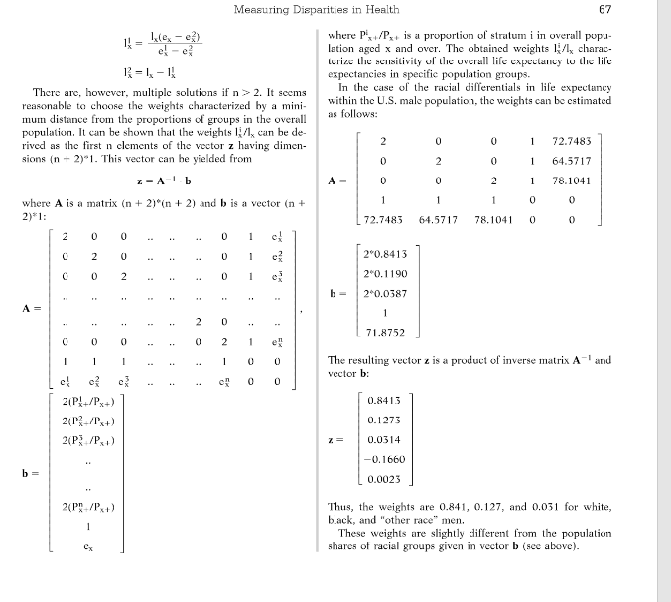

Slide 10
In this study the STATA constrained least squares method (command ‘cnsreg’) is used. It is also possible to rewrite eqns (5) - (7) in the way allowing estimation of constrained regression models when the only available constraint is imposing the intercept equal to zero. This method is described in details in the next section, presenting the algorithm based on minimisation of the absolute deviations, which may be an alternative to the least squares method.

Slide 13
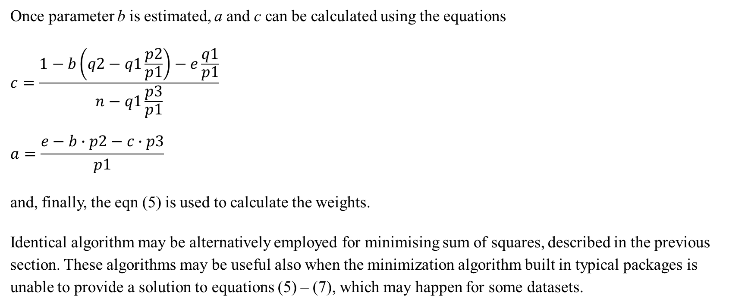
Once parameter b is estimated, a and c can be calculated using the equations
$$c=\frac{1−b\left(q2−q1\frac{p2}{p1}\right)−e\frac{q1}{p1}}{n−q1\frac{p3}{p1}}$$
$$a=\frac{e−b∙p2−c∙p3}{p1}$$
and, finally, the eqn (5) is used to calculate the weights.
Identical algorithm may be alternatively employed for minimising sum of squares, described in the previous section. These algorithms may be useful also when the minimization algorithm built in typical packages is unable to provide a solution to equations (5) – (7), which may happen for some datasets.

Slide 14
1.3 Handling negative solutions in STATA
The algorithms presented in previous sections, neither A & S method do not ensure all positive weights. Receiving negative ones is likely when sub-populations vary considerably in terms of sizes and some of them represent very small (well below 1%) shares. This problem may be handled in two ways. First, by adding an additional constraint in the estimation based on equations (5) – (7). As standard statistical/econometric packages, including STATA, does not allow imposing positive solutions, it has to be written indirectly, after changing eqn (5) from quadratic to cubic. This reduces probability of non-positive solutions, however they are still likely for some data.

Slide 16
1.4 Handling negative solutions in Excel Solver
A non-negativity constraint may be added to mathematical programming problems directly. Though such a constraint may be only in the form “greater or equal zero”, a positivity condition may be imposed indirectly, however at the cost of additional constraint.
Using Excel Solver has two serious limitations:
requires time consuming matrix manipulations that might be avoided when using methods based on regression
Solver cannot manage large datasets: the number of sub-populations cannot exceed 200 divided by the number of constraints; as a result, the weights for 80 Russia’s regions may be calculated only by one of the methods presented below

Slide 18
2. EMPIRICAL ILLUSTRATION
2. 1 The data
12 developed countries included in Human Mortality Database, the last data available (2013 or 2014), men and women separately (hereafter: HMD12)
80 regions in Russia, 2010, men and women together (hereafter: RUSSIA80), source: Human Development Report, 2013

Slide 19
Table 1. Life expectancy and population shares for 12 countries
(in last row life expectancy from life tables in parentheses)
Country | Life exp. women | Population share | Life exp. men | Population share
Czech Republic | 81.15 | 0.01312 | 75.15 | 0.01352
Germany | 82.86 | 0.10088 | 77.99 | 0.1031
Israel | 83.84 | 0.00988 | 80.29 | 0.01035
Japan | 86.63 | 0.15840 | 80.23 | 0.160463
Luxembourg | 83.43 | 0.00066 | 79.37 | 0.000703
New Zealand | 83.42 | 0.00554 | 79.8 | 0.005664
Poland | 80.92 | 0.04876 | 72.98 | 0.048824
Russian Federation | 76.29 | 0.18880 | 65.1 | 0.173701
Sweden | 83.71 | 0.01174 | 80.1 | 0.012477
Switzerland | 84.74 | 0.00998 | 80.52 | 0.01039
USA | 81.29 | 0.39238 | 76.54 | 0.405933
Ukraine | 76.21 | 0.05985 | 66.31 | 0.054875
Mean | 81.13 (80.75) | - | 74.69 (74.49) | -

Slide 20
2.2 Weights estimates
HMD12, men: all positive for STATA and Solver procedures
HMD12, women: all positive for Solver procedure, negative appear for STATA
RUSSIA80: all positive for STATA and Solver procedures, minimisation of absolute values not possible due to Solver capacity
2.3 Inequality measures
range (maximum minus minimum values): from 10.4 to 18.1 years
Gini and Theil inequality indices: strong impact of weighting method
Theil inequality index decomposition: less significant impact of weighting method

Slide 21
Table 2. Life expectancy ranges (in years)
Women 12 | Men 12 | Russia 80
range: e_{max} - e_{min}
86.63 - 76.21 = 10.42 (Japan, Ukraine) | 80.52 - 65.10 = 15.64 (Switzerland, Russia) | 79.08 – 61 = 18.08 (Ingushetia, Tuva)

Slide 22
Table 3. Gini inequality indices under various weighting of sub-populations
(percentage of unweighted index in parentheses)
Weights | Women 12 |  | Men 12 | Russia 80
 | Gini index * 100
no weights | 1.9544 | 3.4823 |  | 2.11644
population shares | 2.22533 | 3.6647 |  | 1.84198
 | (113.9%) | (105.2%) |  | (87.0%)
STATA min. squares | n. a. | 3.88038 |  | 1.80208
 |  | (111.4%) |  | (85.1%)
Solver min. squares | 2.23347 | 3.7847 |  | 1.70628
 | (114.3%) | (108.7%) |  | (80.6%)
Solver min. absolute values | 2.19255 | 3.73571 |  | n. a.
 | (112.2%) | (107.3%)

Slide 23
Tab.4. Theil inequality indices under various weighting of sub-populations
(percentage of unweighted index in parentheses)
Weights | Women 12 | Men 12 | Russia 80
 | Theil index * 100
no weights | 0.0672 | 0.2337 | 0.08709
population shares | 0.08577 | 0.25652 | 0.05721
 | (127.6%) | (109.8%) | (65.7%)
STATA min. squares | n. a. | 0.28188 | 0.05573
 |  | (120.6%) | (64.0%)
Solver min. squares | 0.08632 | 0.26877 | 0.05003
 | (128.5%) | (115.0%) | (57.4%)
Solver min. absolute values | 0.08379 | 0.26421 | n. a.
 | (124.7%) | (113.1%)

Slide 24
Table 4. Decomposition of Theil index into within- and between-group inequality
(post-commmunist countries, „Western” Europe, non-European countries)
Weights | Women 12 |  | Men 12
 | within | between | within | between
no weights | 36.1% | 63.9% | 25.6% | 73.5%
population shares | 38.6% | 61.4% | 17.7% | 82.3%
STATA, min. squares | n. a. | n. a. | 14.7% | 85.3%
Solver, min. squares | 35.0% | 65.0% | 17.1% | 82.9%
Solver min. absolute values | 35.1% | 64.9% | 17.2% | 82.8%

Slide 25
CONCLUDING REMARKS:
1. To weight or not to weight
no weighting: in comparisons of longevity/health status between countries (regions)
weighting: when answering the question “how unequal people are?”
2. Weighting matters
there are no rules of direction of the impact of weights on the inequality measures (varies between datasets)
the resulting differences between types of weights are less important, though noticeable
Excel Solver yields more theoretically consistent weights than constrained regression but is somehow awkward in multiple applications

Slide 26
REFERENCES
Anand, S., F. Diderichsen, T. Evans, V. M. Shkolnikov and M. Wirth (2001), “Measuring disparities in health: methods and indicators”, in.: T. Evans, M. Whitehead, F. Diderichsen, A. Bhuiya and M. Wirth (eds.) Challenging inequities in health: from ethics to action, pp. 48-67. Oxford University Press.
Human Mortality Database. University of California, Berkeley (USA) and Max Planck Institute for Demographic Research (Germany), www.mortality.org.
Koenker, R. W. and G. W.Bassett, Regression Quantiles, Econometrica 46, pp. 33-50,1978
Sustainable Development: Rio Challenges, National Human Development Report for the Russian Federation 2013, UNDP, Moscow
Shkolnikov, V. M., T. Valkonen, A. Begun and E. M. Andreev (2001), Measuring inter-group inequalities in length of life, Genus, Vol. 57, No. 3/4, pp. 33-62.

Slide 27
THANK YOU VERY MUCH FOR YOUR ATTENTION
aszulc@sgh.waw.pl

