Slide 1
Normand Péladeau
President
Provalis Research Corp.
peladeau@provalisresearch.com

Slide 2
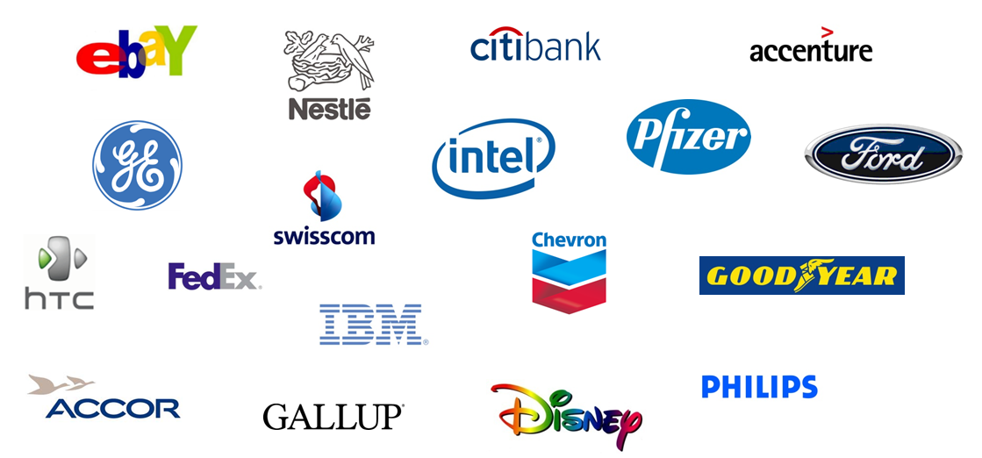
Provalis Research
Some commercial clients:

Slide 3
Provalis Research
Some governmental and NGO clients:

Slide 4
Provalis Research
Some Academic Clients:

Slide 5
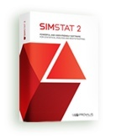
Our Products
1989
Statistical Analysis & Bootstrapping

Slide 6
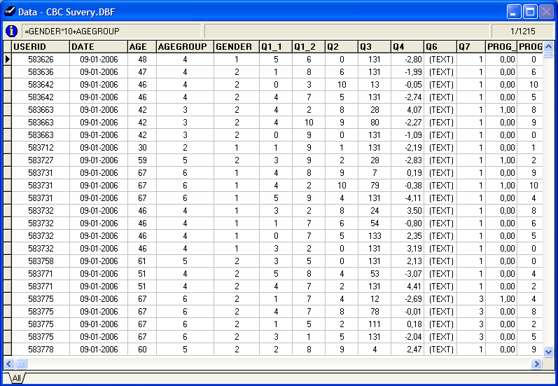
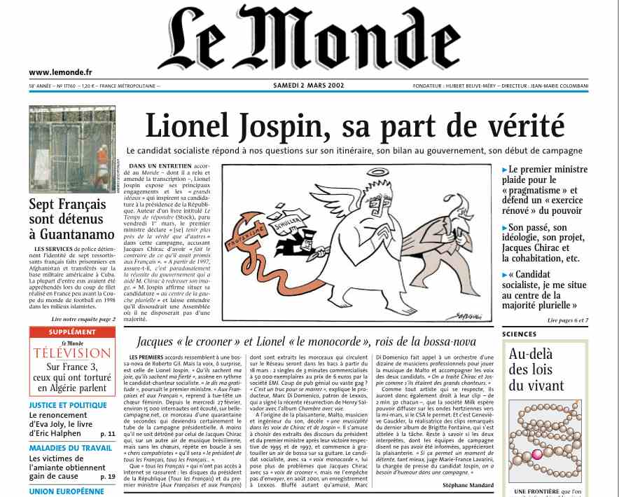
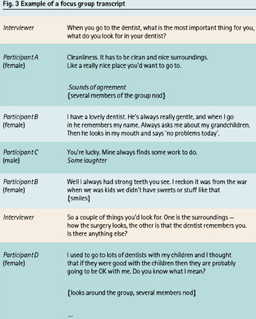
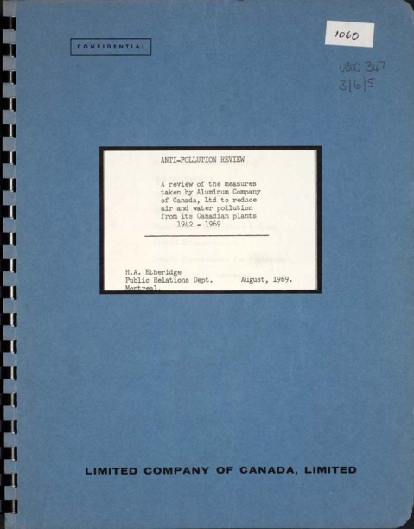
Our Products

Slide 7
Our Products
1989
Statistical Analysis & Bootstrapping
1998
Content Analysis
& Text Mining
2004
Qualitative Analysis
& Mixed Methods

Slide 8
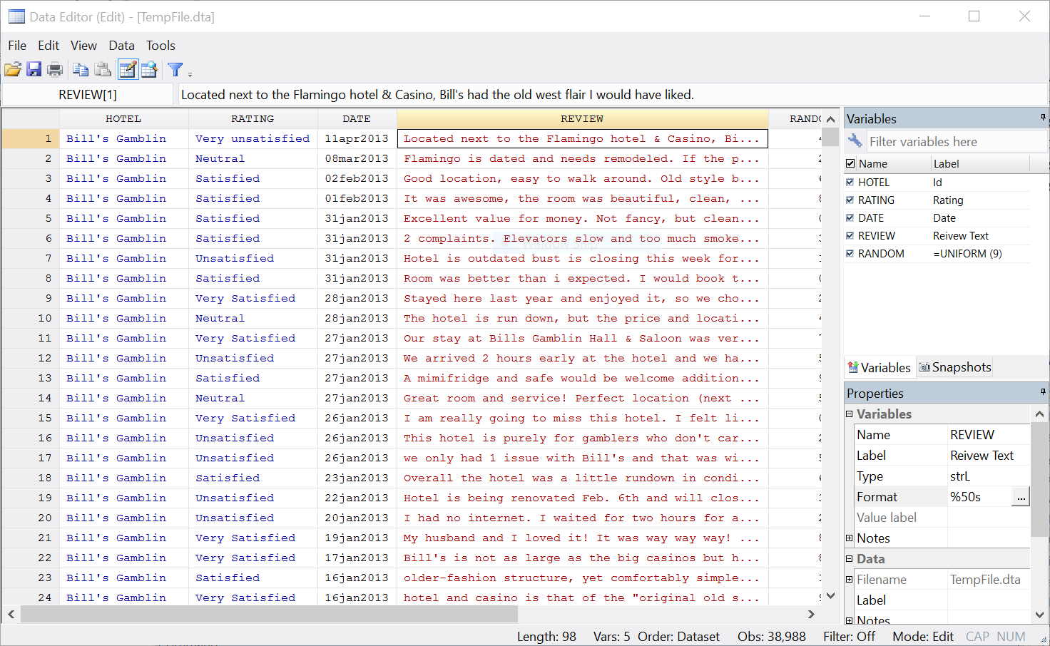
WordStat for Stata
June 2013
Stata 13
Content Analysis
& Text Mining

Slide 9
Necessity is the mother of invention
Innovation
Challenges
issues
Invention

Slide 10
Laziness
Necessity is the mother of invention
Innovation
Challenges
issues
Invention

Slide 11
Text Analytics Challenge
THREE MAJOR OBSTACLES
1) Very large number of word forms

Slide 12
Challenge #1 – Quantity
38,996 comments about hotels
2,1 millions words (tokens)
20,116 word forms (types)
1,8 million course evaluations
35 millions words (tokens)
78,159 word forms (types)

Slide 13
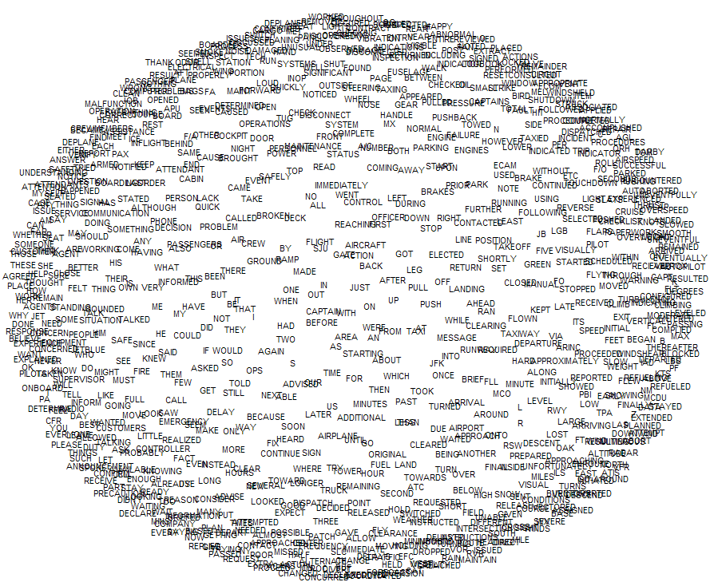
Text Analytics Challenge

Slide 14
Text Analytics Challenge

Slide 15
Text Analytics Challenge
Positive and Negative Reactions
18
15
12
Count
9
6
3
0
CRS
CISCO
COST
MARKET
LAUNCH
UPGRADE
MESSAGING
INTERFACES
NET_NOUNS
ACQUISITION
SOFTWARE
HARDWARE
ARCHITECTURE
SIZEANDPOWER
COMPETITORS
PERFORMANCE
CISCOPRODUCTS
POSITIVES
NEGATIVES

Slide 16
Challenge #1 – Solutions
Statistical tools
Frequency selection
Data reduction techniques (HCA, PCA, FA)
Exploratory data analysis (ex. CA).
Machine Learning

Slide 17
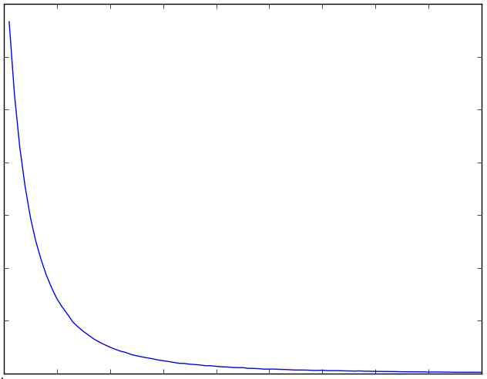
The Statistics of Text
Distribution of words: Zipf distribution

Slide 18
The Statistics of Text
38,988 comments about hotels
2.1 M words (20,114 different words)
MOST FREQUENT FORMS | PERCENTAGE OF FORMS | PERCENTAGE OF WORDS
49 | 0.24% | 50%
300 | 1.5% | 76%
500 | 2.5% | 83%
1000 | 5.0% | 90%

Slide 19
Challenge #1 – Solutions
Statistical tools
Frequency selection
Data reduction techniques (HCA, PCA, FA)
Exploratory data analysis (ex. CA).
Machine Learning
Natural language processing (NLP) tools
Stopword list
Stemming
Lemmatization

Slide 20
Text Mining Approach
PROS
Very fast
Very little efforts
Inductive
CONS
Comparison of results
Does not quantify accurately
Insensitive to low frequency events
Inductive

Slide 21
Text Analytics Challenge
THREE MAJOR OBSTACLES
1) Very large number of word forms

Slide 22
Text Analytics Challenge
THREE MAJOR OBSTACLES
1) Very large number of word forms
2) Polymorphy of language One idea → multiple forms

Slide 23
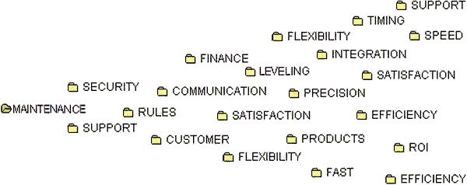
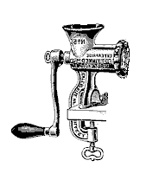
Content analysis method

Slide 24
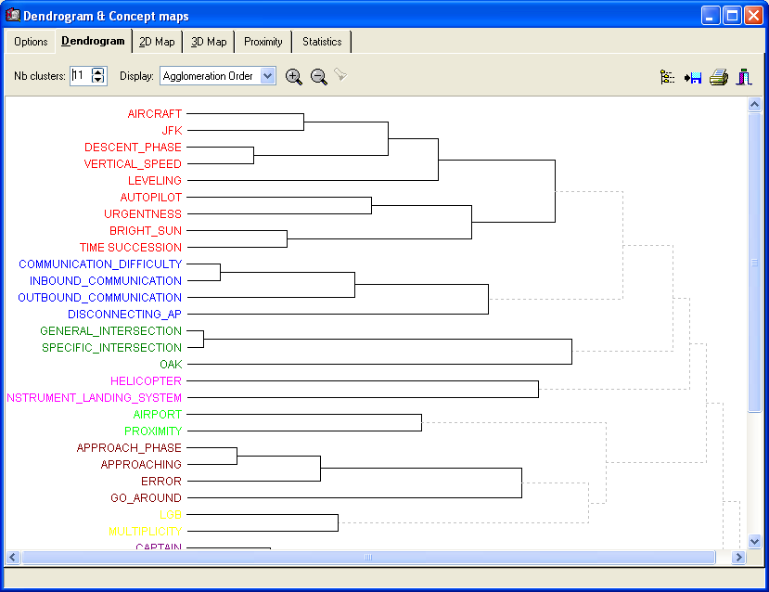
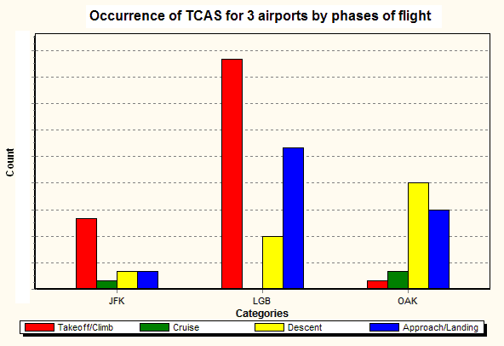
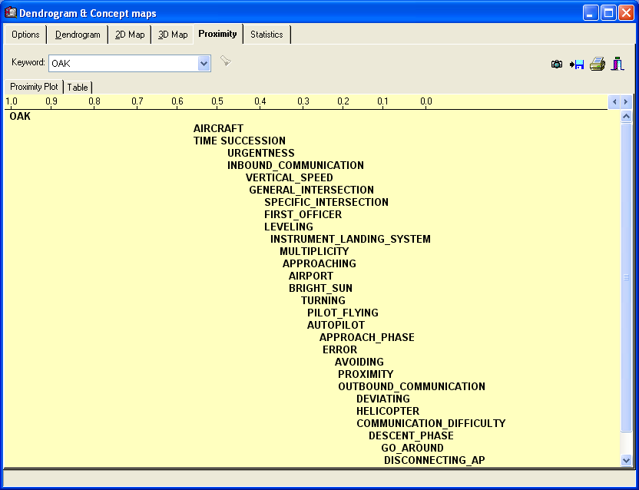
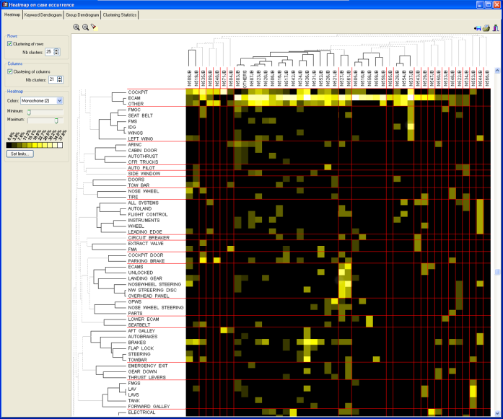
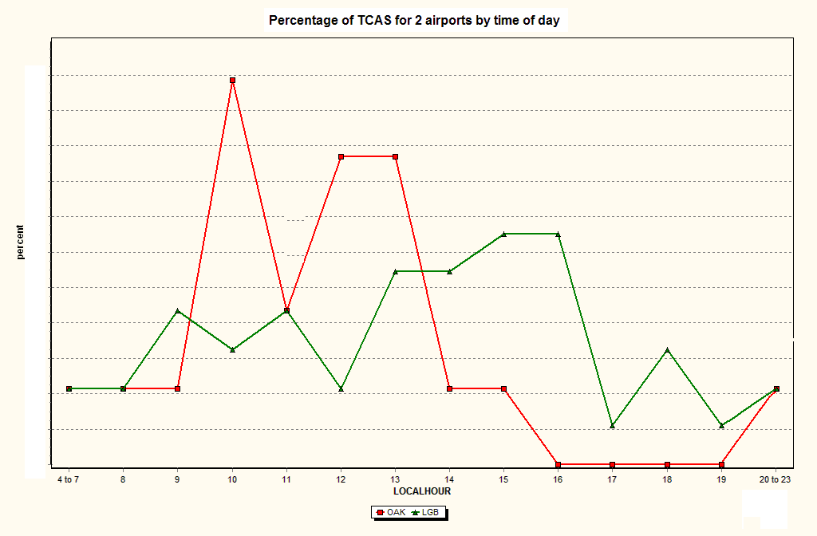
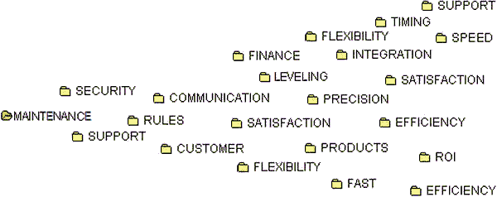
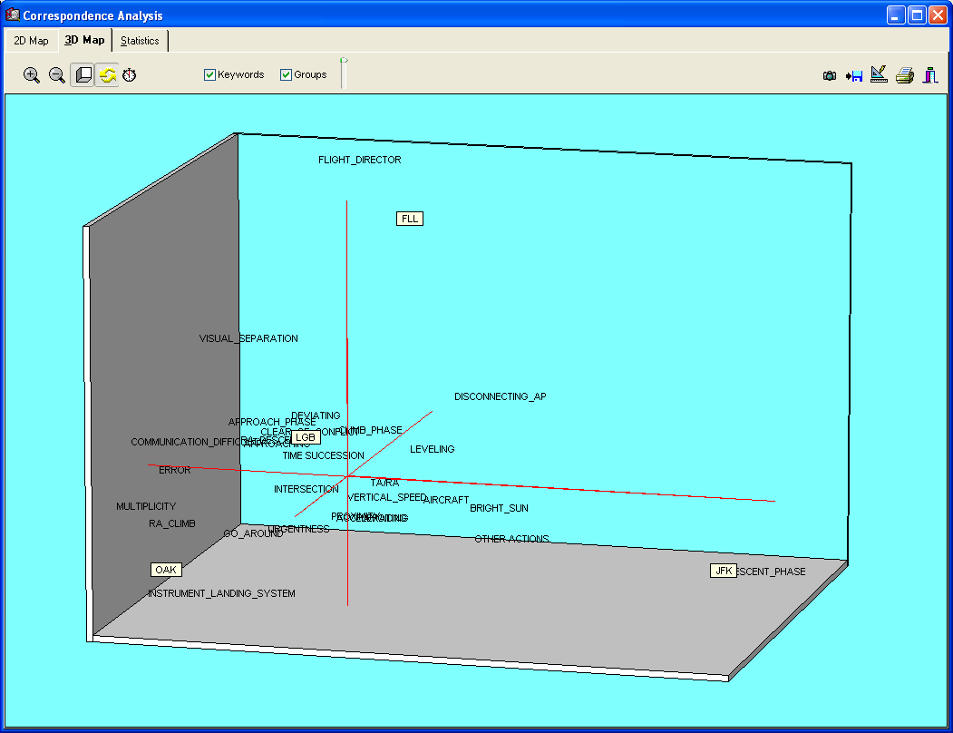
Content analysis method

Slide 25
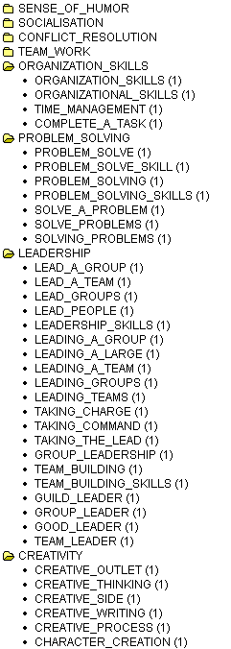
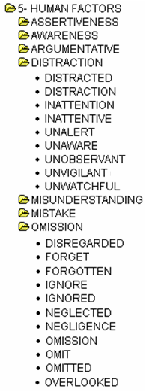
Content analysis method

Slide 26
Content analysis method
PROS
Can measure more accurately
Can be focused (multi-focus)
Allows full automation
CONS
Dictionary construction & validation

Slide 27
Text Analytics Challenge
THREE MAJOR OBSTACLES
1) Very large number of word forms
2) Polymorphy of language One idea → multiple forms

Slide 28
Text Analytics Challenge
THREE MAJOR OBSTACLES
1) Very large number of word forms
2) Polymorphy of language One idea → multiple forms
3) Polysemy of words One word → many ideas

Slide 29
Challenge #3 – Polysemy of words
Keyword in Context List (KWIC)
Senses of word “stress”
#1 (psychology) a state of mental or emotional strain or suspense
#2 (physics) force that produces strain on a physical body
#3 Verb - single out as important

Slide 30
Challenge #3 – Polysemy of words
Keyword in Context List (KWIC)
Disambiguation using phrases
STRESS*_THE or STRESS*_THAT → “single out as important”
UNDER_STRESS → Emotional State

Slide 31
Challenge #3 – Polysemy of words
Keyword in Context List (KWIC)
Disambiguation using rules
TRANSFER* IS NEAR TECHNOLOGY
TRANSFER* IS NOT NEAR BUS
SATISFIED IS AFTER #NEGATION

Slide 32
Challenge #4 – Misspellings
78,159 word forms:
46,404 “unknown” words
75 % misspellings (≈ 35,000)
21 % proper names (products & people)
4% acronyms

Slide 33
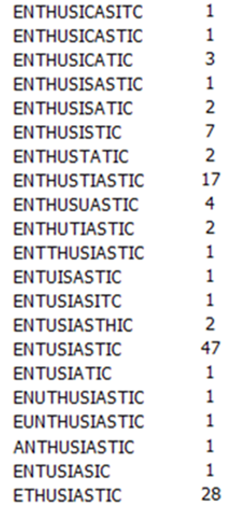
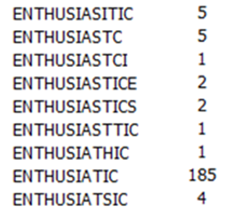
Challenge #4 – Misspellings
61 ways to be “Enthusiastic”

Slide 34
Challenge #4 – Misspellings
Fuzzy and phonetic string comparison algorithms:
Damerau-Levenshtein
Koelner Phonetik
SoundEx
Metaphone
Double-Metaphone
NGram
Dice
Jaro-Winkler
Needleman-Wunch
Smith-Waterman-Gotoh
Monge-Elkan

Slide 35
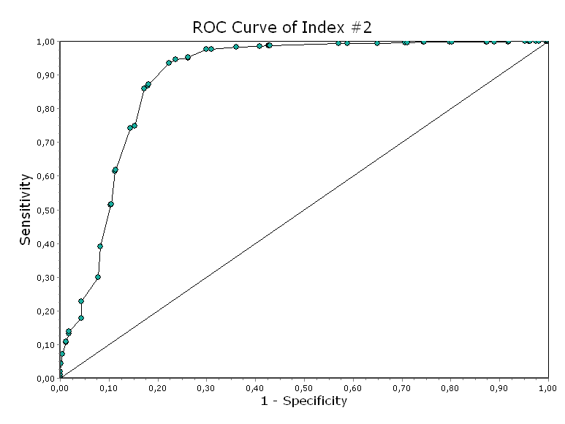
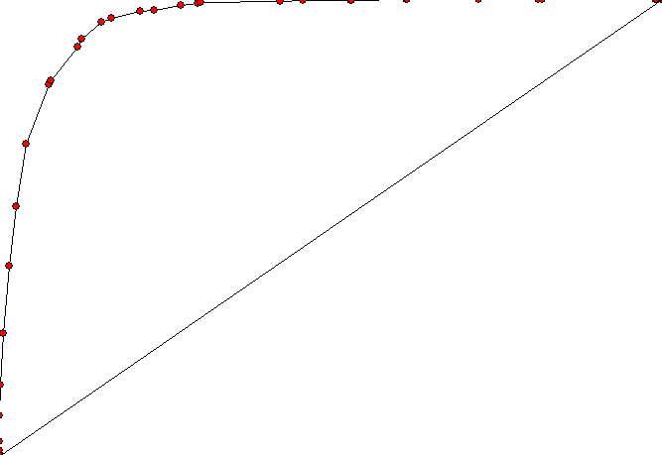
Challenge #4 – Misspellings

Slide 36
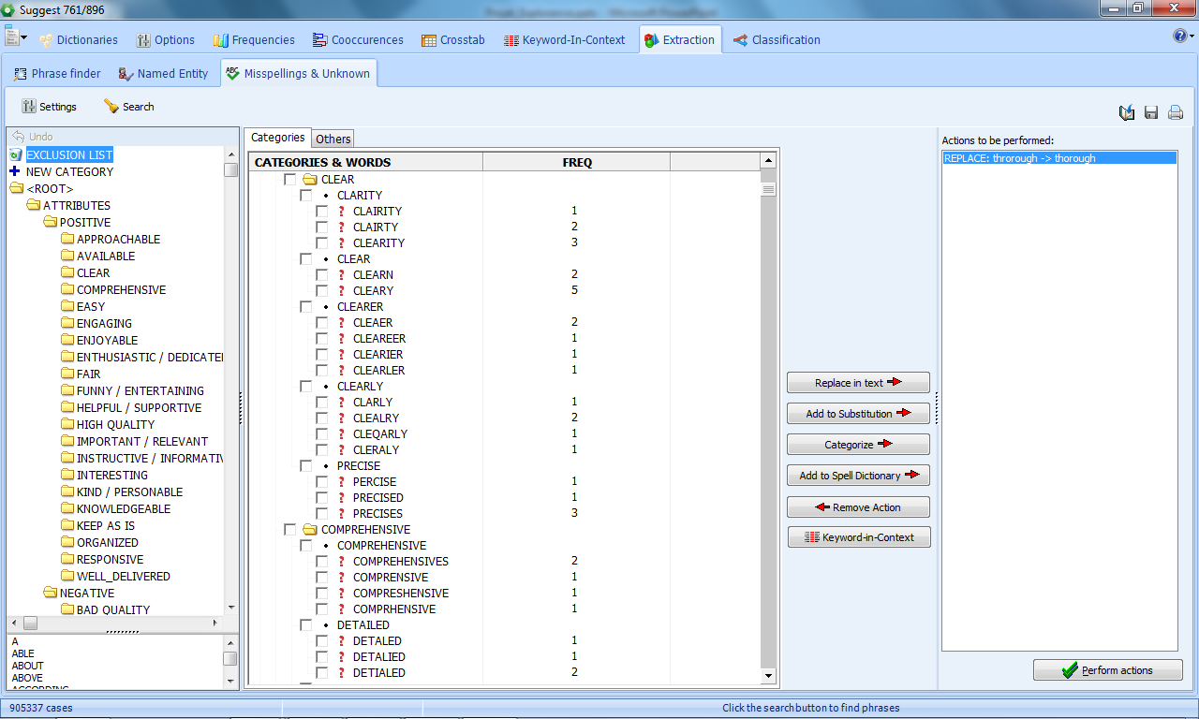
Challenge #4 – Misspellings

Slide 37
What’s next?
Questions?

