Slide 1
Topic: Estimation Of Demand System Elasticities Using Stata
Abstract :
This paper aims to share the experience of estimating of elasticities and analyzing the consumption pattern at the household level. It highlights the use of STATA commands in the estimation and post-estimation of various demand models over the period of two decades in Academia.
Presented By
DR. M PRAHADEESWARAN
Associate Professor
Tamil Nadu Agricultural University,Tamil Nadu

Slide 2
Estimation of Demand System Elasticities using STATA
Dr M Prahadeeswaran
Experience STATA in the World of Data Science
Presented at Indian STaTa Conference 2023 on 30-11-2023 at Mumbai

Slide 3
With STATA
Demand System
Academic & Research
AIDS & QAIDS
In STATA
Other work
Time Series
Experience

Slide 4
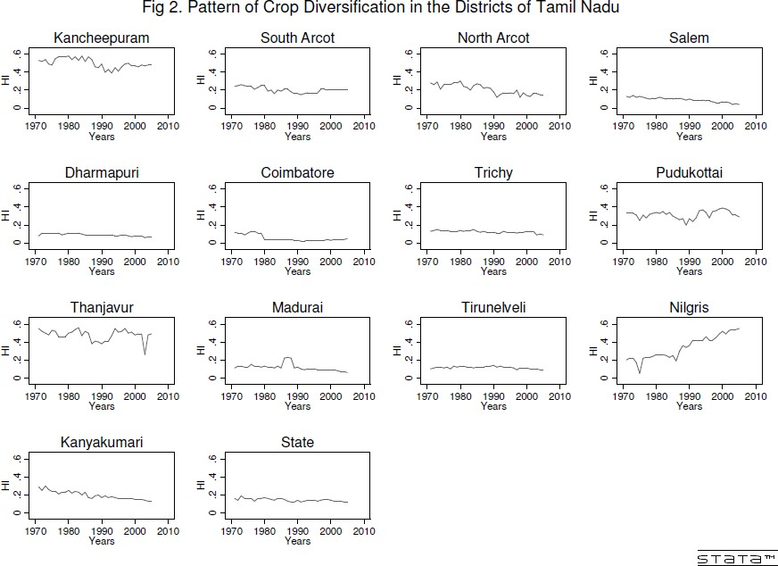
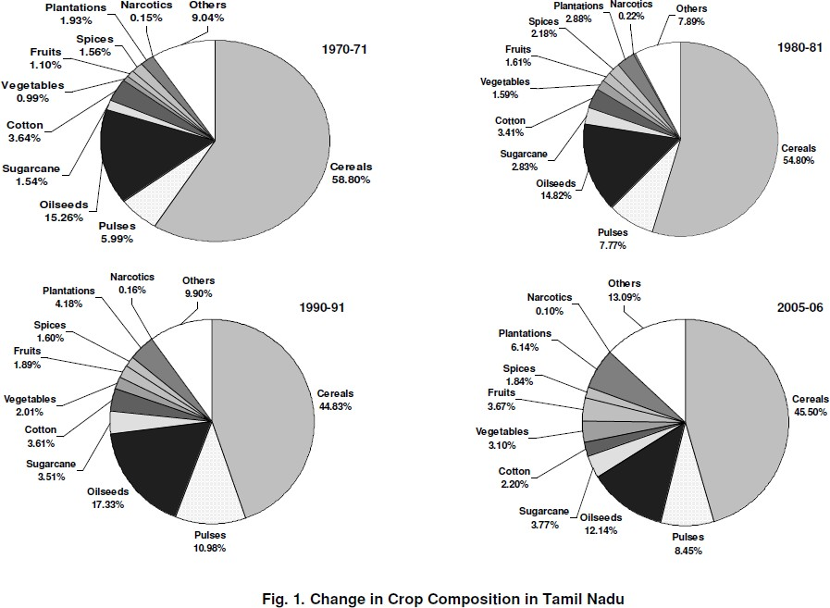
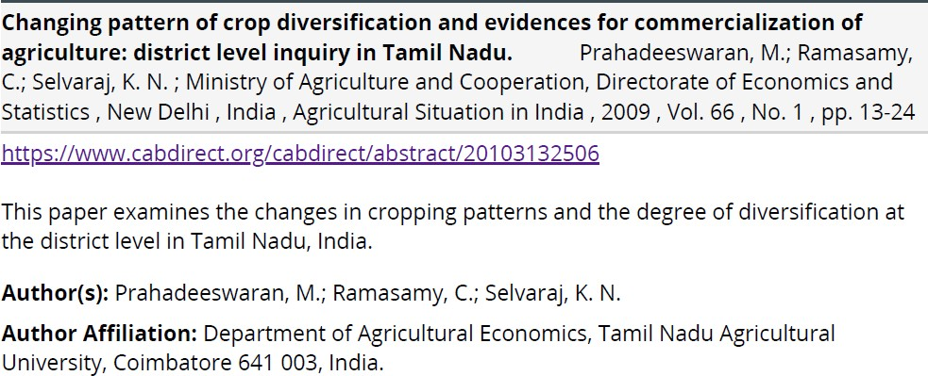
From 10 to 18
My first work
No Log …. No Project

Slide 5
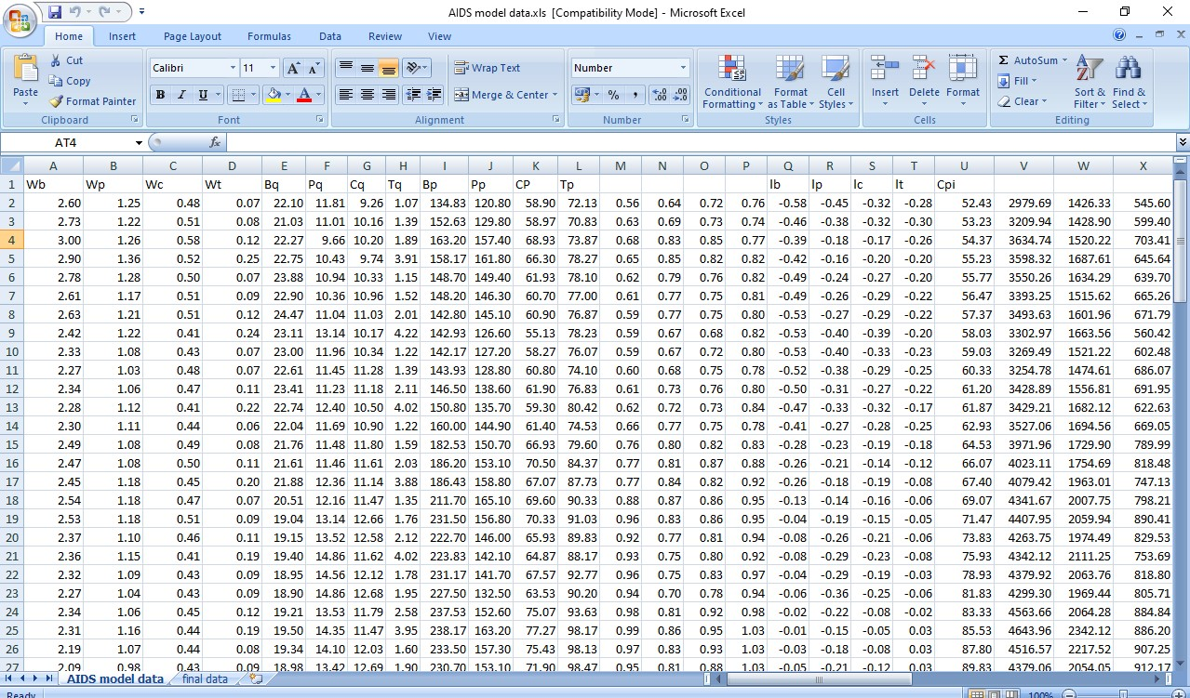
From 10 to 18
My first estimation
x = beef_p*beef_q + pork_p*pork_q
+ chick_p*chick_q + turkey_p*turkey_q;
w_beef = beef_p*beef_q/x; w_pork = pork_p*pork_q/x; w_chick = chick_p*chick_q/x; w_turkey = turkey_p*turkey_q/x; pb_ = (beef_p/b_m);
pp_ = (pork_p/p_m); pc_ = (chick_p/c_m); pt_ = (turkey_p/t_m); lpb = log(pb_);
lpp = log(pp_); lpc = log(pc_); lpt = log(pt_);
lx = log(x);
lp0 = sum(w_beef*lpb + w_pork*lpp + w_chick*lpc + w_turkey*lpt); lxp = lx-lp0;
Elasticities | beef | pork | chick | turkey
Beef | -1.15798529 | 0.39022212 | 0.77102384 | -0.72280462
Pork | -0.02320152 | -1.04798541 | 0.23816144 | -2.94667275
Chick | 0.00398018 | -0.06445681 | -0.84502287 | -4.3488895
 | 0.32192809 | -0.02053899 | -0.77073634 | 3.03127821
income elasticity | 0.85527854 | 0.7427591 | -0.55347706 | 10.5482487

Slide 6
STaTa Vs S**S

Slide 7
Demand Estimation

Slide 8
Single Equation Demand Function
The use of relative prices and real income in the equation as exogenous variable makes the demand equations homogeneous of degree zero in prices and income.
Constant elasticity model (does not vary across groups: income, rural/urban)
This approach is simple but has serious drawbacks. The estimated parameters, in general, do not satisfy the requirements of demand theory, particularly the budget constraint.

Slide 9
Alternate Approaches: Complete System
Linear Expenditure System (LES): Stone (1954)
Almost Ideal Demand System (AIDS):Deaton and Muellbauer (1980)
Quadratic AIDS [Extension of AIDS]
Generalized Almost Ideal Demand System (GAIDS): Ballino (1990)
[combination of LES and AIDS]
Rotterdam model: Theil (1976) and Barten (1969) and
Translog model: Christensen, Jorgenson &Lau (1975).

Slide 10
Alternate Approaches: Complete System
LES model is better applied to large categories of expenditure than to individual commodities, since it does not allow for inferior goods and implies that all goods are gross complements.
The econometric problem with the AIDS model is that the demand equations appear to be unrelated, since none of the endogenous quantities or budget share appear on the right-hand side of the equations.
Most studies of demand systems use static models, which do not account for hypothesis of symmetry and homogeneity, derived from consumer theory.
Thus, there is a need for a dynamic demand system which gives more
realistic and econometrically viable results

Slide 11
Alternate Approaches: Complete System
Demand and income elasticities are not necessarily constant across the consumer groups. Thus the functional form and allow income elasticities to differ between rich and poor households.
The functional form should be able to be estimated when a household has zero consumption of particular foods, otherwise those households have to be dropped from the sample, which could cause sample selection bias (Deaton 1989).
Transcendental Logarithmic Demand System (TLDS), Normalized Quadratic Demand System (NQDS) and Linear Expenditure Demand System (LEDS) and non- econometric Food Characteristic Demand System (FCDS). But still all these models assumed a linearity in expenditure.

Slide 12
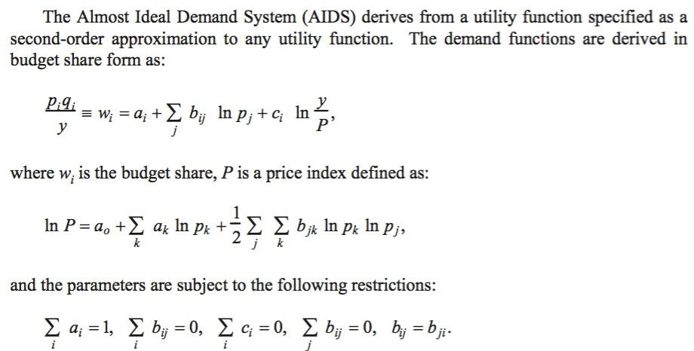
AIDS: Theory

Slide 13
QUAIDS Model
QUAIDS model is an extended form of AIDS model
The model is quadratic in per capita expenditure under the assumption that there is a non-linear relationship between income and expenditure.
Two stage framework
Total expenditure
Total food expenditure
(for example)
Several demand studies have confirmed the appropriateness of QUAIDS in
modelling preferences.

Slide 14
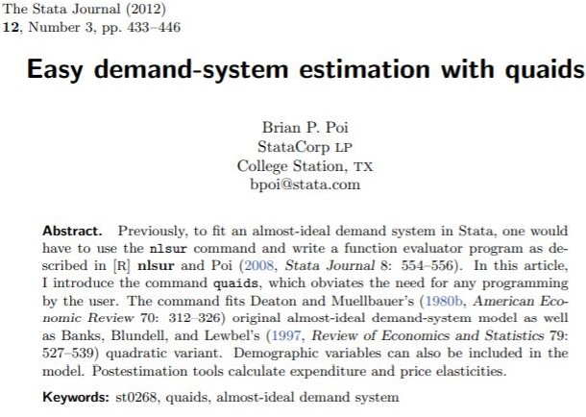
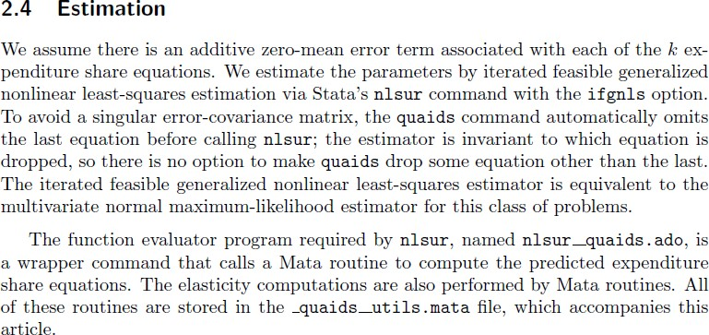
QUAIDS Estimation in STATA
Stata 12.1

Slide 15
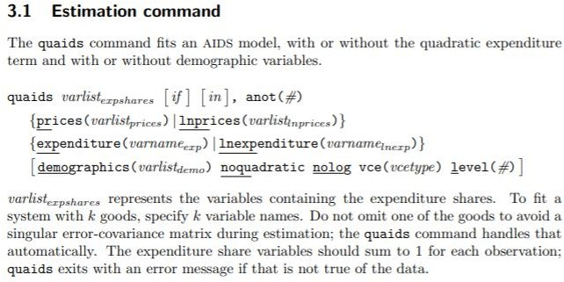
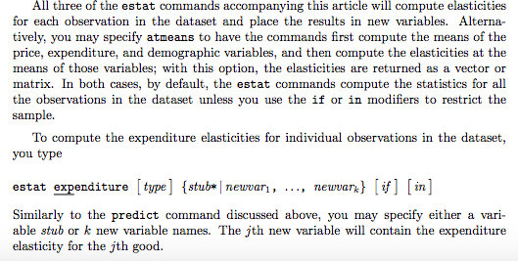
QUAIDS Estimation in STATA

Slide 16
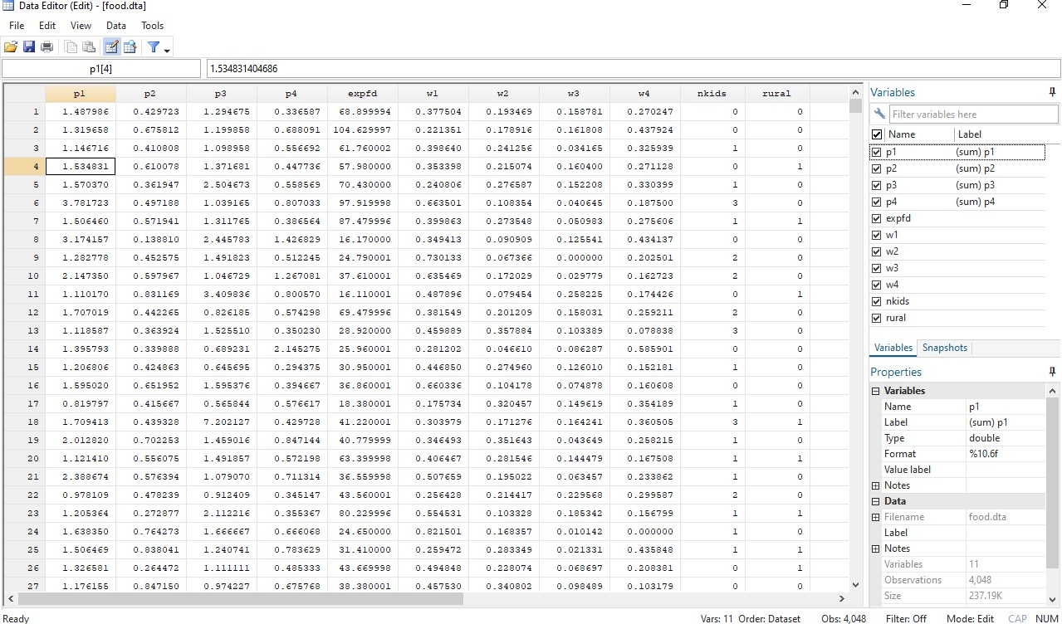

Slide 17
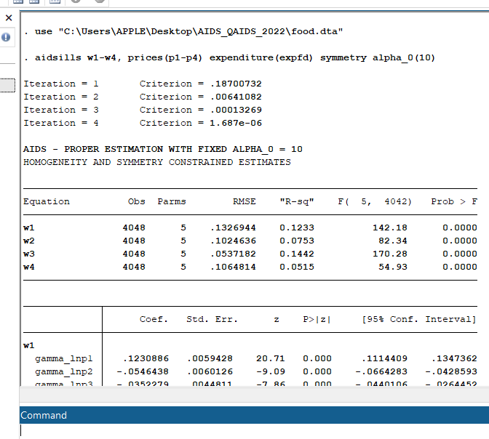
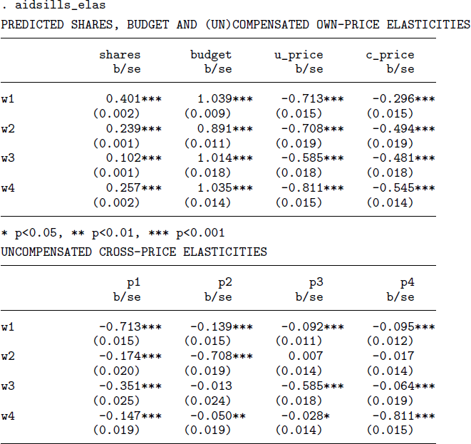

Slide 18
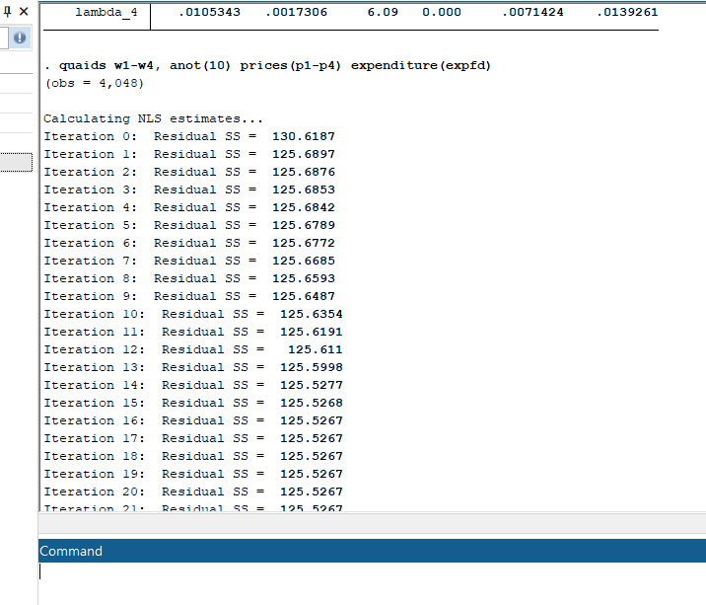
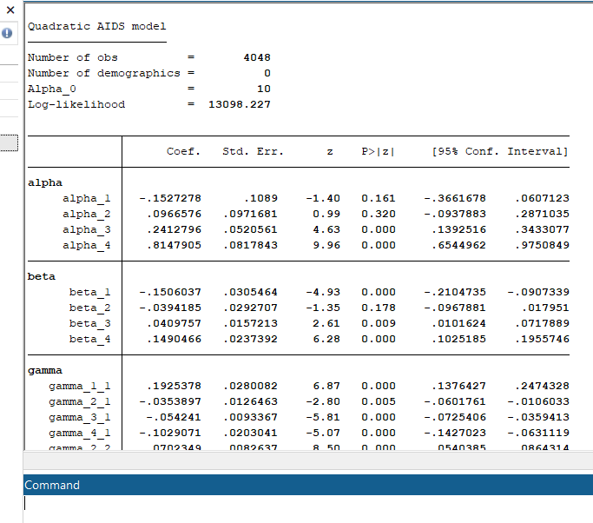

Slide 19
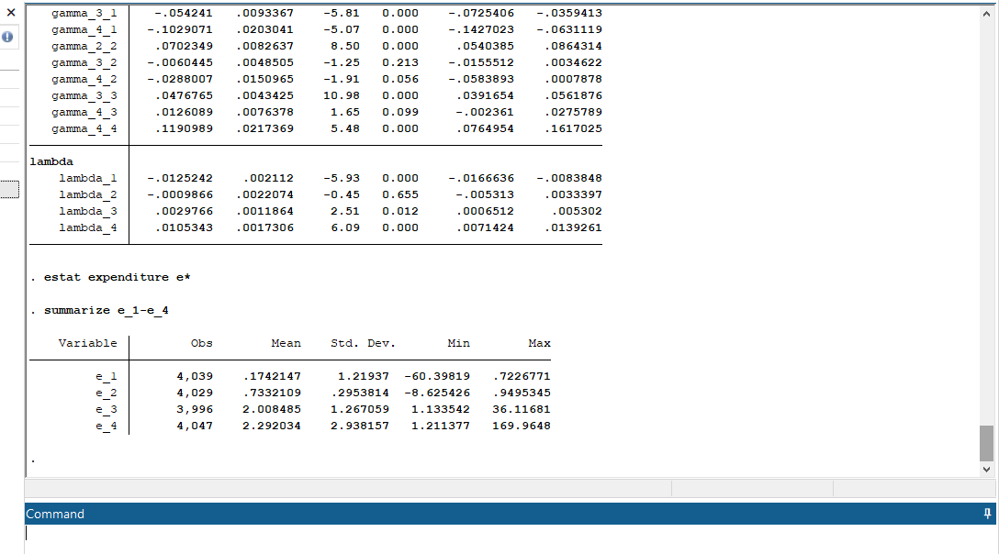

Slide 21
Bibliographical References
Elisabeth Sadoulet and Alain de Janvry. 1995. Quantitative Development Policy Analysis. The John Hopkins University Press, Baltimore and London. ISBN 0-8018-4783-4
Surabhi Mittal (2010): Application of the QUAIDS Model to the Food Sector In India. Journal of Quantitative Economics, Vol. 8 No.1, January 2010. PP 42-54
Brian P Poi. 2012. Easy Demand-Sysem Estimation with quaids.
The Stata Journal. 12 (3), 433-446

Slide 22
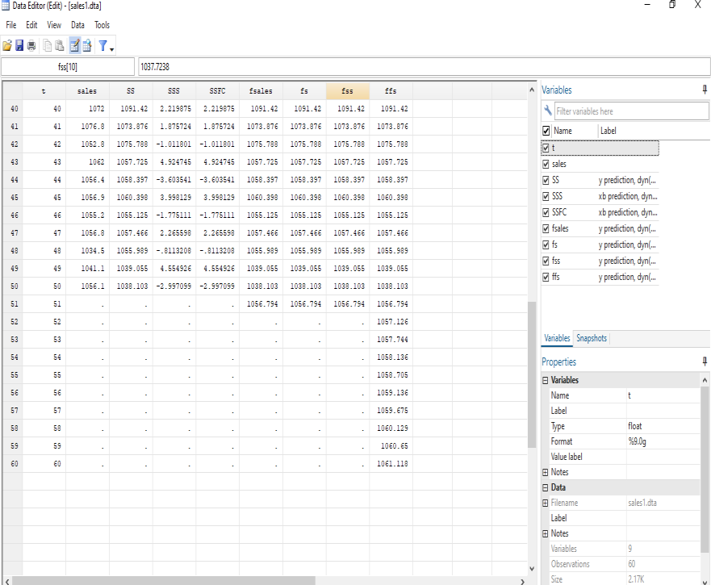
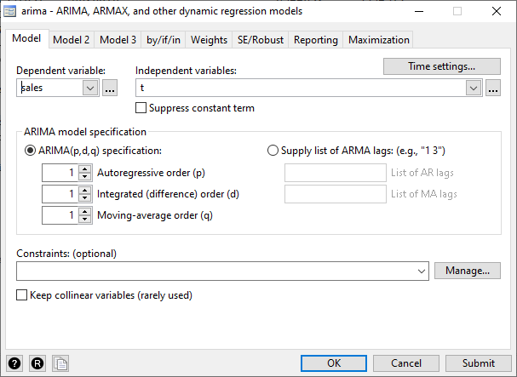
From 10 to 18
Time Series Analysis
1000 1020 1040 1060 1080 1100
0
20 40
60
t
sales y prediction, dyn(51)

Slide 23
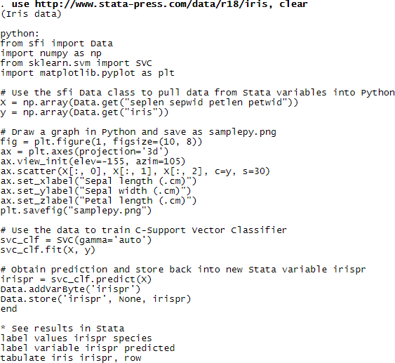
From 10 to 18
Python Integration
Initiated the Work

Slide 24
Thanks

