Slide 1
Biostatistics using Stata
Paul Grootendorst
Leslie Dan Faculty of Pharmacy
University of Toronto

Slide 2
Overview of the course
Graduate students in the pharmaceutical sciences
  Taught the course for the first time in winter 2018
Focused on methods to estimate treatment effects using randomized trials
Used standard econometric treatment of linear regression models and ML models
  Stock & Watson. Introduction to Econometrics 3rd ed.
  Davidson & MacKinnon. Econometric Theory and Methods.
Slides are available from
  http://individual.utoronto.ca/grootendorst/teaching.htm

Slide 3
Why use Stata instead of R?
Stata is relatively easy to use and teach in one term course
  Common syntax for many commands
Very good data management features
I have used Stata for 25 years
Downsides
  Costs money
  .dta compatibility

Slide 4

Course overview
Review of probability [100 slides]
Overview of estimation and inference in the two group RCT [288]
  Linear regression model: $y=β_{0}+β_{1}x+ε$ with cross sectional data, binary $x$ with values randomly assigned to each of $n$ subjects

Slide 5
Overview of Estimation
Data Generating Process (DGP) for Y
DGP is unobserved
reflects how systematic and idiosyncratic (random) factors determine Y
Model of DGP for Y
Reflects our best guess as to how systematic and random factors determine Y
Two types of models: Conditional on other variables (causal effects estimation, prediction) and unconditional (estimating mean, median, variance and other features of probability distribution of Y)
In this course, models depends on unknown constants called parameters
d
d
Data Set
n observations on Y: {Y₁, …,Y_{n}}, possibly other “X” variables as well
Represents 1 set of realizations of DGP
How the observations were sampled from DGP (SRS, non-random, etc.) affects the sampling distribution
d
d
Estimator of unobserved parameters in our model
Plug data set into estimator to get numerical estimates
Quality of the estimates depends on features of estimator’s sampling distribution
Estimator’s Sampling Distribution
Is the probability distribution of estimates one would get by obtaining very large number of data sets from DGP, and for each data set, getting estimate.
Unobserved, but you can sometimes deduce its general shape (normal?), its location (unbiased or biased?) and its width (variance)
The degree of confidence in our estimate is higher if estimator unbiased and low variance.
d
d
Estimator of variance of estimator of the parameters in our model

Slide 6
Course overview
Extensions to the two group RCT [236]
  modeling proportional, not absolute, differences between treatment groups
  bootstrapping
  improving estimator precision by taking multiple observations per subject
  Randomized Block Design
  estimating sample size requirements by simulation
  quantile regression model estimation …

Slide 7
Course overview
Multiple linear regression model [174 slides]
  Express OLS in matrix notation
  Contrast t vs F-tests
Extensions to the multiple linear regression model [128]
  Modelling nonlinear functions using LRMs
  Subgroup analyses
  LRMs for longitudinal data
  Using LRMs for prediction
  Heteroskedasticity
  Using matching to estimate TEs

Slide 8
Course overview
Logit models for binary outcomes [77 slides]
  Expressing treatment effects in logit models
Models for time to event outcomes [73]

Slide 9

Using stata to illustrate statistical results
1. Simulating the shape of an estimator’s sampling distribution
  LRM: $y=β_{0}+β_{1}x+ε$
  We use ${\hat{b}}_{1}$, OLS estimator of $β_{1}$.
  What is the distribution of ${\hat{b}}_{1}$ in repeated samples?

Slide 10
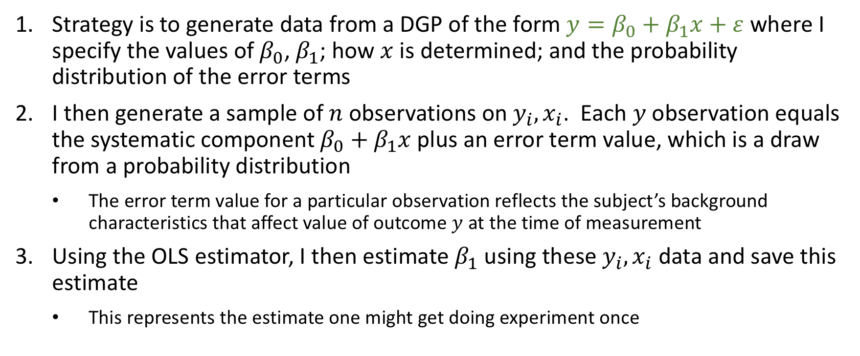

Simulating sampling distribution of ${\hat{b}}_{1}$
  Strategy is to generate data from a DGP of the form $y=β_{0}+β_{1}x+ε$ where I specify the values of $β_{0}$, $β_{1}$; how $x$ is determined; and the probability distribution of the error terms
  I then generate a sample of $n$ observations on $y_{i}, x_{i}$. Each $y$observation equals the systematic component $β_{0}+β_{1}x$plus an error term value, which is a draw from a probability distribution
    The error term value for a particular observation reflects the subject’s background characteristics that affect value of outcome $y$ at the time of measurement
  Using the OLS estimator, I then estimate $β_{1}$ using these $y_{i}, x_{i}$ data and save this estimate
    This represents the estimate one might get doing experiment once

Slide 11
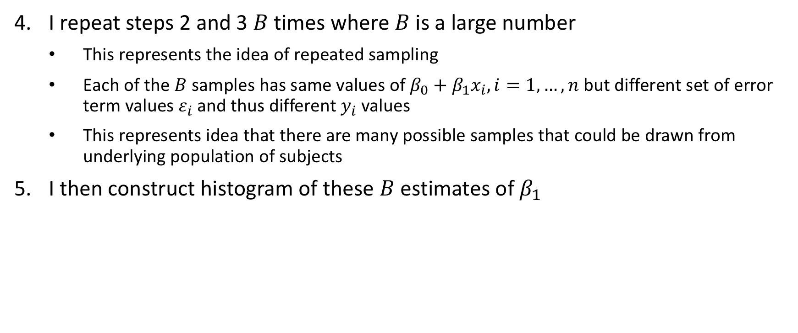
Simulating sampling distribution of ${\hat{b}}_{1}$
  I repeat steps 2 and 3 $B$ times where $B$ is a large number
    This represents the idea of repeated sampling
    Each of the $B$ samples has same values of $β_{0}+β_{1}x_{i}, i=1,…,n$ but different set of error term values $ε_{i}$and thus different $y_{i}$ values
    This represents idea that there are many possible samples that could be drawn from underlying population of subjects
  I then construct histogram of these $B$ estimates of $β_{1}$

Slide 12
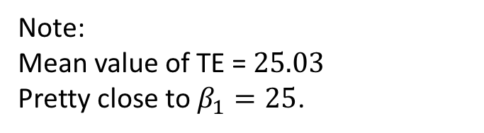
Simulating sampling distribution of ${\hat{b}}_{1}$
Note:
Mean value of TE = $25.03$
Pretty close to $β_{1}=25$.
Histogram of $1000$ estimates of $β_{1}$, each estimated using $n=50$ observations.

Slide 13
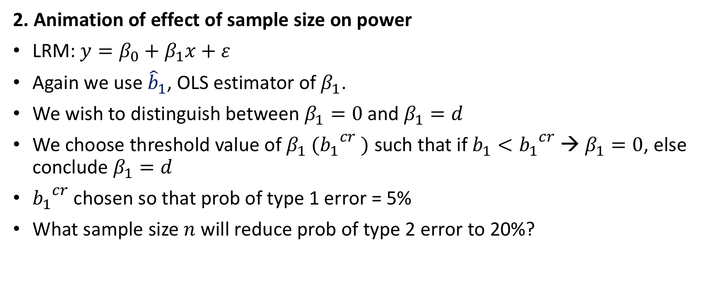
Using stata to illustrate statistical results
2. Animation of effect of sample size on power
  LRM: $y=β_{0}+β_{1}x+ε$
  Again we use ${\hat{b}}_{1}$, OLS estimator of $β_{1}$.
  We wish to distinguish between $β_{1}=0$and $β_{1}=d$
  We choose threshold value of $β_{1}$ $({b_{1}}^{cr} )$ such that if $b_{1}<{b_{1}}^{cr}$ → $β_{1}=0$, else conclude $β_{1}=d$
  ${b_{1}}^{cr}$ chosen so that prob of type 1 error = 5%
  What sample size $n$ will reduce prob of type 2 error to 20%?

Slide 14
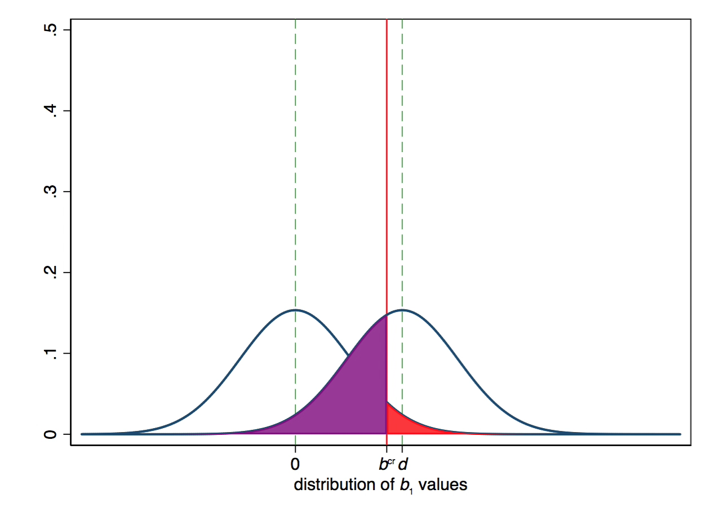



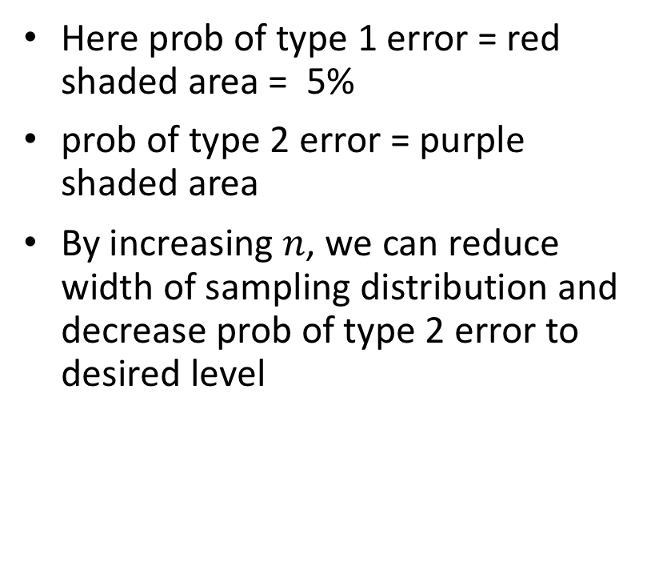

Sample size calculations
$${b_{1}<b_{1}}^{cr}$$
$${b_{1}>b_{1}}^{cr}$$
Conclude $β_{1}=0$
Conclude $β_{1}=d$
  Here prob of type 1 error = red shaded area = 5%
  prob of type 2 error = purple shaded area
  By increasing $n$, we can reduce width of sampling distribution and decrease prob of type 2 error to desired level

Slide 15
Using stata to illustrate statistical results
3. For binary outcome models, size of treatment effect depends on error term variation
With standard LRM of continuous outcomes, we can speak of “the” treatment effect
When modelling binary outcomes, there is no single TE
TE smaller, the greater is the variation in the error term of latent outcome
Anything that reduces error term variation (such as including in LRM covariates that were in error term) increases the TE

Slide 16
Treatment effects vary – simple illustration
Suppose we are modelling vital status (alive vs dead)
You remain alive as long as your underlying continuous health score remains above some threshold level
Health score depends on genetic score and whether or not you take a new prescription drug
You observe vital status and drug use; you don’t observe health score (or genetic score)
We will see that effect of new drug on probability of being alive depends on the variation in the genetic score

Slide 17
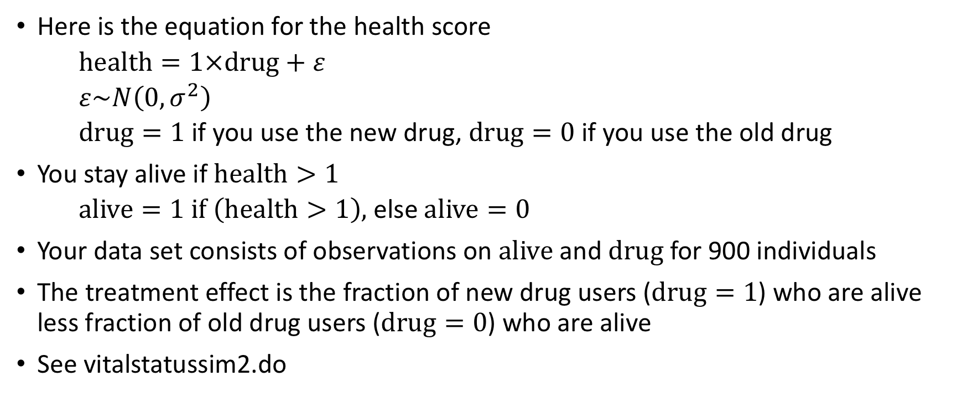
Treatment effects vary – simple illustration
Here is the equation for the health score
  $health=1×drug+ε$
  $ε\sim N\left(0,σ^{2}\right)$
  $drug=1$ if you use the new drug, $drug=0$ if you use the old drug
You stay alive if $health>1$
  $alive=1 if \left(health>1\right)$, else $alive=0$
Your data set consists of observations on $alive$ and $drug$ for 900 individuals
The treatment effect is the fraction of new drug users ($drug=1$) who are alive less fraction of old drug users ($drug=0$) who are alive
See vitalstatussim2.do

Slide 18
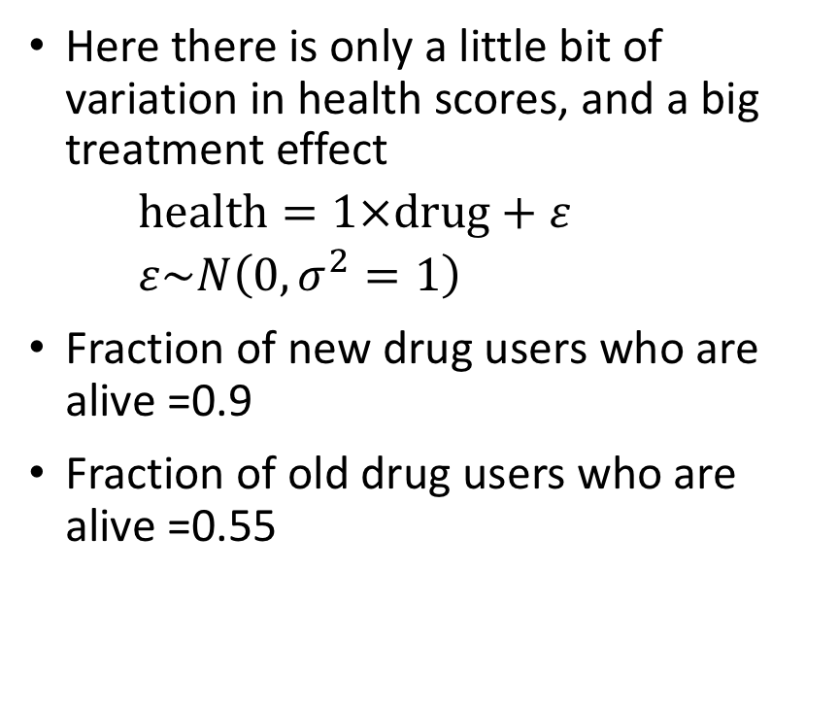
TE size depends on variation in latent error term
Here there is only a little bit of variation in health scores, and a big treatment effect
  $health=1×drug+ε$
  $ε\sim N\left(0,σ^{2}=1\right)$
Fraction of new drug users who are alive =0.9
Fraction of old drug users who are alive =0.55

Slide 19

  $health=1×drug+ε$
  $ε\sim N\left(0,σ^{2}=4\right)$

Slide 20

  $health=1×drug+ε$
  $ε\sim N\left(0,σ^{2}=9\right)$

Slide 21

  $health=1×drug+ε$
  $ε\sim N\left(0,σ^{2}=16\right)$

Slide 22
Treatment effects vary
Thus when analyzing binary outcomes, two studies can evaluate the same treatment and get different results only because of differences in variability in underlying latent index that creates the binary outcome

